Slide 1
為何參加小組 Why Small Groups
出Ex 18:13-25; 徒Acts 2:46-47

Slide 2
徒Acts 2:46-47
他們天天同心合意恆切的在殿裡，且在家中擘餅，存著歡喜、誠實的心用飯，
讚美神，得眾民的喜愛。主將得救的人天天加給他們。
Day by day continuing with one mind in the temple, and breaking bread from house to house, they were taking their meals together with gladness and sincerity of heart,
praising God and having favor with all the people. And the Lord was adding to their number day by day those who were being saved.

Slide 3
小組的概念 The Concept of Small Group
Noah挪亞(Gen創7:1﹐13)
Abraham亞伯拉罕(Gen創12:1-3)
Moses摩西(Ex出18:13-25)
Jesus 耶穌(Mk可3:13-15)
Early Church新約教會 (Acts徒2:46-47)

Slide 4
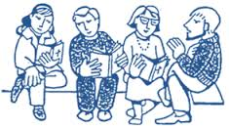
小組造就信徒 Believers Are Edified in Small Groups

Slide 5
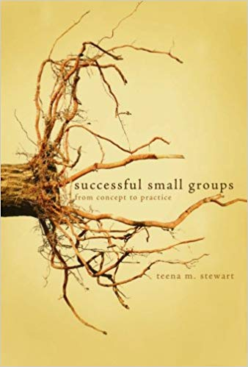
小組擴展教會 Church Is Expanded through Small Groups

Slide 6
大家都來參加小組﹗
Come to Join a Small Group!!!

