Slide 1
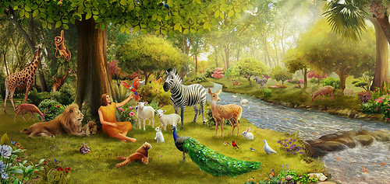
Genesis 1:26-31
Man’s Origin, Relationships, Vocation & Purpose
創世記1：26-31
人的原始、關係、職責與目的
Pastor Ray Petzholt
裴瑞明牧師
（7-25-2021）

Slide 2


Quick Review of our last Study
回顧上篇信息
We quoted honest Evolutionists who admit there is no real empirical scientific evidence (real proof) for the evolution of man.
我們引述了一些進化論者，他們承認關於人的進化
沒有確著的科學證據。
Some experts said all the evidence could fit in a shoebox & pick up truck
某些專家說，所有的證據能夠放進一鞋盒與小型載貨卡車

Slide 3
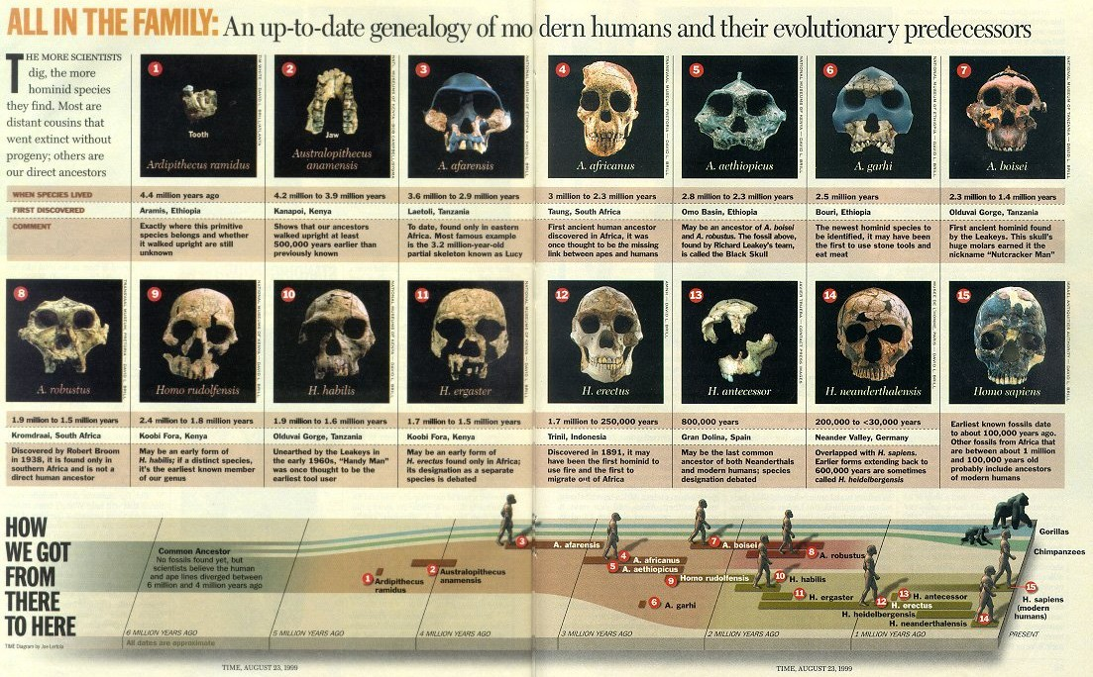
This is why 60% of Americadon’t believe man evolved from an ape like ancestor
這就是爲何60%的美國人不相信人是從猿猴類的始祖進化來的。
A dishonest presentation of evidence

Slide 4
Darwinism is under attack from within science itself!
達爾文主義受科學内部攻擊
‘No real evolutionists, whether gradualist or punctuationist, uses the fossil record as evidence in favour of the theory of evolution” (Ridley, Who Doubts Evolution?, 90 New Scientist 830, 831 (1981); Section 3.4(a))
“沒有真正的進化論者，不論是逐步進化論者或突發進化論者， 使用化石記錄作爲偏袒進化論的證據。”
B. Leith, The Descent of Darwin: A Handbook of Doubts about Darwinism, 1982, p. 10-11
M. Denton, Evolution: A Theory in Crisis (1985), p. 326-28, 345

Slide 5
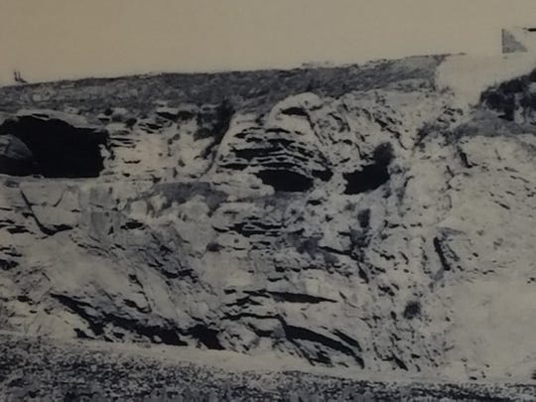
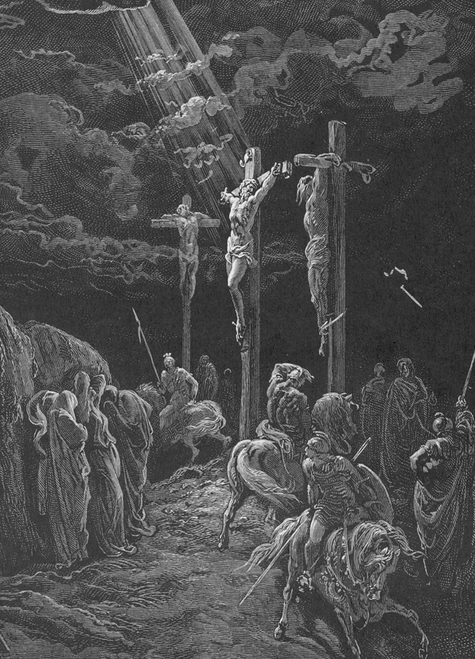
The Only Skull I Will Believe In Is The ‘1’ That Can Save Me
From My Sins!
我唯一相信的頭骨，是拯救我脫離罪惡的頭骨
Place of the skull, Israel, 1917
髑髏地
Golgatha; Calvary 各各他，加略山 (Mk. 15:22; Lk. 23:33; John 19:17

Slide 6
We Battle not with Empirical science but false worldviews that misinterpret the dubious evidence
我們不是與實證科學作戰，而是與用錯誤的世界觀去
錯解可疑的證據作戰
We are to “cast down imaginations, and every high thing that exalteth itself against the knowledge of God” (2 Cor. 10:5).
林後10：5- “將各樣的計謀，各樣攔阻人認識神的那些自高之事，一概攻破了，又將人所有的心意奪回…”
The atheistic materialism dominating the world’s educational & political systems has become a “stronghold” against faith in God.
無神唯物論掌控世界的教育與政治制度，已經成爲反對信仰神的“營壘”。

Slide 7
Why are so many so committed to a theory with so little empirical evidence?
爲何如此衆多的人强烈委身于一個只有極少實證證據的理論？
They already committed to “Philosophical naturalism”
他們已經委身于“哲學自然論”
They Must explain everything in terms of a finite 3-dimensional box of time & space. There is no supernatural.
他們必須以有限的三維時空框架來解釋萬物，沒有超自然。
They created a definition of science (naturalism) so narrow it eliminates God with a mere play on words!
他們創造了狹窄的科學（自然論）定義，用玩弄字句排除了上帝！

Slide 8
Science is not the real issue but a prior ‘philosophical commitment’
科學不是真正的議題，預設的“哲學委身”才是
“Even if all the data point to an intelligent designer, such an hypothesis is excluded from science because it is not naturalistic.”
“即使所有數據指向智能設計者，這種假設被排除在科學之外， 因爲它不合乎自然主義。”
(S.C. Todd, “A View from Kansas on That Evolution Debate,” Nature 401 (Sept. 30, 1999): 423.) also (Richard Dawkins, The Blind Watchmaker, 1986, p. 287) also (John Rennie, “15 Answers to Creationist Nonsense,” Scientific American, June 17, 2002)
Philosophy has gained primacy over empirical facts
哲學勝過實證事實，獲取了首要地位。

Slide 9
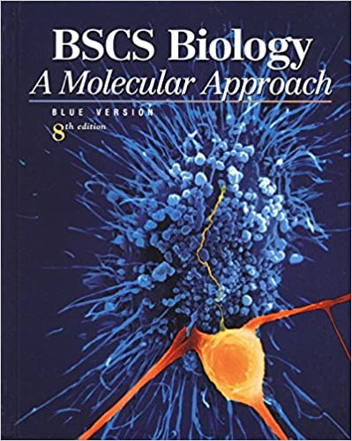
School Textbook definitions of Science exclude God!
學校教科書的科學定義排除上帝！
“Many people believe that a supernatural force or deity created life. That explanation is not within the scope of science” (Quote from High School Textbook: BSCS Biology: A Molecular Approach, 8th ed., Jon Greenberg, 2001, 446.)
“許多人相信超自然的力量或神明創造了 生命，那種解釋不在科學範圍之内。”

Slide 10
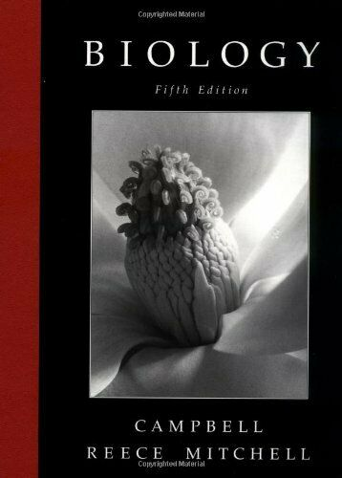
School Textbook definitions of Science exclude God!
學校教科書的科學定義排除上帝！
“By attributing the diversity of life to natural causes rather than to supernatural creation, Darwin gave biology a sound scientific basis” (Neil A. Campbell, J.B. Reece, L. G. Mitchell, Biology, 5th ed., 1999, p. 426)
“將生命的多樣性歸功于自然因素而不是
超自然創造，達爾文給予生物學扎實的
科學基礎。”

Slide 11
Chinese Proverb: “Don’t put your dirty laundry out”
中國俗話：“家醜不外揚”
Evolutionists, with the aide of like-minded media, have been very successful at hiding their dirty laundry from the public!
進化論者與他們想法類似的媒體，很成功地隱藏家醜，不讓公衆知道！
We looked at the dirty laundry of many blunders, frauds, forgeries, imaginary ‘icons’ & artwork deceiving many;
我們已看過許多失誤、詐欺、造假，以及想像的“圖標”和藝術創作，欺瞞許多人；
The fossil evidence is deceptively mis-represented… etc., etc.
化石證據故意被歪曲去矇騙人…等等。

Slide 12
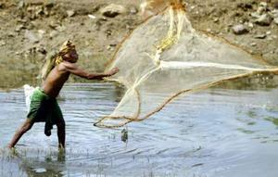
Fallacy of Scientific Reductionism: Naturalism; Materialism; Humanism. 科學簡化論之謬論：自然論, 唯物論,人本主義
Illus.: Sir Arthur Eddington “You can’t catch spiritual truth in a materialistic net”
Sir Arthur Eddington：“你無法用唯物的網子捕捉屬靈的真理。”
Why should we acquiesce to such a definition of science？
爲何我們要默許這般的科學定義？
They can never discover spiritual truth with such a restricted definition of science

Slide 13
God refutes such false Philosophies in Genesis
上帝在創世記駁斥這些錯誤的哲學
He refutes materialism: God is separate from His material universe (Rom. 4:17; Heb. 11:3; Isa. 40:28; John 4:24)
他駁斥唯物論：上帝有別于他所造的物質宇宙，
He refutes naturalism: reveals Nature’s supernatural beginning
他駁斥自然論：他啓示自然界超自然的起源，
He refutes humanism: God, not man, is the ultimate reality
他駁斥人本主義：上帝，不是人，是最終的實際，
He refutes evolution creating all things in 6 days
他駁斥進化，在六天中創造萬物。

Slide 14
In Genesis 1 God Himself Reveals 2 key Lessons
上帝在創世記一章啓示兩個關鍵性功課
There is only 1 God: the sovereign omnipotent Creator of everything that exists.
everything is under His Control. He is LORD!
只有一位真神：創造了萬物的全能自主上帝， 萬事都在他掌管之下，他是主！
Both Men & Woman bear the image of God & are God’s crowning purpose of Creation.
男人與女人都擁有上帝的形像，且是上帝創造最崇高的目的

Slide 15
Genesis 1 Reveals Man’s 4 key Relationships
創世記一章啓示人的四個關鍵性關係
1. Man’s relationship with His Creator
人與他造物主的關係
2. Man’s relationship with himself
人與自我的關係
3. Man’s relationship with Creation
人與造物的關係
4. Man’s relationship with his fellow man (male/female)
人與他人（男性/女性）的關係

Slide 16
1. Man’s Being [relationship with God]: Created not evolved
人的存在【與上帝的關係】：被造，而非進化而來
(Gen 1:26) “& God said, Let us make man in our image, after our likeness: (1:27) So God created man in his own image…
創1：26，27 - 神說：我們要照著我們的形像、按著我們的樣式 造人，神就照著自己的形像造人…
Man’s body is formed from the dust of the ground (Gen. 2:7). Here the soul (both male & female) is created (Isa. 43:7; Eccl. 12:7)
人的身體是從地裏的塵土造的（創2：7），在此，人的靈魂 （男性與女性）是創造出來的。
The soul, not physical bodies, is the essence of man (Matt. 10:28)
靈魂，而非肉身，是人的本質（太10：28）。

Slide 17
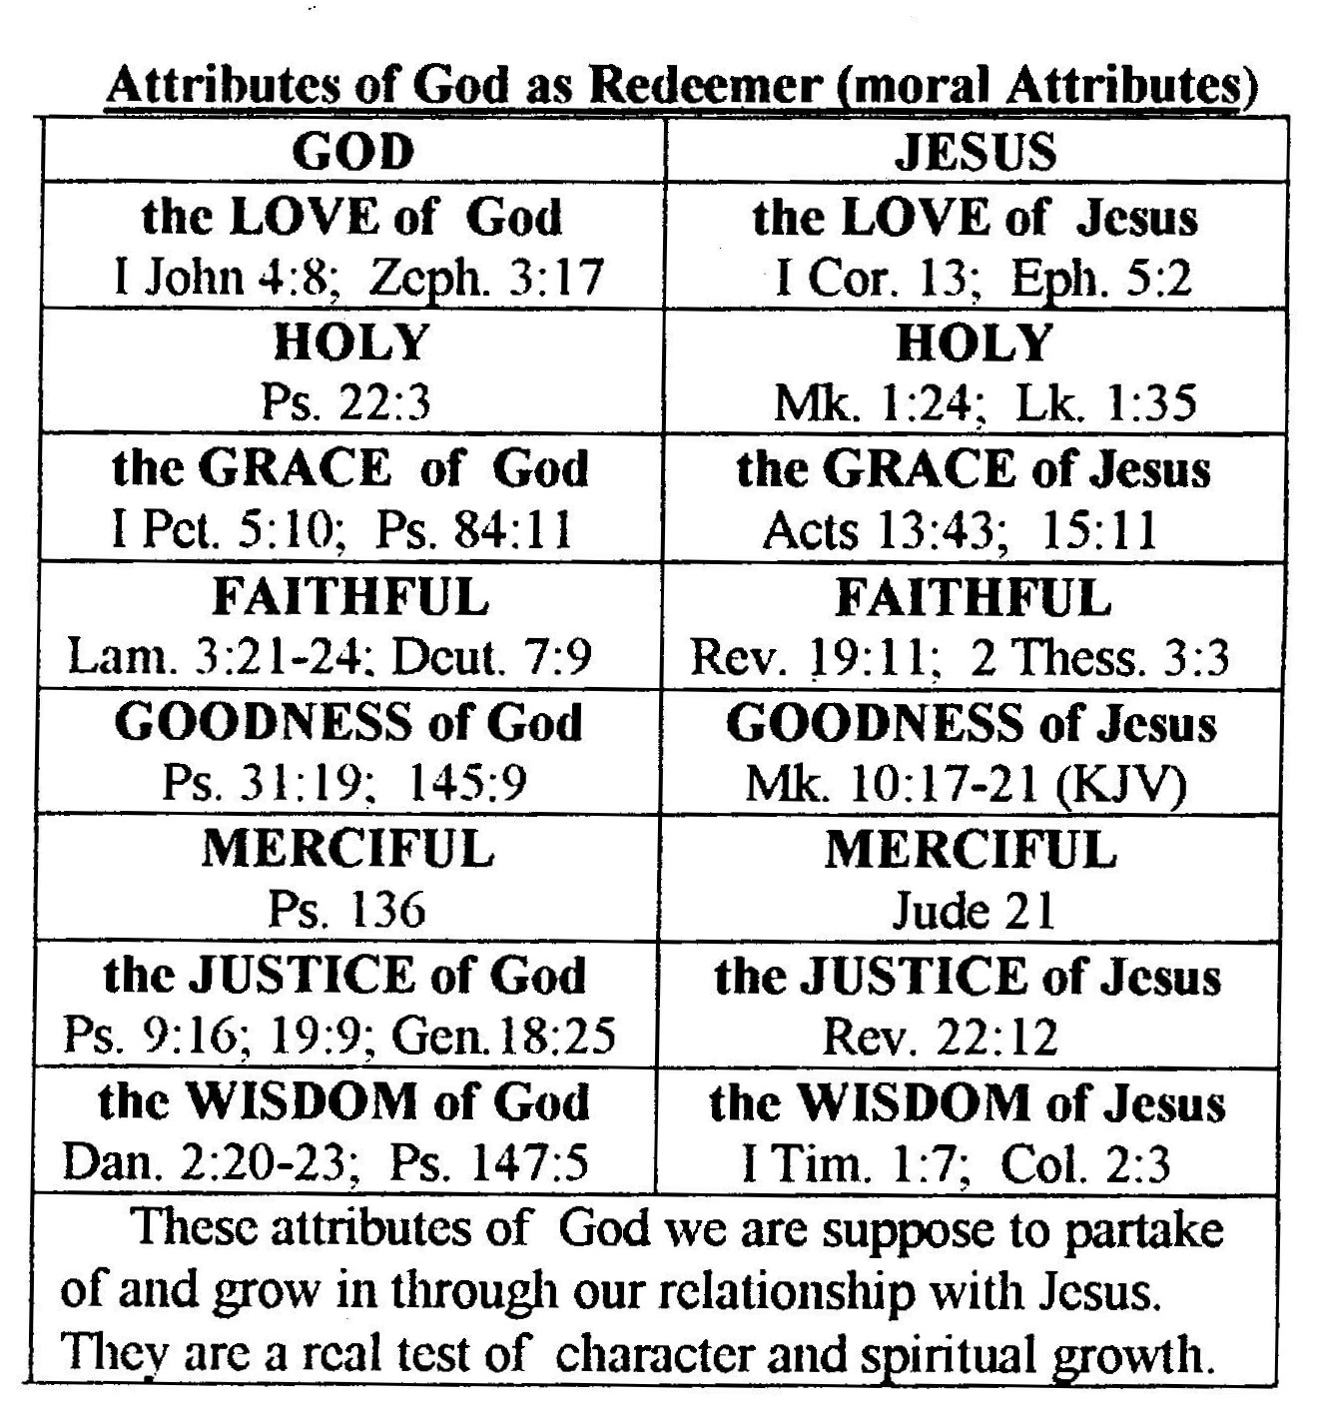
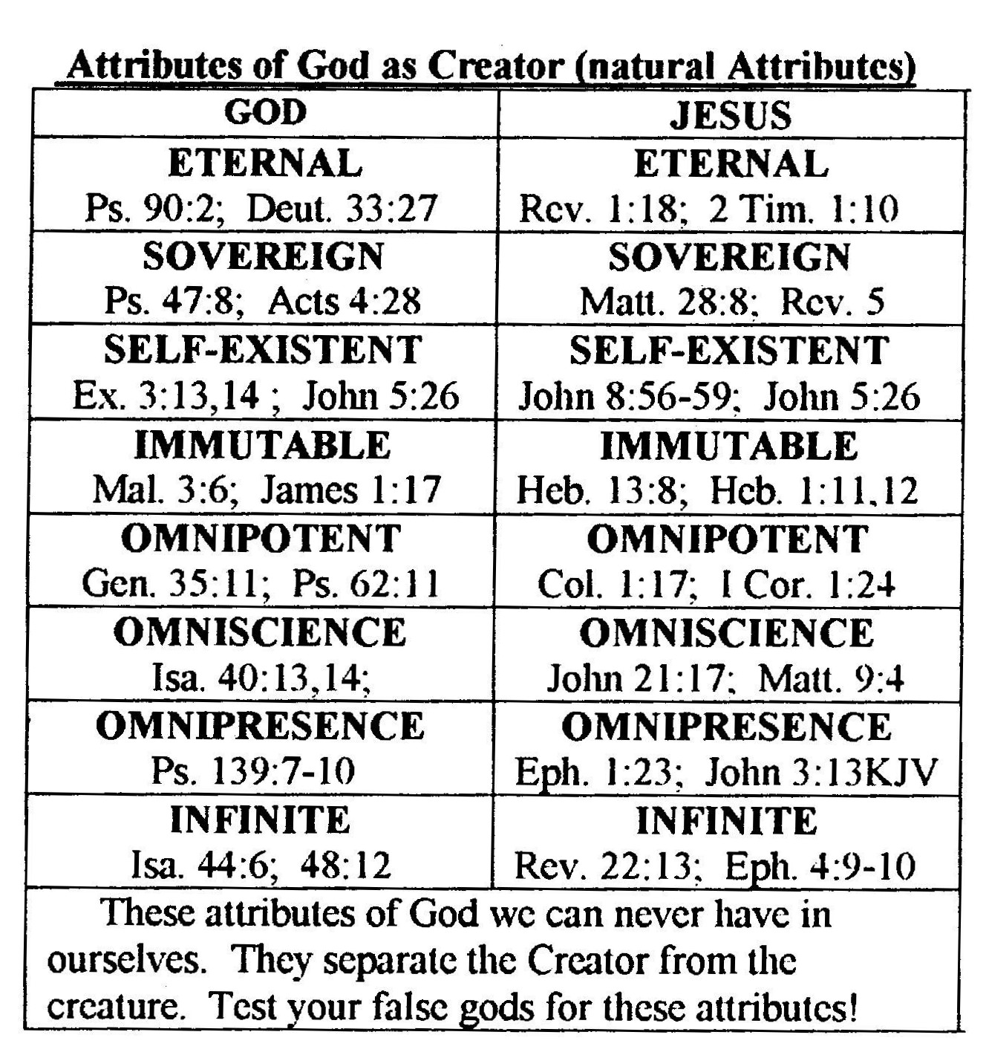
Humans share God’s Moral attributes but not God’s Natural attributes
人享有上帝的道德屬性而非上帝的自然屬性
Apes lack all these! We are not related!
猿猴缺少這些，我們不相關！

Slide 18
2. Man’s Being [relationship with self]: man is self conscious
人的存在【與自我的關係】：有自知
(1:27) So God created man in his own image, in the image of God created he him; male & female created he them.
1：27 - 神就照著自己的形像造人，乃是照著他的形像造男造女
Created in the image of “I AM that I AM” (Ex. 3:14-5) man is self conscious & wants to know: “Who AM I?”
由“我是”（出3：14-15）之上帝的形像所造，因此人是自知的，且要知道“我是誰？”。

Slide 19

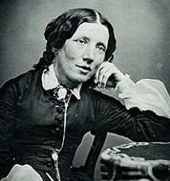
Both Male & Female Created in the Image of God!
男女都按上帝形像所造
Men & woman equally share God’s image & infinite value.
男性與女性平等地享有上帝的形像與無限價值，
Cultures that suppress Biblical worldview tended to make women 2nd class citizens; even kill baby girls
壓制聖經世界觀的文化，傾向於使女性成爲二等公民；甚至殺死女嬰。
Harriet Beecher Stowe [Uncle Tom’s Cabin] documented this in her book, Woman in Sacred History.
Harriet Beecher Stowe （湯姆叔叔的小木屋作者） 在她的書本【神聖歷史中的婦女】記錄此事。

Slide 20
The evils (Dirty Laundry) of Darwinian Evolution
達爾文進化論的邪惡（醜事）
Darwin argued women were inferior to men (J. Bergman, The history of the teaching of human female inferiority in Darwinism, J. Creation 14(1):117-126, 2000)
達爾文辯稱女性低於男性，
Some evolutionists claim rape was a means for men to propagate their genes (R. Thornhill, & C.T. Palmer, A Natural History of Rape: Biological Bases of Sexual Coercion, 2000)
某些進化論者聲稱，强奸是男性繁衍他們基因的途徑。

Slide 21
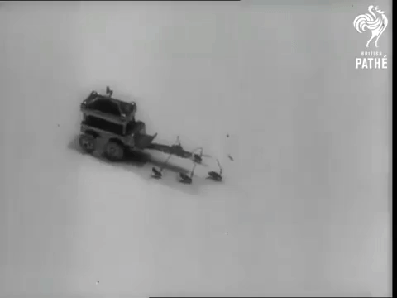
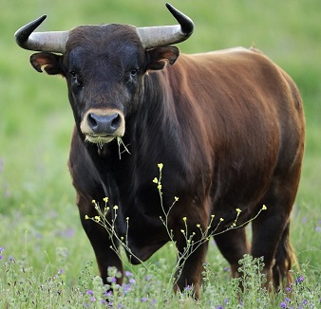
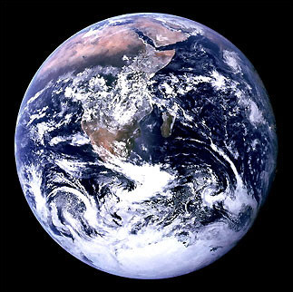
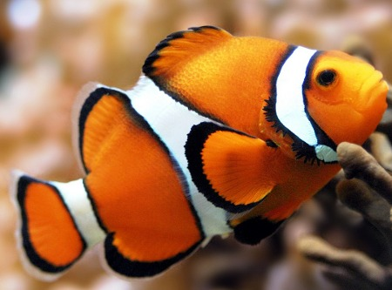
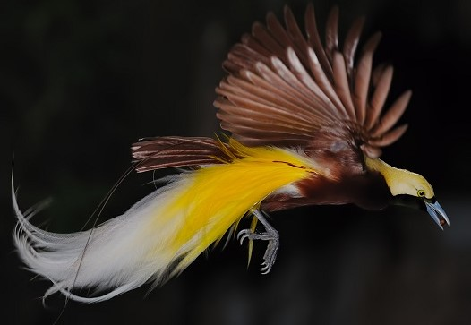
3. Man’s Vocation [relationship with nature]: Dominion over all life forms except other Men (Ex. 21:16; Deut. 24:7)
人的職責（與大自然的關係）：管理所有生物，除了其他人
(1:26) & let them have dominion over the fish of the sea, & over the fowl of the air, & over the cattle, & over all the earth, & over every creeping thing that creepeth upon the earth. [fleas?]
創1：26 - 神說：「我們要照著我們的形像、按著我們的樣式造人，使他們管理海裡的魚、空中的鳥、地上的牲畜，和全地，並地上所爬的一切昆蟲。(跳蚤?)」
A flea circus 1949

Slide 22
3. Man’s Vocation [relationship with nature]: Dominion over the earth (Preserving God’s ecological wonders)
人的職責（與大自然的關係）：管理地球（保存上帝的生態奇觀）
(1:28) replenish the earth, & subdue it: & have dominion over the fish of the sea, & over the fowl of the air, & over every living thing that moveth upon the earth. (Ps. 8:6-8; Heb. 2:5-9)
創1：28 -神…對他們說：「要生養眾多，遍滿地面，治理這地，也要管理海裡的魚、空中的鳥，和地上各樣行動的活物。」
Nature is not our ‘mother.’ We do not imitate her or act like animals! We are to take care of it.
大自然不是我們的“母親”，我們不模仿她，舉止也不像動物！我們要照管它。

Slide 23
Man’s Faith in the Divine Lawgiver & the Dominion Mandate made the modern scientific revolution possible
人對神聖賜律法者與管理命令的信念，使現代科學革命成爲可能
There is such a thing as objective truth. (John 14:6)
有所謂的客觀真理存在（約14：6），
The Universe is real (to Eastern philosophies it is illusion)
宇宙是真實的（東方哲學認爲它是幻象），
The Universe is orderly, governed by Laws (I Cor. 14:33)
宇宙有秩序，被法則管理（林前14：33），
Science studies & experiments to discover the laws that govern orderly reality 科學研究與實驗，發掘掌管秩序的法則。

Slide 24
Scientific Disciplines founded by Bible Believing Scientists
由相信聖經的科學家們創設的科學學科
Bacteriology 細菌學 – Louis Pasteur (1822-1895)
Calculus 微積分學 – Isaac Newton (1642-1727)
Celestial Mechanics 天體力學 – Johann Kepler (1571-1630)
Chemistry 化學 – Robert Boyle (1627-1691)
Comparative Anatomy 比較解剖學 – George Cuvier (1769-1832)
Electrodynamics 電動力學 – James Clerk Maxwell (1831-1879)
Electromagnetics 電磁學 – Michael Faraday (1791-1867)
Electronics 電子產品 – Ambrose Fleming (1849-1945)

Slide 25
Scientific Disciplines founded by Bible Believing Scientists
由相信聖經的科學家們創設的科學學科
Energetics 能量學 – Lord Kelvin (1824-1907)
Fluid Mechanics 流體力學 – George Stokes (1819-1903)
Galactic Astronomy 銀河天文學 – William Herschel (1738-1822)
Gas Dynamics 氣體動力學 – Robert Boyle (1627-1691)
Genetics 遺傳學 – Gregor Mendel (1822-1884)
Glacial Geology 冰川地質學 – Louis Agassiz (1807-1873)
Gynecology 婦科 – James Simpson (1811-1870)
Hydrography 水文學 – Matthew Maury (1806-1873)

Slide 26
Scientific Disciplines founded by Bible Believing Scientists
由相信聖經的科學家們創設的科學學科
Ichthyology 魚類學 – Louis Agassiz (1807-1873)
Isotopic Chemistry 同位素化學 – William Ramsay (1852-1916)
Natural History 自然歷史 – John Ray (1627-1705)
Non-Euclidean Geometry 非歐幾何 – Bernhard Riemann (1826-1866)
Oceanography 海洋學 – Matthew Maury (1806-1873)
Paleontology 古化石學 – John Woodward (1665-1728)

Slide 27
Scientific Disciplines founded by Bible Believing Scientists
由相信聖經的科學家們創設的科學學科
Pathology 病理學 – Rudolph Virchow (1821-1902)
Reversible Thermodynamics 可逆熱力學 – James Joule (1818-1889)
Stratigraphy 地層學 – Nicholas Steno (1631-1686)
Statistical Thermodynamics 統計熱力學 – James Clerk Maxwell (1831-1879)

Slide 28
Scientific Disciplines founded by Bible Believing Scientists
由相信聖經的科學家們創設的科學學科
Systematic Biology 系統生物學 – Carolus Linnaeus (1707-1778)
Thermodynamics 熱力學 – Lord Kelvin (1824-1907)
Thermokinetics 熱動力學 – Humprey Davy (1778-1829)
Vertebrate Paleontology 脊椎動物古化石學 – Georges Cuvier (1769-1832)
Henry M. Morris, The Defenders Study Bible, 1995, Appendix 7. He lists 41 total Scientific Disciplines on pages 1518-1520). A great Study Bible if you are looking for Scientific explanations to some tough questions.
Also: Henry M. Morris, Men of Science Men of God, 1982

Slide 29
4. Man’s Purpose [relationship with Family]: Both Heavenly & earthly Families (Eph. 3:15)
人的目的【與家人的關係】：天上的與地上的家人
(Gen 1:28) “God blessed them, & God said unto them, Be fruitful, & multiply, & replenish the earth,
創1：28 -神就賜福給他們，又對他們說：「要生養眾多，遍滿地面…
God creates Family (male & female) with the blessing of sex in monogamous marriage to raise children & “fill the earth” (Gen. 33:5; Josh. 24:2-4; I Sam. 1:27; I Chron. 28:5; Ps. 127:3).
上帝創造家庭(男性與女性), 賜福他們一夫一妻的婚姻,有性生活,生養兒女,遍滿全地。

Slide 30
Our Omniscient LORD Jesus Christ confirmed Genesis
全知的主耶穌基督確認創世記
Jesus confirmed Genesis 1:27 & 2:24 (Matt. 19:3-9; Mk. 10:2-12). Other Scriptures: Col. 3:10; ICor. 15:45; ITim. 2:13; ICor. 11:7-12; Eph. 5:31-2
耶穌在福音書（太19：3-9；可10：2-12）確認創世記1：27與2：24。其他經文：西3：10，林前15：45，提前2：13；林前11：7-12，弗5：31-32。
Sexual intercourse between male & female is God’s design before the fall & has God’s full blessing in the context of marriage & comes with serious warnings outside marriage (Heb. 13:4; ICor 6:9)
男女之間的性交是上帝在人墮落之前的設計，具有上帝對婚姻的完滿祝福，而對婚外的性交帶有嚴肅的警告 （來13：4；林前6：9）。

Slide 31
Evolutions “dirty laundry” on sex!
進化論的性“家醜”
Male/Female & sexual reproduction is every evolutionists nightmare [they are beyond reasonable explanation]
雌/雄的性繁殖是每一位進化論者的惡夢（它們超乎合理的解釋）。
They can’t begin to explain “How sexual reproduction could evolve from asexual reproduction” & almost always jump to “Why sexual reproduction helps survival.” (a non sequitur)
他們無法解釋“性繁殖如何能夠從無性繁殖進化到有性繁殖”， 而且幾乎總是跳過到“爲何性繁殖幫助了生存。” （一項不合邏輯的推論）

Slide 32
Charles Darwin, Origin of Species, Chapter 6
達爾文，物種原始論，第六章
“If it could be demonstrated that any complex organ existed, which could not possibly have been formed by numerous, successive, slight modifications, my theory would absolutely break down. But I can find out no such case.”
“倘若能够显示任何复杂的器官曾存在，而它不可能是由无数，连续，轻微的修改所形成，那么我的理论将绝对垮掉。但我找不到一个案例。”
Michael J. Behe, Darwin’s Black Box - Michael J. Behe | A (R)evolutionary Biologist (michaelbehe.com) Reveals everything in the cell is infinitely & irreducibly complex

Slide 33
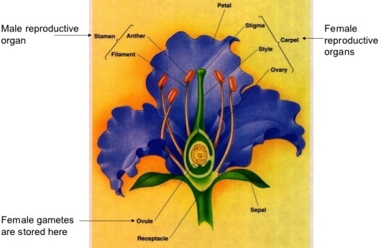
The 250,000 Angiosperm species Reproduce Sexually!
The male & female must be of the same species!
二十五萬被子植物種類經由性交來繁殖！
雌雄體一定屬同一物種！
That means some miraculous unknown mechanism caused 250,000 species to evolve both male & female organs by chance simultaneously!!!
這表示某種奇跡式的機制， 使25萬個種類偶然地、同時地進化出雌雄器官！

Slide 34

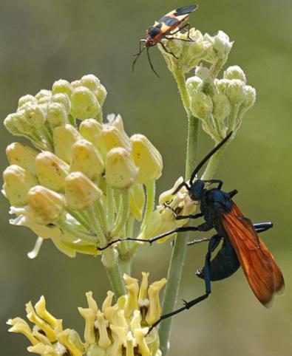
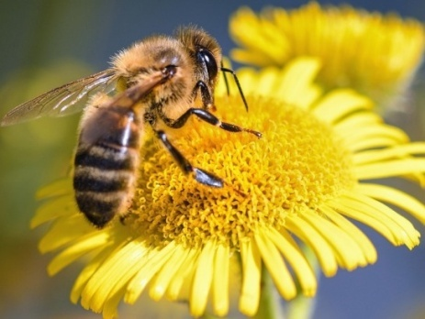
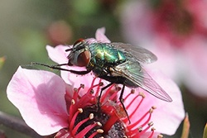

250,000 species of Plants evolved simultaneously with 25,000 species of Bees & 750 species of Butterfly???
25萬個植物種類同時與兩萬五千種蜜蜂和750種蝴蝶一起進化？？
Most flowering Plants need Pollinators!
多數開花的植物需授粉者！
It’s more rational to believe in a Creator!
相信造物主是更理性的

Slide 35
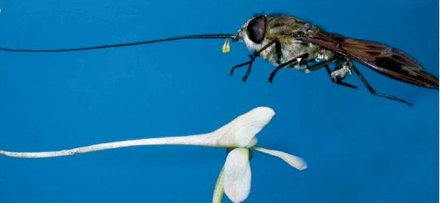
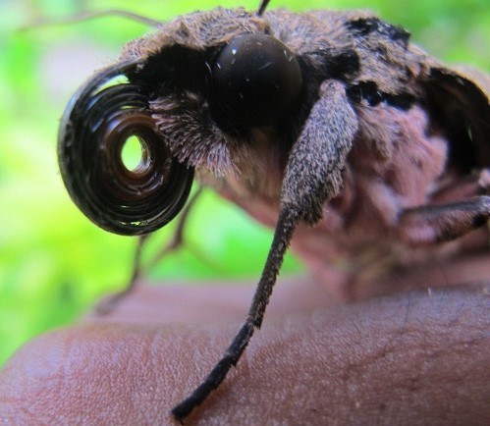
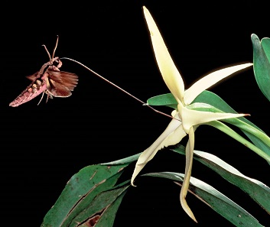

Madagascar Orchid & pollinator moth:
馬達加斯加蘭花與授粉飛蛾
orchid has a 12 – 16 inch shaft & nectar at bottom. moth with a 12-16 inch tongue pollinates
蘭花具有12-16寸的長杆，花蜜在底部，飛蛾具有12-16寸長的舌頭去授粉。
Can’t evolve: everything must be just right or both die. Obvious design
無法進化：不是完全正確配合就是死亡，明顯的設計。
Unexplainable symbiosis
無法解釋的共生關係

Slide 36
Insect Male/Female sexuality: a nail in evolution’s coffin!
昆虫的雌雄性别：進化論棺木上的一根钉子！
“Biologists are embarrassed by the subject [of sex] because of their ignorance. What sex is, why it evolved & how it works are the biggest unsolved problems in biology…
“生物学家对性的题目感到难堪，因为他们无知。性为何，为何进化，如何运作，是生物学最大、尚未解决的问题…
We are still not certain why males exist; & why, if we must have them at all, nature needs so many”
我们仍然不确定为何雄体存在；而且为何，倘若我们必须有它们全部，大自然需要如此众多。”
(Steve Jones, The Language of Genes, 1993, p. 84)

Slide 37
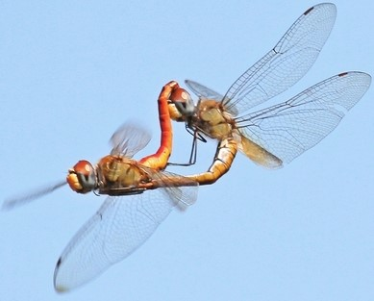

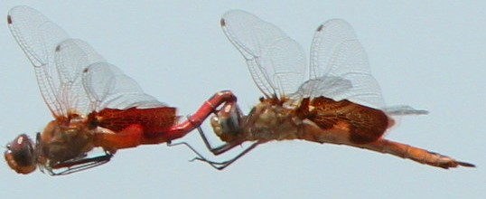
Insect romance & sex clearly points us to the Creator!
昆虫的罗曼史以及性别，清楚地将我们导向造物主！
“soft science” expects us to believe that 1 million different species of insects simultaneously ‘evolved’ their incredibly complicated sexual apparatus of both male & female along with complicated mating rituals by “time & chance” without any intervention of any intelligence!
“軟科學”期望我們相信上百萬不同的種類同時‘進化’它們複雜的性器官（包括雌雄體），只是藉著“時間與偶然”，不需任何智能的介入！

Slide 38
The Nightmare for Evolutionists (Rom. 1:22; Prov. 26:12; Jer. 8:9)
進化論者的惡夢
Common sense knows “that natural selection could not possibly have provided simultaneous, on time delivery of both the male & female of each species, complete with their own unique mating & reproductive processes” (F. LaGard Smith, Darwin’s Secret Sex Problem: Exposing Evolutions' Fatal Flaw – the Origin of Sex, 2018, p. xxxiii) [great book worth reading]
一般常識都知道：“自然選擇無法可能同時、恰時地提供每個物種的雌雄體，且各自具有他們自己完整的獨特交配與繁殖過程。“

Slide 39
4. Man’s Purpose [relationship with Family]: Both Heavenly (Gen. 5:24; Lk. 3:38) & earthly Families
人的目的【與家人的關係】：天上的與地上的家人
“…the whole family in heaven & earth…” (Eph. 3:15)
“天上地上的全家…”(弗3：15）
God made us part of a Heavenly Family (Eph. 6:9; Matt. 6:9; 5:16, 48; 7:11; Isa. 63:16; 64:8; John 20:17; Rom. 8:15; Gal. 4:6) & earthly Family (I Tim. 5:4, 8; Psalm 127 & 128; Ps. 68:6).
上帝創造我們是天上家庭與地上家庭的一部分，
We have potential to bear spiritual & physical children (Gal. 4:19)
我們有潛力生養屬靈與屬肉身的兒女（加4：19）。

Slide 40
Man’s Divine Provision: Super abundant vegetarian food
來自神聖的供給：超豐富的蔬菜食物
(Gen 1:29) “God said, Behold, I have given you every herb bearing seed… upon… all the earth, & every tree, in the which is the fruit of a tree yielding seed; to you it shall be for meat (Gen. 2:16)
創1：29 -神說：「看哪，我將遍地上一切結種子的菜蔬和一切樹上所結有核的果子全賜給你們作食物。」
Man will not be permitted to eat ‘living creatures’ until after the Flood of Noah (Gen. 9:3-4)
人類不准許吃“活物”，直到挪亞洪水之後（創9：3-4）。

Slide 41
No Death before the Fall (Rom. 5:12; ICor. 15:26; 2Tim. 1:10): all Life was vegetarian
墮落前沒有死亡：生物全吃蔬菜
(1:30) “& to every beast of the earth, & to every fowl of the air, & to every thing that creepeth upon the earth, wherein there is life, I have given every green herb for meat: & it was so.
創1：30 -至於地上的走獸和空中的飛鳥，並各樣爬在地上有生命的物，我將青草賜給他們作食物。」事就這樣成了。
(1:31) & God saw every thing that he had made, & behold, it was very good. & the evening & the morning were the sixth day.”
1：31 -神看著一切所造的都甚好。有晚上，有早晨，是第六日。

Slide 42
Plants are considered living by science but not by God
科學認爲植物是活的，但上帝不這麽認爲
Science - 7 things compose life: movement, respiration, sensitivity, growth, reproduction, excretion, nutrition (Mrs. Gren)
科學 – 七件事情組成生命：動作、呼吸、感知、成長、繁殖、排泄、養分（Mrs. Gren)，
God says, ‘life is in the blood’ (Lev. 17:11) & plants have no blood. Killing involves shed blood (Gen 9:4-6). Plants may be biologically alive, but they do not die, they ‘wither’ (Isa. 40:8; Jonah 4:7; etc.)
上帝說：“生命在血裏”（利17：11），而植物沒有血。殺死需要流血（創9：4-6）。植物或許生理上是活的，但它們不會死亡，而是“枯萎”。

Slide 43
Plant/animal differences: animals feel pain & suffer. Plants can’t see, hear, feel, taste, or smell.
植物/動物的差別：動物感受痛苦與受苦，植物無法看、聼、感知、嘗，或聞。
On Day 3 God commanded “earth to bring forth” plants (1:11-2)
第三天上帝吩咐“地要生出”植物來（1：11-12），
On Day 6 God commands the “earth to bring forth the living creature” (1:24, 28, 30)
第六天上帝吩咐“地要生出活物來”（1：24，28，30），
So Biblically, Eating plants does not constitute death.
所以就聖經而言，吃植物不造成死亡。

Slide 44
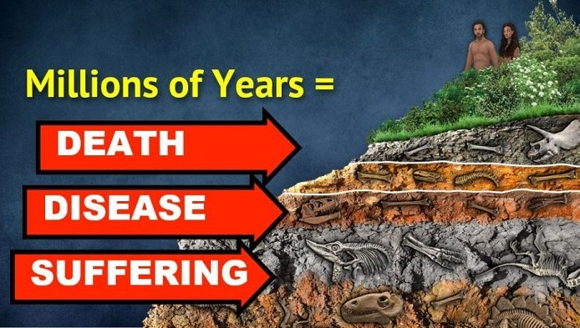
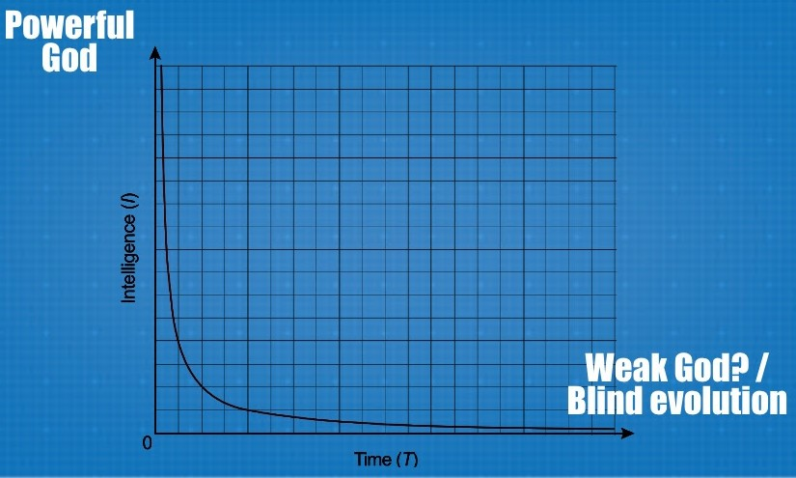
If God used ‘evolution’ to create man [theistic evolution] then He is not good, omniscient or omnipotent
倘若上帝使用“進化”來創造人【神造進化論】，
那麽他就不是良善、全知，或全能的
The world imagined by the Theory of Evolution involves no intelligence & is in no way “very good!”
進化論所想像出來的世界沒有智 能參與，而且不是“很好的！”
Creation in 6 days reveals God to be good, omnipotent & omniscient
六天完成創造，啓示上帝是良善、全能，全知的。

Slide 45
God is Good & Will Restore Creation to its Paradise Condition: no suffering or death (Eternity 永恆中- Rev.啓21 & 22)
上帝是良善的，並要恢復造物到它樂園的狀況：沒有苦難或死亡
(Isa 65:25) “The wolf & the lamb shall feed together, & the lion shall eat straw like the bullock… They shall not hurt nor destroy in all my holy mountain, saith the LORD” (Isa. 11:6-9; 2:4; Mic. 4:3)
賽65：25 （千禧年）- 豺狼必與羊羔同食；獅子必吃草與牛一樣；塵土必作蛇的食物。在我聖山的遍處，這一切都不傷人，不害物。這是耶和華說的。
Creation’s perfection will be restored by Jesus Christ (Eph 1:9-14; Rom 8:18-23) removing all corruption caused by man’s sin (Gen. 3)
造物的完美將被耶穌基督恢復（弗1：9-14；羅8：18-23），挪除所有因人的罪惡所造成的腐敗。

Slide 46

Charles Templeton lost the Battle for his mind & died lost
Charles Templeton 思想戰失敗，死亡失喪
“Surely it would not be beyond the competence of an omniscient deity to create an animal world that could be sustained… without suffering & death” (p. 197-199)
“一位全知全能的神一定有能力創造並維持動物世界…不受痛苦與死亡。”
Rejecting God’s Word (Gen 1-3) he’s deceived to believe in evolution (2 Thess. 2:10-13)
他拒絕上帝的話語（創1-3章），被矇騙去相信進化論（帖後2：10-13）。
He lost his faith at a seminary!

Slide 47
Understanding True Science & True Faith: A matter of life & Death.
明白真實的科學與真實的信心: 生死攸關的事情
(1Tim. 6:20) “O Timothy, keep that which is committed to thy trust, [the Scriptures 2 Tim. 3:15-6]
提前6:20 提摩太啊，你要保守所託付你的，
avoiding profane & vain babblings, & oppositions of science falsely so called:”
躲避世俗的虛談和那敵真道、似是而非的學問。
(6:21) Which some professing have erred concerning the faith.” 已經有人自稱有這學問，就偏離了真道。

Slide 48
We must be aware of the deceptive use of 3 different meanings of the word “evolution”
我們必須明白“進化論”矇騙人的三個不同意義
They equivocate 3 Definitions of Evolution
他們模棱兩可三種進化論定義：
1. “Change over time” – If all evolution means is change then everyone of us can agree evolution is a fact: “if” this is all you mean by evolution.
「經歷長時間而變化」- 倘若進化論所有的定義就是變化, 那麼我們都同意進化論是事實: 「倘若」這就是進化理論的全部.

Slide 49
2. “Special Theory of Evolution” (Micro-evolution) – Many observations of this nature were recorded in Darwin’s book “On The Origin of Species”
「特別進化理論」(微進化) – 對自然的許多觀察被記錄在達爾文 的書「物種原始論」裡.
Microevolution is small changes that take place within species, over time, to produce new characteristics (empirical & observable)
微進化是在物種當中發生的微小變化, 經過時間, 產生新的特徵 (實證, 可觀察到的).

Slide 50
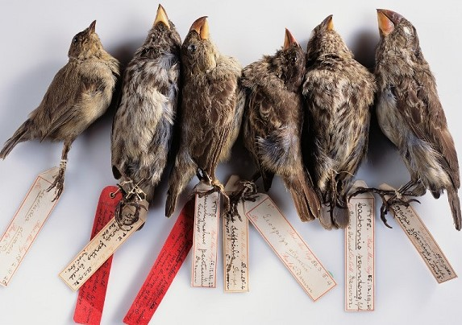


Examples of Micro-evolution 微進化例子
1. Darwin’s Finches: change in their beaks due to changes in their environment.
達爾文的雀鳥:鳥嘴因環境改變而變化.
2. Antibiotic resistant bacteria.
抵抗抗生素的細菌.
3. All the dog breeds
所有狗的品種.
4. Changes in humans: skin color, etc.
人類的改變: 膚色, 身高, 眼睛

Slide 51
3. The General Theory of Evolution (macro-evolution). This definition “unscientifically” claims one species can ‘evolve’ into a new species
一般進化論(大進化) – 這個理論「非科學地」宣稱， 一個物種能夠進化到另一個新的物種。
This definition is not a fact but unproven “Theory.” It has never been observed & has no hard empirical science to support it
這個定義不是事實，而是沒有經過證實的「理論」, 它也觀察不到。

Slide 52
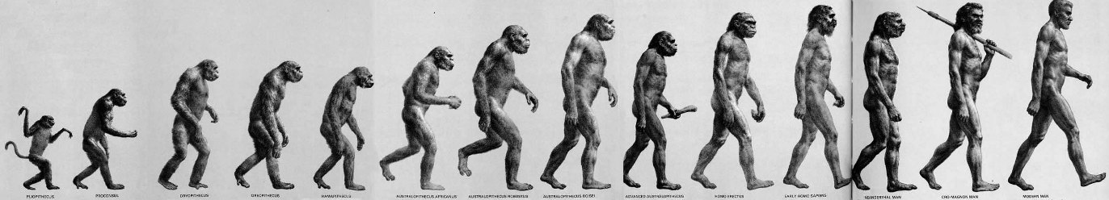
Supposed Examples of Macro-evolution 大進化例子
1. The supposed evolution of reptiles to birds [no evidence]
虛設的爬蟲類進化到鳥類（沒有證據），
2. Supposed evolution of land mammals to whales [deception]
虛設的陸地哺乳動物進化到鯨魚（欺騙），
3. Supposed evolution of apes to humans [6 million yrs. of fantasy & only a pickup truck worth of evidence!]
虛設的猿猴類進化到人類（六百萬年的妄想，只有一小型載貨卡車的證據！）
x
x
x
x
x
x
x
x
x
x

Slide 53
When someone uses ‘evolution’ to disprove Biblical Creation, ask them: 當人使用進化論攻擊你的基督教信仰時, 反問:
“What definition of evolution are you using?
「你使用的進化論定義是什麼?」
If they use definition #1 or #2 we can agree with them. It is observable science BUT does not disprove anything in the Bible!
倘若他們使用的是定義1或2, 我們也同意, 因那是可觀察到的科學, 它們不否認聖經任何部分！
But if they assume definition #3 we must disagree that their definition is not science but based on philosophical materialism!
但倘若他們假設定義3, 那麼我們必須拒絕那個定義不是科學, 而只是沒有經過證實的理論!

Slide 54
Important Lessons 重要功課
Darwinian evolution from single cell to man has almost no empirical evidence to support it.
達爾文進化論說人從單細胞進化而來，幾乎沒有任何實證證據支持這個理論。
So many are so committed to it simply because they made a prior commitment to ‘Philosophical Materialism’
如此衆多的人委身于它，只因爲他們已經先委身于“哲學唯物論”。

Slide 55
The existence of male/female sexual reproduction in over one million species proves the fallacy of evolution
雌雄體在上百萬物種中性繁殖的存在，證明進化論是謬論。
The Bible is more rational, reasonable & scientifically sound (intelligent design) than Darwinism’s unintelligent chance
聖經比達爾文無智能的偶然更合理、合科學（智能設計）。

Slide 56
God has Given us 4 key Relationships to pursue
上帝要我們追求四個關鍵性關係
1. Our relationship with our Creator (Col. 3:10)
與造物主的關係
2. Our relationship with ourself (Acts 24:16)
與自我的關係
3. Our relationship with Creation (Job 12:7-10)
與造物的關係
4. Our relationship with our fellow man especially through our Heavenly & earthly Family (Heb. 12:9-11; Eph. 3:14-21)
與他人的關係，特別是與天上的和地上的家人的關係。

Slide 57
Pursuing these God given relationships will bring meaning, purpose, & satisfaction in this life & a glorious eternity in the Kingdom of God
追求這些上帝給予的關係
將在今生帶來意義、目的，與滿足，
以及來生在上帝國度中榮耀的永恆。

Slide 59
Following are a few extra slides that we couldn’t fit into the study but are added as they will strengthen you faith in God’s inerrant Word
And help you see some of the weaknesses of modern-day evolutionary theory.

Slide 60
Genesis 1:28-30 is known as “the Edenic Covenant”
Begins with God blessing them & then follows 4 parts:
1. They are to populate the earth (28b)
2. They are given authority over the material world (26, 28)
3. They are given authority over the animal kingdom (Hosea 2:18)
4. They are given a special diet (1:29-30; 2:16)

Slide 61
Darwin’s secret sex problem is the death knell of evolution
A species is a group of organisms capable of interbreeding. Sexual reproduction is ubiquitous in nature but species specific!
Species can’t have sex & reproduce with another species!
The fossil record proves there are no intermediate forms where these sexual boundaries have ever been crossed
To evolve asexual life (mitosis) to (meiotic) sexually reproducing life, must create an unfathomable amount of new information, for both male & female simultaneously! There is no evidence for it because it is impossible!

Slide 62
Darwin’s secret sex problem is the death knell of evolution
Evolution cannot explain sex origins: How a male & female reduce their chromosomes in half then join the halves together in a mind blowing process to form a one of a kind offspring. [The Queen of Evolutionary Problems]
Because the millions of species male/female sexual organs & rituals are so uniquely complicated they could not possibly have evolved by natural selection incrementally over time
It would require reorganization of the entire anatomy & physiology of the organism!

Slide 63
Ricard Dawkins acknowledges the Problem of sex:
“Why did sex, that bizarre perversion of straightforward replication, ever arise in the first place?... This is an extremely difficult question for the evolutionist to answer” (Richard Dawkins, The Selfish Gene, 2006, reprint 2009, p. 43)
“For reasons that I haven’t the space to go into, the existence of sexual reproduction poses a big theoretical puzzle for Darwinians” (Richard Dawkins, The Blind Watchmaker, 1986, p. 268).

Slide 64
Even Charles Darwin in the introduction to Origin of Species wrote:
“For I am well aware that scarcely a single point is discussed in this volume on which facts cannot be adduced, often apparently leading to conclusions directly opposite to those at which I have arrived. A fair result can be obtained only by fully stating & balancing the facts & arguments on both sides of each question”
Why are evolutionists today so adverse to hearing the other side?

Slide 65
The Origin of Species Revisited, by W. R. Bird (1991) (He argued the issue before the Supreme Court)
2000 quotations & 5,400 footnotes assesses Darwin’s theory of Evolution verses the theory of abrupt appearance (i.e., Creation)
Shows the evidence can be interpreted to fit both theories but fits the theory of abrupt appearance better.
A scholarly criticism of evolutionary theory presenting strong evidence for the theory of abrupt appearance.

Slide 66
Public Schools are Indoctrinating not Educating!
公立學校灌輸,而非教育學生
If I tell you only part of the evidence and you believe it, you have not been taught, you have been indoctrinated.
只被告知部分的證據就相信, 那不是教導,而是灌輸
If I tell you all the evidence and you make a decision, then you have been taught. 我們需要所有的證據才作決定,那才是教導

Slide 67
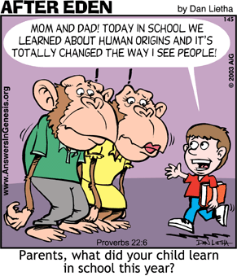
There are consequences for teaching error
錯誤的教導
有其後果

Slide 68
Research Exposing the reality of zero Empirical evidence for the evolution of Man
Christopher Rupe & John Sanford, Contested Bones, 2019,
Jerry Bergman, Evolution’s Blunders, Frauds & Forgeries, 2018
Jerry Bergman, Fossil Forensics: Separating Fact from Fantasy in Paleontology, 2017
Jerry Bergman, Peter Line, Jeffrey Tomkins, & Daniel Biddle, Apes as Ancestors: Examining the Claims About Human Evolution, 2020

Slide 69
Research Exposing the reality of zero Empirical evidence for the evolution of Man
Roger Lewin, Bones of Contention: Controversies in the Search for Human Origins, 1987
M.L. Lubenow, Bones of Contention, Updated and revised edition, 2004

Slide 70
The Problem of Materialistic Philosophy overriding Science
Paleoanthropologists being heavily influenced by personal beliefs & prejudices is well documented. It is often nothing more than materialistic philosophy disguised as modern empirical science.
古人類學者受個人信念與偏見影響有據可查。經常它只是唯 物哲學，假冒為現代實證科學。
(Wells, p. 226) [Jonathan Wells, Icons of Evolution: Science or Myth?, 2000, p. 210, 218, 219-220, 221, 222-223, 224-225] [David Pilbeam, American Scientist 66(3): 378-379, 1978]

