Slide 1
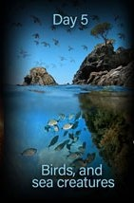
Genesis 1:20-23 Day 5: God Creates Sea Life & Fowl
創世記1:20-23 第五天：上帝創造海洋生物與天空飛鳥
(Gen 1:20) And God said, Let the waters bring forth abundantly the moving creature (Heb. = living soul) that hath life, & fowl that may fly above the earth in the open firmament of heaven.
創1:20- 神說：「水要多多滋生有生命的物；要有雀鳥飛在地面以上，天空之中。」

Slide 2
(Gen 1:21) And God created great whales, & every living creature that moveth, which the waters brought forth abundantly, after their kind, & every winged fowl after his kind: & God saw that it was good. (Why good? Rom. 1:19-20)
創1:21- 神就造出大魚和水中所滋生各樣有生命的動物，各從其類； 又造出各樣飛鳥，各從其類。神看著是好的。
(22) And God blessed them, saying, Be fruitful, & multiply, & fill the waters in the seas, & let fowl multiply in the earth.
創1:22- 神就賜福給這一切，說：「滋生繁多，充滿海中的水； 雀鳥也要多生在地上。」
(23) And the evening & the morning were the 5th day.
創1:23 - 有晚上，有早晨，是第五日。

Slide 3
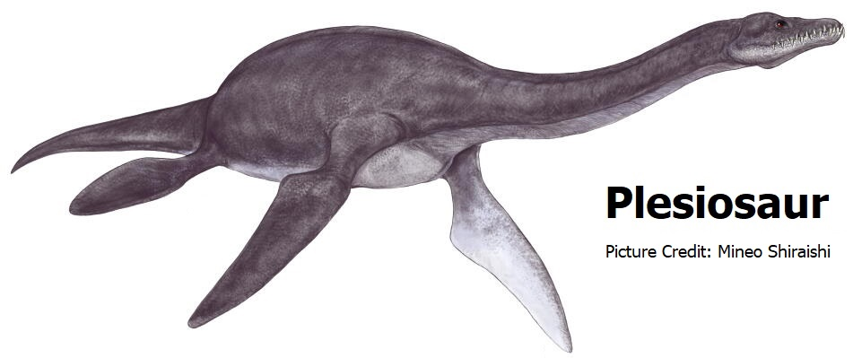
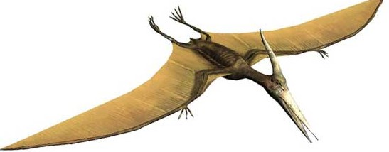
On Day 5 God Creates 2 Kinds of Living Creatures
第五天上帝創造兩類生物
1. Every Living creature in the waters (salt water & fresh)
每一個在水裡的生物（鹽水與淡水）(Ps. 104:25-26)
Emphasis on Great whales (Hebrew = tanniym) [also dragons; Ps. 74:13; Isa. 27:1; & monsters Lam. 4:3; & serpent Ex. 7:9-10]
強調大魚（大鯨魚，希伯來文= tanniym ）{還有龍-詩74:13；賽27:1；大獸-哀4:3；以及蛇-出7:9-10}
2. Every winged fowl
每一隻有翅膀的飛鳥

Slide 4

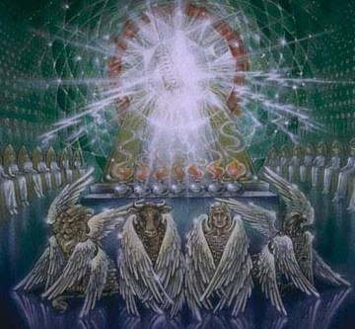
3 Spiritual Purposes for Animals
動物的三個屬靈目的
1. To teach us wisdom by revealing the infinite attributes, wisdom & glory of God (Job 39, 40, 41;Ps. 33:6-9; Ps. 148; Isa. 40:26, 31; Rom. 1:19-20)
藉著上帝無限的屬性、智慧、榮耀，教導我們智慧
（伯39,40,41章；詩33:6-9,148；賽40:26,31； 羅1:19-20）

Slide 5
3 Spiritual Purposes for Animals
動物的三個屬靈目的
2. Designed as metaphors to reveal spiritual truths so as to stir the heart & convict the conscience (i.e. 2 Sam. 12:1-7; Job 12:7-9; Deut. 23:18; 2Pet. 2:22; Ps. 78:52; John 10:11-14)
上帝設計它們為比喻，啟示出屬靈的真理，來攪動我們的心， 並使良心知罪。
Some people are swine (pigs); strong as an ox; sly as a fox (Lk. 13:22). People can act like “brute beasts” (2 Pet. 2:12; Jude 1:10)
有些人是豬；像牛一樣有力；像狐狸般狡猾（路13:22）。人們的行為有 時好像“野蠻的獸” （彼後2:12；猶1：10）。
God “roars like a lion” (Joel 3:16; Jer. 25:30-31)
上帝“像獅子吼叫”（珥3:16；耶25:30-31）。

Slide 6
3 Spiritual Purposes for Animals
動物的三個屬靈目的
3. Designed as “Types”: A type is “a shadow, cast by Divine design, of good things to come” & not the very image of the things (Heb. 10:1; 8:5; 9:9, 11).
上帝設計他們為“預表”：“預表”是“神聖的設計，是未來之事的 影子，而不是事情的表象”（來10:1,8:5,9:9,11）。
The Holy Spirit reveals the glory of Christ designed into the O.T. Types to transform our lives (2 Cor. 3:18)
聖靈啟示出被設計進舊約中基督榮耀的預表，來改變我們的 生命（林後3:18）。

Slide 7
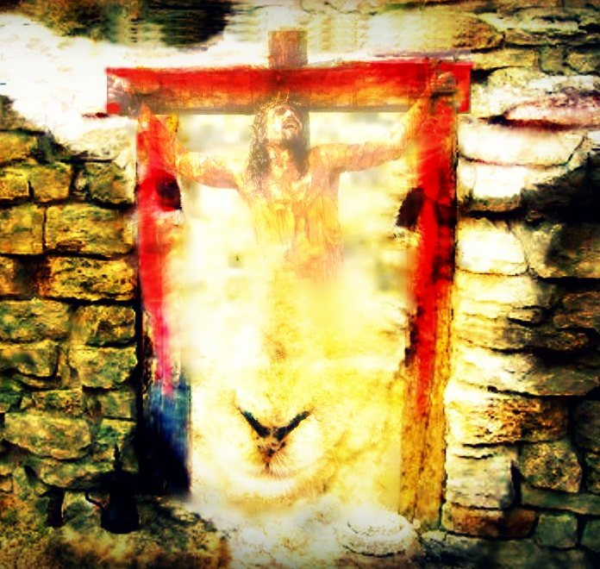
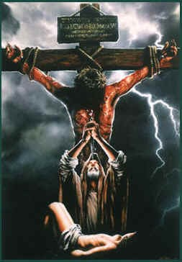
Some animals are designed to prefigure N.T. redemptive truth.
某些動物的設計用來預表新約救贖的真理。
Jesus is our “Passover Lamb” (I Cor. 5:7; Exodus 12; Isa. 53:7)
耶穌是我們“逾越節的羔羊” （林前5:7；出12；賽53:7）。
Oh! How understanding the “Types” like “the Lamb of God” transforms our life! (John 1:29, 36; Heb. 10:14; Genesis 22:8)!
明白像“上帝的羔羊”之類的“預表”如何改變我們 的生命（約1:29,36；來10:14；創22:8）！

Slide 8
INTRODUCTION 引言
To be wise we must learn god’s biblical use & definition for a word
智慧的人必須從上帝在聖經中的用法及定義，來明白一個字

Slide 9
Whales [tanniym]: an important “Type” in Scripture
大魚（鯨魚）是經文中一個重要的預表
(Isa 27:1) “In that day the LORD with his sore & great & strong sword shall punish leviathan the piercing serpent, even leviathan that crooked serpent; & he shall slay the dragon that is in the sea
賽27:1 - 到那日，耶和華必用他剛硬有力的大刀刑罰鱷魚(leviathan )，就是那快行的蛇，刑罰鱷魚(leviathan )，就是那曲行的蛇，並殺海中的大魚(龍）。
Dragon is ‘tanniym’ & is one with the serpent & leviathan.
龍也是‘tanniym’ ，是與蛇和大魚合一的。
All Types of satan in the Bible (Job 41:1, 34; Ezek. 32:2; Rev. 12:9)
這些都是聖經中撒旦的預表（伯41:1,34；結32:2；啟12:9）。

Slide 10
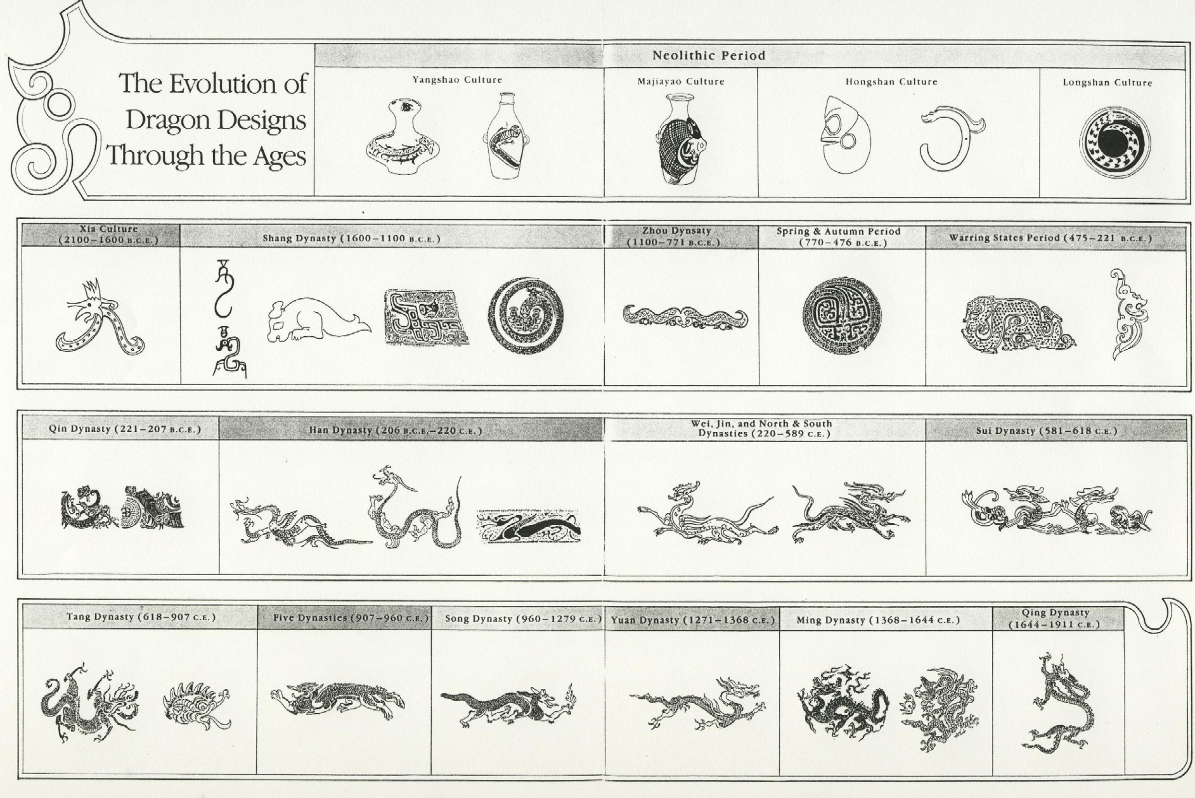
In China there is a progression from serpent…中國蛇變成龍的進展
…to Dragon
History comes alive with God’s Wisdom!

Slide 11
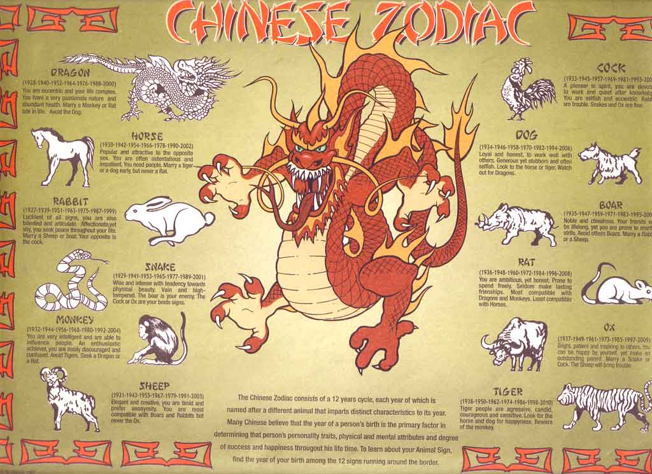
Chinese Zodiac
Speaking of Context…
Why would the Chinese have 11 real animals and one “mythical” dragon? 12生肖

Slide 12
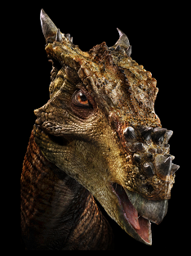
Real or myth?
真的，還是神話？
Was this a real animal or just somebody’s imagination?
這是一個真實的動物，還只是某人的想像？
Notes:
Look like it came from some movie, or some museum of fossils?

Slide 13
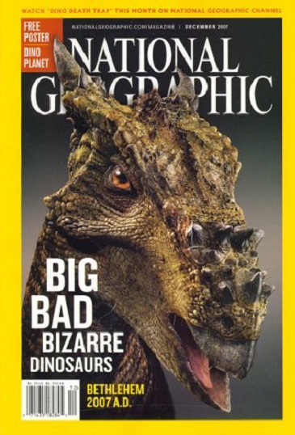
Say Hello to “Dracorex Hogwartsia”
Nearly complete Dracorex skeleton found May 2003 in South Dakota
2003年5月在南德科達州發現
此恐龍完整的骨骼。
No other of its species have yet been found
還沒有發現它其他的同種。
National Geographic Dec. 2007 Issue
Notes:
Mention brontosaurus not a real dinosaur. Missing head.

Slide 14
Dragons and Dinosaurs
龍與恐龍
“The dinosaur’s skull… surprised the scientists. Dracorex has a remarkable resemblance to the dragons of ancient China & medieval Europe.”
“恐龍的頭骨…令科學家吃驚。Dracorex 恐龍與古中國和中世紀歐洲的龍極為相似。” (Adrienne Mayor)
Source: https://humanexperience.stanford.edu/feature-dragons

Slide 15


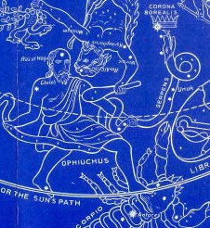
Snake & crown in the constellations
星座中的蛇與冠冕
1. Most ancient oracle bone character (最老甲骨文字) 1000+ BC. Note snake with crown on head.
2. Bronze character (金文编裏的字) 1000+ BC. Note snake with crown on head

Slide 16
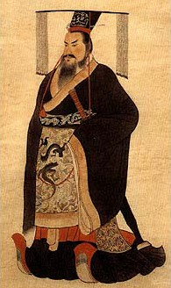
Qin Shi Huang Di 秦始皇帝
Lived (259-209 BC)
1st to deflect worship from Shang-Ti to the Dragon
第一位從上帝轉到龍的敬拜的皇帝。
1st “antichrist” figure in Chinese history. (I John 2:18; 4:3)
中國歷史中第一個“敵基督”的預表。
（約一2:18,4:3）

Slide 17

We must resist the Devil’s work in the World
我們必須抵擋魔鬼在世界的工作
“Be sober, be vigilant; because your adversary the devil, as a roaring lion, walketh about, seeking whom he may devour:
“Whom resist stedfast in the faith… (I Peter 5:8-9)
彼前5:8-9 - 務要謹守，警醒。因為你們的仇敵魔鬼，如同吼叫的獅子，遍地遊行，尋找可吞吃的人。你們要用堅固的信心抵擋他…

Slide 18
When Solomon was Gifted Divine Wisdom...
當所羅門被恩賜神的智慧…
“...he spake of beasts, & of fowl, & of creeping things, & of fish” (I King 4:33) whose creation by God is revealed in Genesis 1
王上4:33 - 他…又講論飛禽走獸、昆蟲水族。是神在創世記一章所啟示的。
And there came of all people to hear the wisdom of Solomon…” (I King 4:29-34; 10:23-24; 2Chron. 1:10-12; Eccl. 2:26)
王上4:34 - 天下列王聽見所羅門的智慧， 就都差人來聽他的智慧話。
Discovering Divine wisdom in creation is life changing
在自然界發現神聖的智慧帶來生命的改變。

Slide 19
Illus: I visited a Sunday School & a pastor said something shocking:
He held up his hand, missing a finger, & said: “I find nothing in the Bible that tells me I will have that finger back in heaven!”
Octopus & starfish can grow back limbs that are totally severed!
God reveals the future healing of our glorified bodies in the things He has created! (Phil. 3:21; I Cor. 15:35-44; I John 3:2)

Slide 20
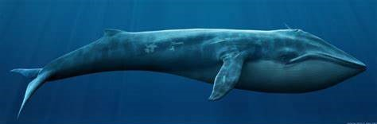
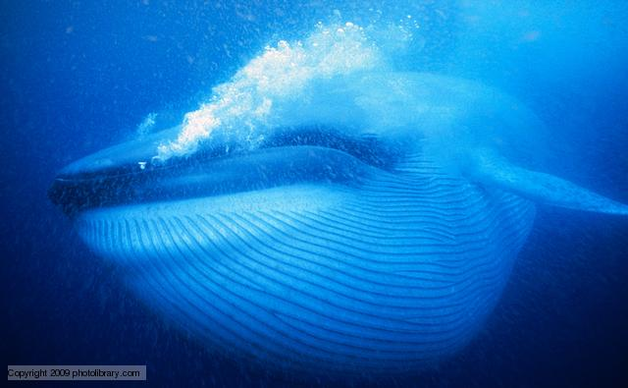
I. Divine wisdom from the wonders of modern-day whales
從現代鯨魚的奇妙來探索上帝的智慧

Slide 21
The Wonders of Whales are a Major Problem for the irrational theory of their evolution
鯨魚的奇妙是用不合理性去解釋它的進化理論最大的問題
Whales' uniqueness makes its impossible to have evolved little by little, slowly, over time from a small land mammal!
鯨魚的獨特無法使它從小型的陸地哺乳動物，一點一點去進化出來。
Their respiratory system, reproductive system, eating habits, size, special skin, ability to deep dive, ability to produce music! Etc., etc., etc. all so unique!
他們的呼吸系統，繁殖系統，吃食習慣，大小，特別的皮膚，能夠深水潛泳，製造音樂…等等，都十分獨特！

Slide 22
The Blue whale is the largest animal that ever lived
藍鯨是世上最大的動物
So we are confronted with a Scientific Law: “Law of cause & effect:” It is the most universal & most certain of all laws.
我們面對一科學定律：“因果定律”：最普世也最確鑿的定律，
“Every material effect must have an adequate cause that existed before the effect.” The effect is never greater than the cause.
“每一物質結果，必須先有它之前適當的因存在”，而果從不會大於因。

Slide 23
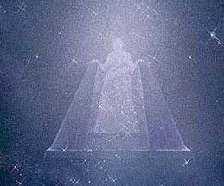
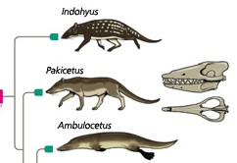
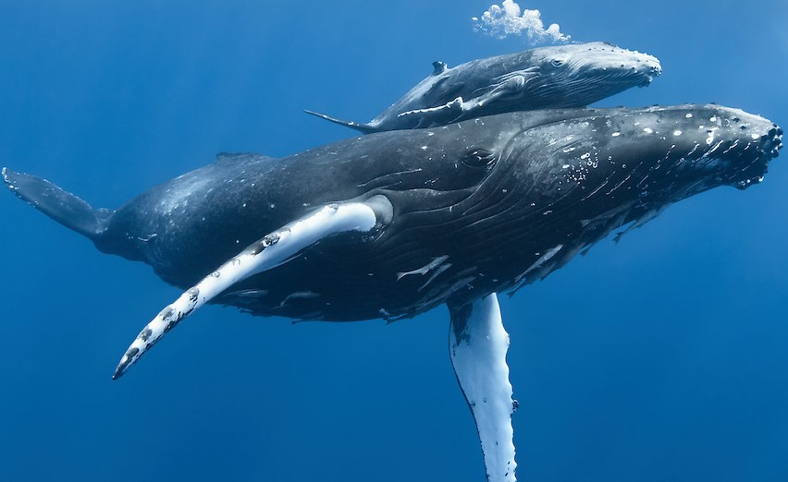
Only 2 possibilities for the “Cause” of Whales
鯨魚只有兩種“因”的可能性
Evolved from indohyus, pakicetus, ambulocetus, & rodhocetus by chance! No science, its imagination! Robs God of His glory
偶然進化而來，沒有科學證據，只有想像，剝奪上帝的榮耀。
God Created whales on the 5th day designed to live in the ocean. Reveals God’s Glory!
上帝在第五天創造它活著海洋裡，顯明上帝的榮耀！
Size of a dog
200 tons
infinite omnipotent Creator

Slide 24
Wonders of Whales 鯨魚的奇妙
Whales can dive to 9800 feet & spend 1-2hr. Under water! Their muscles can store oxygen (the rete mirabile or miracle network)
鯨魚可以潛水下到9800英呎，在水下停留1-2小時！它們的肌肉可以儲存氧氣。
When you read Jonah 2 its literal. His body died in the whale. His soul headed to hell under the deep (Ps. 69:14-15; Matt. 12:40).
當我們讀約拿書第二章，它是按字面意義讀的。約拿的身體在鯨魚中死了，他的靈魂下到海底深處的陰間（詩69:14-15；太12:40）。
Just as Jesus descended to hell before his resurrection (Eph 4:8-10)
正如耶穌在復活之前下到陰間（弗4:8-10）。

Slide 25
Baby blue whale weighs 8 tons at birth! Only mammal born in ‘breech’ position.
藍鯨寶寶出生時重8噸！是唯一生產以尾部先出來的哺乳動物。
Some whales migrate 16,000 miles/yr. Can maintain speed of 22mph. & maintain body temp. of 97.7F
有些鯨魚一年遷居16,000英里，可以保持一小時22英里的速度以及華氏97.7的體溫。
Track their food with sonar. 用聲吶追蹤它們的食物。
Ears are unique from all animals. 耳朵與其他動物都不一樣。
Each whale species identified by the spout of water when they breach (some as high as 50ft.) 每一鯨魚種類是藉著它們噴水的方式來識別（有些高達50英呎）。

Slide 26
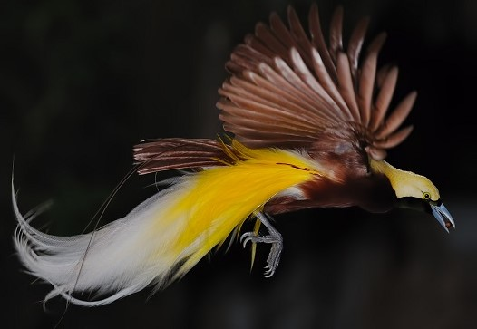
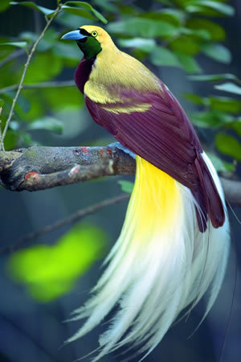
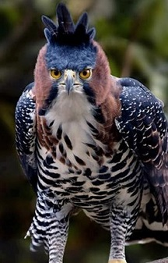
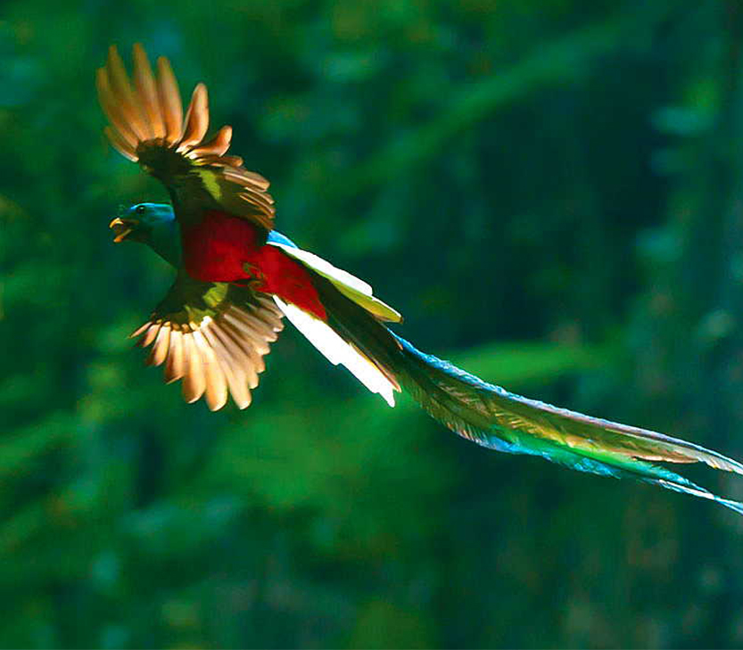
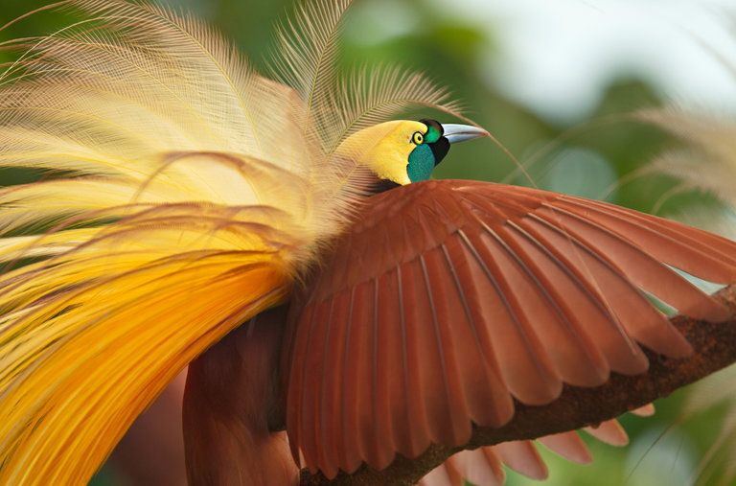
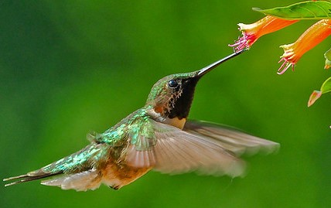
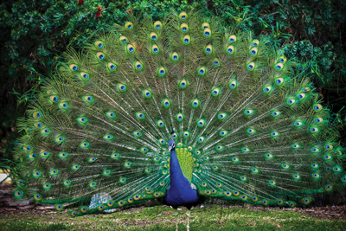
II. Divine wisdom from the miraculous beauty, behavior & brilliance of birds
從鳥類的奇美、行為、光彩
來觀察上帝的智慧
a lesson in Victory over evil
勝過罪惡的功課

Slide 27
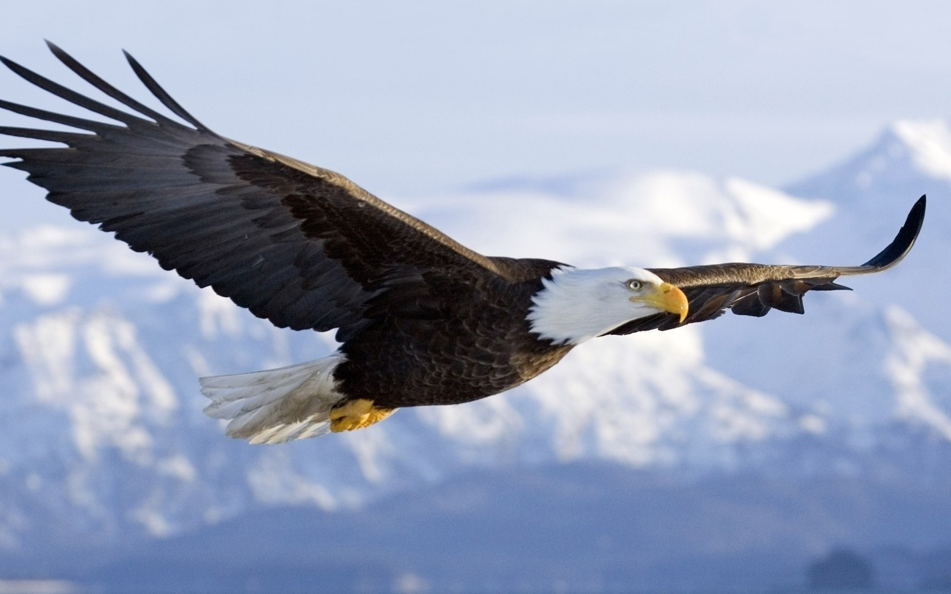
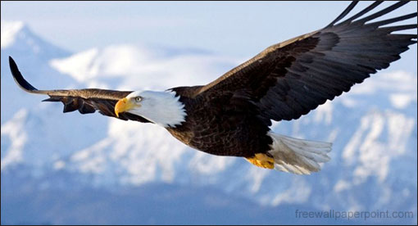
The EAGLE: An amazing Teacher of Spiritual Truth
(Isa. 40:28-31; Eph. 2:4-7)
老鷹：教導屬靈真理的奇妙導師（賽40:28-31；弗2:4-7）
We were Created to Triumph over the Trials of Life By Ascending the Heavens on the winds of God's Holy Spirit
上帝創造我們藉著祂聖靈的風升到天上, 勝過生命的試煉.

Slide 28
A Great Reality of the Christian life:
基督徒生命的重大真相:
(Eph 2:6) God “hath raised us up together, and made us sit together in heavenly places in Christ Jesus..”
弗2:6 他又叫我們與基督耶穌一同復活，一同坐在天上，
God has raised us up to a position of authority over our spiritual enemies
上帝將我們升到權柄的位置， 擊退屬靈的敵人。

Slide 29
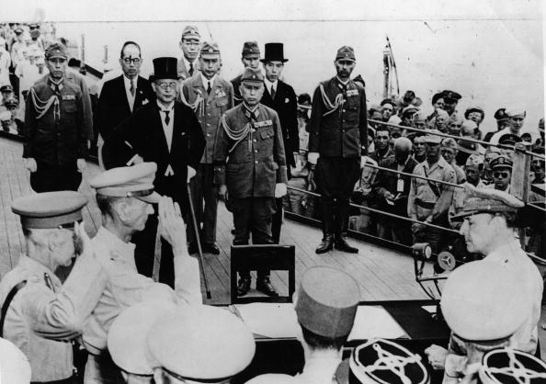
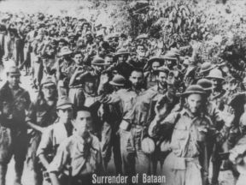
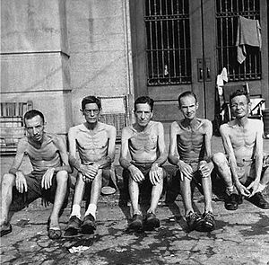
Difference between Authority & Power 權柄 VS.權力
General Wainwright WWII 二次世界大戰維恩萊特將軍

Slide 30
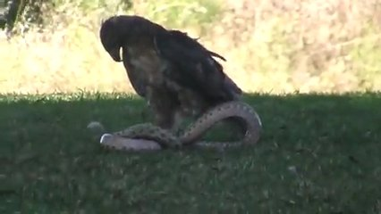
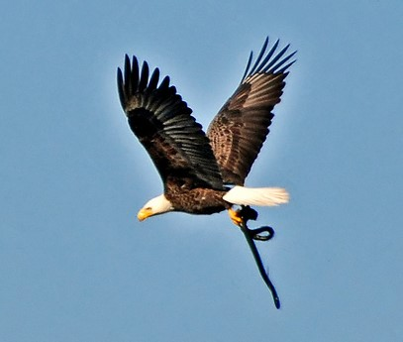
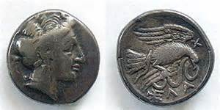
(Lk. 10:19) “Behold, I give unto you power to tread on serpents & scorpions, & over all the power of the enemy: & nothing shall by any means hurt you.” (read Rom. 16:20)
路10:19 - 我已經給你們權柄可以踐踏蛇和蠍子， 又勝過仇敵一切的能力，斷沒有什麼能害你們 （讀羅16：20）。

Slide 31
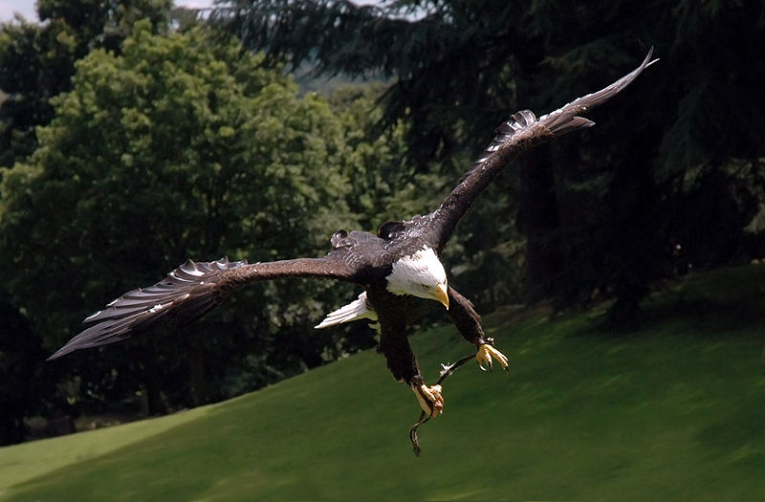
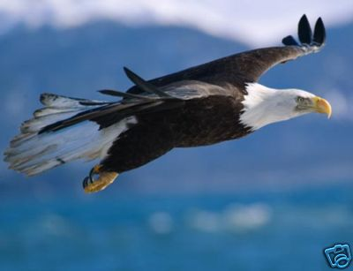
(Isa 40:31) But they that wait upon the LORD shall renew their strength; they shall mount up with wings as eagles;
they shall run, & not be weary; & they shall walk, & not faint.
賽40:31 但那等候耶和華的必從新得力。他們必如鷹展翅上騰；他們奔跑卻不困倦，行走卻不疲乏。

Slide 32
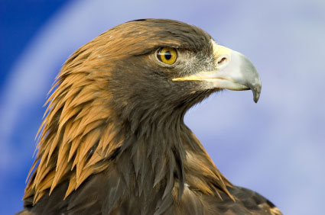
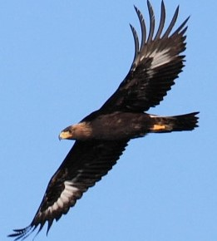
The Eagle is a Royal Bird! 老鷹是皇家之鳥
God has made us Kings “in Christ” (Rev. 1:6; 5:10; 20:6; I Pet. 2:9)
上帝已經“在基督裡”使我們作王（啟1:6,5:10,20:6；彼前2:9）
Notice his golden “Crown”
Prov. 30:18-19

Slide 33
Colossians 哥羅西書 3:1-2 (Heb來. 3:1)
"If ye then be risen with Christ, seek those things which are above, where Christ sitteth on the right hand of God.”
西3:1 所以，你們若真與基督一 同復活，就當求在上面的事； 那裡有基督坐在神的右邊。
“Set your affection on things above, not on things on the earth”
西3:2 你們要思念上面的事， 不要思念地上的事

Slide 34
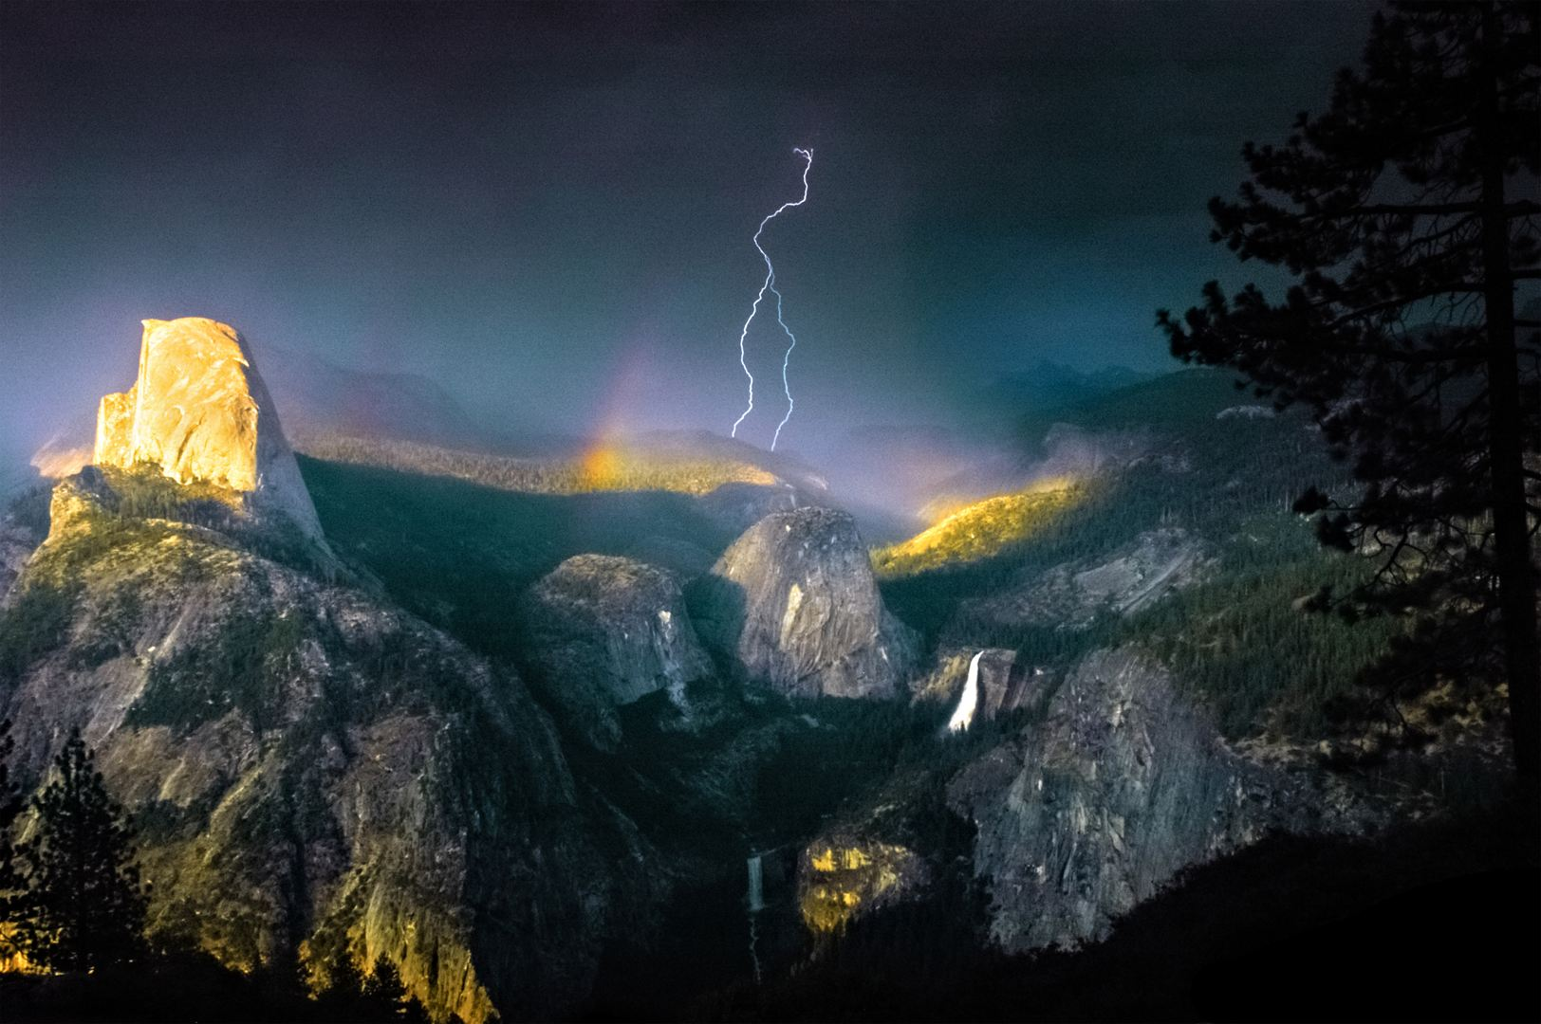

The Eagle does not fear the Coming Storm
老鷹不畏懼即將來臨的風暴
Storms don’t drain the Eagles strength because it uses the force of the storm to its own advantage
風暴無法耗盡老鷹的力氣,因牠善用風暴的力量成為自己的益處

Slide 35
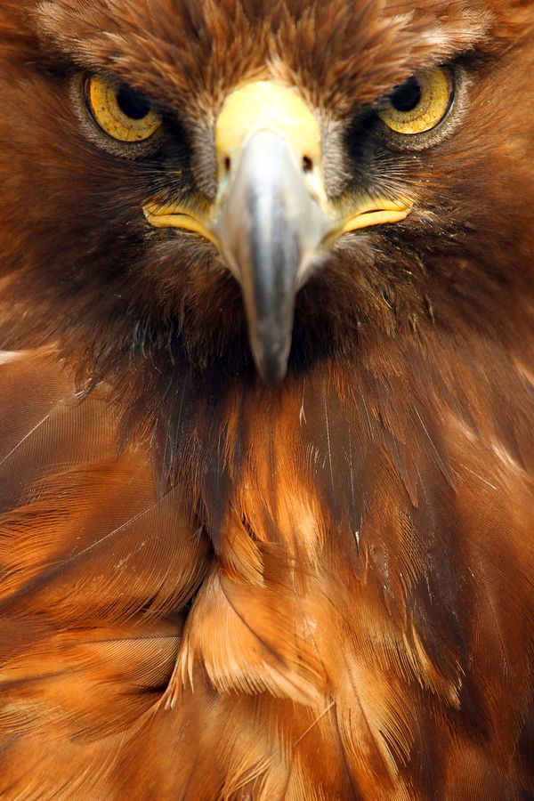
The miraculous eyesight of the eagle.
老鷹的眼力奇妙
The eagle can see a quarter at 200 yards. (People can only see at 35 yds).
老鷹可從200碼處看見錢幣 （人只能見35碼） ，
His vision enables him to see storms coming long before any other creatures.
它的視力能夠比任何其他生物提早看見風暴的來臨。

Slide 36
So the Christian is to be “eagle eyed”
基督徒應具有「老鷹的眼力」
Able to see things others simply can’t see.
能夠看見他人所看不見的，
"We endure as seeing him who is invisible" (Heb. 11:27; 2 Cor. 4:18).
來11:27 …恆心忍耐，如同看見那不能看見的主。
Eagle eyes are anointed with a special oil
老鷹的眼睛用特別的油膏抹。

Slide 37

THE ADULT MATURE EAGLE is a truly great wonder 成年老鷹真是奇妙
Eagles are solitary birds often soaring alone with God.
老鷹是孤獨的鳥,經常獨自與上帝高飛。
So Eagle Christians must pursue times of solitude to be alone with God (A quiet time).
鷹式的基督徒必須追求與上帝單飛的時刻。（安靜的時間-靈修）

Slide 38
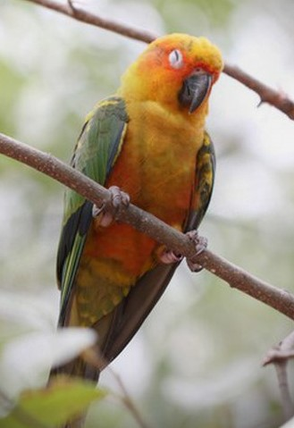
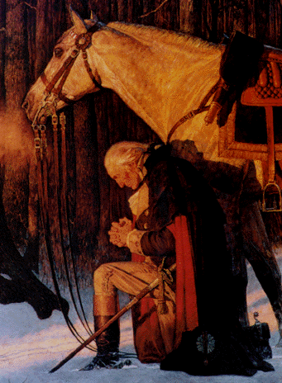
God’s Wisdom in the Bended Knee: a lesson in Prayer
膝蓋跪下的禱告功課：上帝的智慧
How do Birds sleep on a perch & never fall off?
鳥類如何能在枝頭睡覺而不跌下？
God designed the claws to contract with a steel like grip when the leg bends at the knee.
上帝設計它們的爪在膝蓋彎曲時能牢牢抓住。
Wisdom: when we bend our knees in prayer it will keep us from falling to our hurt?
智慧：是否我們跪下禱告可預防我們跌倒受傷？

Slide 39
Avoid “oppositions of science falsely so called” (1Tim. 6:20)
要逃避“敵真道、似是而非的學問” （提前6:20）
Man’s “theories frequently clash & reverse almost as fast as fashions”
人的“理論幾乎經常像時裝一樣，相互抵觸並顛倒”
(Jerry Bergman, Fossil Forensics: Separating Fact from Fantasy in Paleontology, 2017, p. 267)

Slide 40
III. The wisdom of this world is foolishness with god
世上的智慧在神是愚拙
(I Cor. 3:19-20; 1:19-20; Rom. 1:21-22)
（林前3:19-20,1:19-20；羅1:21-22）

Slide 41
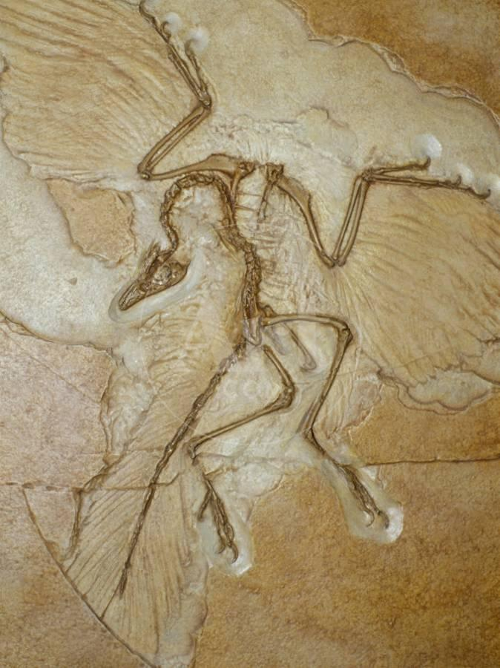
Evolution’s failures to explain the evolution of Birds
進化論無法解釋鳥類的進化
“Of all classes of vertebrates, the birds are least known from their fossil record.”
“在所有脊椎動物中，鳥類是從化石記錄中 最不被人知的。” (Colbert, Evolution of the vertebrates, 2001, p. 236)
Most famous icon is Archaeopteryx. But there is a 90 million yr. gap to the next fossil!
最有名的代表是始祖鳥，但在與其下一個 化石之間有九千萬年的距離。
(Alan Feduccia, The Origin & Evolution of Birds, 1996, p. 404)

Slide 42
Evolution’s deception about Birds
進化論關於鳥類的欺騙
Many fossil birds are merely fragments & must be ignored.
許多鳥化石僅是片段，不能重視它們。 (Alan Feduccia, The Origin & Evolution of Birds, 1996, p. 165)
All “good” bird fossils are fully formed birds. There are no missing links! Has Caused great controversy the last 100 yrs.
所有“好的”鳥化石都是完整成形的鳥，沒有遺失的鏈接！這在過去100年造成重大的爭議。 (John Ruben, “Paleobiology & the Origins of Avian Flight.” Proceedings of the National Academy of Sciences. 107(7): 2733-2734. Feb. 16)，(Jonathan Wells, Icons of Evolution, 2000, pp. 111-135)

Slide 43
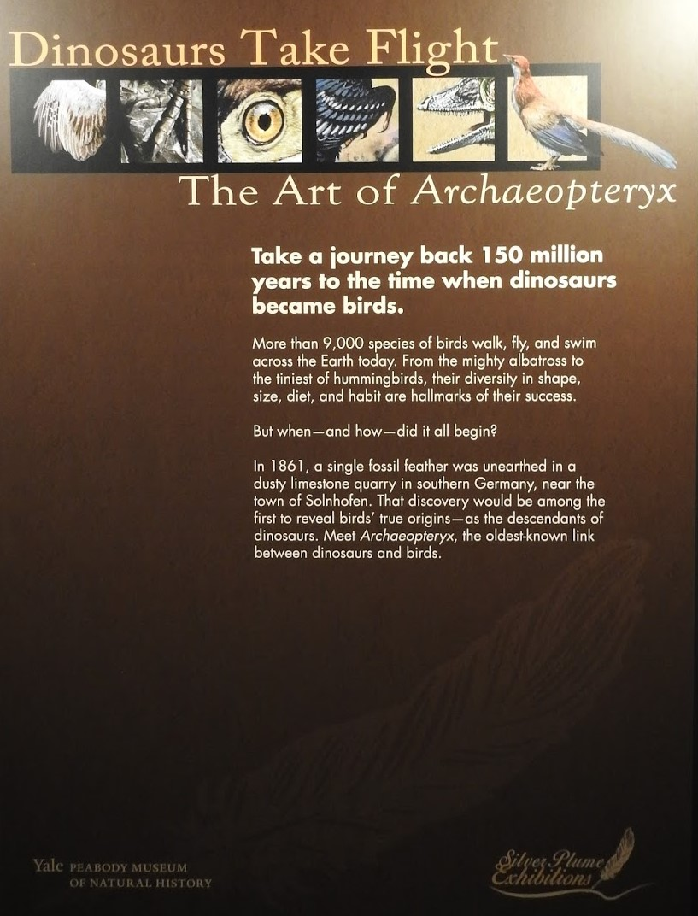
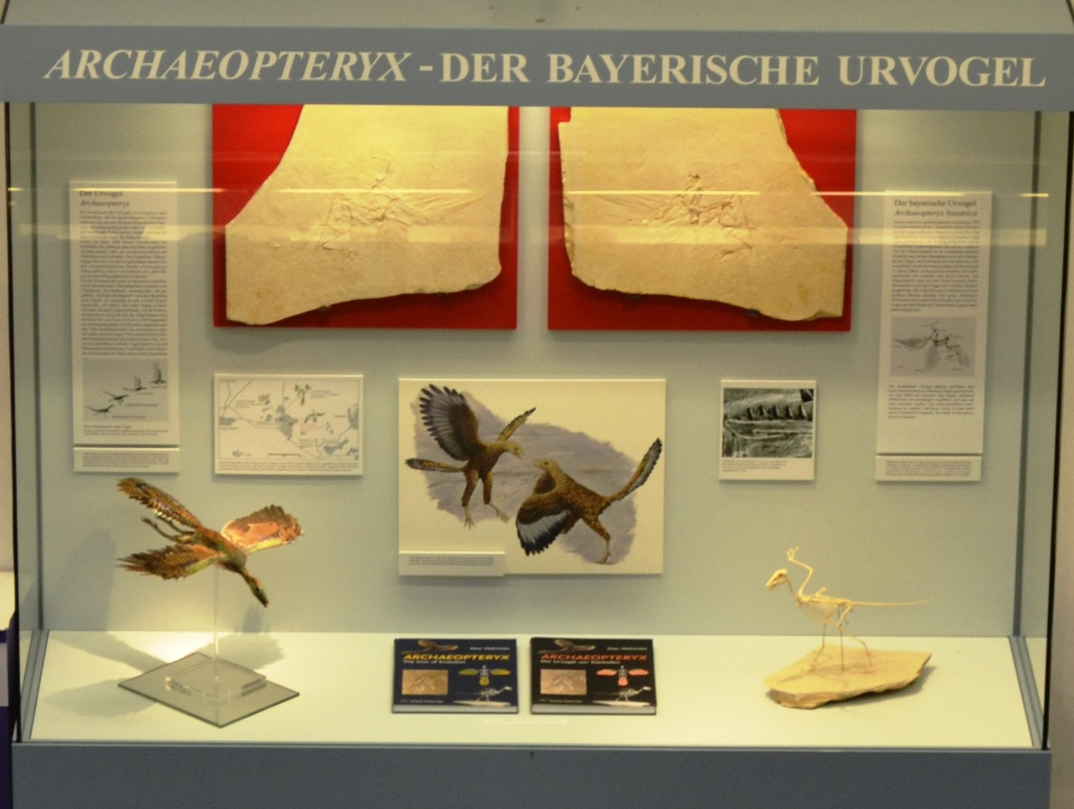
Despite all the evidence against it, Archaeopteryx still in Text Books & Museums as a ‘missing link’
即使有證據反駁，始祖鳥仍然在教科書以及博物館中
呈現為“遺失的鏈接”
Textbooks: Raven & Johnson, Biology, 2014, p. 424 still calls Archaeopteryx the first bird.
Prothero, Bringing Fossils to Life, 2013, p. 88 calls Archaeopteryx ‘a missing link.’
We must take God’s warnings about deception seriously！
我們必須嚴肅對待上帝對欺瞞的警告！
(Eph. 4:14; 5:6; Gal. 6:7; 2 Tim. 3:13; Titus 3:3; Rev. 20:10)

Slide 44
The most widely propagated Theory is Birds evolved from Dinosaurs
最普及的宣傳理論是：鳥類從恐龍進化而來
“A problem for Darwinism, thousands of fossilized bird tracks have been found alongside dinosaur foot tracks in many parts of the world, creating problems for their evolution from dinosaurs.”
“達爾文主義的問題是，在世界許多地方，上千個化石鳥蹤跡在恐龍的足跡旁一同被發現，產生它們是從恐龍進化而來的問題。” (Philip Snow, The Design & Origin of Birds, 2006, p. 155)
There are no fossil “missing links” for Birds!!
就鳥類而言，化石的“遺失鏈接”不存在。

Slide 45
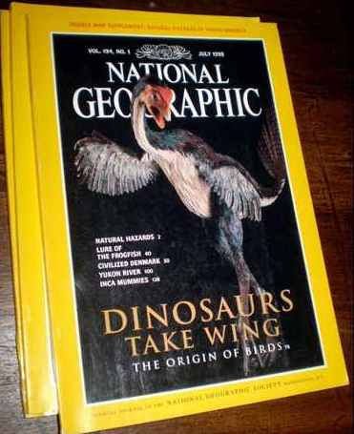
Evolution’s frauds, & deception about Birds
進化論關於鳥類的欺詐與矇騙
A serious scientific Hoax & fraud (1999).
嚴重的科學騙局和欺詐。
Archaeoraptor was a forged fossil somehow smuggled out of China
Archaeorptor是從中國偷渡出來偽造的化石
Scientists desperate to prove evolution fall easy pray to deception
急於證實進化論的科學家們最容易被騙。

Slide 46
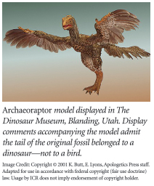
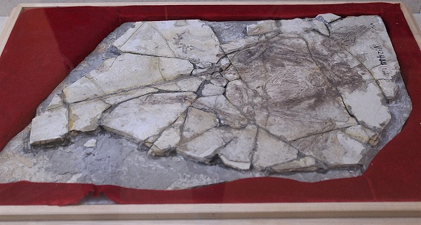
Even after scandal still in museum
即使醜聞發生仍然在博物館
Below is the actual fake fossil
下圖為真實的偽化石。

Slide 47
References for the Major Problems of Bird Evolution
鳥類進化重大問題的參考文獻
Jerry Bergman, Fossil Forensics: Separating Fact from Fantasy in Paleontology, 2017, pp. 255-286.
Alan Feduccia, The Origin & Evolution of Birds, 1996, p. 404;
Luis M. Chiappe, The First 85 million Years of Avian Evolution.” Nature, 378:349-355
Jonathan Wells, Icons of Evolution, Science or Myth, 2000, pp. 111-135
Jonathan Wells, Zombie Science, 2017. pp. 61-63

Slide 48
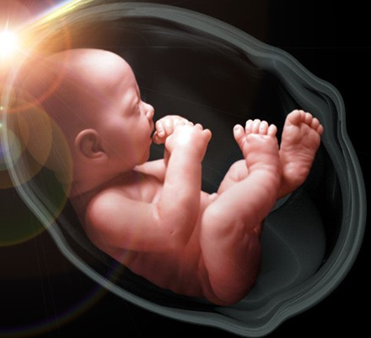
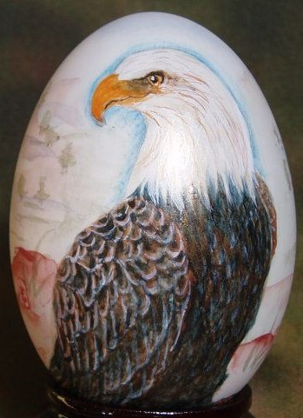
A moral disaster created by deceptive evolutionary teaching: Which of the following is more valuable?
欺騙人的進化論教導所製造出的道德災難：
下列哪一個更具價值？
Destroy An unborn child: no penalty. People get paid for doing it!!! Taxpayer pays for it!
Destroy An eagle egg: $5000 fine. 2nd offence 2yr. in prison & $250,000 fine

Slide 49
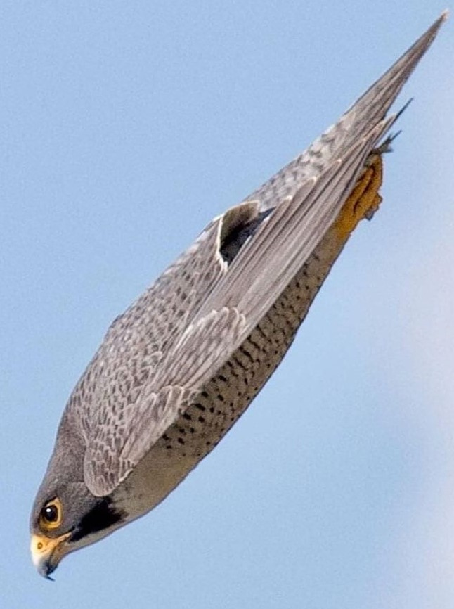
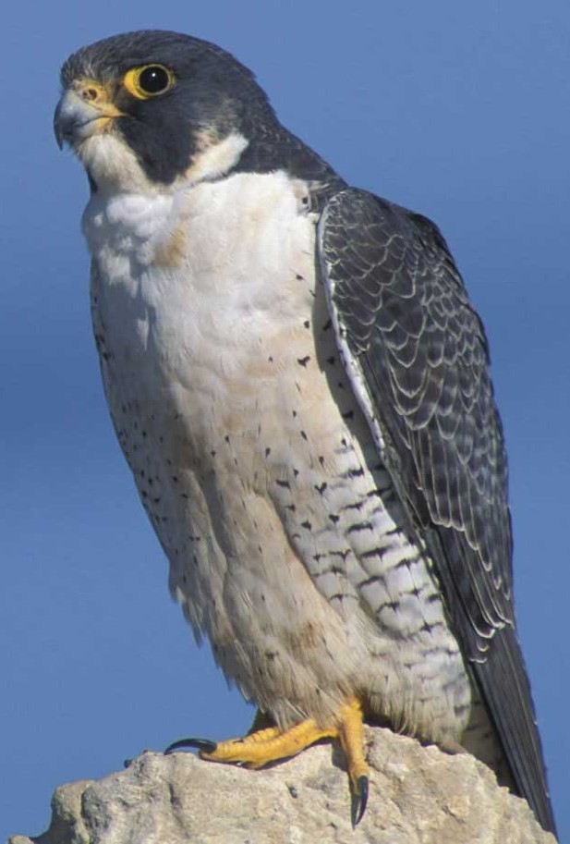
Brilliant Unique Design of Birds
鳥類光彩獨特的設計
The entire warm blooded anatomy is uniquely designed around their flight capabilities.
完全溫血的體質特別為飛行能力而設計。
Peregrine falcons can fly 180 miles/hr. & dive at 245 miles/hr.
禿鷹能夠一小時飛行180英里，下沖一小時245英里。

Slide 50


Bird navigational skills are unsurpassed among animals
它們導航的技能在動物界無法超越
Arctic Terns migrate 44,000 miles/yr. from pole to pole
北極燕鷗每年從兩極來回遷移44,000英里。

Slide 51

The Brilliant Unique Design of Birds
鳥類光彩獨特的設計
Feathers are “lightweight miracles of engineering”
鳥的羽毛是“‘輕’的工程奇跡” (Philip Snow, The Design & Origin of Birds, 2006, p. 54-95)
Birds have lightweight but very strong skeletons
鳥雖然輕，但骨骼強壯。
So ingeniously complicated couldn’t evolve step by step by chance!

Slide 52


Birds have a unique unidirectional respiratory system
鳥類具有獨特的單一方向呼吸系統
Empirical science says its impossible to evolve from cold blooded reptiles
實證科學說，這個特性無法從冷血的爬蟲動物進化而來。

Slide 53
Brilliant Unique Design of Birds
鳥類光彩獨特的設計
Birds among the most intelligent species known. Can perform complex activities like building nests & singing elaborate songs
鳥類是物種中最聰明的，能夠執行複雜的活動，好比造鳥巢，唱縝密的歌。
Living Birds truly stand far apart from all other animals
活著的鳥類確實與所有其他動物有別。 (Lawrence Witmer, The Search for the Origin of Birds. 1995, p. 10)
Reptile to bird transitions are not even remotely feasible
爬蟲類進化到鳥類根本不可能。 (Philip Snow, The Design & Origin of Birds, 2006, p. 159)

Slide 54



Hope Giving Wisdom from The Golden Plover
金斑鸻帶給我們“盼望的智慧”
They fly 2400 miles Alaska to Hawaii nonstop over the Ocean each year
它們每年從阿拉斯加穿越海洋飛到夏威夷，2400英里，途中不休息。
Parents leave before the babies can fly
父母在嬰孩還不會飛時就先離開。
The babies fatten up for the trip
嬰孩先長胖才起飛。

Slide 55

The babies have never made the journey before!
嬰孩從未飛過此航程！
Their wings beat 250,000 times without rest or eating. (88 hr.)
它們的翅膀搧動25萬次，沒有休息或進食（88小時）。
No one bird could eat enough fat to make the journey alone
沒有一隻鳥能夠吃足夠的脂肪來單獨完成這旅程，
But flying together in formation, to conserve energy, they never fail to reach their destination!
但排出字形群飛，它們從不失敗地抵達
目的地！

Slide 56
What a Miracle: A baby Plover, born in a hostile environment, miraculously reaches their far away paradise (Hawaii).
多大的奇跡：金斑鸻寶寶生在敵對的環境，卻從不失敗地抵達它們遠處的樂園（夏威夷），
Even though they have never made such an amazing trip before.
雖然它們從未到過那地方。
Is not Wisdom teaching us about our future? We are born into this hostile world. Our Parents leave before we do.
智慧難道不在教導我們的未來？我們生在這個敵對的世界，父母在我們之前離開，
We must prepare for a miraculous trip to our Heavenly paradise.
我們必須為到天上樂園的奇跡旅程預備。

Slide 57
We’ve never made the trip before: Will we make it?
我們從未踏上此旅程：會抵達嗎？
Of course we will! Why am I so certain?
當然會！為何我如此確定？
The same Creator God who enables the Golden Plover to make the miraculous journey successfully…
使金斑鸻成功地完成旅程的造物主，
Will enable us to reach our home in Paradise through faith in our LORD Jesus Christ!
將會使我們能夠藉著在主耶穌基督裡的信心，抵達我們在樂園的家！

