Slide 1
3. Homo Floresiensis (Hobbit)
Found in 2003 on Indonesian Island of Flores. Only 3ft. 6 in. tall. Fragments of 14 individuals found by 2009.
Dating methods yield 1,000 to 1 million yrs. Old! Have Skeletal features shared by modern pygmies still living near the cave!
Evidence suggests they were fully human

Slide 2
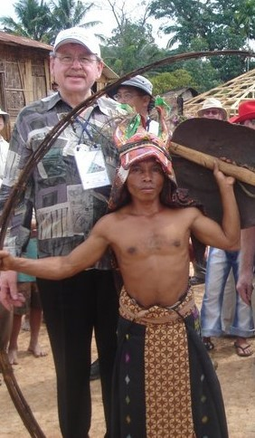
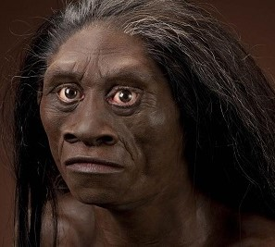
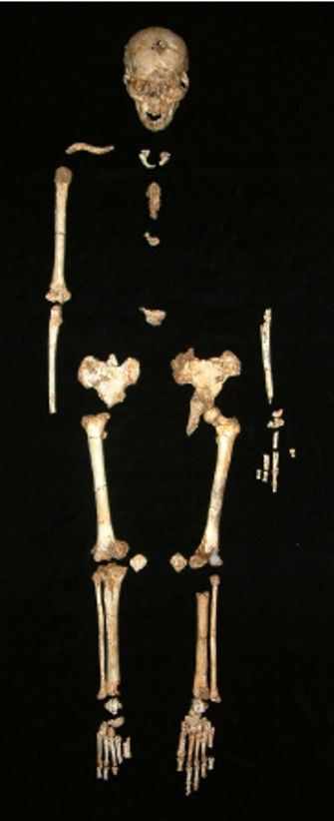
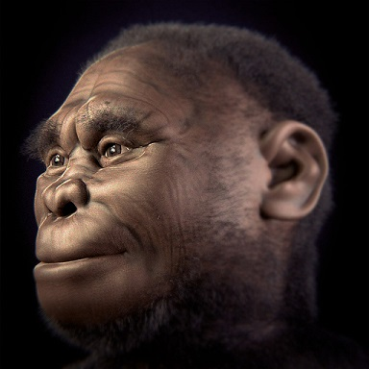
3. Homo Floresiensis (Hobbit)
Bones similar to living pygmies nearby
Original bones damaged beyond repair. No longer can be studied

Slide 3
3. References for Homo Floresiensis (Hobbit)
Christopher Rupe & John Sanford, Contested Bones, 2019, Chapt. 5, Homo Floresiensis, pgs. 79-93
Jerry Bergman, Peter Line, Jeffrey Tomkins, & Daniel Biddle, Apes as Ancestors: Examining the Claims About Human Evolution, 2020, Chapt. 18 Homo Floresiensis, pgs. 333-358.

Slide 4
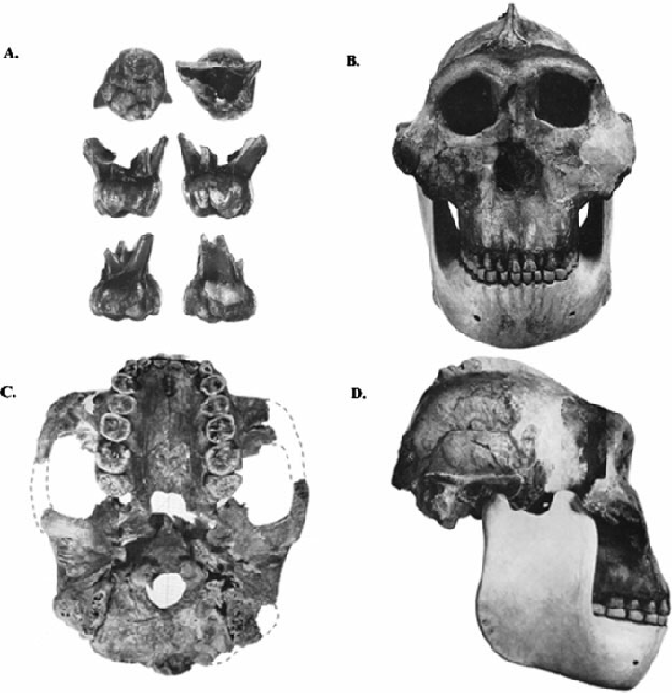
6a. Zinjanthropus boisei or Australopithecus boisei or Paranthropus boisei
Leakey’s found in 1959 & claimed it was a human ancestor (because stone tools found nearby)
Now called a robust australopithecine (because it resembles large bodied ape)

Slide 5
6a. He wanted to find a human ancestor, so he did!
Leakey interpreted the evidence according to his own preconceptions (John Reader, Missing Links, 2011, p. 317). The evidence was weak & His evolutionary bias was great.
Leakey retracted his ideas after discovering Homo Habilis (1964) (Christopher Rupe & John Sanford, Contested Bones, 2019, p. 160-162)

Slide 6
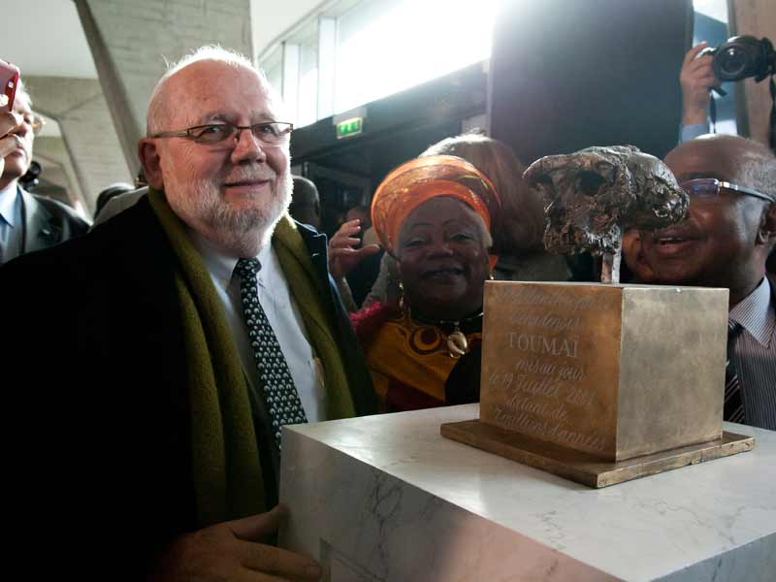
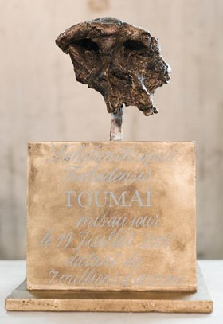
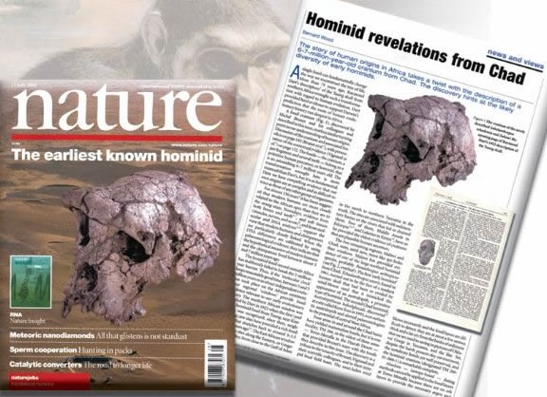
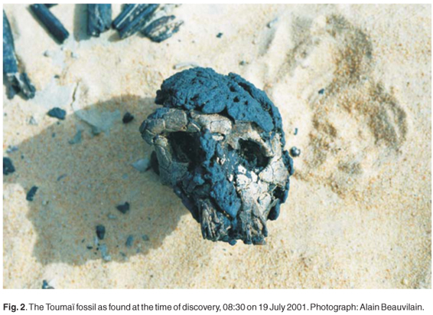
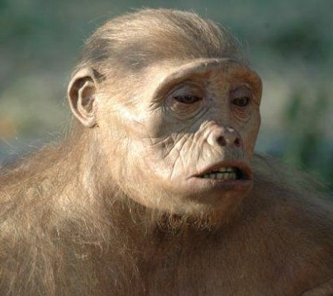
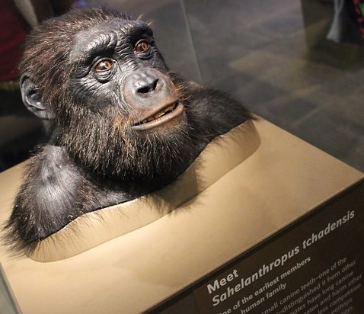
The drive for fame & funding still overrides science (2002) Brunet finds Sahelanthropus (Toumai) (Donates model to UNESCO)
museum
Model made for documentary

Slide 7
Media hype confirms the paucity of fossil evidence
The constant media hype that comes regularly with each new fragile & fragmented bone proves how weak the evidence is!
“With a single discovery, a U.S. scientist revised our understanding of the lives of early hominids” (Time Magazine (Special Edition) Great Scientists: The Geniuses & Visionaries Who Transformed Our World, 2018, p. 44.

Slide 8
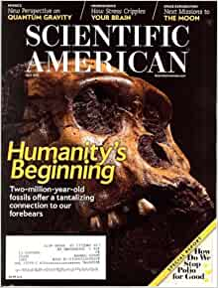
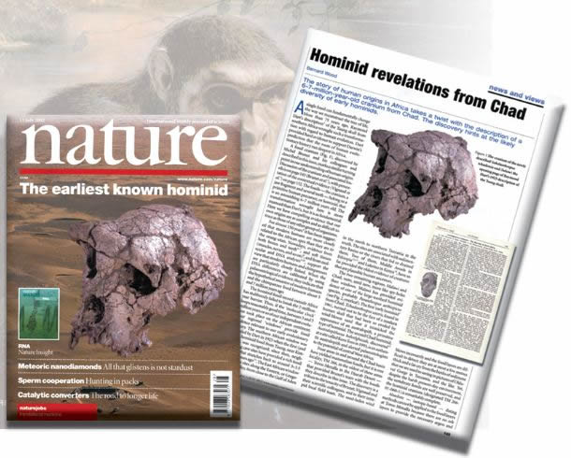
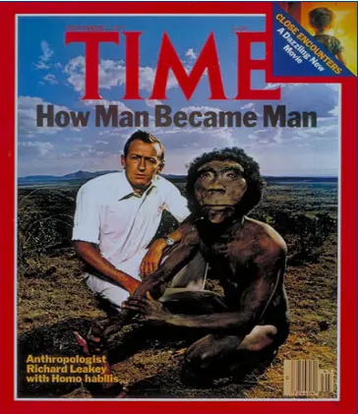
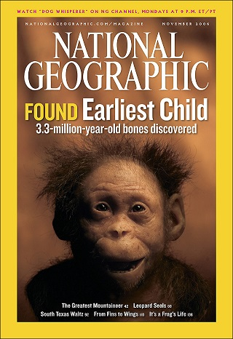
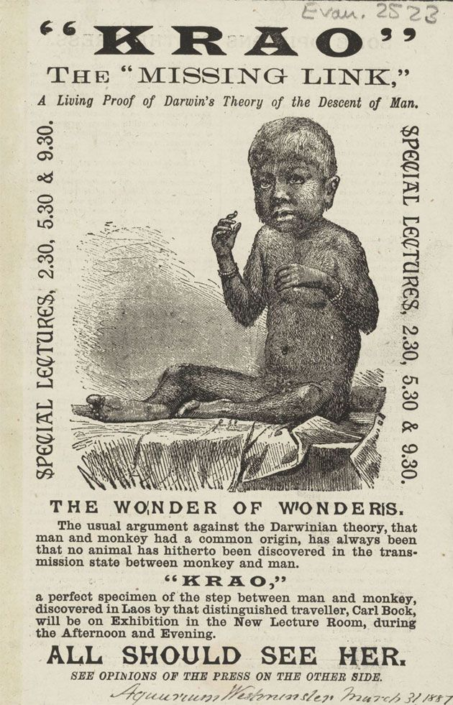
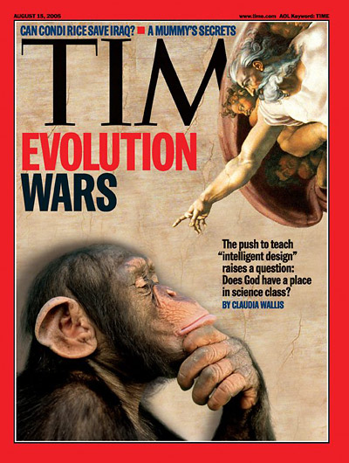
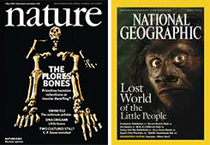
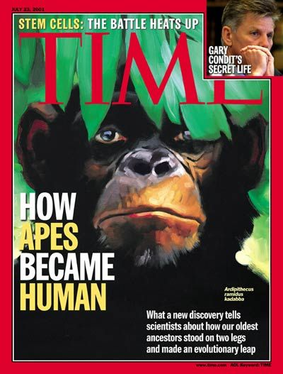
We cannot trust the popular media for ‘hard’ scientific fact

Slide 9
This is why 60% of Americadon’t believe man evolved from some ape like ancestor

Slide 10
“All known remnants of our ancestors from 1 million to 5 million yrs. Ago could be spread out on two large trestle tables” (Elizabeth Peer, “Review of People of the Lake by Richard Leakey and Roger Lewin,” Newsweek, p. 80. Sept. 4 1978).

Slide 11
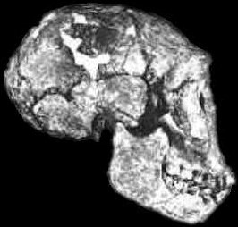
“The fossils that decorate our family tree are so scarce that there are still more scientists than specimens. The remarkable fact is that all the physical evidence we have for human evolution can still be placed, with room to spare, inside a single coffin!” (Dr. Lyall Watson, ‘The water people’ Science Digest, vol. 90, May 1982, p.44)

Slide 12
Research Exposing the reality of zero Empirical evidence for the evolution of Man
Christopher Rupe & John Sanford, Contested Bones, 2019,
Jerry Bergman, Evolution’s Blunders, Frauds & Forgeries, 2018
Jerry Bergman, Fossil Forensics: Separating Fact from Fantasy in Paleontology, 2017
Jerry Bergman, Peter Line, Jeffrey Tomkins, & Daniel Biddle, Apes as Ancestors: Examining the Claims About Human Evolution, 2020

Slide 13
Research Exposing the reality of zero Empirical evidence for the evolution of Man
Roger Lewin, Bones of Contention: Controversies in the Search for Human Origins, 1987
M.L. Lubenow, Bones of Contention, Updated and revised edition, 2004

Slide 14
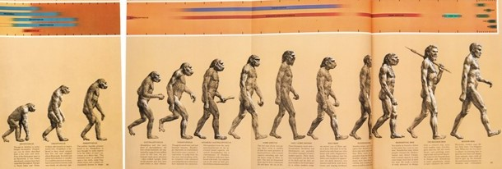
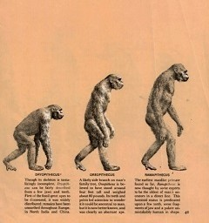
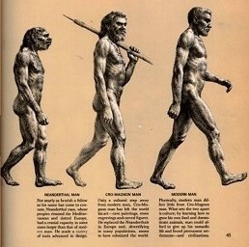
For a great discussion on Evolutionary charts & pictures like The March of Progress, We recommend: Jerry Bergman, Evolution’s Blunders, Frauds & Forgeries, 2018 Chapter 13, The ape-to-human evolutionary progression… is a fraud, p. 207-217.

Slide 15
There are consequences for teaching error
錯誤的教導
有其後果

Slide 16
Public Schools are Indoctrinating not Educating! 公立學校灌輸,而非教育學生
If I tell you only part of the evidence and you believe it, you have not been taught, you have been indoctrinated.
只被告知部分的證據就相信, 那不是教導,而是灌輸
If I tell you all the evidence and you make a decision, then you have been taught. 我們需要所有的證據才作決定,那才是教導

Slide 17
Paleoanthropology (the study of ancient man)
“All that paleoanthropologists have to show…are remains from fewer than 2000 of our ancestors…” An “assortment of jawbones, teeth & fossilized scraps, together with molecular evidence from living species, to piece together a line of human descent going back 5 to 8 million years…”
Colin Tudge, “Human Origins Revisited,” New Scientist (vol. 146. May 20, 1995), p. 24

Slide 18
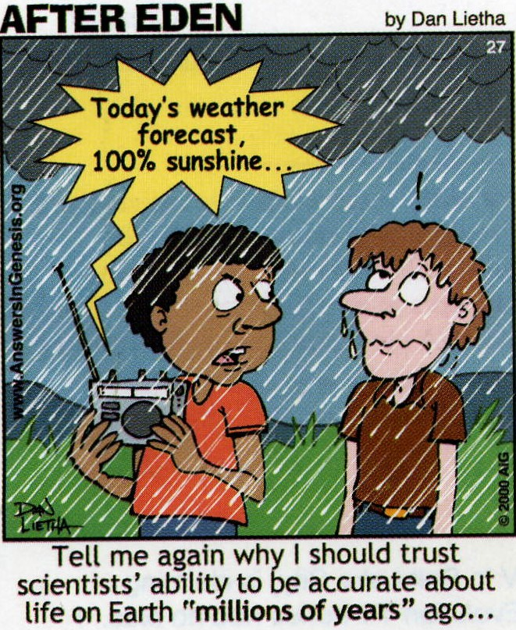

Slide 19
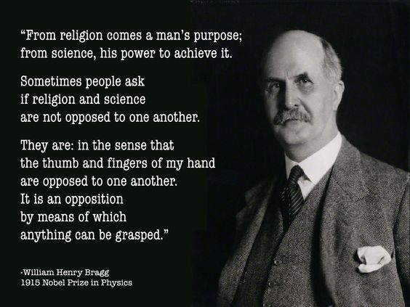
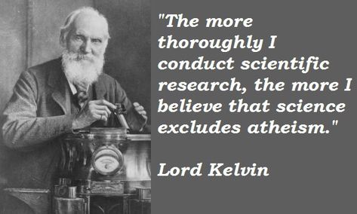

Slide 20
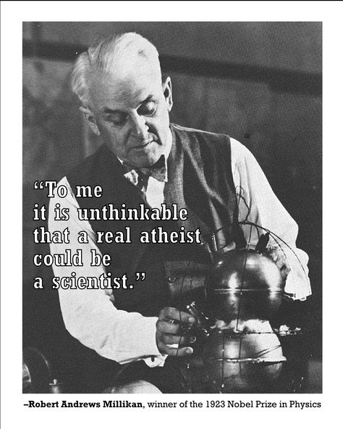
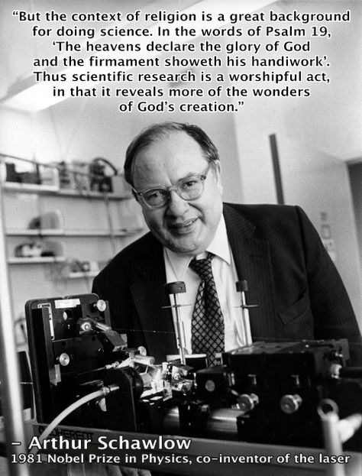

Slide 21
Men who are products of evolution can’t tell you who you really are!

Slide 22
Darwin agreed you can’t trust the Mind of a Scientist if it is a product of Evolution!
“But then with me the horrid doubt always arises whether the convictions of man’s mind, which has been developed from the mind of the lower animals, are of any value or at all trustworthy. Would any one trust in the convictions of a monkey’s mind, if there are any convictions in such a mind?”
Darwin Correspondence Project, “Letter no. 13230,”
| Darwin Correspondence Project (darwinproject.ac.uk)

Slide 23
Some considerations about cave men, the fossil record, & the scriptures

Slide 24
‘Cave Men’ Fossils & the Bible (Job 30:3-8)
(Job 30:3) For want & famine they were solitary; fleeing into the wilderness in former time desolate & waste.
(30:5) They were driven forth from among men…
(30:6) To dwell in the clifts of the valleys, in caves of the earth, & in the rocks.
(30:8) They were children of fools, yea, children of base men: they were viler than the earth.
They were not ape-men. Either from before the flood or after Babel. People who deteriorated mentally, physically & spiritually

Slide 25
Most of the so called ‘missing links’ were found in caves!
Neanderthals #1 & Denisovans (contested bones, p. 33, 42, 44). Out of 500 sites, 258 were burials or shelters in caves (p. 51)
Homo floresiensis (Hobbit) #3 (Contested Bones, p. 79-80)
Homo naledi #8 (Contested Bones, p. 199-200, 202, 222-226, 228)

Slide 26
Homo erectus #2 (“upright man”) (Java Man)
“Interestingly, bones of Homo erectus are often found in caves which can be hotspots for radiation & thus radiation induced diseases. Can explain some anomalous skull shapes of Erectus.”
Erectus is now extinct. Appear to be genetically compromised & on the low end of human cultural spectrum
Christopher Rupe & John Sanford, Contested Bones, 2019, p. 66, 75
Jerry Bergman, Peter Line, Apes as Ancestors: Examining the Claims About Human Evolution, 2020, p. 221

Slide 27
“homo” species found in caves but not ‘australopithecines’
We don’t find evidence of “australopithecines” (Australopithecus) living in caves or burying their dead in caves because they are extinct ape-like primates & have nothing to do with human evolution
Only 1 exception: Australopithecus robustus uncovered from 6 collapsed cave sites (Jerry Bergman, Peter Line, Apes as Ancestors: Examining the Claims About Human Evolution, 2020, p. 82).

