Slide 1
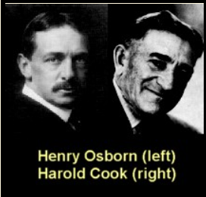
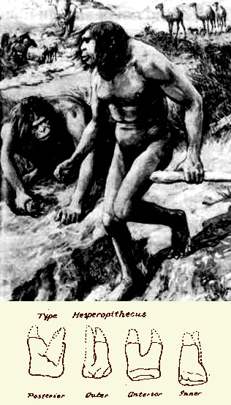
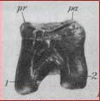
Nebraska man fiasco! Trust the Science? 内布拉斯加人的慘敗！信靠科學？
Scientific name: Hesperopithecus haroldcookii (ape of the land where the sun sets) (found 1922 by Harold Cook)
學名：猿猴哈羅德庫奇（日落地猿猴）
Henry F. Osborn said it as a link between apes & humans (1 mya) based on 1 tooth!
Henry F. Osborn 根據一顆牙齒說他是猿
猴與人類之間（一百萬年前）的鏈接。

Slide 2
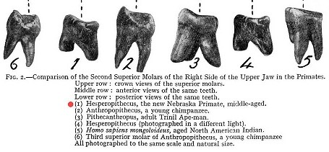
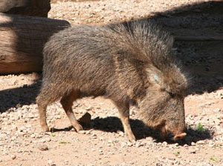
Just 1 of many major problems with paleoanthropology 古人類學衆多問題之一
In 1925 it was proved to be a tooth of an extinct Peccary
1925年它被證實為絕跡的野豬的牙齒。

Slide 3
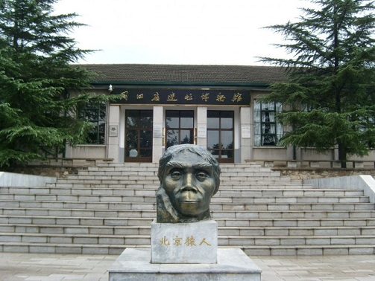
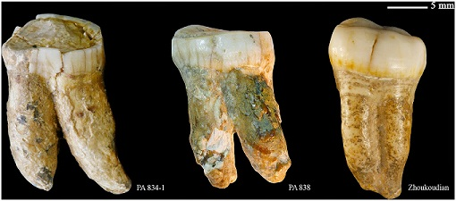
Paleontologists go where Dentists fear to tread! 古人類學者去到牙醫不敢踏足的地方！
In 1927, 1 tooth was all Davidson Black needed to ‘imagine’ a new genus: Sinanthorpus pekinensis or Peking man
1927年，Davidson Black只需要一顆牙齒就‘想像出’ 一個新的種類：北京人。
(Jerry Bergman, Peter Line, Apes as Ancestors: Examining the Claims About Human Evolution, 2020, p. 18)

Slide 4
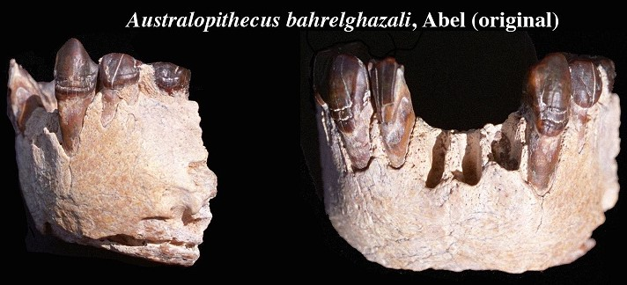
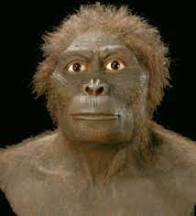
Teeth still drive the desire for fame & funding (1996) 牙齒仍然激發成名與資金的欲望
Australopithecus bahrelghazali. Teeth found 1995. In 1996 named a new species by Brunet.
南方古猿，1995年發現牙齒，1996年
Brunet給他一個新的物種名稱。
So many know so much about so little! How long will you let fossil teeth take a bite out of your faith?
許多人對如此稀少的證據卻知道許多！你意欲讓化石牙齒咬你的信仰一口多久呢？

Slide 5
The 8 best candidates for missing links are all highly controversial; hotly debated by scientists & ultimately prove to be nothing more than the imagination of paleontologists
最佳的八個遺失連鍵候選人都受高度爭議；
科學家們熱切議論，
至終證明只是古人類學家的想像

Slide 6
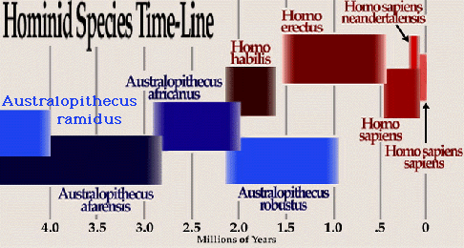
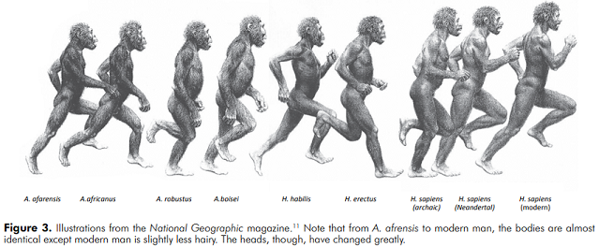
Australopithecus is more ape like
南方古猿更像猿猴
‘Homo’ bones are more like humans
‘人屬’骨更像人類
Notice 1million year overlap!
其中相隔一百萬年
2
1
6
4
6a
5

Slide 7
1. Homo neandertalensis or Neanderthal man 尼安德達人
1st found in 1856. Now there are about 500 skeletons.
1856年首度發現，現有大約500具骷髏。
Generally, paleoanthropologists regard them as an extinct variant of man.
一般説來，古人類學者認爲他們是絕跡的人類變體。
2 skeletons found In 1886 were misleadingly reconstructed to appear ape-like & brutish. The fraud endured 50 yrs.
1886年發現的兩具骷髏誤導地被重組像猿猴且野蠻，這個詐欺
持續了50年。

Slide 8
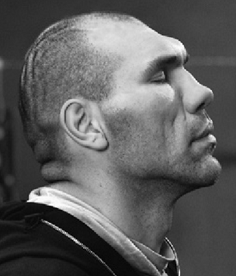
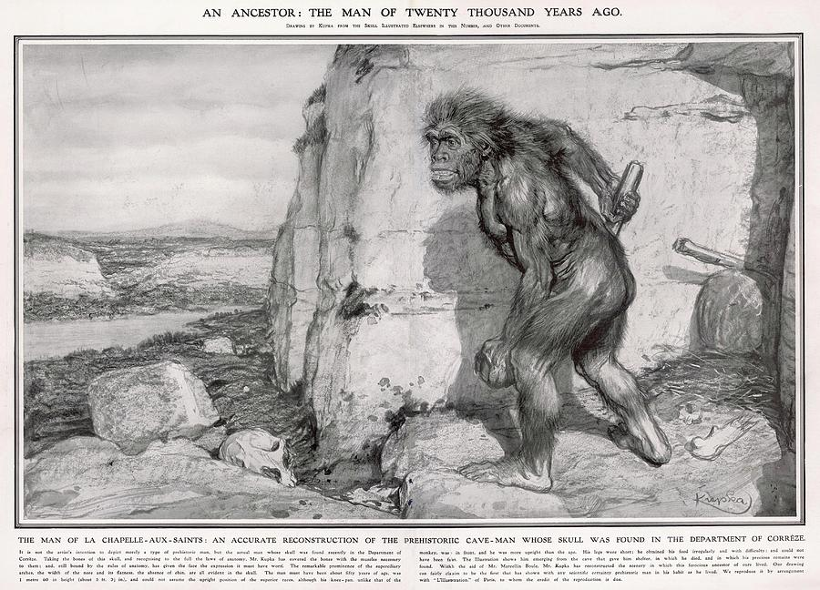
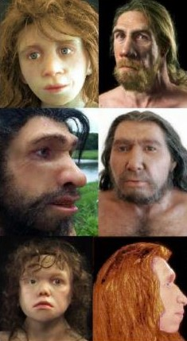
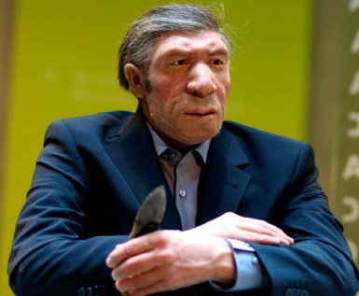
Neanderthal man: Fraudulent Pictures (1909) & today 尼安德達人：欺詐的圖片（1909）及今日
Nikolai Valuev Russian boxer
蘇俄拳擊手
Old & new
1909

Slide 9
1. Homo neandertalensis [the evidence is they are human] 尼安德達人（證據是他們就是人）
Several DNA analysis now show Neanderthals & modern humans are the same species. Their DNA found in Europeans & Asians
幾個DNA分析現在指出，尼安德達人與現代人類屬於同一物種。他們的DNA在歐洲人與亞洲人中找到。
Christopher Rupe & John Sanford, Contested Bones, 2019, Chapt. 3 Homo neanderthalensis, pgs. 31-53; also Franz Lidz, “What Do We Really Know About Neanderthals?” The Smithsonian Mag. May 2019 50(2):24-35

Slide 10
2. Homo erectus (“upright man”)(Java Man) 直立人（爪哇人）
1st found by Eugene Dubois in Java (1891).
首度被 Eugene Dubois 在爪哇找到（1891）。
Evidence for human status: extensive culture of woodworking, art, sailing ships! Found from Africa to Australia
屬於人類的證據：廣汎的木工、藝術、帆船文化！從非洲到澳洲
都找到。
Erectus is clearly human but displays evidence of pathologies.
直立人明顯是人類，但展現病態的證據。
(Christopher Rupe & John Sanford, Contested Bones, 2019, chapt. 4, Homo erectus, pgs. 55-77) (Jerry Bergman, Peter Line, Apes as Ancestors: Examining the Claims About Human Evolution, 2020, p. 217-277

Slide 11
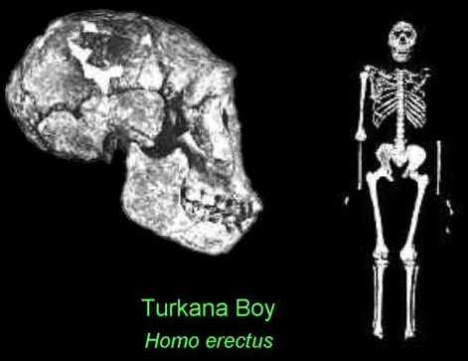
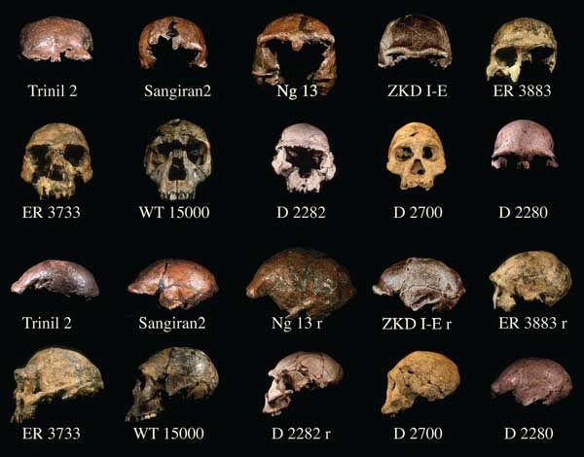
3. Turkana Boy (homo ergaster): most complete Erectus skeleton 圖爾卡納男孩（埃爾加斯特人）：最完整的直立骷髏
Erectus anatomically human! Almost identical to modern Kenyan bushman!
直立人，從解剖學就是人類！與現代肯尼亞叢林人幾乎完全一樣！
300 Erectus bones: most are skullcaps, a few broken bones or teeth. [dated 1.9mya to 140,000 yrs. ago].
三百個直立人的骨頭：多數為頭骨，以及一些破碎的骨頭或牙齒（年代被定為一百九十萬年到十四萬年前）
Found 108 of 206 bones 1984

Slide 12
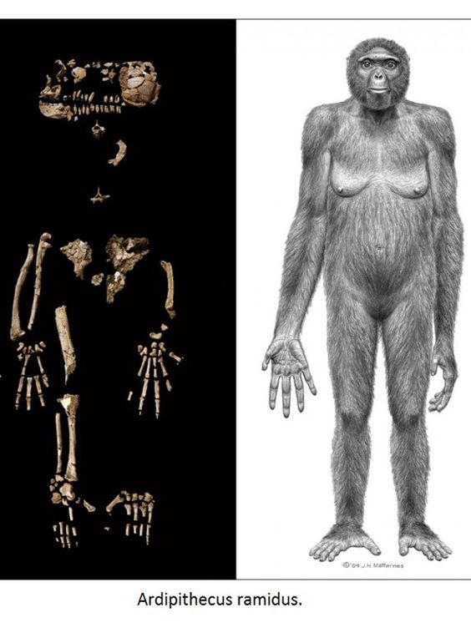
4. Ardipithecus ramidus or “Ardi” 地猿人或 ‘阿爾迪人’
Found by Tim White in Ethiopia (1992). Not published till 2009! Took so long to digitally produce the crushed skull & hip. Back-bone missing!
1992年被Tim White 在衣索匹亞發現，直到2009年才發表！花了很長時間以數字方式造出壓碎的頭骨與臀部，背骨缺失！
Well preserved hands & feet match living ape
保存良好的手與脚與活著的猿猴一致。
No lower vertebrae recovered!!

Slide 13
White boldly proclaimed he found the missing link between human & ape [Nature (1994)]. Other headlines said it was the discovery of the century [Science 326:36-40, 2009]
White大膽宣稱他找到了人與猿猴之間遺失的鏈接【自然雜志 （1994）】。其他頭條說它是本世紀最重要的發現。
The skull was crushed to 100 pieces, as was the hip. They had to be digitally reconstructed which involves uncertainty & guesswork!
頭骨壓碎成100片，臀部也是。它們必須用數位化重建， 具有不確定性與猜測！
So the artists’ renditions & museum displays are a fabrication!
因此藝術家的演繹和博物館的展示都是僞造品！

Slide 14
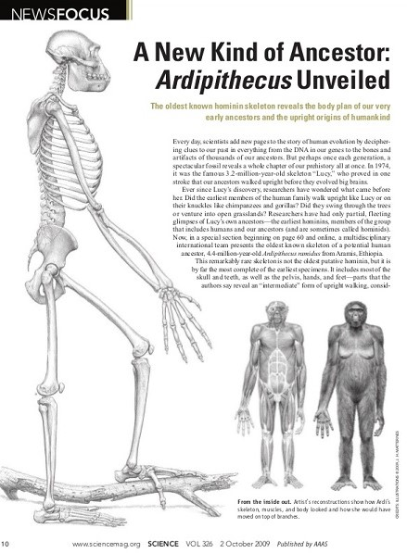
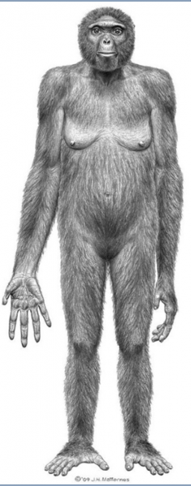
Unbelievable amount of DECEPTION with Ardipithecus 阿爾迪人令人難以置信的欺騙數量
The living bonobo looks just like Ardi
現存的倭黑猩猩看起來就像阿爾迪人。
The Science article deceptively shows Ardi standing upright like man
科學文章欺騙式地展現阿爾迪人像人直立。

Slide 15
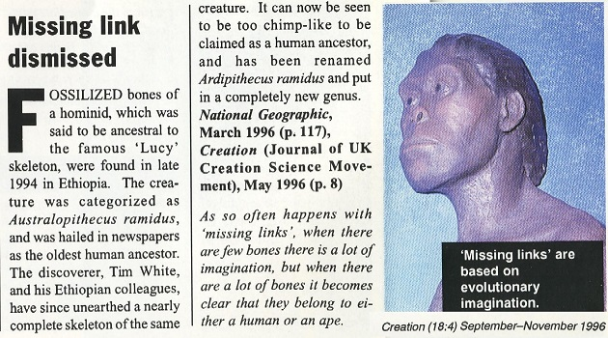
References for Ardipithecus
Online: https://genesisapologetics.com/ardi/
Christopher Rupe & John Sanford, Contested Bones, 2019, Chapt. 6, pgs. 97-112.
Jerry Bergman, Peter Line, Apes as Ancestors: Examining the Claims About Human Evolution, 2020, Chapt. 10 Ardipithecus, pgs. 137-149

Slide 16
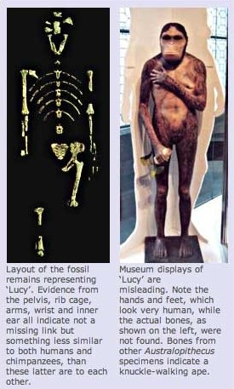
5. Australopithecus afarensis or “Lucy” 阿法種南方古猿或 ‘路西’
Partial skeleton found 1974 by Donald Johanson in Ethiopia. 400 total bones found.
部分骷髏在1974年被Donald Johanson在衣索匹亞發現，找到400個骨頭。
Jack stern & Randall Susman research shows Lucy to be a typical ape (The locomotor anatomy of Australopithecus afarensis. Journal of Physical Anthropology, 60(3):279-317, p. 281-286, 312.
Jack stern & Randall Susman的研究指出，路西是典型的猿猴。

Slide 17
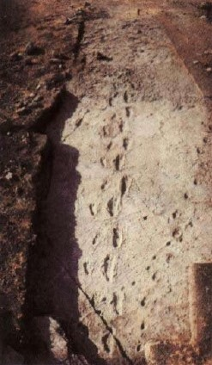
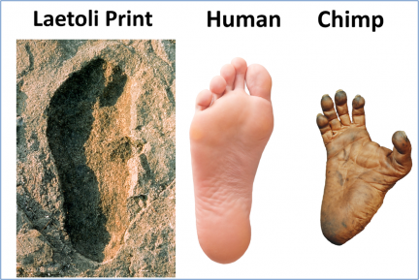
There’s a continuous unresolved debate over ‘lumping’ all the bones into one afarensis species or ‘splitting’ them into 2 species: one human / one ape.
對於將全部的骨頭‘結集’為一阿法物種，或將他 們‘分割’為兩個物種：一個人、一個猿猴，尚在 持續，尚未解決的辯論中。
Textbooks & media mislead the public with only one view: Johanson’s, that Lucy is the ape that stood up. He says the footprints are from afarensis instead of humans!
教科書和媒體以只有一個觀點誤導大衆：即約翰森的 觀點，路西是直立的猿猴。他説足跡來自阿法而非人類！
Laetoli footprints
Experts identified foot prints as human (3.6mya)

Slide 18
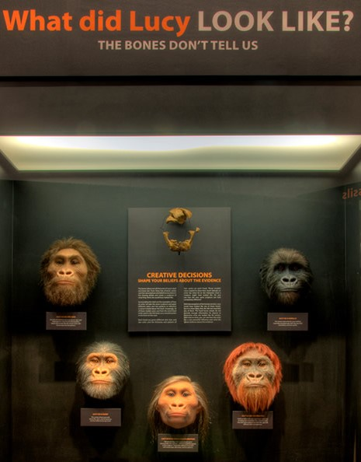
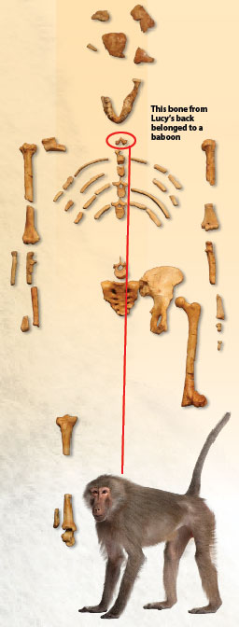
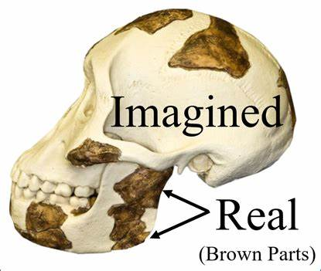
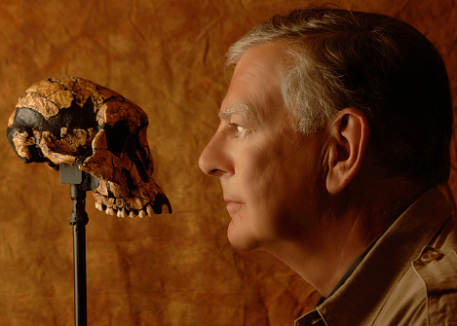
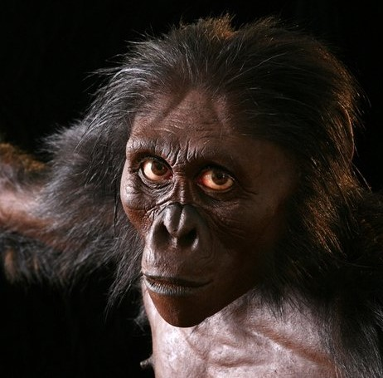
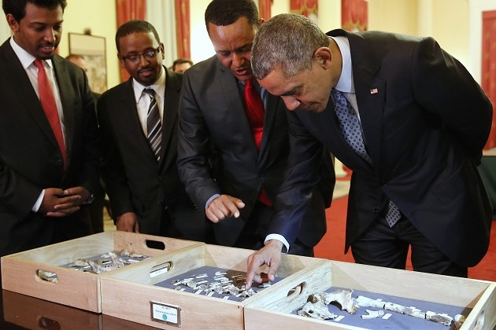
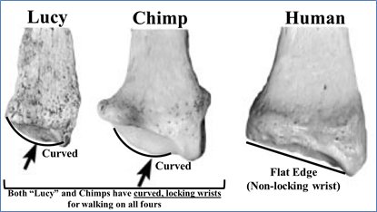
Lucy is not a missing link
路西不是遺失的鏈接。
Artist bias
Donald Johanson ethical problems
She’s too famous to give up
Took 40yrs. To find!

Slide 19
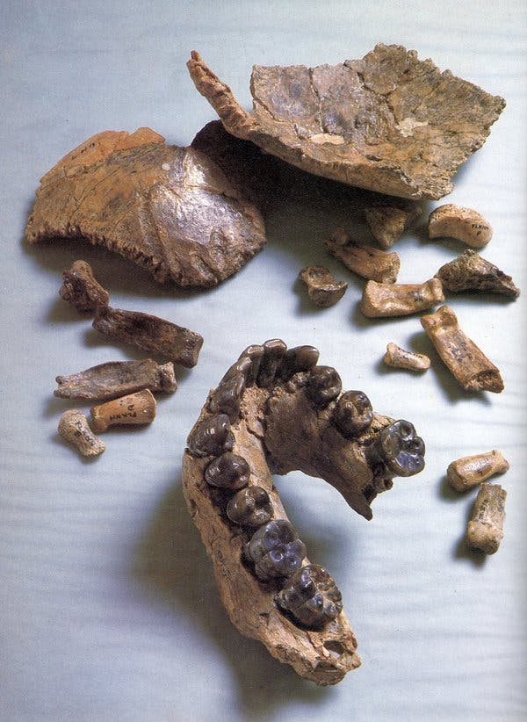
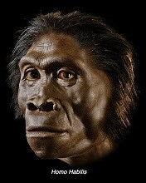
6. Homo habilis (handy man) 能人
Found by Louis & Mary Leakey in 1960.
1960年由Louis & Mary Leakey發現。
Notice the pitifully few bones pitifully mangled. Announced in 1964, it threw the field of human evolution into a turmoil continuing till today!
請注意極其稀少的、可憐地被破壞的骨頭 它1964年被發表，引發人類進化領域
極大的動蕩，直到今天！
This was made the “defining specimen” or “type specimen”

Slide 20
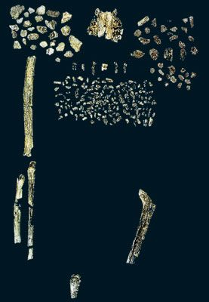
“Homo habilis is an all-embracing ‘wastebasket’ species into which a whole… variety of fossils could be conveniently swept.” (Tattersall & Schwartz, Extinct Humans, 2002, p. 111)
“能人是無所不包的物種‘垃圾桶’，在裏面各種 化石都可以方便地掃進去。”
No one knows if Habilis is a real species or just a collection of random bone fragments
無人知曉 ‘能人’ 是否是真實的物種，或只 是隨意收集的骨頭片段集合。

Slide 21
Habilis can be added to the growing list of falsely claimed “ape-men” or ‘missing links’ ‘能人’可以加進還在成長的、錯誤地宣稱為‘猿猴人’或‘遺失鏈接’的清單
Christopher Rupe & John Sanford, Contested Bones, 2019, Chapt. 8, Homo habilis, p. 159-173
Jerry Bergman, Peter Line, Jeffrey Tomkins, & Daniel Biddle, Apes as Ancestors: Examining the Claims About Human Evolution, 2020, p. 169-214 [their research refers to 344 references in the chapter on Homo Habilis]

Slide 22
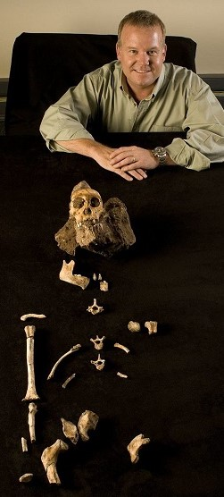
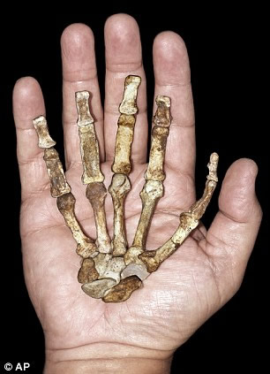
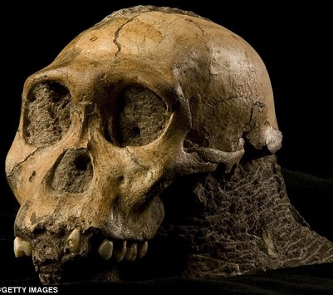
7. Australopithecus sediba 南方古猿賽地巴
Found by Lee Berger & son Matthew in 2008. Dated at 2mya
被Lee Berger 和兒子Matthew在2008年發現，年代被訂爲兩百萬年前。
National Geographic (4.12.2013) said it could dethrone Lucy as our most recent ancestor.
國家地理雜志（4.12.2013）聲稱它能夠把路西拉下寶座，成爲我們最近的祖先。

Slide 23
Some experts claim Sediba is not a legitimate hominin ancestor but a combination of Australopithecus & Homo bones
某些專家聲稱賽地巴不是合法的人類祖先，而是南方古猿與 人類骨頭的綜合。
Sediba bones found in a pit with 1000’s of other bones from 18 species. So easy to unintentionally mix bones of different species.
賽地巴骨頭在一個坑裏，與其他十八個物種的上千個骨頭一起發現， 很容易在無意中與不同物種的骨頭參雜在一起。
Especially when you are motivated to find an ‘in-between’ creature!
特別當你有動機去發現物種之間的連鍵！
Sediba “is not a missing link” (John Hawks, Discovery team leader)
賽地巴不是遺失的鏈接。
(Christopher Rupe & John Sanford, Contested Bones, 2019, p. 175-197)

Slide 24
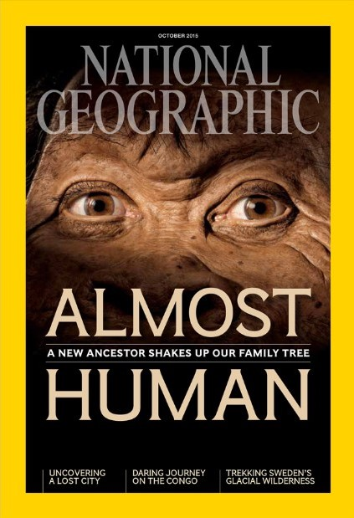
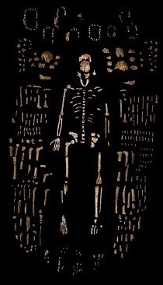
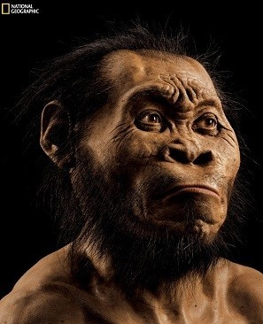
8. Homo naledi 納萊迪人
Found 2013 in Gauteng S. Africa cave.
Lee Berger came in to investigate.
2013年在南非的山洞發現， Lee Berger 前來偵察。
Announced the find as the root ancestor to the genus Homo. He guessed to be 2-3 mya.
宣稱這發現是人屬的根源祖先 他猜測兩百到三百萬年前。

Slide 25
Most of the bones were human in nature & the ones that deviated could be explained as due to pathologies.
多數骨頭本質上是屬人的，而變樣的骨頭可解釋為因病態而
造成。
The strongest evidence Naledi was fully human is the cultural evidence. The cave was obviously used as a burial chamber
最强烈證實納萊迪人是人類，是文化的證據。山洞明顯地 被使用作埋葬室。
(Christopher Rupe & John Sanford, Contested Bones, 2019, p. 199-232).

Slide 26
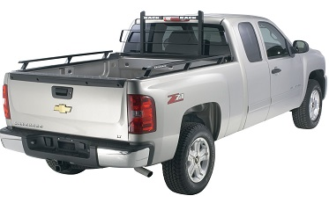
Only a truckload of evidence! 只有一卡車的證據！
“You could fit it all into the back of a pickup truck if you didn’t mind how much you jumbled everything up.”
“你可以將它們全數裝入一個貨運卡車，如果你不在乎把它 們搞得亂七八糟。”
(Ian Tattersall: he produced the most authoritative & comprehensive documentation of the fossil record up to 2004) (Bill Bryson, A Short History of Nearly Everything, 2004, p.440)

Slide 27
Paleoanthropologists admit the scarcity of the evidence 古人類學者承認證據極其稀少
Our genus homo has only a few fragmentary fossils older than 2million years.
我們的人屬類只有少許比兩百萬年老的片段化石。
“There are only a handful of specimens. You could put them into a small shoe box and still have room for a good pair of shoes” (William Kimbel quoted in Fischman, National Geographic, Aug. 2011)
“只有少許的標本，你可以將他們放入 一個小鞋盒，還有空間放入一雙鞋。”

Slide 28
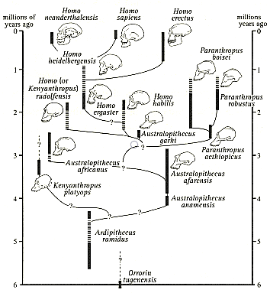
(Richard Klein, “The Dawn of Human culture,” 2002, p. 78)
Look at all the question marks ? in their theory! How many won’t they admit?
看看他們理論中所有的問 號！他們有多少不願承認？
Note all the ‘dead ends.’ There are no sure missing links!
留意所有的‘死胡同’，沒有 確定的遺失鏈接。

Slide 29
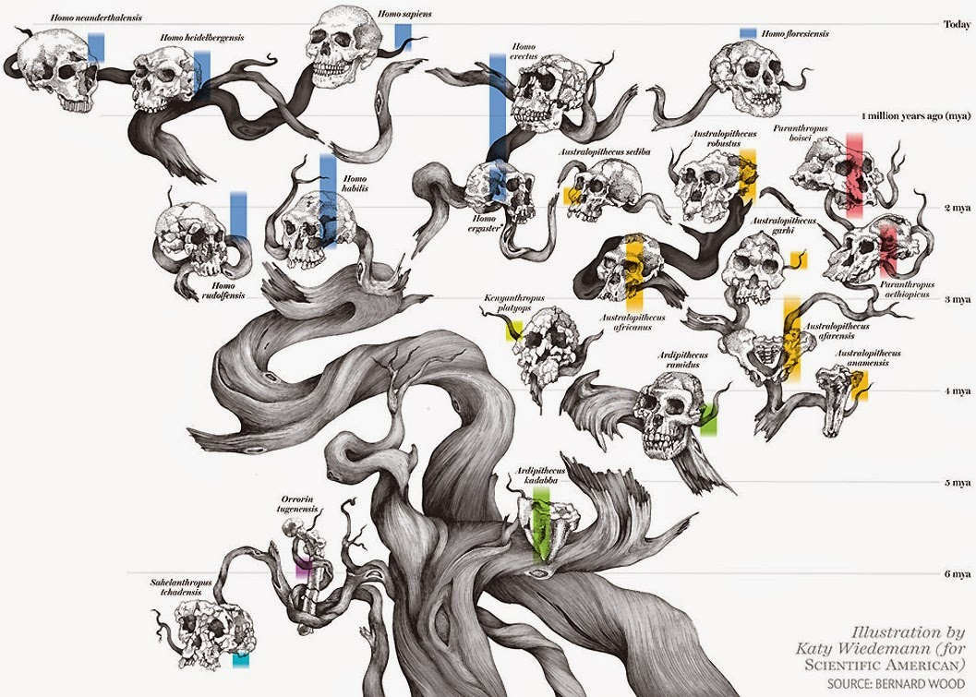
Look at all the gaps that can’t be connected.
看看所有無法連在一起的間隔。
Why let such nonsense effect your faith in God?
爲何讓此種瞎扯影響你對上帝的信仰？
2014

Slide 30
Evolutionists themselves acknowledge… 進化論者自己承認…
“…, according to Darwin, … the fossil record should be rife with examples of transitional forms leading from the less to the more evolved.”
“…根據達爾文…化石記錄應有非常多的過度例子，從較低到更進化的。”
But there are “only gaps in the fossil record, with no evidence of transformation intermediates between documented fossil species”
Jeffrey H. Schwartz, Sudden Origins, 1999, p. 89
但“在化石記錄中只有間隔，沒有文字記錄中過度的化石物種證據。”

Slide 31
So the Revelation of God is True! 所以，上帝的啓示才是真的！
(Gen. 1:27) “God created man in his own image, in the image of God created he him; male & female created he them.”
創1：27 - 神就照著自己的形像造人，乃是照著他的形像造 男造女。
And the “vain imaginations of man are false!” (Rom. 1:21, 25)
而人“虛妄的想像是錯謬的！”（羅1：21，25）

Slide 32
What a difference the Truth will make in your Life 真理造成你人生的差異
1. Knowing you are Created is foundational to believing there is a Plan (Design) for your life.
認識你是被造的，是相信你的人生有計劃（設計）的基礎。
2. Knowing you are Created is foundational to believing there is a Purpose for your life.
認識你是被造的，是相信你的人生有目的的基礎。
3. The Creator brings us into a relationship with Himself! (We are both physical & spiritual Beings)
造物主帶領我們與祂自己建立關係！
（我們是同具物質與靈性的人類）

