Slide 1
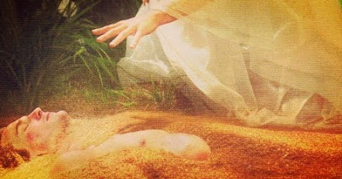
Is Man Created by God
or an Evolved Animal?
我們是上帝獨特的創造，
還是進化而來的動物？
Pastor Ray Petzholt
裴瑞明牧師
6-27-2021
This Photo by Unknown Author is licensed under CC BY-NC

Slide 2
Which Foundation of Faith will you choose to find life 你會選擇哪個信仰根基去找到生命？
1. The Revelation of an omniscient God:
獨一，無所不知真神的啓示：“起初上帝創造…”
“In the Beginning God created.” (Gen. 1:26-28; 2:7; 5:1; Rev. 4:11)
[How? By Infinite Wisdom & Power]
【如何？藉著他無限的智慧與權能】
If true, we are special; life has eternal value, morals, meaning & purpose
倘若為真，我們就是獨特的；生命具有永恆的價值、 道德、意義，與目的。

Slide 3
Which Foundation of Faith will you choose to find life 你會選擇哪個信仰根基去找到生命？
2. The Theory of ignorant men: In the Beginning Nothing Created something; then something evolved itself into everything
無知的人的理論：起初“虛無”創造了“某個”，然後“某個”
自己進化成萬物。
[How? By Time & Chance without intelligence]
【如何？藉著時間和偶然，沒有任何智能參與】
If true you are an accident; life has no value, morals, meaning or purpose
倘若你是意外為真，生命就沒有價值、道德、意義， 或目的。

Slide 4
Listen as God Tells You who you Really Are! 請聽上帝告訴你你真正是誰！
(Gen 1:26) “& God said, Let us make man in our image, after our likeness: & let them have dominion over the fish of the sea, & over the fowl of the air, & over the cattle, & over all the earth, & over every creeping thing that creepeth upon the earth.
創1：26 - 神說：「我們要照著我們的形像、按著我們的樣式造人， 使他 們管理海裡的魚、空中的鳥、地上的牲畜，和全地， 並地上所爬的一切昆 蟲。」
(1:27) So God created man in his own image, in the image of God created he him; male & female created he them.
1：27 - 神就照著自己的形像造人，乃是照著他的形像造男造女。

Slide 5
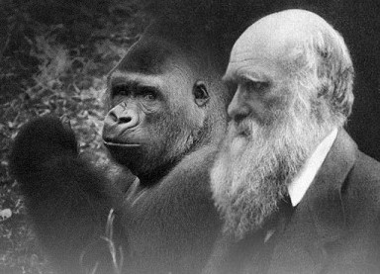
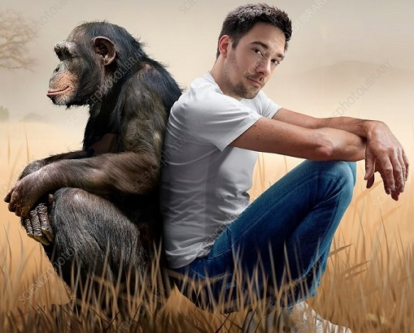
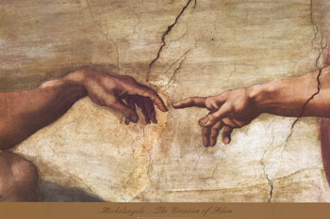
We Must Know Our True ‘Roots’ as a Human Being 我們必須知道身爲人的真實 ‘根源’
Are we a unique Being created in the image of God or Are we are nothing more than animals?
我們是按照上帝形像創造的獨特人類，還是與動物一樣呢？
Most Youth (14 to 24) consider the #1 evidence for evolution to be the apes to man evolutionary sequence! THE REASON –
多數年輕人（14-24嵗）認爲進化論的首要證據是猿猴進化為人
的順序！原因是：

Slide 6
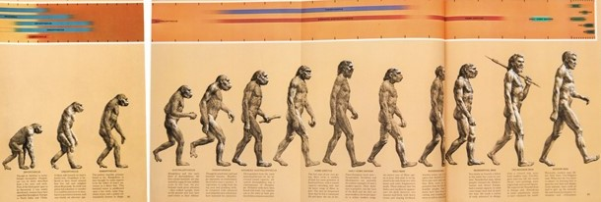
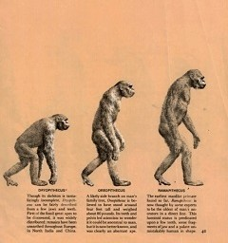
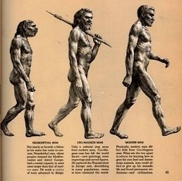
Most famous ‘icon’ of Evolution 最有名的進化論 ‘圖標’
The March of Progress, in Time Life 1965, 1968, 1973
進步的行進，時代生命雜志1965，1968，1973.

Slide 7
The Figure’s Caption cautioned readers it was Fictitious! 這個圖表的標題提醒讀者它是虛擬的！
The picture, based on “fragmentary fossil evidence,” warns:
根據 “片段的化石證據” 製出的圖片，警告讀者：
“Although proto-apes & apes were quadrupedal, all are shown here standing for the purpose of comparison” (Time Life 1970, p. 40)
“雖然猿猴原型與猿猴是四足的，它們這裏以站立方式呈現，目的是比較.”
The persuasive image overshadowed the fine print & became a masterpiece of Madison Avenue promotion! (not science!)
具有説服力的圖像使小字黯然失色，並成爲麥迪森大道推廣的傑
作（而非科學）！

Slide 8
The science community knew it was Fictitious! 科學界知道它是虛擬的！
“Many of the figures… are products of educated guessing” (F.C. Howell, Early Man, Time Life Books, p. 41, 1970)
“許多的圖像…是有教育的猜測的產物。”
The “evolutionary ‘march to modern man’ has been proven wrong for more than 60 years.” But its still used by scientists, writers & editors.
“進化論的 ‘行進到現代人’ 被證實為錯已有60多年。”
(Tim White, Paleoanthropology: five’s a crowd in our family tree, Current Biology 23(3):R112-R115, 2013; p. R114).

Slide 9
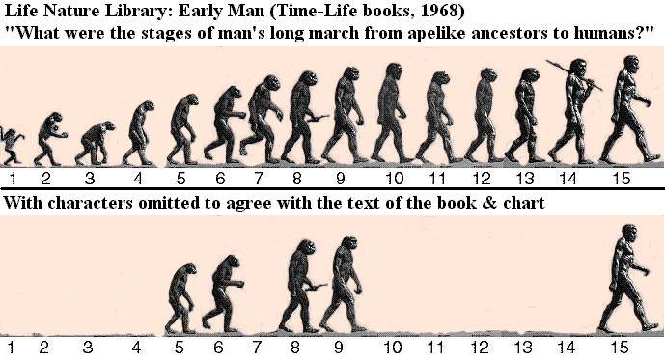
Such icons indoctrinate us in materialistic Philosophy 這樣的圖標用唯物哲學洗腦我們
Absurd lack of evidence makes for an absurd fairy tale!
缺乏證據的荒謬，造成荒謬的神話！
Ramapithecus

Slide 10
They knew the deceptions in 1965 but only now admit: 他們在1965年就知道此欺騙，現在才承認：
“The once-popular fresco showing a single file of marching hominids becoming ever more vertical, tall, and hairless now appears to be fiction” (J.J. Hublin, An evolutionary odyssey, Nature 403:363-364, 27 Jan. 2000). He is director of the Department of Human Evolution at the Max Planck Institute for Evolutionary Anthropology in Leipzig Germany.
“一度受人歡迎的壁畫，呈現原始人行進變成更垂直、高大的、 無毛的人類，現在看起來是小説。”
Read Jeremiah 17:5-7; Psalm 118:8
讀耶利米書17：5-7；詩篇118：8.

Slide 11
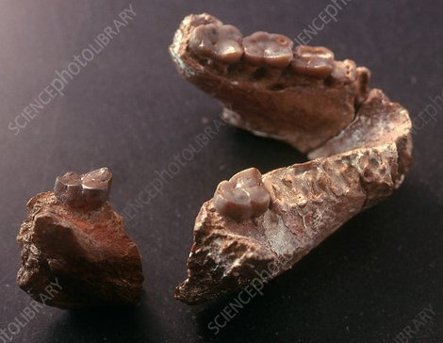
Ramapithecus (#5) supposed ape/human Common ancestor (15 mya) 1932-1978 被認爲是猿猴/人類共同祖先的長毛猿（1500萬年前）
Evidence: 2 parts of a single upper jaw
證據：一個上顎的兩部分

Slide 12
The power of preconceptions: believing in ‘tooth fairytales’ 先入爲主的力量：相信 ‘童話’
David Philbeam & Elwyn Simons made up fairy tales about ‘rama’
David Philbeam 和 Elwyn Simons 捏造‘羅摩’的童話，
They admitted their errors were due to a pre-commitment to the Darwinian view of human origins. They said: “we found exactly what we expected to find.” “This occurs often because of the uncertainty of interpreting fragmentary anatomy in fossils”
他們承認，他們的錯誤是因爲已經委身于達爾文人類起源的觀點。他們說：“我們找到自己期待找到的。” “因爲解讀片段化石本身的不確定性，這種事情經常發生，”

Slide 13
References for Ramapithecus:
Roger Lewin, Bones of Contention: Controversies in the Search for Human Origins, 1987, p. 121-123
Paleoanthropologists being heavily influenced by personal beliefs & prejudices is well documented. It is often nothing more than materialistic philosophy disguised as modern empirical science.
古人類學者受個人信念與偏見影響有據可查。經常它只是唯 物哲學，假冒為現代實證科學。
(Wells, p. 226) [Jonathan Wells, Icons of Evolution: Science or Myth?, 2000, p. 210, 218, 219-220, 221, 222-223, 224-225] [David Pilbeam, American Scientist 66(3): 378-379, 1978]

Slide 14
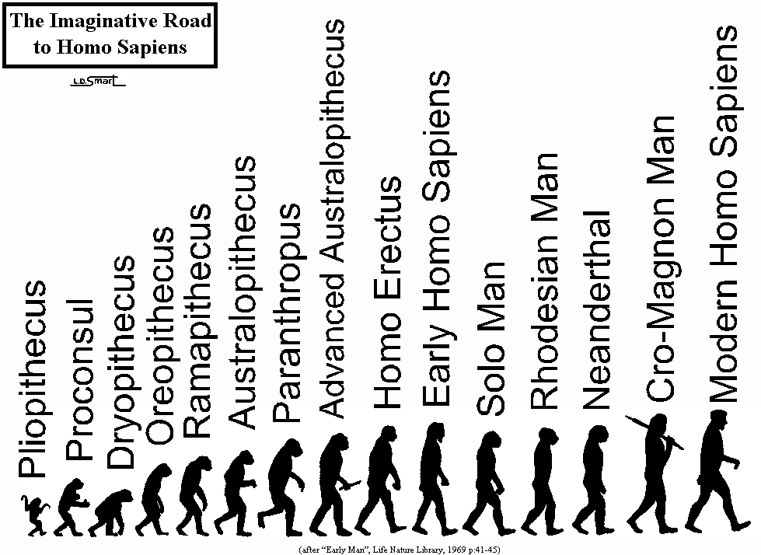
“It’s such a beguiling image that even the experts are loath to let it go. But it is an illusion” (B. Wood) “它是如此誘人的圖像，甚至專家都厭惡放下它，但它其實是幻象。”
(Bernard Wood, “Who are we?” New Scientist 2366:44, 2002).
The lie: they admitted this was not an ancestor
謊言：他們承認這不 是一個祖先。
(F.C. Howell, Early Man, Time Life Books, 1970, p. 41)
An outright lie

Slide 15
6 Reasons ‘hominid’ fossils called ‘bones of contention’ ‘原始人’ 化石被稱爲 ‘爭論的骨頭（焦點）’ 的六個原因
1. Incredibly few Fossils, most in a poor state of preservation, leaves a lot of room for interpretation (very subjective)
極少的化石，多數處於不佳的保存狀態，解讀上留出很多空
間（非常主觀）。
2. Scientists can be self deceived into seeing what they want to see. Tremendous pressure to find something important to gain funding & fame (R. Lewin, Bones of Contention, 1987, p. 26-28, 44-45)
科學家們可能自欺，看自己想看到的。他們有極大壓力去尋 找某個重要東西來獲取資金和名聲。

Slide 16
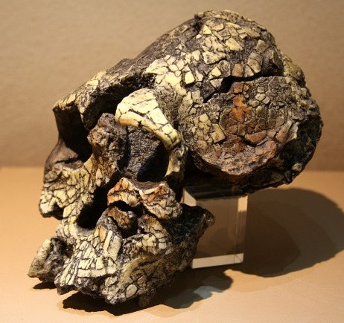
3. Fraud is a “a serious deeply rooted problem” especially in the field of evolution”
詐欺是 “根深蒂固的嚴重問題”，特別在進化論的領域裏。
(M. Roman, When good scientists turn bad, Discover 9(4):58, 1988; also H. F. Judson, The Great Betrayal: Fraud in Science, 2004, p. 82-83; also Jerry Bergman, Evolution’s Blunders, Frauds & Forgeries, 2017: especially Chapt. 2 & 18)
4. Expanding matrix distortion (EMD)
擴大矩陣失真。
(Jerry Bergman, Peter Line, Apes as Ancestors: Examining the Claims About Human Evolution, 2020, p. 87)

Slide 17
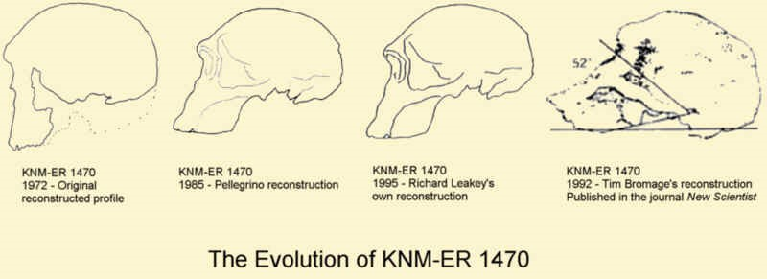
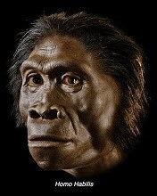
4. Bone specimens can be reconstructed in a variety of ways (an example is ‘skull 1470’) [pieced together from 100’s of fragments]
骨頭標本可用許多方式重組。
(see Jonathan Wells, Icons of Evolution: Science or Myth?, 2000, p. 218-9)
(Jerry Bergman, Peter Line, Apes as Ancestors, 2020, p. 187-189)

Slide 18
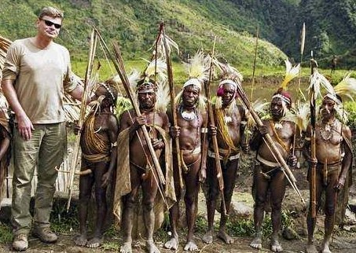
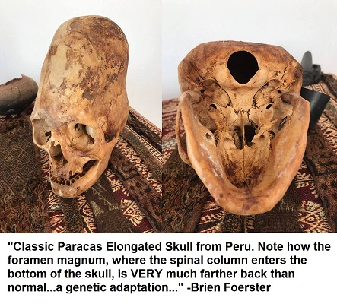
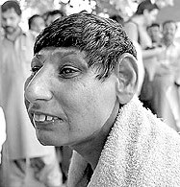
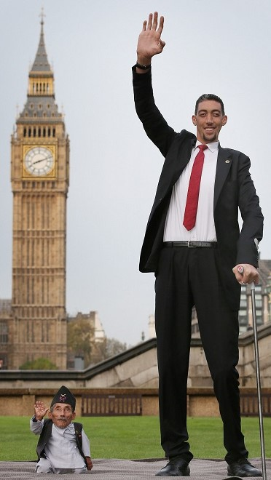
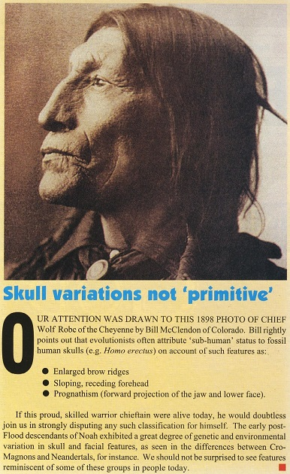
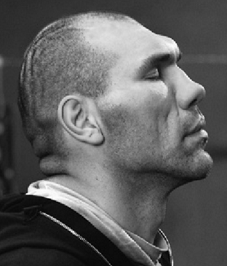
5. Ignoring variation between people in a given population led to little differences often interpreted as a new species
忽視既定人群中的差異，
導致某些小差異被解讀
為新物種。
(Roger Lewin, Bones of Contention, 1987, p. 27)
Examples of microevolution

Slide 19
6. Fossil records can’t establish ancestor-descendant relationships. The pitifully few bones used to construct man’s evolutionary history is like reconstructing the plot of War and Peace (1,400pgs.) with 13 randomly selected pages!
化石記錄無法建立祖先-後代關係。使用極少的骨頭來組建 人的進化歷史，就好像用隨意選擇的13頁，來重建戰爭與和 平（1400頁）的故事。
The supposed millions of yrs. separating fossils prohibits saying anything definite about evolutionary links (ancestry & descent)!
將化石分隔幾百萬年，人實在無法證實任何確鑿的進化鏈接。
(Roger Lewin, Bones of Contention, 1987, p. 27)

Slide 20
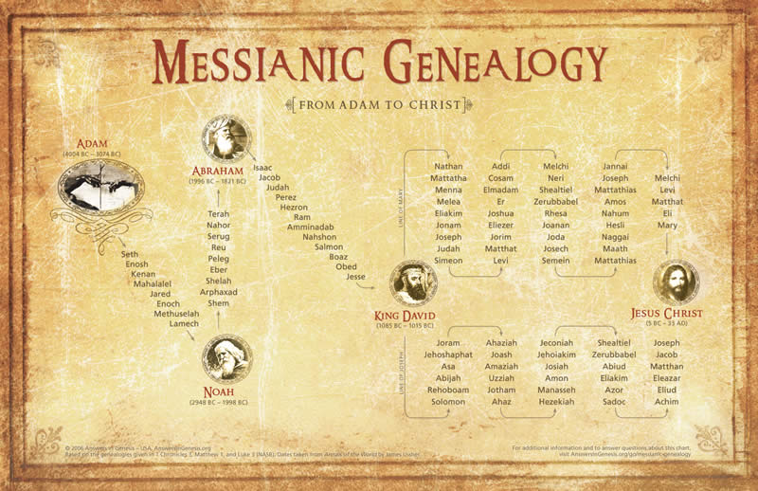
Contrast Biblical Genealogies!!! Anchors in real History 與聖經家譜對照！扎穩在真實歷史裏
Genealogies anchor the entire O.T. into history! A written record kept by relatives.
家譜將整本舊約扎穩在歷史裏！是一個親屬保存的文字記錄。

Slide 21
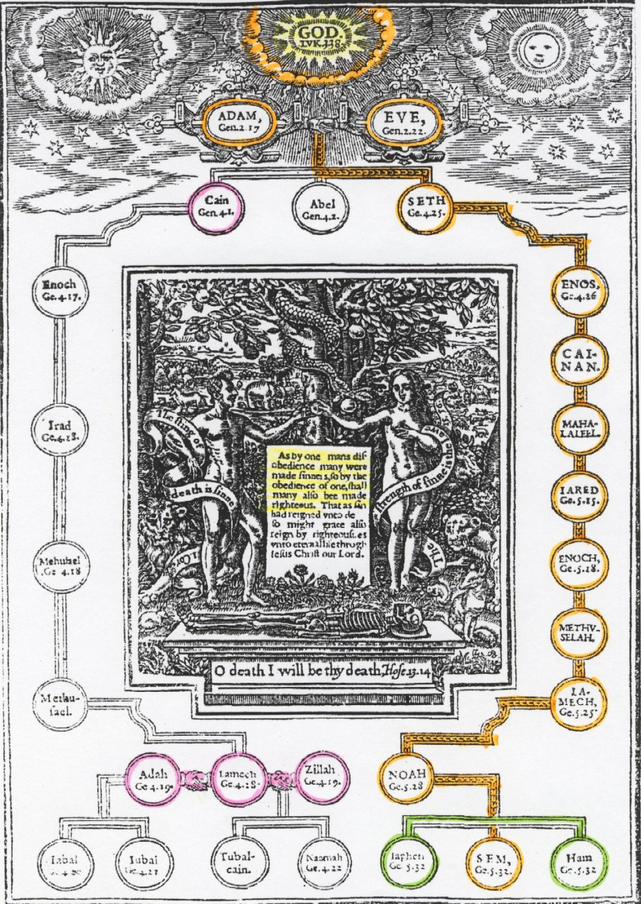
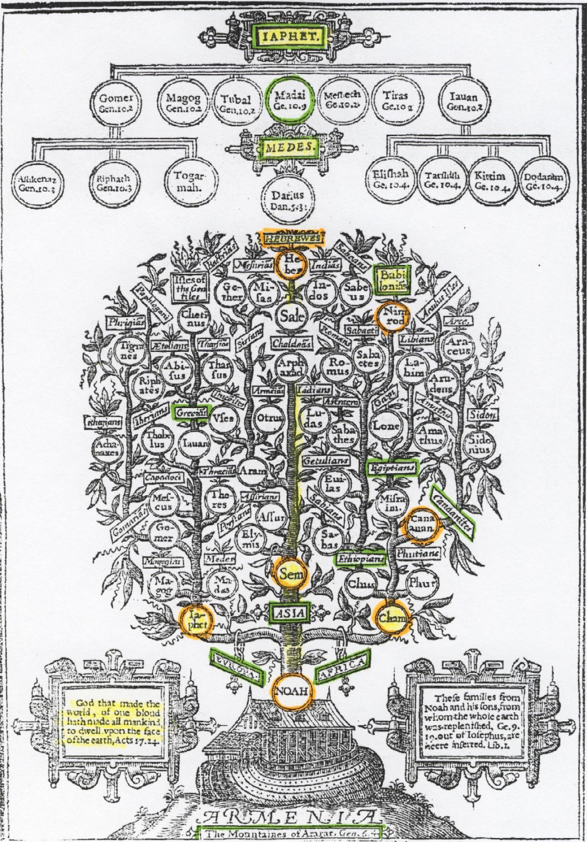
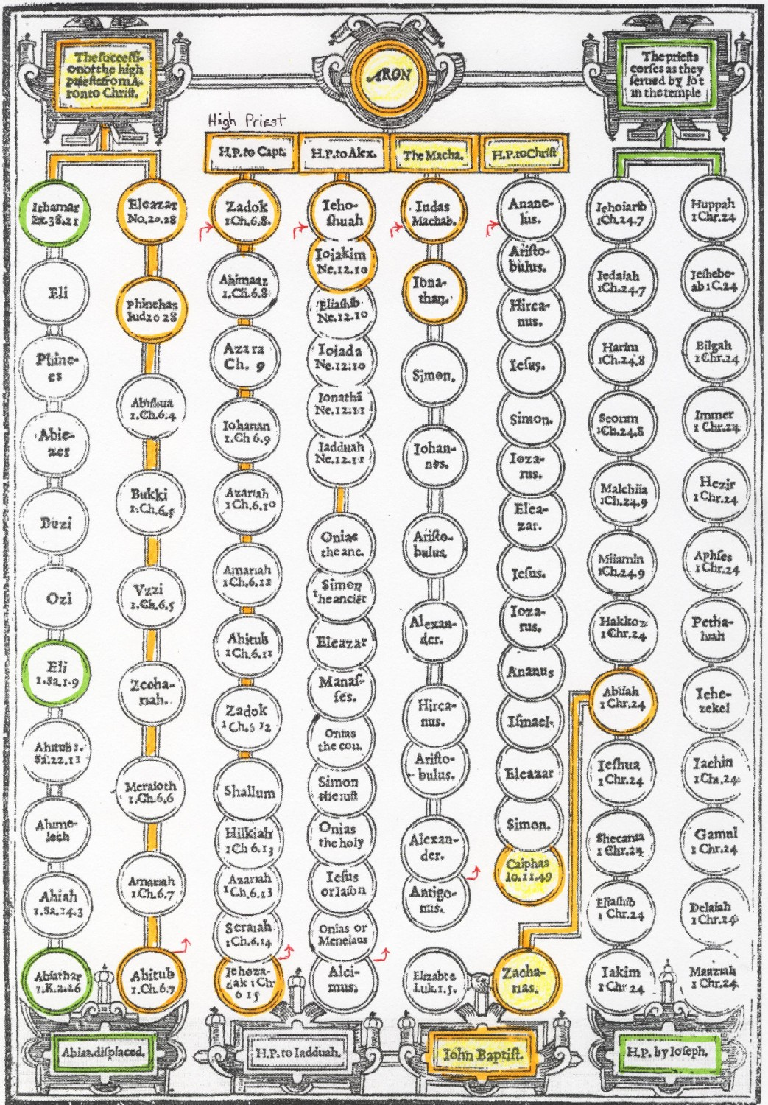
Old Bibles document the Genealogies! 15 pgs. 4,000yrs eyewitness testimony! 古老聖經記錄家譜！15頁，四千年的證人見證！

Slide 22
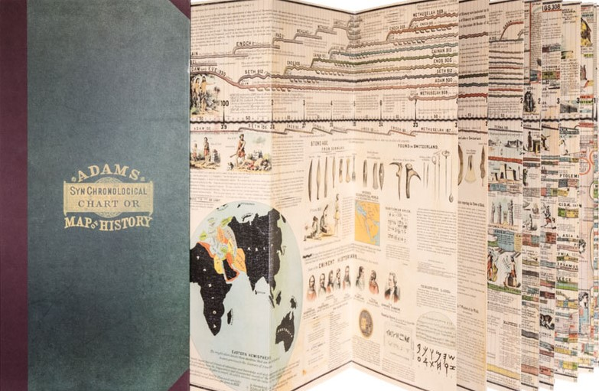
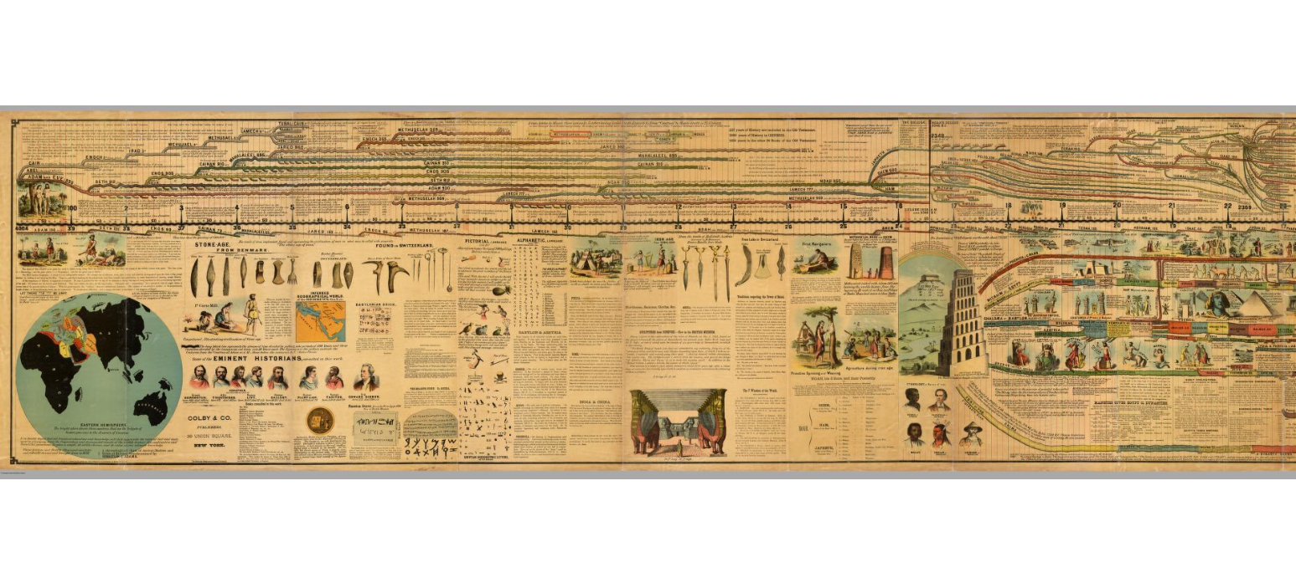
Every one should buy a 27ft. “Adams Chart of History.” It anchors your Faith in real History!
每人都該購買27英尺長的“亞當斯歷史圖表”。它扎穩你的信仰在真實歷史中！

Slide 23
astonishing contrast of the unbroken inspired Biblical genealogies & the fragmented fairy tale genealogies of atheistic evolutionists
沒有間斷，聖靈啓示的聖經家譜
與無神進化論者片段的童話家譜的
驚人對照
The 1st is a record of life: Real names of living People the 2nd is a record of death! Made up names of fossils! (read Deuteronomy 30:19)
第一個是生命記錄：活人的真實姓名
第二個是死亡記錄!捏造的化石名稱

Slide 24
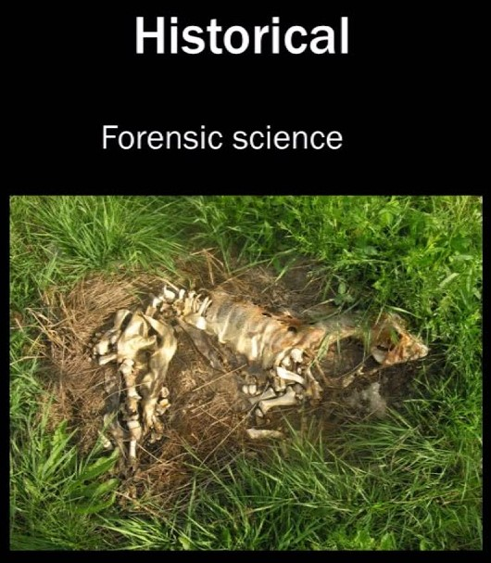
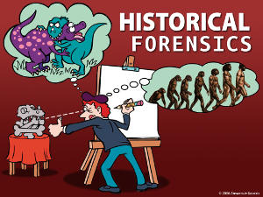
Evolution is ‘materialistic philosophy’ & soft science masquerading as hard empirical science
進化論是 ‘唯物哲學’ 與軟科學
僞裝為硬、實證科學
Hard Empirical Science
硬的實證科學
Soft Science
軟科學

Slide 25
Their “theories have often said far more about the theorists than they have about what actually happened” (Roger Lewin, Bones of Contention: Controversies in the Search for Human Origins, 1987, p. 43)
他們的 “理論經常道及理論者，過於到底發生了什麽。”
1st they construct a story (narrative) about what they believe happened in the past (i. e. Darwinism). The historical narrative then becomes the framework for interpreting the evidence.
他們首先組建一個他們認爲過去發生的事的故事（敘事，即
達爾文主義），然後，這個歷史敘事成爲解讀證據的框架。

Slide 26
Paleoanthropologists are charged with being: 對古人類學者的控訴：
“Overzealous in identifying new species from their finds – presumably out of a desire for fame & further research funding”
“過分熱心在發現的東西中認證新的物種 – 想必是出於成名的 欲望，以及更多的研究資金。”
(Bernard Wood, Welcome to the Family, Scientific American, p.46, Sept. 2016)
Or to put it Biblically: “They are lying, vain, greedy, sinners just like the rest of us!”
或是用聖經的話說：“他們説謊、虛榮、貪心，就如我們一樣 是罪人！”

Slide 27
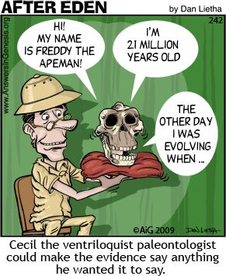
Bones don’t talk 骨頭不會説話
“Everybody knows fossils are fickle; bones will sing any song you want to hear.”
“每個人都知道化石是多變的；骨頭會唱任何你想要聼的歌曲。”
(Jim Shreeve, Argument over a woman, Discover 11(8):58, 1990)

Slide 28
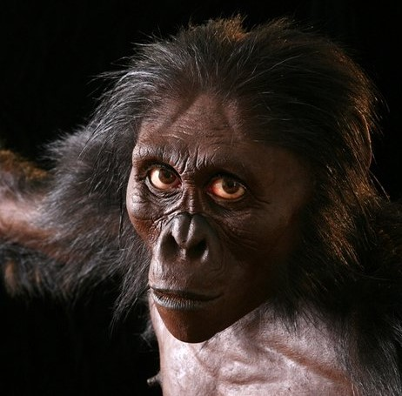
Even the ‘artists’ are not free from bias 即使 ‘藝術家’ 也無法免於偏見
John Gurche admitted concerning A. Afarensis work for National Geographic: “I wanted to get a human soul into this apelike face, to indicate something about where he was headed” (National Geographic, 189(3):96-117, p. 109
John Gurche 承認他為國家地理雜志的畫作: “我想把人的靈魂注入這張像猿猴的臉，來 表明他將往哪去的一些事情。”
Notice the whites of the eyes!

Slide 29
Fossil Teeth: taking a bite out of evolutionary theory 化石牙齒：把進化論咬一口
Because teeth preserve so well they are excellent for evaluating whether Darwinism is true or not.
牙齒可良好保存，它們是絕佳的評估達爾文主義真僞的證據。
Much of the evidence for the evolution of vertebrates is provided by teeth
脊椎動物的進化證據多半來自牙齒。
(Butler, Chapt. 14: The evolution of tooth shape & tooth function in primates, pp. 201-211 in Development, Function & Evolution of Teeth, 2000) (Jerry Bergman, Peter Line, Apes as Ancestors: Examining the Claims About Human Evolution, 2020, pg. 47-55).

Slide 30
So many are so sure about so much from so little! 許多人對許多事如此確定，證據卻如此稀少！
Millions of fossil teeth & not 1 provides clear evidence of macroevolution. A computer search of 20 million articles showed:
上百萬的化石牙齒，但無一個提供大進化（宏觀進化） 清楚的證據。
“…no evidence of transitional tooth forms between the no-tooth condition & completely developed teeth has been discovered.”
“…從無牙齒狀態進化到完整成型的牙齒狀態之間，沒有過度的牙齒證據。”
(Jerry Bergman, Fossil Forensics: Separating Fact from Fantasy in Paleontology, 2017, Chapt. 2 Teeth, p. 25-28, 33)

