Slide 1

學習做耶穌/眾人的僕人
Learn to Be a Servant of Jesus, a Servant of People
裴賀安慈師母
Mrs. Annie Petzholt

Slide 2
馬可福音 Mark 10:42-45
Mar 10:42 耶穌叫他們來，對他們說：「你們知道，外邦人有尊為君王的，治理他們，有大臣操權管束他們。
But Jesus called them to him, and saith unto them, Ye know that they which are accounted to rule over the Gentiles exercise lordship over them; and their great ones exercise authority upon them.

Slide 3
Mar 10:43 只是在你們中間，不是這樣。你們中間，誰願為大，就必作你們的用人；
But so shall it not be among you: but whosoever will be great among you, shall be your minister:

Slide 4
Mar 10:44 在你們中間，誰願為首，就必做眾人的僕人。
And whosoever of you will be the chiefest, shall be servant of all.
Mar 10:45 因為人子來，並不是要受人的服事，乃是要服事人，並且要捨命作多人的贖價。」
For even the Son of man came not to be ministered unto, but to minister, and to give his life a ransom for many.

Slide 5
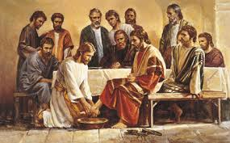
耶穌說明祂的領導與世俗不同
Jesus differentiates His leadership from the world’s leadership
世界: 君王治理, 大臣操權管束
- 從上往下領導 Top down leadership
The World: the Rulers rule, princes lord over people
耶穌: 有為首的身份, 卻以僕人樣式來服務眾人
- 從下往上提攜 Bottom up leadership
Jesus: He is the master but ministers to people as a
servant

Slide 6
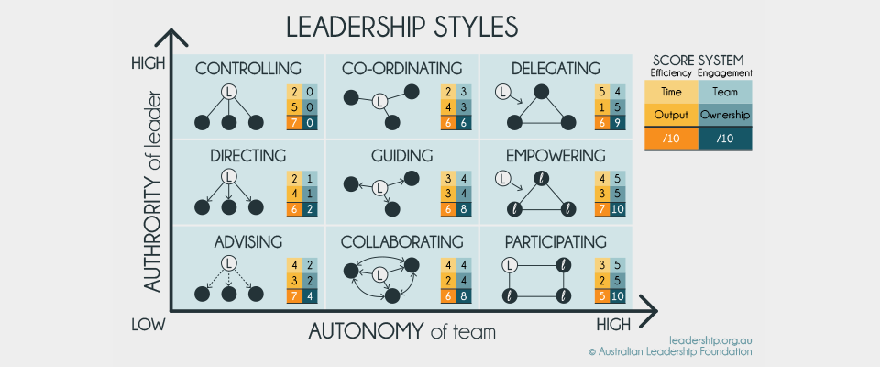
領導模式 – 效率與參與度的分析
Leadership Styles- Efficiency & Engagement
領導風格
領導的權威
團隊的自主權

Slide 7
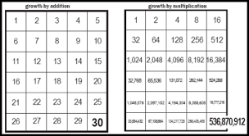
倍增的模式 Multiplication Model

Slide 8
A. 耶穌是信徒服事人的動力與榜樣
Jesus is the Motivator and Example of Those Who Serve
感恩有學像耶穌的機會 – 成為眾人的僕人
Grateful for the opportunity to be more like Jesus – a servant/leader

Slide 9
耶穌的形像 Image of Jesus
先知 /教師 – 指明真理
Prophet/teacher – tells the truth
2. 行神蹟奇事者 – 憐恤人的軟弱
Miracle worker – has compassion for man’s weakness
3. 造就門徒的師父 – 提升門徒的生命, 能力, 任務
The master who trains disciples – uplift their life, ability, task
4. 背負人類的過犯 – 救贖的任務
Bearing our sins and transgressions – task of redemption
以僕人的身份
With a Servant Attitude, As a Servant

Slide 10
上帝僕人的形像 Image of the Servant
Isa 42:1 看哪，我的僕人我所扶持所揀選、心裡所喜悅的！我已將我的靈賜給他；他必將公理傳給外邦。
Behold my servant, whom I uphold; mine elect, in whom my soul delighteth; I have put my spirit upon him: he shall bring forth judgment to the Gentiles.
Isa 42:2 他不喧嚷，不揚聲，也不使街上聽見他的聲音。
He shall not cry, nor lift up, nor cause his voice to be heard in the street.

Slide 11
上帝僕人的形像 Image of the Servant
Isa 42:3 壓傷的蘆葦，他不折斷；將殘的燈火，他不吹滅。他憑真實將公理傳開。
A bruised reed shall he not break, and the smoking flax shall he not quench: he shall bring forth judgment unto truth.
Isa 42:4 他不灰心，也不喪膽，直到他在地上設立公理；海島都等候他的訓誨。
He shall not fail nor be discouraged, till he have set judgment in the earth: and the isles shall wait for his law.

Slide 12
僕人的形像特性 Characteristics of the Servant
1). 知曉真理/公理, 傳揚真理/公理, 實踐真理/公理. (Isa. 42:1,3,4)
Know, proclaim, and practice the truth.
- 以身作則 lead by example
- 知行合一 knowing and doing go hand in hand
- 實踐是體驗真理的唯一標準
Practice is the only standard for experiencing truth
藉著操練, 實踐真理/公義來體現天國的治理
To practice and execute the truth to reflect Kingdom reign

Slide 13
僕人的形像特性 Characteristics of the Servant
2). 不張揚, 不喧鬧, 不邀功, 不追求自我名聲. (Isa. 42:2)
Does not publicize, make racket, take credit, or seek fame.
- 右手做的不要讓左手知道 (太Matt. 6:3)
Don’t let your left hand know what your right hand does.
- 真正的義人不求自己得榮耀, 而求上帝得榮耀 (約John 7:18)
Seeks not your own glory but God’s glory.
- 從內心安靜地服事主 (西 Col.3:23)
Quietly serve the Lord from the heart

Slide 14
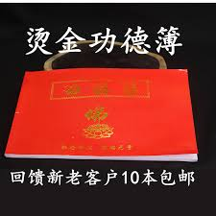
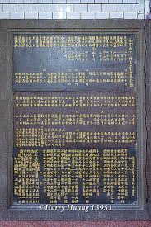
主知名 the Lord knows my name

Slide 15
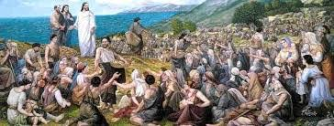
僕人的形像特性 Characteristics of the Servant
3). 對人群具有強大的同理心與憐憫. (賽Isa. 42:3)
Possess great empathy and sympathy for people.
- 憐憫眾人如同羊沒有牧人一般 (太Matt. 9:36, 彼前 I Pet. 2:25), 關愛他們都找到靈魂的牧人.
Has compassion for people who are as sheep without a shepherd. Care for them until they find the shepherd of their souls.

Slide 16
僕人的形像特性 Characteristics of the Servant
4). 不灰心, 不喪膽, 直到任務/使命完成. (賽Isa. 42:4)
Does not get discouraged or lose heart until the
task/mission is accomplished.
5). 對傳播上帝的訓誨到世界各處有熱切的負擔 (賽Isa. 42:4b)
Is zealous about spreading God’s Words and Precepts to the world.

Slide 17
感激有被上帝呼召的使命與恩賜 –
Thankful for the mission and gifting from God who calls us to serve – giving us a life purpose
- 倘若沒有異象, 我們就沒有目的而活.沒有目的, 起床就沒有意義 – 不如倦起身來看日間電視.
If you’ve no vision, you’re living without purpose. And without purpose, there’s no point in getting out of bed – you may as well just curl up and watch daytime TV. – Nicholas Ferguson, a British businessman
- 知道人生目的, 帶給你穩定性.
Knowing your purpose in life gives you stability. – John Maxwell, a Christian leader

Slide 18
使命Purpose/Mission
若你沒有想成為什麼人, 想擁有什麼, 或想在生命中成就什麼的意識, 那麼只保證兩件事情 – 搖擺的人品,和沒有目的地的顛簸旅程.
Not having a sense of the type of person you want to become, what you want to have, or giving thought to what you want to accomplish in life, guarantees only two things — wavering character and a bumpy ride to destination nowhere. – Nicholas Ferguson
我們的使命 – 認識並事奉基督, 也使祂被世人認識和事奉.
Our mission- to know and serve Christ, and to make Him known and be served.

Slide 19
恩賜 Gifts
基本概念 Basic Concept -
希腊文有两个字，都是用来形容恩赐的。第一个字是pneumatikos，意思是「属灵的事」，或「关于灵的事」。这个字强调属灵恩赐的本质和始源，恩赐不是天赋才干，而是从圣灵而来的。恩赐是圣灵用超然的方式赐给信徒的（林前十二11）。
There are two Greek words describing spiritual gifts. One is “pneumatikos”, meaning “spiritual things” or “concerning spirituals.”This word emphasizes the nature and origin of spiritual gifts which are not natural talents but coming from the Holy Spirit. Spiritual gifts are given to believers supernaturally (I Cor. 12:11).

Slide 20
恩賜 Gifts
另一个字是charisma，意思是「恩典的赐予」。这个字强调属灵的恩赐是神恩典的赐予。属灵恩赐不是一种与生俱来的能力，乃是神给予信徒的一种恩赐（林前十二4）。这个字的这种用法，在罗马书十二章可以看到，保罗在那里论到属灵的恩赐是借着「所赐给我的恩」，赐给信徒的（罗十二3、6）。
Another word is “charisma”, meaning “giving of grace.” This word emphasizes that spiritual gifts are God’s grace gifts, they are not inherent abilities but grace given by God to the believers (I Cor. 12:4). We can see how this word is used in Romans 12 when Paul says “by the grace given unto me”, and “by the grace that is given to us.” (Rom. 12:3,6)

Slide 21
恩賜 Gifts
属灵的恩赐可以有一个简单的定义，它是一种「恩典的赐予」。较详尽的定义，就是「赐给基督身体里的肢体，一种特别的事奉能力。」
So the spiritual gift can be defined very simply – that it is “a grace gift.” To put it more fully – it is “a special ministry ability given to the members within the body of Christ.”

Slide 22
两个概念 Two Concepts
关于属灵的恩赐，有两个概念必须加以说明。第一，赐给个人的属灵恩赐，就是神赐给人力量，以完成属灵的事奉（林前十二11）。第二，赐给教会的属灵恩赐，就是一个得到特别装备的人，让他可以建立教会，叫教会成长（弗四11至13）。
There are two concepts which need further explanation. First, it is a gift given to individual believers to carry out spiritual ministry (I Cor. 12:11). Second, it is a gift given to the church, that is, people with special training to build up the church for the church to grow (Eph. 4:11-13).

Slide 23
耶穌是信徒服事人的榜樣
Jesus is the motivator and example
3. 感謝有弟兄姊妹的同工與支持 – 僕人不孤單
Thankful for the support of brothers and sisters – You are not alone
一起完成大使命 To Fulfill the Great Commission-
耶穌有同工 Jesus has co-workers
保羅有同工 Paul has co-workers
我們有同工 We have co-workers

Slide 24
B. 保持正確的心態 Maintain the Right Mindset
- 確定主僕關係 Affirm Master/Servant Relationship
Luk 17:7 你們誰有僕人耕地或是放羊，從田裡回來，就對他說：『你快來坐下吃飯』呢？
Luk 17:8 豈不對他說：『你給我預備晚飯，束上帶子伺候我，等我吃喝完了，你才可以吃喝』嗎？
But which of you, having a servant plowing or feeding cattle, will say unto him by and by, when he is come from the field, Go and sit down to meat?
And will not rather say unto him, Make ready wherewith I may sup, and gird thyself, and serve me, till I have eaten and drunken; and afterward thou shalt eat and drink?

Slide 25
Luk 17:9 僕人照所吩咐的去做，主人還謝謝他嗎？
Luk 17:10 這樣，你們做完了一切所吩咐的，只當說：『我們是無用的僕人，所做的本是我們應分作的。』」
Doth he thank that servant because he did the things that were commanded him? I trow not.
So likewise ye, when ye shall have done all those things which are commanded you, say, We are unprofitable servants: we have done that which was our duty to do.
不忘記與基督的主僕關係 -
Don’t forget our master/servant relationship with Jesus

Slide 26
Mat 11:28 凡勞苦擔重擔的人可以到我這裡來，我就使你們得安息。
Come unto me, all ye that labour and are heavy laden, and I will give you rest.
Mat 11:29 我心裡柔和謙卑，你們當負我的軛，學我的樣式；這樣，你們心裡就必得享安息。
Take my yoke upon you, and learn of me; for I am meek and lowly in heart: and ye shall find rest unto your souls.
Mat 11:30 因為我的軛是容易的，我的擔子是輕省的。」
For my yoke is easy, and my burden is light.

Slide 27
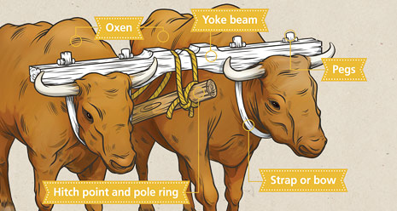

Slide 28
C. 僕人的獎賞
The Reward of a Servant
最大的報償是成為效法基督的人,
The greatest reward is to become a follower of Jesus
有機會學習祂的樣式,
Having the opportunity to learn His ways
目標在效法基督,
The goal is to become like Jesus
生命被祂得著.
And to be known by Him
享受主人的快樂
Enjoying the happiness of the Master

Slide 29
最後的叮嚀: 作耶穌僕人要牢記的三件要素
Three Things to Remember
生命要與耶穌時時連結在一起 (靈修/領袖)
Connect with the Life of Jesus
耶穌說: 離了我你們什麼都不能做
但保羅說: 靠著那加給我力量的, 凡事都能行
2. 學習耶穌僕人的樣式 – 心裡柔和謙卑
Learn from Jesus – meek and lowly in heart
3. 願意服事眾人, 等候上帝親自的獎賞.
Willing to serve others, and wait for the Lord’s reward

