Slide 1
THE GREATEST PROPHESY EVER: Pt. 2 Isaiah 53 有史以來最偉大的預言- 以賽亞書 53章第二部分
What Isaiah was commanded to write was to be “forever!”
(Isa 30:8) “Now go, write it before them in a table, and note it in a book, that it may be for the time to come for ever & ever” (see Psalm 119:89; 160; Matt. 5:18; I Pet. 1:25)
赛30：8 -現今你去，在他們面前將這話刻在版上，寫在書上，以便傳留後世，直到永永遠遠。
Isaiah made his original Prophecies 740-686 B.C.

Slide 2
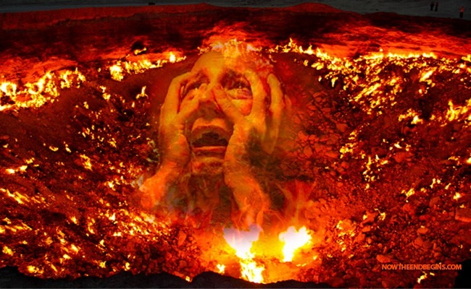
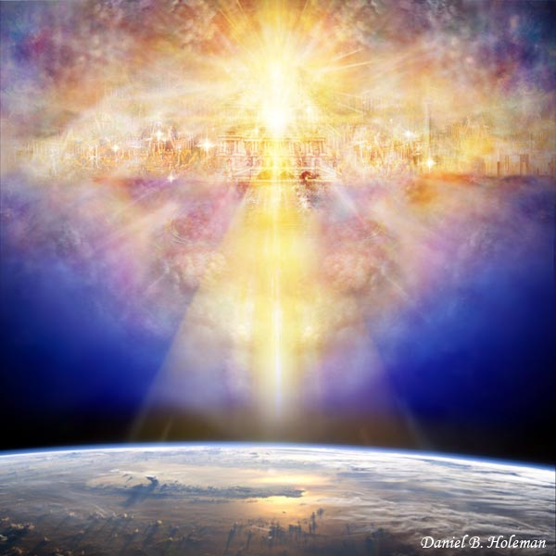
ISAIAH 53 is THE GREATEST PROPHESY EVER Because it Answers LIFE‘S GREATEST QUESTION 以賽亞書53章是有史以來最偉大的預言，因它回答人生最大的問題
How can a sinner be “right” with a Holy God so as to escape eternal Hell & enter eternal Glory? (John 5:29)
罪人如何在上帝面前成為“對的人”，能夠逃避永恆的地獄，而進入永恆的榮耀呢？

Slide 3
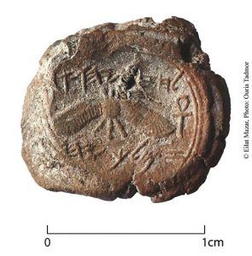
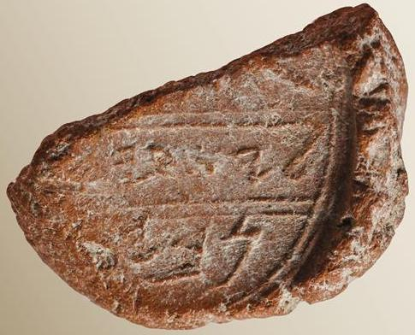
There is Great Archaeological Proof of the Truth of Isaiah’s Prophesy from 700 B.C. 考古有許多證明，證實以賽亞書在主前七百年 預言的真理
Archaeologists
found the
Isaiah
& Hezekiah seal impressions

Slide 4
Nelson Glueck renowned Jewish archaeologist 著名的犹太考古学家的话
“It may be stated categorically that no archaeological discovery has ever controverted a biblical reference” (ref. “Rivers in the Desert” p. 31, 1969)
To this day there is not 1 unquestionable find of archaeology that proves the Bible to be in error at any point”

Slide 5
Prophesy is The Great IRREFUTABLE PROOF THE BIBLE IS THE WORD OF THE ONE TRUE GOD 预言是聖經是全能上帝的話語最伟大无可驳斥的證據
Isa. 52 & 53 has at least 36 distinct prophecies whose literal fulfillment is confirmed in over 150 different verses from 9 different O.T. books & 17 different N.T. books! [See handout]
以賽亞書52,53章中至少36個顯著的預言，在9卷舊約和17卷新約中的150節經文確實應驗。
Such prophecy could only have been written by a Sovereign, all knowing, eternal being outside our “time domain”
这些预言只可能是在我们的时间领域外，权能， 全知， 永恒者所写。

Slide 6
Fulfilled Prophesy is the Single Greatest Test to determine if a Religion is True or not? 應驗了的預言是測驗信仰真偽最好的試金石
(Isa 46:9) “…for I am God, and there is none else; I am God, and there is none like me,
赛46：9 -你們要追念上古的事。因為我是神，並無別神； 我是神，再沒有能比我的。
(Isa 46:10) Declaring the end from the beginning, & from ancient times the things that are not yet done, saying, My counsel shall stand” (Isa. 46:9-10; 41:23-24,26; 45:20-22; 48:3-5; John 13:19; 14:29)
赛46：10- 我從起初指明末後的事，從古時言明未成的事，說：我的籌算必立定；凡我所喜悅的，我必成就。

Slide 7
Dead Sea Scrolls ( 150 – 200 B.C. ) 死海古卷 One of the Greatest Archaeological finds ever 最偉大的考古發現之一
The spiritual Battle between light & darkness
介乎光明与黑暗之战
Shrine of the Book in Israel

Slide 8
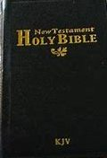
Shrine of the book inside 以色列聖經博物館
To prove prophesy you need
a written record recorded
Long before the prophesies
were fulfilled
Copy of Isaiah
2,200 yrs. old!
Then you need a written history that proves the Prophecies were fulfilled as previously written

Slide 9
I.) BEHOLD, THE LORD’S GREAT SERVANT 看哪 - 耶和華的僕人
(Isa 52:13) “Behold, my servant… he shall be exalted & extolled, & be very high”
賽52:13 – 看哪，我的僕人行事必有智慧（或作：行事通達）， 必被高舉上升，且成為至高。
“Behold!” 看哪！– something unusual here to take note of
“My Servant” – Servants were poor. Jesus became poor for us (2 Cor. 8:9)
我的僕人 – 耶和華的僕人- 貧窮，一無所有。 耶穌為我們成為貧窮

Slide 10
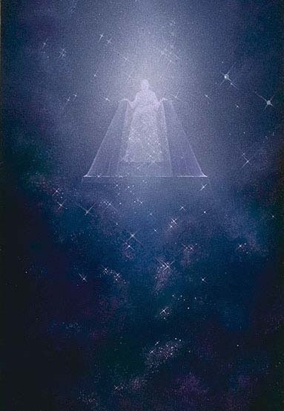
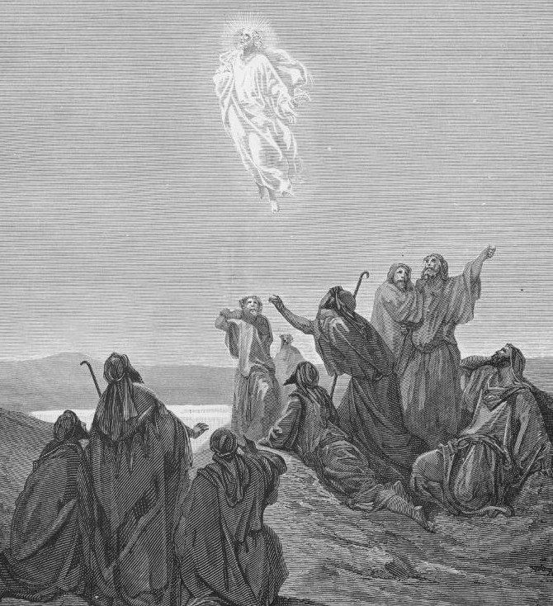
Behold: This servant Obtains the Greatest Glory 看奇妙的事：這位僕人獲得最高的榮耀
(Isa 52:13) “Behold, my servant shall be… exalted & extolled, & be very high”
賽52:13-看哪，我的僕人行事必有智慧
（或作：行事通達），必被高舉上升，且成
為至高。You will never regret serving God!

Slide 11
The Greatest Glory Fulfilled in Jesus Christ 最崇高的榮耀應驗在耶穌基督身上
(Eph. 1:20-21) God “raised Christ from the dead, & set him at his own right hand in the heavenly places, Far above all principality, & power, & might, & dominion, & every name that is named,
弗1:20-21 -就是照他在基督身上所運行的大能大力，使他從死裡復活，叫他在天上坐在自己的右邊，遠超過一切執政的、掌權的、有能的、主治的，和一切有名的；

Slide 12
Behold: This servant Obtains the Greatest Glory by means of the Greatest Suffering! 看哪：這位僕人因最大的苦难獲得最高的榮耀
(Isa 52:14) “many were astonied at thee; his visage was so marred more than any man, & his form more than the sons of men”
賽52:14 -許多人因他﹝原文作你﹞驚奇；他的面貌比別人憔悴；他的形容比世人枯槁。
Perfectly describes the suffering & glory of the LORD Jesus
(I Pet. 1:10-11; Lk. 24:25-27; Acts 26:22-23; Phil. 2:5-11)
完美地描绘主耶稣的苦难与荣耀。

Slide 13
II.) Behold Our Blindness to the Glory of Christ 看哪 - 我們自己看不見基督的榮耀
Isa 53:3 He is despised & rejected of men… & we hid as it were our faces from him; he was despised, & we esteemed him not.
賽53:3 -他被藐視，被人厭棄；多受痛苦，常經憂患。他被藐視，好像被人掩面不看的一樣；我們也不尊重他。
We (me & you) were blinded to the fact He was sinless & suffering for our salvation!
我们没看见无罪的他为我们救恩而受苦的事实。

Slide 14
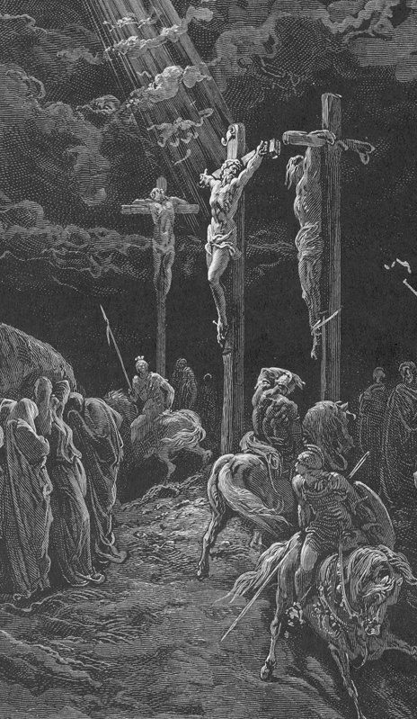
III.) Behold the great revelation of the doctrine of salvation by substitution (53:4-6) 看哪 - 聖經中最偉大關於「救恩是藉由代替」的教義的經文
(53:4) Surely he hath borne…
(53:5) But he was wounded (pierced)
he was bruised…
…our griefs, & carried our sorrows
…For our transgressions,
…for our iniquities:
Zechariah 12:10

Slide 15
(53:5)
…was upon him;
and with his stripes…
(53:6) and the LORD hath laid on him…
(53:8)
… was he stricken
(11) He shall bear
The chastisement of our peace
… we are healed.
… the iniquity of us all.
…for the transgression of my people… {Israel}
…their iniquities
Zechariah 12:10

Slide 16
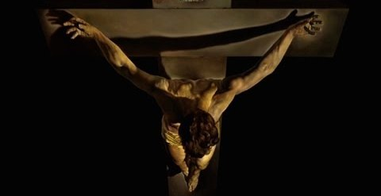
My Sins must lie somewhere! Either on me or on Christ! 我的罪放在哪裡？在我身上還是基督身上？
Illustration: R. A. Torrey
God alone can remove the guilt & consequences of my sin from me and place it on Christ.
只有上帝能将我的罪疚和其后果从我身上移到基督身上。

Slide 17
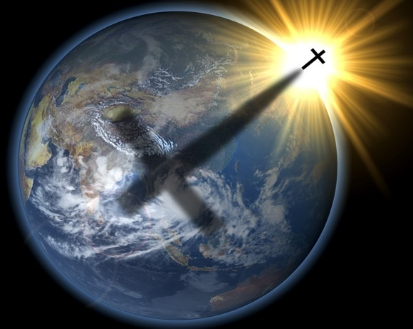
How Could 1 Man die for the sins of the Whole World? (Isa. 53:11: Heb. 9:12-14; 10:12-14) 为何一人能够为全世人而死？
Because Jesus is God incarnate, Creator of Heaven & Earth (John 1:1-3, Col. 1:14-17)
因為耶稣是创造天地的上帝道成肉身
(Gen 18:14) Is any thing too hard for the LORD? (Jer. 32:17; Matt. 19:26)
耶和華豈有難成的事？

Slide 18
Serious Implications of Being Created in the Image of God 按照上帝形象而造的严肃含意
Every person (male & female) is Created in the image of God (Gen. 1:26-27; 5:2; Isa. 43:7; Matt. 19:4; Mk. 10:6)
每人都按照上帝形象而造，
Sinning against man created in God’s image proves we would sin against God Himself if He was here in person! (I John 4:20; 3:17; 4:12; Jer. 16:10-12)
向有上帝形象的人犯罪，证明我们是向上帝自己犯罪，倘若他亲自在此！

Slide 19
Proof: Jesus was God incarnate & and look how everyone ultimately treated Him! (Matt. 25:40, 45; Prov. 19:17)
证明：耶稣是上帝道成肉身，看看每人最终如何对待他！
Every wrong against our fellow man is ultimately against God Who Created us! (Gen. 9:6; 39:9; Deut. 20:18; I Sam. 12:23).
每一错待同胞的行为，最终都是冒犯创造我们的上帝！

Slide 20
3 Presuppositions necessary to Understand Salvation 1. We were Created by a Holy God 明了救恩必要的三个前提 1. 我们由圣洁的上帝所造
Because God created us for His eternal purposes we are obligated to Obey Him (Matt. 22:37-40). Being LORD He is our Owner!
上帝为了他永恒的目的创造我们，所以我们有义务顺从他 （太22：37-40）。主是我们的拥有者！
Our Creator rightfully holds us accountable for our thoughts, words & actions (Rom. 9:20; Isa. 45:9-10)
我们的造物主有合法的权利，要我们为自己的思想，言语， 和行为负责。

Slide 21
2. We have all failed to Obey our Creator 2. 我们都没有顺从造物主
(Isa 53:6) “All we like sheep have gone astray; we have turned every one to his own way…” (I Pet. 2:25; Rom. 3:10-12)
赛53：6 -我們都如羊走迷；各人偏行己路；
God’s word & our Conscience makes it clear we have all failed to live up to God’s standard & sinned against our Creator (Rom. 1:19; 2:14-16; 3:23)
上帝的话语和我们的良心都清楚说明，我们没有活出上帝的标准且向他犯罪。

Slide 22
3. Because all sin is ultimately against God, our Salvation must begin & end with God 3。 由于罪至终是冒犯上帝，所以我们的救恩必须从上帝开始与终结
(Ps. 51:4) David confesses: “Against thee, thee only, have I sinned, and done this evil in thy sight…” (see Gen. 20:6; 39:9; Isa. 44:22)
詩51：4- 我向你犯罪，惟獨得罪了你；在你眼前行了這惡，
Because Jesus is God incarnate, He can forgive sins on behalf of God! (Matt. 9:2-7: Lk. 5:20-25; 7:47-50)
耶稣是道成肉身的上帝，他能够代替上帝赦免！

Slide 23
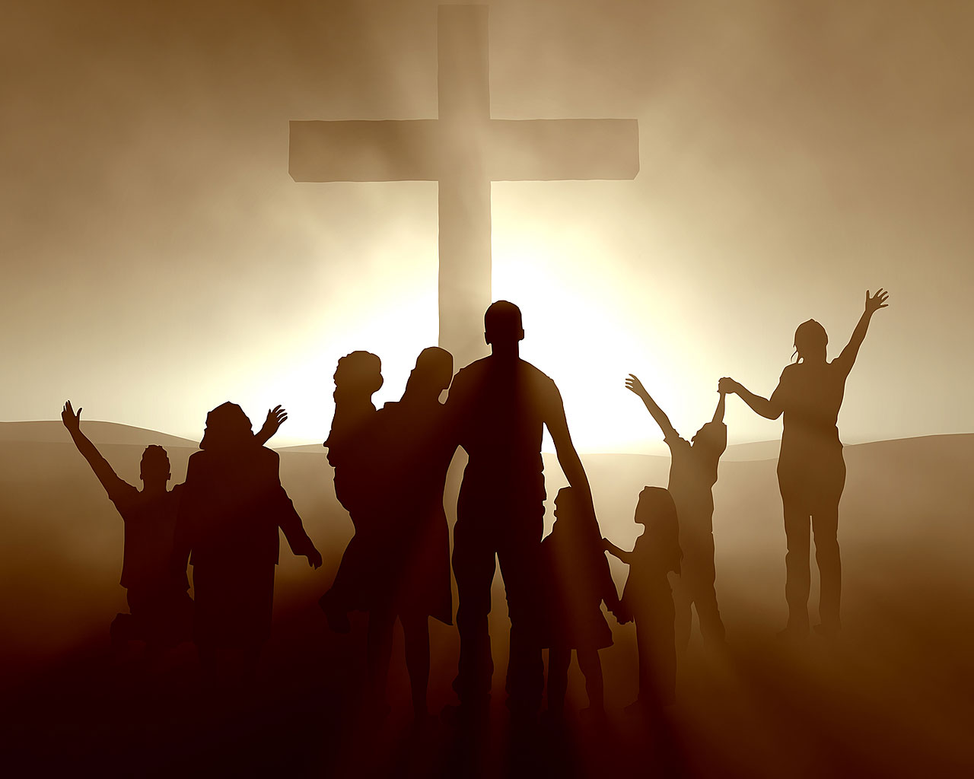
That is why God can forgive ALL my sins when i believe Christ died on the Cross as my “sin bearer” (Rom. 3:24-26)
这就是为何当我相信基督“担负罪恶”死在十字架上时，上帝能够赦免我所有的罪。

Slide 24
IV.) Behold the Lamb of God (Isa. 53:7; Gen. 22:8, 14). 看哪上帝的羔羊
(Isa 53:7) He was oppressed, & he was afflicted, yet he opened not his mouth: he is brought as a lamb to the slaughter, and as a sheep before her shearers is dumb, so he openeth not his mouth.
赛53：7 -他被欺壓，在受苦的時候卻不開口；他像羊羔被牽到宰殺之地，又像羊在剪毛的人手下無聲，他也是這樣不開口。
7 Times it is revealed that this Lamb is really a man! This is the cause for which Christ came into the world (Mk.10:45; John 1:29)
七次启示这羔羊其实是一人！基督为了这原因来到世上。

Slide 25
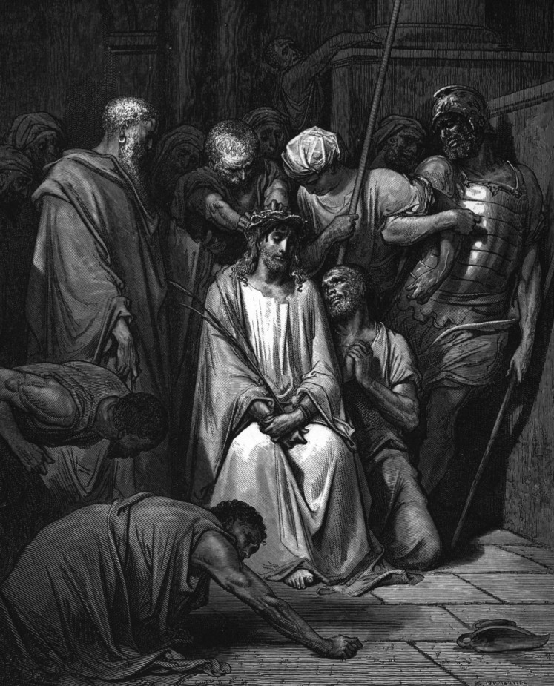
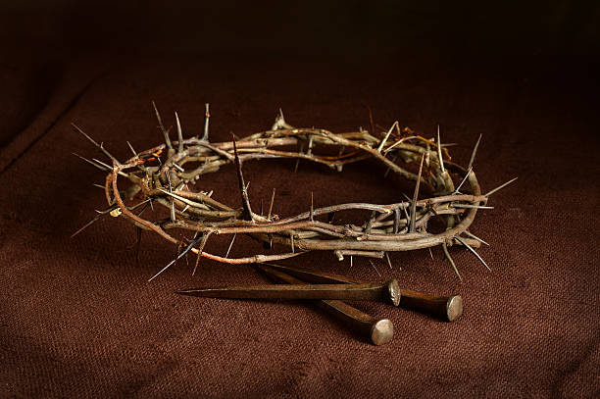
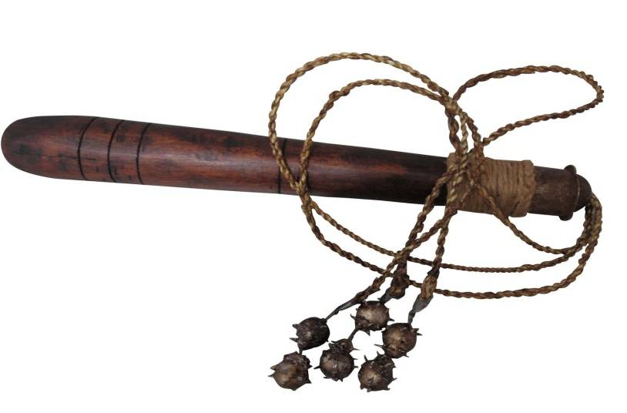
“he is brought as a lamb to the slaughter, & as a sheep before her shearers is dumb, so he openeth not his mouth” (Isa. 53:7) 他像羊羔被牽到宰殺之地，又像羊在剪毛的人手下無聲，他也是這樣不開口

Slide 26
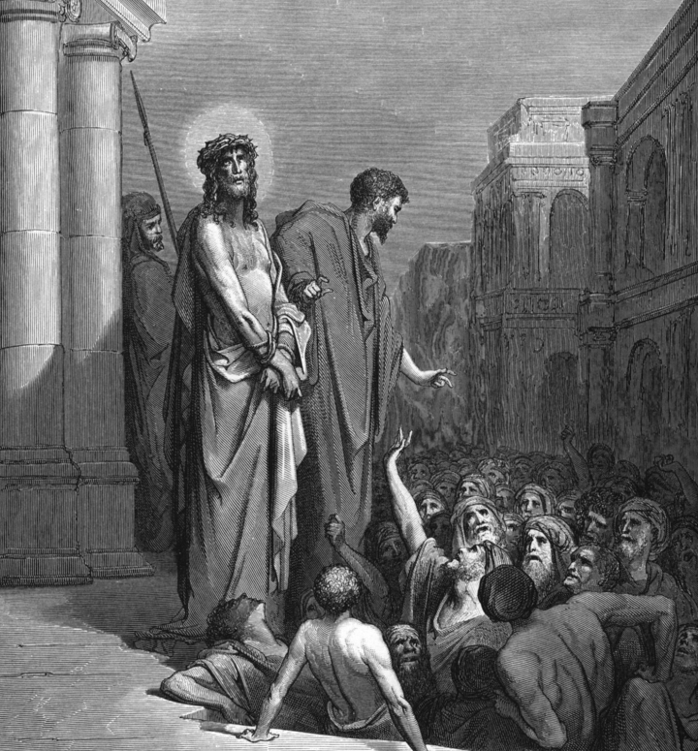
V. Behold the Lamb Dies in the Sinners Place (53:7-9) 看哪 - 羔羊代替罪人而死
(8) “He was taken from prison & from judgment…
因受欺壓和審判…

Slide 27
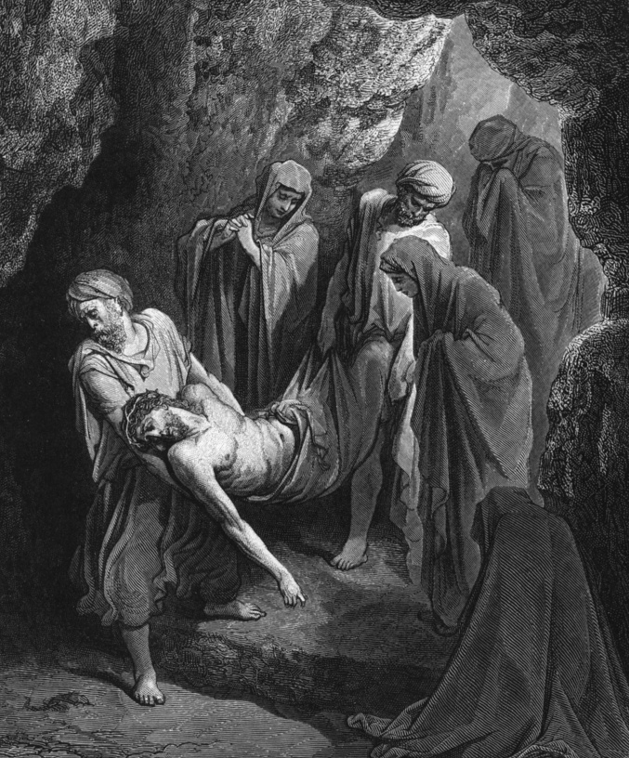
V. Behold the Lamb Dies in the Sinners Place (53:7-9) 看哪 - 羔羊代替罪人而死
(8) “for he was cut off out of the land of the living:
從活人之地被剪除，
for the transgression of my people was he stricken.”
受鞭打…是因我百姓的罪過呢？

Slide 28
Behold: The Lamb is irrefutable Proof of the Bible’s Supernatural Inspiration 看哪：羔羊是圣经超自然的启示无法驳斥的证明
The Doctrine of Salvation by Faith in a perfect substitutionary sacrifice is supernaturally & progressively revealed throughout the Bible from Genesis (written 1500 BC) to Revelation (written 90 AD)
因信“替代牺牲”而得救的教义，圣经从创世纪（主前1500年） 到启示录（主后90年）超自然地且渐进地启示出来！
66 different Books; 40 human writers; 1600 years; yet the Lamb consistently reveals the same eternal plan of salvation!
66卷书，40为作者，1600年，羔羊一致启示同样的永恒救恩计划。

Slide 29
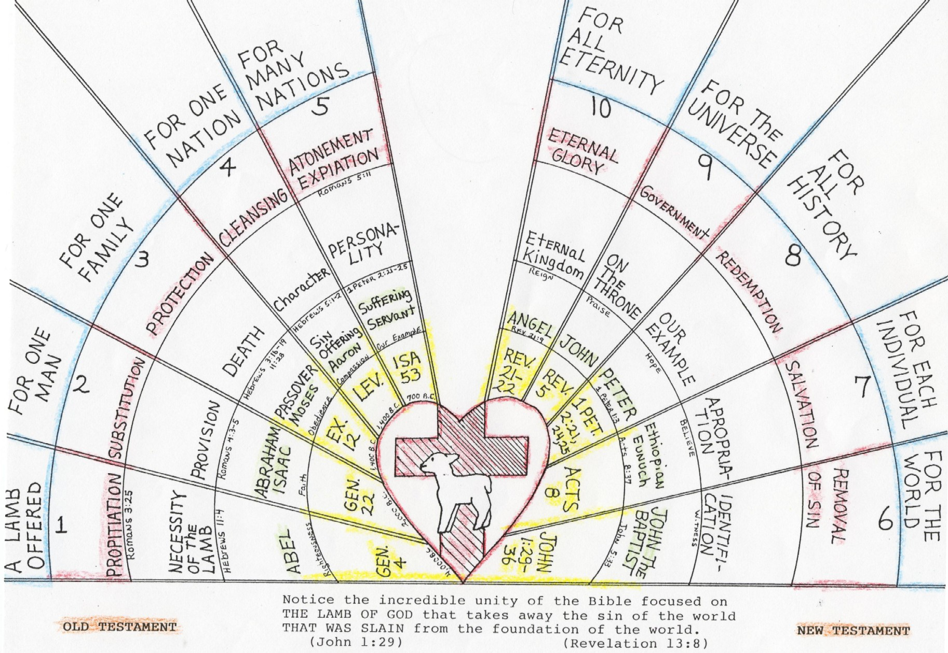
Genesis 3:21

Slide 30
VI.) Behold “the only” Perfect Sinless Sacrificial Lamb (Isa. 53:7, 9) 看哪 - 唯一完美、无罪、献祭的羔羊
Every Sacrificial Lamb of the Law must be without Blemish (Ex. 12:5; Lev. 4:23; 5:15; 22:19; Num 6:14)
按律法，每一献祭的羔羊必须没有瑕疵。
Isaiah reveals God’s righteous servant (vs. 11) has no sin of His own! He is the Perfect sin offering Who bears the sins of others (Isa. 53:4,5,6,8,11)
以赛亚启示上帝公义的仆人自身无罪！他是那完美的赎罪祭，担负他人的罪恶。

Slide 31
VI.) Behold “the only” Perfect Sinless Sacrificial Lamb (Isa. 53:7, 9) 看哪 ：唯一完美、无罪、献祭的羔羊
“In Jesus is no sin” {no sin nature} (I John 3:5; I Pet. 1:19).
耶稣里面无罪 ，没有罪性
“Jesus did no sin, (I Pet. 2:22). He never sinned in word or deed.
耶稣没有罪行，
“Jesus knew no sin” (2 Cor. 5:21). He never had a sinful thought.
耶稣不知罪。

Slide 32
This explains why Jesus alone could die for all the sins of the entire human race! {Oh the value of a Sinless Man!}
(Isa. 53:11) “My righteous servant shall justify many”
赛53：11-有許多人因認識我的義僕得稱為義,
“…Jesus Christ the righteous: he is the propitiation for our sins: and not for ours only, but also for the sins of the whole world” (I John 2:1-2; Mk. 10:18; Rom. 3:10, 23; Ps. 14:1-3)
约一2：2 - 他為我們的罪作了挽回祭，不是單為我們的罪，也是為普天下人的罪。

Slide 33
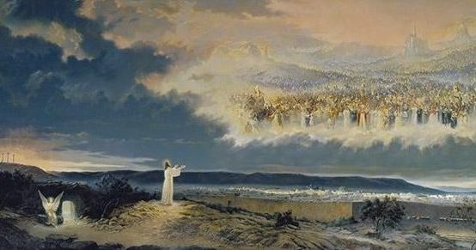
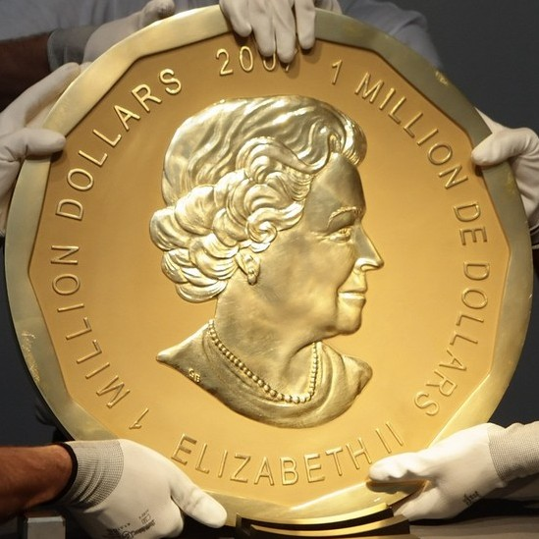
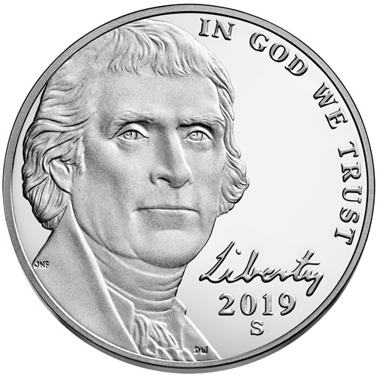
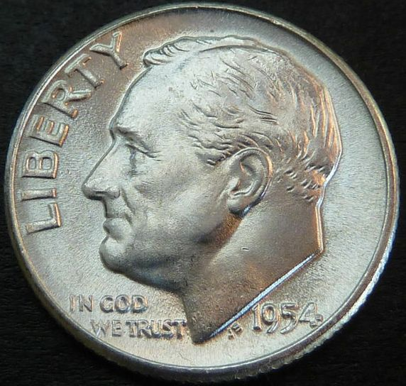
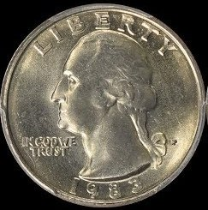
Illus: Redeeming things with money: why is a penny a penny? Why is a nickel a nickel? Why can a nickel redeem 5 pennies?

Slide 34
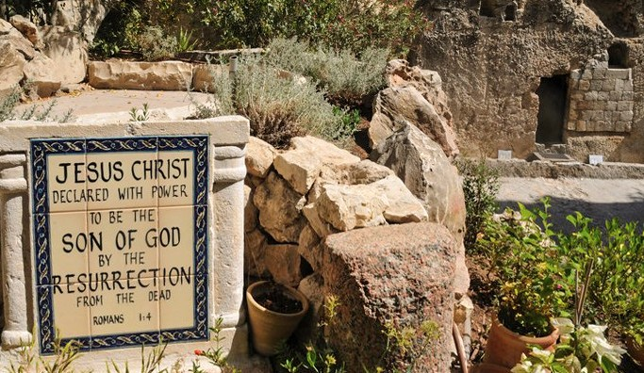
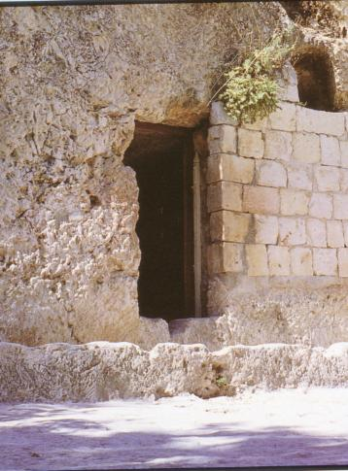
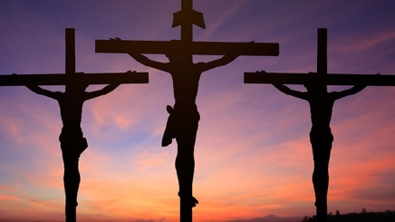
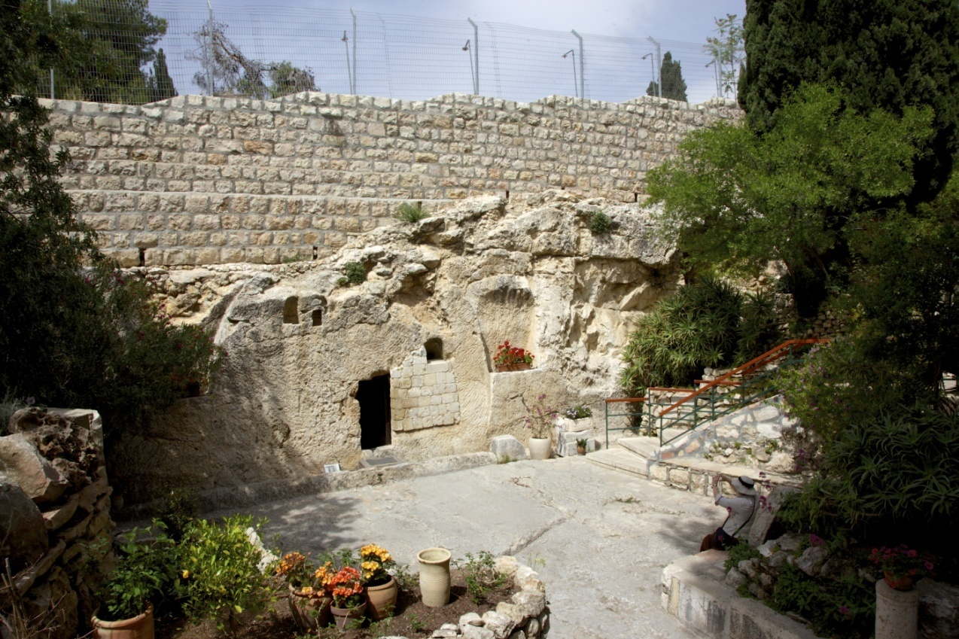
The Gospel: The Death, Burial & Resurrection of Messiah 福音：弥赛亚的死亡，埋葬，与复活
(Isa 53:9) “he made his grave with the wicked, and with the rich in his death…” “numbered with the transgressors” (53:12)
赛53：9 -人還使他與惡人同埋；誰知死的時候與財主同葬。

Slide 35
VII. Behold the Love Of God the Father & The Son (53:10) 看哪， 天父与圣子之爱
Some falsely perceive God the Father to be cruel & abusive: “Yet it pleased the LORD to bruise him” (53:10; 53:4)
耶和華卻喜悅將他壓傷,
Why? it was impossible to save us any other way (Matt. 26:39)
The Father had to lay our sins on Jesus (53:6)
耶和華使我們眾人的罪孽都歸在他身上。
But God was in Christ reconciling the world (2 Cor. 5:19; John 10:38; 14:10-11, 20; 17:21, 23; 8:29; 16:32)
上帝在基督里叫世人与自己和好（林后5：19）。
Illus: Father jumping into the fire to save his son.

Slide 36
VIII) The Double Blessing of the LAMB: He takes my Sin, Gives me His Righteousness! 羔羊的双重祝福：拿去我的罪，又赐我他的公义
(Isa 53:10) “… thou shalt make his soul an offering for sin (asham)”
赛53：10 - 耶和華以他為贖罪祭,
(Isa 53:11) “…by his knowledge shall my righteous servant justify many; for he shall bear their iniquities” (Acts 13:39; Rom. 3:20-24; 5:1; Gal. 2:16)
赛53：11 - 有許多人因認識我的義僕得稱為義；並且他要擔當 他們的罪孽。

Slide 37
VIII) The Double Blessing of the lamb! (Isa 53:11-2) 羔羊的双重祝福
Every sinner needs a “sin offering” to remove their sin (vs. 10-12)
Every saint needs a “burnt offering” to impart God’s righteousness (vs. 11) (2 Cor. 5:21; Compare Daniel 9:24)
Illus: The sinner & the Lamb

Slide 38
“Justify many” = literally “the many” hinting at “multitudes” (Rev. 5:9; 7:9). Enough are saved to make his suffering worthwhile
I know I am included in “the many.” Have you made sure you are one of the many? You can make sure right now (IJohn 5:10-13)

Slide 39
After Death & Burial – Resurrection Life! 死亡与埋葬之后 – 复活的生命！
(Isa 53:10) “…he shall see his seed, he shall prolong his days, and the pleasure of the LORD shall prosper in his hand. (Rev. 1:18)
赛53：10 -他必看見後裔，並且延長年日。耶和華所喜悅的事必在他手中亨通。
When we believe this O.T. Gospel we become “His seed” by being “born again” (I Pet. 1:23-25; John 3:3-7)
当我们相信这旧约的福音，我们就因“重生”而成为他的后裔。

Slide 40
After Death & Burial – RESURRECTION LIFE! 死亡与埋葬之后 – 复活的生命！
(53:11) “He shall see of the travail of his soul, & shall be satisfied”
赛53：11 -他必看見自己勞苦的功效，便心滿意足。
Will you be able to look back on your life with all its travail, all its sorrow and its tears – and say “I am satisfied!”
You will if you have given your life to Jesus (read Rev. 21 & 22)

Slide 41
Christ Makes me Great, Strong, & Incredibly Wealthy! 基督使我强大、坚固、十分富有！
(Isa 53:12) “Therefore will I divide him a portion with the great,
赛53：12 - 我要使他與位大的同分,
Who are these “great?” Believers in Jesus! (Matt. 11:11; Lk. 7:28)
“and he shall divide the spoil with the strong.”
與強盛的均分擄物。
Do you know what Jesus has obtained for you? (I Cor. 3:21-23; Rom. 8:32; Rev. 21:7; I Cor. 2:9)

Slide 42
This Great Salvation Obligates us to fulfill the Great Commission 伟大的救恩使我们有完成伟大的使命的义务
Christ’s tomb is opened & empty. Death has no more power over Jesus, or the justified believer in Jesus! Hallelujah!
基督的坟墓敞开无人，死亡不再能掌控耶稣或在耶稣里面成义的信徒！
Christ’s Resurrection is a total triumph (Col. 2:13-15; Eph. 4:8)
基督的复活是完全的得胜。
This News is too good to keep to ourselves!
这消息不能自己保留而不传给他人！

Slide 43
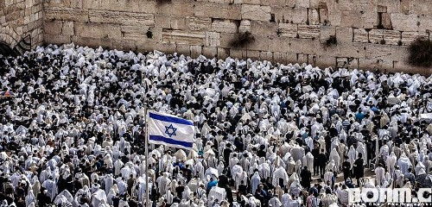
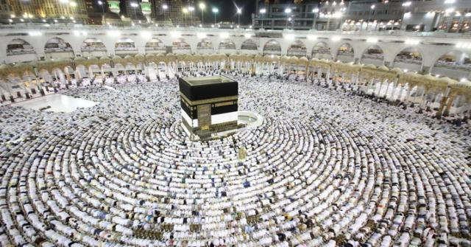
This Great Salvation Obligates us to fulfill the Great Commission 伟大的救恩使我们有完成伟大的使命的义务
Remember the intro to Isaiah 53. A runner bringing great news of a great victory after a devastating battle? (Isa. 52:7-10)
We are witnesses to the greatest Victory in History! Run and tell the World the good news!

Slide 44
VIII) The Double Blessing: His Robes for Mine! (Isa 53:11-2; Zechariah 3:1-8; Col. 3:8-10)
Every sinner needs a “sin offering” to remove their sin (vs. 10-12)
Every saint needs a “burnt offering” to impart God’s righteousness (vs. 11) (2 Cor. 5:21; Compare Daniel 9:24)
Illus: The sinner & the Lamb

