Slide 1
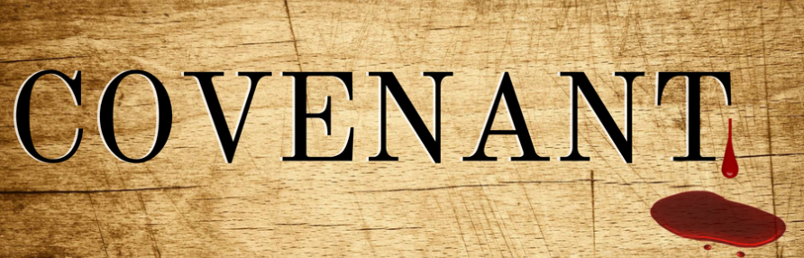
認識審判的神 Knowing God as Our Judge
挪亞之約 The Noahic Covenant

Slide 2
盟約的分類 Covenants in Two Categories
普世性盟約
Universal Covenants
救贖性盟約
Redemptive Covenants

Slide 3
#1 | 伊甸之約 The Edenic | 亞當之約 The Adamic | 挪亞之約 The Noahic
代表 Head | 亞當 Adam | 亞當 Adam | 挪亞 Noah
事件 Event | 創造 Creation | 墮落 Fall | 洪水 Flood
記號 Sign | 生命樹 Tree of Life | 後裔 The Seed | 彩虹 Rainbow
應許 Promise | 神的同在 Being with God | 必有拯救 Salvation | 不再毀滅 No more flood

Slide 4
#2 | 伊甸之約 The Edenic | 亞當之約 The Adamic | 挪亞之約 The Noahic
祝福 Blessing | 生養眾多 Be fruitful | 生養眾多 Be fruitful | 生養眾多 Be fruitful
 | 管理全地 Rule over earth | 管理全地 Rule over earth | 管理全地 Rule over earth
審判Judgment | 勿食禁果 Forbidden fruit | 充滿敵意 Enmity among all | 不可害命 Don’t kill
 | 逐出伊甸 Out of Eden | 洪水毀滅 Destroy all flesh | 神必追討 God revenges

Slide 5
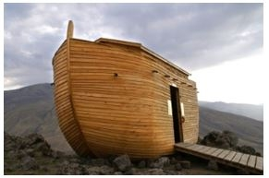
挪亞之約 The Noahic Covenant (1)
上帝重新修訂了亞當之約
God revised terms in the Adamic Covenant
挪亞及後代繼承管理責任
Noah & sons inherited the ruling of the earth

Slide 6
挪亞之約 The Noahic Covenant (2)
地球環境惡劣 Earth became more adverse
人類開始食肉 Humans began to eat meats
國家種族出現 Nations and races emerged

Slide 7
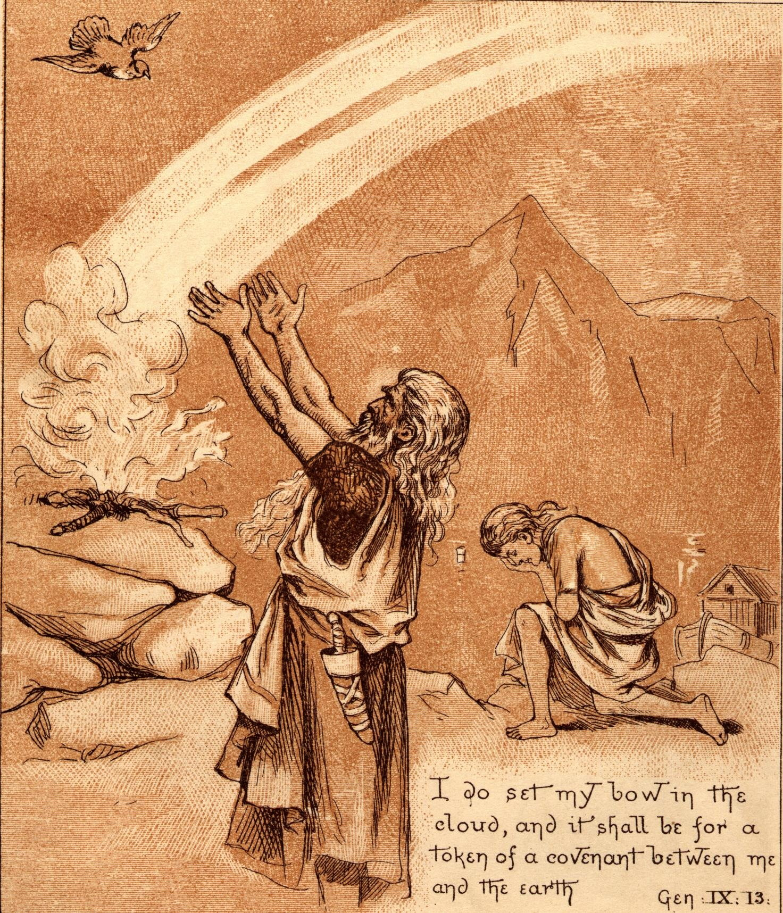
為什麼舊約中的上帝如此殘暴﹖ Why was God in OT so ruthless?
上帝既是公義﹐也是慈愛
God is a God of love and a God of justice
上帝是不會改變的
God does not change

Slide 8
以敬畏的心面對上帝! Fear the Lord in Every day's Life!

