Slide 1
THE GREATEST PROPHESY EVER.(period) Isaiah 52:10 – 53:12 有史以來最偉大的預言- 以賽亞書52:10-53:12
The Prophet Isaiah wrote in 700 B.C. He is the writer of this profound prophesy. But it becomes obvious that God is the Author by the inspiration of God’s Spirit (I Tim. 3:15-17; 2 Pet. 1:19-21)
以賽亞先知寫作於主前七百年。他是這深奧預言的作者，但很明顯地上帝藉著祂的聖靈寫下這個預言（提前3:15-17；彼後1:19-21）。
Why? Because it reveals things that it was impossible for any human being to have known or guessed at the time
為何？因它啟示出當時任何人所不可能知道或猜到的事情。

Slide 2
ISAIAH 53 is THE GREATEST PROPHESY EVER Because it Answers LIFE‘S GREATEST QUESTION 以賽亞書53章是有史以來最偉大的預言，因它回答人生最大的問題
Most people avoid dealing with this Question: Which is foolish for the answer determines your eternal destiny! (Deut. 30:19)
多數人避免處理這問題，這是愚昧的，因答案決定你永恆的命運（申30:19）！
How can a sinner be “right” with a Holy God so as to escape eternal Hell and enter eternal Glory? (Luke 3:7)
罪人如何在上帝面前成為“對的人”，能夠逃避永恆的地獄，而進入永恆的榮耀呢？

Slide 3
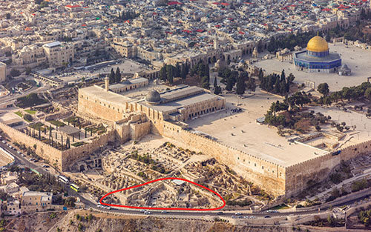
There is Great Archaeological Proof of the Truth of Isaiah’s Prophesy 考古學有許多證明，證實以賽亞書預言的真理
The “Ophel” where the Isaiah & Hezekiah seal impressions found
在Ophel這地方找到以賽亞與希西家的印章印記

Slide 4
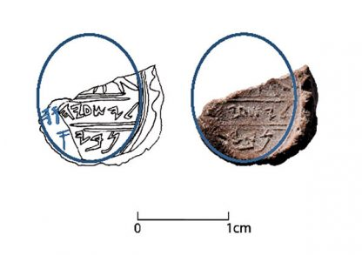
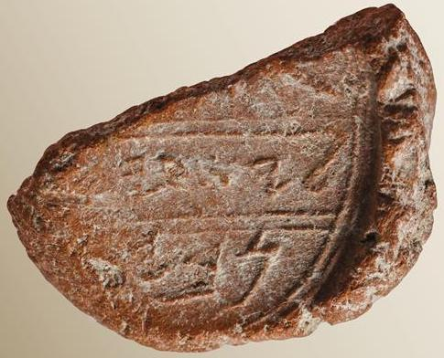
Isaiah seal impression found by Eilat Mazar (article 2018) 以賽亞的印章印記
Reads “belonging to Isaiah the prophet” (assuming missing letter is an “aleph”)
“屬於先知以賽亞”

Slide 5
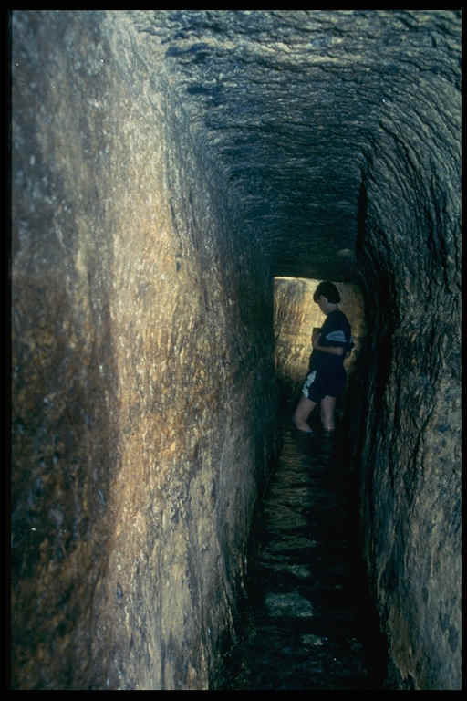
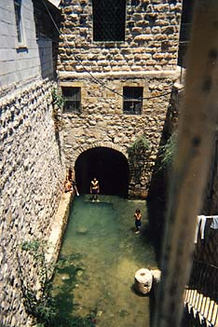
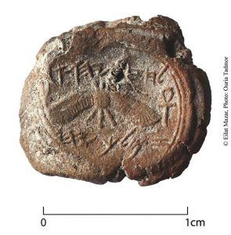
Hezekiah seal impression found by Eilat Mazar 希西家印章印記
Hezekiah’s tunnel in Jerusalem (2Kings 20:20; Isa. 22:11; 2 Chron. 32:30)
耶路撒冷希西家隧道

Slide 6
The Greatest Prophesy Proclaims the Greatest Freedom 最偉大的預言宣告最偉大的自由
The Background is Isaiah chapters 42-52 which contains many incredible & supernatural Prophecies of Israel’s future
以賽亞書42-52的背景包括許多有關以色列未來難以置信且超自然的預言。
Amazing prophecies of their eventual Freedom from their Babylonian Captivity by a man named Cyrus (Isa. 44:24-28; 45:1-6)
一位名為古列的人將釋放他們從巴比倫被擄中歸回 （賽44:24-28；45:1-6）

Slide 7
The Greatest Prophesy Proclaims the Greatest Freedom 最偉大的預言宣告最偉大的自由
Isaiah 53 looks forward to the greater liberation from sin that was to be accomplished by the Messiah (servant of the LORD)
以賽亞書53章前瞻彌賽亞將完成的從罪得更大的自由。
Believe the Truth of this great prophesy & you can experience FREEDOM from the bondage of sin
相信這偉大預言的真理，你就能經歷從罪的捆綁中得自由。

Slide 8
I.) Behold the IRREFUTABLE PROOF THE BIBLE IS THE WORD OF THE ONE TRUE GOD 看哪 -聖經是全能上帝無誤的話語的證據
Isa. 52 & 53 has at least 36 distinct prophecies whose literal fulfillment is confirmed in over 150 different verses from 9 different O.T. books & 17 different N.T. books! [See handout]
以賽亞書52,53章中至少36個顯著的預言，在9卷舊約和17卷新約中的150節經文確實應驗。
The “Law of Compound Probability” states that 合成概率律
Each detail of a prophecy doubles the odds against it being fulfilled by Chance alone預言的每一細節雙倍降低它被偶然應驗的機率

Slide 9
A prophecy with 1 detail has 1 chance in 2 of fulfillment; A prophecy with 2 details has 1 chance in 4 of fulfillment 預言應驗的機率
# of Details
3
4
5
10
20
30
36
Odds of Fulfillment: 1 chance in:
8
16
32
1,024
1,048,576
1,073,741,824
68,719,476,736

Slide 10
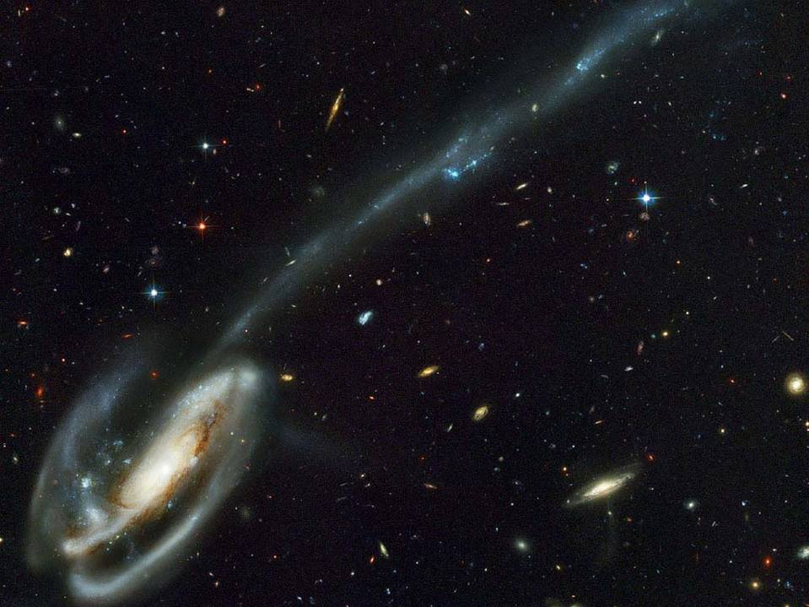
PROPHESY REVEALS THE GREAT GOD BEHIND IT! 預言顯明它背後偉大的上帝
It must be written by someone from outside our “time-domain”
它必是我們時間範疇之外的人所寫
Someone not confined by time & space
不受時空所限
It could not have been written by mere men
不可能是人寫的
It must be written by a sovereign, all knowing, eternal Being!
它必是全能，全知，永恆者所寫

Slide 11
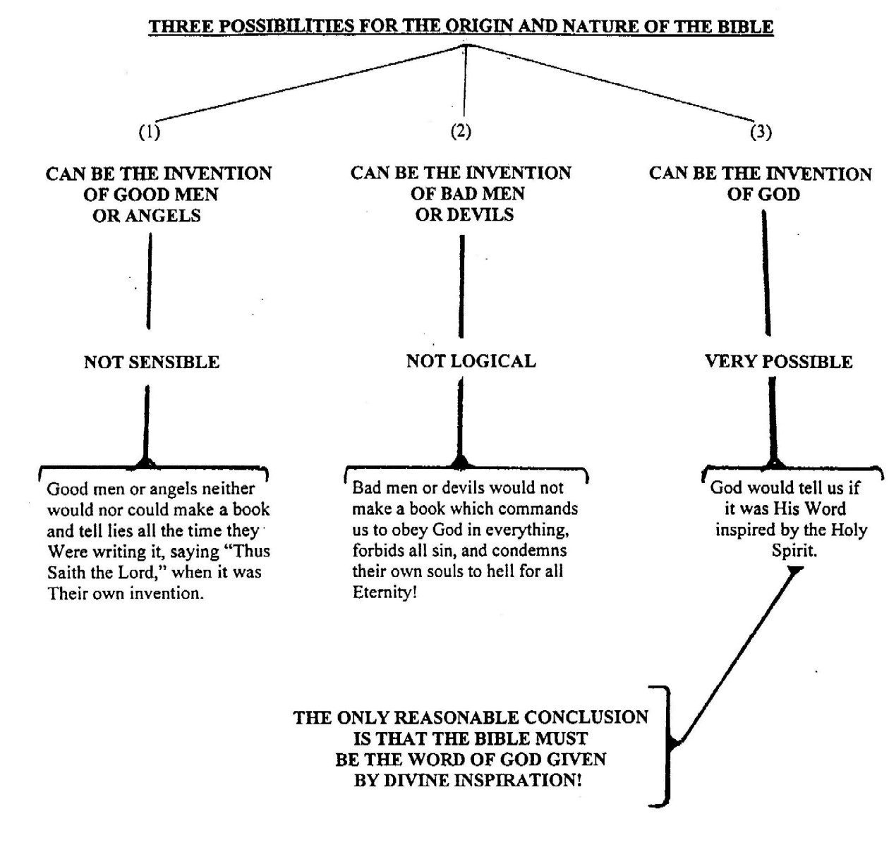
Good men can’t prophesy
Bad men can’t prophesy
Only a Sovereign God can Prophesy

Slide 12
Fulfilled Prophesy is the Single Greatest Test to determine if a Religion is True or not? 應驗了的預言是測驗信仰真偽最好的試金石
“Shew the things that are to come hereafter, that we may know that ye are gods:
要說明後來的事，好叫我們知道你們是神。
“Behold, ye are of nothing, & your work of nought: an abomination is he that chooseth you” (Isa. 41:23-24,26; 45:20-22; 46:9-10; John 13:19; 14:29)
看哪，你們屬乎虛無；你們的作為也屬乎虛空。那選擇你們的是可憎惡的。(賽41:23-24）
A religion with no prophesy is a revelation of man’s ignorance; prophesy is revelation of God’s omniscience!

Slide 13
Dead Sea Scrolls ( 150 – 200 B.C. ) 死海古卷 One of the Greatest Archaeological finds ever 最偉大的考古學發現之一
To prove prophesy you need a written record recorded long before the prophesies were fulfilled

Slide 14
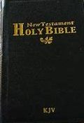
Shrine of the book inside 以色列聖經博物館
We have Infallible Proof of the Divine Inspiration of Bible Prophesy
Copy of Isaiah 2,200 yrs. old!
Then you need a written history that proves the Prophecies were fulfilled as previously written

Slide 15
The Background: Redemption, Salvation from Sin 背景：救贖，從罪得救
(Isa 52:3) the LORD says: “ye shall be redeemed without money”
賽52:3 -耶和華如此說：「你們是無價被賣的，也必無銀被贖。
(52:7) “How beautiful upon the mountains are the feet of him that bringeth good tidings…
賽52:7- 那報佳音的…這人的腳登山何等佳美！
that publisheth salvation…” (Rom. 10:15)
羅10:15- 報福音、傳喜信的人，他們的腳蹤何等佳美。
Illustration: 52:7-10 is word picture of bringing great news of a great victory after a dreadful battle (ex. 2 Sam. 18:24-28)

Slide 16
(52:9) “Break forth into joy… for the LORD hath… redeemed Jerusalem.”
賽52:9 -要發起歡聲…因為耶和華…救贖了耶路撒冷。
(52:10) The LORD hath made bare his holy arm… and all the ends of the earth shall see the salvation of our God.”
賽52:10 - 耶和華在萬國眼前露出聖臂；地極的人都看見我們神的救恩了。
All the earth “shall see” (i.e. experience) this salvation!
全地都“看見”（經歷）這個救恩！
Our anticipation & excitement are stirred by the messenger! But how has God “saved us?” 報信息的人激起我們的期待與熱誠！但上帝如何“拯救我們”呢？

Slide 17
II.) Behold, the LORD’s Servant 看哪 - 耶和華的僕人
(Isa 52:13) “Behold, my servant shall deal prudently, he shall be exalted and extolled, and be very high”
賽52:13 – 看哪，我的僕人行事必有智慧（或作：行事通達），必被高舉上升，且成為至高。
“Behold!” 看哪！– something unusual here to take note of
“My Servant” – the servant of Jehovah. Servants were poor, they owned nothing. Jesus became poor for us 我的僕人 –
耶和華的僕人- 貧窮，一無所有。耶穌為我們成為貧窮
(2 Cor. 8:9; Matt. 8:20; Lk. 9:58)

Slide 18
Behold Something Amazing: This servant Obtains the Greatest Glory 看奇妙的事：這位僕人獲得最高的榮耀
(Isa 52:13) “… he shall be exalted & extolled, & be very high”
賽52:13- “祂必被高舉上升，且成為至高。”
God reveals the Eternal glory (52:13) before he reveals the Great but temporary suffering (52:14) {I Pet. 1:11; Lk. 24:26-27)
“Jesus for the joy set before him endured the cross, despising the shame, & is set down at the right hand of God” (Heb. 12:2)
來12:2-他因那擺在前面的喜樂，就輕看羞辱，忍受了十字架的苦難，便坐在神寶座的右邊。

Slide 19
The Greatest Glory Fulfilled in Jesus Christ 最崇高的榮耀應驗在耶穌基督身上
(Phil. 2:9) “God hath highly exalted him, & given him a name which is above every name:
腓2:9-所以，神將他升為至高，又賜給他那超乎萬名之上的名，
2:10 That at the name of Jesus every knee should bow, of things in heaven, & things in earth, & things under the earth;
腓 2:10 叫一切在天上的、地上的，和地底下的，因耶穌的名無不屈膝，
2:11 & every tongue confess that Jesus Christ is Lord
腓 2:11 無不口稱「耶穌基督為主」。

Slide 20
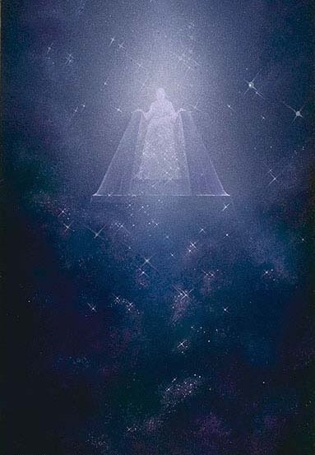
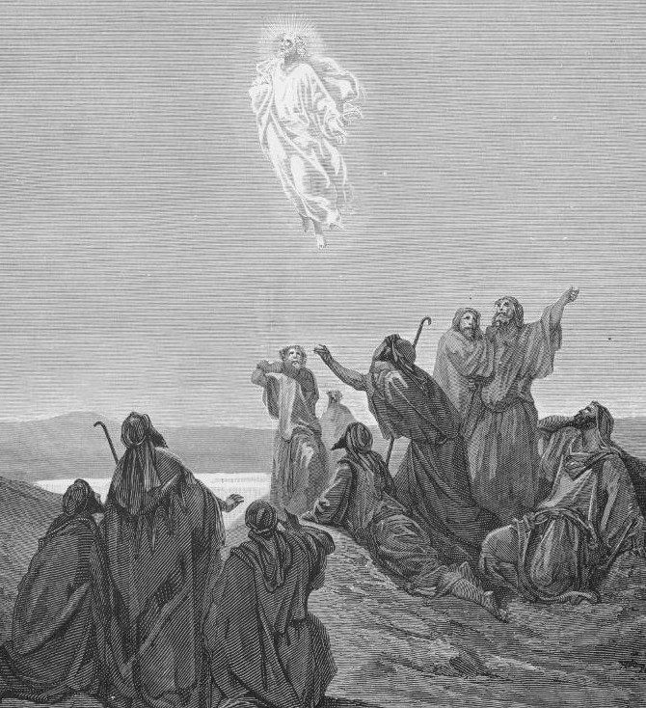
The Greatest Glory Prophesied 預言最崇高的榮耀
(Isa 52:13) “Behold, my servant shall deal prudently, he shall be exalted & extolled, & be very high”
賽52:13-看哪，我的僕人行事必有智慧
（或作：行事通達），必被高舉上升，且成
為至高。

Slide 21
The Greatest Glory Fulfilled in Jesus Christ 最崇高的榮耀應驗在耶穌基督身上
(Eph. 1:20-21) God “raised Christ from the dead, & set him at his own right hand in the heavenly places, Far above all principality, & power, & might, & dominion, & every name that is named,
弗1:20-21 -就是照他在基督身上所運行的大能大力，使他從死裡復活，叫他在天上坐在自己的右邊，遠超過一切執政的、掌權的、有能的、主治的，和一切有名的；
not only in this world, but also in that which is to come”
不但是今世的，連來世的也都超過了。

Slide 22
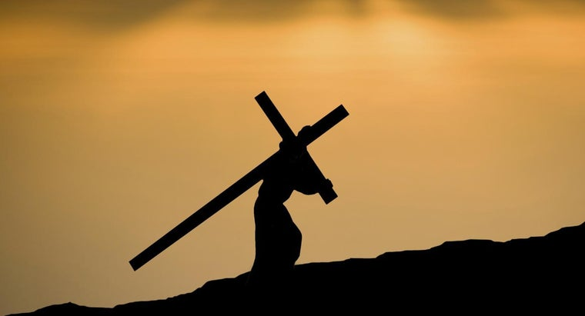
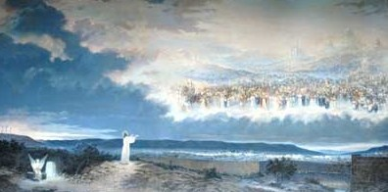
We Learn there is Great Purpose in all our suffering 我們學習到 –在一切苦難中有偉大的目的
We share in His glory if we share in His suffering (2 Cor. 4:16-18; I Pet. 4:12-14; Rom. 6:5; Eph. 2:6; Col. 3:1-3; Rev. 3:21; John 14:3)
分擔祂的苦難，共享祂的榮耀。
“…the sufferings of this present time are not worthy to be compared with the glory which shall be revealed in us” (Rom. 8:18)
現在的苦楚若比起將來要顯於我們的榮耀就不足介意了(羅8:18）

Slide 23
III.) Be “Astonied” at the Great Horror of Our Sin 因我們罪的可怕而大大吃驚
(Isa 52:14) “many were astonied at thee; his visage was so marred more than any man, & his form more than the sons of men”
賽52:14 -許多人因他﹝原文作你﹞驚奇；他的面貌比別人憔悴；他的形容比世人枯槁。
“astonied” means made like a stone; petrified
He looked like a bloody worm hanging on a stick (Ps. 22:6)
祂看似流滿血的蟲，掛在木頭上（詩22:6）。
Has the Holy Spirit ever allowed you to see an accurate picture of what Jesus suffered to save you? (John 16:13-15; Heb. 9:14)

Slide 24
Why was His suffering so great? (Ps. 22; Zech. 13:6; Matt. 27:29-30) 為何祂受此大苦？
Jesus “tasted death for every man” (Heb. 2:9; 2 Cor. 5:15) (Isaiah 53:9 “in his death” is plural in Hebrew “in his deaths!)
耶穌“為人人嚐了死味”（來2:9；林後5:15）
Jesus “is the propitiation for the sins of the whole world” (I John 2:2). He bore the Just punishment due all sin (John 1:29)
耶穌“為我們的罪作了挽回祭，不是單為我們的罪，也是為普天下人的罪。 祂擔負所有罪的懲罰（約1:29）。
That means you & me are included! Hallelujah!

Slide 25
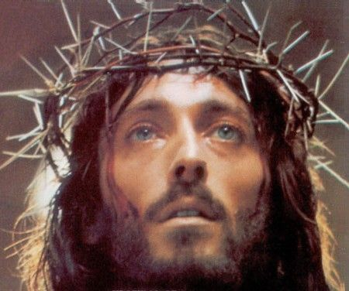
A Clear Vision of Sin in The Cross will cause us to flee sin (2 Tim. 2:22; I Cor. 6:18; 10:14).
God has given us a picture of Sin that empowers Victory!
What is your picture of sin? We must understand what we are saved from!
Forget all those beautiful pictures of Christ

Slide 26
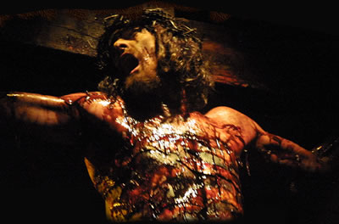
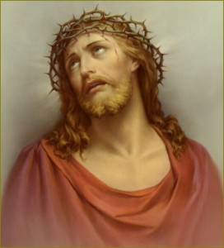
The Terrifying Picture of what Sin does: Christ Crucified (Isa. 52:14; Ps. 22:6) 罪的後果：基督被釘十架（賽52:14；詩22:6）
Forget the idolatrous pictures of man’s imagination.

Slide 27
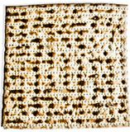
The Terrifying Picture of what Sin does: Christ Crucified (Isa. 52:14; Ps. 22:6) 罪的慘痛後果：基督被釘十架 )
The only Picture of Jesus God has given us is the unleavened Bread of the LORD’s Supper (Matt. 26:26; Mk. 14:22; Lk. 22:19; I Cor. 11:24)
無酵餅象征傷痕累累的耶穌的身體
This is a picture of what sin will do to me in Hell if I reject Christ

Slide 28
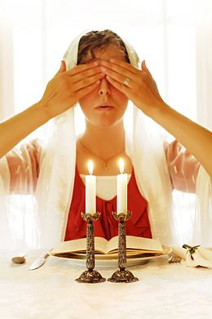
When a Jewish Mother Prays before Passover….
She covers her eyes & is temporarily blinded from “the light”
Just as most Jews are now blinded to Jesus as the Light of the world; the Bread of Life; & the Lamb of God!

Slide 29
The Servant of the LORD is God’s Great High Priest 耶和華的僕人是上帝的大祭司
(Isa 52:15) “So shall he sprinkle many nations”
賽52:15-他必洗淨許多國民;
The Sprinkling is Christ’s ministry as our Great High Priest (I Peter 1:2)
洗淨是大祭司耶穌基督的服事（彼前1:2）。

Slide 30
The Servant of the LORD is the King of Kings 耶和華的僕人是萬王之王
(Isa 52:15) “… the kings shall shut their mouths at him”
賽52:15 -君王要向他閉口。
At Christ’s 1st Coming people were astonished by the depths of His suffering. At Christ’s 2nd Coming even Kings will be astonished at the magnificence of His Glory!
Mission history has many examples of whole Nations turning to Christ when their King became a believer!

Slide 31
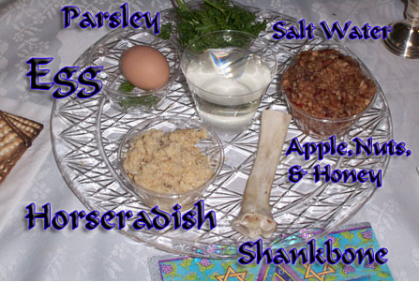
IV.) Behold Israel Blinded to the Glory of Christ 以色列看不見基督的榮耀
(Isa 53:1) Who hath believed our report? and to whom is the arm (zeroa) of the LORD revealed?
賽53:1 -我們所傳的有誰信呢？耶和華的膀臂向誰顯露呢？
The arm of the LORD is the servant of the LORD. He is God Himself working salvation in the world
The Zeroa of the Lamb!

Slide 32
IV.) Behold Our own Blindness to the Glory of Christ 我們自己看不見基督的榮耀
Isa 53:2 “he shall grow up before him as a tender plant, & as a root out of a dry ground: he hath no form nor comeliness; when we shall see him, there is no beauty that we should desire him.
賽53:2 -他在耶和華面前生長如嫩芽，像根出於乾地。他無佳形美容；我們看見他的時候，也無美貌使我們羨慕他。
Isa 53:3 He is despised & rejected of men; a man of sorrows, & acquainted with grief: & we hid as it were our faces from him; he was despised, & we esteemed him not.
賽53:3 -他被藐視，被人厭棄；多受痛苦，常經憂患。他被藐視，好像被人掩面不看的一樣；我們也不尊重他。

Slide 33
The emphasis on “we” in verses 2-3 forces us to admit we used to be blind to the truth of Jesus
The Devil blinds us to the Truth (2Cor. 3:14; 4:4; Eph. 2:2)
Illustration: I would like you to close your eyes now and listen to this description of our King Jesus (2 Cor. 4:6)

Slide 34
V.) Behold the greatest passage on the doctrine of salvation by substitution in the Bible (53:4-6) 看哪 - 聖經中最偉大關於「救恩是藉由代替」的教義的經文
No one can save himself. The Great purpose of the Cross was to save us from our sins & thus eternal Hell
無人可自救。
8 times it says Christ bore our sins: (a perfect salvation)
基督背負我們的罪說了八次（一個完滿的救恩）。
Jesus suffered the judgment you and I deserved!
耶穌承擔你我該受的審判！
Illustration: The African response to the preaching of the Cross

Slide 35
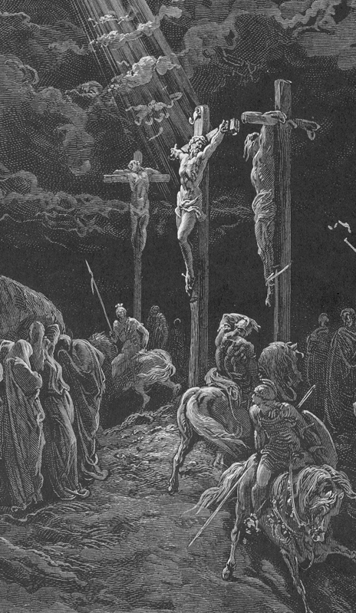
8 Times God says Christ bore our sins (Isaiah 53:4-6, 8) 基督背負我們的罪說了八次
(53:4) Surely he hath borne…
(53:5) But he was wounded…
he was bruised…
…our griefs, & carried our sorrows
…For our transgressions,
…for our iniquities:

Slide 36
(53:5)
…was upon him;
and with his stripes…
(53:6) and the LORD hath laid on him…
(53:8)
… was he stricken.
(11) He shall bear
The chastisement of our peace
… we are healed.
… the iniquity of us all.
…for the transgression of my people…
…their iniquities

Slide 37
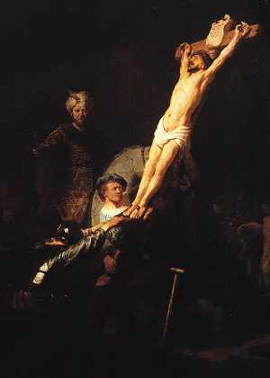
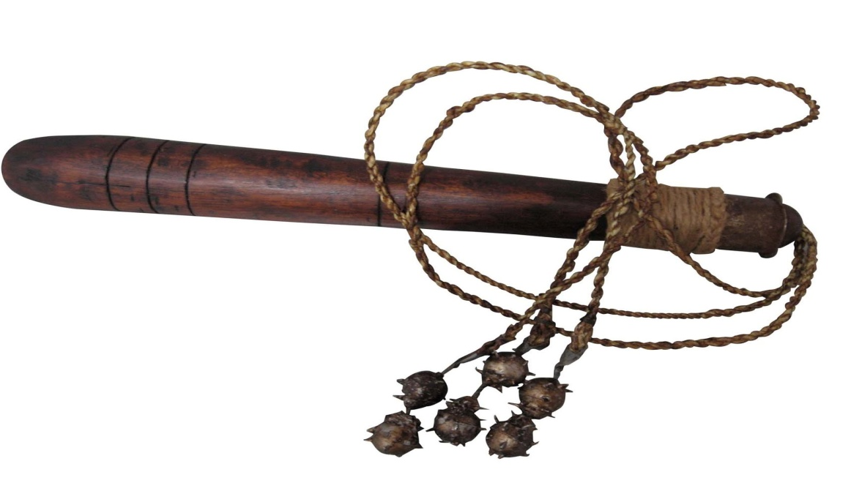
Illustrations: Me & You are Responsible for the Death of Jesus!
Rembrandt understood this saving truth & painted himself into his painting of the Cross
Illus: The Dreamer

Slide 38
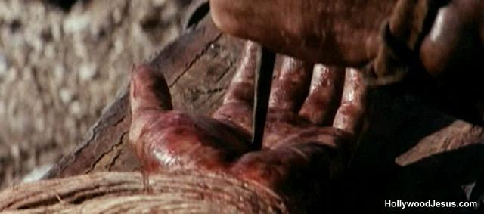
In the movie “The Passion” Mel Gibson himself nailed Jesus to the Cross

Slide 39
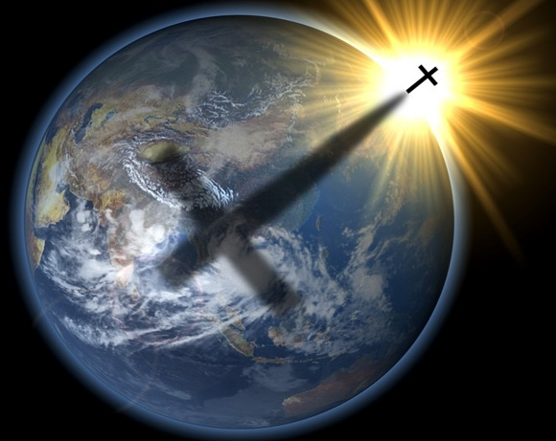
How is it the Blood of Jesus has the Power to Cleanse all of us of all our sin? (Isa. 53:11: Heb. 9:12-14; 10:12-14) 耶穌的血如何具有洗淨我們一切罪的能力？
Because of who He is! Jesus is God Almighty, Creator of Heaven & Earth (John 1:1-3, Col. 1:14-17)
因為祂是誰！
(Gen 18:14) Is any thing too hard for the LORD? (Jer. 32:17; Matt. 19:26)
耶和華豈有難成的事？

Slide 40
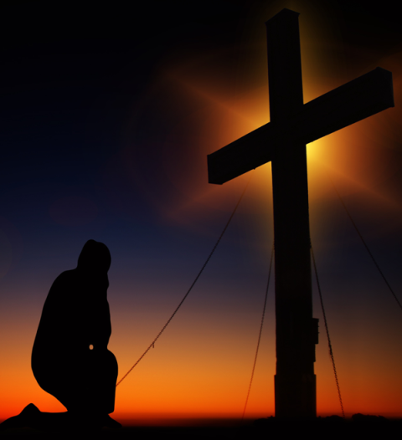
How is it the Blood of Jesus has the Power to Cleanse all of us of all our sin? (Isa. 53:11: Heb. 9:12-14; 10:12-14) 耶穌的血如何具有洗淨我們一切罪的能力？
Because Jesus is omniscient (John 21:7; Matt. 9:4) & knows every sin!
因為耶穌無所不知！
Because Jesus is omnipotent (I Cor. 1:24) & can bear all sin!
因為耶穌無所不能!

Slide 41
Why Can God in Christ Forgive & Cleanse all our Sin? 為何上帝在基督裡可以赦免並洗淨我們所有的罪？
Because ultimately “all” sin is against God!
因為至終所有的罪都是沖著上帝來的！
(Ps. 51:4) “Against thee, thee only, have I sinned, and done this evil in thy sight: that thou mightest be justified when thou speakest, and be clear when thou judgest” (Gen. 20:6; 39:9)
詩51：4- 我向你犯罪，惟獨得罪了你；在你眼前行了這惡，以致你責備我的時候顯為公義，判斷我的時候顯為清正。

Slide 42
My Sins must lie somewhere! Either on me or on Christ! 我的罪放在哪裡？在我身上還是基督身上？
Illustration: R. A. Torrey
Testimony of Ed E. in Taiwan.

Slide 43
Experiencing forgiveness of sins through faith in the power of the blood of Christ is a life changing experience!

Slide 44
Important Lessons 重要功課
God has given every reasonable person irrefutable proof the Bible is His Word.
上帝已經給人無法駁斥的證據，證實聖經是祂的話語；
Jesus Christ (Yeshua) fulfilled every detail of Isaiah 52 & 53
耶穌基督應驗以賽亞書52,53章每一細節；
Will you trust in Him to save you from your sins & give you a glorious eternal life?
你願意信靠祂，拯救你脫離罪，並賜永生給你嗎？
You have a very important decision to make!
你需要做這重要的決定！

