Slide 1
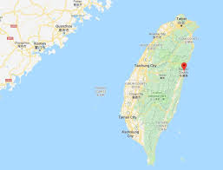
2019 Taiwan STM
July 20-August 2, 2019
Participants: Meian Chen,
Annie Petzholt, Hong Yao

Slide 2
Pre-Mission Training 宣教前期 培训

Slide 3
Pre-Mission Training - Preparing Ourselves
Pastoral Encouragements:
Pastor Frederic Chen
陳腓利牧師
1. Confess your
hidden sins
2. Present yourself as
a living sacrifice
3. Be filled with the
Holy Spirit

Slide 4
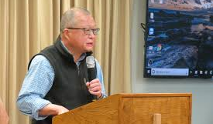
Pre-Mission Training - Preparing for the Work
Pastor Joseph Cheng
鄭秀全牧師
– Spiritual Warfare
(Eph. 6:10-18)
1. Two opposing
kingdoms – God/Satan
2. The weapons and the
battleground
3. The basis of our victory
4. The full armor of God
5. Weapons of Attack

Slide 5
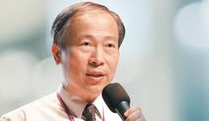
Pre-mission Training - Serving from God’s Perspective
Pastor David Yang 楊寧亞牧師
- Love and teach with God’s unconditional love
His personal resolution:
Ask God to fill him with the Holy Spirit every morning
Love and serve someone everyday

Slide 6
Practice Teaching in the afternoon

Slide 7
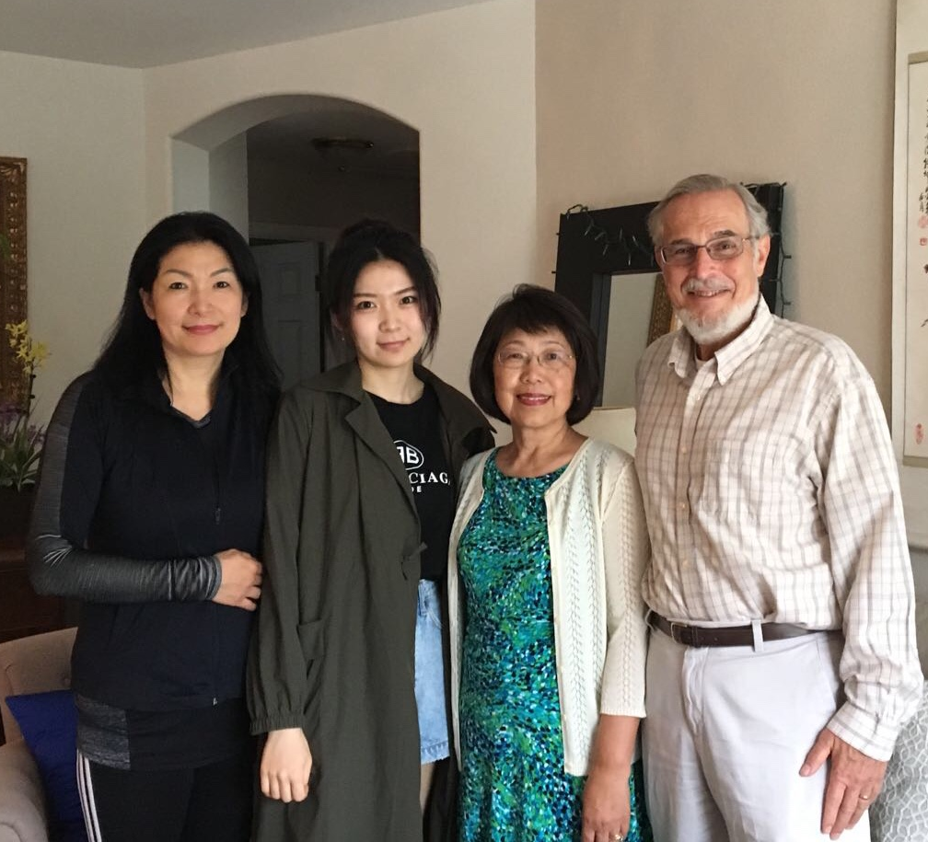
出发 Departure – Pray Together

Slide 8
Leaving for Ontario, CA

Slide 9
Gathering at Ontario Airport
And pray

Slide 10
Arriving at Taoyuan International Airport

Slide 11
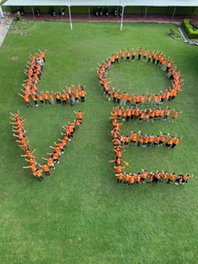
到职培训 Co-Workers Assembly – First Week

Slide 13
Co-Worker Assembly - Second Week

Slide 14
Leaders – Spiritual, Administrative, Teaching, School, Camp Supervisors

Slide 15
Mission Leaders

Slide 16
看重祈祷 Emphasis on Prayer
《Camp 1》 1. Thank God, today as the teachers taught about Easter and shared testimonies and made altar call, the students listened attentively, accepted Jesus as Savior, took the Bible to read, and some even cried. May God watch over these tender seeds that they can sprout and grow. 2. We had so many sharing of thankful stories tonight. May God renew the strength of our missionaries, help them grow toward maturity, that they become holy and noble vessels fit for the Lord’s use. 3. Please pray for the “showcase” tomorrow. May joy and gratefulness abound.
《第一營地》 1.感謝上帝，今天各校各班教導復活節、分享見證和呼召時，學生們都好專心，願意接受耶穌為救主，也拿了聖經又好認真讀，甚至許多人流眼淚。求上帝保守這些稚嫩的種籽，在主裡漸漸發芽長大。

Slide 18
Surprise - Seeing Old Friends

Slide 19
每日事工 – Begin with Morning Group Devotions

Slide 20
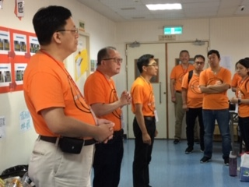
上阵 - Spiritual Leaders guide us every day

Slide 21
Put on the armor of God every morning 每早穿戴全副属灵军装

Slide 22
Put on the full armor every day before we head out

Slide 23
Singing as We Go 在得胜诗歌中出发
Glory Glory Hallelujah
Glory Glory Hallelujah
Glory Glory Hallelujah
His truth is marching on

Slide 24
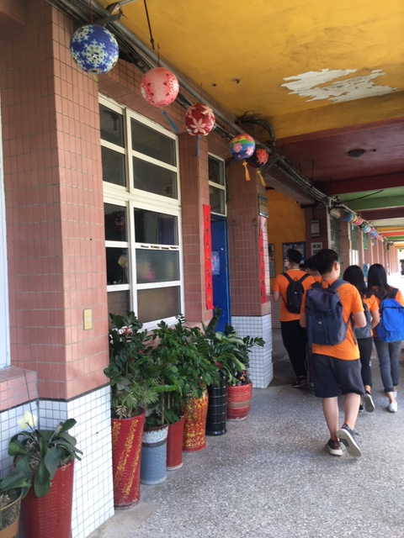
Taiwan 文化
Still very traditional
Preserving the Chinese culture
Religion – Folk religion
Buddhism
Daoism

Slide 25
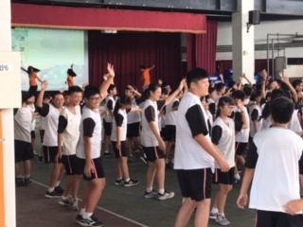
Daily Ministry – Opening Assembly

Slide 27
课程 Curriculum

Slide 28
Student Curriculum 学生课本

Slide 29
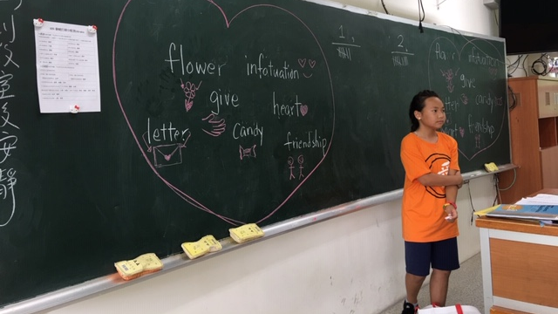
Classroom Teaching
- American Holidays
Valentine

Slide 31
Making Valentine Craft

Slide 32
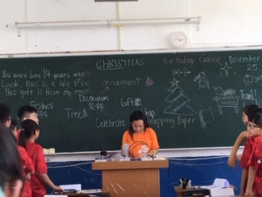
Classroom Teaching - American Holidays

Slide 33
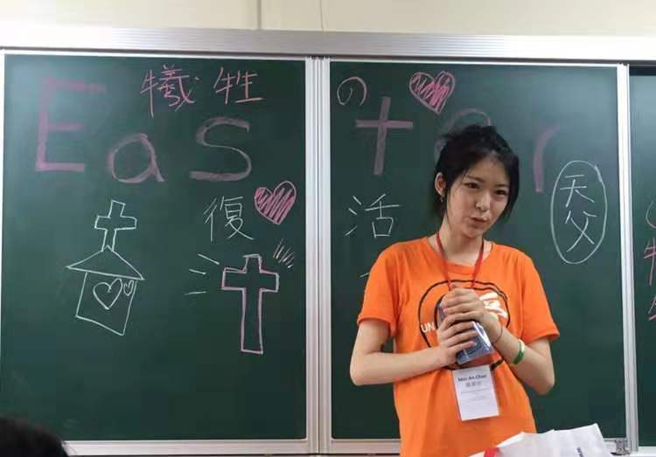
Teaching Easter and sharing personal testimony

Slide 34
Explain the Gospel Bracelet and Make Altar Call 解释福音手环并呼召

Slide 35
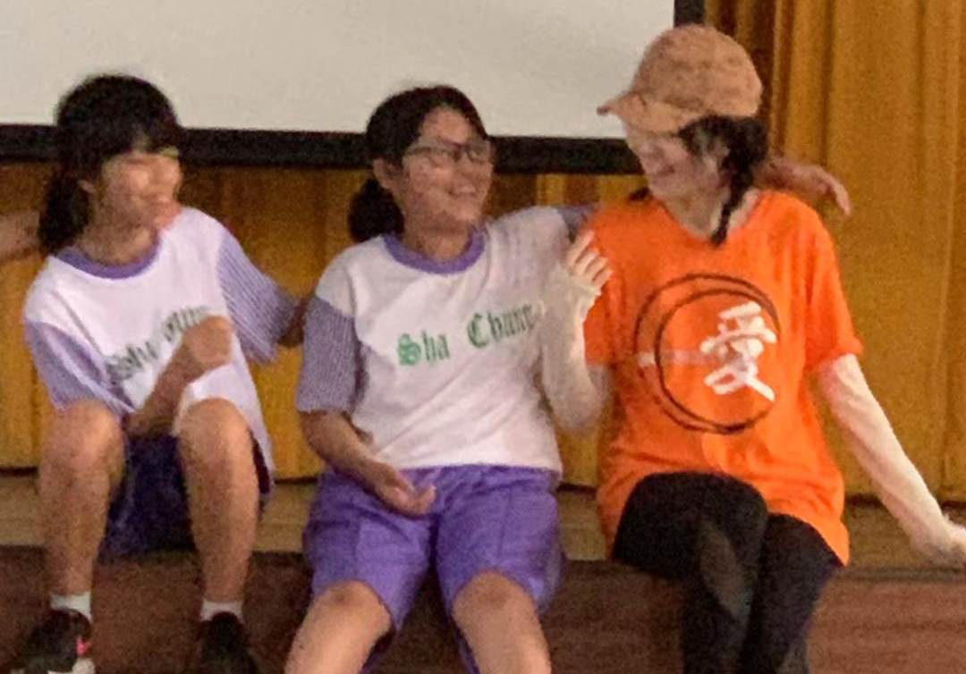
Spending Time with the Students

Slide 37
A Special Young Man - 精彩故事（一）

Slide 38
Mazu’s children – wearing temple clothing

Slide 39
A Happy Bunch – Co-worker/Artist 精彩故事 （二）

Slide 40
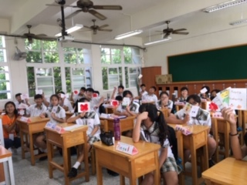
Craft Making and Showcase Preparation

Slide 41
Showcase Practice

Slide 42
Practicing for the Showcase

Slide 43
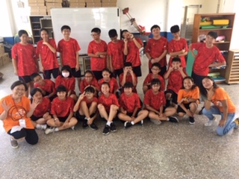
Two Classes

Slide 44
Lunch Time

Slide 45
A brief Lunchtime Break

Slide 46
Dinner back at the camp

Slide 47
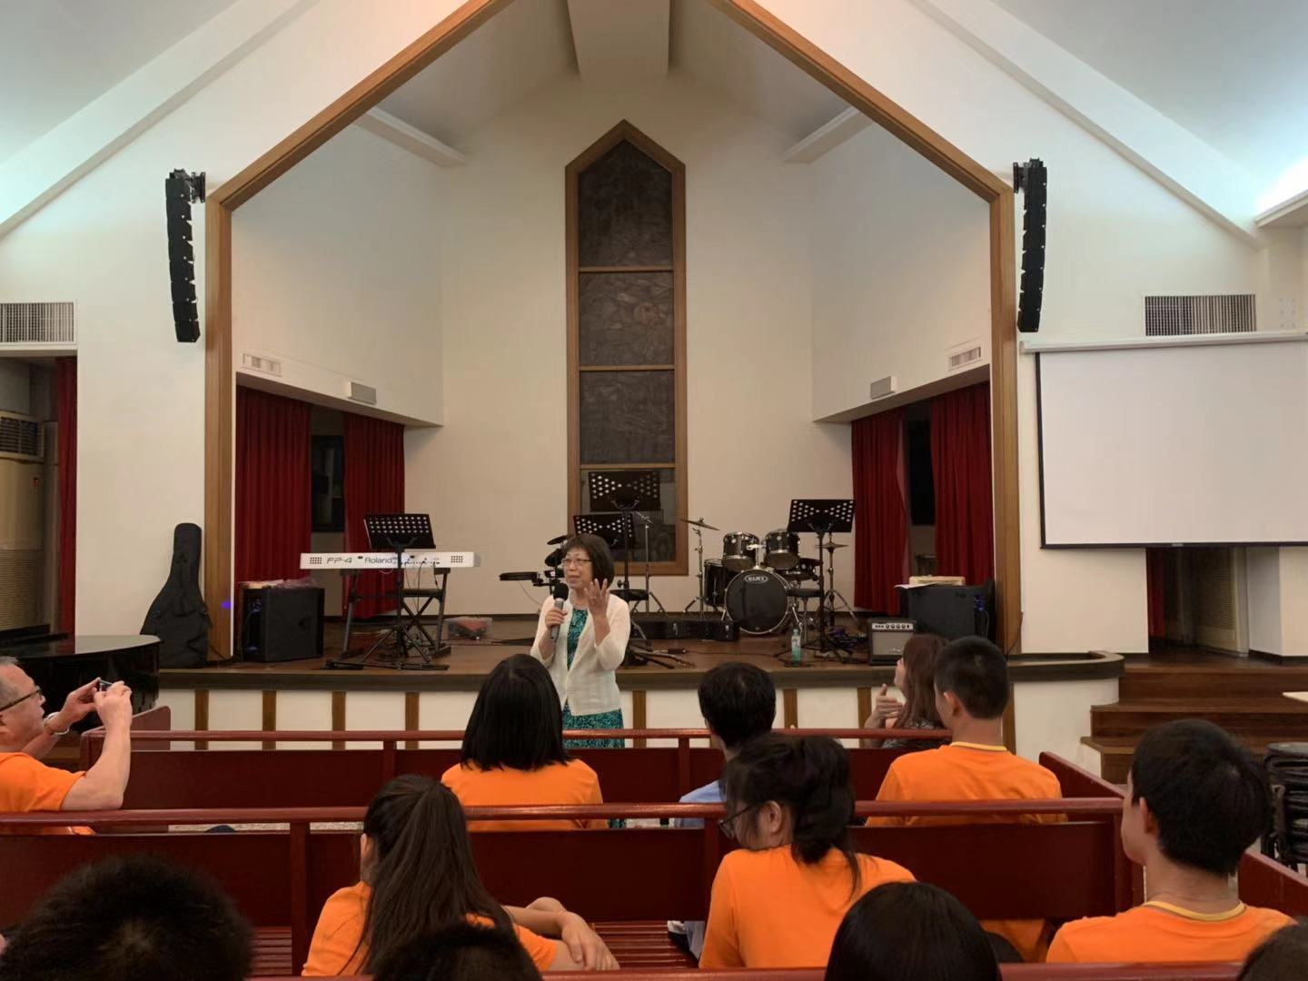
Night Briefing 晚间简报

Slide 48
Teachers Practice for the Showcase

Slide 49
Teachers Practice for the Showcase

Slide 50
Showcase Day 成果表演

Slide 51
道别 Last Day - Personal Card for the Student

Slide 52
Students write thank-you cards

Slide 53
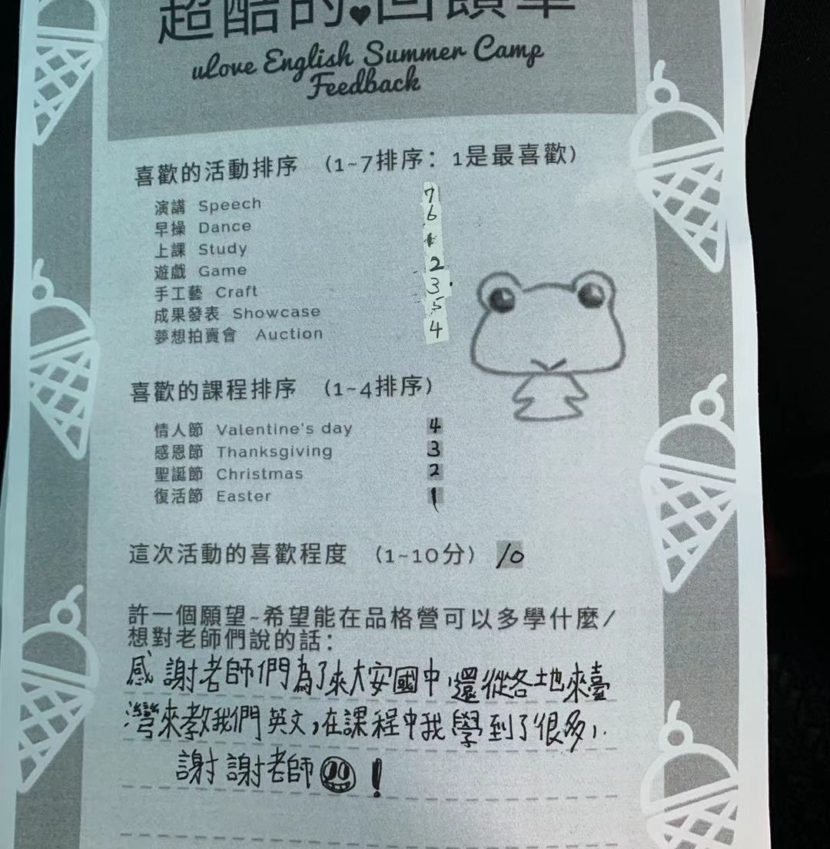
Student Feedback

Slide 54
Souvenir

Slide 56
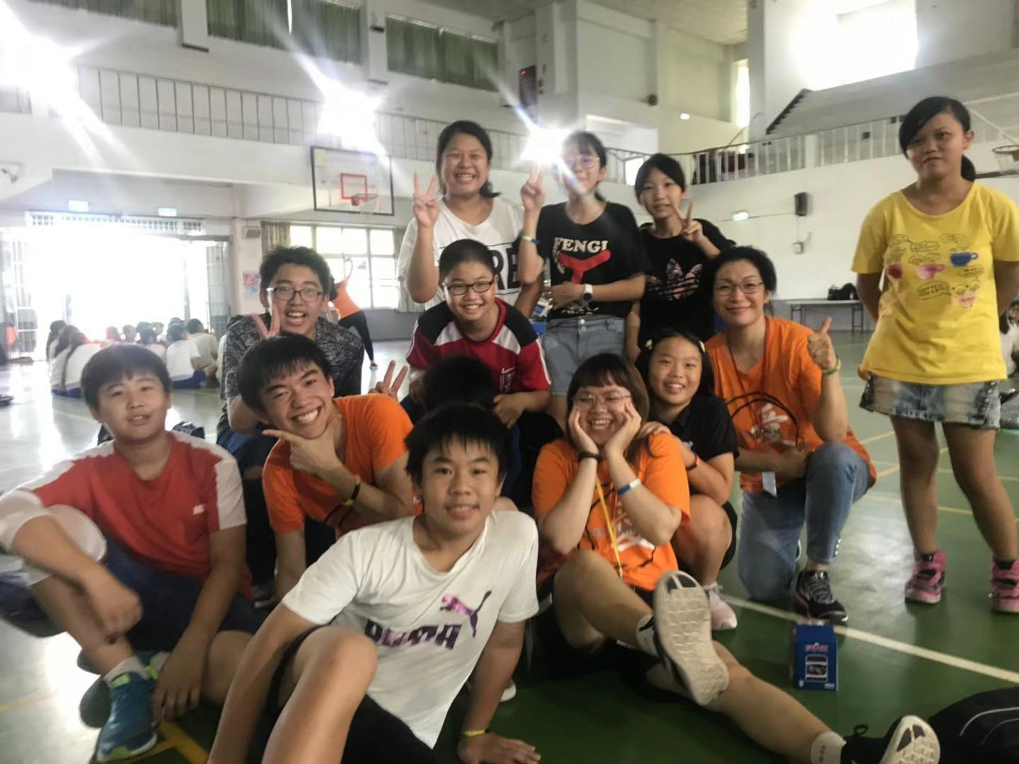
Last Day after Showcase

Slide 58
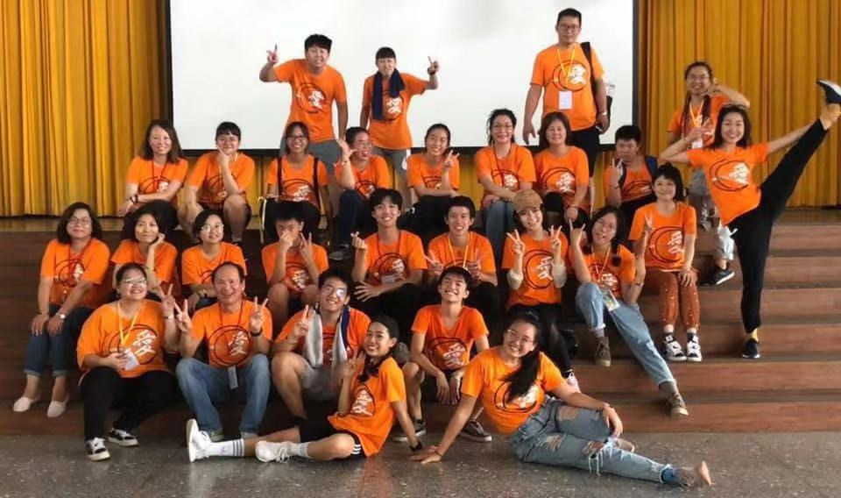
Co-Workers

Slide 59
Mission Extension 宣教延伸

Slide 60
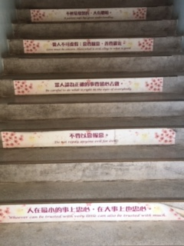
Scriptures on the stairs in schools 圣经经文贴纸

Slide 61
Children watching Christian videos at gospel centers 社区关怀中心

Slide 62
Giving awards to underprivileged students at community gospel centers 颁发贫寒儿童上进奖金

Slide 63
Visit Blessing Church 造访福氣教會 与地方教会 连结

