Slide 1
復活﹐確有其事嗎﹖
Resurrection, Is It Possible? 1 Cor 15:1-6

Slide 2
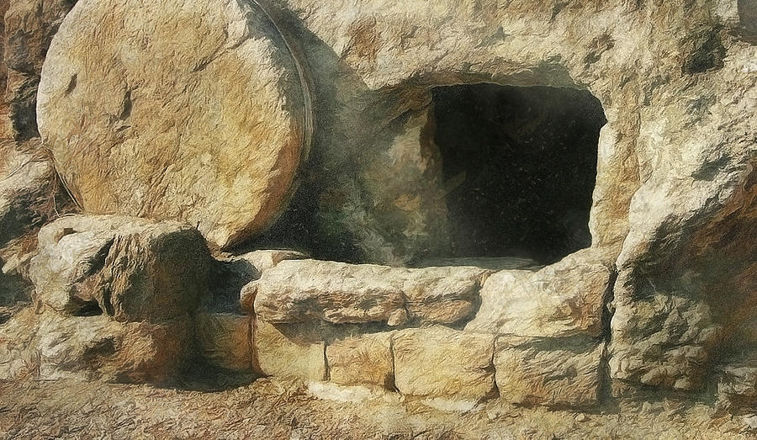
證據之一﹕空墳墓見證 Evidence #1: The Empty Tomb
A 被盜說:屍體被人偷走﹐羅馬人﹑猶太人﹑其他人。Someone such as Romans, Jews, or others stole the body.

Slide 3
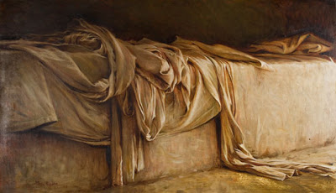
證據之一:空墳墓見證 Evidence #1: The Empty Tomb
B 欺騙說:屍體被門徒偷走﹐然後製造復活的神話。Disciples stole the body, and told a fake story.

Slide 4
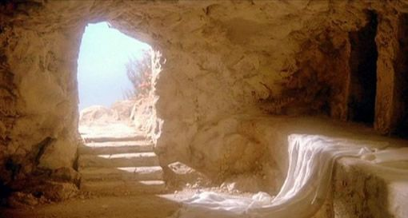
證據之一:空墳墓見證 Evidence #1: The Empty Tomb
C 昏厥說:耶穌只是昏厥﹐而後在墳墓中甦醒過來﹐逃走了。
Jesus passed out, then woke up in the tomb, and ran away.

Slide 5
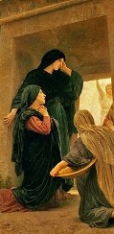
證據之二:婦女的見證 Evidence #2: The Witness of Women
D 幻覺說:認為這些婦女所見﹐乃是幻影或者鬼魂﹐並非復活的耶穌。
The women were hallucinated, and they saw visions or ghosts, not a real person of Jesus.

Slide 6
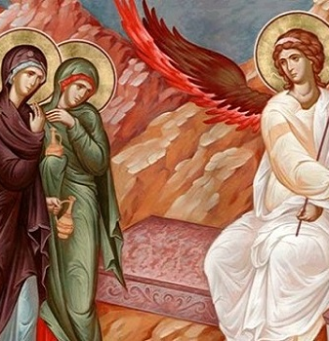
證據之三:天使的見證 Evidence #3: The Witness of Angels
天使親自顯現向婦女解釋耶穌的復活﹐這是無法簡單用幻覺來抹殺的。
Angels explained the resurrection of Jesus to the women.

Slide 7
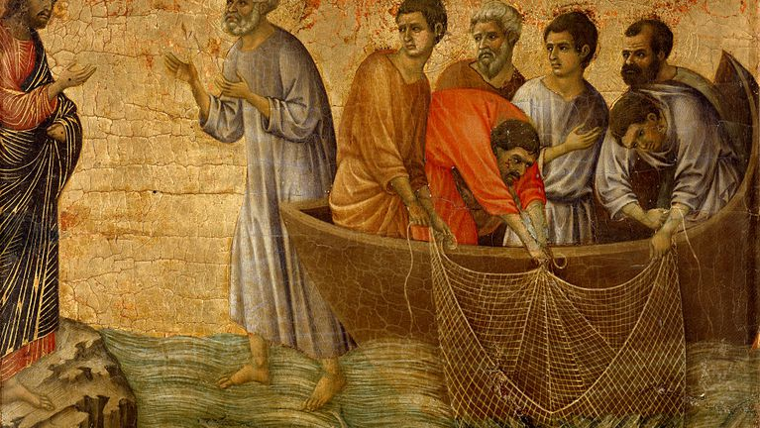
證據之四:門徒的見證 Evidence #4: The Witness of Disciples
耶穌多次向門徒顯現。Jesus showed himself to disciples.

Slide 8
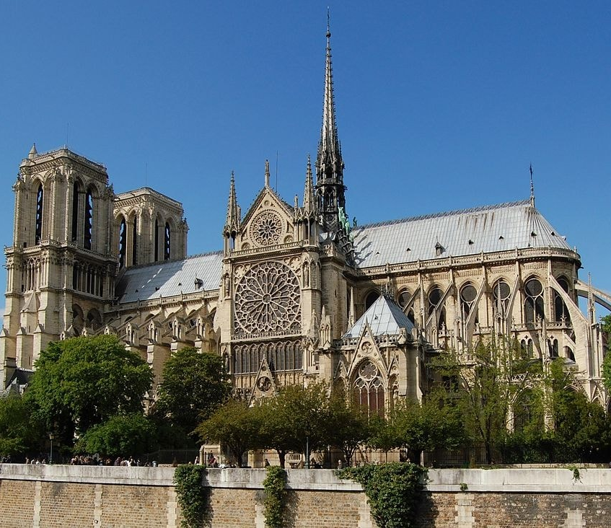
證據之五:教會的見證 Evidence #5: The Witness of Church
教會得以建立﹐並在初期迅速發展﹐正是門徒見證耶穌復活的結果。The founding of Church is the direct result of Jesus’ resurrection.

Slide 9
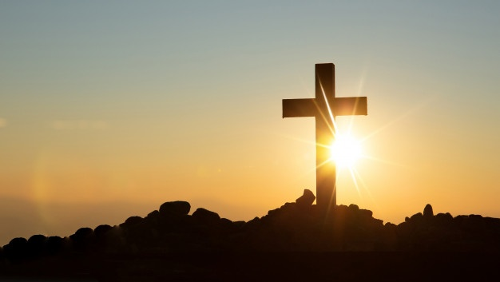
證據之六:歷史的見證 Evidence #6: The Witness of History
E 迷信說: 接受死人復活是出於人的需要﹐是一種迷信。 It is out of self comfort that people accept resurrection.

Slide 10
證據之七:反駁的見證 Evidence #7: The Witness of Unsuccessful Rebuke
兩千年來攻擊基督教的人始終無法推翻﹐耶穌復活這個事實。People who attacked Christianity can not overthrow the claim of Jesus’s resurrection over two thousand years.

Slide 11
耶穌說﹐我就是道路﹑真理和生命。 Jesus Says, “I am the way, the truth and the life.”

