Slide 1
Genesis 1:24-25 Day 6 Cattle, Creeping things, Beasts 創世記 1:24-25 第六天 畜類、昆蟲、野獸
(Gen 1:24) “& God said, Let the earth bring forth the living creature after his kind, cattle, & creeping thing, & beast of the earth after his kind: & it was so.
1:24 神說：「地要生出活物來，各從其類；牲畜、昆蟲、野獸，各從其類。」事就這樣成了。
(Gen 1:25) “& God made the beast of the earth after his kind, & cattle after their kind, & every thing that creepeth upon the earth after his kind: & God saw that it was good.
1:25 於是神造出野獸，各從其類；牲畜，各從其類；地上一切昆蟲，各從其類。神看著是好的。

Slide 2
(Ps. 104:24) “O LORD, how manifold are thy works! in wisdom hast thou made them all…. (Isa. 40:5; Ps. 19:1-3; Hab. 2:14)
詩104:24 耶和華啊，你所造的何其多！都是你用智慧造成的；遍地滿了你的豐富。
(Job 12:7-8) “Ask now the beasts, & they shall teach thee; & the fowls of the air, & they shall tell thee: (8) Or speak to the earth, & it shall teach thee: & the fishes of the sea shall declare unto thee.” (compare I Cor. 15:39-42) [they all speak of a Creator!]
伯12:7-8 你且問走獸，走獸必指教你；又問空中的飛鳥，飛鳥必告訴你； 或與地說話，地必指教你；海中的魚也必向你說明。
God designed all creation to teach us eternal wisdom. (Isa. 6:3)
上帝設計萬物來教導我們永恆的智慧（賽6:3）。

Slide 3
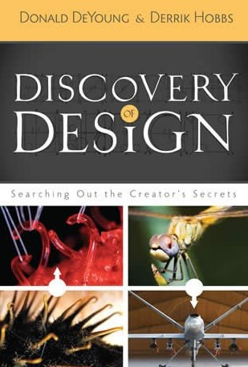
‘Biomimicry’ is 1 way animals speak to us: many of man’s inventions 1st appeared in, or learned from nature 仿生學是動物對我們說話的一種方式：許多人類的發明首先是在自然界出現，或從自然界學來的
Donald DeYoung & Derrik Hobbs, Discovery of Design, 2009. [They discuss 79 Designs in nature leading to human inventions!]
Ross E. Hutchins, Nature Invented It First, 1980.
Such facts are empirical evidence of Intelligent Design in Creation
這些事實是自然界具有智能設計的實證證據。

Slide 4
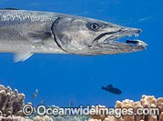
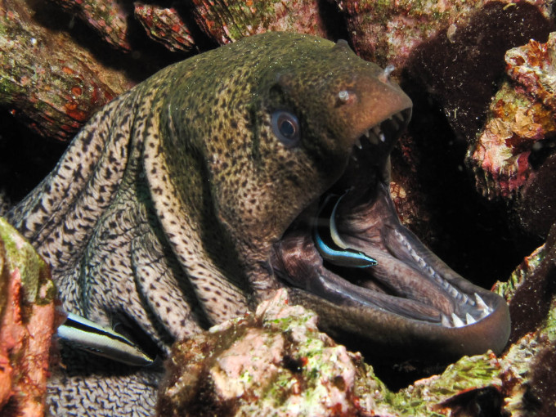
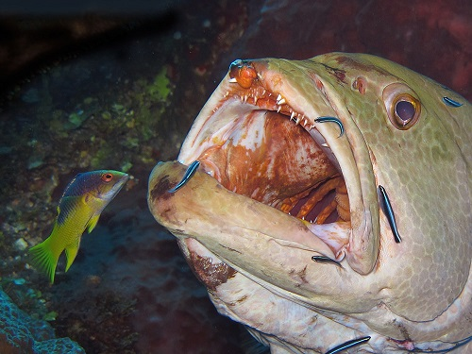
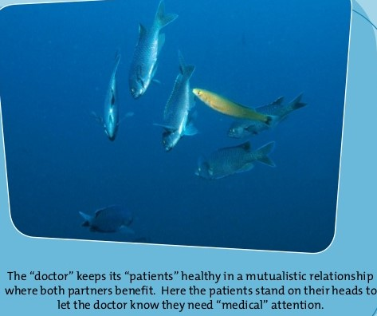
Nature speaks to us through ‘Irreducible complexity.’ Things are too complex to have evolved by mindless chance 自然界經由“不可簡化的複雜性”對我們說話。 自然界的事物太複雜，不可能經由無心智的偶然進化而來
Garrett Hardin, 39 Steps To Biology, Part II, Nature’s Challenges to Evolutionary Theory, Chapters 13-17, pgs. 104-149. Articles of various dates from 1952 to 1965.
Werner Gitt, Creation Speaks for Itself: If Animals Could Talk, 2006
Cleaning symbiosis

Slide 5
Nature speaks to us through incredible ‘instincts’ (Divine Wisdom Programmed Before Birth – (Prov. 30:24)) 自然界藉著奇妙的“本能”對我們說話 （出生之前就設計好的神聖智慧- 箴30:24）
“INSTINCT” is a word evolutionists use to avoid having to admit something is the result of intelligent design!
‘本能’是進化論者使用的詞彙以避免承認某事是智能設計的結果！
The migrations of Countless species of Birds, fish, & mammals
數不清的鳥類、魚類、哺乳動物的遷徙。
Millions of blind termites work together & build air-conditioned homes 上百萬的盲目白蟻同工來建築空調房屋。

Slide 6
‘Instincts’ are Impossible to Explain as the result of blind, undirected natural causes ‘本能’無法靠著盲目、不經引導的自然原因來解釋
Pronuba moth & yucca plant miraculous relationship
飛蛾與絲蘭植物奇跡式的關係
Mimosa girdler beetle relationship with the mimosa tree
含羞草環繞的甲蟲與含羞草的關係
How does a baby kangaroo, born blind find it’s mother’s pouch?
生下來眼盲的袋鼠如何找到母親的袋子？
Bee & Ant societies; etc. etc. etc. (Prov. 6:6-8; 30:25)
蜜蜂與螞蟻社團…等等（箴6:6-8,30:25）。

Slide 7
This study continues our Pursuit of God’s Eternal Wisdom hidden in the things He has Created
本篇信息繼續探討隱藏在造物中
上帝永恆的智慧

Slide 8
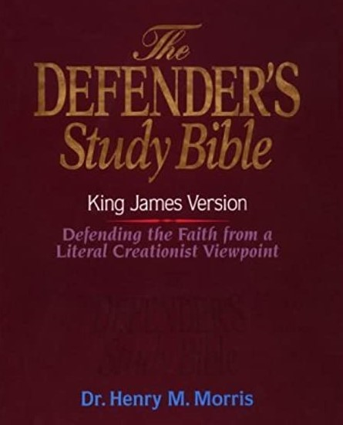
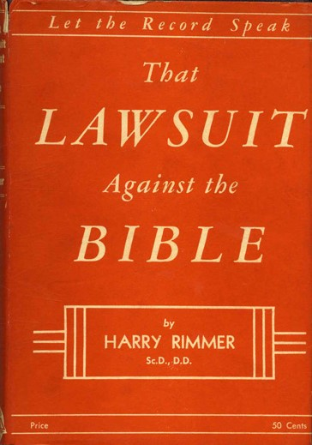
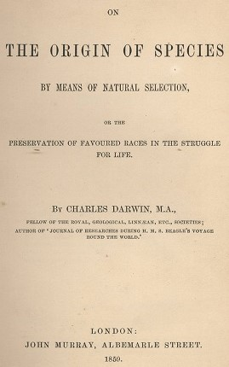
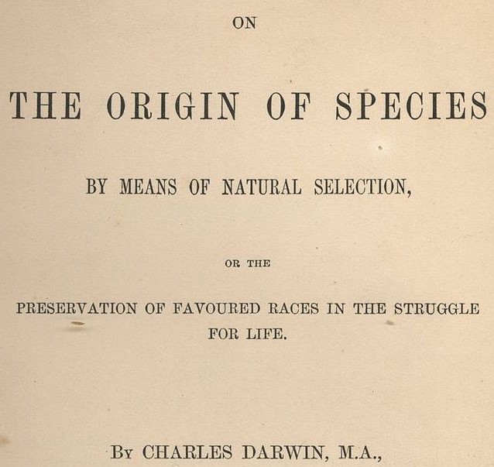
Our Previous Studies revealed 前幾次信息顯示:
Man’s theories of the origin of the universe & origin of life are all Disproven by Hard Empirical science! God’s Word has no proven scientific errors
人對生命起源的理論都被硬實證科學否認！
上帝的話語沒有被證實的科學錯誤

Slide 9
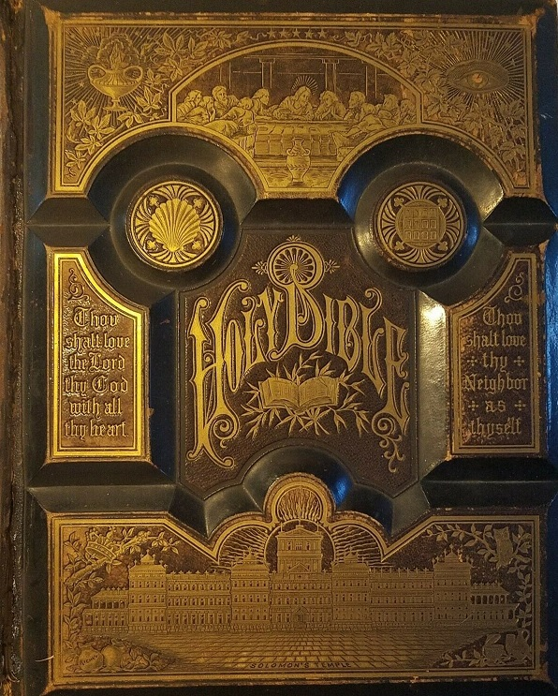
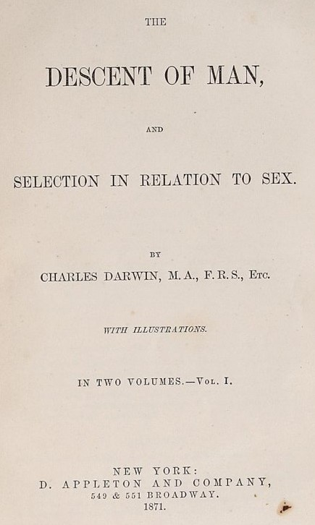
The Wisdom of God is easily distinguished from the wisdom of men when it comes to Sexual reproduction ‘after their kind’
上帝的智慧
很容易與人的智慧區分
當探究“各從其類”的繁殖

Slide 10
Absurdity of Absurdities! 荒謬至極！
“soft science” expects us to believe that over 1 million different species simultaneously ‘evolved’ their incredibly complicated sexual apparatus of both male & female by mere “time & chance” without any intervention of any intelligence!
“軟科學”期望我們相信上百萬不同的種類同時‘進化’它們複雜的性器官（包括雌雄體），只是藉著“時間與偶然”，不需任何智能的介入！
Do you realize how preposterous & utterly impossible that is? (Romans 1:21-22)
你明白這是多麼荒謬與不可能的呢？（羅1:21-22）

Slide 11
Universal Male/Female Sexuality & Reproduction among millions of species Could only have been Created by a Sovereign God 在上百萬的種類中，普世性的雌雄性別與繁殖， 只可能由一位全能上帝所創造
By creating Sexual Reproduction God’s Wisdom exposes the irrational imaginations of Evolutionists.
上帝的智慧創造出經由性別繁殖，揭發進化論者不合理性的想像
Being created & designed by God makes sexuality Holy & sacred
被上帝創造且設計，使性活動是神聖且聖潔的。

Slide 12
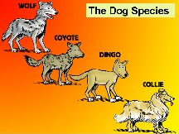
God Designed All life to Reproduce “after their Kind” (1:21) 上帝設計所有生命的繁殖是“各從其類”（1:21）
“After their kind” (10 times in Gen. 1)
各從其類在創世記一章出現10次，
This was known as the “fixity of the species:” When the word “kind” & “species” had the same definition.
這就是人所知的“物種固定性”， ‘類’與‘種’的定義相同。
Dog Kinds only reproduce other dog kinds

Slide 13
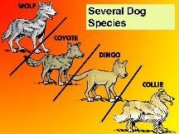
But…Scientists changed the definition of Species 但…科學家改變了‘種類’的定義
A group of individuals capable of inter-breeding to produce offspring that are fertile which produce fertile offspring
一群能夠行使交配的個體產生可以繁殖的後代，繼續產生具有繁殖力的後代
Under the new definition sometimes ‘Species’ change into new ‘species’
根據新的定義，有時‘物種’變成新的‘物種’。
This is simply micro-evolution

Slide 14
Biblical “Kind” & Scientific term “Species” no longer equal 聖經的“類”與科學名稱“物種”不再相等
Confusing definitions cause confusion between ‘micro-evolution’ & “macro-evolution.”
混亂的定義造成‘小進化’與‘大進化’之間的混亂。
So called new species are just new variations within a Biblical “Kind.” (micro evolution)
所謂新的物種只是聖經所謂‘類’之內的新差異。
No hard science supports the evolution of dogs from some non dog kind! (macro evolution)
沒有任何硬科學支持狗類從非狗類進化而來。

Slide 15
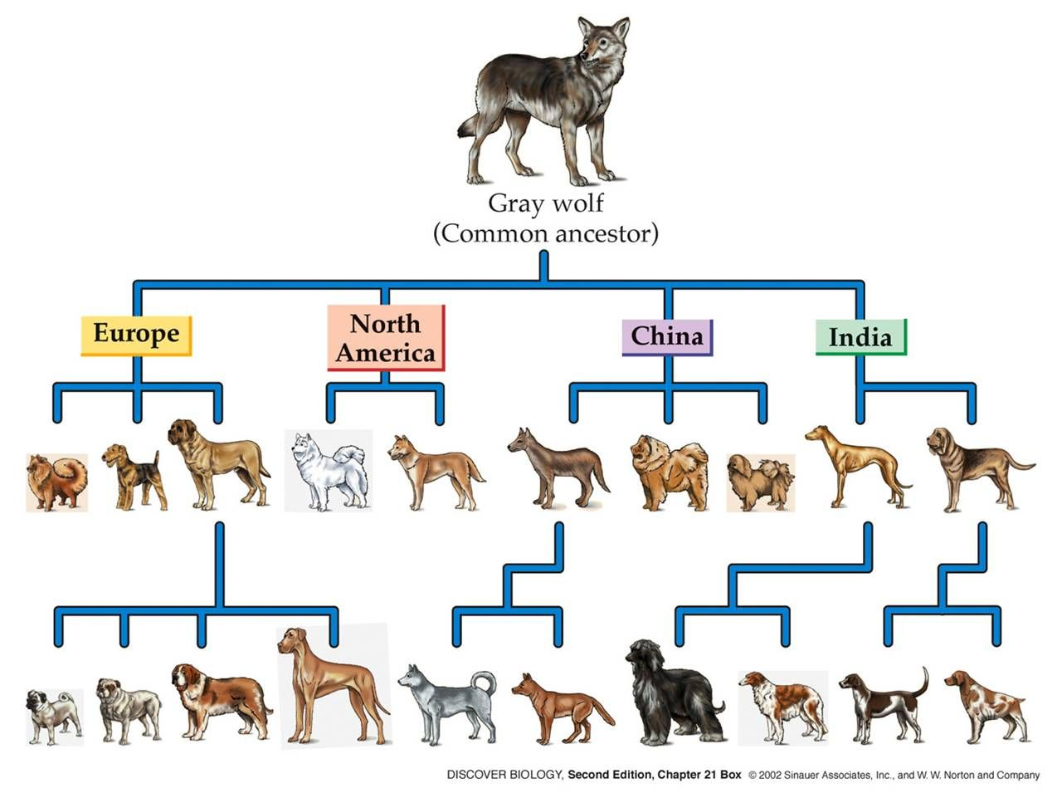
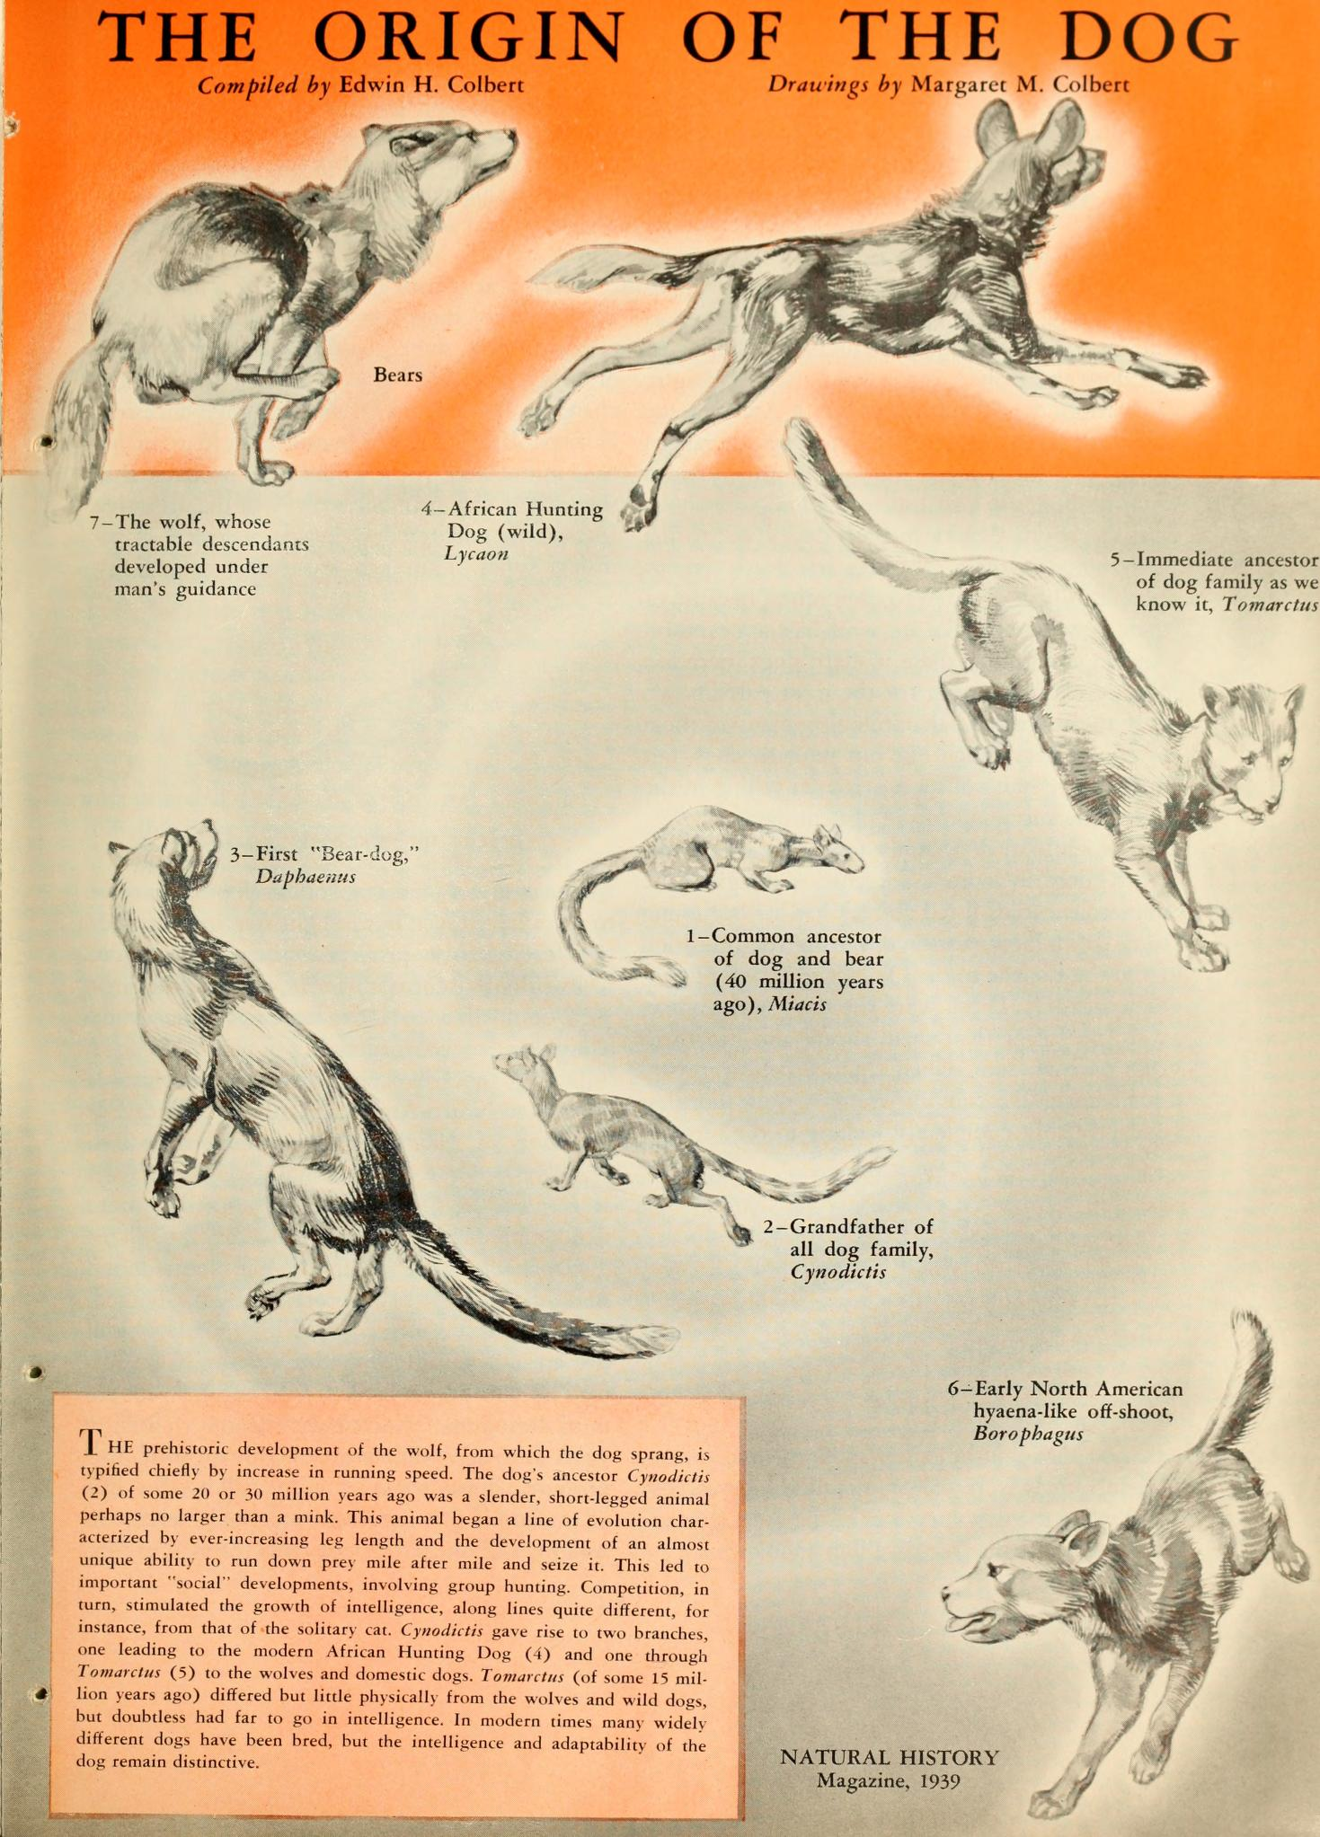
Examples
Hard Empirical Science
Micro- evolution
Soft science macro- evolution fantasies!
40 million yrs. Of evolution
They are all still dogs! Illustrates great variety within kinds

Slide 16
There is a constant “bait & switch” with the definition of Evolution in textbooks & media 進化論的定義在教科書和媒體中，持續地使用‘誘餌與轉換’
“evolution” is used for both observable & unobservable changes
“進化”同時使用在可觀察與不可觀察的改變上，
They subtly switch from empirical (hard) science to historical (soft) science (molecules to man) deceiving their audience.
他們巧妙地從實證（硬）科學轉換到歷史（軟）科學（分子到人），欺騙聽眾。
Students are indoctrinated to accept a ‘theory of evolution’ as hard observational science!
學生被洗腦去接受‘進化論’為硬的、可觀察到的科學！

Slide 17
God has set “limits” on diversification of “Kinds” 上帝對”類的多樣化”設限
Genetic studies reveal comparatively narrow limits of change within Kinds.
基因研究顯示在類別中相當狹窄的改變限制。

Slide 18
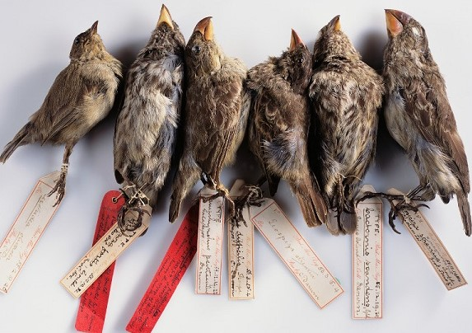
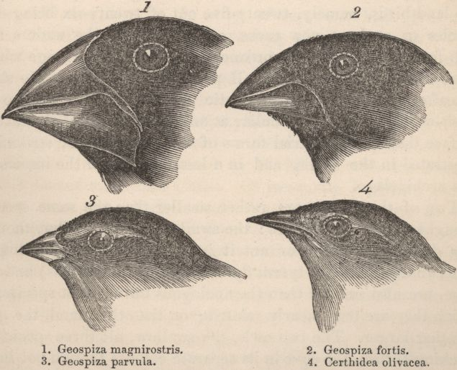
Darwin’s Finches (Beaks): An ICON of Evolution 達爾文的雀（喙）：進化的圖標
One of the most widely cited evidences for evolution is merely micro-evolution
這是最被引述的進化證據，它不過是小進化而已。
Change is only 10ths of a millimeter!
鳥喙的改變只是一毫米的十分之一！
It’s Only a cyclical fluctuation: the beaks returned to normal
它只是循環的波動：鳥喙回到正常

Slide 19
Darwin Admitted in a Letter to Jeremy Bentham in 1863 there was no hard empirical evidence for Natural Selection 達爾文在1863年致Jeremy Bentham的信中，說物競天擇沒有實證證據
“The belief in Natural Selection must at present be grounded entirely on general considerations…When we descend to details, we can prove that no one species has changed… nor can we prove that the supposed changes are beneficial, which is the groundwork for the theory.”
“目前對物競天擇的信任只能建基於一般的考慮…當觸及細節時，我們能證明沒有一物種改變了…我們也無法證明所謂的改變是有益的，而這是此理論的基礎工作。”
Francis Darwin (ed.), Charles Darwin, Life & Letters, Vol. 3, p. 25 or
https://www.darwinproject.ac.uk/letter/DCP-LETT-4176.xml

Slide 20
Lessons in God given ‘limits’ & amazing ability to ‘adapt’? 上帝賜予的‘限制’與奇妙的‘適應’能力
Humans created in the image of God never have to cross the line & behave like animals (a different kind) (2 Cor. 3:18)
以上帝的形像所創造的人類，從不必須跨線，像動物（另一種類）一樣表現（林後3:18）。
Or be stubborn as a mule! (Judg. 2:19; Ps. 78:8; Ps. 32:9)
也不必像騾子那樣頑固（士2:19；詩78:8；32:9）！
God designed us to adapt to our ever-changing world while being fruitful & multiplying godly disciples for Christ! (Col. 3:10)
上帝設計我們去適應一直在改變的世界，同時為基督結果並增生屬神的門徒（西3:10）！

Slide 21
We alone are Created to seek Answers to the Great Questions of Life (Job 38-42) 只有我們被創造去尋求人生最大問題的答案（伯38-42）
Recent research of the human brain reveals that people are “hard wired for fellowship with our fellow man & God.”
近來對人類大腦的研究顯示，人“被緊固連線，要與同胞和上帝相交。”
(The Commission on Children at Risk cosponsored with the YMCA, Dartmouth Medical School and the Institute for American Values, 2003)

Slide 22
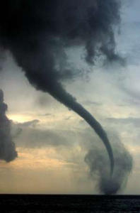
Job’s suffering caused him to ask 25 profound questions 約伯的受苦導致他求問25個深刻的問題
Even without answers the questions are important. They deal with truth we all need to think through.
即使沒有答案，這些問題仍然重要， 它們處理我們都需要深思的真理。
God speaks to Job “out of the whirlwind” (Job 38:1)
上帝“從旋風中”對約伯說話（伯38:1），
God’s answers are concealed in the 70+ questions He asks Job!
上帝的答案隱藏在祂質問約伯的70多個問題中！

Slide 23
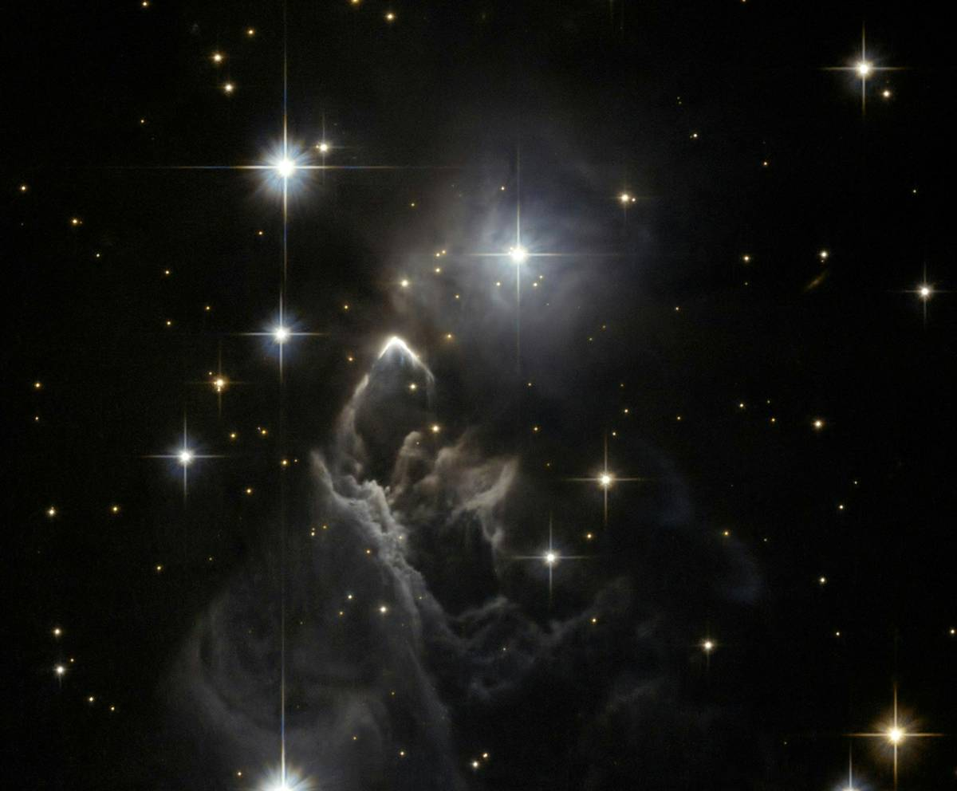
God directs us to His General Revelation in Creation 上帝指引我們去到祂在造物中的普遍啟示
Creation, Conscience, & God’s righteous Control of history
創造，良知，以及上帝公義的掌管歷史
This study focuses on the things God Created (Rom 1:18-20).
這篇信息專注在造物（羅1:18-20），
But the ultimate answers are found in God’s Special Revelation in Jesus Christ & the Bible (Heb. 1:1-2).
但最終的答案是在上帝在耶穌基督和聖經的特殊啟示中找到 （來1:1-2）。

Slide 24
We need what Job needed 約伯所需要的，我們也需要
A Divine revelation (Job 42:5-6). [not Science & Philosophy]
一個神聖的啟示（伯42:5,6），{不是科學或哲學}
1st we will look at partial answers to some questions in God’s General Revelation
首先我們會查看普遍啟示，來回答某些問題，
Then we will look at the fullest answer in Jesus Christ.
其次我們在耶穌基督裡查看完整的答案。

Slide 25
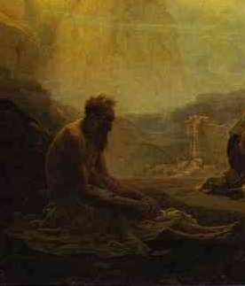
Question # 1: “Can we suffer evil & still love God?” 問題1：我們能承受罪惡卻仍然愛神嗎？
Job’s wife told him: “… curse God, & die.”
約伯的妻子告訴他：“…咒詛神，去死吧。”
He responded: “Thou speakest as one of the foolish women speaketh. What? shall we receive good at the hand of God, & shall we not receive evil?” (Job 2:9-10)
約伯回答：“你說話像愚頑的婦人一樣 。噯！難道我們從神手裡得福， 不也受禍嗎？”

Slide 26
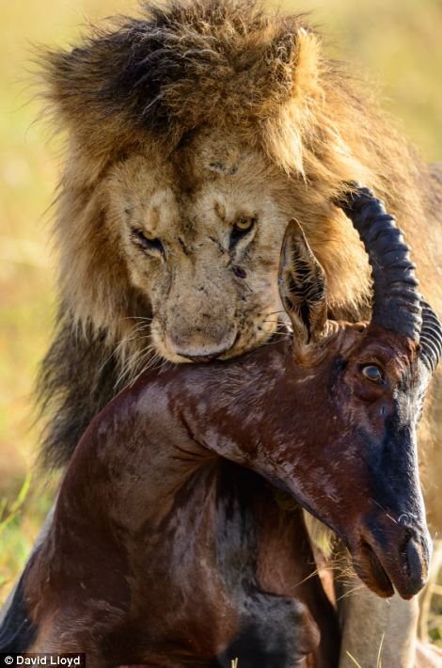
Job had insight from General Revelation (Job 12:7-10) 約伯從普遍啟示得到洞見（伯12:7-10）
Job responds to Zophar’s false accusations by pointing to truth revealed in nature.
約伯指出自然所顯示的真理， 來駁斥瑣法錯誤的控訴。
“But ask now the beasts, & they shall teach thee”
“你且問走獸，走獸必指教你”
They reveal the curse! (Rom. 8:18-24; Rev. 22:3)
牠們顯明咒詛的事實（羅8:18-24；啟22:3）！

Slide 27
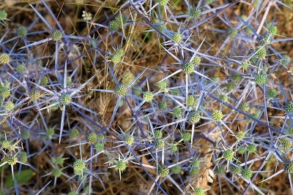
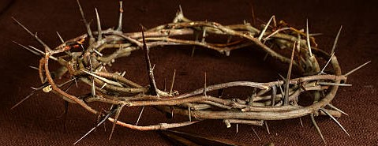
Job Knew the History of Adam (Job 31:33,40) 約伯知道亞當的歷史 （伯31:33,40）
Job knew the whole creation was under a curse because of Adam’s sin! (Job 14:1; Gen. 3; 47:9); He knew about the Promised Redeemer who would remove the curse (Job 19:25-27; Gen. 3:15);
約伯知道因亞當的犯罪，萬物都在咒詛之下（伯14:1；創3；47:9）！他也知道應許的救贖主將要移除這咒詛（伯19:25-27；創3:15）。

Slide 28
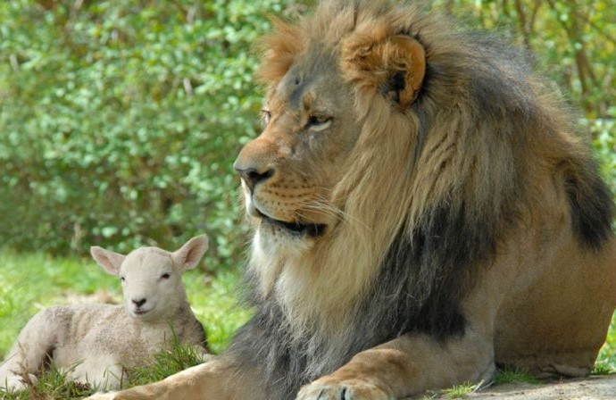
Job’s insight from General Revelation (Job 12:7-10) 約伯從普遍啟示獲得的洞見（伯12:7-10）
“Who knoweth not that the hand of the LORD hath wrought this in whose hand is the soul of every living thing…” (Rom. 8:18-24)
伯12:9 看這一切，誰不知道是耶和華的手做成的呢？ （羅8:18-24）
The final answer comes when Christ Jesus restores Creation: the lion again lies down with the Lamb! (Isa. 11:6; 65:25; Rev 21:5). No more death!
最終的答案是當基督耶穌更新萬物： 獅子再次 與羔羊同臥，不再有死亡！ （賽11:6；65:25；啟21:5）

Slide 29
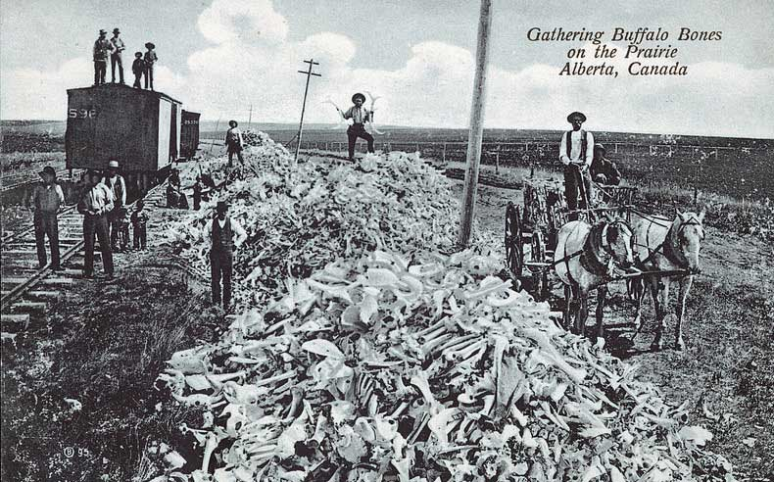
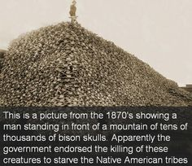
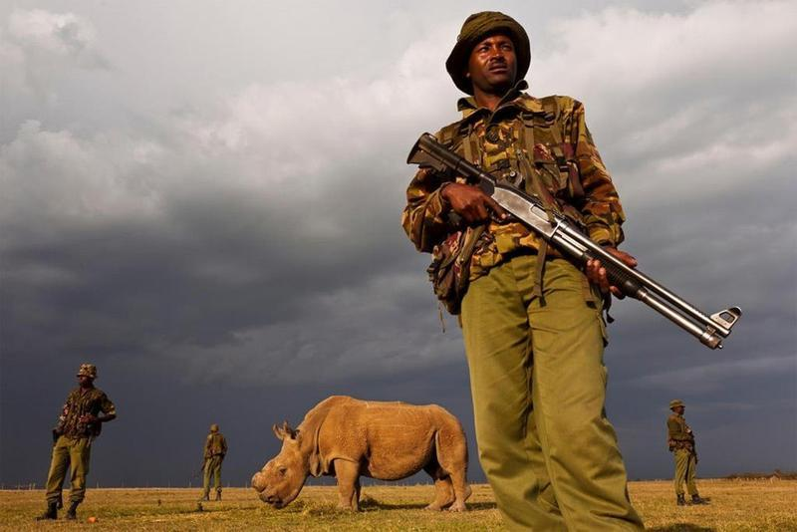
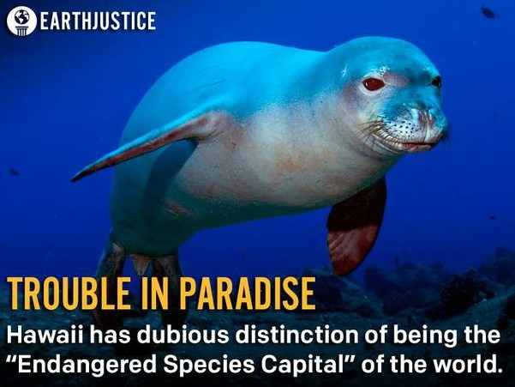
“But ask now the beasts, & they shall teach thee…” 且問走獸，走獸必指教你…
The beasts speak to us of man’s sin
走獸指教人的罪！
Last male white rhino 24hr. guard
Proverbs 12:10

Slide 30
“Who knoweth not that the hand of the LORD hath wrought this… (Job 12:7-10; Romans 8:20-23) 誰不知道是耶和華的手做成的呢…
Job knew the history of Adam’s sin & God’s just judgment
約伯知道亞當犯罪的歷史以及上帝公義的審判，
Job could accept his suffering “If I covered my transgressions as Adam, by hiding mine iniquity…” (Job 31:33)
約伯能夠接受他的苦難，“我若像亞當遮掩我的過犯，藏起我的罪孽…”(伯31:33）
He knew the curse on all creation because of sin! But forgot the part satan played in the disaster!!! We have enemies!
他知道萬物因罪惡受咒詛！但忘記了撒旦在災難中扮演的角色！

Slide 31
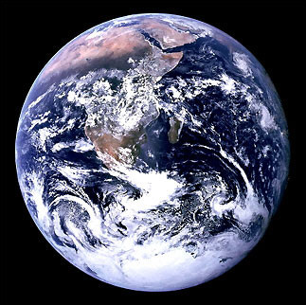
Job 38: God asks 35 Questions related to Earth & Heaven 約伯記38章：上帝問與天地相關的35個問題
“Where wast thou when I laid the foundations of the earth? Declare, if thou hast understanding” (Job 38:4-6)
38:4 我立大地根基的時候，你在那裡呢？ 你若有聰明，只管說吧！
Job is humbled before his CREATOR (Rom 9:20)
約伯在他的造物主面前謙卑下來（羅9:20）
Such a small ball in such a big universe!

Slide 32
Question # 1: Lessons from the Sea & Sand 問題1：從海與陸地學習功課
“Who shut up the sea with doors, when it brake forth, as if it had issued out of the womb? & said, Hitherto shalt thou come, but no further: & here shall thy proud waves be stayed?” (Job 38:8, 11)
38:8 海水衝出，如出胎胞，那時誰將他關閉呢？
38:11說：你只可到這裡，不可越過； 你狂傲的浪要到此止住。

Slide 33
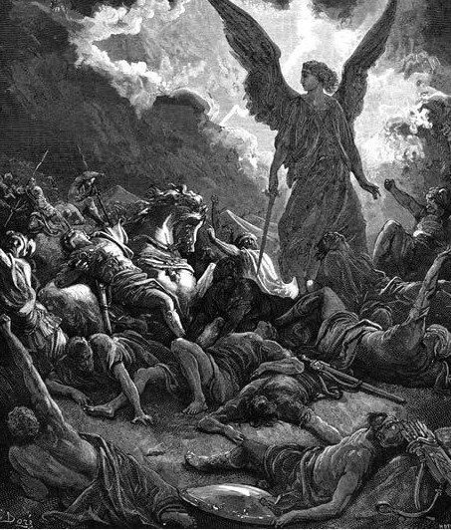
Lesson in the Question: Proud waves of Nature & evil men are under God’s control 功課：大自然洶猛的海浪與驕傲的惡人，都在上帝的掌控之下
Vile men overwhelmed Job like ‘a flood of waters’ (Job 1:15; 30:14)
邪惡的人像‘大水’一樣衝擊約伯（伯1:15；30:14）
When “the enemy comes in like a flood” (Isa. 59:19) God’s permissive will sets the bounds of such consequences of sin.
當 “仇敵好像急流的河水沖來”（賽59:19）， 上帝會限制他們造孽的後果。

Slide 34
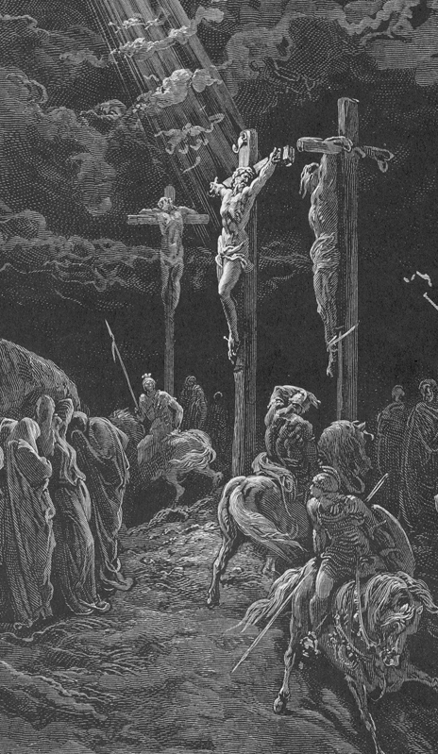
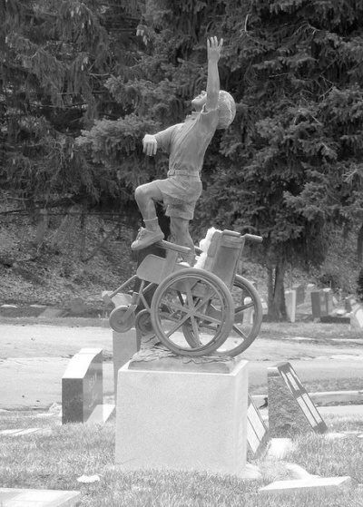
God limits the Duration & Degree of affliction 上帝限制苦難的期限和程度
“…our light affliction, which is but for a moment, worketh for us a far more exceeding & eternal weight of glory” (2Cor. 4:16-7; Job 42:10-17; James 5:11)
林後4:17 我們這至暫至輕的苦楚，要為我們成就極重無比、永遠的榮耀。

Slide 35
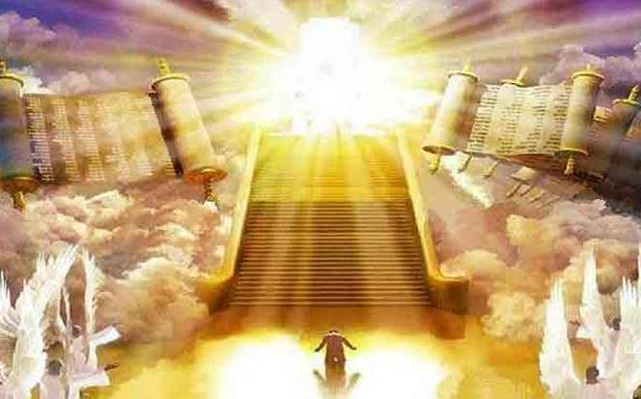
Evil men that killed Job’s children get justice at the Final Judgment (Job 35:14; 36:18; Rev. 20:11-15; Heb. 9:27; 10:26-27) 殺死約伯兒女的惡人，在最後審判時會得到報應
That’s why it is so important that we REPENT of our sins (Lk. 13:3-5; Phil. 2:8-11; Rev. 2:21-22)
這就是為何我們的悔罪那麼重要。

Slide 36
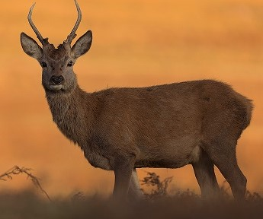
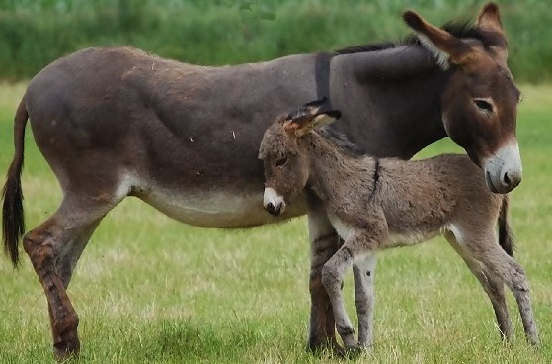
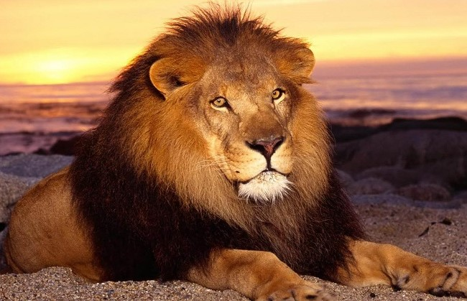
Job 38:39 thru 39 God’s 23 questions from the animal kingdom. 約伯記38:39-39章，上帝從動物界發出23個問題
God created animals to teach spiritual Truth.
上帝創造動物來指教屬靈的真理，
We are all born “like a wild ass’s colt” (Job 11:12; 15:14-16)
我們的出生都像“野驢駒子”（伯11:12；15:14-16），
The Lion & Hind [deer] had profound relevance to Job’s situation
獅子與鹿與約伯的情況極度相關。

Slide 37
Question 2: God’s Purpose for regal power: Serve humanity (LION - Job 38:39-40) 問題2：上帝對權力的目的：服務人類（獅子-伯38:39-40）
The “king of beasts” had no natural enemies. It reigned supreme.
‘萬獸之王’在自然界沒有對手，牠超然統治。
Job had been a King (Job 19:9) & learned from the King of beasts
約伯曾作王（伯19:9），並從萬獸之王學了功課。
Like a lion, Job fulfilled his God given responsibility to hunt down & bring criminals to justice (Job 29:14, 17; Rom. 13:3-4). And Not prey on the poor (Job 31:13-23)
約伯好比獅子，實踐了上帝賦予的責任，獵捕罪犯受審（伯29:14,17；羅13:3,4），而不掠奪窮人（伯31:13-23）。

Slide 38
Know your Enemy
Job forgot the other lion in the spiritual realms that could hunt him down!
約伯忘了屬靈境界另一能獵捕他的那隻獅子！
His “adversary the devil, as a roaring lion, walketh about, seeking whom he may devour” (I Pet. 5:8).
他的”仇敵魔鬼，好像吼叫的獅子，遍地尋找可吞吃的人。” （彼前5:8）
Job became an innocent prey
約伯成為無辜的獵物。

Slide 39
Question 3: Why do the Righteous Suffer? How can the Meek survive in a fallen World? (Matt. 5:5; James 4:6) 問題3：為何公義的人受苦？ 柔和謙卑的人在墮落的世界如何存活？（太5:5；雅4:6）
God directed Job to consider the Hind (Deer) (Job 39:1-4).
上帝指引約伯思想鹿（伯39:1-4），
A Hind was a loving, pleasant, friendly animal (S.O.S. 2:7, 9; 3:5).
鹿是慈愛、可喜、友善的動物 （歌2:7,9；3:5）

Slide 40
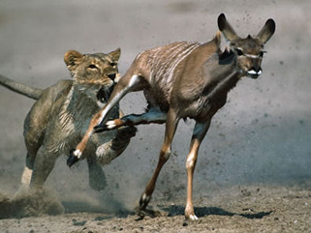
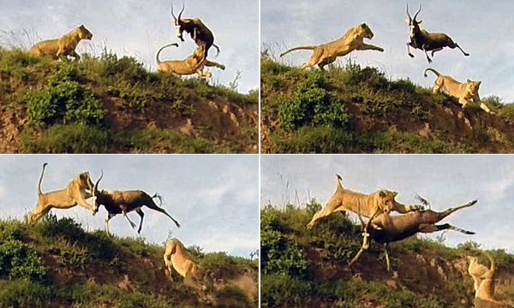
Job sought God like a deer “panteth after water brooks” (Ps. 42:1-2)
約伯尋求上帝，好像鹿“切慕溪水”（詩42:1-2）。
But the hind has enemies & if careless can fall prey to the Lion (I Pet. 5:8-11; Lk. 22:31-32).
但鹿有敵人，倘若不小心就會成為獅子的獵物（彼前5:8-11；路22:31-32）。

Slide 41
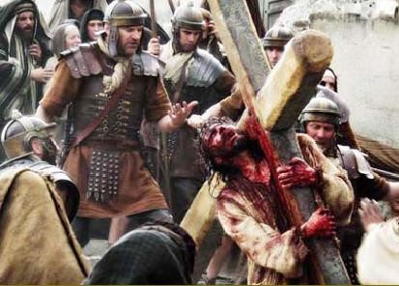
God’s Ultimate answer in Christ 上帝在基督裡的最終答案
Psalm 22 was set to the music of “Aijeleth Shahar” meaning “the hind of the dawn
詩篇22篇調用朝鹿，
Jesus is likened to the loving pleasant hind hanging on the cross, surrounded by violent beasts like bulls, roaring lions, & dogs.
耶穌被比喻成鹿，掛在木頭上，被兇惡如
公牛、吼叫的獅子和狗等走獸環繞。
Men acted like animals

Slide 42
(Ps. 22:13) “They gaped upon me with their mouths, as a ravening & a roaring lion.” 詩22:13 -他們向我張口，好像抓撕吼叫的獅子。
Satan surrounded the Cross “like a roaring lion” (I Pet. 5:8).
撒旦好比吼叫的狮子
（彼前5:8）

Slide 43
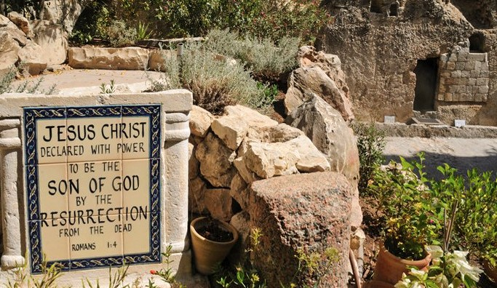
Jesus reveals the triumph of the meek designed into Nature in many ways: Especially in overcoming the difficult path of death by His resurrection at “dawn” (Matt. 28:1-10; Mk. 16:2-6; Phil. 2:5-11)
耶穌在多方面應驗設計在自然中的預表：特別是祂克服死亡，在‘破曉’時分復活（太28:1-10；可16:2-6）。

Slide 44
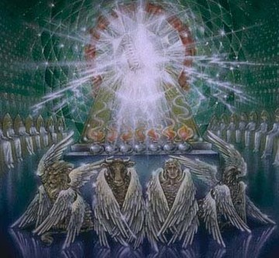
Like Jesus we too will suffer (John 16:33; Acts 14:22) 我們也與耶穌一樣會受苦 （約16:33；徒14:22）
But like a lion we are destined to reign with Jesus, the Lion of the Tribe of Judah (2Tim. 2:12; Rom. 8:17)
我們也註定要與猶大支派的獅子耶穌一同作王（提後2:12；羅8:17）。
1st the Cross then the Crown; 1st the Suffering then the Glory

Slide 45
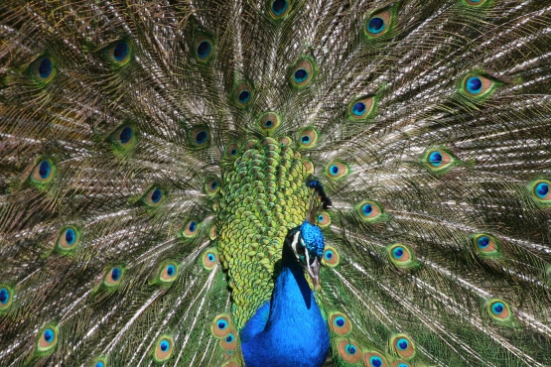
Question 4: “Gavest thou the goodly wings to the peacocks? (Job 39:13) 問題4：你給了孔雀美麗的翅膀嗎？（伯39:13）
How was this relevant to Job?
這與約伯有何相關？
satan smote Job’s whole body with boils
撒旦攻擊約伯從頭到腳都長瘡
He lost all his physical beauty (Job 2:7-8)
他失去所有身體的美容，（伯2:7-8）
Our looks at each stage of life are designed by God
我們人生每個階段的容貌都為上帝所設計。

Slide 46
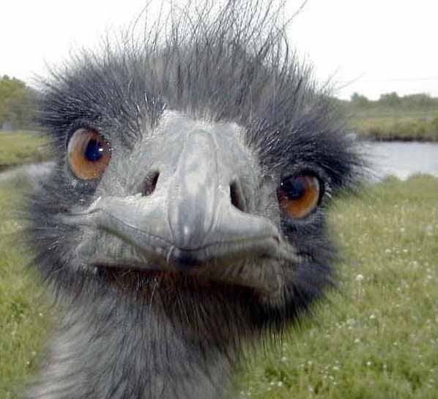
Question #5: Is there life after death? 問題5：死後有生命嗎？
“If a man die, shall he live again?” (Job 14:14)
“人若死了，豈能再活呢？”（伯14:14）
How painfully poignant: Job’s 10 children had just died!
痛苦的憂傷：約伯的10個兒女才剛死！
Why did God bring the ostrich to his attention? (Job 39:13-17)
為何上帝要約伯關注鴕鳥？ （伯39:13-17）

Slide 47
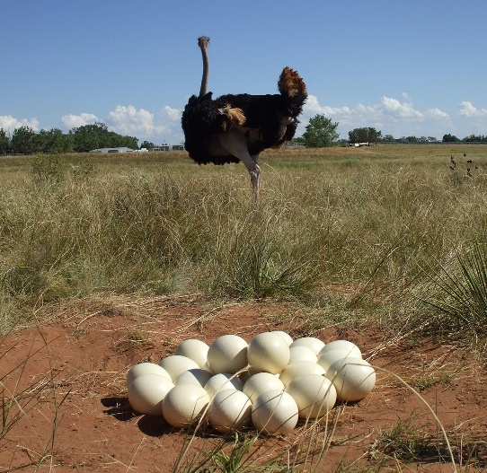
On the surface she doesn’t seem to be a good parent: 從表面看鴕鳥不像好母親
She parents the way God designed her to.
她的教養方式是上帝設計的，
“Gavest thou …wings & feathers unto the ostrich? She leaves her eggs in the earth & forgets the foot may crush them… Because God deprived her of wisdom… (Job 39:13-7) illus.: Jesus’ Parents
鴕鳥的翅膀歡然搧展…他把蛋留在地上，在塵土中使得溫暖；卻想不到被腳踹碎，或被野獸踐踏。(伯39:13-17 ）
Her young are always in danger!

Slide 48
Job’s Hope: He Know there was a bodily resurrection! 約伯的盼望：他知道未來身體復活！
(Job 19:25) “For I know that my redeemer liveth, & that he shall stand at the latter day upon the earth:
伯19:25我知道我的救贖主活著，末了必站立在地上。
(19:26-7) And though… worms destroy this body, yet in my flesh shall I see God: (I Cor. 15:53; Phil. 3:21)
19:26-7 我這皮肉滅絕之後，我必在肉體之外得見神。
Why was Job so certain of this?
為何約伯如此確信此事？

Slide 49
GOD DESIGNED THE TRUTH OF THE RESURRECTION INTO CREATON! 自然界復活的設計
The cold colorless death of winter
The gloriously hued resurrection of Spring
Job 38:22; 37:6
Job 38:25-27

Slide 50
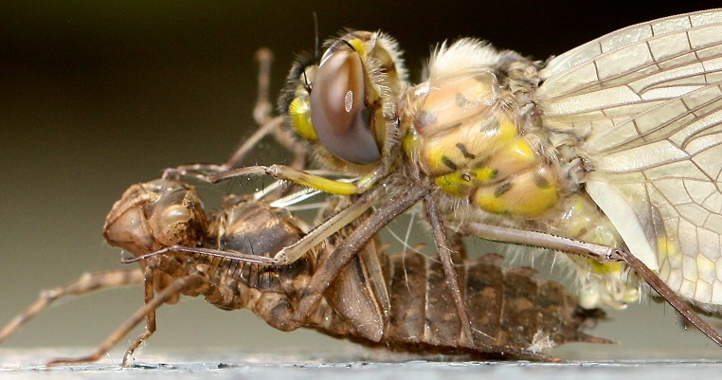
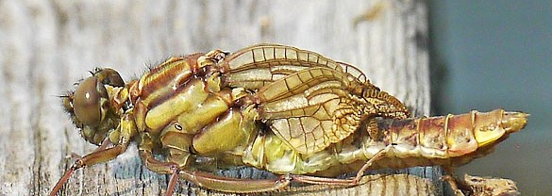
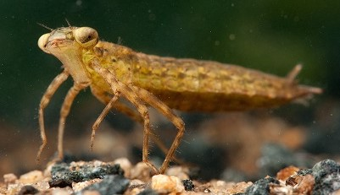
BIG QUESTION:
(I Cor. 15:35) “But some man will say, How are the dead raised up? and with what body do they come?”
或有人問：「死人怎樣復活，帶著什麼身體來呢？」
Illus: Cecil B. DeMille

Slide 51
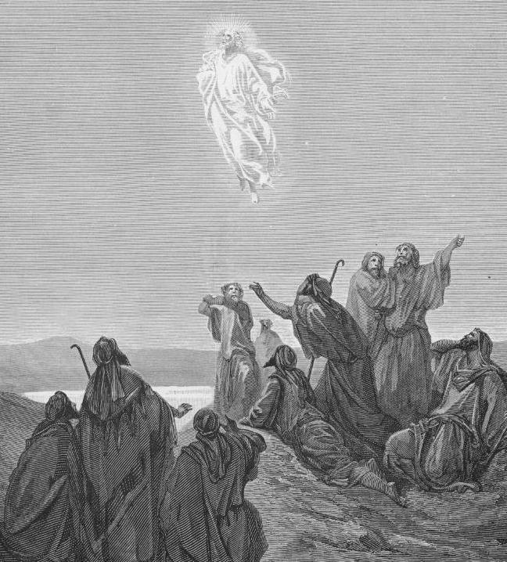
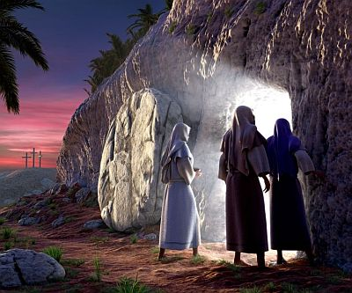
God’s Final Answer concerning Life after Death is only found in Christ 上帝對死後有生命的最終回答只在基督裡找到
“Jesus is the resurrection, & the life… Believest thou this?” (John 11:25-6)
耶穌是復活，是生命…你相信嗎？（約11:25-26）
Jesus “abolished death & brought life & immortality to light” (2 Tim. 1:10)
耶穌“已經把死廢去，藉著福音，將不能壞的生命彰顯出來。 ”（提後1:10）

Slide 52
God designs every Body for its purpose 上帝對身體的設計有各自的目的
God gave us an earthly body to enjoy life on earth; He will give us a heavenly body to enjoy Heaven! (Job 19:25-27)
上帝賜我們地上的身體來享受地球的生活, 祂會賜我們天上的身體來享受天堂!（伯19:25-27）
A sinless, perfect, eternal, glorious Body (I Cor. 15:42-44)
那是無罪, 完美, 永恆, 榮耀的身體。（林前15:42-44）

Slide 53
Important Lessons 重要功課
God reveals His wisdom in Creation. Learn to search out its eternal spiritual truths.
上帝在造物中顯明祂的智慧，我們可從造物中尋見它們永恆的屬靈真理。
The greatest source of Wisdom comes from a relationship with Jesus Christ through faith in God’s Word. (I Cor. 1:30) （林前1:30）。
最偉大的智慧資源來自相信上帝的話語，與耶穌基督建立關係
There is a lot of Divine Wisdom available to triumph over trials & tribulations – if you will look for it
許多從神來的智慧都在，幫助我們勝過試煉與苦難 – 倘若你去尋找它。

Slide 54
Important Lessons 重要功課
Men’s books impart information [often wrong & ever changing]
人的書本給予資訊 {經常錯誤且不斷更改}，
God’s Book leads to our glorious transformation!
上帝的書本引領到我們榮耀的轉變！
As God designed animals to be transformed by the information programed into their DNA so God transforms us as we engraft His word into our soul! (James 1:21; I Cor. 15:40-54)
正如上帝設計動物，藉由牠們的DNA訊息來改變，上帝也轉化我們，當我們將祂的話語深植入靈魂！（雅1:21；林前15:40-54）

Slide 56
The following slides contain some more life changing truth to be gleaned from studying nature.
We did not have room to put them in the current teaching.

Slide 57
A Profound Relationship between Genesis, Revelation & Job
Our study began with a 8 page Chart revealing the supernatural relationship between the Books of Genesis & Revelation
Eternal Wisdom designed into Creation bears witness to God’s glorious & majestic redemptive plan revealed in Scripture.
Majesty involves issues of life & death (Dan. 5:19; Matt. 10:29-31)

Slide 58
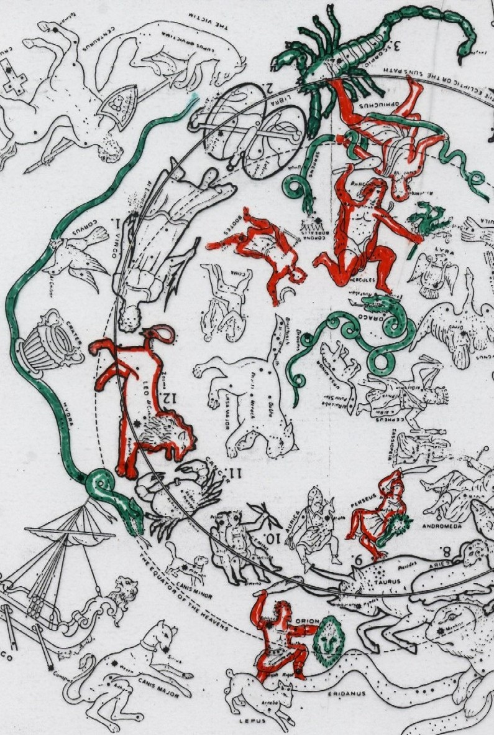
Job’s questioning led him to faith in Christ
“I know that my redeemer liveth, & that he shall stand at the latter day upon the earth. & though…worms destroy this body, yet in my flesh shall I see God” (Job 19:25-27)
Job may have learned this from the Gospel in the stars (Job 26:13-4; 38:32-3)
Job 38:32

Slide 59
INSIGHT FROM LIGHT:
“Hast thou commanded the morning; & caused the dayspring [dawn] to know his place;
That it might take hold of the ends of the earth, that the wicked might be shaken out of it?” (Job 38:12-13) [light conquers darkness]
The Lesson in the Question? Cycles of light & darkness are a consequence of living in a fallen World

Slide 60
God’s final answer in Christ
“God is light & in Him is no darkness at all” (I John 1:5).
Whatever the source of our darkness it doesn’t originate with God!
Job was wrong to think God was his enemy when it was actually satan (Job 13:24; 33:10). Job was ignorant of satan devices (2 Cor. 2:11)

Slide 61
God wonderfully & Intelligently designs every Body for its Purpose 上帝對身體的設計有各自的目的
God designed every “body” [plant, fish, animal, & human] specifically to live & flourish in its own environment to fulfill God’s purpose.
上帝設計每一”身體” (植物, 魚類, 動物, 人類)特別在他們自己的環境生活, 興旺, 來實踐上帝的目的.
Thus the incredibly fine-tuned balance in nature
使自然界處於精細的平衡!

Slide 62
God’s Intelligent Design is clearly revealed in the things He Created
“Thou fool, that which thou sowest is not quickened, except it die: and that which thou sowest, thou sowest not that body that shall be, but bare grain . . .” (1Cor. 15:36-37)

Slide 63
God’s Intelligent Design is clearly revealed in the things He Created
(I Cor. 15:38) “But God giveth it a body as it hath pleased Him, and to every seed his own body”
I have a perfect, beautiful glorified body waiting for me in Heaven (2 Cor. 5:1-9)
Chrysanthemum show, China

Slide 64
God gives Everything an Intelligently designed Body 上帝對身體的設計
“All flesh is not the same flesh: there is one kind of flesh of men, another flesh of beasts, another of fishes, & another of birds.” (I Cor. 15:39)
凡肉體各有不同：人是一樣，獸又是一樣，鳥又是一樣，魚又是一樣。
Each body specifically designed for each creature's purpose

Slide 65
God gives Everything an Intelligently designed Body 上帝對身體的設計
There are celestial bodies, & bodies terrestrial: but the glory of the celestial is one, and the glory of the terrestrial is another. (I Cor. 15:40)
有天上的形體，也有地上的形體；但天上形體的榮光是一樣，地上形體的榮光又是一樣。
Job 27:18

Slide 66
The Silkworm: a type of Christ in resurrection
Its greatest work is weaving something for our beautiful clothing
It finishes this work in death. Just as Christ died so we could be clothed in His righteousness (Isa. 61:10; Rom. 13:14; Rev. 7:9-14)
The worm rises a more glorious creature, perfectly white (a metaphor for purity & righteousness!)
Jesus was a worm (Ps. 22:6) who rose in glory, who imparts His purity & righteousness to those who trust Him

Slide 67
I have learned: 我學到: “What will happen to me when I die?” 當我死亡時會發生什麼?
I know for sure without a doubt where I will go when I die & the Glory that awaits me! (I John 5:10-13 John 20:30-31).
我毫無疑問地知道會去哪, 且榮耀等著我?
This life is not all there is. There is a whole new realm of existence.
A world more real than our 3 dimensional physical world.

Slide 68
THEREFORE 因此:
I must pursue a loving relationship with God through faith in Jesus Christ.
我必須相信耶穌基督,追求與上帝建立愛的關係.
I am a special creation of God’s love not an accident of evolutionary mindless chance
我是上帝愛的創造, 不是進化而來的偶然,意外
There is a purpose for my whole life including all my suffering
我的生命有目的, 包括所有的苦難

Slide 69
Job Knew the History of Adam (Job 31:33,40)
Job knew the whole creation was under a curse because of Adam’s sin! (Job 14:1; Gen. 3; 47:9); He knew about the Promised Redeemer who would remove the curse (Job 19:25-27; Gen. 3:15);
He knew about the Flood of Noah (Job 22:15-17 & Gen. 6:5; Job 12:14-15 & Gen. 7:16; Job 26:10 & Gen. 8:22; 9:11)

Slide 70
Question #3: Where can I find Wisdom?
“But where shall wisdom be found? & where is the place of understanding?” (Job 28:12)
God points us to wisdom Designed into The Wild Goats (Job. 39:1).

Slide 71
THE WILD GOATS: Wisdom always finds an answer to a seemingly impossible situation!

Slide 72
God’s Ultimate Answer to our quest for Wisdom: Christ!
“Christ the power of God, & the wisdom of God” (I Cor. 1:24)
“…Christ Jesus, who of God is made unto us wisdom (1Cor. 1:30)
“In Christ are hid all the treasures of wisdom” (Col. 2:3)
Find this Wisdom & you find everything you will ever need!

Slide 73
Recent Genetic Studies Prove Dogs have always been Dogs!
“We provide several lines of evidence supporting a single origin for dogs, & disfavoring alternative models in which dog lineages arise separately from geographically distinct wolf populations (Figures 4-5, Table S10)
Adam H. Freedman dt al., “Genome Sequencing Highlights the Dynamic Early History of Dogs,” PLoS Genetics 10, no. 1 (2014): 8.

Slide 74
Truths about Darwin Evolutionists & media keep secret
In Darwin’s entire book there is no real scientific evidences of evolution empirically verified; no examples are cited of new species; no transitional forms are shown; no evolutionary mechanisms are documented.
It is all speculation! No empirical science for macro-evolution.
(Dr. Henry Morris, The Long War Against God, 2000, pg. 154-156)

Slide 75
You Must Choose the Right Foundation to Build Your Life Upon (Genesis 1)
The solid rock of Saving Faith from believing the infallible Word of God.
Saving Faith connects us with God and separates us from sin.
We experience the pleasures of righteousness
The quicksand of Faulty Faith from trusting in the fallible books (theories) of men.
Faulty faith separates us from God and
Leaves us to wallow in the pleasures of sin.

Slide 76
When fallible men disagree with an infallible God – Believe God!
When fallible science textbooks, that will be useless in a few years, disagree with the the Word of God, that has remained unchanged for 1,000’s of years – Believe God’s Word
Your Faith is only as secure as the object of your Faith

