Slide 1
彼此認罪 Confess to One Another
雅各書James5:13-18

Slide 2
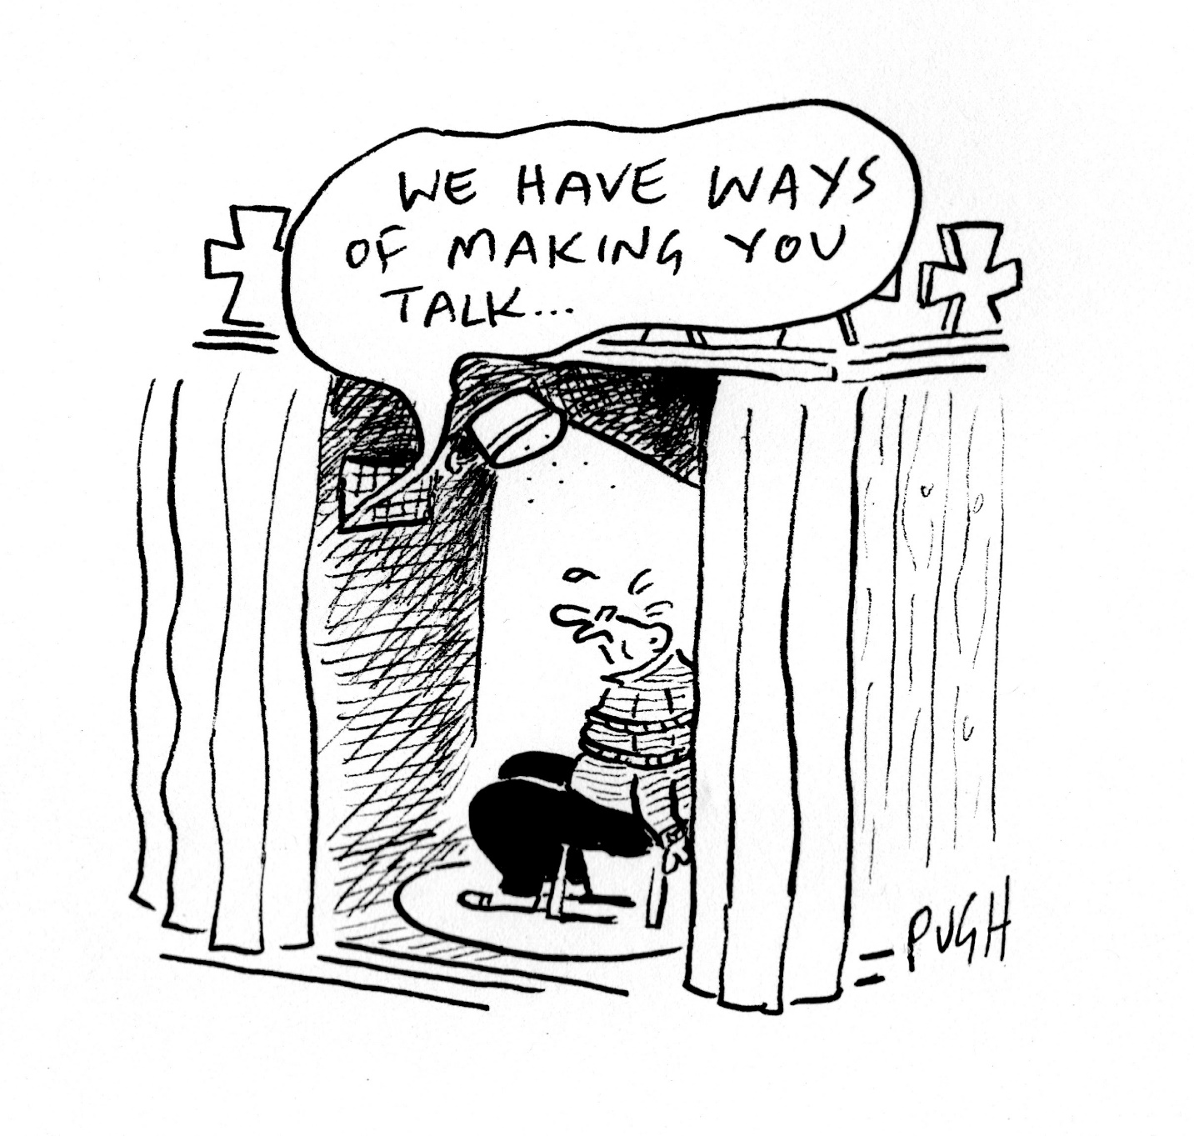

Slide 3
定義Definition
悔改﹕認識錯誤﹐改變方向
Repent: acknowledge wrongdoing and change the course of life
認罪﹕承認﹐同意﹐請求原諒
Confess: admit, agree, ask for pardon

Slide 4
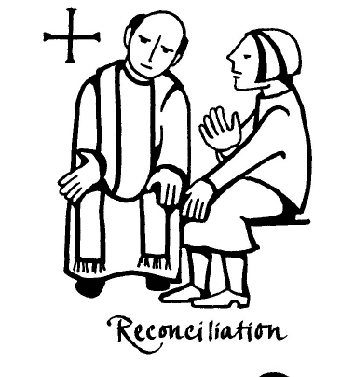
彼此認罪Confess to One Another
向神承認Acknowledge to God
向人承認Acknowledge to People

Slide 5
認識Understanding
原因Reason
時機Occasion
方式Manner

Slide 6
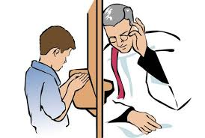
操練Exercise
個人認罪
Private Confession
彼此認罪
Confession to One Another
公開認罪
Public Confession

Slide 7
約翰壹書 1John 1:9
我們若認自己的罪， 神是信實的、是公義的，必要赦免我們的罪，洗淨我們一切的不義。
If we confess our sins, He is faithful and righteous to forgive us our sins and to cleanse us from all unrighteousness.

Slide 8
彼此認罪﹐生命得力! Confess to One Another, Grow Strong in Christ!

