Slide 1
彼此寬恕Forgive One Another
馬太福音Mt.18:21-35

Slide 2
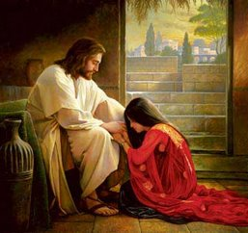
寬恕不是忍耐
Forgiveness is not the same as tolerance

Slide 3
寬恕Forgive:
不再記恨No more resentment
主權交托Trust the Lord

Slide 4
寬恕不是修行
Forgiveness can not be achieved through self-discipline

Slide 5
寬恕不是和解
Forgiveness is not equal to reconciliation

Slide 6
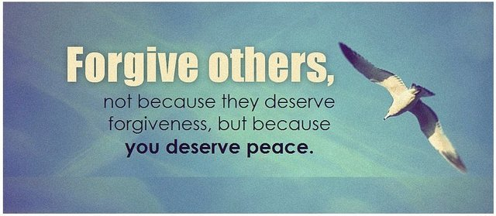
以弗所書 Eph 4:32
並要以恩慈相待，存憐憫的心，彼此饒恕，正如神在基督裡饒恕了你們一樣。
Be kind to one another, tender-hearted, forgiving each other, just as God in Christ also has forgiven you.

Slide 7
寬恕來自基督的生命! Forgiveness Comes from the Life in Christ!

