Slide 1
全人關懷的宣教事工
李偉強牧師 – 基督教角聲佈道團南加州分會
Holistic Gospel In Mission
Rev David Lee – Superintendent,
Chinese Christian Herald Crusades, S. Cal. Branch

Slide 2
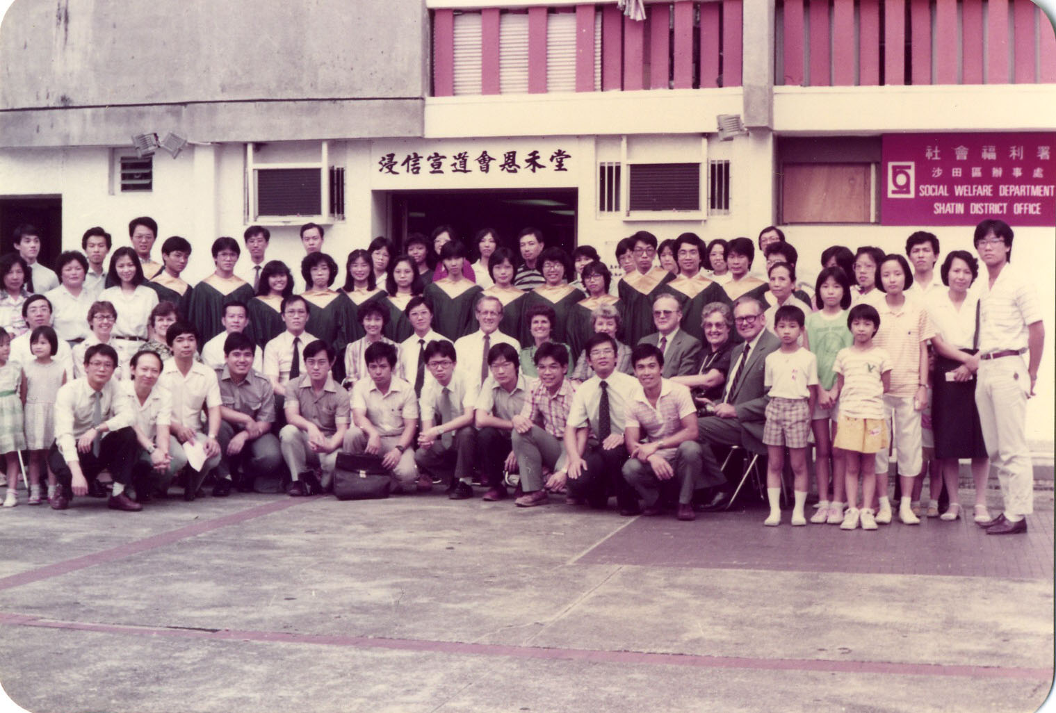
1983-5

Slide 4


Slide 5


Slide 6
耶穌走遍各城各鄉，在會堂裡教訓人，宣講天國的福音，又醫治各樣的病症。 (太 9:35)
Jesus went through all the towns and villages, teaching in their synagogues, preaching the good news of the kingdom and healing every disease and sickness.
(Mt 9:35)

Slide 7
耶穌走遍各城各鄉，在會堂裡教訓人，宣講天國的福音，又醫治各樣的病症。 (太 9:35)
Jesus went through all the towns and villages, teaching in their synagogues, preaching the good news of the kingdom and healing every disease and sickness.
(Mt 9:35)
教訓
價值觀
Christian Values
Teaching

Slide 8
耶穌走遍各城各鄉，在會堂裡教訓人，宣講天國的福音，又醫治各樣的病症。 (太 9:35)
Jesus went through all the towns and villages, teaching in their synagogues, preaching the good news of the kingdom and healing every disease and sickness.
(Mt 9:35)
教訓
價值觀
Christian Values
Teaching
福音
Christian Faith
宣講
Preaching

Slide 9
耶穌走遍各城各鄉，在會堂裡教訓人，宣講天國的福音，又醫治各樣的病症。 (太 9:35)
Jesus went through all the towns and villages, teaching in their synagogues, preaching the good news of the kingdom and healing every disease and sickness.
(Mt 9:35)
教訓
價值觀
Christian Values
Teaching
福音
Christian Faith
宣講
醫治
Preaching
Healing
關懷
Christian Care

Slide 10
全人福音
Holistic Gospel
教訓
價值觀
Christian Values
Teaching
福音
Christian Faith
宣講
醫治
Preaching
Healing
關懷
Christian Care

Slide 11
福音
Christian Faith
宣講
醫治
Preaching
Healing
關懷
Christian Care

Slide 12
沒有基礎
No Foundation
福音
Christian Faith
宣講
醫治
Preaching
Healing
關懷
Christian Care

Slide 13
教訓
價值觀
Christian Values
Teaching
醫治
Healing
關懷
Christian Care

Slide 14
社會福音
Social Gospel
教訓
價值觀
Christian Values
Teaching
醫治
Healing
關懷
Christian Care

Slide 15
教訓
價值觀
Christian Values
Teaching
福音
Christian Faith
宣講
Preaching

Slide 16
假冒為善
Hypocrite
教訓
價值觀
Christian Values
Teaching
福音
Christian Faith
宣講
Preaching

Slide 17
全人福音
Holistic Gospel
教訓
價值觀
Christian Values
Teaching
福音
Christian Faith
宣講
醫治
Preaching
Healing
關懷
Christian Care

Slide 18

基督教角聲佈道團
Chinese Christian Herald Crusades
價值觀
Christian Values
號角月報
Herald Monthly

Slide 19


基督教角聲佈道團
Chinese Christian Herald Crusades
價值觀
Christian Values
號角月報
Herald Monthly
福音
Christian Faith
角聲使團
the Heralders

Slide 20
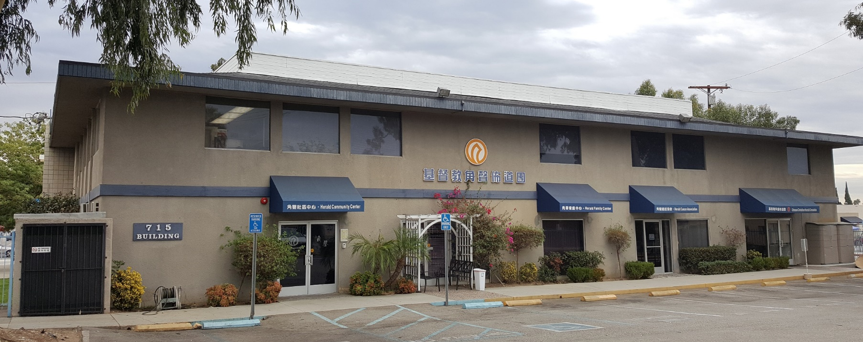
基督教角聲佈道團
角聲社區中心
Chinese Christian Herald Crusades
Herald Community Center
社區關懷 Community Services
癌症協會 Cancer Care Ministry
家庭中心 Family Center
價值觀
Christian Values
關懷
Christian Care
號角月報
Herald Monthly
福音
Christian Faith
角聲使團
the Heralders

Slide 21
基督教角聲佈道團
角聲社區中心
Chinese Christian Herald Crusades
Herald Community Center
社區關懷 Community Services
癌症協會 Cancer Care Ministry
家庭中心 Family Center
價值觀
Christian Values
關懷
Christian Care
號角月報
Herald Monthly
基督教角聲醫療中心
Herald Christian Health Center
福音
Christian Faith
咸陽巿角聲兒童之家(中國)
角聲使團
Xianyang Herald Children Home, China
the Heralders

Slide 22
祂看見許多的人，就憐憫他們；因為他們困苦流離，如同羊沒有牧人一般。 (太 9:36)
When He saw the crowds, he had compassion on them, because they were harassed and helpless, like sheep without a shepherd. (Mt 9:35)

Slide 23

祂看見許多的人，就憐憫他們；因為他們困苦流離，如同羊沒有牧人一般。 (太 9:36)
When He saw the crowds, he had compassion on them, because they were harassed and helpless, like sheep without a shepherd. (Mt 9:35)
「動了慈心」
(splagchnizomai)

Slide 24

We are not in the coffee business serving people,
Howard Schultz
(1953 - )
Founder and
Chairman Emeritus

Slide 25
We are not in the coffee business serving people,
but in the people business serving coffee.
Howard Schultz
(1953 - )
Founder and
Chairman Emeritus

Slide 26

為何一個無名、邊緣的耶穌運動，能在短短幾百年後，變成一般主流的宗教力量。
Princeton University Press
1996

Slide 27
To cities filled with the homeless and impoverished, Christianity offered charity as well as hope.
在充滿著無處棲身和貧困家庭的城巿，基督教提供了慈惠和希望。

Slide 28
To cities filled with newcomers and strangers, Christianity offered an immediate basis for attachment.
對新移民和異鄉客，基督教提供了即時的援助和支持；

Slide 29
To cities torn by violent ethnic strife, Christianity offered a new basis for social solidarity.
在充滿著暴力和種族衝突的環境中，教會提供了一種新的和諧關係；

Slide 30
And to cities faced with epidemics, fire, and earthquakes, Christianity offered effective nursing services. . . .
在充滿著疾病、火災，和地震的城巿，基督教提供了有效的護理服務。

Slide 31
To cities filled with orphans and widows, Christianity provided a new and expanded sense of family.
在充滿孤兒和寡婦的城巿，基督教為他們提供了另一個家；

Slide 32
於是對門徒說：要收的莊稼多，作工的人少。所以，你們當打發工人出去收他的莊稼。 (太 9:37-38)
Then he said to his disciples, “The harvest is plentiful but the workers are few. Therefore, send out workers into his harvest field.” (Mt 9:37-38)

Slide 33
於是對門徒說：要收的莊稼多，作工的人少。所以，你們當求莊稼的主打發工人出去收他的莊稼。 (太 9:37-38)
Then he said to his disciples, “The harvest is plentiful but the workers are few. Ask the Lord of the harvest, therefore, to send out workers into his harvest field.” (Mt 9:37-38)

Slide 34
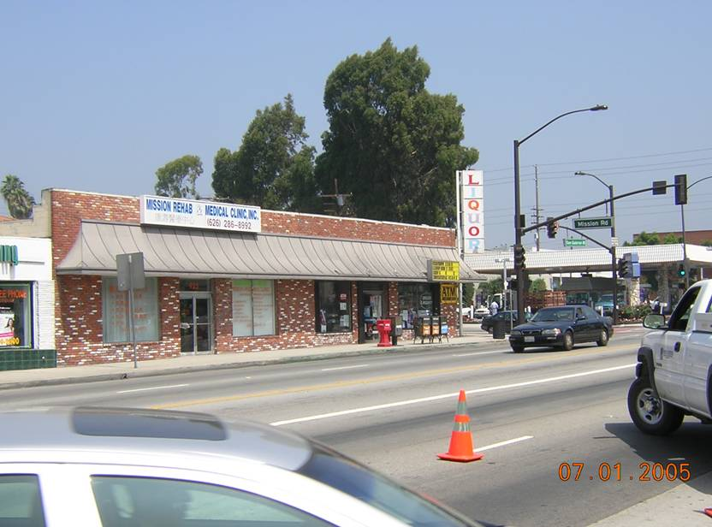

A Dream
一個夢想

Slide 35
A Sign
一個印証
10
Days
10
10 x $10,000
10
Medical
Personnel

Slide 36

$10,000
$10,000
$10,000
$10,000
$10,000
$10,000
$10,000
$10,000
$10,000
$10,000

Slide 37

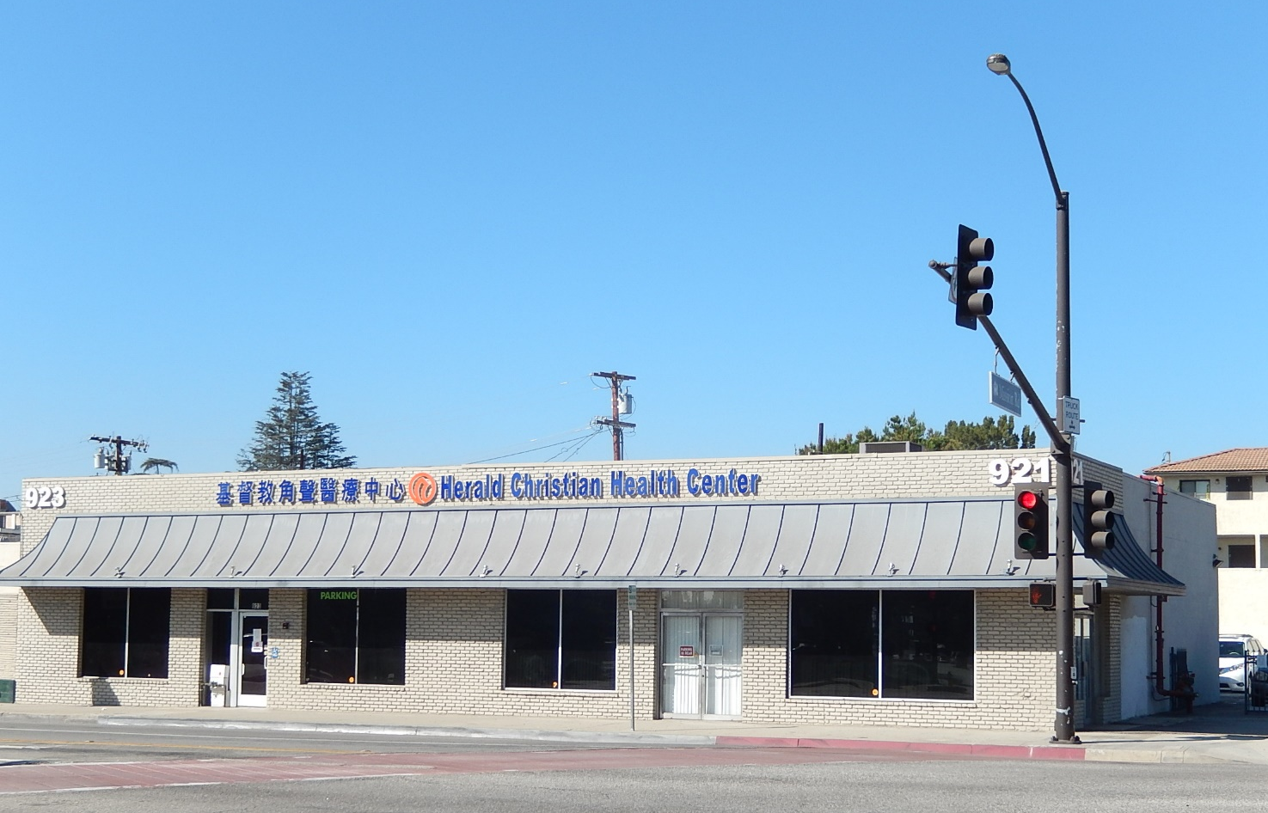
The Dream Comes true
夢想成真

Slide 38


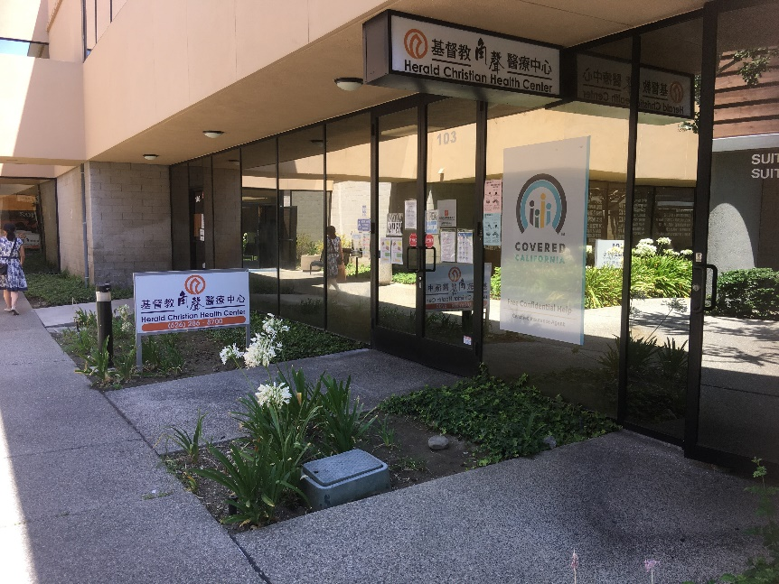
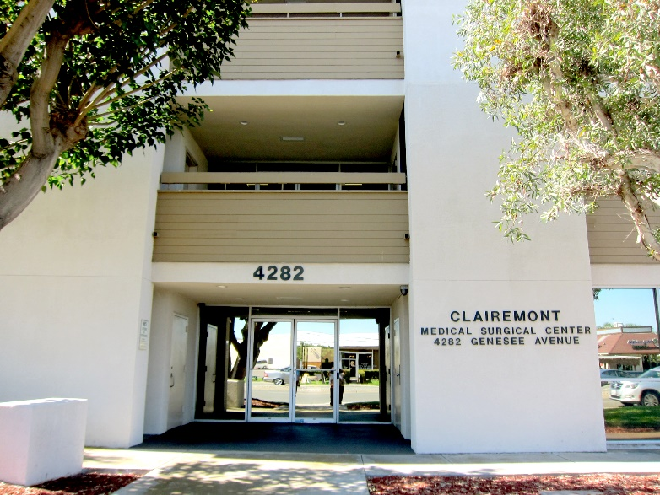
San Gabriel
全年服務人次
Rosemead
Annual Visits
56,060
City of Industry
San Diego

Slide 39
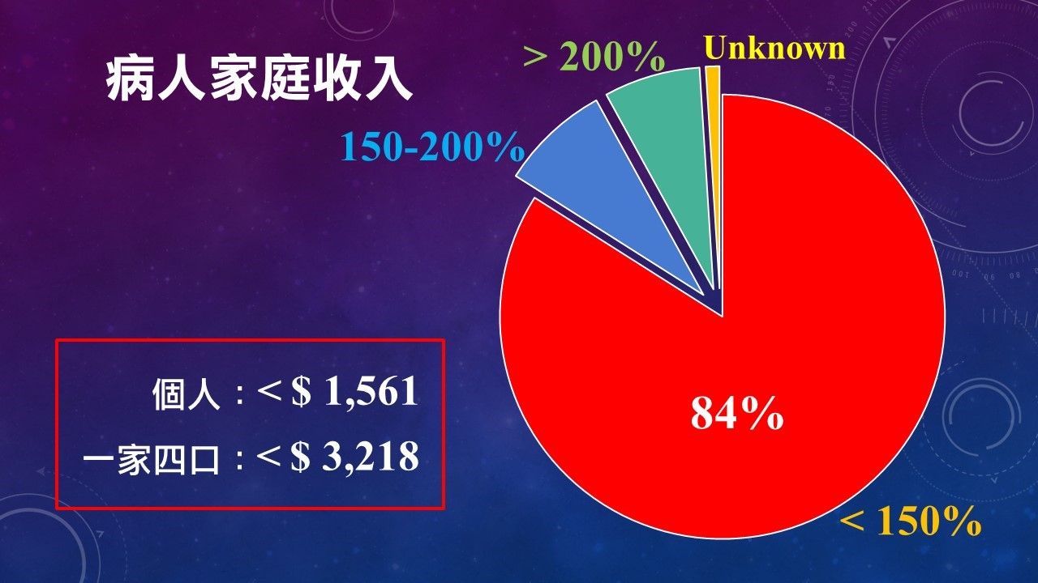
Family Income
Single
Family of 4

Slide 40


Slide 41


Slide 42
全人關懷的宣教事工
Holistic Gospel In Mission
教訓
價值觀
Christian Values
Teaching
福音
Christian Faith
宣講
醫治
Preaching
Healing
關懷
Christian Care

Slide 43
耶穌走遍各城各鄉，在會堂裡教訓人，宣講天國的福音，又醫治各樣的病症。 (太 9:35)
Jesus went through all the towns and villages, teaching in their synagogues, preaching the good news of the kingdom and healing every disease and sickness. (Mt 9:35)

Slide 44
祂看見許多的人，就憐憫他們；因為他們困苦流離，如同羊沒有牧人一般。 (太 9:36)
When He saw the crowds, he had compassion on them, because they were harassed and helpless, like sheep without a shepherd. (Mt 9:35)

Slide 45
於是對門徒說：要收的莊稼多，作工的人少。所以，你們當求莊稼的主打發工人出去收他的莊稼。 (太 9:37-38)
Then he said to his disciples, “The harvest is plentiful but the workers are few. Ask the Lord of the harvest, therefore, to send out workers into his harvest field.” (Mt 9:37-38)

