Slide 1
重新啟航 LIFE REBOOT
新年信息 New Year Message

Slide 2
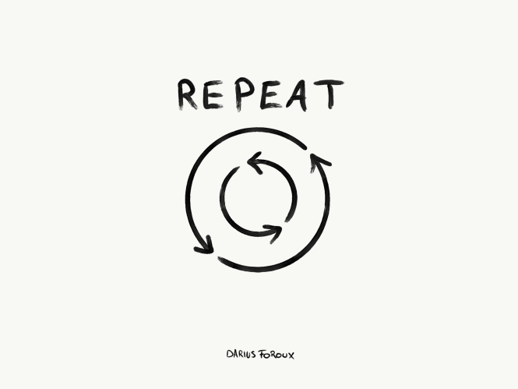
新年不是機械的重複 New Year Is Not a Repetition

Slide 3
新年不是簡單的累加 New Year Is Not an Addition

Slide 4
新年乃是重新來過 New Year Is an Opportunity

Slide 5
林後 2Cor 5:17
若有人在基督裡，他就是新造的人，舊事已過，都變成新的了。
Therefore if anyone is in Christ, he is a new creature; the old things passed away; behold, new things have come.

Slide 6
祝大家新年快樂﹗
HAPPY NEW YEAR TO ALL!

