Slide 1
DNA: God’s marvel; man’s deception; the Bible’s Revelation DNA：上帝的奇跡；人的欺騙；聖經的啓示
1. What is DNA – A chemical marvel full of information requiring an Omniscient Designer
什麽是DNA- 一個充滿資訊的化學奇跡， 它需要無所不知的設計者；
2. Atheist scientists use it to turn men into animals: deceptions of scientific reports claiming Apes & Humans 98.5% the same
無神科學家使用它將人變成動物：騙人的科學報告宣稱猿與人類98.5%是一樣的。

Slide 2
DNA: God’s marvel; man’s deception; the Bible’s Revelation DNA：上帝的奇跡；人的欺騙；聖經的啓示
3. The Bible cryptically & supernaturally revealed DNA 3000 yrs. Ago
聖經在三千年前神秘地、超自然地啓示出DNA；
4. Scientific Bible Truths confirmed by DNA
合乎科學的聖經真理被DNA確認；
5. Understanding DNA’s relationship to our physical body helps us accept ourself & fulfill our purpose in life
明白DNA與我們身體的關係，幫助我們接受自己並完成人生 的目的。

Slide 3
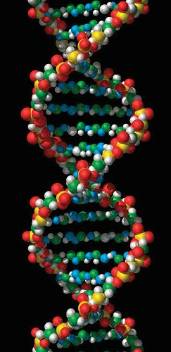
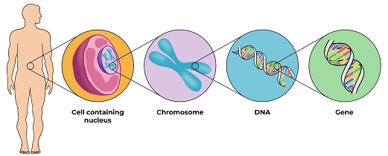
1. What is DNA 什麽是脫氧核糖核酸
A chemical marvel of massive information that mandates an Omniscient Designer
一個充滿大量資訊的化學奇跡，絕對需要 一位無所不知的設計者。

Slide 4
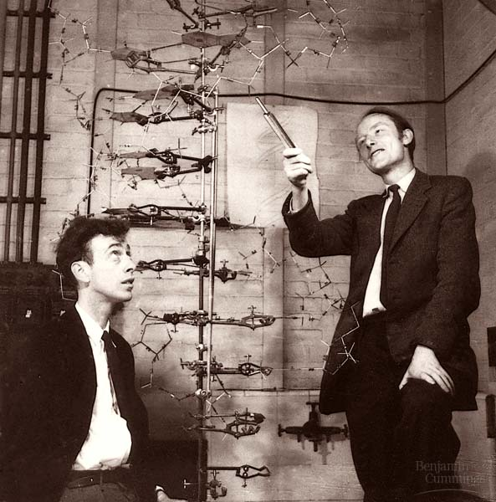
The Chemical instruction manual for all Life discovered in 1953 1953年發現的生物化學指導手冊
James Watson & Francis Crick discovered the helical structure of the DNA molecule.
James Watson 與 Francis Crick發現了螺旋結構的DNA分子，
Awarded Nobel Prize in Medicine 1962
1962年被授予醫學諾貝爾獎。

Slide 5
Francis Crick saw the impossibility of DNA originating naturally by time & chance so… Francis Crick看見DNA以時間和偶然而發生的不可能性，因此…
He proposed a theory of ‘directed panspermia’ (1973) & wrote a Book about it: Life Itself (1981)
他提出一個“定向汎精症”理論（1973），寫下一本書， 名為：Life Itself 生命本身 (1981).
Jerry Bergman, Panspermia – The Theory that Life came from outer Space. This good overview of the theory is online at:
j07_1_82-87.pdf (creation.com)
Jerry Bergman，汎精症 – 生命來自外太空的理論

Slide 6
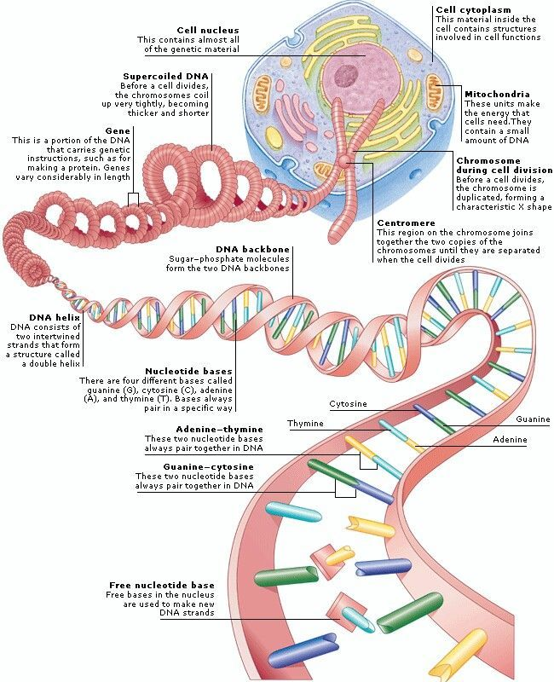
DNA is the template for making all proteins needed by any biological organism to live & reproduce
DNA是製造所有生物賴以存活並繁殖的蛋白質的模板，
Its complexity & information content is irrefutable evidence for intelligent design!
它的複雜性及資訊内容是無法反駁的智能設計的證據！

Slide 7
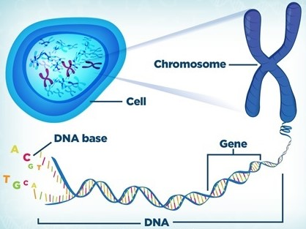
Each of our Body’s Trillions of cells contains 46 Chromosomes (23 pairs) in the nucleus
身體内上兆的細胞，每個細胞核都含有46個（23對）染色體
Half the chromosomes from Mom; half from Dad. Each chromosome is a tightly coiled molecule of DNA
染色體一半來自母親，一半來自父親，每一染色體都是緊密盤繞的DNA分子。

Slide 8
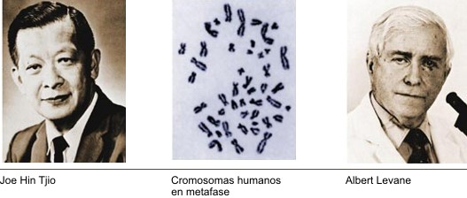
Trust the Science: Caution alert! 測驗科學：要小心！
1923 Theophilus Painter announced 48 human chromosomes. Accepted by science 30 yrs.! [called: reinforcement syndrome]
1923年Theophilus Painter 宣佈有48個人類染色體，科學接受了它30年！（稱作：强化綜合症）
Believed until 1956 when Albert Levane & Joe Tjio showed the actual number was 46.
一直到1956年Albert Levan & Joe Tjio 才顯示確實數目是46.

Slide 9
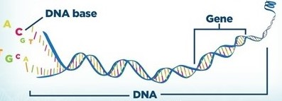
What is DNA? 什麽是DNA？
Entire length of DNA composed of building blocks [bases or letters A,C,T,G] forming about 25,000 Genes [segments of DNA]
由構建塊 [鹼基或字母 A、C、T、G] 組成的整個 DNA 長度， 形成大約 25,000 個基因 [DNA 片段] ，
Genes: instruction manuals for making 100,000 proteins & RNA’s
基因：製作 100,000 種蛋白質和 RNA 的指導手冊，
DNA folds into 2 & 3-dimensional structures encoding higher levels of information
DNA 折疊成 2 維和 3 維結構，編碼更高層次的信息 。

Slide 10
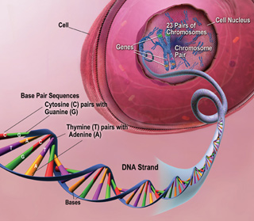
We have 2 genomes: 23 chromosomes from mom, 23 from Dad. The Sequence of 46 Chromosomes is ‘the Genome’ 我們有 2 個基因組：23 條染色體來自母親， 23 條來自父親。 46條染色體的序列是“基因組”
Each genome has 3 Billion DNA bases (letters) (3 gigabytes of information!) DNA from a single cell = 6ft.; Total DNA in our body = 120 billion miles!
每個基因組有 30 億個 DNA 鹼基（字母）（3 GB 的信息！）來自單個細胞的 DNA = 6 英尺；我們體內的總 DNA = 1200 億英里！

Slide 11
DNA causes all living things to reproduce “after their Kind” DNA 使所有生物“各從其類”繁衍
Every time a fertilized cell divides it faithfully copies the original. Somehow each division knows what part of the body to form until you have a complete human being!
每次受精細胞分裂時，它都會忠實地複制原始細胞。不知何故，每個部門都知道要形成身體的哪個部分，直到您成爲一個完整的人！
The information coded in one cell would require 1000 volumes of 500 pages each to record it all {Tall as the Washington Monument} a dividing cell copies all 1000 volumes in 20 minutes
在一個單細胞中編碼的信息需要 1000 卷，每卷 500 頁才能全部記錄{高得像華盛頓紀念碑}，當一個單細胞分裂時，它會在 20 分鐘內復制所有 1000 卷 。

Slide 12
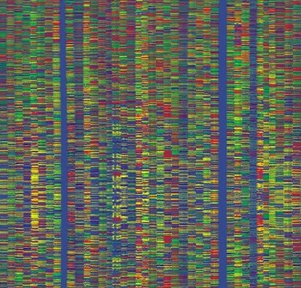
Mapping the Genome is amazing! It documents all the ‘Hardware’ needed to make & maintain a Human Body 繪製基因組圖是驚人的！它記錄了製造和維護人體所需的 所有“硬件”
Illus.: Like taking 12 volumes, 500 pgs. Each, of the Oxford English Dictionary; ripping each page into 300,000 pieces; mix it all in a barrel; & then restore the volumes back together!
舉例：比如牛津英語詞典12 卷，每卷500 頁。將每頁撕成 300,000 份，將其全部混合在桶中；然後將卷恢復在一起！

Slide 13
Explaining the printed words in a Dictionary is much more complex than describing the paper & ink (Hardware - material)
解釋字典中印刷的單詞，比描述紙張和墨水（硬件 - 材料）複雜得多 ，
Information conveyed by the words (Software – immaterial) allows us to know, understand & make things!
文字傳達的信息（軟件 - 非物質）使我們能夠知道、理解和製作事物！
In all our scientific experience, anything that involves language-like information, must involve an intelligent mind!
在我們所有的科學經驗中，任何涉及類似語言信息的事物，都必須涉及智能！

Slide 14
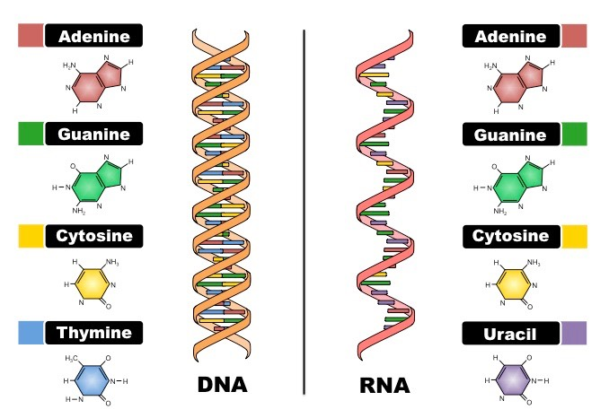
DNA / RNA conundrum requiring a Creator: way too complex to have evolved much less simultaneously DNA / RNA 的難題需要有創造者：太複雜了，更難以同時進化
You need DNA to make RNA but you need RNA to make & maintain DNA! [need both at the same time]
我們需要DNA來製造RNA，但也需要RNA來製造並維持DNA！【兩者同時需要】。

Slide 15
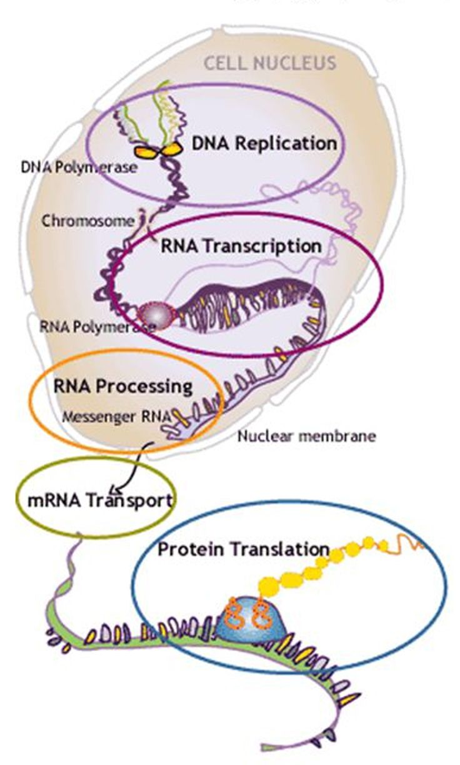
You need DNA & 3 kinds of RNA to make proteins. But you need proteins to make DNA & RNA [must have both simultaneously]
我們需要DNA及三種RNA來製造蛋白質，但我們也需要蛋白質來製造DNA及RNA（兩者都必須有）。
Scientists identified at least 8 other such paradoxes that plague cell biology if you leave out a Creator!
科學家認出至少其他八種吊詭，倘若排除造物主，就殃及細胞生物學。
& This is only the material “Hardware”
而這只是物質的‘硬體’而已。

Slide 16
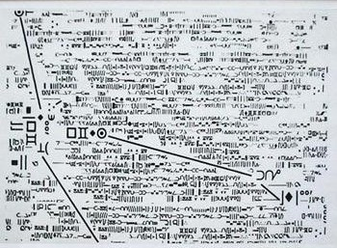
The Greatest Challenge to Evolution is The Inconceivably complex immaterial ‘Information’ Programmed into DNA 進化的最大挑戰是編入 DNA 的難以置信的複雜、非物質“信息”
Such Information requires an Omniscient Mind to program & Its implementation requires an Omnipotent Power!
這樣的信息需要全知的頭腦來編程，它的實施需要全能的力量！
Illustration: The book & movie: “Contact” by atheist Carl Sagan
Actual message from space in Movie ‘Contact’

Slide 17
Famous Atheist, Antony Flew, writes how He came “to believe there is a God!” (pg. 1) 著名無神論者Antony Flew寫下他如何“相信有上帝的存在”
A Major factor in his conversion was “DNA’s almost unbelievable complexity; the number of elements; how they work together, & require intelligence (pg. 75) & information.” (pg. 126-132)
他轉變的一個主要因素是“DNA 幾乎令人難以置信的複雜性；元素數量；他們如何一起運作”，都需要情報（第 75 頁）和信息”（第 126-132 頁）。

Slide 18
2. Atheist scientists use DNA to turn men into animals 無神論科學家使用DNA將人變成動物
Claims that Apes & Humans are 98.5% the same are very deceptive
他們聲稱猿與人類98.5%相似，是十分欺騙人的
Why? for evolution to work apes & humans must be that similar!
爲何？因爲進化論要能施行，猿與人類就必須如此類似！
Geoffrey Simmons, M.D., What Darwin Didn’t Know: A Doctor Dissects the Theory of Evolution, p. 305

Slide 19
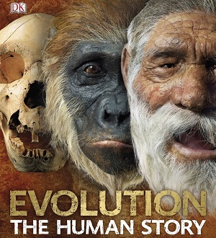
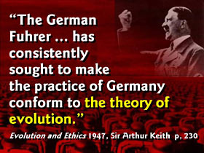
Scientists are turning men into animals without morals Why we must proclaim the truth of god! 科學家將人變成沒有道德的動物 爲何我們必須宣告上帝的真理！
Much Evil results from rejecting God’s Truth!
許多罪惡是拒絕上帝真理的結果！

Slide 20
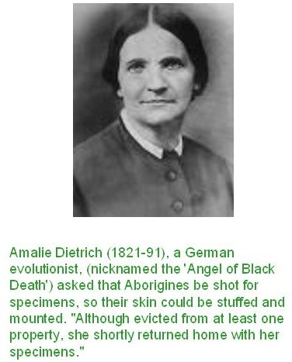
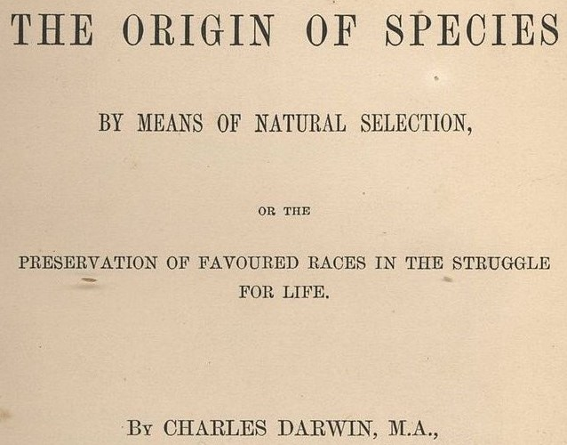
Countless atrocities were spawned by Darwin’s Theory 數不清的暴行都因達爾文理論而產生
Notice the part of the Title conveniently left out today

Slide 21
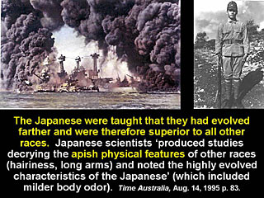
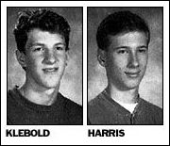
Harris & Klebold killed 13 in the Columbine massacre (notice his tee-shirt)

Slide 22
Past Errors concerning Human/Ape DNA 有關人類/猿DNA過去犯的錯誤
Francis Collins, The Language of God, 2006, said Human & chimp shared 98% of DNA; human chromosome 2 made of a fusion of Chimp chromosomes 2A & 2B; & 45% of human DNA is junk!
Francis Collins，2006年出版的【上帝的語言】，說人類與黑猩猩共享98%的DNA；人類的染色體2號是由黑猩猩的染色體2A，2B融合而來的；而人類45%的DNA是垃圾！
Sadly, YouTube duo Rhett & Link mention these things as reasons they left the Christian faith. 可悲的是，油管二人組Rhett & Link 提及這些事情是他們離開基督信仰的原因。
a good response at: https://creation.com/letter-to-rhett-mclaughlin

Slide 23
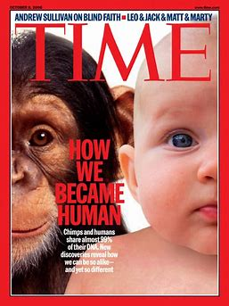
Past Errors about Human/Ape DNA 有關人類/猿DNA過去犯的錯誤
In 2005 scientists did believed 98% of chimp DNA matched human DNA
2005年，科學家確實相信98%的黑猩猩DNA與人類的DNA是匹配的，
Magazine bias exaggerates to 99% as does Richard Dawkins (1986)
雜志的偏見誇大到99%，Richard Dawkins (1986)也如此。

Slide 24
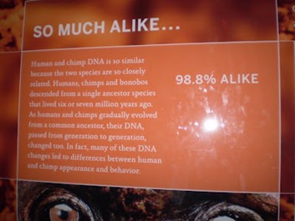
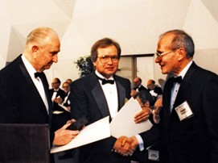
Past Errors about Human/Ape DNA 有關人類/猿DNA過去犯的錯誤
American Museum of History 2008
2008年美國歷史博物館
The man who 1st came up with the %, Jon Ahlquist, became a creationist: https://creation.com/jon-ahlquist
首位提出百分比的人， Jon Ahlquist，後來成爲創造論者。

Slide 25
Be aware of Bias & Deceptions: Human/Chimp not similar 小心偏見與欺騙：人類/黑猩猩不類似
Even 2% difference is 60 million base pairs (6 million words; 20 large books of information). An impossible amount for evolution!
即使 2% 的差異也是 6000 萬對鹼基（600 萬個單詞；20 大信息書籍）。進化的不可能數量！
They don’t inform us 2 identical stretches of DNA can work differently: ‘turned on’ in different amounts, places & times!
他們沒有告訴我們 2 段相同的 DNA 可以以不同的方式工作： 以不同的數量、地點和時間“開啟”！

Slide 26
Be aware of Bias & Deceptions: Human/Chimp not similar 小心偏見與欺騙：人類/黑猩猩不類似
Deception: evolutionary scientists used only the coding portion of the gene for comparison (exon). Non alignable regions & gaps are often omitted. Key data consistently omitted.
欺騙：進化科學家只使用基因的編碼部分進行比較（外顯子）。不可對齊的區域和間隙通常會被省略。關鍵數據始終被省略。
They use the human genome as a guide to assemble & annotate the chimp genome! So there is no unbiased chimp sequence!
他們使用人類基因組作為組裝和註釋黑猩猩基因組的指南！所以沒有無偏差的黑猩猩序列！

Slide 27
Currently known Facts of Human/Ape DNA 目前已知的人類/猿DNA事實
A 2012 Study shows 86-89% similarity. Saying similarity proves common ancestry with apes is not hard empirical science but soft historical science. Data just as well proves a common Design!
2012 年的一項研究顯示 86-89% 的相似性。說相似性可證明與猿有共同祖先不是硬實證科學，而是軟歷史科學。數據也同時證明他們具有共同的設計！
It is now known there was widespread contamination of primate databases with human DNA. See article:
現在知道人類 DNA 對靈長類動物數據庫的廣泛污染，見文章： https://creation.com/human-chimp-dna-similarity-literature

Slide 28
Currently known Facts of Human/Ape DNA 目前已知的人類/猿DNA事實
Y
Y-chromosome bombshell: human have 60 genes, chimp only 25; they have marked differences in structure;
染色體重磅炸彈：人類有60個基因，黑猩猩只有25個；它們在結構上有顯著差異； (Hughes, J.F. et al., Chimpanzee & human Y chromosomes are remarkably divergent in structure and gene content, Nature 463:536–539, 2010)

Slide 29
Previously scientists believed 98% of DNA was Junk
之前科學家認爲98%的DNA是垃圾，
A 2012 study of the ‘Encode Project’ say its about 20% Junk Breakthrough study overturns theory of 'junk DNA' in genome | Genetics | The Guardian
2012 年對“編碼項目”的一項研究，稱大約 20% 是垃圾。突破研究推翻了基因組中“垃圾 DNA”的理論 |遺傳學 |守護者 。
A review of the literature shows junk DNA is highly controversial & ignorance about it is still too huge to make conclusions
對文獻的回顧表明，垃圾 DNA 是極具爭議的，對它的無知仍然太大而無法下結論 。
Wise to remember “God don’t make no junk!” 請記住：“上帝不造垃圾”

Slide 30
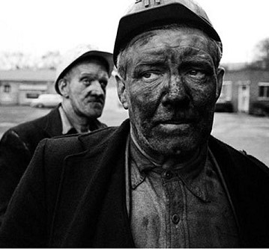
If what evolutionists say is true, why are Humans & Apes so different? 倘若進化論者所説為真，爲何人類與猿如此不同？
A Jewish Rabi tells a story to determine if you have enough common sense to overcome authoritarian deceptions & understand God’s Word
一位猶太拉比講述了一個故事，以確定你是否有足夠的常識去克服專制的欺騙，並理解上帝的話語 。

Slide 31
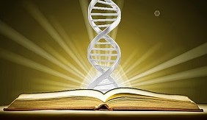
3. The Bible cryptically & supernaturally revealed DNA & its workings 3000 yrs. Ago
聖經神秘地，超自然地在三千年前啓示出DNA以及它的運作

Slide 32
DNA: The Bible’s Supernatural Revelation (Ps. 139:14-17) DNA： 聖經超自然的啓示（詩篇139：14-17）
(14) “I will praise thee; for I am fearfully & wonderfully made: marvelous are thy works; & that my soul knoweth right well”
14節：我要稱謝你，因我受造，奇妙可畏；你的作為奇妙，這是我心深知道的。
Human body is the most amazing & complicated thing that exists!
人體是所有存在事物中最奇妙與複雜的！
(15) “My substance was not hid from thee, when I was made in secret, & curiously wrought in the lowest parts of the earth.”
15節：我在暗中受造，在地的深處被聯絡；那時，我的形體並不向你隱藏。

Slide 33
(Ps 139:16) “Thine eyes did see my substance, yet being unperfect; (Jer. 1:5; Isa. 49:1, 5; Gal. 1:15-16)
16節：我未成形的體質，你的眼早已看見了；
& in thy book all my members were written, which in continuance were fashioned, when as yet there was none of them.”
你所定的日子，我尚未度一日（或作：我被造的肢體尚未有其一），你都寫在你的冊上了。
(17) “How precious also are thy thoughts unto me, O God! how great is the sum of them!” (Rom. 8:29; Eph. 1:4-6)
17 節：神啊，你的意念向我何等寶貴！其數何等眾多！

Slide 34
Psalm 139 matches many scientific descriptions of DNA. Some call The Human Genome: ‘the Book of Life’! 詩篇139篇匹配許多DNA的科學描述 有些人稱人類基因庫為：“生命之書”
A, C, T, G, are the letters of our instruction manual.
A,C,T,G是我們指導手冊的字母，
Small clusters of the 4 letters make up (the words)
四個字母集合造出文字，
The words combine to form genes (the chapters);
文字組合形成基因（篇章），
Genes combine to form chromosomes (the volumes);
基因組合形成染色體（冊）；

Slide 35
4. Scientific Bible Truths are confirmed by DNA 合乎科學的聖經真理被DNA確認
DNA, in light of god’s word, helps explain how sin affected mankind throughout history
DNA，根據上帝的話語，有助於解釋
罪如何一直在歷史中影響著人類

Slide 36
DNA witness to a real Historical Adam & Eve DNA見證亞當與夏娃是真實存在歷史中
1987 – report mitochondrial DNA demonstrates every human being descended from the same female [mitochondrial Eve]
1987 – 有報告線粒體 DNA 表明，每個人都來自同一個女性 [線粒體夏娃] ，
Y chromosome analysis found every human male descended from one single male [Y-chromosome Adam]
Y染色體分析發現，每個人類男性都來自一個單身男性[Y染色體亞當] ，
Scientists boasted Adam & Eve never met as Adam lived long after Eve! So the Bible’s wrong. 科學家誇耀說亞當與夏娃從未見過面，因在夏娃之後很久亞當才出現！所以聖經錯了。

Slide 37
Solution: Most Recent Common Ancestor [MRCA] 解決方案：最靠近的共同祖先【MRCA】
The males on Noah’s Ark all shared the same Y-chromosomes
挪亞方舟上的男性都擁有同樣的Y染色體，
The 4 woman were not related & traced their lineages back to Biblical Eve.
四位婦女沒有血緣關係，但追溯她們的血統到聖經的夏娃。
The MRCA of the men was Noah; the MRCA of the woman was Eve [DNA bears witness to the Biblical History]
男性的MRCA是挪亞；女性的MRCA是夏娃。 【DNA見證聖經歷史】

Slide 38
Why is DNA degenerating? 爲何DNA在退化？
(Gen 2:17) “But of the tree of the knowledge of good & evil, thou shalt not eat of it: for in the day that thou eatest thereof thou shalt surely die. [Hebrew literally: ‘dying thou shalt die’]
創2：17-只是分別善惡樹上的果子，你不可吃，因為你吃的日子必定死！」 （希伯來文字意：在死亡中你必死）
Adam’s sin results in Genetic mutations, mistakes, & the mortifying process of dying.
亞當的罪導致基因突變、錯誤，以及死亡的痛苦過程。

Slide 39
The human genome is irrevocably degenerating over time.
隨著時間的推移，人類基因組正在不可逆轉地退化。
Dr. J.C. Sanford, Genetic Entropy, gives empirical evidence that the human genome is & has always been deteriorating – ever since its origin. This is all due to the accumulation of mutations.
遺傳熵的 J.C. Sanford 博士給出了實證證據，證明人類基因組自其起源以來一直在惡化。這都是因為突變的積累。
We start ‘dying’ from the moment of conception!
我們自受孕時刻就開始“死亡”！

Slide 40
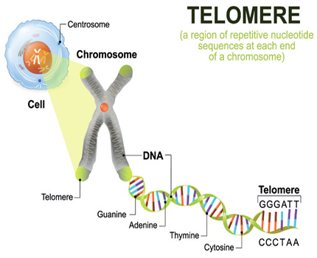
The average human life span (Ps. 90:9-10) & upper limit (Gen 6:3) match recent DNA discoveries of Telomeres 人類的平均壽命（詩篇 90:9-10）和上限（創世紀 6:3） 與最近發現的 DNA端粒相符
(Job 14:5, 14) “his days are determined, the number of his months are with thee, thou hast appointed his bounds that he cannot pass” (Job 7:1; Ps. 39:4)
約伯記14：5- 人的日子既然限定，他的月數在你那裡，你也派定他的界限，使他不能越過，

Slide 41
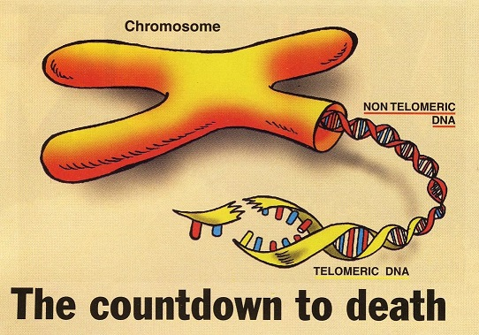
Human life spans seem to be pre-determined & programmed into DNA itself (Telomeres)
人類的壽命似乎是預先確定的，並被編入 DNA 本身（端粒） ，
Good diet, exercise & stress management slows down the shortening of telomeres.
良好的飲食、運動和壓力管理可以減緩端粒的縮短。
A fruit of the Spirit: self control
屬靈的果子之一：自制。
Once the Telomere ends are worn down cells can no longer divide – and death will ensue
一旦端粒的尾端消耗，細胞就不再分裂-死亡就隨之而來。

Slide 42
5. DNA & finding peace with my physical body DNA & 安於我的身體
We must accept how god created us & brought us into this world (Jer. 1:5; Gal. 1:15-16)
我們必須接受上帝如何造了我們，並將我們帶入這個世界
we wouldn’t be here if god hadn’t allowed the imperfect dna from countless sinful ancestors (Ps. 51:5) to come together & “mold me” (Job 10:8; Ps. 119:73; Isa. 43:7)
如果上帝不讓無數有罪的祖先（詩篇 51:5）的不完美 DNA 聚集在一起並“塑造我”（約伯記 10:8；詩篇 119:73；以賽亞書 43： 7) ，
我就不會在此。

Slide 43
DNA inherited from Countless Ancestors produced many unchangeable things in my life: 從數不清的祖先繼承的DNA，製造出人生許多無法改變的事情：
My Parents: Half my DNA from mom & half from dad 父母親
My racial background (Gal. 3:28-29) 種族背景
My National heritage 國家遺產
My Gender 性別
My physical features 體徵
My mental abilities 智力
My aging & death 老化與死亡

Slide 44
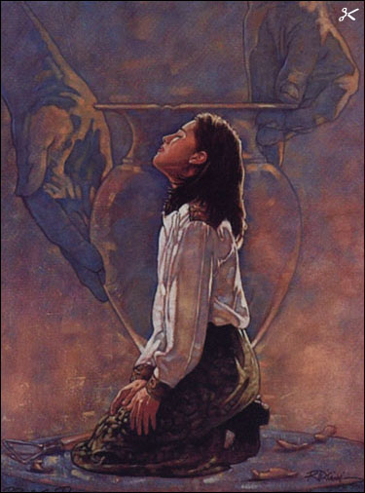
God determines the details of my physical Body 上帝決定我身體的細節
(Job 10:8-9) Thine hands have made me & fashioned me…
伯10:8-9 你的手創造我，造就我…
…thou hast made me as the clay; (Ps. 119:73; Isa. 43:7; 64:8)
詩119:73 - …你的手製造我…

Slide 45
God completely knew me before conception 在我受孕前上帝就完全曉得我
(Jer. 1:5) Before I formed thee in the belly I knew thee... (Ps. 71:6)
耶1:5 - 我未將你造在腹中，我已曉得你….
Every person is 1st known in the heart of God to do good works & then formed in the womb to carry out those works (Eph. 2:10).
每人首先在上帝的心意中被創造來行善, 然後在子宮中被形成來完成這些善行 (弗2:10).

Slide 46
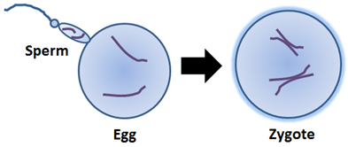
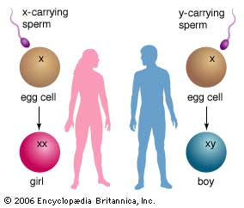
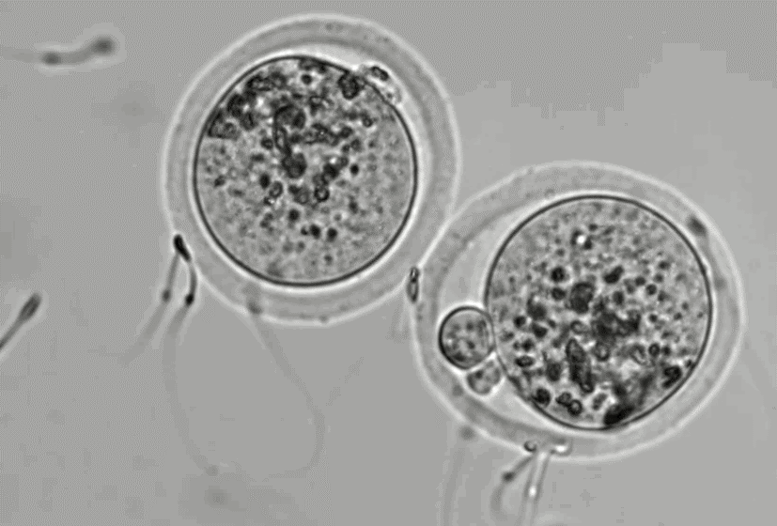
God picks the DNA from 1 sperm out of possible millions 上帝從百萬精子中挑選其中一個精子的DNA

Slide 47
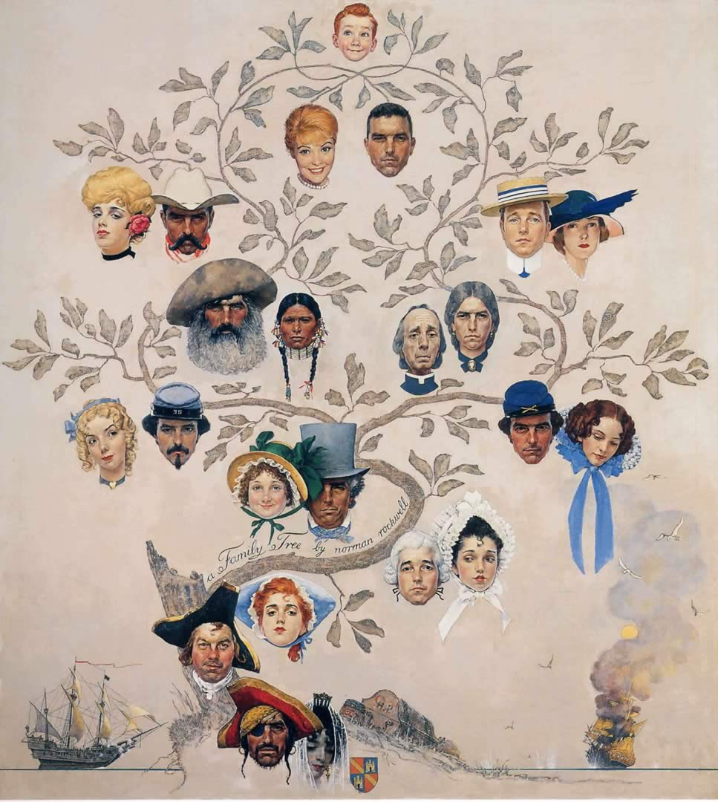
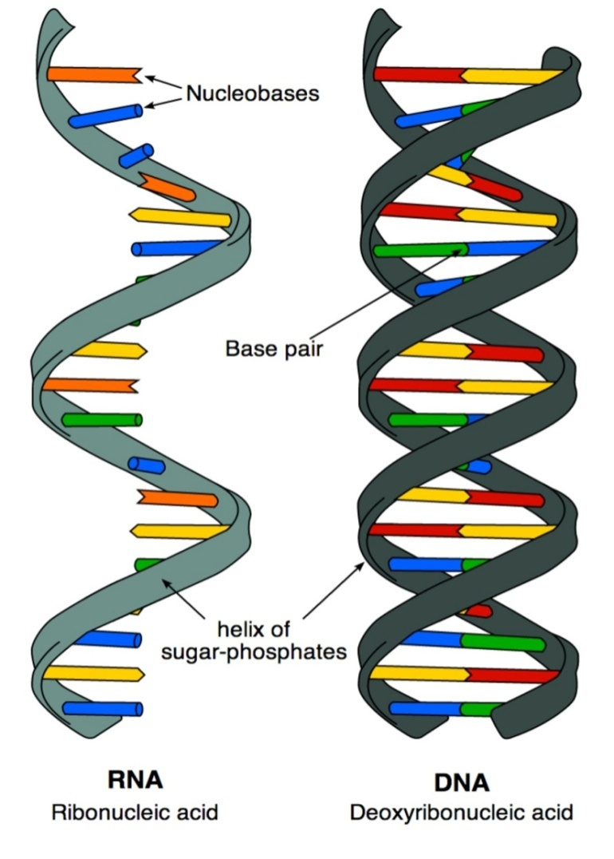
God formed my DNA from many sinful ancestors 上帝自許多有罪祖先開始, 寫下我的DNA

Slide 48
God sovereignly arranged for my DNA to come together over countless generations going back to ADAM! 上帝以祂的權能,自亞當開始,經過數以百計的世代, 將我的DNA 安排出來
God created MY SOUL uniquely me (Gen. 1:26-27)
上帝創造我的靈魂 – 獨特的我.
But every one of my ancestors contributed to the DNA that went into forming MY PHYSICAL BODY.
但我祖先的每一位,都提供他們的血統,進入我的DNA, 來塑造我的身體.

Slide 49
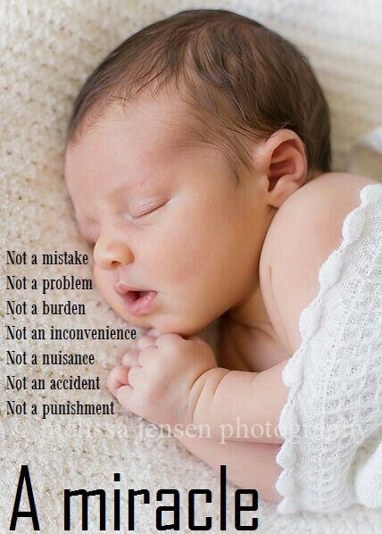
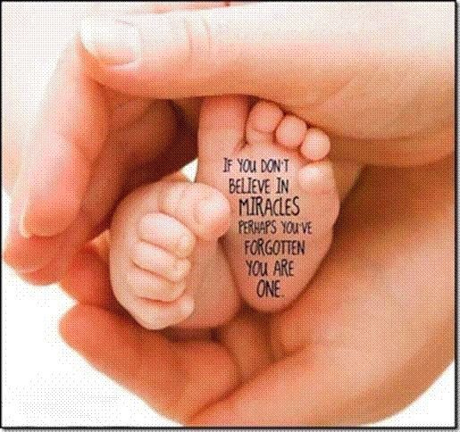
Thank God for the Miracle that is YOU! 感謝上帝-你是奇蹟!

Slide 50
Does God cause Physical Defects? 上帝造成了身體缺陷嗎?
Neither God’s Word, nor science, allows us to blame God for the effects of sin on genetics.
上帝的話語和科學, 都不容許我們因罪對遺傳的影響,而怪罪於上帝.
God cautions us about placing specific blame for life’s tragedies. (John 9:1-7)
上帝的話語也告誡我們,不要因人生的悲劇而責怪某些人.
Illustration: “forgive us our debts, as we forgive our debtors” (Matt. 6:12). Who do I owe the greatest debt to? Who do I blame when things don’t go the way I wanted them to?

Slide 51
God’s Grace triumphs over man’s Sin 上帝的恩典勝過人的罪惡
(Rom 5:20) “where sin abounded, grace did much more abound:
羅5:20 - 只是罪在那裡顯多，恩典就更顯多了
(21) That as sin hath reigned unto death, even so might grace reign through righteousness unto eternal life by Jesus Christ our Lord.
羅5:21-就如罪作王叫人死；照樣，恩典也藉著義作王，叫人因我們的主耶穌基督得永生。

Slide 52
In this life physical defects, & results of aging have an eternal purpose 今生身體的缺陷, 老化的結果, 都具有永恆的目的
2Co 4:16 For which cause we faint not; but though our outward man perish, yet the inward man is renewed day by day.
林後4:16 - 所以，我們不喪膽。外體雖然毀壞，內心卻一天新似一天。
Thus we focus on our INNER CHARACTER not our outer physical appearance, to prepare for eternity! Are You Focused?
因此, 我們專注在內在的品格, 而非外在的相貌.

Slide 54
The following slides contain additional helpful faith building information for those who wish to do more study

Slide 55
Science bears witness to Biblical History!
DNA evidence can now generally document the movements of mankind's dispersion after the tower of Babel (Gen. 10)
(Gen 9:19) “These are the three sons of Noah: and of them was the whole earth overspread.”
Y-chromosome studies proved conclusively that Arab & Jewish populations shared a MRCA, who by genetic dating lived about 4000 years ago.
Jews refrained from intermarrying so “the divergence of Jewish populations was low despite great geographical dispersion (Ex. 33:16; Lev. 20:24; Num. 23:9; Deut. 7:3-4; I Kings 8:53)

Slide 56
The Aaronic Priesthood is confirmed for the End-Times
the Cohen Modal Haplotype (CHM), is distinctly associated with Jewish men who claim genetic descent from Aaron
Genetic data estimates the original Person of the CHM lived about 3300 years ago
God’s promise to keep His people throughout history (& to regather them in the end times) can now be documented!

Slide 57
Mapping the Genome may help Cure disease
Misspellings (mutations) in a Gene sequence causes disease. Scientists identify 6000 genetic diseases.

Slide 58
DNA: Infinite complexity points to an Intelligent Designer!
Antony Flew (1923-2010) “the findings of more than 50yrs. Of DNA research have provided materials for a new & enormously powerful argument to design”
(My pilgrimage from atheism to theism: an exclusive interview with Antony Flew by Gary Habermas, Philosophia Christi, Winter 2005. https://digitalcommons.liberty.edu/cgi/viewcontent.cgi?article=1336&context=lts_fac_pubs

Slide 59
Antony Flew writes how He came “to believe there is a God!” (pg. 1)
A Major factors in his conversion was: “DNA’s almost unbelievable complexity; number of elements; how they work together” requiring intelligence (pg. 75) & information (pg. 126-132)
Also design in Nature; Laws of nature (pg. 95-112)
The anthropic principle (pg. 113-121)

Slide 60
DNA is beyond human comprehension or ability to imitate
“On a good day about 1 million bases in the Human DNA cell are damaged” (Salisbury, D.F., Newly discovered DNA repair mechanism, Science News, sciencedaily.com, 5 October 2010)
DNA contains proof-reading & error checking machinery encoded; so amazing it keeps the error rate down to less than 1 error per 10⁷ letters
DNA is so unstable it must be stored in liquid nitrogen at -200º C

Slide 61
Why Mutations can’t cause evolution from simple to complex
Neo-Darwinism teaches evolution proceeds through the combined efforts of natural selection & genetic mutations.
3 kinds of mutations: 1. Bad 2. good 3. neutral (accomplish nothing)
99% of mutations are neutral or harmful. They're errors in the code
If you introduce errors in a computer program it destroys it!

Slide 62
“Most all mutations are neutral or harmful. Beneficial mutations are so few they can’t be measured! The few good ones cannot overcome the negative effects of many bad ones.” (Dr. J. C. Sanford, Genetic Entropy & the Mystery of the Genome, 2008, pp. 21-27; also Bataillon, T. 2000. Estimation of spontaneous genome-wide mutation rate parameters: whither beneficial mutations? Heredity 84:497-501)
“Speciation (i.e. macro-evolution) still remains one of the biggest mysteries in evolutionary biology”
(Bob Holmes, “Accidental Origins,” New Scientist (March 13, 2010): p. 31)

Slide 63
The Scientific Problems with the Evolution of Cells & DNA by Chance is well known!
“For any cell to evolve by chance is absolutely impossible according to all the known laws of science!”
(Robert Gange, Ph.D. (research scientist with extensive research in the field of cryophysics and information systems), Origins and Destiny, 1986, p. 77.)
(Johnjoe McFadden (Evolutionist & professor of Molecular Biology & Quantum Physics), Quantum Evolution, 2000, p. 85)
(Franklin M. Harold, Professor of Biochemistry & Molecular Biology at Colorado State U., The Way of the Cell, 2001, p. 235)

Slide 64
Some Birth Defects are Genetic, inherited from sins of previous generations 某些天生缺陷來自基因, 承繼上幾代的罪惡
The #1 preventable cause of birth defects is drinking alcohol during pregnancy (Greeks called alcohol - teratogen)
第一個可預防的天生缺陷是懷孕期間飲酒 (致畸劑)
So we are warned to “flee youthful lusts” (2Tim. 2:22; ICor. 6:18)
聖經警告我們要「逃避少年的私慾」 (提後2:22)
A father who smokes marijuana can cause his son to be sterile

Slide 65
Some Genetic Birth Defects caused by the effects of sin on all Creation (Rom. 8:20-22; Hos. 4:1-3) 某些來自基因的天生缺陷,是萬物中受罪的影響造成的
We underestimate the seriousness, power & effect of sin on the whole world. (Gen. 3)
我們低估了罪對全世界的嚴重性, 能力,和影響力 (創3章).
DNA studies reveal each parent contributes 200 new genetic mutations to the next generation! (genetic entropy)
遺傳學顯示, 每一位家長為下一個世代貢獻200種新的基因突變! (基因熵).

Slide 66
No Physical defects diminish in any way our infinite value as a human beings! 身體缺陷絲毫不減少我身為人的無限價值!
But only God’s Word teaches this & only Christians have lived it out in history
但只有上帝的話語教導此點,也只有基督徒在歷史中活出此點.
Most cultures eliminated their weak & deformed. The 1st orphanages started by Christians in Rome
多數文化消除他們當中軟弱和畸形的人.
第一個孤兒院是羅馬的基督徒開始的.
Illus: How do you determine somethings value? 例:你如何決定價值? By what price someone is willing to pay for it! The Cross!

Slide 67
Never lose sight of God’s Eternal Purpose 不要看不見上帝永恆的目的
(Rom 8:28) We know all things work together for good to them that love God, to them who are called according to his purpose.
羅8:28 -我們曉得萬事都互相效力，叫愛神的人得益處，就是按他旨意被召的人。
(8:29) For whom he did foreknow, he also did predestinate to be conformed to the image of his Son” (Our hope: I Cor. 15:52-54)
8:29 -因為他預先所知道的人，就預先定下效法他兒子的模樣，使他兒子在許多弟兄中作長子

Slide 68
Important Lessons 重要功課
Flee “youthful lusts” because what you do will effect your descendants for generations to come
逃避「少年的私慾」, 因為你的行為將會影響你許多世代的子孫.
No physical handicap or deformity can diminish my infinite value as a human being
沒有任何身體缺陷或畸形, 會減少我身為人的無限價值.

Slide 69
Important Lessons 重要功課
No physical handicap or deformity can keep me from fulfilling my God given purpose
沒有任何身體缺陷或畸形,能夠防止我完成上帝賜給我的目的.
I am specially designed by God to fulfill an extraordinary Divine purpose in this life.
我是上帝特別設計的,要在今生來完成特殊的神聖目的.
I can only learn that purpose from God’s Word. 我只能從上帝的話語中學到這目的.

Slide 70
I can only fulfill God’s purpose through a personal relationship with Jesus Christ
我也只能從與耶穌基督的個人關係中,完成上帝的目的.
The supernatural power to accomplish God’s purpose is supplied by the Holy Spirit in me
完成上帝的目的的超然力量, 經由我裡面的聖靈供應給我.
Once I accept myself the way God made me I am Free to begin the supernatural adventure of serving my LORD Jesus
一旦我接受上帝造我的樣式, 我就有自由開始這超自然的, 事奉主耶穌的探險.

Slide 71
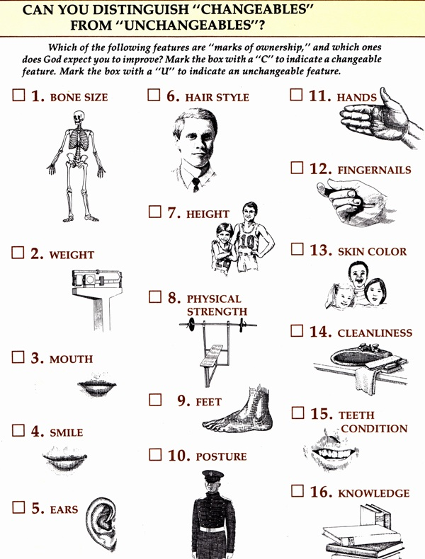
Can you separate Changeable & Unchangeable Physical Features 可改變或 不可改變的 身體特徵

