Slide 1

詩篇 Psalms 3
¹耶和华啊，我的敌人何其加增。有许多人起来攻击我。
² 有许多人议论我说，他得不着神的帮助。（细拉）
³ 但你耶和华是我四围的盾牌。是我的荣耀，又是叫我抬起头来的。
⁴ 我用我的声音求告耶和华，他就从他的圣山上应允我。（细拉）
⁵ 我躺下睡觉。我醒着。耶和华都保佑我。
⁶ 虽有成万的百姓来周围攻击我，我也不怕。
⁷ 耶和华啊，求你起来。我的神啊，求你救我。因为你打了我一切仇敌的腮骨，敲碎了恶人的牙齿。
⁸ 救恩属乎耶和华。愿你赐福给你的百姓。（细拉)

Slide 2
詩篇 Psalms 3
¹ O LORD, how are they increased that trouble me! many are they that rise up against me.
² Many there be which say of my soul, There is no help for him in God. Selah.
³ But thou, O LORD, art a shield for me; my glory, and the lifter up of mine head.
⁴ I cried unto the LORD with my voice, and he heard me out of his holy hill. Selah.
⁵ I laid me down and slept; I awaked; for the LORD sustained me.
⁶ I will not be afraid of ten thousands of people, that have set themselves against me round about.
⁷ Arise, O LORD; save me, O my God: for thou hast smitten all mine enemies upon the cheek bone; thou hast broken the teeth of the ungodly.
⁸ Salvation belongeth unto the LORD: thy blessing is upon thy people. Selah.

Slide 3
1) 將困境帶到神面前 (詩篇 Psalms 3: 1, 2 )
Bring the Predicament to God
A) 大衛逃亡 David Fled
(撒下 II Samuel 15: 9, 10; 13,14)
B) 大衛受咒詛 David Was Cursed
(撒下 II Samuel 16 : 5 – 8)
大衛審視處境
David Assessed the Predicament

Slide 4
2) 請神掌管困境(詩篇 Psalms 3: 3 - 6)
Invite God Intervene in the Predicament
從關注環境轉向關注神
Turn the Eye from the Surrounding to God
仰賴神的名 Entrust God’s Name (6 次 times)
C) 完全信靠並交託給神
Totally Trust and Give the Situation to God

Slide 5
3) 向神祈求 Supplication (詩篇 Psalms 3: 7, 8)
求神施恩拯救 Ask for Mercy and Salvation
神的作為超乎所求所想
God’s Way Is Beyond Our Imagination
(撒下 II Samuel 18: 9, 14, 15)
C) 救恩属乎神 Deliverance Comes from the Lord

Slide 6
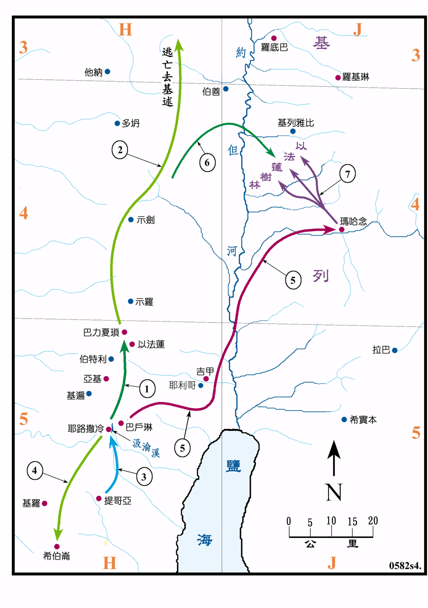

Slide 7
4) 總結 Conclusion 詩篇 Psalms 3
神的慈愛圍繞著我們
God’s Loving Kindness Surrounded Us
B) 任何環境中抬起頭 仰望信靠 神
Left Our Head and Trust the Lord in All Situation
C) 神渴望我們經历 衪
God Desires for Us to Experience Him

