Slide 1
委身基督 Committed to Christ 路加福音 Luke 9:57-62 陳金昌牧師 Pastor Jinchang Chen

Slide 2
第一個門徒: 自願、熱情、態度堅定,但是對付出的代價估計不足
The first disciple: voluntary, firm, and passionate, but he under-estimated the cost of following Christ

Slide 3
願意犧牲享受 Sacrifice in This Life Willingly
一個莽撞冒失的門徒
A reckless disciple
甘心為主付出
Willing to pay the price

Slide 4
第二個門徒: 耶穌親自呼召,願意跟從,但是將家庭放在 第一優先 _____________
The second disciple: Jesus called him, and he was willing to follow, but he put his family needs in the first place

Slide 5
耶穌呼召優先 Prioritize Jesus’ Calling Exclusively
一個本末倒置的門徒
An inverted Disciple
忠心於主的呼召
Devoted to the calling of Christ

Slide 6
第三個門徒:自告奮勇,樂于付出, 但是瞻前顧後,不能專心
The third disciple: voluntary, and ready to sacrifice, but he was double-minded in following Jesus

Slide 7
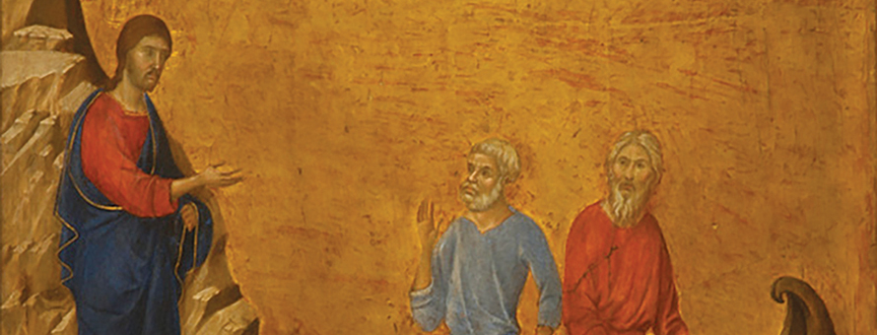
一心追隨基督 Follow the Leading of Christ Decisively
一個瞻前顧後的門徒
A hesitant disciple
專心為主工作
Concentrated on the labor for Christ

Slide 8
一個有為的基督徒 A Contagious Christian
必須是一個甘願付出的人
Must become a self-sacrificing person

