Slide 1
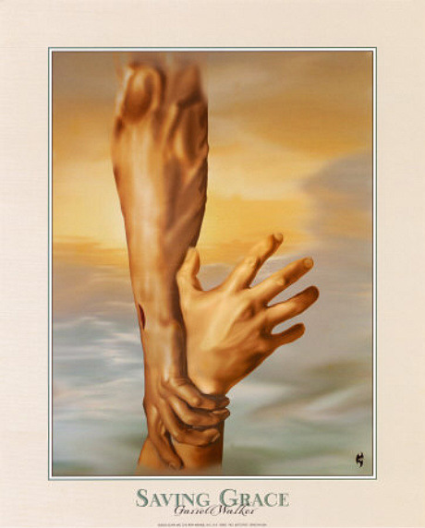
谁能使我们与神的爱隔绝呢？ Who shall separate us from the Love of God?
罗8：14 – 17
Romans 8：14 -17
崔東燮牧師
Pastor Dongxie Cui

Slide 2
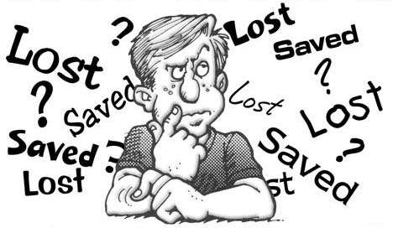
引言： Introduction:
你有得救的确据吗？
Do you have the assurance of salvation?

Slide 3
保罗的告白（Paul’s Confession)：
羅8:38. 因为我深信无論是死，是生，是天使，是掌权的，是有能的，是现在的事，是将來的事，39. 是高处的，是低处的，是别的受造之物，都不能叫我们与神的爱隔绝；这爱是在我们的主基督耶稣裏的。
Rom. 8:38. For I am convinced that neither death nor life, neither angels nor demons, neither the present nor the future, nor any powers, 39. neither height nor depth, nor anything else in all creation, will be able to separate us from the love of God that is in Christ Jesus our Lord.

Slide 4
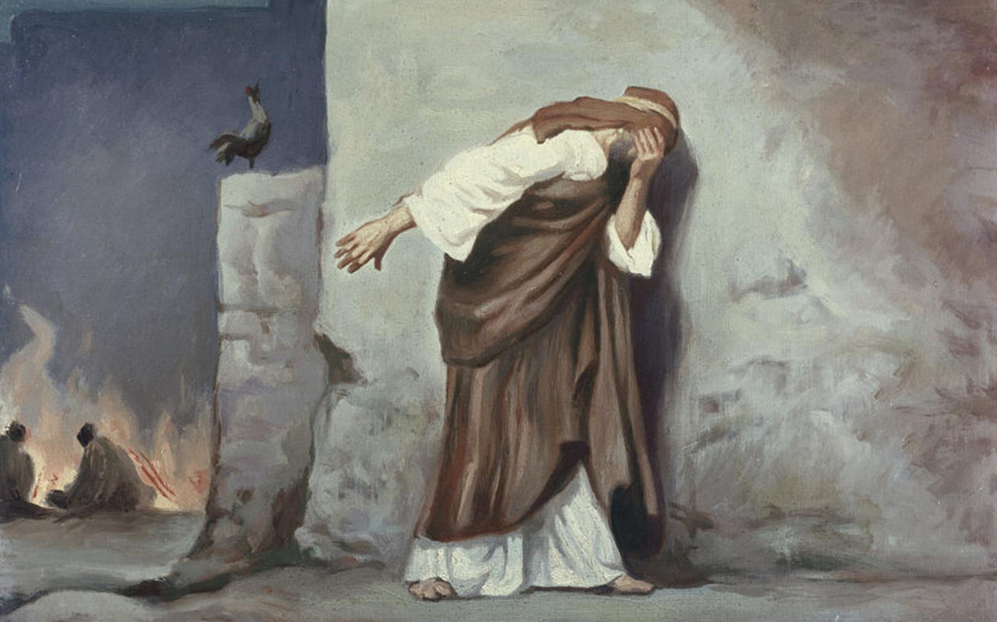
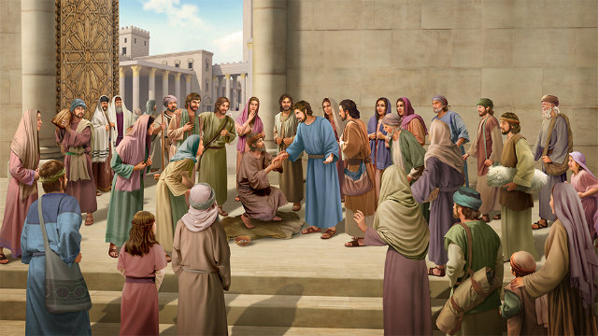
得救确信的重要性
否认耶稣的彼得 – 传讲耶稣的彼得
我们确信得救的确据是什么？
What is the Assurance of Salvation?

Slide 5
一。耶稣基督的工作 （罗Rom. 8：1-3） Jesus’ work on the Cross
1。耶稣的宝血 （The Blood of Jesus Christ)
没有义人，连一个都没有，罪的工价乃是死！
如今，那些在基督耶稣裏的就不定罪了！
Therefore, there is now no condemnation for those who are in Christ Jesus,
2。错误的确据 （False Assurance）
把信心大小当作确据 （Size of Faith)
把生命表现当作确据 ( Fruits of Life)

Slide 6
二。圣灵的工作 The Work of the Holy Spirit
1。儿子的名分 （The Sonship of God)
14. 因为凡被神的灵引导的，都是神的儿子。 15. 你们所受的，不是奴仆的心，仍旧害怕；所受的，乃是儿子的心，因此我们呼叫：阿爸！父！ 16. 圣灵与我们的心同證我们是神的儿女；
14. because those who are led by the Spirit of God are sons of God. 15. For you did not receive a spirit that makes you a slave again to fear, but you received the Spirit of sonship. And by him we cry, "Abba, Father."16. The Spirit himself testifies with our spirit that we are God's children.

Slide 7
加4：5-6
5. 要把律法以下的人赎出來，叫我们得著儿子的名分。 6. 你们既为儿子，神就差他儿子的灵进入你们（原文作我们）的心，呼叫：阿爸！父！
5. to redeem those under law, that we might receive the full rights of sons. 6. Because you are sons, God sent the Spirit of his Son into our hearts, the Spirit who calls out, "Abba, Father.“
阿爸！父！ ( Abba, Father!)

Slide 8
约10：27-29
27. 我的羊听我的声音，我也认识他们，他们也跟著我。28. 我又赐给他们永生；他们永不灭亡，谁也不能从我手裏把他们夺去。29. 我父把羊赐给我，他比万有都大，谁也不能从我父手裏把他们夺去。
27. My sheep listen to my voice; I know them, and they follow me. 28. I give them eternal life, and they shall never perish; no one can snatch them out of my hand. 29. My Father, who has given them to me, is greater than all; no one can snatch them out of my Father's hand.

Slide 9
2。圣灵的见证 （The Testimony of the Holy Spirit)
16. 圣灵与我们的心同證我们是神的儿女；
16. The Spirit himself testifies with our spirit that we are God's children.

Slide 10
3. 圣灵的印 （The Seal of the Holy Spirit)
13. 你们既听见真理的道，就是那叫你们得救的福音，也信了基督，既然信他，就受了所应许的圣灵为印记。（弗1：13）
13. And you also were included in Christ when you heard the word of truth, the gospel of your salvation. Having believed, you were marked in him with a seal, the promised Holy Spirit,

Slide 11
三。庆祝信徒的保障的救恩 Celebrate Believer’s Security
31. 既是这样，还有甚麽说的呢？神若帮助我们，谁能敌挡我们呢？
32. 神既不爱惜自己的儿子，为我们众人舍了，豈不也把万物和他一同白白的赐给我们吗？
33. 谁能控告神所拣选的人呢？有神称他们为义了。

Slide 12
三。庆祝信徒的保障的救恩 Celebrate Believer’s Security
34. 谁能定他们的罪呢？有基督耶稣已经死了，而且从死裏复活，现今在神的右边，也替我们祈求。
35. 谁能使我们与基督的爱隔绝呢？难道是患难吗？是困苦吗？是逼迫吗？是饥饿吗？是赤身露体吗？是危险吗？是剑吗？

Slide 13
三。庆祝信徒的保障的救恩 Celebrate Believer’s Security
36. 如经上所记：我们为你的缘故终日被杀；人看我们如将宰的羊。
37. 然而，靠著爱我们的主，在这一切的事上已经得胜有馀了。

Slide 14
三。庆祝信徒的保障的救恩 Celebrate Believer’s Security
38. 因为我深信无論是死，是生，是天使，是掌权的，是有能的，是现在的事，是将來的事，
39. 是高处的，是低处的，是别的受造之物，都不能叫我们与神的爱隔绝；这爱是在我们的主基督耶稣裏的。

Slide 15
三。庆祝信徒的保障的救恩 Celebrate Believer’s Security
31. What, then, shall we say in response to this? If God is for us, who can be against us? 32. He who did not spare his own Son, but gave him up for us all -- how will he not also, along with him, graciously give us all things? 33. Who will bring any charge against those whom God has chosen? It is God who justifies.

Slide 16
三。庆祝信徒的保障的救恩 Celebrate Believer’s Security
34. Who is he that condemns? Christ Jesus, who died -- more than that, who was raised to life -- is at the right hand of God and is also interceding for us. 35. Who shall separate us from the love of Christ? Shall trouble or hardship or persecution or famine or nakedness or danger or sword? 36. As it is written: "For your sake we face death all day long; we are considered as sheep to be slaughtered."

Slide 17
三。庆祝信徒的保障的救恩 Celebrate Believer’s Security
37. No, in all these things we are more than conquerors through him who loved us. 38. For I am convinced that neither death nor life, neither angels nor demons, neither the present nor the future, nor any powers, 39. neither height nor depth, nor anything else in all creation, will be able to separate us from the love of God that is in Christ Jesus our Lord.

Slide 18
结论： Conclusion：
得救的确据什么？ （What is the assurance of Salvation?)
耶稣的宝血 ( The Blood of Jesus)
儿子的名分 ( The Sonship of God)
神的爱 ( The Love of God)
现在有没有得救的确信？ ( Are you truly saved?)
Amen！

