Slide 1
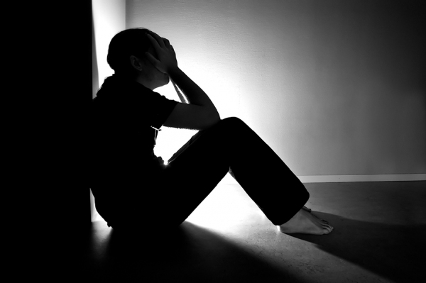
當壞事發生在好人身上...
When Bad Things Happen to Good People…
詩篇 Ps.13: 1–6
陳金昌牧師
Pastor Jinchang Chen

Slide 2
質問上帝 Question God?
為什麼會有苦難﹖
Why is there suffering in this world?

Slide 3
神義論 Theodicy
上帝即是全能﹐又是慈愛﹐我為什麼還要受苦﹖
If God is sovereign and love, why do I have to suffer?

Slide 4
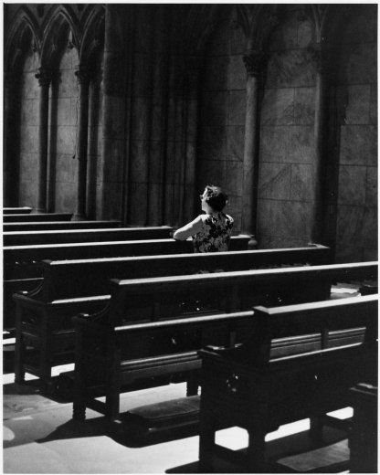
神的公義 God 's Justice
上帝永遠保持其屬性的真實。
God remains always true to who he is.

Slide 5
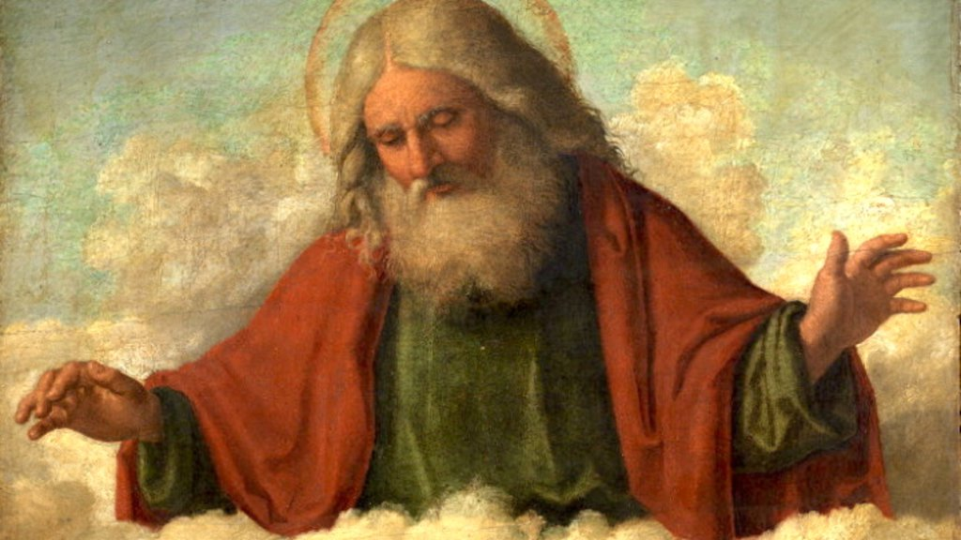
回顧與展望 Remember & Look Forward
上帝的慈愛和祂的救恩。
God’s lovingkindness and his salvation.

Slide 6
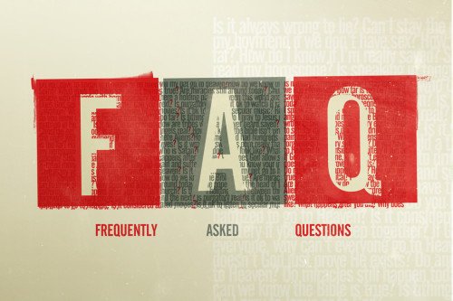
什麼是壞事﹖ 我們曉得萬事都互相效力，叫愛神的人得益處(羅8:28)。 What Is the Bad Thing? And we know that God causes all things to work together for good (Rom. 8:28).
命題 Q&A (1)

Slide 7
誰又是好人呢﹖ 沒有義人，連一個也沒有(羅3:10)。 Who Is a Good Person? There is none righteous, not even one (Rom 3:10) .
命題 Q&A (2)

Slide 8
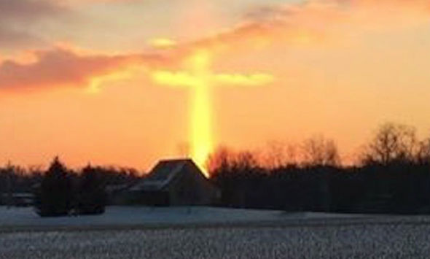
苦難之中榮耀神
Glorify God in All Things

