Slide 1
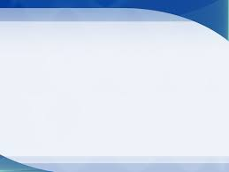
講題: 初代教會三問題
Three Questions of the Early Church
經文: 加拉太書3:26-28
Galatians 3:26-28
鄭昌國牧師
Rev. Joseph Cheng

Slide 2
一. 誰可得救？Who Can Be Saved?
種族之界限
Race Boundaries
2. 地位之界限
Status Boundaries
3. 性別之界限
Gender Boundaries

Slide 3
二. 如何得救? (羅2:25-29; 3:19-24)
How to Be Saved? (Rom. 2:25-29; 3:19-24)
三. 誰是救主？(約一4:1-3)
Who Is the Saviour? (I John 4:1-3)

