Slide 1
有信心的母親 A Mother of Faith
裴賀安慈師母
5/13/18

Slide 2
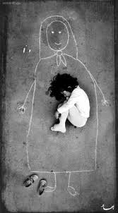

Slide 3
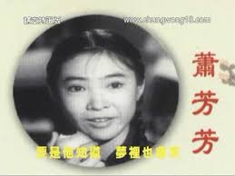

Slide 4
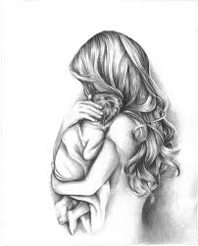
世上只有媽媽好
世上只有媽媽好 有媽的孩子像個寶 投進媽媽的懷抱 幸福少不了
世上只有媽媽好 沒媽的孩子像根草 離開媽媽的懷抱 幸福哪裡找
世上只有媽媽好 有媽的孩子不知道
要是他們知道 夢裡也會笑！
(苦兒流浪記主題曲)

Slide 5
詩經小雅＜蓼莪 lu er＞
要句：無父何怙？無母何恃？出則銜恤，入則靡至。
語譯：沒有了父親要依賴誰？失去了母親要倚靠誰？出門在外就滿懷憂傷，入門回家卻如無所歸。

Slide 6
上帝給予婦女/母親之獨特身份 The Unique Position God Gives to Woman
林前11:11 然而照主的安排(在主裡)，女也不是無男，男也不是無女。
Nevertheless neither is the man without the woman, neither the woman without the man, in the Lord.
林前11:12 因為女人原是由男人而出，男人也是由女人而出；但萬有都是出乎神。
For as the woman is of the man, even so is the man also by the woman; but all things of God.

Slide 7
上帝給予婦女/母親之獨特身份 The Unique Position God Gives to Woman
彼前 3:7 你們作丈夫的，也要按情理﹝原文作知識﹞和妻子同住；因她比你軟弱，（比你軟弱：原文作是軟弱的器皿）與你一同承受生命之恩的，所以要敬重她。這樣，便叫你們的禱告沒有阻礙。
1Pe 3:7 Likewise, ye husbands, dwell with them according to knowledge, giving honour unto the wife, as unto the weaker vessel, and as being heirs together of the grace of life; that your prayers be not hindered.
沒有男尊女卑的觀念

Slide 8
婦女/母親的獨特性 The Uniqueness of Woman/Mother
只有她能懷孕生育
孕育/生育帶來養育和教育
養育/教育發展出與兒女一生的情感連結並
實踐上帝賦予的使命
4.勞苦付出/犧牲貢獻
產生無法取代的人生價值
5.無法取代的價值被世人尊重/推崇

Slide 9
尊貴之後 - 母親的陷阱……
令人戰慄的殘酷權貴妒婦
權傾天下的女皇帝
幕後專權的皇太后
令人想入非非的性感女神
被神化和聖化的崇拜對象

Slide 10
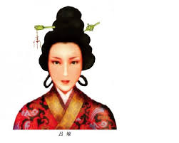
呂后- 令人戰慄的殘酷權貴妒婦

Slide 11
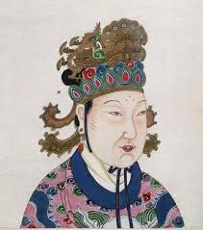
武則天- 權傾天下的女皇帝

Slide 12
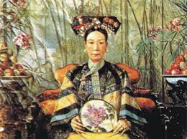
慈禧太后 (聖母皇太后) -幕後專權誤國的皇太后

Slide 13
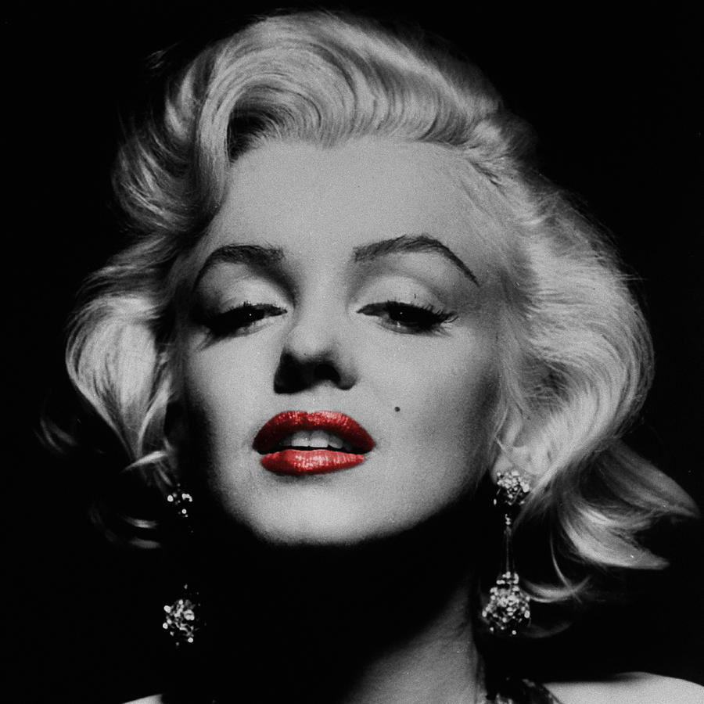
令人想入非非的性感女神

Slide 14
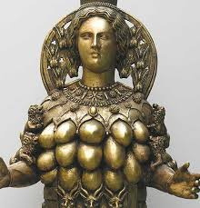
亞斯他錄

Slide 15
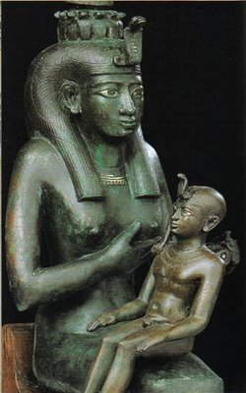
Iris with Horus

Slide 16
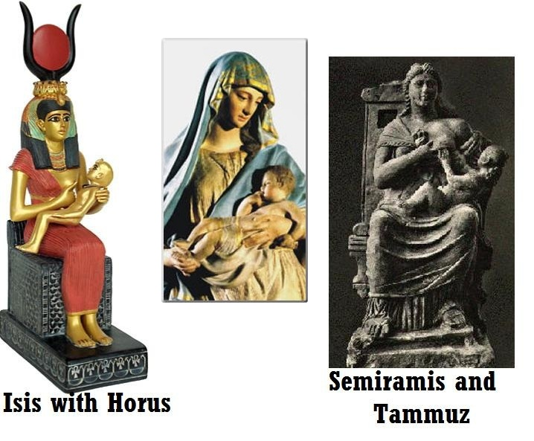

Slide 17
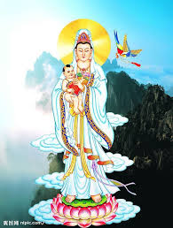
送子觀音

Slide 18
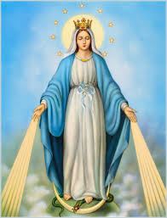
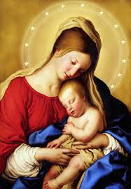
聖母馬利亞

Slide 19
現代婦女
的掙扎
Struggles of Modern Day Woman
辣媽

Slide 20
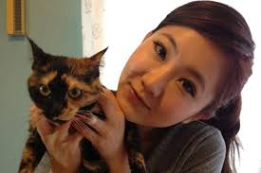
母親的危機 Crisis of Motherhood
少子化造成巨大教育, 社會問題

Slide 21
有信心的母親 – A. 承認自己是軟弱不足的 Admits she is insufficient
1.認知自己是軟弱的
2.明白禱告的重要
3.仰望倚靠上帝賜的恩典與資源

Slide 22
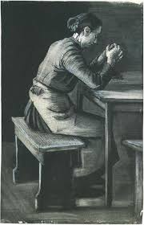
Suzanna Wesley (raised 19 children)

Slide 23
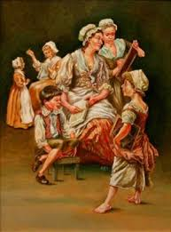
16 HOUSE RULES BY SUSANNAH WESLEY (JOHN & Charles WESLEY’S MOM)
1. Eating between meals not allowed.
2. As children they are to be in bed by 8 p.m.
3. They are required to take medicine without
complaining.
*4. Subdue self- will in a child, working together with God to save the child’s soul.
*5. To teach a child to pray as soon as he can speak.
*6. Require all to be still during Family Worship.

Slide 24
16 HOUSE RULES BY SUSANNAH WESLEY (JOHN & Charles WESLEY’S MOM)
7. Give them nothing that they cry for, and only that when asked for politely.
*8. To prevent lying, punish no fault which is first confessed and repented of.
*9. Never allow a sinful act to go unpunished.
*10. Never punish a child twice for a single offense.
*11. Comment and reward good behavior.

Slide 25
16 HOUSE RULES BY SUSANNAH WESLEY (JOHN & Charles WESLEY’S MOM)
12. Any attempt to please, even if poorly performed, should be commended.
13. Preserve property rights, even in smallest matters.
14. Strictly observe all promises.
15. Require no daughter to work before she can read well.
16. Teach children to fear the rod.

Slide 26
SUSANNAH WESLEY – on DiSCIPLINE
Susannah Wesley believed that for a child to grow into a self-disciplined adult, he/she must first be a parent-disciplined child.
To her, the stubborn flesh was the hardest battle for Christians to fight, and Godly parents would do well to equip their children to overcome it early.

Slide 27
有信心的母親 B. 承擔上帝給她的職份 Bears God-given responsibility
天職

Slide 28
有信心的母親 – B. 承擔上帝給她的職份
營造健康的家庭環境
Build healthy family environment

Slide 29
1. 營造健康的家庭環境
1).平等的原則 (共同為家庭付出) Equality
- 與丈夫合作共同營造家庭
2).和睦的原則 (幫助者) Harmony/complimentary
- 讓丈夫作頭
3).敬畏的原則 (維繫下代的幸福) Has reverence for the Lord –維護婚姻，培育敬虔的後代

Slide 30
3). 敬畏的原則
瑪2:15 雖然神有靈的餘力能造多人，他不是單造一人 (二人合而為一) 嗎？為何只造一人 (合而為一) 呢？乃是他願人得虔誠的後裔。所以當謹守你們的心，誰也不可以詭詐待幼年所娶的妻。
Mal 2:15 And did not he make one? Yet had he the residue of the spirit. And wherefore one? That he might seek a godly seed. Therefore take heed to your spirit, and let none deal treacherously against the wife of his youth.
箴 14:1 智慧婦人建立家室；愚妄婦人親手拆毀。
Pro 14:1 Every wise woman builds her house: but the foolish pluckes it down with her hands.

Slide 31
母親- 家中的調溫計
Mother-
A Thermostat

Slide 32
有信心的母親 – B. 承擔上帝給她的職份
2. 培養才德,持續成長
Cultivates virtue, continues to grow
(箴言31章10-31)

Slide 33
女子無才便是德?
A woman without talent is considered virtuous?

Slide 34
女子无才便是德出自明·张岱《公祭祁夫人文》：“眉公曰：丈夫有德便是才，女子无才便是德。此语殊为未确。”明末·陈继儒之语说：“女子通文识字，而能明大义者，固为贤德，然不可多得；其它便喜看曲本小说，挑动邪心，甚至舞文弄法，做出丑事，反不如不识字，守拙安分之为愈也。女子无才便是德。可谓至言。”

Slide 35
2. 培養才德, 持續成長
(箴言31章10-31)
有敬畏上帝的心
勤勉,值得信賴
做事理財精明,會照顧自己、家人
有愛心,未雨綢繆
說話得體,信心好
與丈夫, 兒女關係良好

Slide 36
成熟的表記
*1. Realizing how much you don't know.
明白自己還有許多不知道的東西.
2. Listening more and talking less.
多聽少說.
*3. Being aware and considerate of others as opposed to being self-absorbed, self-centered, and inconsiderate.
查覺、體貼他人，而不自我中心或不懂得體諒.

Slide 37
4. Not taking everything personally, getting easily offended, or feeling the need to defend, prove, or make excuses for yourself.
不容易被冒犯、不感覺需要維護、證明自己、或替自己找藉口.
5. Being grateful and gracious, not complaining.
懂得感恩、態度優雅、不抱怨.
*6. Taking responsibility for your own health and happiness, not relying on others to "fix" you or placing blame for your circumstances.
承擔自己健康和快樂的責任，不依賴他人來解決你的問題，或因自己的境遇責怪他人.

Slide 38
7. Having forgiveness and compassion for yourself and others.
對自己和他人有饒恕與同情.
*8. Being calm and peaceful, not desperate, frantic, or irrational.
沉著安穩，不急迫、匆促、或失去理性.

Slide 39
*9. Showing flexibility and openness as opposed to resisting, controlling, or being unreasonable.
表現彈性和開放，不是抗拒、控制、或不合理.
10.Helping yourself, not just expecting others to do it for you out of a sense of entitlement.
幫助自己，而不只是期待他人有義務為你辦事.

Slide 40
*11.Doing good deeds even when there is nothing in it for you other than knowing you helped, being selfless.
即使沒有自我利益也行善、不自私.
12.Respecting another's point of view, beliefs, and way of life without judgment, not insisting you are right, belittling another, or using profanity or violence to get your point across.
尊重他人的觀點、信念、生活方式而不論斷；不堅持自己是對的、小看他人、或使用髒話或暴力來發抒己見.

Slide 41
3.出於愛的服事 Serve with Love
多 2:4 (年長婦人)…指教少年婦人，愛丈夫，愛兒女，
Tit 2:4 That they may teach the young women to be sober, to love their husbands, to love their children,

Slide 42
3.出於愛的服事
多 2:5 謹守，貞潔，料理家務，待人有恩，順服自己的丈夫，免得神的道理被毀謗。
Tit 2:5 To be discreet, chaste, keepers at home, good, obedient to their own husbands, that the word of God be not blasphemed.
天職 - 家是第一個服事上帝的工場

Slide 43
有信心的母親 – C. 承受忠於職守的獎賞
發揮勝過珍珠的價值
實踐人生意義
2. 家人的祝福與稱讚
3. 傳承祝福給後代，以致全人類

Slide 44
1. 母親的獎賞- 發揮勝過珍珠的價值， 實踐人生意義
詩 128:3 你妻子好像在你的屋旁多結果子的葡萄樹；你兒女圍繞你的桌子，好像橄欖栽子。 (穩定的力量，多結果子)
詩 128:4 看哪，敬畏耶和華的人必要這樣蒙福！
Psa 128:3 Thy wife shall be as a fruitful vine by the sides of thine house: thy children like olive plants round about thy table.
Psa 128:4 Behold, that thus shall the man be blessed that feareth the LORD.

Slide 45
Pro 18:22 得著賢妻的，是得著好處，也是蒙了耶和華的恩惠。

Slide 46
2. 母親的獎賞 – 家人的祝福與稱讚
Pro 31:28 他的兒女起來稱他有福；他的丈夫也稱讚他
Pro 31:28 Her children arise up, and call her blessed; her husband also, and he praises her.
Pro 31:30 艷麗是虛假的，美容是虛浮的；惟敬畏耶和華的婦女必得稱讚。
Pro 31:30 Favour is deceitful, and beauty is vain: but a woman that fears the LORD, she shall be praised.

Slide 48
3. 母親的獎賞 – 傳承祝福給後代、造福全人類
申 7:9 所以，你要知道耶和華你的神，他是神，是信實的神；向愛他、守他誡命的人守約，施慈愛，直到千代；
Deu 7:9 Know therefore that the LORD thy God, he is God, the faithful God, which keeps covenant and mercy with them that love him and keep his commandments to a thousand generations;

Slide 49
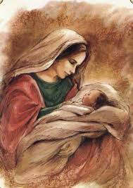
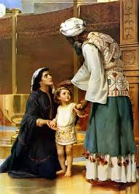
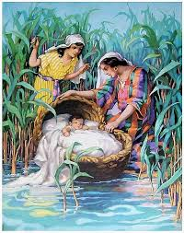
有信心的母親們 – 獎賞是大的

Slide 50
Jonathan Edwards and his wife Sarah left a great godly legacy for his 11 children. (1703-1758 A.D.) Jonathan Edwards’ godly legacy includes: 1 U.S. Vice-President, 3 U.S. Senators, 3 governors, 3 mayors, 13 college presidents, 30 judges, 65 professors, 80 public office holders, 100 lawyers and 100 pastors/missionaries. (150 years after Edwards’ death)

Slide 51
林三綱 牧師師母養育10位兒女

Slide 52
年青有異象的一代 Young generation with parenting visions

Slide 53
結語 Conclusion: 有信心的母親
明白並接受上帝給予的使命
以愛服事家人, 自己持續成長
以虔敬, 禱告實踐天職
等候上帝的獎賞
不要抹殺、拒絕作母親的影響力
發揮 、發揚母愛的必要與重要性

