Slide 1
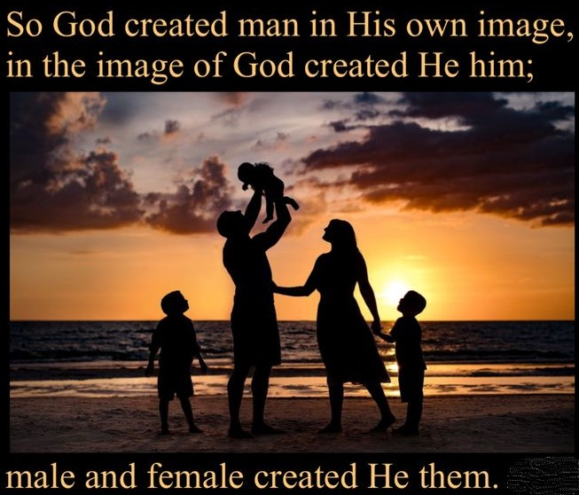
Genesis 2 Part 2 創世記第二章， 第二部分
What does it mean to be human?
America’s current identity crisis
何為人？
美國現今的身份認同危機

Slide 2
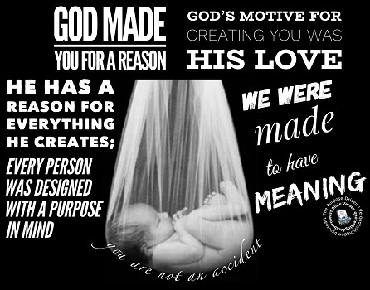
The Crisis fades as we Learn God’s Eternal Purpose for us. MAN IS THE GOAL & CROWN OF CREATION!
這個危機在我們學會上帝對我們永恆的目的之後會褪去
人是創造的目標與冠冕！

Slide 3
Man’s Divine Image, Dignity & Value are Being Attacked on two Fronts 人神聖的形像、尊嚴，與價值在兩方面被攻擊
From Science which has no means to do even simple basic studies of the human soul & spirit but denies their existence!
來自科學 - 科學沒有途徑來從事人的魂與靈最基本的研究，卻否認他們的存在！
From Lost Liberal scholars who attack God’s Word (2 Cor. 4:3-6; Matt. 11:25; 13:11-16)
來自失喪的自由派學者 – 他們攻擊上帝的話語（林後4：3-6，太11：25；13：11-16）。

Slide 4
We exposed the Deceptive attacks against Genesis 1 & 2 我們已揭發對創世記1，2章欺騙人的攻擊
We have to learn to think like God (Isa. 55:8-9; I Cor. 2:11-14)
我們必須學會像上帝一樣思想（賽55：8-9；林前2：11-14）。
In Chapt. 1 man is revealed as being the goal & pinnacle of Creation. All Creation is prepared for him.
創世記一章啓示，人是創造的目標與頂點，所有的創造都是為他而預備；
In Chapt. 2 man is presented as the starting point of History, impacting it for good or bad depending on his obedience to God!
創世記二章，人是歷史的開端，他是否順從上帝直接影響歷史的好或壞！

Slide 5
WE MUST NOT SEPARATE GENESIS FROM REVELATION 我們不能將創世記與啓示錄分開
History culminates with the glorious Kingdom of Christ, the last Adam (I Cor. 15:45-50; Eph. 1:9-10; Rev. 20-22)
歷史以基督，末後的亞當，榮耀的國度達至最高潮，
This earthly creation is preparatory for the eternal spiritual creation (I Cor. 15:42-49; John 3:3-7; Heb. 8:2, 5; 9:23; Col. 2:17)
地上的創造是為永恆屬靈的創造作預備，
The spiritual creation is the goal & perfecting of the earthly
屬靈的創造是屬地創造的目標與成全。

Slide 6
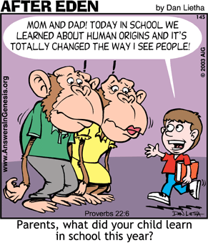
Choose your Teachers Wisely (Prov. 13:20; Isa. 54:13; John 6:45) 謹慎選擇你的教師
Will you follow sinful fallible men to destruction or the holy omniscient god to eternal glory?
你要追隨有罪、會犯錯的人走向滅亡，還是聖潔全知的上帝走向永恆的榮耀？

Slide 7
In Part 1 we Learned: God & Jesus Proved they Created & Control Time 第一部分我們學到： 耶穌將時間分開，證明祂是時間的主宰。
By an Unexplainable 7 day week & History’s Division into B.C. & A. D.
藉著無法解釋的一周七天，與歷史分成基督之前和基督之後

Slide 8
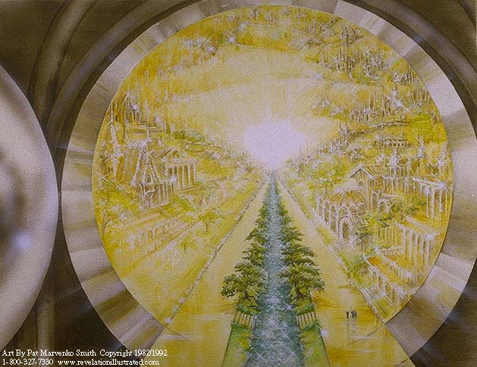
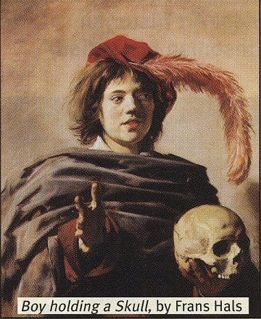
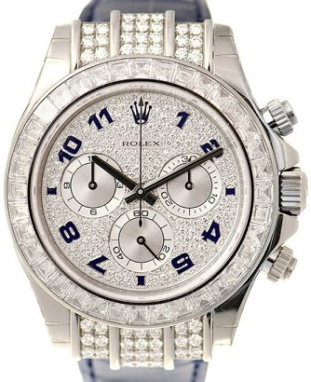
Constraints of Time should Motivate us to Live for Eternity (Hebrews 4:1-11) 時間的約束應該激勵我們為永恆而活
Psalm 90:12
Deut. 32:29; Lk. 12:16-21

Slide 9
TODAY WE WANT TO MAKE YOU AWARE OF SOME INTERESTING FACTS ABOUT CHINESE LANGUAGE & GENESIS CHAPTERS 1 thru 11
It can be a powerful tool to help you witness to friends & loved ones
今天我們要分享有趣的中國文字與創世記1-11章
它們是很有力與親友作見證的工具

Slide 10
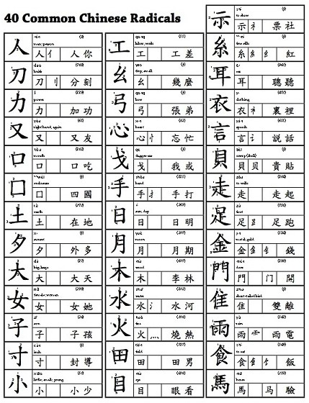
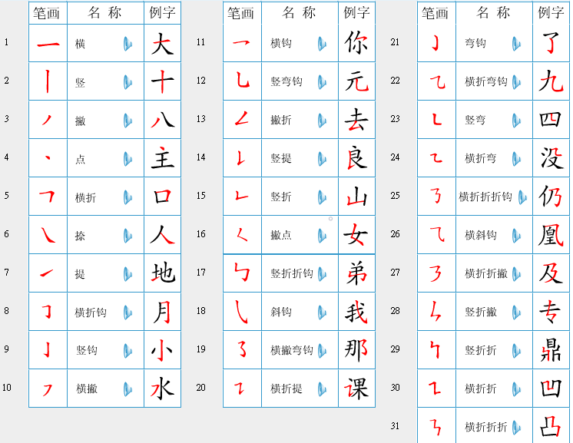
Statistically Improbable Parallels of Chinese Characters & Genesis 1-11 按統計數據，極其不可能的中國文字與創世記1-11章的平行
Chinese strokes form words
中文筆畫形成字體
strokes compose Radicals (214) the base components of characters
筆畫組成部首（214），是中文字體基本的成分。

Slide 11
Chinese ideographs preserve the History of Genesis 1-11 中文會意字保存了創世記1-11章的歷史
Chinese characters: Pictographs (600); ideographs (700); & phonetics (20,000)
中國文字：象形字（600），會意字（700），形聲字（20，000）
Modern day ideograph
現代會意文字
Common knowledge to all

Slide 12
Why ancient Chinese Contains the History of Genesis 1-11 爲何古代中國人包含創世記1-11章的歷史
Oldest Chinese writing: Shang oracle bones 1700 B.C.; Tower of Babel 2248 B.C.; Genesis written 1444 B.C.
最古老的中文：商朝甲骨文（紀元前1700年）；巴別塔（紀元前2248年），創世記寫作（紀元前1444年）。
Geographical isolation preserved the language almost unchanged
地理的隔離保存了幾乎沒有變更的語言。
Uniquely positioned to preserve history of Genesis 1 thru 11 in “ideographs” or “picture stories” (Act 14:15-17)
獨特的定位，在“會意字”和“圖畫故事”中保存創世記1-11章的歷史

Slide 13
Human bodies are designed for god & eternity (I Corinthians 6:13, 15, 19)
人的身體是為上帝和永恆而設計

Slide 14
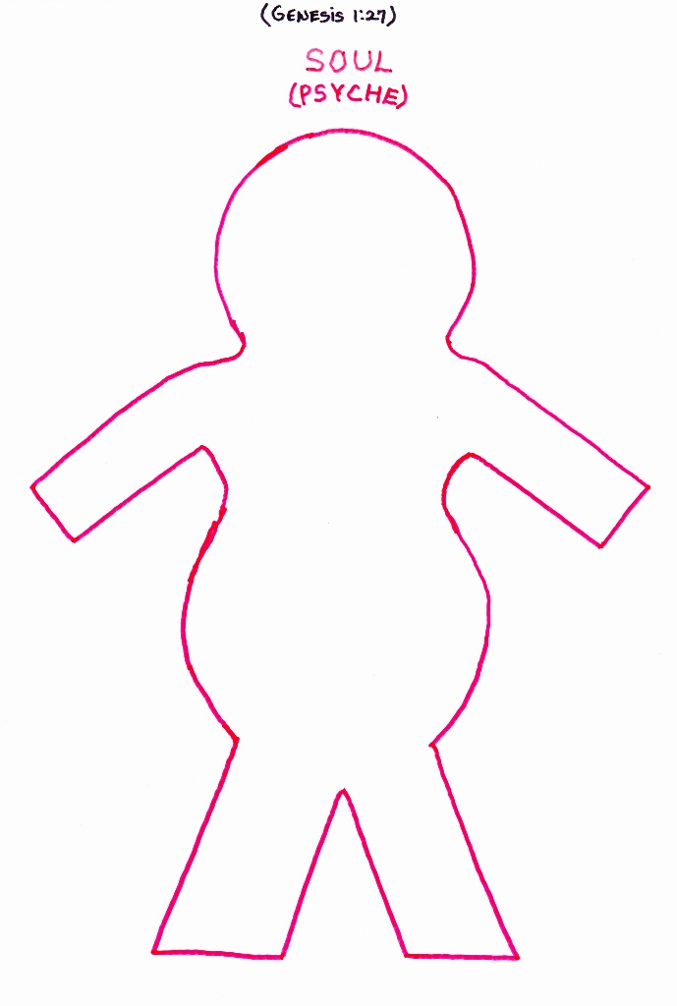
Our soul was Created in God’s image 我們的魂按上帝的形像而造
“God created man in his own image, in the image of God created he him; male & female created [Hebrew = bara] he them.” (Gen. 1:27)
創1:27 神就照著自己的形像造人，乃是照著他的形像造男造女。

Slide 15
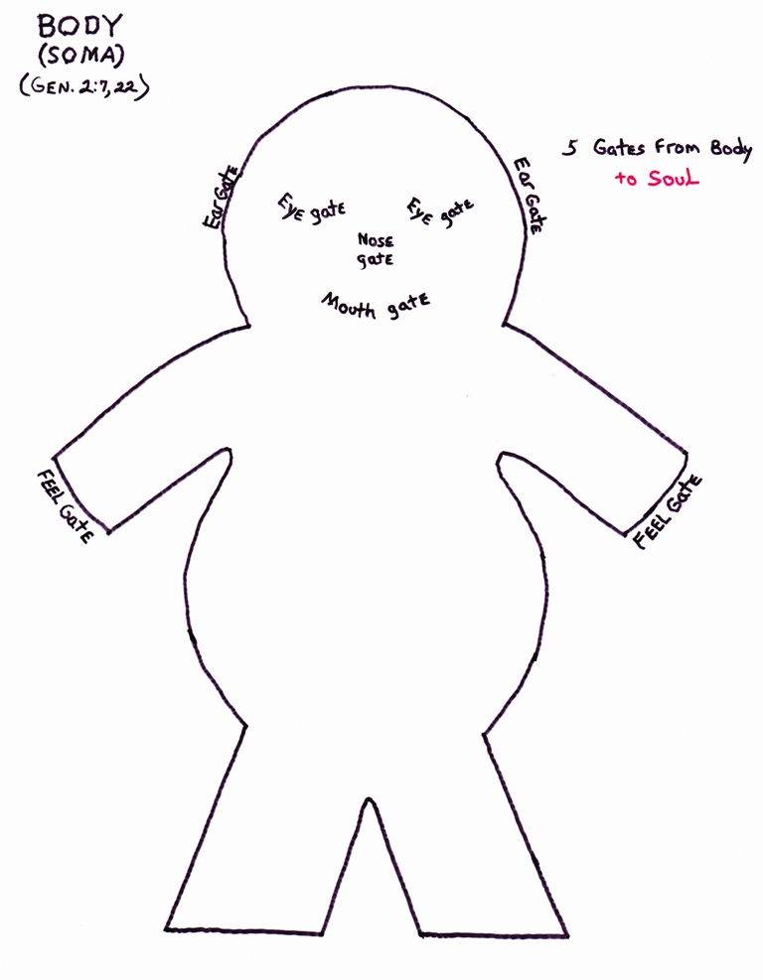
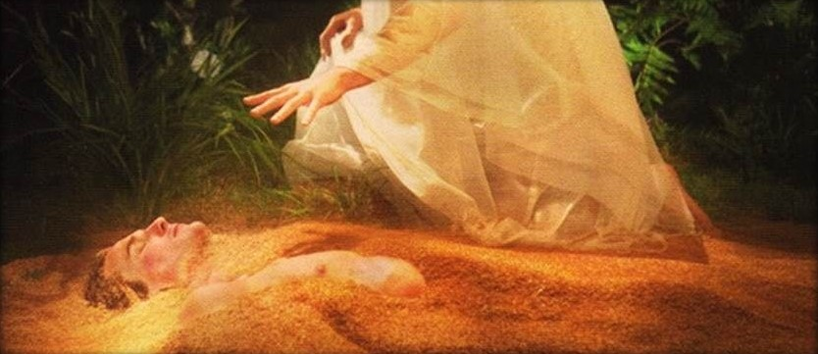
Adam’s body formed from Dust 亞當的身體從塵土而出
“the LORD God formed [Hebrew = yatsar] man of the dust of the ground…” (Gen. 2:7). 創2：7 - 耶和華上帝用地上的塵土造人

Slide 16
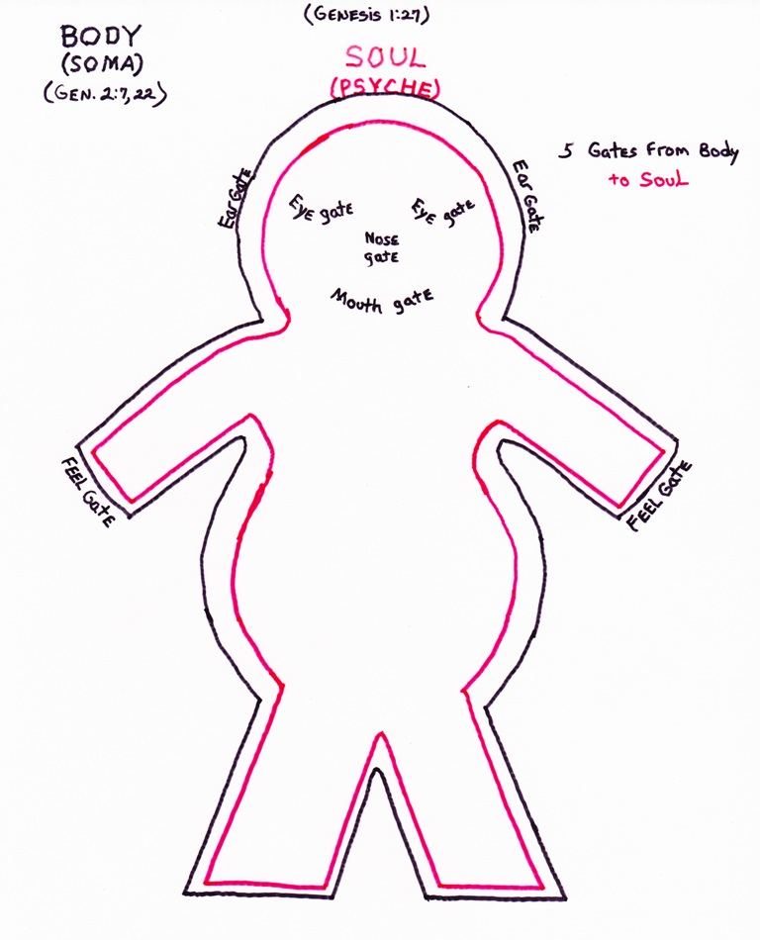
An intimate union of soul & body 魂與體親密的結合
The body is the house for the soul & the means to communicate through the 5 senses & speech (I Cor. 5:1-9; 2 Pet. 1:13-14)
身體是魂的居所，藉著五種感官和語言來溝通。

Slide 17
Why our Body is fearfully & wonderfully made (Ps. 139:14-6) 爲何我們身體的被造奇妙可畏
Our Body is designed by God to be glorified & live for eternity! (Rom. 8:30; I Cor. 15:42-49; Phil. 3:21)
我們的身體被上帝設計去得榮耀，且活到永遠！
Our Body is designed to become a ‘Temple of God’ (I Cor. 3:16-17; 6:13, 19; 2 Cor. 6:16; Col. 1:27; 3:3)
我們的身體被設計成爲“上帝的殿”。
Through our body we display God’s moral attributes (love, goodness, mercy, justice, joy, etc)
經由我們的身體，展示上帝的道德屬性（愛、良善、恩慈、正義、喜樂…等）。

Slide 18
Christ’s Body is fully Human – without Sin (2 Cor. 5:21; Heb. 4:15; I Pet. 2:22; I John 3:5) 基督的身體是完全的人 – 沒有罪
Christ’s physical body was designed to become the eternal Temple of God (Matt. 1:20-23; Lk. 1:35-37; John 2:18-22; Rev. 21:22). [Christ is Our predestined image – Rom. 8:29; Col. 1:15; Heb. 1:3]
基督的肉身被設計成爲上帝永恆的殿；
Even now Jesus reigns from Heaven in a glorified human body (John 20:19-20, 25, 26-27; Col. 2:9; I Tim. 2:5)
即使現在，耶穌以得榮耀的人的身體從天上統治。

Slide 19
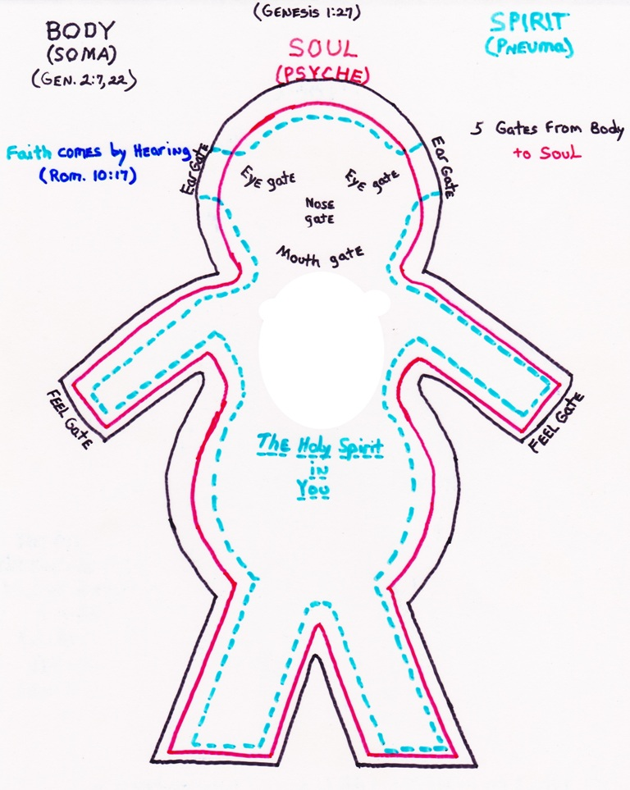
God’s Spirit Gives Life to both Body & Soul 上帝的靈賜生命給體與魂
God “breathed into his nostrils the breath of life; & man became a living soul” (Gen 2:7; John 20:22)
創2:7 耶和華上帝…將生氣吹在他鼻孔裡，他就成了有靈的活人。
Hebrew = ruach

Slide 20
Our body is the instrument through which the spirit manifests.
我們的身體是彰顯靈的工具，
Man’s spirit is directly formed from the Spirit of God (Gen. 2:7; Zech. 12:1; Heb. 12:9) & so intimately related, it returns to God when our Body dies (Eccl. 12:7)
人的靈直接從上帝的靈而造，且親密相關，所以當我們身體死時，靈回到上帝那裏去（傳12：7），
Through Our body, soul & spirit manifests the image of God (Gen. 1:26-27; 5:1; 9:6; James 3:9)
我們的魂與靈藉著身體彰顯上帝的形像。

Slide 21
In Chinese “Ancestor” included “the image of God” (Gen. 1:26) 中文的 “祖” 字包括 “上帝的形像”
Character for “ancestor” (also founder, originator)
Literally: “also” or “moreover” with character for “God”
“神”的部首，加上“也”或“另外”。

Slide 22
The Trinitarian God Creates a Trinitarian Man 三位一體的上帝創造了三位一體的人
“the very God of peace sanctify you wholly; & I pray God your whole spirit & soul & body be preserved blameless unto the coming of our Lord Jesus Christ” (I Thess. 5:23)
帖前5：23-願賜平安的神親自使你們全然成聖！又願你們的靈與魂與身子得蒙保守，在我主耶穌基督降臨的時候，完全無可指摘！

Slide 23
Genesis 2: Beginning of History in The Garden of Eden 創世記二章 – 伊甸園歷史的開始
(Gen 2:8) “& the LORD God planted a garden eastward in Eden; and there he put the man whom he had formed.”
創2:8 耶和華 神在東方的伊甸立了一個園子，把所造的人安置在那裡。

Slide 24
The Fullness of Joy in Paradise 樂園裏滿足的喜樂
(2:9) “& out of the ground made the LORD God to grow every tree that is pleasant to the sight, & good for food; the tree of life also in the midst of the garden, & the tree of knowledge of good & evil.”
創2:9 -耶和華 神使各樣的樹從地裡長出來，可以悅人的眼目，其上的果子好作食物。園子當中又有生命樹和分別善惡的樹。

Slide 25
The Nobility of work in Paradise before sin! 犯罪之前樂園裏工作的高貴
(Gen 2:15) “& the LORD God took the man, & put him into the garden of Eden to dress it & to keep it”
創2:15-耶和華 神將那人安置在伊甸園，使他修理，看守。
Man’s Kingship eventually extends over all the earth (Gen. 1:26-28; Ps. 8:3-6) because Man is above all nature. 1 human soul is more valuable than all the World combined! (Matt. 6:26; Mk. 8:36)
人的統治至終延及全地球，因人在全自然之上。一個人的靈魂比全世界加起來都珍貴！

Slide 26
We have Work in Heaven! (Rev. 1:6; 2:26-27; 3:21 with 22:3, 5) 我們在天上要工作！
Hebrew word for work (vocation) = ’melachah’ מְלָאכָה)) related to ’malach’ מֲלְאָך) ) translated angel about 200 times
希伯來文的“工作”與翻譯成“天使”的字（大約200次）相關。
“to dress” & “to keep” sometimes used of the work of Priests! Our work is a way of worshipping God (& P.F.E.)!
“修理” 和 “看守” 有時用來描寫祭司的工作！我們的工作是敬拜上帝的一種方式！
This insight should change your entire perspective of Work (Eccl. 2:24; 3:22; Matt. 16:27; Rom. 2:6, 9-11; Gal. 6:7-8; Jer. 17:10)
這個看見應改變我們對工作的全部觀點。

Slide 27
7 times God judged His own work as “Good” in Genesis 1 Can this be said of our own work? 上帝在創世記一章七次判定自己的工作是“好的”。 你可以如此說自己的工作嗎？
The Chinese character for “Work” has a man uniting heaven & earth
中文的“工”字是一個連結天與地的人。
Someone said: “Choose a job you love & you will never have to work a day in your life”
有人說：“選擇你喜愛的工作，你一生就不必再工作了。”

Slide 28
God gives man Freedom for a purpose 上帝賜人自由的目的
(16) “& the LORD God commanded the man, saying, Of every tree of the garden thou mayest freely eat:”
2:16 耶和華 神吩咐他說：「園中各樣樹上的果子，你可以隨意吃，
God wants his people free to serve Him (Ex. 7:16; 8:1, 20; 10:3; 20:1)
上帝希望祂的百姓有自由去服侍祂。

Slide 29
1 simple Commandment concerning “Trees” 關於“樹”的一個簡單吩咐
(17) “But of the tree of the knowledge of good & evil, thou shalt not eat of it: for in the day that thou eatest thereof thou shalt surely die.”
2:17 -只是分別善惡樹上的果子，你不可吃，因為你吃的日子必定死！」

Slide 30
Man must know he is uniquely different from animals (not evolved from them) 人必須認識他與動物是絕對不同的（不是從它們進化來的）
(Gen 2:19-20) “& out of the ground the LORD God formed every beast of the field, & every fowl of the air; & brought them unto Adam to see what he would call them…
創2:19-20 -神用土所造成的野地各樣走獸和空中各樣飛鳥都帶到那人面前，看他叫什麼…
… & Adam gave names to all cattle… to the fowl… & to every beast… but for Adam there was not found an help meet for him.
2:20 那人便給一切牲畜和空中飛鳥、野地走獸都起了名；只是那人沒有遇見配偶幫助他。

Slide 31
Some Major Differences between Man & beasts 人與動物的差別
Man’s spirit & an animals spirit are different (Eccl. 3:21)
人的靈與動物的靈不同（傳3：21），rth?
Man’s Flesh & an animals flesh is different (I Cor. 15:15)
人的肉身與動物的肉身不同（林前15：15） ，
Animals are created “without understanding” (Ps. 32:9)
動物的被造“沒有知識”（詩32：9），
Man has a will, animals' instincts
人有意志，動物有本能。

Slide 32
Differences between Man & beast (animals) 人與動物的差別
Only Humans have such a long childhood & allow children to come back home (Lk. 15:11-32)
只有人具有長期的童年，且准許兒女回家，
Man has a religious sense & worships God; a moral conscience; desire for knowledge; & an aesthetic sense or delight in beauty.
人具有宗教意識且敬拜神，具有道德良知，渴望知識，並具有美感。
Not only wants to know where he came from but also his destiny!
人不但要知道從何處來，且往何處去！

Slide 33
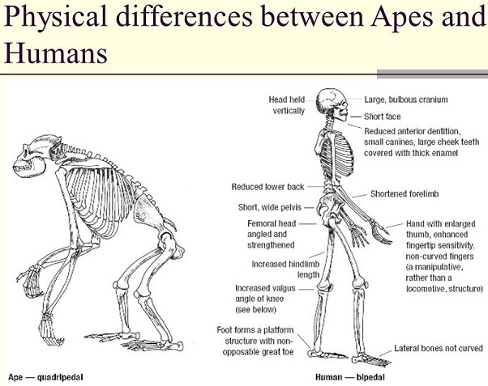
Out of 4000 mammals only humans are upright bipedal
四千種哺乳動物中，只有人是直立雙足的，
Strong big toes; arched feet; long legs; upright back, skull, knee joints & hip joints; angled femur bones for balance;
强壯的大脚趾、拱足、長腿、直立的背脊、頭骨、膝蓋關節、髖關節、維持平衡有角度的大腿骨…

Slide 34
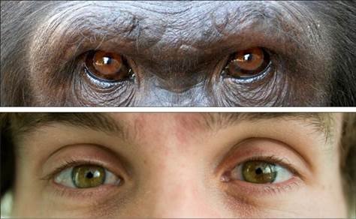
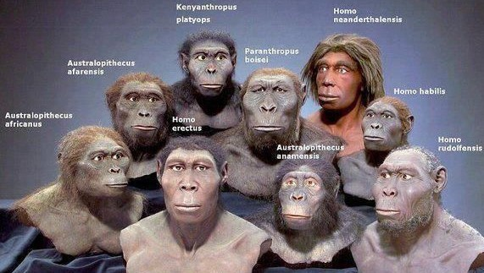
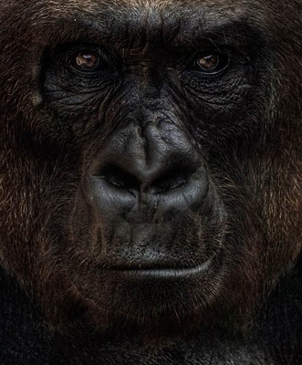
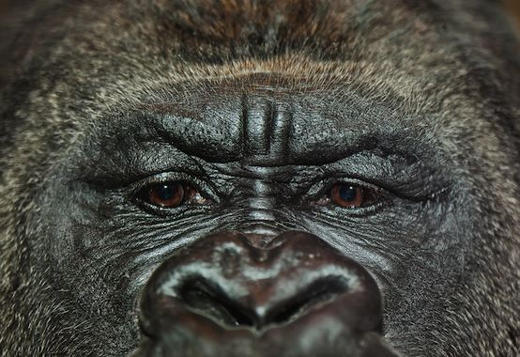
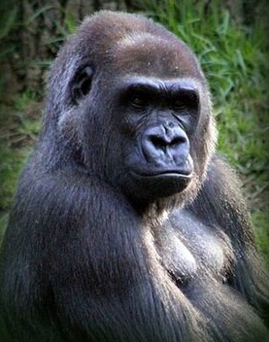
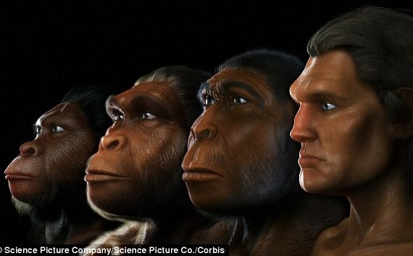
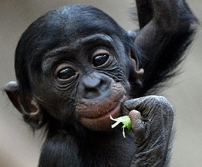
Human eyes are windows to the soul (Observe the deceptions of Evolutionists models) 人的眼睛是靈魂之窗 （觀察進化論者模型的欺騙）
The whites (sclera) of human eyes are visible.
人的眼白（鞏膜） 是可見的，
Contrast all apes whose white sclera is not normally visible
所有猿猴的眼白通常是不可見的。

Slide 35
Humans, ‘the naked ape’ is a major problem for evolution 人類，“赤裸的猿猴”，是進化的重大難題
Desmond Morris in The Naked Ape, notes that 192 species of primates are covered with hair: 1 exception is Homo sapiens! (p. 9, 15)
Desmond Morris在“赤裸的猿猴”一書中，提到192靈長類物種都滿身是毛，唯一的例外是人類！
Ape hair protects from UV rays; Humans have unique melanin
猿猴的毛保護它們不受紫外綫傷害；人具有獨特的黑色素。
Human skin is incredibly complex compared to apes
人的皮膚比猿猴複雜多了。

Slide 36
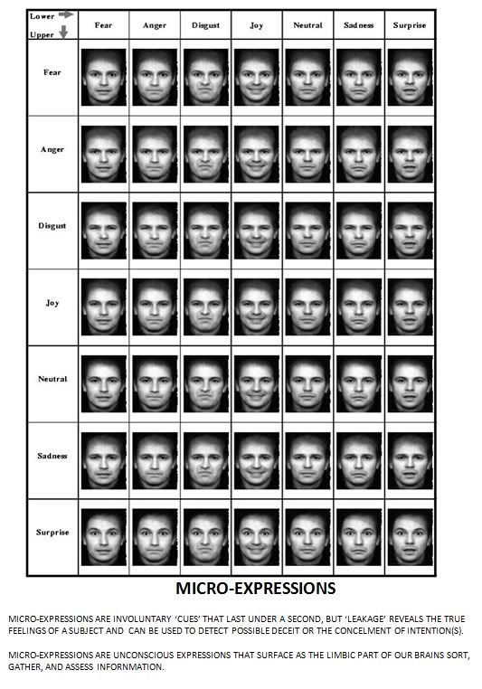
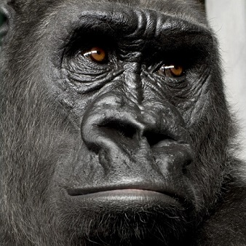
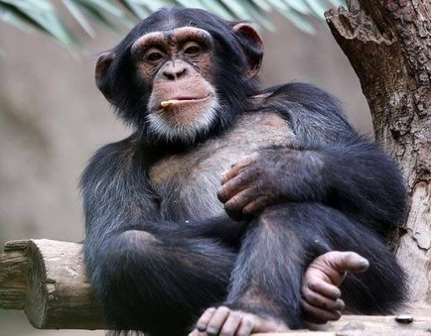
Humans 50 facial muscles can make 10000 different facial expressions 人的50個面部肌肉能做出一萬種不同的臉部表情
Contrast apes: 30 muscles make 12 facial emotions & cannot smile (Terry Mortneson, Searching for Adam, 2016, p. 356)
對比猿猴：30個肌肉，做出12種臉部表情，無法笑。

Slide 37
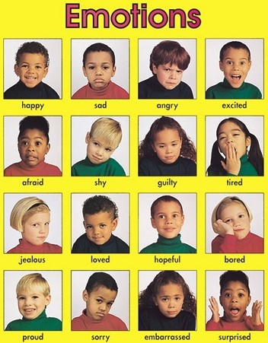
Human faces reflect inner feelings of soul & spirit (laughing, crying, anger, fear, etc.) 人的臉面反映出靈魂内在的感受
A smile is unique to humans, conveys friendship! For most primates baring teeth is a threat.
笑容是獨特屬於人類的，傳達友情！對多數靈長類動物來説，露出牙齒是威脅
Apes have tear ducts to lubricate eyes; humans can cry to express emotions!
猿猴有淚腺來濕潤眼睛；人類能哭來表達情緒！

Slide 38
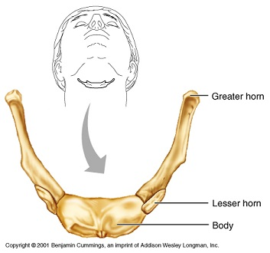
Man has a language, animals make sounds 人類有語言，動物有聲音
The Cambridge Encyclopedia of Human Evolution, conceded ‘there are no non-human languages,’ & ‘language is unique to humans’ (1999, p. 128). Speech sets us apart from animals!
劍橋【人類進化百科全書】承認：“沒有非人類的語言”，且“語言是人類特有的。” 語言使我們與動物不同！
Jesus revealed He is the Creator of human language by some of his miracles (Lk. 1:64; Mk. 7:35; with Ex. 4:10-11).
耶穌藉著祂所行的一些神跡， 啓示祂是人類語言的創造者。

Slide 39
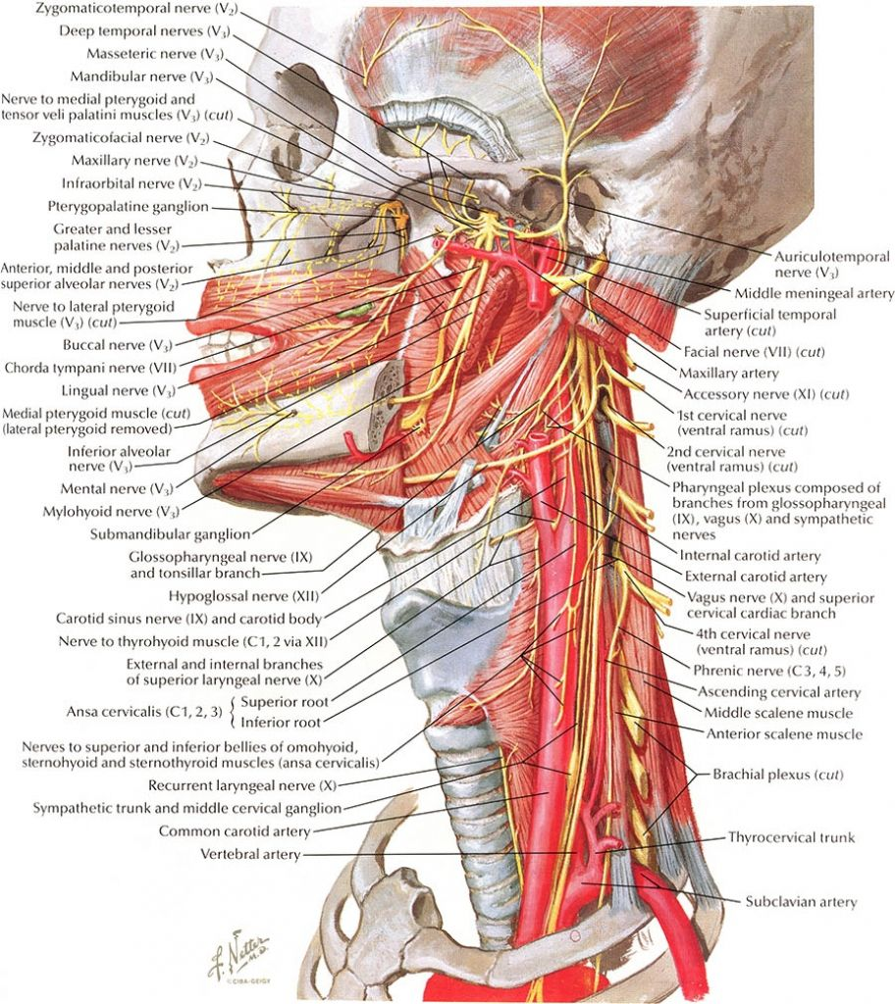
Human Speech: The dental-maxillary system is an example of ‘irreducible complexity’ 人類的語言：牙上颌系统是‘不可減少的複雜性’的例子
Could not evolve in small increments
無法以小增量來進化，
Speech is a direct self-revelation of the human spirit. Word & Spirit go together (Prov. 1:23; Isa. 59:21; John 3:34; 6:63)
語言是人類靈魂的直接自我揭露，語言與靈魂是不能分開的。

Slide 40
A Scary Situation: we are turning “humans” into “animals” 一個可怕的情況：我們將“人類”改變成“動物”
Evolution denies God; makes man an evolved animal; you can act like an animal because you are!
進化否認上帝，將人視爲進化的動物，你可以舉止像動物，因爲你就是動物！
You have no special purpose in this life & no eternal destiny!
你的人生沒有特別的目的，也沒有永恆的去處！
There is no final judgment & you won’t be held accountable for your actions
沒有最終審判，你不必為自己的行爲負責。

Slide 41
Jeffrey Dahmer (Homosexual, killed & ate his victims) Jeffrey Dahmer （同性戀者，殺害並吃他的受害者）
“If a person doesn’t think that there is a God to be accountable to, then what’s the point of trying to modify your behavior to keep it within acceptable ranges? I always believed the theory of evolution as truth… that we all came from slime…when we died that was it…” (Jeffrey Dahmer, Dateline NBC interview with Stone Phillips, recorded Feb. 1994, aired Nov. 29, 1994, a day after his death)
“倘若一個人不認爲有神，要對神負責，那麽又何必改造你的行爲在可接受的範圍内？我一直相信進化論是真理…我們都來自粘液…死了就沒了…”

Slide 42
One thing is Necessary to perfect Paradise 一件必要的事
(Gen 2:18) “& the LORD God said, It is not good that the man should be alone; I will make him an help meet for him”
創2:18 -耶和華 神說：「那人獨居不好，我要為他造一個配偶幫助他。」

Slide 43
(Gen 2:21) “& the LORD God caused a deep sleep to fall upon Adam, & he slept: & he took one of his ribs, & closed up the flesh instead thereof; (2:22) & the rib, which the LORD God had taken from man, made he a woman, & brought her unto the man.
創2:21-耶和華 神使他沉睡，他就睡了；於是取下他的一條肋骨，又把肉合起來。2:22 -耶和華 神就用那人身上所取的肋骨造成一個女人，領他到那人跟前。
God took both bone & flesh (illus.: 1st surgery under anesthesia)
上帝取了骨頭和肉。

Slide 44
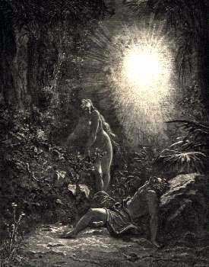
內-nei
The Chinese man refers to his wife as “my inside man”-
中國男性稱他們的妻子為“內人” Nei Ren”

Slide 45
肉- rou - Is like a moving picture (Pictograph) of Genesis 2:21 肉-好像創2：21的象形字
(Gen 2:23) “& Adam said, This is now bone of my bones, & flesh of my flesh: she shall be called Woman (Ishah), because she was taken out of Man (Ish).
創2:23-那人說：這是我骨中的骨，肉中的肉，可以稱他為「女人」，因為他是從「男人」身上取出來的。

Slide 46
How Profoundly God Exalts the Status of Women! 上帝極度地高舉女人的地位！
Genesis 2:18-22 is the only full account of the creation of woman in ancient Near Eastern literature!
創2:18-22是古代近東文學中女人被造的唯一完整記錄！
Her name describes her essence. She is the lost part of man, she is that which was taken from man. She completes him & thus he treasures her immensely.
她的名字描寫她的本質。她是男人缺失的那一部分，她也是從男人取出的那一位。她完成他，因此他大大珍惜她。

Slide 47
Thus God’s Work in the Garden was Complete 由是，上帝在伊甸園的工作完整了
By coming into Marriage, a man acquires a missing part of himself in his spouse & finds wholeness
兩人的結合，男人在他的配偶找到他缺失的那部分，找到完整。

Slide 48
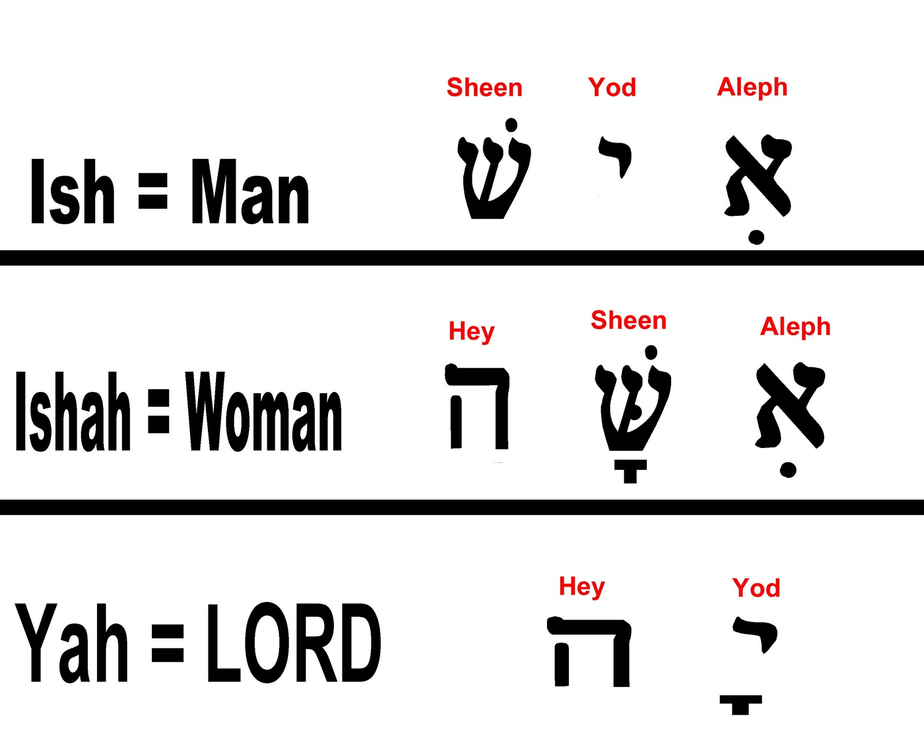
The Word of God is “Spirit & Life” (John 6:63) 上帝的話語是“靈和生命”（約6：63）
God’s Word in Hebrew reflects Reality
希伯來聖經文反映出事實
Without God in their life both man & woman become “ash” = ‘fire’
生命中沒有神，男人與女人成爲“ash”=“火”。
Illus.: George Washington

Slide 49
火-huo - The word for “fire” is made of 人 (man) & two flames 火字由人和兩個火焰組成
Why does man appear to be on fire? Did they know the history of the Garden when man was Clothed with Glory?
爲何人好像着火了？他們知道在園子裏人穿上榮光嗎？
God “covers Himself with light as with a garment” (Ps. 104:2) & created man in that image (I Cor. 11:7)
上帝“披上亮光，如披外袍…” （詩104：2）， 用那形像造人 （林前11：7）。

Slide 50
Such Profound Parallels in Chinese are amazing 中文中驚人的、深刻的平行
The glory of God is represented by ‘fire’ over man. ‘Naked’ is 2 glorious beings
上帝的榮耀以‘火’代表，在人之上；兩位發光的人是‘裸體’的。
(Gen 2:25) “& they were both naked, the man & his wife, & were not ashamed”
創2:25 -當時夫妻二人赤身露體，並不羞恥。

Slide 51
God crowned man with glory (Ps. 8:5). Glory shines like light (Acts 22:11; I Cor. 15:41-42). Moses shone with God’s glory (Ex. 34:29-30, 34)
上帝以榮耀為人的冠冕（詩8：5）。榮耀像光照耀。摩西光照出上帝的榮耀（出34：29-30,34).
God’s Glory appeared as “fire” (Ex. 24:17; 3:2) as did Jesus on the Mount of transfiguration (Matt. 17:2; Rev. 21:23; John 1:9)
上帝的榮光出現像‘火’（出24:17;3:2)，耶穌登山變像時也發光如火（太17:2；啓21:23；約1:9）。
Man & woman shone with God’s Glory before the fall into sin…
在犯罪之前，男人與女人發射出上帝的榮光。

Slide 52
We will “shine” with God’s glory in the Resurrection (Dan. 12:3) 我們在復活時會“照射”出上帝的榮光（但12:3)
(Dan 12:3) “they that be wise shall shine as the brightness of the firmament; & they that turn many to righteousness as the stars for ever & ever.
但12:3 -智慧人必發光如同天上的光；那使多人歸義的，必發光如星，直到永永遠遠。
What Tree must this be?

Slide 53
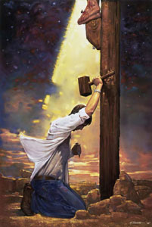
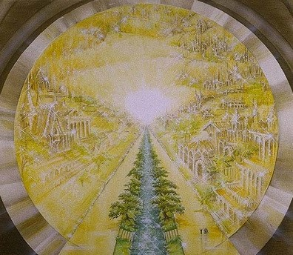
If we come under the cover of the Tree Christ died on we guarantee ourselves eternal glory (I Pet. 2:24) 倘若我們來到基督死的那棵樹的覆蓋之下， 我們有保證獲得永恆的榮耀（彼前2:24)
Repent & Believe in Christ as your only means of salvation from your sin & you shall be saved (Rom. 10:9-10; Mk. 1:15)
悔改並相信基督為你唯一從罪中得救恩的途徑，你必得救（羅10:9-10;可1:15).

Slide 55
Following are a few extra slides that might be helpful for those that want to study some more on this subject

Slide 56
The human spirit’s relationship to the Holy Spirit of God 人的靈與上帝的靈的關係
Jesus said it is the “spirit that gives life” (John 6:63)
耶穌說 - 叫人活著的乃是靈 (約6:63)
This is the “Law of Biogenesis” – life only come from life!
這就是「生原定律」 – 生命來自生命!
Hebrew = ruach

Slide 57
Our “mind” is distinct from but uses our physical “brain” (Rom. 7:25)
Our mind is intimately involved with our own human spirit and God’s Holy Spirit (2 Tim. 1:7):
We have the mind of Christ (I Cor. 2:16) through the Holy Spirit (I Cor. 2:12-13)
We must be renewed in the Spirit of our mind (Rom. 12:2; Eph. 4:23)

Slide 58
Only God’s Word can reveal distinctions of Soul, Spirit & Body! [Not Psychology; not science] (Hebrews 4:12) 只有上帝的話語能夠啓示魂、靈、與身體的區別（來4：12）
“For the word of God is quick, & powerful, & sharper than any two-edged sword, piercing even to the dividing asunder
of soul & spirit & of the joints & marrow, (body) & is a discerner of the thoughts & intents of the heart” (Heb. 4:12; I Cor. 14:24-25)
來4：12-神的道是活潑的，是有功效的，比一切兩刃的劍更快，甚至魂與靈，骨節與骨髓，都能刺入、剖開，連心中的思念和主意都能辨明。 (林前14：24-25）

Slide 59
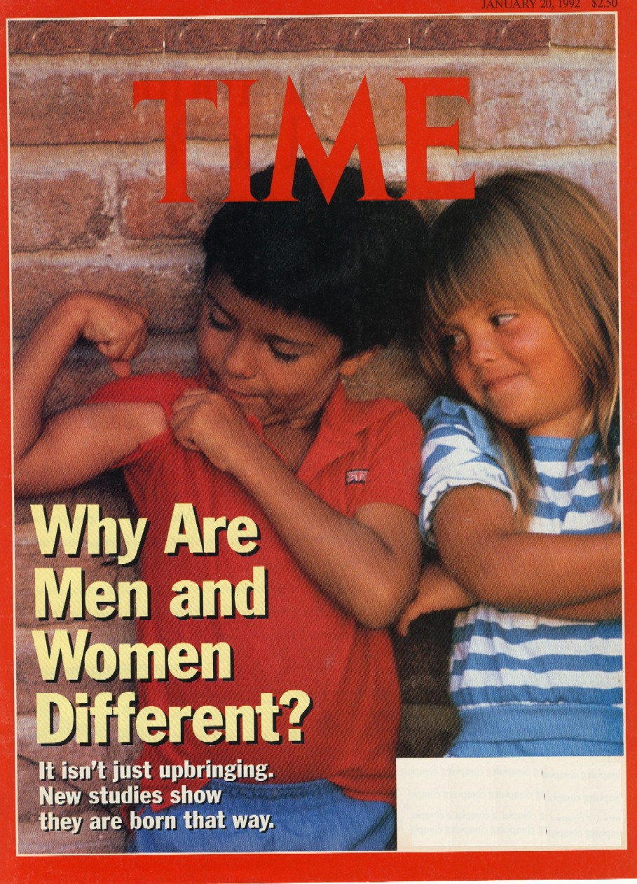
Male/female distinction is one of the most basic irrefutable scientific facts of Humans (I Pet. 3:7)
男/女的區別是有關人最基本、無法駁斥的科學事實（彼前3：7）。
Our world is becoming insanely irrational by blurring the clear biological & psychological differences between male/female
我們的世界瘋狂地失去理性，模糊男/女之間清楚的生理與心理差異。

Slide 60
To succeed in Life we must know how the world really works & live wisely according to that Truth
Our society has exchanged the objective scientific reality of 2 sexes for subjective "identity." Basic biological facts about our bodies are ignored in favor of subjective self-determination.
This is illogical, wholly unscientific & wholescale rebellion against Truth.

Slide 61
Build your life on the impregnable foundation of God’s Word (Matt. 7:24-29) not the quicksand of godless theories
“The theory of evolution is a theory universally accepted, not because it can be proved by logically coherent evidence to be true, but because the only alternative, special creation, is clearly incredible” (D.M.S. Watson, “Adaptation,” Nature, Vol 124, 10 Aug. 1929, 233). See Wikipedia on D.M.S. Watson.

Slide 62
2 Worldviews in Conflict: 1 error, 1 Truth
Evolution’ error
God’s Truth
The universe exploded into existence out of NOTHING
X
In the beginning God created
Life evolved from a pool of chemicals by natural processes
X
God created all life. Law of Biogenesis
Different life forms evolved from a common ancestor over millions of years
X
God designed all life to reproduce after its kind
Notes:
This slide to make sure people know you cannot have evolution and the Bible. These 2 slides point this out
All worldviews: a belief in the existence and nature of God

Slide 63
God’s Word Reveals Answers
Who created?
What was created?
How was it created?
When was it created?
How long did it take to create?
God
All things
By His power
In the beginning
6 days

Slide 64
Some honest evolutionists admit the lack of evidence & weakness for their theory…
Suzan Mazur, The Altenberg 16: An Expose of the Evolution Industry, 2009, 2010
Neil Thomas, Taking Leave of Darwin: A Longtime Angostic Discovers the Case for Design, 2021
F. LaGard Smith, Darwin’s Secret Sex Problem: Exposing Evolution’s Fatal Flaw – the Origin of Sex, 2018

Slide 65
God’s Word always taught there is only 1 Race! Evolution has struggled with it historically
Dr. Venter & scientists at the National Institutes of Health recently announced that they had put together a draft of the entire sequence of the human genome, and the researchers… and unanimously declared, there is only one race, the human race.
(Natalie Angier, “Do Races Differ? Not Really, DNA Shows,” New York Times, Aug. 22, 2000, http://partners.nytimes.com/library/national/science/082200sci-genetics-race.html.

