Slide 1
Genesis 2 Part 1 創世記第二章， 第一部分
What does it mean to be human?
America’s current identity crisis
何為人？
美國現今的身份認同危機

Slide 2
Time is Sacred: use it Wisely! (Ps. 90:12; 39:4-5) 時間是神聖的：智慧地去使用（詩90：12；39：4-5）
(Gen 2:1) Thus the heavens & the earth were finished, & all the host of them. [1st Law of Thermodynamics instituted]
創2:1-天地萬物都造齊了。
(2:2) & on the 7th day God ended his work which he had made; & he rested on the 7th day from all his work which he had made.
到第七日，神造物的工已經完畢，就在第七日歇了他一切的工，安息了
(Gen 2:3) & God blessed the 7th day, & sanctified it: because that in it he had rested from all his work which God created & made.
2:3 -神賜福給第七日，定為聖日；因為在這日，神歇了他一切創造的工，就安息了。

Slide 3
The 7th Day didn’t begin with the 10 Commandments 第七日不是從十誡才開始的
(Ex. 20:10) “But the 7th day is the sabbath of the LORD thy God: in it thou shalt not do any work
出20:10-但第七日是向耶和華你神當守的安息日。這一日…無論何工都不可做；
(20:11) For in 6 days the LORD made heaven & earth, the sea, & all that in them is, & rested the 7th day: wherefore the LORD blessed the sabbath day, & hallowed it.
20:11 因為六日之內，耶和華造天、地、海，和其中的萬物，第七日便安息，所以耶和華賜福與安息日，定為聖日。

Slide 4
God calls it “My Sabbath” (Ex. 31:13; Lev. 19:30; 26:2; Ezek. 20:12, 20-21; Deut. 5:14)
上帝稱它為“我的安息日”（出31：13；利19：30， 26：2； 結20：12，20-21；申5：14）。
God sanctified the Sabbath to accomplish His Holy purposes (Mk. 2:27; Isa. 58:13) (Neh. 9:14; Ex. 16:23; 31:15; 35:2; Lev. 23:3)
上帝將安息日分別為聖，來完成祂神聖的目的。
We all need to set one day aside to refresh spiritually (Act 20:7; I Cor. 16:2; Rom. 14:5; Col. 2:16-17)
我們都需要將一天分別出來，修整我們的靈性。
Illus.: Russian & communist revolution tried to eliminate it

Slide 5
7 Day Week: The LORD of Time assures us of the Inspiration of Genesis (Rom. 1:20) 一周七天：時間的主向我們保證創世記的啓示（羅1：20）
All important time markers are based on astronomical constants.
所有重要的時間標記都依據天文常數。
The week has no astronomical basis whatsoever! But most of the world functions around a 7-day cycle.
然而周卻沒有天文依據！世界大多地方都依據一周七天來運作
The most obvious explanation: It’s just as Genesis says!
最明顯的解釋：正如創世記所言！

Slide 6
“And God said, Let there be lights in the firmament of the heaven to divide the day from the night; and let them be for signs, & for seasons, & for days, & years: (Gen. 1:14-15)
神說：「天上要有光體，可以分晝夜，作記號，定節令、日子、年歲， 並要發光在天空，普照在地上。」事就這樣成了。 (創1：14-15）

Slide 7
The Day is the duration of one rotation of the earth on its axis 一日是地球按其軸繞一圈的期間

Slide 8
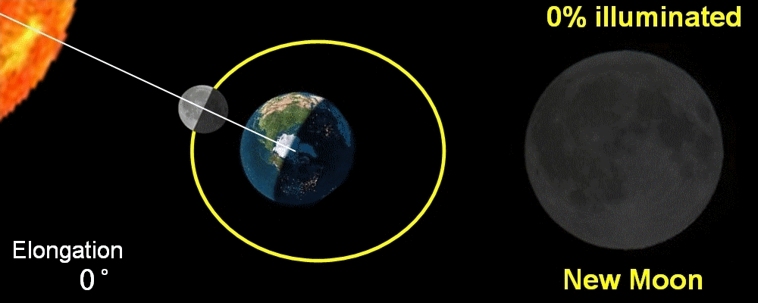
The Month: sidereal (27.32 days); synodic period (29.5 days) The time between new moons 一個月：恆星（27.32天）；會合周期（29.5天） 新月之間的時間

Slide 9
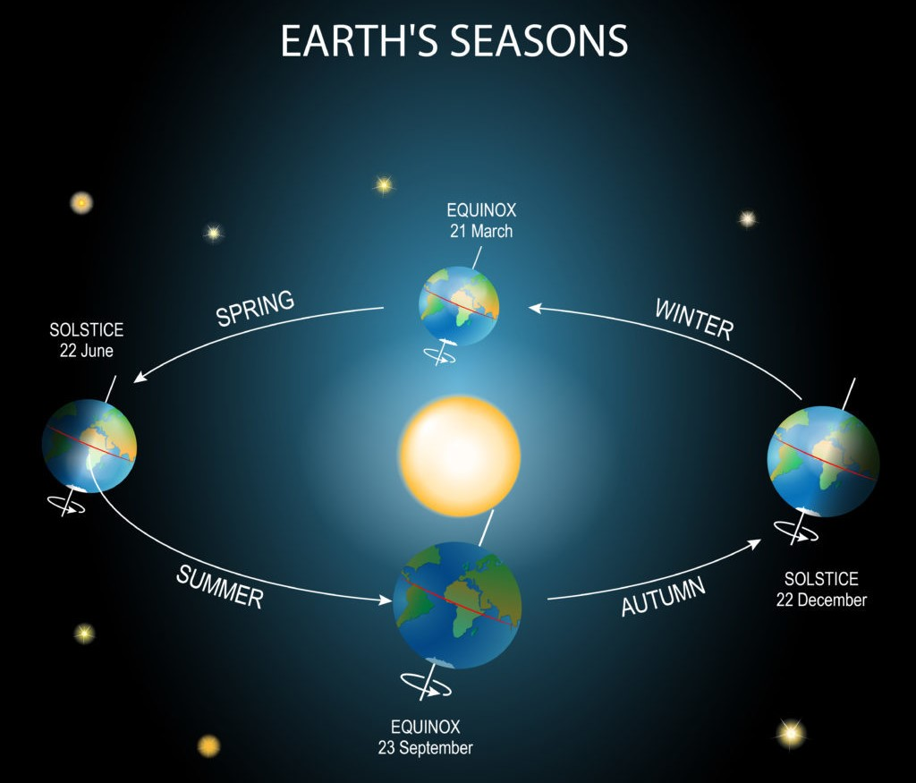
Year & Seasons is the duration of 1 orbit of the earth around the sun (365.25 days) 年與季節是地球繞太陽一圈的期間（365.25天）

Slide 10
Jesus Proved He is LORD of Time by dividing it (Mk. 2:27-28; Matt. 12:8; Lk. 6:2-5)
耶穌將時間分開，證明祂是時間的主宰。

Slide 11
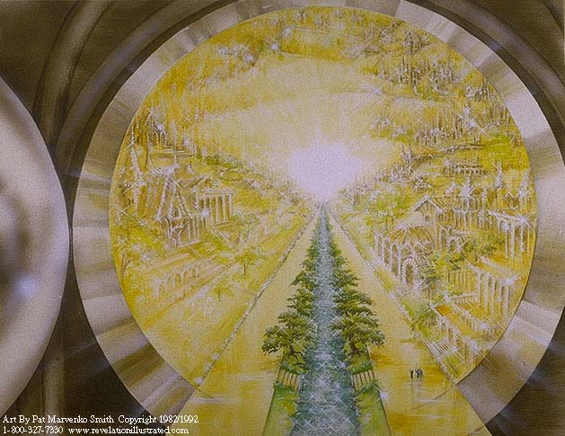
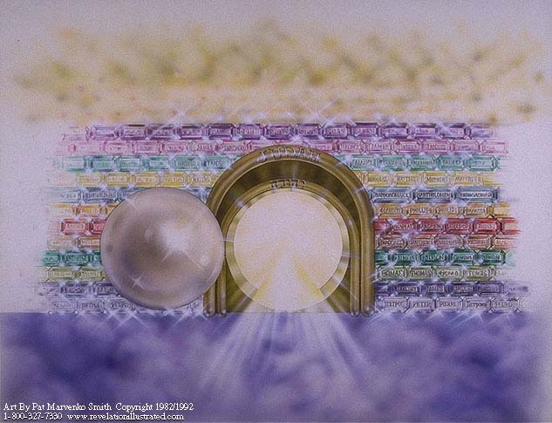
The Sabbath is a Prophetic Type of Redeemed Humanity’s Glorious Rest in Christ’s Eternal Kingdom 安息日是蒙救贖的人類在基督永恆過度中榮耀地安息的預表
Heb. 4:1-11 & Col. 2:14-17

Slide 12
Now we will study God’s word to learn what it truly means to be human so we can live the most meaningful satisfying life possible
現在讓我們研討上帝的話語
學習何爲人的真義
好使我們活出最可能有意義與滿足的人生

Slide 13
To Fulfill our Humanity, we must know The Source of Human Dignity & Value 實踐人性，我們必須明白人的尊嚴與價值的來源
God reveals that He Created man in His image, a unique eternal Being, for eternal purposes.
上帝啓示祂按自己的形像創造人，人是一個獨特，永恆的存在，具有永恆的目的。
Evolutionary Science [materialism] teaches that man is the temporary product of unintelligent chance without any purpose (Reduces man to a hominid animal: no soul, no spirit)
進化科學（唯物論）教導人是沒有智能、偶然產生的暫時產物，沒有任何目的（將人降級為原始動物：沒有魂與靈）。

Slide 14
In Scripture God communicates with us in Human Language but in His own Unique Way (Isa. 55:8-9; Rom. 11:33-36) 在經文中，上帝用祂自己獨特的方式，使用人的語言與我們溝通
The Bible is 25% Prophesy. Unique to an Omniscient God. To do this God uses 1600 years to record His Word for mankind
聖經25%是預言，是無所不知的上帝所獨具的。上帝使用一千六百年為人類記錄祂的話語來完成。
The Book of Hebrews reveals how to understand God’s unique Prophetic Types that powerfully connect the O.T. to the LORD Jesus Christ
希伯來書顯示如何明白上帝獨特的預表，將舊約與主耶穌基督連接起來。

Slide 15
The O.T. is written with Eastern thought patterns & the N. T. with both Eastern & Western thought Patterns. 舊約是依據東方思想模式而寫， 新約是依據東方與西方思想模式而寫
In an Eastern worldview (Semitic, Asian) Repetition is common.
在東方世界觀裏（閃族，亞洲人），重複十分普遍。
Deuteronomy (“Second Law”) repeats Laws of Ex., Lev. & Num., to expand their applications & increase insights
申命記（“第二律法”）重複出埃及記、利未記、民數記的律法來擴展它們的應用和增强洞見。
Events are often out of order chronologically in order to emphasize important Lessons
事件經常脫離時間順序，用以强調重要的功課。

Slide 16
The Holy Spirit Guides us to understand God’s thoughts (John 14:17, 26; I Cor. 2:9-14, 16) 聖靈引導我們明白上帝的思想
4 Different Gospels make studying the Life of Christ like an exciting search for hidden treasure! [Why Four Gospels, by Danny Akin, or J. Vernon McGee, or A.W. Pink available free online PDF]
四部福音書使研讀基督生平更像興奮地尋寶一樣！
Not knowing the Author, lost liberals find errors
不認識作者，迷失的自由派尋找錯誤。
Illus.: Religious but lost people criticize God & the Bible (i.e. me)

Slide 17
Lost liberal scholars turn God’s Unique Thoughts into errors & attack His Word (Matt. 11:25; 13:11-16; 2 Cor. 4:3-6) 迷失的自由派學者將上帝獨特的思想轉變成錯誤， 且攻擊祂的話語
A common attack says: Genesis 1 & 2 are so different they can’t both be authored by Moses! The bible is not inspired by God!
一個常見的攻擊說：創世記1，2章如此不同，不可能同為摩西所寫！這本聖經不是上帝啓示的！
News Alert! Moses isn’t the author of the Torah, just the human writer. God is the Author! (Ex. 33:11; Num. 12:6-8; Deut. 34:10)
新聞警報！摩西不是妥拉的作者，他只是人，上帝是作者！

Slide 18
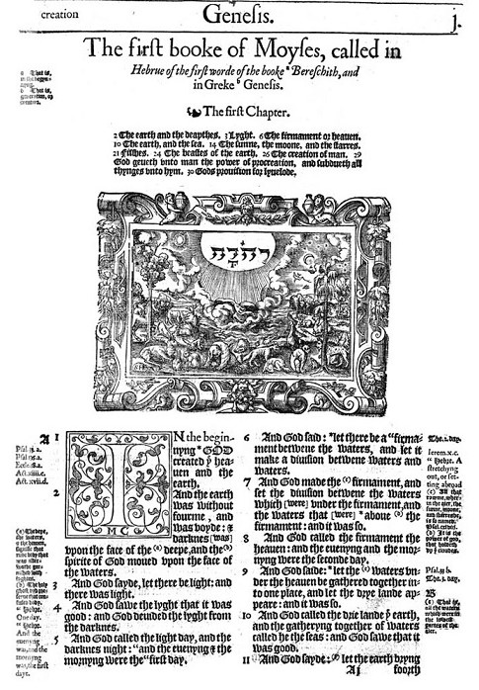
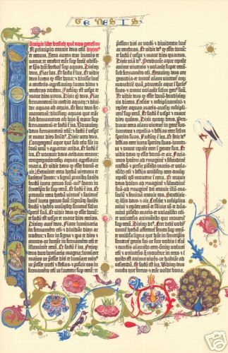
Let’s Look at the Supposed contradictions between Genesis 1 & 2
讓我們看創世記1，2章
所謂的矛盾

Slide 19
(Gen. 2:7-25) describes only events on the 6th day in the Garden of Eden. The trees in Gen. 2:9 are only in the Garden of Eden. Allowed Adam to observe God Create! 創2：7-25 只描述在伊甸園裏第六天的事件。創2：9的樹木只在伊甸園中，讓亞當觀看上帝創造！
1. Gen. 1:11 trees made on day 3 before man
創1：11， 樹木在第三天被造，早於人之前
The entire story chronological
整個故事是按時間次序記載
1. Gen. 2:9 trees made on day 6 after man
創2：9 樹木在第六天被造，在人之後
2:4-6 summarizes 1st five days
創2：4-6 總結頭五天

Slide 20
Birds created out of the ground in the Garden of Eden, on day 6 allows Adam to name some “kinds.” The rest of the world was full of birds from day 5 鳥在第六天伊甸園中從地裏被造，容讓亞當為某些“種類”命名。世界其他地方從第五天就充滿鳥。
2. Gen. 1:20 birds made out of water on day 5 before man
創1：20 鳥第五天從水裏被造，在人之前
2. Gen. 2:19 birds made out of ground after man on day 6
創2：19 鳥第六天從地裏被造，在人之後

Slide 21
Gen. 2:19 only describes animals created in the Garden, after man. Purpose: exercise dominion by naming; Adam realizes none could make him a suitable mate (2:20-22) 創2：19只描述伊甸園中後於人被造的動物。 目的：亞當為動物命名來練習他的管理，他明白沒有一個動物 適合當他的伴侶（2：20-22）。
3. Gen. 1:24-5 animals made on day 6 before man
創1：24，25 動物在第六天先於人被造
3. Gen. 2:19 animals made on day 6 after man
創2：19 動物在第六天後於人被造

Slide 22
There are no Contradictions Between Genesis 1 & 2 Chapter 2 just explains in more detail the events in the Garden of Eden on Day 6.
創世記1，2章沒有矛盾
第二章只更詳細解釋第六天
伊甸園中的事件

Slide 23
An Example in a debate between Kent Hovind (creationist) & Michael Shermer (atheist) 創造論者Kent Hovind與無神論者Michael Shermer的辯論
Michael Shermer was a Christian but became an atheist. He cited the difference between Genesis 1 & 2 along with evolution as reasons for abandoning his faith.
Michael Shermer本為基督徒，但後來成爲無神論者。他引用創世記1，2章中的差異與進化論，作爲丟棄信仰的理由。
https://www.youtube.com/watch?v=MPGtCuEvmBA&t=5493&ab_channel=TheBible-smithProject

Slide 24
Choose your Teachers Wisely (Prov. 13:20; Isa. 54:13; John 6:45) 要智慧地選擇你的教師
We will now learn more truth about ourselves than we could learn getting an advanced degree in anthropology or psychology from a secular university!
我們現在學習有關自己的真理
勝過從世界上先進的人類學或心理學所能學到的！

Slide 25
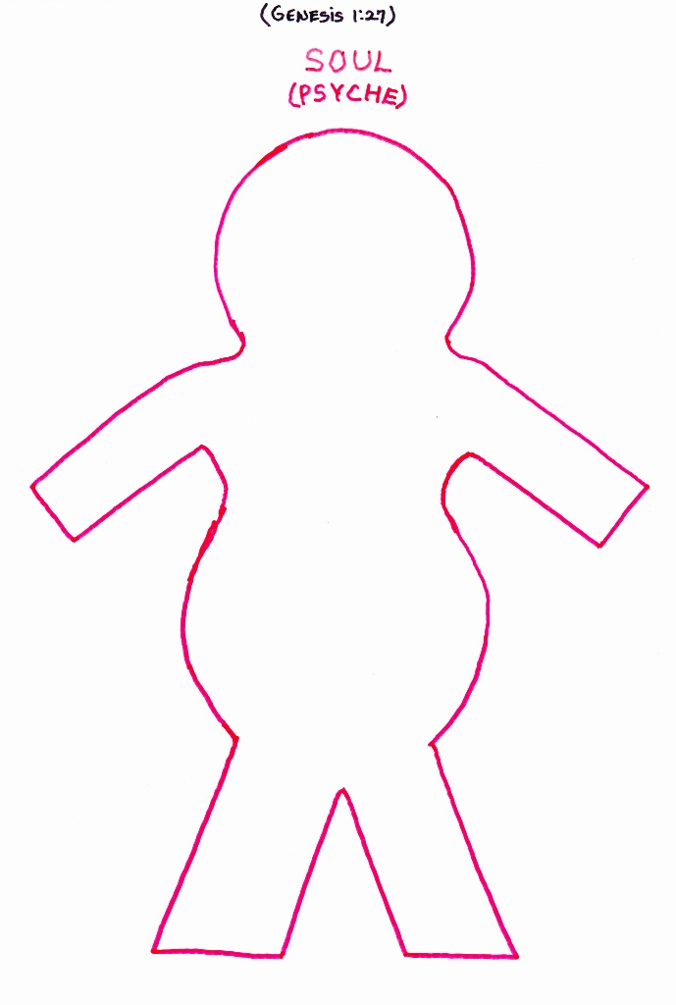
Spiritual Anatomy 屬靈解剖學 101
“God created man in his own image, in the image of God created he him; male & female created [Hebrew = bara] he them.” (Gen. 1:27)
創1:27 神就照著自己的形像造人，乃是照著他的形像造男造女。
Here the male & female soul is created! 男女魂被造

Slide 26
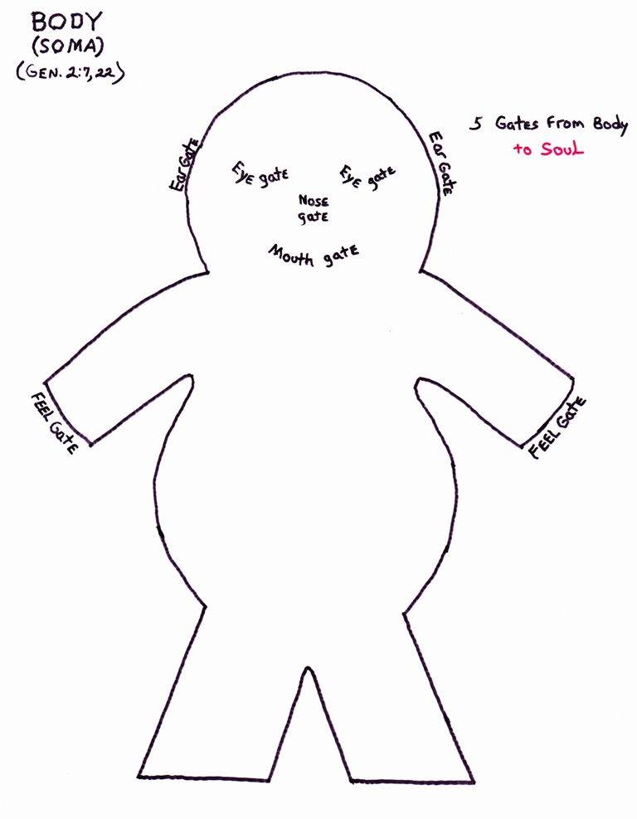
“the LORD God formed man of the dust of the ground…” (Gen. 2:7). 耶和華上帝用地上的塵土造人
Here the word “form” [Hebrew = yatsar] means to “mold something into form” like a potter molds clay (Ps. 139:14-16) 「造」意指「將某件東西塑成形狀」好像陶匠塑泥一樣。

Slide 27
1 way The supernatural nature of God’s written word is revealed is in the incredible way it reflects reality
上帝寫下來的話語具有超自然的本質
其中一個顯示是來自祂的啓示的方式
是它不可思議地反映現實

Slide 28
(Ground) “ADAM AH” = אֲדָמָ֖ה
(Gen 2:7) “& the LORD God formed man of the dust (aphar) of the ground (adamah)…”
創2：7-耶和華上帝用地上的 (adamah) 塵土 (aphar) 造人
“man” = ‘adam’; “ground” = ‘Adamah’. His name reminds him of his physical relationship with the earth he must care for.
“人”= ‘adam’; “地上的”= ‘Adamah’. 他的名字提醒他與必須照顧之地土的身體的關係。
Hebrew “dam” = ‘blood’; Hebrew “am” = ‘nation’ (Act 17:26)
希伯來文“dam”= “血”，希伯來文”am”= “國”（徒17：26）。

Slide 29
(Act 17:24) God that made the world & all things therein, seeing that he is Lord of heaven & earth…
徒17：24創造宇宙和其中萬物的神，既是天地的主…
(25) …seeing he giveth to all life, & breath, & all things;
17:25 …自己倒將生命、氣息、萬物，賜給萬人。
(26) & hath made of one blood all nations of men for to dwell on all the face of the earth…
17:26 他從一本（本：有古卷是血脈）造出萬族的人，住在全地上…
(27) That they should seek the Lord, & find him…
17:27 要叫他們尋求神，或者可以揣摩而得…

Slide 30
“And the LORD God formed man of the dust of the ground, (Gen. 2:7)
“上帝從地上的塵土造人” （創2：7）。
The Bible revealed Scientific fact thousands of years before man discovered it
在人發現以前幾千年，聖經就已經啓示出科學事實。

Slide 31
Part of every Human being is ‘created’ & part is ‘formed’ 每個人有些部分是“被創造的”，有些部分是“做成的”
“Even every one that is called by my name:
for I have created him for my glory,
I have formed him; yea, I have made him.” (Isa. 43:7)
賽43：7- 就是凡稱為我名下的人，
是我為自己的榮耀創造的，
是我所做成，所造作的。

Slide 32
The male & female body is ‘formed’ by God 男性與女性的身體是上帝“做成的”
The 1st Male body is formed from the dust of the ground (Gen 2:7) 第一個男人的身體是從地裏的塵土造的（創2：7），
The 1st Female body is formed from Adam’s rib (Gen. 2:21-22)
第一個女人的身體是從亞當的肋骨造的（創2：21-22），
The soul, not physical bodies, is the essence of man (Matt. 10:28)
靈魂，而非肉身，是人的本質（太10：28）。

Slide 33
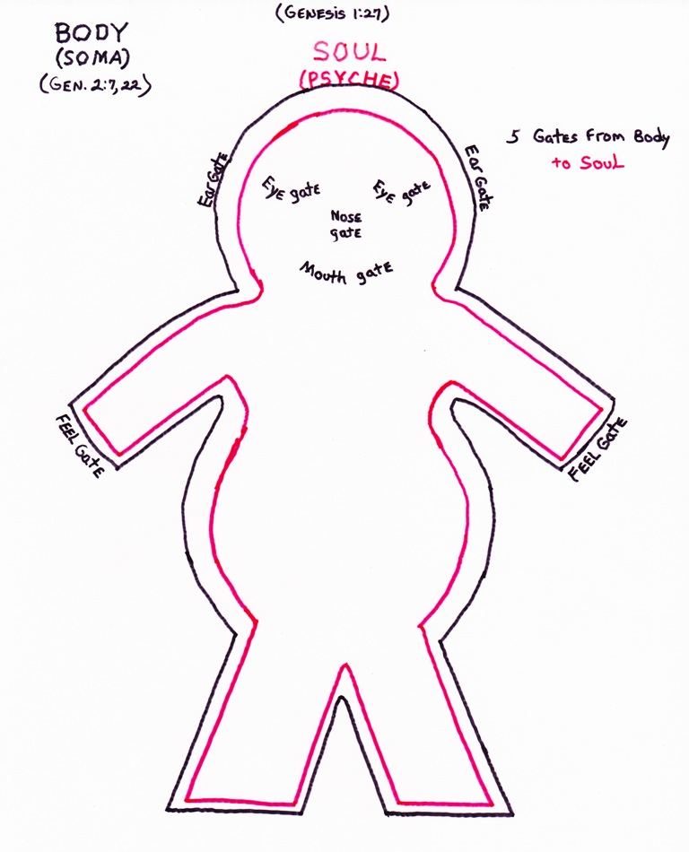
The relationship of the soul & body 魂與體的關係
The body is the house for the soul (I Cor. 5:1-9; 2 Pet. 1:13-14)
身體是魂的居所
My body is the physical part of me; but “I” (my soul) lives in ‘my’ body
我的身體是我肉身的部分:
但“我”（靈魂）住在“我的”身體內

Slide 34
The relationship of the soul & body 魂與體的關係
The soul fits perfectly into the body just as a hand fits into a glove
魂完美地住在身體裡面,就好像手放進手套裡.
5 senses [gates] connect the Body & Soul: eye; ear; nose; mouth; feeling
五種感官（門）連接身體與魂：視覺（眼）、聽覺（耳）、嗅覺（鼻）、味覺（口）、觸覺（手脚、皮膚）

Slide 35
The relationship of the soul & body 魂與體的關係
Jesus explains what the soul is like after death in the true story of the rich man & Lazarus (Lk 16:19-31)
耶穌在富人與拉撒路的故事中, 解釋魂在死亡後的狀態 。 (路16:19-31)
Jesus Reveals the 5 senses are present in the Soul with our consciousness
耶穌啓示五種感官在魂裏與意識共存。

Slide 36
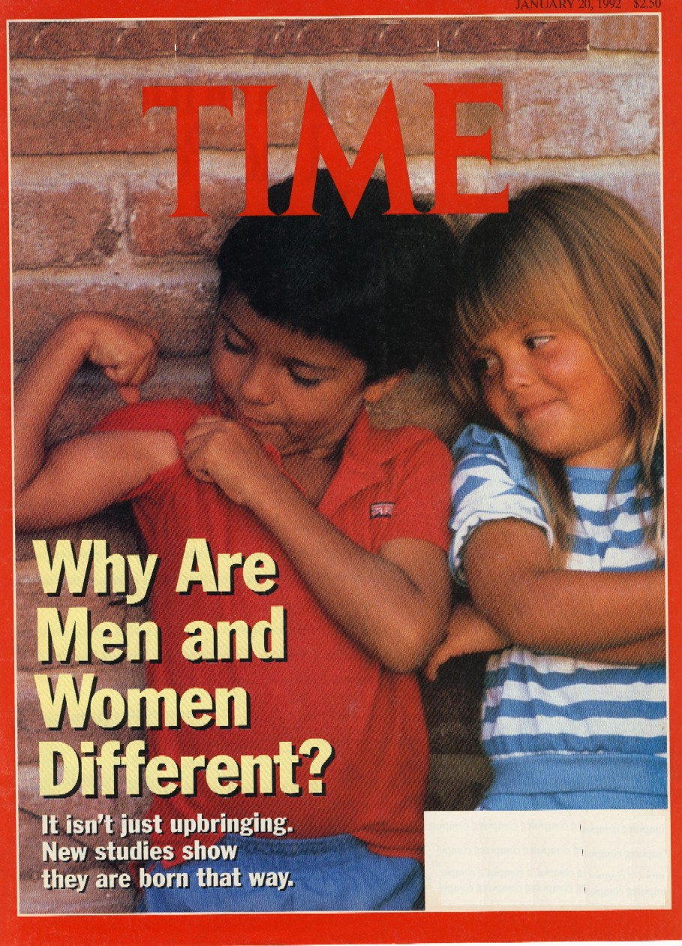
Male/female distinction is one of the most basic irrefutable scientific facts of Humans (I Pet. 3:7)
男/女的區別是有關人最基本、無法駁斥的科學事實（彼前3：7）。
Our world is becoming insanely irrational by blurring the clear biological & psychological differences between male/female
我們的世界瘋狂地失去理性，模糊男/女之間清楚的生理與心理差異。

Slide 37
They replace hard Science with abnormal psychology: Science deals with empirical fact; Psychology with how a person thinks/feels 他們用不正常的心理學取代硬科學：科學是根據實證事實， 而心理學針對人的想法與感受
CNN said “It’s not possible to know a person’s gender at birth…”
CNN說，“人出生時不可能知道他的性別…”
James Talarico, Dem. Rep. Texas (Harvard grad) – says there are 6 biological sexes: XX, XY, X, XXY, XYY, XXXY.
James Talarico, 德州民主黨衆議員，說有六種生理性別： XX, XY, X, XXY, XYY, XXXY。
These are abnormalities in sex chromosomes not biological sexes. If they have a ‘Y’ they are male. 這些是性別染色體的異常，不是生理性別。

Slide 38
Psychology’s Failure to acknowledge the Reality of Sin 心理學未能承認罪的現實
(Ps. 41:4) “I said, LORD, be merciful unto me: heal my soul; for I have sinned against thee.”
詩41：4 - 我曾說：耶和華啊，求你憐恤我，醫治我！因為我得罪了你。
Our soul can be sick. Psychology that denies sin cannot heal the soul. We can only find mental health through God given moral values
我們的魂會生病，否認罪的心理學無法醫治魂。我們只能從上帝賜予的道德價值來找到精神健康。
1973

Slide 39
We live in a fallen world being destroyed by sin 我們住在一個被罪毀滅的墮落世界
Destructive chaos results from rejecting God’s revelation:
拒絕上帝的啓示導致毀滅性的混亂：
Allowing men in woman’s sports just because he says he’s a woman (i.e. MMA fighters; track & field, men in woman prison, etc. )
容許男性參與女性的運動項目，只因他說他是女性。
They try to punish those who won’t go along with their insanity!
他們試圖懲罰那些不跟隨他們瘋狂行徑的人！(CA schools)
Trying to change one’s gender is a rejection of God’s design
試圖改變一個人的性別，就是拒絕上帝的設計！

Slide 40
The most important thing about us 有關我們最重要的一件事
Our main identity is not found in our sexuality but in our relationship with god through Christ
我們主要的身份不是在性別中找到，
而是在基督裏與上帝建立關係。
Sexuality is sacred It has a divine purpose to fulfill according to god’s will
性別是神聖的，
它具有根據上帝的旨意去完成的神聖目的。

Slide 41
Choose your Teachers Wisely (Prov. 13:20) 智慧地選擇你的教師
There is no more accurate or healthy source for what it means to be male or female than god’s word
關於何爲男性或女性，沒有什麽來源比上帝的話語
更具正確或健康的定義
Don’t become a victim of secular anthropology & psychology & a lost world’s bad ideas
不要成爲世俗的人類學與心理學，
以及迷失的壞主意的受害者

Slide 42
The Holy Spirit of God & the spirit of Man 上帝的聖靈與人的靈
(Gen 2:7) “the LORD God formed man of the dust of the ground, & breathed into his nostrils the breath of life (plural); & man became a living soul.” (Job 33:4; 34:14-15; 32:8; Isa. 42:5)
創2：7-耶和華 神用地上的塵土造人，將生氣(複數）吹在他鼻孔裡，他就成了有靈的活人…。
God’s Spirit - “breath of lives” gives life to both our body (Ps. 146:4; 104:29; James 2:26) & soul (Ps. 22:29; 89:48; Eccl. 8:8)
上帝的靈- “生氣”， 賜生命給身體與魂。

Slide 43
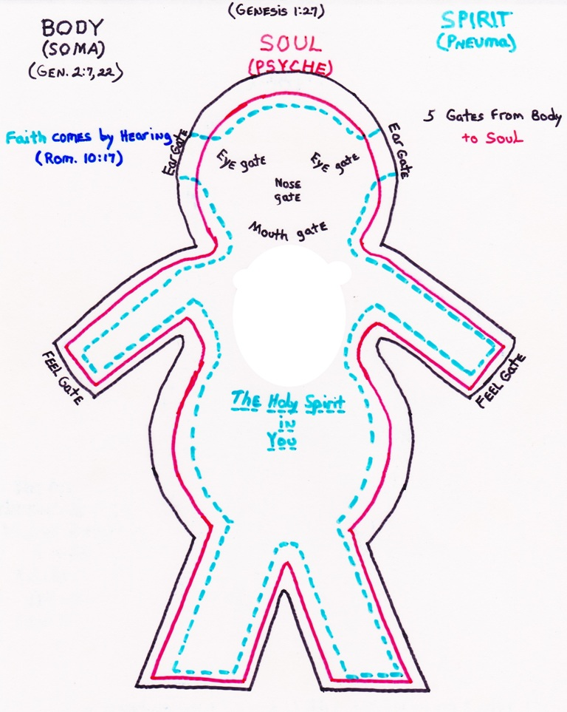
The human spirit’s relationship to the Holy Spirit of God 人的靈與上帝的靈的關係
God “breathed into his nostrils the breath of life; & man became a living soul” (Gen 2:7)
創2:7 耶和華上帝…將生氣吹在他鼻孔裡，他就成了有靈的活人。
Hebrew & Greek word ‘Spirit’ = breath, spirit, wind (John 3:8)
希伯來、希臘文的“靈”=氣息、靈、風（約3：8）。
Hebrew = ruach

Slide 44
The human spirit’s relationship to the Holy Spirit of God 人的靈與上帝的靈的關係
Jesus said it is the “spirit that gives life” (John 6:63)
耶穌說 - 叫人活著的乃是靈 (約6:63)
This is the “Law of Biogenesis” – life only come from life!
這就是「生原定律」 – 生命來自生命!
God’s Word is life! (John 6:63; IPet. 1:23)
上帝的話語就是生命！（約6：63）
Hebrew = ruach

Slide 45
There’s an intimate relationship between our breath (spirit) & God’s Spirit (breath) (I Cor. 2:9-12) 我們的氣息（靈）與上帝的靈（氣息）有著密切的關係 （林前2：9-12）
(Ps. 104:29) “Thou hidest thy face, they are troubled: thou takest away their breath, they die, & return to their dust” (James 2:26)
(104:30) “Thou sendest forth thy spirit, they are created” (Zech. 12:1; Heb. 12:9; Num. 16:22)
詩104：29你掩面，他們便驚惶；你收回他們的氣， 他們就死亡，歸於塵土。
104:30 你發出你的靈，他們便受造…

Slide 46
The spirit of man was formed from the Spirit of God! Thus God is called “the Father of spirits” (Heb. 12:9; Eccl. 12:7; Zech. 12:1)
人的靈從上帝的靈所造
因此上帝被稱爲“萬靈之父”
（來12：9；傳12：7；撒12：1）

Slide 47
The Trinitarian God Creates a Trinitarian Man 三位一體的上帝創造了三位一體的人
“the very God of peace sanctify you wholly; & I pray God your whole spirit & soul & body be preserved blameless
unto the coming of our Lord Jesus Christ.” (I Thess. 5:23)
帖前5：23-願賜平安的神親自使你們全然成聖！又願你們的靈與魂與身子得蒙保守，在我主耶穌基督降臨的時候，完全無可指摘！
The Soul: created by God; The Body: formed from the dust; the Spirit: breathed into man by God. (Eccl.傳 11:5; 12:7)
魂：上帝所創造；身體：從塵土中所造；靈：被上帝吹氣進人而來
I have a body; I have a spirit; but I am a soul (Matt. 16:25-26)
我有身體；我有靈；但我是魂（太16：25-26）。

Slide 48
Only God’s Word can reveal distinctions of Soul, Spirit & Body! [Not Psychology; not science] (Hebrews 4:12) 只有上帝的話語能夠啓示魂、靈、與身體的區別（來4：12）
“For the word of God is quick, & powerful, & sharper than any two-edged sword, piercing even to the dividing asunder
of soul & spirit & of the joints & marrow, (body) & is a discerner of the thoughts & intents of the heart” (Heb. 4:12; I Cor. 14:24-25)
來4：12-神的道是活潑的，是有功效的，比一切兩刃的劍更快，甚至魂與靈，骨節與骨髓，都能刺入、剖開，連心中的思念和主意都能辨明。 (林前14：24-25）

Slide 49
Without the light of God’s Word psychology cannot help people overcome the devastating consequences of sin & spiritual warfare
若無上帝話語的光，心理學無法幫助人勝過罪的毀滅性後果和靈界的爭戰。
Science in studying the body & psychology in studying the soul are heavily tainted by human sin (& rejection of God) & easily go astray (Rom. 1:22; Prov. 26:12)
研究身體的科學與研究魂的心理學，嚴重地被人類的罪（包括拒絕上帝）所污染，容易誤入歧途（羅1：22，箴26：12）。

Slide 50
The relationship between soul, body & spirit is so intimate we must take care of all 3! 魂、體、靈有著密切的關係，我們必須此三者都顧及
Our spirit has a profound effect on our body (Prov. 17:22; 15:13; 18:14) [illus: Norman Cousins miraculous healing]
我們的靈會深刻影響我們的身體，
The emotional state of our soul effects our body (psycho-somatic) (Prov. 12:4; 2 Cor. 7:10; Ps. 102:3-5)
我們魂的情感狀態會影響我們的身體（身心的），
Living in obedience to God’s Word maintains our health (Prov. 3:1-2; 3:7-8, 13, 16; 4:7, 10, 21-22)
順從上帝的話語而活能維持我們的健康。

Slide 51
The intimate relationship between our spirit, soul & body 我們的魂、體、靈之間密切的關係
Man’s Trinitarian nature explains 3 levels of consciousness.
從人三位一體的本質解釋意識的三個層次：
We are all self conscious (through the soul), (emotional)
我們都有自我意識（經由魂），（情感的），
World conscious (through the body) (physical)
世界意識（經由身體）（肉身的），
God-conscious (through the spirit). (spiritual)
上帝意識（經由靈）（靈性的）
Depression can be emotional, physical or spiritual!
抑鬱可以是情感的、肉體的、或靈性的！

Slide 52
We choose our soul’s eternal destiny in this life! 我們在今生選擇我們魂的永恆命運！
Since Christ died on the Cross the soul of lost unbelievers descends into hell inside the Earth & begins its eternal torments (Prov. 9:18; 15:24; Isa. 14:9, 15; Rev. 20:13-14)
從基督死在十字架後，迷失的非信徒的魂下到地球裏面的地獄，開始受永遠的折磨；
The soul & spirit of saved believers ascends to the presence of God in Heaven (John 11:25-26; 14:3; 2Cor. 5:1-9; Phil. 1:21-23; I Thess. 4:13-18; Eccl. 12:7; Acts 7:59; Ps. 73:24-26; Rev. 7:14-17) to experience eternal pleasures & fullness of joy (Ps. 16:11)
得救的信徒的靈魂升到天上上帝的面前，經歷永遠的福樂與滿足的喜樂。

Slide 53
What happens to our body when we die? 我們死時身體發生什麽？
“The dust (body) returns to the earth” (Eccl. 3:20; 12:7) to await the resurrection of the body (I Cor. 15:42-54; 2Cor. 5:1-9; I Thess. 4:13-18; Rom. 8:22-23)
塵土（身體）回到地裏，等待身體復活；

Slide 54
You are Soul with a body & spirit 你是一個有身體與靈的魂
Are you prepared emotionally (Phil. 3:20-24), physically (I Cor. 9:24-27), & spiritually (Heb. 12:14; 2 Tim. 4:8) to spend eternity in the Glorious Kingdom of our LORD Jesus Christ?
你在情感上、身體上、靈性上都預備好，在主耶穌基督榮耀國度中度過永恆嗎？
The most important thing we do in this life: Prepare for Eternity!
今生必須做最重要的一件事：預備永恆！

Slide 56
The following are some extra slides that will be helpful for those who wish to do further study

Slide 57
The Image of God involves:
Conscience (Morality)
Communication (Language); Can cry and laugh
Character (godly; universal moral ideals)
Creative ability (Cultivate the Garden 2:15)
Capacity to conquer & control creation (1:28)
Eternal Soul (your eternal soul will spend eternity in one of 2 places!)
Glory (Psalm 8; 104:1-2)

Slide 58
We must learn to Think Like God (Isa. 55:8-9; 2 Cor. 2:16)
Numbers # are designed into Scripture to reveal spiritual truth [E. W. Bullinger, Number in Scripture, is a good book to begin study]
One of my favorites: The # 6 the number of man
1 & 2 Chronicles (God’s view of history) repeats 1 & 2 Kings (man’s view of history) providing countless life changing insights.

Slide 59
The Unity & Historicity of Genesis 1 & 2 is confirmed by our Omniscient LORD Jesus: (Matt. 19:4-5; Mk. 10:6-8)
“And he said unto them, Have ye not read, that he which made them at the beginning made them male & female” (Gen. 1:27)
“… For this cause shall a man leave father & mother, & shall cleave to his wife: & they twain shall be one flesh?”(Gen. 2:24)

Slide 60
The Reality of Adam is confirmed by Biblical genealogies
Jesus’ lineage traced from Mary all the way back to Adam.
“And Jesus himself began to be about thirty years of age, being (as was supposed) the son of Joseph, which was the son of Heli…
Which was the son of Enos, which was the son of Seth, which was the son of Adam, which was the son of God” (Lk 3:23, 38)

Slide 61
Genealogies from Adam to Jesus were meticulously preserved by the Jews & copies kept in the temple
For 70 years After Jesus’ birth anyone could go to the temple & verify His descent from Adam – Abraham – David
The temple & genealogies were destroyed in 70 AD. Since then, no one else can prove if they are the real messiah (Daniel 9:24-26)
The Genealogies proving Jesus is the Promised Messiah are Preserved in the N. T. (Lk 3:23-38; Mat. 1:1-17)

Slide 62
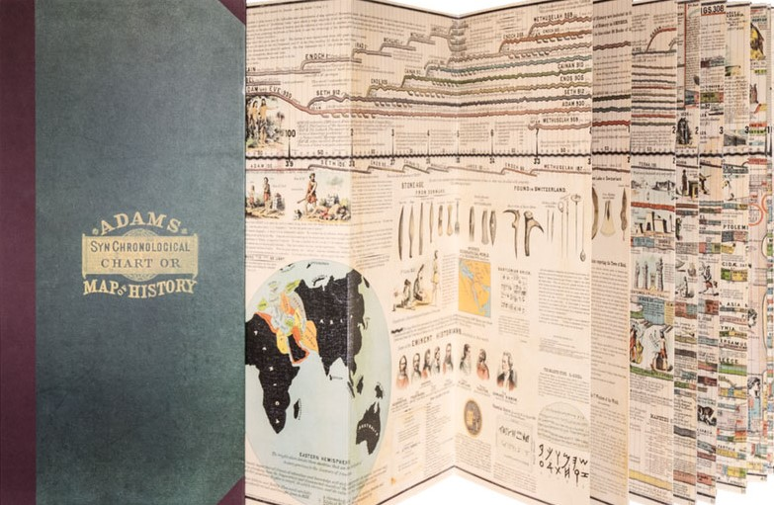
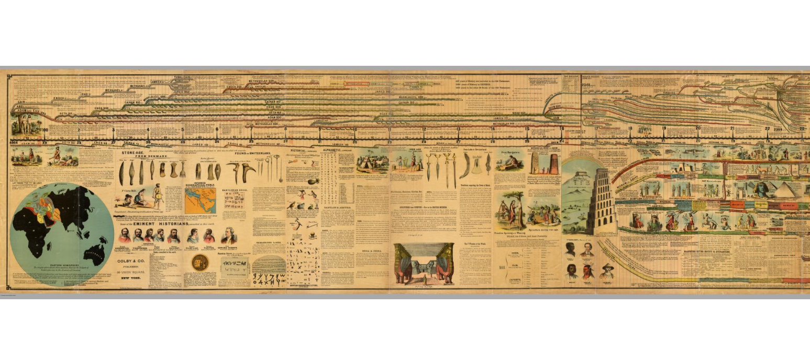
Every one should buy a 27ft. “Adams Chart of History.” It anchors your Faith in real History!
每人都該購買27英尺長的“亞當斯歷史圖表”。它扎穩你的信仰在真實歷史中！

Slide 63
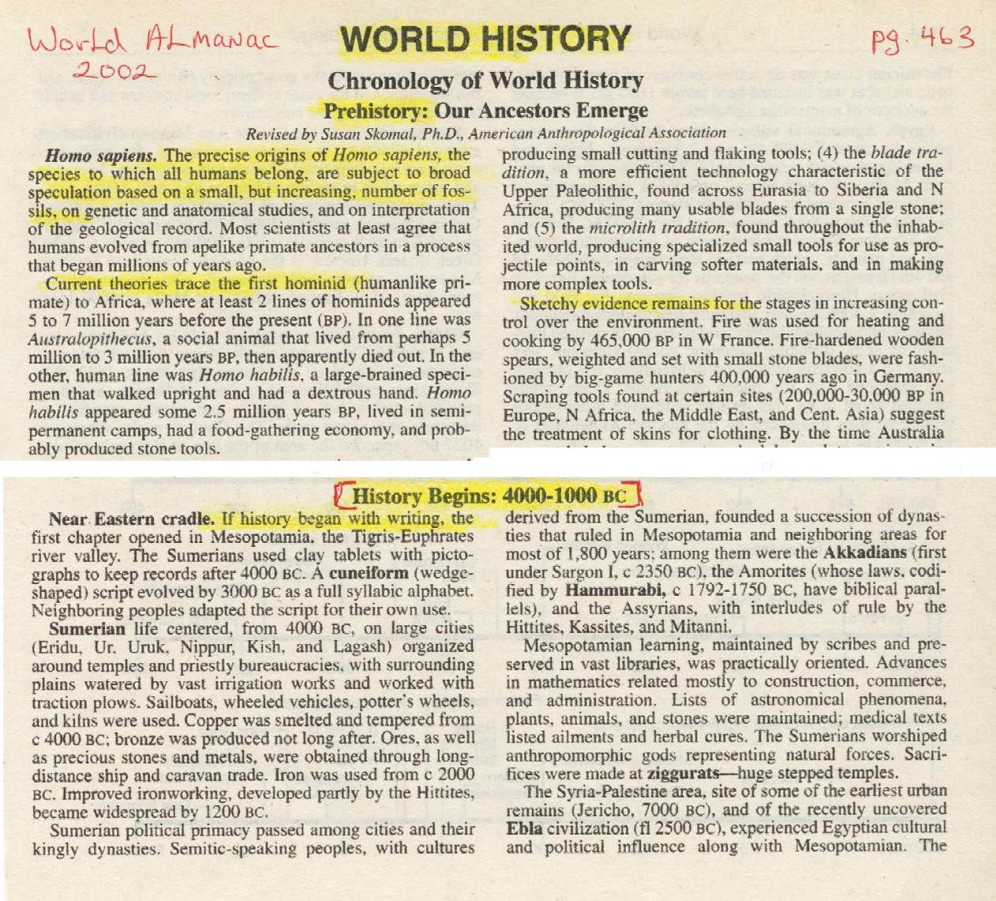
The World Almanac admits that “History” begins 4000 B.C.
Notice Prehistory involves speculation, theories & sketchy evidence!

Slide 64
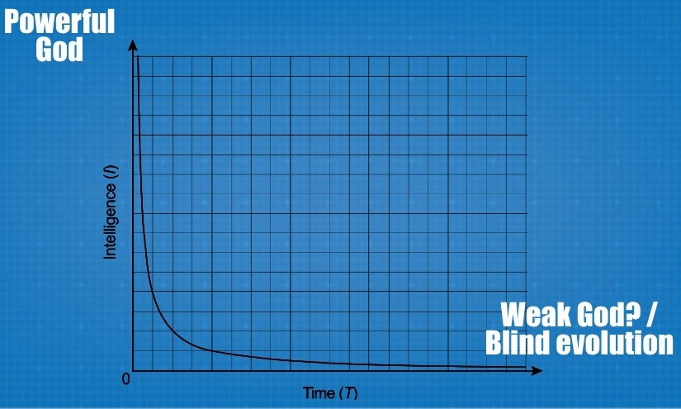
The Sabbath proves the 6 Days of Genesis 1 are literal 24hr. Days: For God says:
“For in six days the LORD made heaven & earth” (Ex. 20:8-11; 31:16-17)
Theistic evolution makes a God who is neither Omnipotent or Omniscient

Slide 65
Build your life on the impregnable foundation of God’s Word (Matt. 7:24-29) not the quicksand of godless theories
“The theory of evolution is a theory universally accepted, not because it can be proved by logically coherent evidence to be true, but because the only alternative, special creation, is clearly incredible” (D.M.S. Watson, “Adaptation,” Nature, Vol 124, 10 Aug. 1929, 233). See Wikipedia on D.M.S. Watson.

Slide 66
The ‘theory’ of evolution is impossible according to The ‘scientific Law’ of Causality: 因果關係的科學定律
“No effect can be greater than its cause”
「果無法大於它的因」.
A Universe of intelligible complex effects, including living systems & conscious personalities is proof of an intelligent, complex, living, conscious Person as its Cause!
一個彰顯智能,複雜的宇宙, 包括生物系統和有意識的人類, 證明一位有智能, 複雜, 活著的位格是它的因!

Slide 67
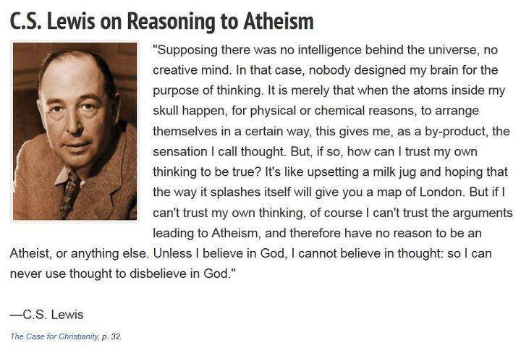
Men who are products of evolution can’t tell you who you really are!

