Slide 1
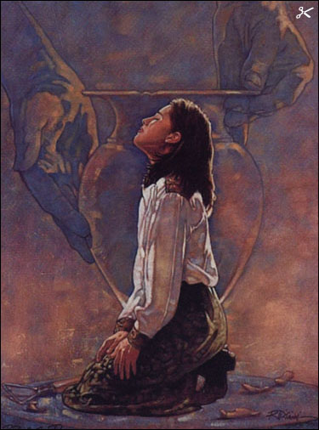
Romans 8:26-30 Predestined to be conformed to the Image of Christ
羅馬書8：26-30 預定模成基督的形像
We are predestined to become like Jesus through the Power of prayer
藉著禱告的力量，我們注定會像耶穌。
I. The intercession of the Holy Spirit:
I. 聖靈的代禱：

Slide 2
(8:26) “…the Spirit helpeth our infirmities: for we know not what we should pray for as we ought: but the Spirit itself maketh intercession for us with groanings which cannot be uttered.
羅8：26 - 況且我們的軟弱有聖靈幫助，我們本不曉得當怎樣禱告，只是聖靈親自用說不出來的歎息替我們禱告。
(8:27) And he that searcheth the hearts knoweth what is the mind of the Spirit, because he maketh intercession for the saints according to the will of God.
羅8:27 鑒察人心的，曉得聖靈的意思，因為聖靈照著神的旨意替聖徒祈求。
Illus: The Spirit in each member of the church (John 14:15-17) [for my wife]
例： 聖靈在教會每位肢體裏面（約14：15-17）。

Slide 3
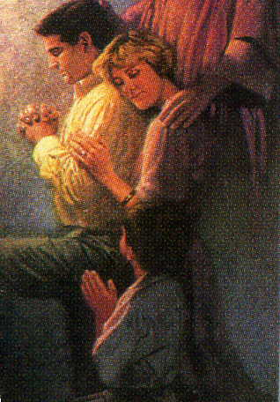
II. We are predestined to become like Jesus through Christ’s intercession on our behalf
藉著基督為我們代禱，我們注定會像耶穌
(Rom 8:34) Who is he that condemneth? It is Christ that died, yea rather, that is risen again, who is even at the right hand of God,
羅8：34 -誰能定他們的罪呢？有基督耶穌已經死了，而且從死裡復活，現今在神的右邊，
who also maketh intercession for us.”
也替我們祈求 (Heb. 7:25; 9:24; Isa. 53:12; John 17:9-26; I John 2:1-2)

Slide 4
III. We are predestined to become like Jesus by the Sovereignty of a Good God (Rom. 8:28-29)
藉著良善上帝的主權，我們注定會像耶穌
(Rom 8:28) “& we know that all things work together for good to them that love God, to them who are the called according to his purpose”
羅8：28 - 我們曉得萬事都互相效力，叫愛神的人得益處，就是按他旨意被召的人。
The sovereignty of God guarantees our destiny & the goodness of God achieves it
上帝的主權保證我們的命運，而上帝的良善會成就它。

Slide 5
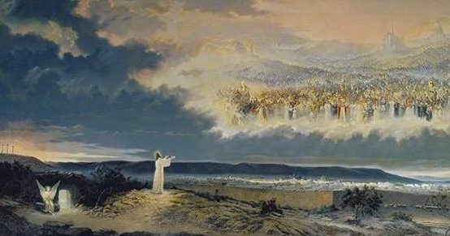
Our Glorious Divine Destiny Guaranteed!
我們榮耀神聖的命運已被保證！
(Rom 8:29) “For whom he did foreknow, he also did predestinate to be conformed to the image of his Son, that he might be the firstborn among many brethren” (Eph. 1:5-10; I Cor. 15:42-58; John 17:22-23; 2 Cor. 3:18; I John 3:2)
羅8：29 – 因為他預先所知道的人，就預先定下效法他兒子的模樣，使他兒子在許多弟兄中作長子。
[illus.: Atheist Madalyn Murray O’Hair’s son gets saved!]

Slide 6
Our Glorification Involves our Body, Soul & Spirit
我們的得榮耀包括身體，魂，與靈
Our physical body will be transformed into the likeness of Christ’s physical body (Phil. 3:21; I Cor. 15:42-49; 2 Cor. 5:1-5)
我們的肉身將轉變成基督肉身的形像，
Our soul & spirit will become “Christlike” (Eph. 1:4; 4:22-24)
我們的魂與靈也將變成“基督的樣式”，
This is an ongoing process (2 Cor. 3:18; Rom. 12:2; Col. 3:10)
這是一個持續進行的過程，
Completed when we see Him (I John 3:2; I Cor. 15:49)
直到親眼見祂時完成。

Slide 7
The Bible gives incredible proof of this by taking everyone in the O.T. that was “called according to God’s purpose” & conforming them to the image of Christ (Eph. 1:10)
對此，聖經給予奇妙的明證，將舊約中每一“按照上帝旨意被召的人”，模成基督的形像。
Every one that was called in the O.T. was created for God’s glory (Isa. 43:7; Rom. 9:23-24)
每一舊約中被召的人，都為上帝的榮耀所造（賽43：7；羅9：23-24）。
God not only revealed the glory of His Son in O.T. saints (I Pet. 1:10 -11); He reveals His Son in us!(Gal. 1:15-6; Col. 1:27; 2Cor. 3:2-3)
上帝不但在舊約聖徒中啓示祂兒子的榮耀，也在我們裏面啓示祂的兒子！

Slide 8
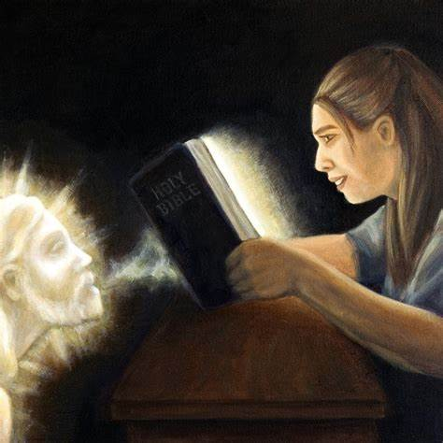
IV. The Holy Spirit revealing the glory of Christ, designed into the O.T. Types, transforms us into His Image!
聖靈藉著設計入舊約的預表來啓示基督的榮耀，
並轉化我們變成祂的形像！
“But we all, …beholding as in a glass the glory of the Lord, are changed into the same image from glory to glory,
我們眾人既然敞著臉得以看見主的榮光，好像從鏡子裡反照，就變成主的形狀，榮上加榮，
even as by the Spirit of the Lord.”
如同從主的靈變成的。 (2 Cor. 林後 3:18) [illus.: D.L. Moody – mercy]

Slide 9
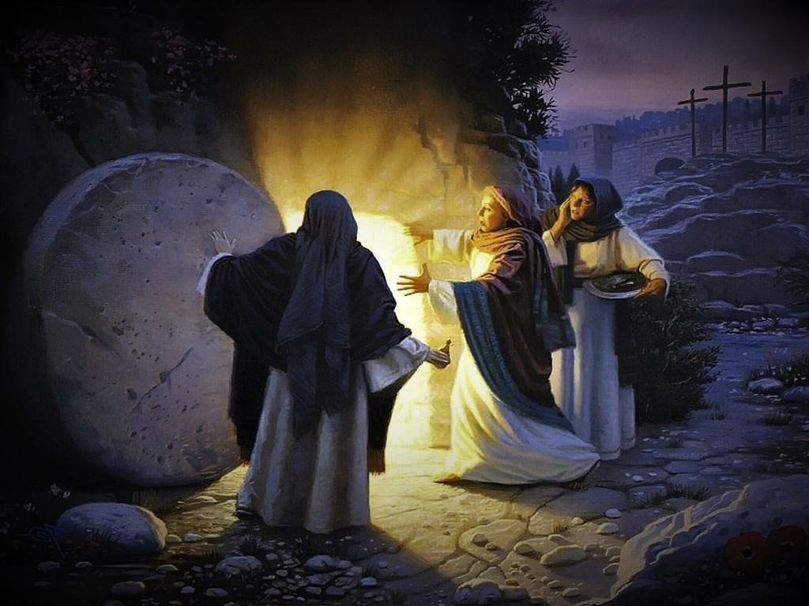
The Bible is Greater inspiration for this Faith than someone rising from the Dead!
聖經對這樣的信心，比從死裏復活的人，是更大的啓發，！
Jesus said “If they hear not Moses & the prophets, neither will they be persuaded, though one rose from the dead” (Lk. 16:31; 24:25-7, 44-47)
耶穌說：若不聽從摩西和先知的話，就是有一個從死裡復活的，他們也是不聽勸。（路16：31）

Slide 10
Why Does God’s Word have such Power?
爲何上帝的話語具有如此的能力！
25 % of the Bible is Prophesy which is an infallible irrefutable concrete proof of its Divine inspiration.
聖經的25%都是預言，它們是聖經來自神聖啓示不會錯誤、無法駁斥、具體的明證。There’s 300 Prophecies of Christ in the O.T.
舊約中關於基督的預言有300個。
Peter Stoner in Science Speaks, reveals the probability of just 8 of them being fulfilled in any one individual is 1 in 10 to the 17th power (1 in 100,000,000,000,000,000) [1 in 100 quadrillion]
Peter Stoner在科學會説話這本書中，顯示8個預言在一個人身上應驗的或然率是十萬兆分之一。

Slide 11
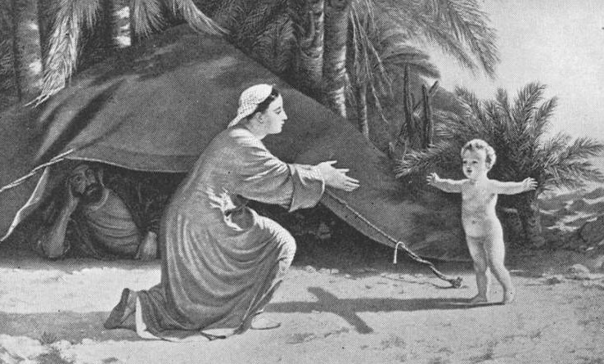
The most amazing kind of Prophesy is “Prophetic Types” Absolutely inexplicable apart from Divine Revelation!
最奇妙的預言種類是“預表”，
若非神聖的啓示，是絕對無法解釋的！
A type is “a shadow, cast by Divine design, of good things to come” & not the very image of the things (Heb. 10:1; 8:5; 9:8-9, 11; Col. 2:16-17)
預表是“一個影子，是經過神聖的設計顯明將來美事的影兒，而非本物的真像。” （來10：1）

Slide 12
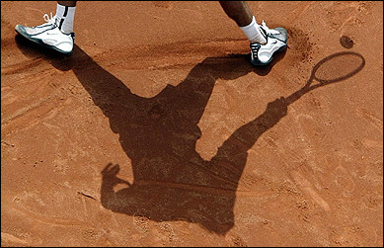
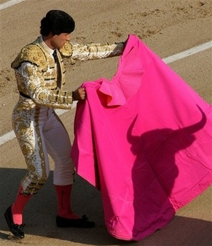
The resemblance between a Shadow & the object that casts the Shadow can be very striking!
影子和投擲影子實體之間的類似，會十分明顯！
As you learn to observe them, you will find shadows cast by Biblical Types are very striking indeed!
當你學會觀察它們時，你會發現聖經預表所投射的影子十分鮮明！

Slide 13
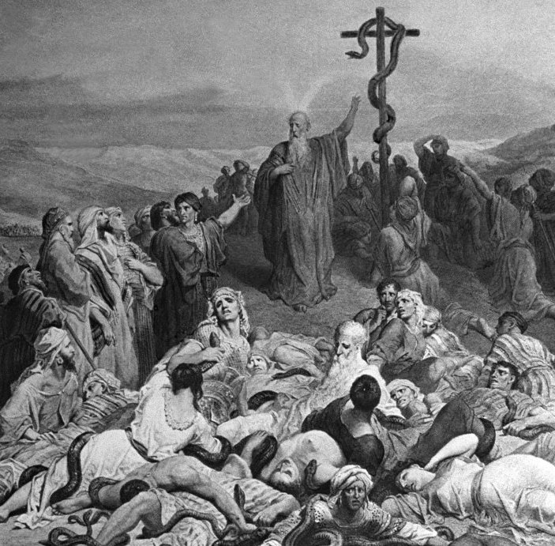
The resemblance between the O.T. Shadow (type) & their N.T. fulfillment is so striking as to preclude the possibility of chance.
舊約預表與他們新約的應驗十分明顯，排除了偶然的可能性。
Moses lifting up the serpent was a Type of Christ Crucified (John 3:14-16; Num. 21:5-9; 2Cor. 5:21)

Slide 14
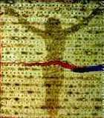
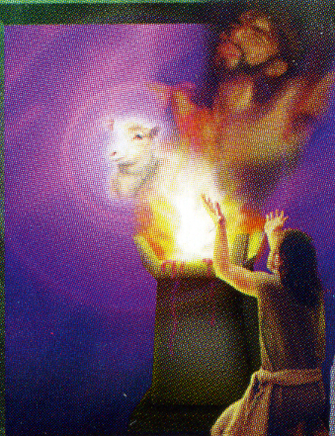
Learn how to discover Prophetic Types & you will never doubt the Supernatural Inspiration of the Bible
學會如何發現預表，你將永遠不會懷疑聖經超自然的啓示
You will know it could only have been inspired by an Omniscient, Omnipotent, Eternal Sovereign God!
你將明白他們只可能是無所不知、無所不能、永恆自主的上帝的啓示！
Every O.T. Lamb is a Type of Christ (John 1:36)
Bread of the Passover reveals Christ Crucified

Slide 15
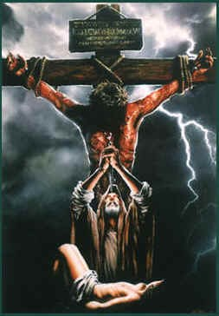
A Prophetic Type can be:
預表可以是：
A person, thing (Heb. 9:24), or event in the O.T. (Heb. 11:17-19), designed to represent or prefigure some person, thing, or event in the New Testament.
舊約的一個人物、事物、或事件，被設計來代表或預表新約中某個人、事物，或事件。

Slide 16
V. This Study focuses on People who became Prophetic Types of Jesus Christ
這篇信息專注在舊約中成爲預表耶穌基督的人物
The lives of certain people are recorded by the Holy Spirit, in such a way, so as to reflect the glory of the person and work of Jesus Christ (Hos. 12:10; Heb. 7:3, 15)
這些人物的人生被聖靈記錄下來的方式，反映出耶穌基督的位格與工作的榮耀。
It was impossible to know the prophetic importance of O.T. Types until Jesus Christ fulfilled them in the N.T.!
我們不可能明白舊約預表的重要性，直到耶穌基督在新約中應驗他們。

Slide 17
All Scripture Points us to Jesus (John 5:39-40; Lk. 24:44-47)
所有的聖經都將我們指向耶穌
Adam was a Type of Christ (the last Adam) (I Cor. 15:45-49; Rom. 5:12-21)
亞當是基督的預表（末後的亞當）（林前15：45-49；羅5：12-21）
The record of Melchizedek is designed to be a Type of Christ as Priest-King (Gen. 14:18-20; Ps. 110:4; Heb. 7). He was “made like unto the Son of God” (Heb. 7:3)
麥基洗德的記錄，被設計成預表基督是祭司-君王（創14：18-20；詩110：4；來7）；他“與上帝的兒子相似”（來7：3）。

Slide 18
Discover how everyone who was called & justified in the O. T. was conformed to Christ, and you will never doubt God will accomplish THis Same glorious Destiny for your life
發現舊約中每一被召並被稱義的人
如何變成基督的樣式
你就永不懷疑上帝會為你的人生
成就同樣榮耀的命運

Slide 19
3 Great Examples of this Truth: Abraham, Isaac, Jacob, (a very dysfunctional family!)
這項真理的三個偉大範例：亞伯拉罕，以撒，雅各
（一個功能十分失常的家庭）
1st we will observe their sinful humanity. They are just as human & sinful as you & me. You might say: “Wow, that just like me!”
我們首先觀察他們罪惡的人性，他們與我們一樣有人性與罪。
2nd we will observe their Glorious Transformation into the image of Christ. We observe the triumph of God’s grace.
其次我們觀察他們榮耀的轉化成基督的樣式，我們觀察上帝恩典的得勝。

Slide 20
1a. Abraham’s sinful humanity
亞伯拉罕罪惡的人性
A tough man to live with. At times it seems he doesn’t appreciate or value his wife much (Gen. 12:11-20; 20:1-2, 11).
一個難與他共同生活的人，有時他好像不感激、看重他的妻子（創12：11-20；20：1-2，11），
He is prone to lie when He thinks it is to his advantage (Gen. 12:12-13; 20:1-3)
他認爲有利于己就傾向撒謊（創12：12-13；20：1-3）。
He tried to fulfill God’s promise in a very carnal manner before he learned to trust God to fulfill it His way. (Gen. 15:4; 16:1-5)
在學會信靠上帝，以祂的方式來實現應許之前，他使用各種屬肉體的方式來完成上帝的應許（創15：4；16：1-5）。

Slide 21
1b. Abraham’s transformation into Christ’s Image
亞伯拉罕轉化成基督的形像
Abraham called the father of the faith (Gen. 15:6; Rom. 4:3, 16-18) Jesus is the author & finisher of our faith (Heb. 12:2)
亞伯拉罕被稱爲信心之父（創15：6；羅4：3，16-18）
耶穌是我們信心的創始成終者（來12：2）。
Learned Christlike obedience to God (Gen. 18:18-19; 26:5; John 8:29)
學會基督樣式，順服上帝（創18：18-19；26：5；約8：29），
Obeyed God in moving to a foreign Land (Gen. 12:1; John 6:38, 42)
順服上帝遷徙到外鄉（創12：1；約6：38，42），
Obeyed God in offering up Isaac (Gen. 22; with John 10:17)
順服上帝獻上以撒（創22，參約10：17）。

Slide 22
Abraham is a Type of Christ in his intercessory prayer ministry (Gen. 18:22-33; 20:7; with Heb. 7:25; Rom. 8:34)
亞伯拉罕在代禱事奉上預表基督（創18：22-33；參來7：25；羅8：34）。
He is a Type of Christ in that “all nations of the earth shall be blessed in him” (Gen. 18:18; 12:2-3; 22:17-18 & Acts 3:25-26; Gal. 3:8)
他在“地上萬國都必因你得福”上預表基督（創18：18，12：2-3）
The LORD made the Abrahamic Covenant with Abraham (Gen. 15:18) & the New Covenant through Jesus (Isa. 42:6; Jer. 31:31-34; Matt. 26:27-29)
耶和華與亞伯拉罕訂立亞伯拉罕之約，經由耶穌訂立新約（賽42：6；耶31：31-34；太26：27-29）。

Slide 23
2a. Isaac’s sinful humanity
以撒罪惡的人性
Very passive (Gen. 26:18-22); filial to a fault (Gen. 22)
一個被動的人（創26：18-22）；孝順到盲從（創22），
He played favorites with his two sons (Gen. 25:28; Eph. 6:4)
在兩個兒子之間玩偏愛（創25：28），
He had a weakness for certain foods (Gen. 25:28; 27:4; Phil. 3:19)
對某些食物有弱點（創25：28），

Slide 24
2a. Isaac’s sinful humanity
以撒罪惡的人性
Lies out of fear, just like his father (Gen. 26:7, 9)
因懼怕而撒謊，正像他父親（創26：7，9），
Counseled Jacob to marry a believer (Gen. 28:1-4) but failed to counsel Esau (Gen. 26:34-35)
建議雅各娶信徒（創28：104），但沒有如此建議以掃（創26：34-35）。

Slide 25
2b. Isaac’s Transformation into Christ’s Image
以撒轉化成基督的形像
The Life of Isaac is recorded in such a way by the Holy Spirit that we can’t miss the similarities of his person & experience with the person & experience of Jesus
聖靈記錄以撒人生的方式，讓我們不會錯過他的身份和經驗與耶穌身份和經驗的類似處。
With Isaac becoming a Type of Christ the Son; Abraham now becomes a Type of God the Father.
以撒成爲基督為兒子的預表，亞伯拉罕現在成爲天父的預表。

Slide 26
Both were born by supernatural birth (Gen. 21:1-3; Matt. 1:18-23) A Christian is a son of God by supernatural birth (Joh 1:12-13; 3:3-7)
兩位都是超自然誕生，基督徒也藉著超自然誕生成爲上帝的兒子
（約1：12-13；3：3-7）
ISAAC 以撒 (2000 B.C.)
He was promised by God long before he was born.
出生以前很久就被上帝應許
(Gen. 15:4; 18:9-14)
（創15:4;18:9-14）
JESUS 耶穌 (Fulfillment)
He was promised by God long
before he was born
出生以前很久就被上帝應許
(Gen. 3:15; Isa. 9:6-7)
（創3:15；賽9:6-7）

Slide 27
Many struggle with the supernatural nature of being a true Christian born again by the Holy Spirit (Nicodemas - John 3:3-7)
許多人對經由聖靈重生成爲真正基督徒的超自然本質感到困惑
ISAAC 以撒
Sarah thought it’s impossible for her to conceive (Gen.18:12-13)
撒拉以爲她不可能懷孕（創18：12-13）
JESUS 耶穌
Mary thought it’s impossible for her to conceive (Lk. 1:34)
馬利亞以爲她不可能懷孕（路1:34）

Slide 28
Hebrews 11:18-19 reveals the events in Genesis 22 are a Prophetic Type of Christ
希伯來書11:18-19 顯示創世記22章中的事件是基督的預表
“….it was said, that in Isaac shall thy seed be called:
論到這兒子，曾有話說：「從以撒生的才要稱為你的後裔。」
Accounting that God was able to raise him up, even from the dead; from whence also he received him in a figure” [Gk.= parable] (Hosea 12:10)
他以為神還能叫人從死裡復活；他也彷彿從死中得回他的兒子來。（仿佛：希臘文=比喻）

Slide 29
Every born again Christian is “a son” of God (John 1:12; 3:3-7)
每一重生的基督徒都是上帝的“兒子”（約1:12;3:3-7）
ISAAC 以撒
"take now thy son, thine only son” & offer him a sacrifice on Mt. Moriah (Gen. 22:2)
神說：「你帶著你的兒子，就是你獨生的兒子，你所愛的以撒，往摩利亞地去，在我所要指示你的山上，把他獻為燔祭。」 （創22:2）
JESUS 耶穌
Jesus was God’s “only begotten son” offered on Mt. Moriah (John 3:16; 1:14; 2 Chron. 3:1)
耶穌是上帝的“獨生子”，被獻在摩利亞山上（約3:16，1:14）

Slide 30
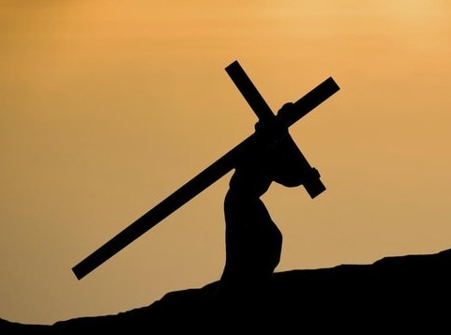
We must take up our Cross & follow Jesus (Matt. 16:24; Mk. 8:34; Lk. 9:23); the Purpose? (Galatians 2:20)
我們必須背起自己的十字架來跟隨耶穌
ISAAC 以撒
carried the wood, on which he would be offered in sacrifice (Gen. 22:6)
背著柴，將被獻在其上 （創22:6）
JESUS 耶穌
"And he bearing his cross went forth" (John 19:17)
耶穌“背著十字架出來” （約19:17）

Slide 31
Isaac & Jesus had profound questions for their Father. Do you have unanswered questions of your Heavenly Father causing doubts?
以撒與耶穌都深刻地質問他們的父親。
你有從天父得不到回答而導致懷疑嗎？
ISAAC 以撒
“where is the lamb for a burnt offering?” (Gen. 22:7)
“燔祭的羊羔在哪裏？” （創22:7）
JESUS 耶穌
“My God, my God, why hast thou forsaken me?” (Ps. 22:1; Matt. 27:46)
“我的神，我的神，為什麽離棄我？”（詩22:1；太27:46）

Slide 32
Have you trusted the Lamb of God to take away your sin?
你信靠上帝的羔羊除去你的罪孽了嗎？
ISAAC 以撒
Abraham, a prophet, prophesied "God will provide himself a lamb for a burnt offering” (Gen. 22:8, 14KJV)
亞伯拉罕，一位先知，預言到：“上帝自己會預備燔祭的羊羔（或上帝會預備自己為燔祭的羊羔）” （創22:8,14）
JESUS 耶穌
"Behold the lamb of God, which taketh away the sin of the world.” (John 1:29, 36; 2 Cor. 5:19)
“看哪，上帝的羔羊，除去世人罪孽的。”（約1:29,36；林後5:19）。

Slide 33
Do You Obey God in every thing? (Rom. 12:1)
你凡事順從上帝嗎？（羅12:1）
ISAAC 以撒
Submitted to his father’s will in everything
凡事順從他父親的意願，
He was obedient unto death (Gen. 22:9-10)
甚至順從到死（創22:9-10）
JESUS 耶穌
Submitted to his fathers will in everything
凡事順從他父親的旨意，
He was obedient unto death (Phil. 2:5-8)
甚至順從至死（腓2:5-8）

Slide 34
(Rom. 羅馬書 8:11)
ISAAC 以撒
Saved by God’s grace and miraculous provision, rises from the altar a Type of resurrection after 3 days (Heb. 11:19; Gen. 22:4, 13)
憑上帝的恩典與奇跡式的供應獲救，從祭壇起來，預表三天後復活（來11:19；創22:4,13）
JESUS 耶穌
Literally rose from the dead on the 3rd day according to the Scriptures. He is the Resurrection! (John 11:25-26; I Cor. 15:3-4)
按照經文，第三天從死裏復活。祂是復活！（約11:25-26；林前15:3-4）

Slide 35
Are You part of Christ’s Bride? Looking for His return? (I John 3:1-3)
你是基督新婦的一份子嗎？你期待他歸來嗎？（約一3:1-3）
ISAAC 以撒
It never says he came down from the mountain (Gen. 22:19)
聖經從未說他從山上下來（創22:19）
Isaac is next seen when his bride is coming to him (Gen. 24:63-67)
以撒的下一幕是他的新娘來到他身旁（創24:63-67）
JESUS 耶穌
Jesus disappears from public sight after His resurrection
耶穌復活後從公衆面前消失
Will be seen next when he comes for His Bride (Jon 14:1-3)
下次看到他將是他為新婦歸來（約14:1-3）

Slide 36
3a. Jacob’s Sinful Humanity: his name means “supplanter” or “trickster” (Gen. 27:36)
雅各罪惡的人性：他的名意爲“抓住/欺騙”
Overly confident he could make it big with his own brains, cunning & hard work. (Gen. 30:30-43; 31:38-41)
過度自信，認爲可以靠著自己的腦袋、狡猾、及勞苦成功（創30:30-43;31:38-41)，
Takes advantage of his brother for material gain (Gen. 25:29-34)
爲了獲利佔哥哥的便宜（創25:29-34），
He lies to His father to get a blessing (Gen. 27:19-24)
欺騙父親獲得祝福（創27:19-24）。

Slide 37
Jacob’s Sinful Humanity: Must learn to Love God’s Will
雅各罪惡的人性：必須學會喜愛上帝的旨意
Marries 2 women: His love for Rachel came naturally. He must learn to love Leah for her place in his life in God’s plan (Gen. 29:18, 30-32)
娶了兩位婦人：愛上拉結是自然的，但他必須學會在上帝計劃中利亞在他生命中的位置，而愛利亞。
Like his father he plays favorites with his children {Joseph} (Gen. 37:3-4)
與他父親一樣在兒女中玩偏愛（約瑟）（創37:3-4）。

Slide 38
3b. Jacob’s transformation into Christ’s Image: slow & painful
雅各轉化成基督的形像：緩慢且痛苦
Jacob does not have a close relationship with God but God sovereignly watches over him (Gen. 28:15; 31:6-13, 24, 29, 42; 33:5, 11)
雅各與上帝沒有親密的關係，但上帝按照自己的旨意眷顧他，
He has little revelation or communion with God for most of his life (Gen. 29-31:3). He allowed idols in his home (Gen. 31:30-34; I John 5:20-21)
一生中多半沒有與上帝相交或得著啓示（創29-31:3），
他容讓偶像在家中（創31:30-34；約一5:20-21）。

Slide 39
Jacob’s transformation: Focused on experiences instead of relationship
雅各的轉化：著重在經驗而非關係上
He focuses on 2 great spiritual experiences rather than a constant daily fellowship with God. (Gen. 28:12-16; 31:3, 11-13; 32:9, 12)
他著重在兩個大的屬靈經驗上，而非持續與上帝每日的相交；
Even after wrestling with God he still lies to Esau (Gen. 32:24-30 with 33:12-17). Have you quit lying? (Rev. 21:8; Prov. 19:9)
甚至在與上帝摔跤後，仍然對以掃撒謊（創32:24-30，33:12-17）。

Slide 40
Jacob’s transformation: the long circuitous route
雅各的轉化：漫長迂迴路綫
He goes back to the place of his 1st encounter with God (Bethel) putting away all the idols (Gen. 35:1-4; 28:10-22).
他回到第一次與上帝相遇的地方（伯特利），移除所有偶像（創35:1-4；28:10-22），
Focuses more on the blessings he receives from God (Gen. 28:20-22; 30:30; 31:9, 42) rather than on the God who Blesses!
更多著重在從上帝得到的福氣（創28:20-22；30:30；31:9,42)
Builds a place of worship & has his most profound & intimate experience with God (Gen. 35:7-15)
設立敬拜的地方，獲得與上帝最深刻且親密的關係（創35:7-15)

Slide 41
Neglecting our spiritual growth has its consequences!
忽視我們屬靈的成長具有其後果！
The carnal emphasis of his life (Rom. 7:14-24) & his slow spiritual growth took its toll on his family. He has one of the most dysfunctional families in Scripture! (Gen. 34; 37-50).
雅各一生看重世俗（羅7:14-24），緩慢的屬靈成長令家人付出代價。他的家人是聖經中最功能失調的！（創34:37-50）
Eventually God fulfills his Blood Covenant Promises to Abraham (Gen. 15:4-18) through Jacob’s son, Joseph (Gen. 37, 39-50)
上帝至終藉著雅各的兒子約瑟，實現祂對亞伯拉罕血盟的應許（創15:4-18；37，39-50）。

Slide 42
Anyone who follows Jesus will be hated for His Names sake (Matt. 10:22; 24:9)
任何跟隨耶穌的人將因祂的名被痛恨（太10:22;24:9）
Jacob was hated by his brother Esau to the point of wanting to murder him (Gen. 27:41)
雅各被哥哥以掃痛恨，想要殺他（創27:41）
Jesus came to his own brethren Israel; they hated him & had him crucified (John 1:11; 7:1; 19:15)
耶穌來到自己的弟兄以色列人中，他們痛恨他，將他釘十字架（約1:11；7:1；19:15）

Slide 43
We must learn to humble ourselves before the LORD (I Pet. 5:6; James 4:10)
我們必須學會在耶和華面前謙卑下來（彼前5:6；雅4:10）
Jacob became Christlike in humility (Gen. 32:10; 47:9-10) & blesses all his children (Gen. 49:1-27)
雅各在謙卑上變成基督的樣式（創32:10；47:9-10），且祝福他所有的子女（創49:1-27）
Jesus was meek (Matt. 11:29) and always blesses all his children as God’s great High Priest (Num. 6:23-27; Heb. 4:14-16)
耶穌柔和謙卑（太11：29），且作爲上帝的大祭司祝福祂所有的兒女（民6:23-27；來4:14-16）

Slide 44
Eventually the entire World will Learn Jesus is alive & is LORD (Phil. 2:5-11; Rev. 19:11-16)
最終全世界都將明白耶穌活著，且是全地的主（腓2:5-11；啓19:11-16）
Jacob realizes Joseph is alive & LORD of Egypt; he experiences revival & recommits to fulfill God’s will for his life
雅各得知約瑟還活著成爲埃及的主；他經歷復興，並重獻自己去完成上帝對他生命的旨意
When Israel realizes Jesus is alive & LORD, they will experience revival & recommit to fulfill God’s will for them (Zech. 12:10; Rom. 11:25-26)
當以色列人明白耶穌活著且是耶和華時，他們將經歷復興，並重獻自己去完成上帝對他們的旨意（撒12:10）

Slide 45
We Learn so many important Lessons from these 3 men
我們從這三人學到諸多重要功課
Learn them well & put them into practice. Work with God to fulfill your glorious eternal destiny
好好學習且應用，與上帝同工去完成你榮耀永恆的命運。
God has predestinated us to be conformed to the image of his Son
上帝已預定我們模成祂兒子的樣式。
Pursuing that destiny brings you the greatest character, greatest peace, greatest joy & greatest meaning & fulfillment possible for a human being!
追求那命運帶給你人生最高大的品格，最龐大的平安，最多的喜樂，以及最大的意義和滿足！

Slide 48
Jacob chose Rachel. She was set aside & Leah took her place & bore fruit (Gen. 29:20-27)
Rachel was barren (29:31)
Jacob returns to his father’s house & brought both wives home in triumph
Jesus calls Israel first. She’s set aside temporarily & the church is fruitful for God (Rom 9-11)
When Jesus 1st came Israel was as a barren fig tree (Matt 23:15)
Jesus comes back with His Bride the Church to set up the kingdom Promised Israel by God the Father

Slide 49
Justified by God’s Grace (Rom. 8:30, 33; 3:24)
(saved from the penalty, power & presence of sin)
When God justifies a sinner we are free from the condemnation of breaking God’s law (Rom. 3:24-25; 5:1, 7-8) because Christ paid the penalty for ALL our sins (Past)
Justification saves us from an ever present condemnation (Rom. 8:1, 33-34) because Christ gives the Holy Spirit to brake the power of sin in us (Rom. 8:1-5) (Present)
Justification saves us from the wrath to come (Rom. 5:9; I Thess. 1:10; Rev. 20:11-15) because the righteousness of Christ is imparted to us (future)

