Slide 1
Ps. 91 Comprehensive Ultimate Eternal Security: Our CUES not to Fear
詩篇91篇 完整至終永恆的保障 – 不要懼怕
Written by Moses under Divine inspiration Psalm 91 appears to be an encouragement to Joshua to lead Israel into the Promised Land
摩西在上帝的啓示下寫下詩篇91篇，用來鼓勵約書亞帶領以色列人進入應許地。
God specifically charged Moses “to encourage & strengthen” Joshua for that monumental task. (Deut. 3:21-22, 28)
上帝明確吩咐摩西去“鼓勵並堅固”約書亞，從事那里程碑的任務（申3：21-22，28）。

Slide 2
Why could Moses give Joshua such great Divine Promises?
爲何摩西給約書亞如此重大從神來的應許？
Joshua “wholly followed the LORD” (Num. 14:24; 32:11-12; James 2:17-26). God’s Spirit was ‘in’ him (Num. 27:18; Deut. 34:9)
約書亞“全心跟隨耶和華”，上帝的靈在他“裏面”。
Moses observed Joshua’s character & faith (Num. 11:28) in all the battles, trials, & judgments of Israel; so under Divine inspiration could predict God’s special watch care over him (Ps. 103:7)
摩西在所有戰事、試煉、對以色列人的審判中，觀察到約書亞的品格與信心，因此在上帝的啓示下能夠預見上帝對他特別的眷顧，以及任何效仿約書亞的品格與信心的人。
& anyone else who emulates the character & faith of Joshua

Slide 3
Observe The 3-fold Inspiration by our Trinitarian God
留意三位一體真神的三層啓示
Encourage Joshua to fulfill His calling [encourage faithfulness]
鼓勵約書亞去完成祂的呼召【勉勵忠心】，
Prophecy of Christ: “the Spirit of Christ” in Moses empowered Moses to “testify before hand the sufferings of Christ, & the glory that should follow” (I Pet.1:11; Lk. 24:44-47) [inspires Faith]
基督的預言：在摩西裏面“基督的靈”使摩西有能力去“預先證明基督受苦難，後來得榮耀” (彼前1：11）【激發信心】，
Motivate us to obey God (I Pet. 1:12; Heb. 11:40) [empowers ministry]
激動我們順服上帝（彼前1L2，來11：40）【服事有力量】。

Slide 4
F M I [For Me If]: Every Bible Promise has Conditions that must be met before the Promise can be fulfilled
每一聖經的應許都必須滿足其條件才會應驗【倘若你…]
The greatness of the Promises inspires us to make whatever sacrifice is necessary to meet the Conditions
最大的應許會激勵我們做任何必要的犧牲去滿足其條件。
Many Christians claim God’s Promises by presumption rather than faith because they ignore the necessary conditions (James 1:6-8). True Faith comes from the Word of God (Rom. 10:17)
許多基督徒不凴信心而凴假定，宣告上帝的應許，因爲他們忽視必要的條件（雅1：6-8），真正的信心來自上帝的話語 （羅10:17)。

Slide 5
When we repent of our sin & are born again we bear the name ‘Christian’ which means ‘follower of Christ’
當我們悔改罪惡重生後，我們承擔了“基督徒”的名字，
就是“基督的跟隨者”之意。
Moses called Oshea (Joshua) Jehoshua (Num 13:16; Ex 33:11)
摩西就稱嫩的兒子何希阿為約書亞
Hebrew means ‘Jehovah saves’
希伯來意為“耶和華拯救”
The ultimate fulfillment is in Yeshua (Jesus) [Isa. 12:2]
最終的應驗在耶穌裏面。
Hebrew means ‘salvation’
希伯來意為“救恩”

Slide 6
The Supreme Condition
至上的條件
Security from countless dangers only comes from an intimate relationship with the LORD God
無數危險中得保障
只來自與耶和華上帝
有親密的關係

Slide 7
You can find the Safest Place in the world!
你能夠在世上找到最安全的地方！
(Ps 91:1) He that dwelleth in the secret place of the most High shall abide under the shadow of the Almighty.
詩91：1 住在至高者隱密處的，必住在全能者的蔭下。
(91:4) He shall cover thee with his feathers, & under his wings shalt thou trust:
91：4 他必用自己的翎毛遮蔽你；你要投靠在他的翅膀底下；

Slide 8
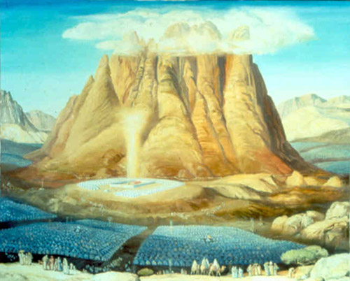
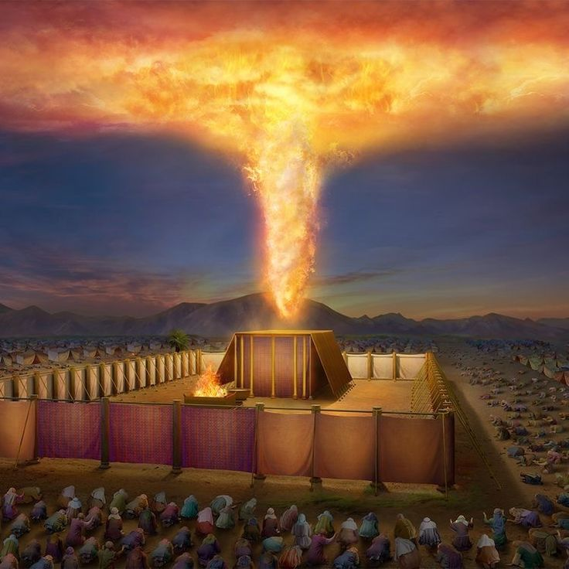
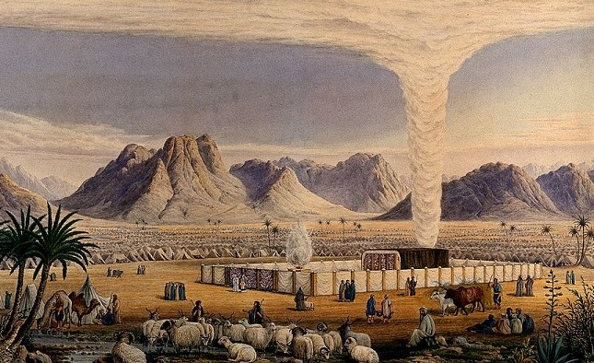
Joshua experienced the “shadow of the Almighty” from the Cloud & Pillar of Fire over the Tabernacle
約書亞從會幕之上的雲柱與火柱，經歷了在“全能者的蔭下”
Exodus 49:38; Num. 9:15-19

Slide 9
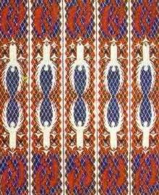
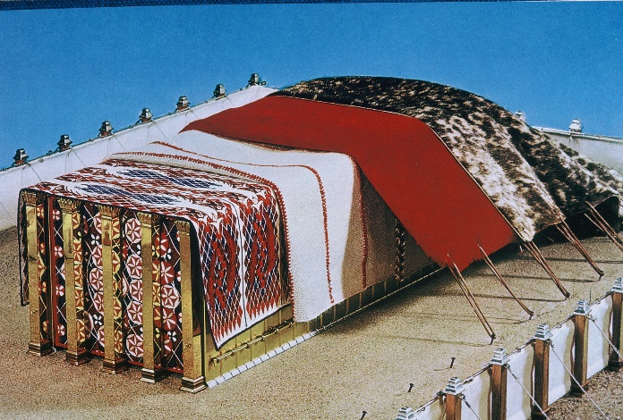
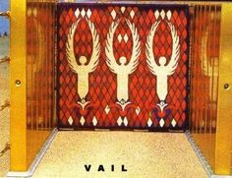
God Points Joshua & us to Learn from the Tabernacle
上帝指教約書亞和我們從會幕學功課
Cherubim wings covered the Holy Place & Mercy seat
基路伯的翅膀遮蓋聖所與施恩座。

Slide 10
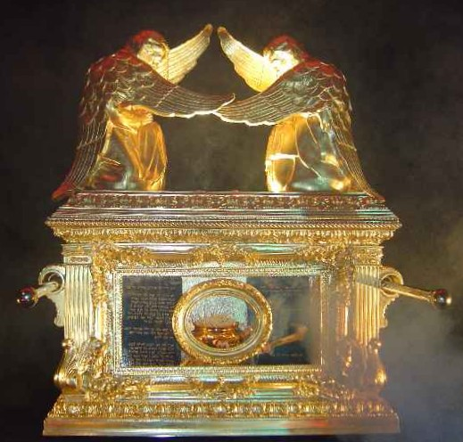
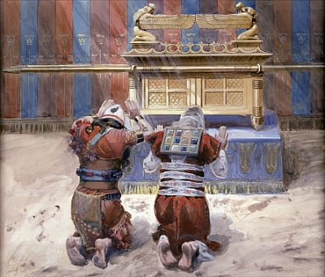
God’s Glory cast a shadow of Cherubim Wings over whoever entered the Holy of Holies
上帝的榮耀，照射基路伯翅膀的蔭影，
在任何進入至聖所的人身上
Moses & Joshua met with God in the Tabernacle (Ex. 33:11; Deut. 31:14)
摩西與約書亞在會幕與上帝相會。

Slide 11
Jesus, spiritually “made us sit together in heavenly places in Christ Jesus” (Eph. 2:6) giving us direct access to God’s presence in the heavenly holy of holies (Heb. 10:19-20; Rev. 11:19)
耶穌在靈裏“使我們與祂一同坐在天上”（弗2：6），
賜給我們在天上的至聖所直接進入上帝的同在。
Joshua loved to abide in the Tabernacle of God’s presence (Ex. 33:11)
約書亞喜愛在會幕上帝的同在中逗留（出33：11）
Jesus always abode in His father's presence (John 1:18; 3:13KJV; 8:29)
耶穌總是住在祂父親的同在中（約1：18;3:13)

Slide 12
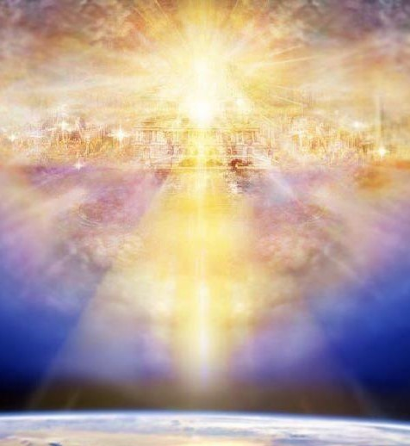
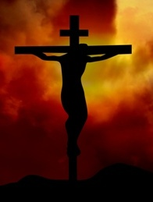
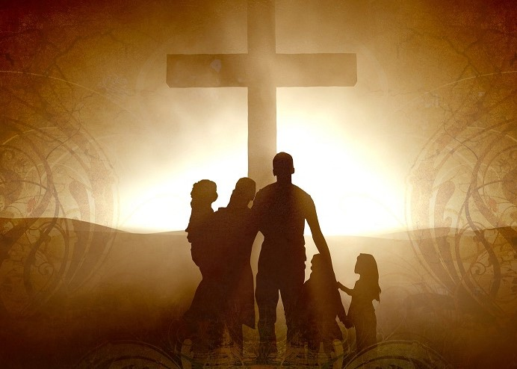
Because of our Relationship with Jesus we can enter the True “holiest” in the Heavenly Tabernacle by Prayer
因爲我們與耶穌的關係，我們可以經由禱告
進入天上會幕真正的“至聖所”
(Heb 10:19-23) “Having therefore, brethren, boldness to enter into the holiest by the blood of Jesus,
來10：19-23 “弟兄們，我們既因耶穌的血得以坦然進入至聖所…”

Slide 13
Security is not in a place but in God (John 4:20-24)
保障不在某地方，而在上帝裏面
（約4：20-24）
The safest place in the world: the center of the will of God for your life (Ps. 40:6-8; Heb. 10:5-7)
世上最安全的地方：
你的人生在上帝的旨意中
（詩40：6-8，來10：5-7）

Slide 14
3 CLUES you have an intimate relationship with God
與上帝有親密關係的三個綫索
(91:2) “I will say of the LORD, He is my refuge & my fortress: my God; in him will I trust.”
詩91：2- 我要論到耶和華說：他是我的避難所，是我的山寨， 是我的神，是我所倚靠的。
When you flee from an enemy where do you take refuge?
逃躲敵人時，你去哪避難？
When you stand up & fight evil forces what’s your fortress?
對抗邪惡勢力時，你的山寨爲何？
Whether “flight” or “fight” who do you Trust most?
不論躲避或對抗，你最信任的是誰？

Slide 15

Illustration: Dayna Curry & Heather Mercer, Afghanistan 2001
Imprisoned by Taliban for showing the Jesus Film just before 9/11
9-1-1前放映耶穌影片而被塔利班囚禁，
Prisoners for 100 days.
被關押100天，
Maintained group worship & private prayer
維持小組敬拜及個人私自禱告，
Rescued against all odds by special forces
在不可能的情況下被特種部隊營救。

Slide 16
Meet the Conditions; Experience the Promises
滿足條件；經歷應許
(91:3) “Surely he shall deliver thee from the snare of the fowler, & from the noisome pestilence.”
詩91：3 -他必救你脫離捕鳥人的網羅和毒害的瘟疫。
[illus: Heather Mercer – 10 inch worm crawls out her mouth]
Fear brings a snare (Prov. 29:25). Satan uses the fear of death to keep us in bondage to his will (Heb. 2:14-15)
恐懼帶來網羅（箴29：25）。撒旦使用對死亡的懼怕，來捆綁我們按他的意思行。

Slide 17
We must overcome sexual snares (I Cor. 6:13-18; 7:5; Heb 13:4); snares of false teachers (2 Tim. 2:24-26) & snares of riches (I Tim. 6:9-10KJV)
我們必須勝過性方面的網羅（林前6：13-18），假教師的網羅（提後2：24-26），以及財富的網羅（提前6：9-10）。
Joshua overcame the snare of Balaam’s sexual trap while many in Israel fell (Num. 25:1-3; 31:16)
約書亞勝過巴蘭的性陷阱，而許多以色列人失敗了（民25：1-3；31：16）。
Jesus defeated every snare of satan (Matt. 4:1-11) & those of Israel’ religious leaders (Matt. 22:15-22; Lk. 20:19-40)
耶穌擊敗撒旦的每個網羅（太4：1-11），以及以色列宗教領袖的陷阱。

Slide 18
What is the Key to overcoming the snares of both men & devils
勝過人與魔鬼各種網羅的關鍵爲何
The same Key for Joshua, Jesus & us:
約書亞、耶穌、與我們是一樣的：
Joshua filled with the Spirit (Num. 27:18; Deut. 34:9)
約書亞被聖靈充滿（民27：18；申34：9）
Jesus filled with the Spirit (Lk. 2:40; Matt. 3:16; John 3:34; Isa. 11:1-4)
耶穌被聖靈充滿（路2：40；太3：16）
Believer filled with the Holy Spirit (Eph. 5:18-21; Joh 14:17; Jam 1:5)
信徒被聖靈充滿（弗5：18-21；約14：17；雅1：5）

Slide 19
If you are alive today you have been saved from countless pestilences. But eventually the time of our departure will come! Will you be ready & have peace? (Deut. 31:14; 2 Tim. 4:6; 2 Pet. 1:14)
倘若你今天活著，你從無數的疾病中被救，
但至終我們離開的時間會到來！你預備好並且有平安嗎？
Joshua was saved from the pestilence of plague (Num. 11:33-35; 14:37-38) & Leprosy (Num. 12:10-15)
約書亞從瘟疫和痲瘋中獲救（民11：33-35；14：37-38；民12：10-15）
Jesus proves He is LORD by healing all pestilence (Matt. 4:24; Lk. 4:40) & Leprosy (Lk. 17:12-14)
耶穌醫治所有疾病和痲瘋，證明祂是耶和華（太4：24；路4：40；17：12-14）

Slide 20
An intimate relationship with God’s Word maintains our intimate relationship with God
與上帝的話語有親密的關係
維持我們與上帝有親密的關係

Slide 21
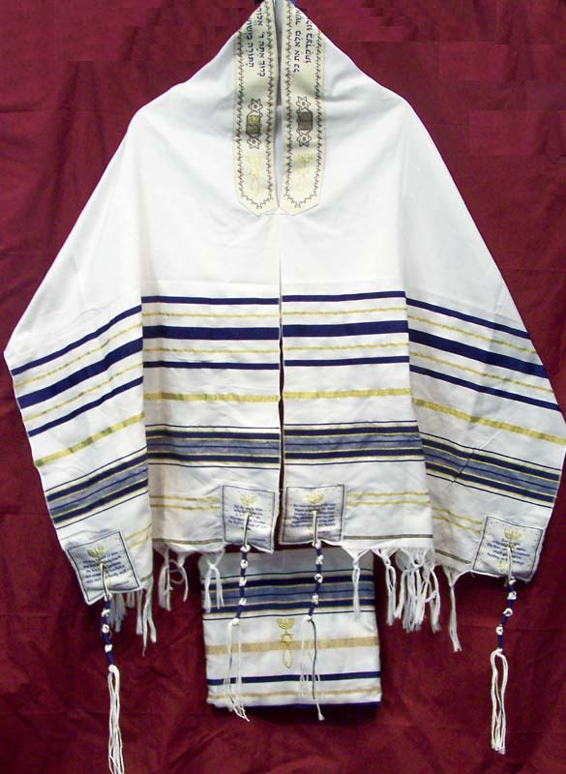
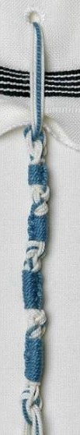
(91:4) “… under his wings shalt thou trust: his truth shall be thy shield & buckler.
詩91：4-…你要投靠在祂的翅膀底下；祂的誠實(真理）是大小的盾牌。
Jews understand “his wings” to refer to the Tzit-Tzit that they wore on the 4 ‘borders’ of their garments (Num. 15:38; Deut. 22:12).
猶太人明白“祂的翅膀”指的是衣服下端四角邊緣的綴子（民15：38；申22：12）
In Hebrew they are called ‘wings.’
在希伯來語中它們稱作“翅膀”。

Slide 22
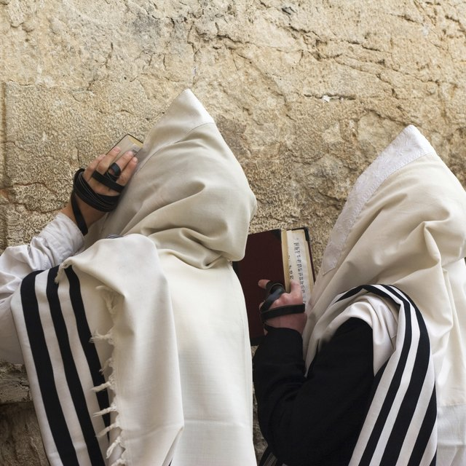
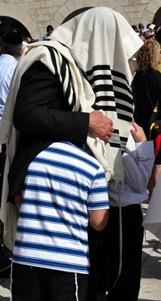
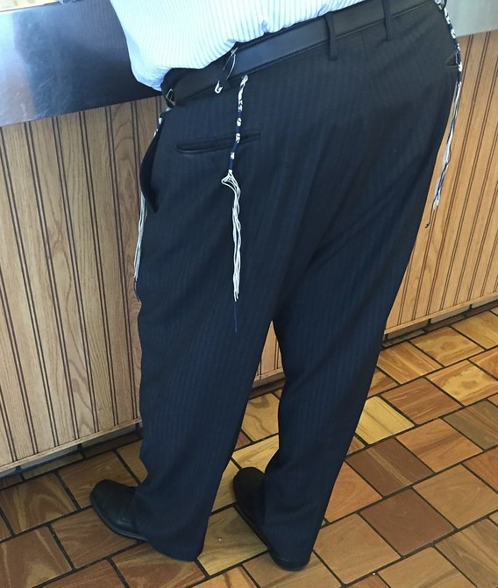
A Jew considered himself literally under ‘God’s wings’ when he put on these special garments!
猶太人認爲，當他披上這特別的衣服時，他就在“上帝的翅膀”下。
Jews entered the secret place when they prayed under their prayer shawl with the Tzit-tzit (Matt. 6:6)
當猶太人披上有綴子的禱告披肩禱告時，他們就進入隱秘處（太6：6）。

Slide 23
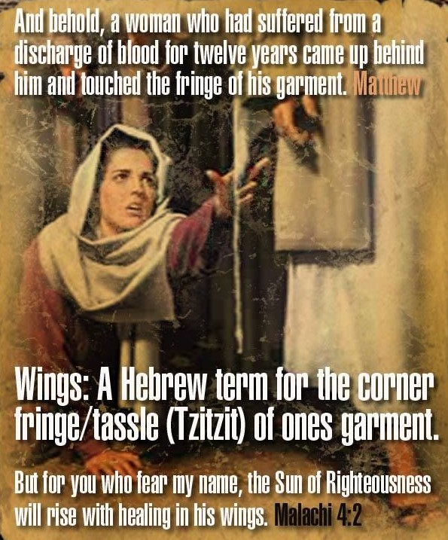
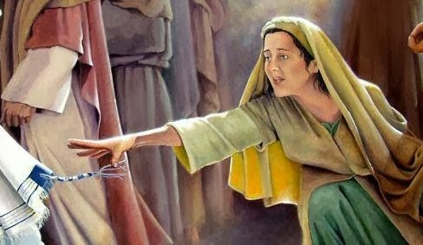
Jesus Literally fulfilled prophesy by coming with Healing in His wings!
耶穌“翅膀下有醫治”的到來，
實際應驗了預言。
(Mal. 4:2) “But unto you that fear my name shall the Sun of righteousness arise with healing in his wings…” (Lk. 8:43-48)
瑪拉基書4：2- “但向你們敬畏我名的人必有公義的日頭出現，其光線（原文作翅膀）有醫治之能…”(路8：43-48）

Slide 24
Both His wings & His Truth Point us to God’s Word
祂的翅膀與祂的真理都將我們指向上帝的話語
The Tzittzit knots symbolize all 613 Laws in the Torah. Wearing it symbolized their intimate relationship with God’s Word (Deut. 11:18-21) [they put on the Word]
綴子的結象徵妥拉中的613條律法，披戴它象徵他們與上帝話語的親密關係（申11：18-21）。
“His Truth” is a clear reference to God’s Word. Making it our shield & buckler means we wear it as armor in Battle!
“祂的真理”明白指向上帝的話語，用它作我們大小的盾牌，就是在戰場上穿上它作軍裝！
Something every Christian must do (Eph. 6:10-12, 17)
每位基督徒必須如此行（弗6：10-12，17）。

Slide 25
An intimate relationship with God & His Word enables us to triumph over fear
與上帝和祂的話語有親密的關係
使我們有勝過懼怕的力量

Slide 26
Visible (day) & invisible (night) Dangers
看得見（白天）與看不見（夜晚）的危險
(91:5) Thou shalt not be afraid for the terror by night; nor for the arrow that flieth by day; (6) Nor for the pestilence that walketh in darkness; nor for the destruction that wasteth at noonday.
詩91：5, 6-你必不怕黑夜的驚駭，或是白日飛的箭， 也不怕黑夜行的瘟疫，或是午間滅人的毒病。
Illus: Mother ask her daughter to go out in the night
(91:7) A 1,000 shall fall at thy side, & 10,000 at thy right hand; but it shall not come nigh thee.
91:7 -雖有千人仆倒在你旁邊，萬人仆倒在你右邊，這災卻不得臨近你。

Slide 27
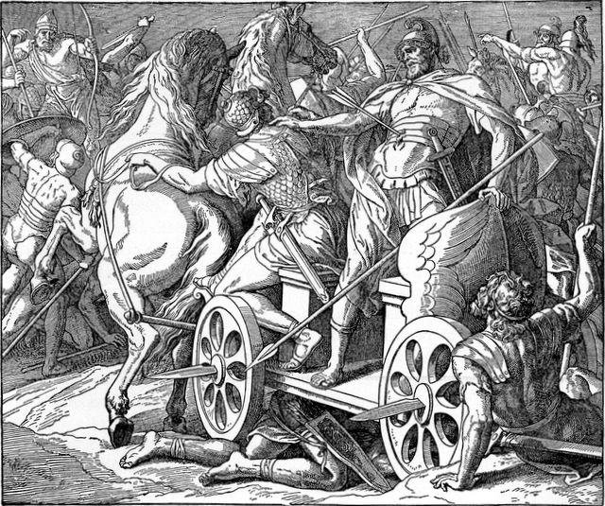
There is no escaping the “arrow” of God if you make Him your enemy
倘若你把上帝當作仇敵，你就無法躲避祂的“箭”
Ahab killed by an arrow shot by chance! (I Kings 22:34-38)
亞哈王被突發的箭射中身亡（王上22：34-38）！
Josiah when he rebelled against God’s will (2 Chron. 35:20-25)
約西亞王背叛上帝的旨意也如此（代下35：20-25）。

Slide 28
I am sure everyone here can look back on their lives & discover times they could have died (Wesley, Spurgeon, Livingstone, etc)
我確信在座者回顧一生時，都會發現他們可能死去的那些時刻。
Intimacy with God makes us immortal till its our time to go Home [Deut 31:14; 2Tim. 4:6-8]
與上帝親密使我們死不了
直到回家的時刻
（申31：14；提後4：6-8）

Slide 29
Illus: The Early Church triumphed over fear of Death (Heb. 2:14-5)
早期教會勝過死亡的懼怕（來2：14-15）
They knew where they were going when they left their physical body (2 Cor. 5:1-9; Phil. 1:20-23; I Thess. 4:13-18; 5:9-11; John 11:25-26)
他們知道離開肉身時會去到哪裏，
So they didn’t fear “the pestilence,” “terror” or “the destruction”
所以他們不怕“瘟疫”、“驚嚇”，或“毀滅”，
They knew they might be martyred in the will of God (Lk. 21:16) but not “a hair of their head would perish” (Lk. 21:18; Rom 8:28, 35)
他們明白可能在上帝的旨意中殉道（路21：16），但“連一根頭髮也必不損壞。”（羅8：28，35）

Slide 30
Covid19: CDC List of underlying conditions leading to death
新冠病毒：CDC對導致死亡的底層情況清單
#1 Essential hypertension – 272,591 (Aug. 2021) 高血壓
#3 Obesity – 178,153 肥胖症
#4 Diabetes – 171,727 糖尿病
#8 ANXIETY & FEAR- disorders – 98,846 焦慮與懼怕
#11 Depressive disorders – 85,150 抑鬱症候
https://www.youtube.com/watch?v=EJYoLbmv8nk&t=187s&ab_channel=MedicinewithDr.Moran
https://www.youtube.com/watch?v=iY98nuD3Bco&t=487s&ab_channel=HighIntensityHealth

Slide 31
We are responsible to pursue intimacy with God to reap its rewards
我們有責任追求與上帝親密
來收穫獎賞

Slide 32
Secure in The Final Judgment (John 5:27-29; Rev. 20:11-15)
最終審判時有保障（約5：27-29；啓20：11-15）
(91:8) “Only with thine eyes shalt thou behold & see the reward of the wicked.” [I Corinthians 6:2-3; Daniel 12:1-3]
91：8-你惟親眼觀看，見惡人遭報。
(91:9) Because thou hast made the LORD, which is my refuge, even the most High, thy habitation; [I Thess. 1:10; 5:9-11]
91:9- 耶和華是我的避難所；你已將至高者當你的居所， （帖前1：10；5：9-11）

Slide 33
Intimacy with God brings us into an intimate relationship with the unseen spiritual world (Hebrews 13:2)
與上帝親密帶來
與看不見的屬靈世界的
親密關係（來13：2）

Slide 34
Our unseen spiritual help in the spiritual warfare
在屬靈爭戰中看不見的屬靈幫助
(91:10) There shall no evil befall thee, neither shall any plague come nigh thy dwelling. (11) For he shall give his angels charge over thee, to keep thee in all thy ways.
91：10-禍患必不臨到你，災害也不挨近你的帳棚。
(91:12) They shall bear thee up in their hands, lest thou dash thy foot against a stone.
91:12 -他們要用手托著你，免得你的腳碰在石頭上。

Slide 35
Satan does everything he can to get you to misuse the Promises of God
撒旦儘其所能使你錯用上帝的應許
satan quoted Ps. 91:11-12 in Matt. 4:6 & Lk. 4:10 to tempt Jesus to avoid the Cross; but ignores vs. 13 which prophesies his own crushing defeat (Gen. 3:16).
撒旦在太4：6與路4：10引用詩91：11-12來試探耶穌，但忽視13節預言他自己的潰敗（創3：16），
(91:13) “Thou shalt tread upon the lion & adder: the young lion & the dragon shalt thou trample under feet.”
91：13-你要踹在獅子和虺蛇的身上，踐踏少壯獅子和大蛇。

Slide 36
the lion is a Type of satan (I Pet. 5:8); the adder [snake] is a Type of satan (Gen. 3:1-5); the dragon is a Type of satan (Rev. 12:9; Isa. 27:1)
獅子（彼前5：8）、虺蛇（創3：1-5）、
龍（啓12：9；賽27：1）都是撒旦的預表
Jesus revealed such dangerous animals are also Types of real spiritual enemies (‘devils’) (Luke 10:17-20; Rev. 12:9-12)
耶穌啓示這些危險的動物是真實屬靈仇敵（魔鬼）的預表（路10：17-20；啓12：9-12），
Paul also likened spiritual enemies to ‘beasts.’ (I Cor. 15:32 with Acts 19:11-20). Related to witchcraft & evil spirits (I Cor. 10:20-21; I Tim. 4:1; Rev. 18:2)
保羅也將屬靈仇敵比喻為“獸”（林前15：32；徒19：11-20），與邪術和邪靈有關（林前10：20-21；提前4：1；啓18：2）。

Slide 37
Our Comprehensive Security in The LORD
我們在耶和華裏面完整的保障
(91:3) – From the snare of the fowler 捕鳥人的網羅
From the noisome pestilence 毒害的瘟疫
(91:5) – from the terror by night 夜間的驚嚇
From the arrow that flieth by day 白天的飛箭
(91:6) – from the pestilence 瘟疫
From the destruction that wasteth at noonday 午間滅人的毒病

Slide 38
Our Comprehensive Security in The LORD
我們在耶和華裏面完整的保障
(91:7) When 1,000’s & 10,000’s fall at thy side
當千人與萬人仆倒在你旁邊
(91:10) – from evil (Matt. 6:13) 離開罪惡
From any plague 任何瘟疫
(91:13) – from the lion, adder, young lion, & dragon
獅子、虺蛇、少壯獅子、龍

Slide 39
Condition: Do you really Love the LORD? (John 14:21,23-24)
條件：你真愛耶和華嗎？（約14：21，23-24）
(91:14) Because he hath set his love upon me, therefore will I deliver him: I will set him on high, because he hath known my name.
91：14 - 神說：因為他專心愛我，我就要搭救他；因為他知道我的名，我要把他安置在高處。
Joshua was miraculously delivered his whole life; Jesus was miraculously delivered his whole life till it was time to go the cross
約書亞一生奇跡式地蒙拯救；耶穌一生奇跡式地獲救，直到上十字架的時刻。

Slide 40
God will set us on high in both His millennial Kingdom & eternal Kingdom (Eph. 2:4-7; Rev. 5:9-10)
上帝將在千禧年國度與永恆國度中高舉我們（復：4-7；啓5：9-10）
God set Joshua on high as the Leader of Israel who replaced Moses (Deut. 31:7-8; Josh. 1:5-7)
上帝高舉約書亞成爲代替摩西領導以色列人的領袖
God set Jesus “at his own right hand in the heavenly places, far above every name that is named” (Eph. 1:20-22)
上帝使耶穌 “坐在高天自己的右邊，超過一切有名的”
（弗1：20-22）

Slide 41

Illustration: The bullet proof George Washington 喬治華盛頓
A Man of faith. Experience in battle like Joshua
有信心的人，像約書亞一樣經歷戰爭
He was supernaturally delivered from death
奇跡般地從死亡中獲救
God set him on high as our 1st President!
上帝高舉他成爲美國第一任總統！

Slide 42
Prayer Activates Our Security when troubles surround us
當四圍麻煩環繞，禱告啓動我們的保障
(91:15) He shall call upon me, & I will answer him: I will be with him in trouble; I will deliver him, & honour him. (John 5:44; 12:43)
91：15-他若求告我，我就應允他；他在急難中，我要與他同在；我要搭救他，使他尊貴。 （約5：44；12：43）
Prayer naturally flows out of an intimate relationship with God & is crucial for deliverance!
禱告是與上帝關係親密的自然流露，
是獲得拯救的關鍵！

Slide 43
God hears our prayers that are according to His will (Matt. 6:6; Lk. 11:9-13; John 14:13-14; 15:7); & will make us Kings & Priests (Rev. 1:6; 5:10; 20:6)
上帝垂聼我們符合祂旨意的禱告，
並使我們作祂的君王與祭司。
God answered Joshua’s prayers & honored him before all Israel (Josh. 3:7; 4:14)
上帝回應約書亞的禱告，在以色列人面前尊榮他（書3：7；4：14）
God answered Jesus’ prayers (Heb. 5:7-9; John 11:42) & honored him with the name above every name (Phil. 2:9-11)
上帝回應耶穌的禱告，以超乎萬名之上的名尊榮他（腓2：9-11）

Slide 44
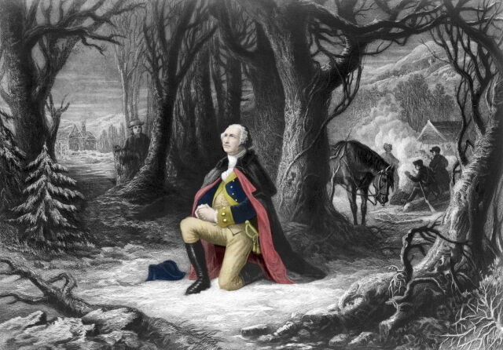
George Washington: A man of prayer
喬治華盛頓：禱告的人
Valley forge 1778
The man behind the tree is Isaac Potts (a Quaker against the war)

Slide 45
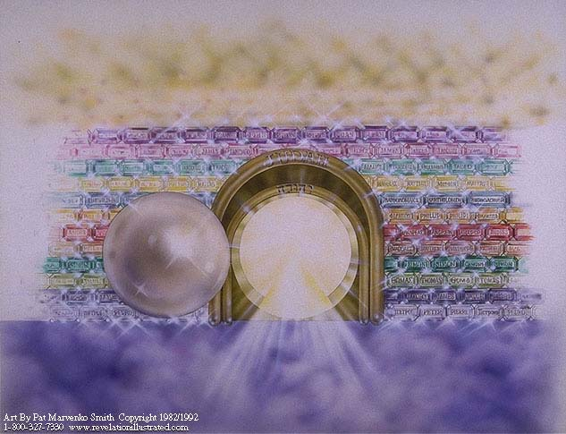
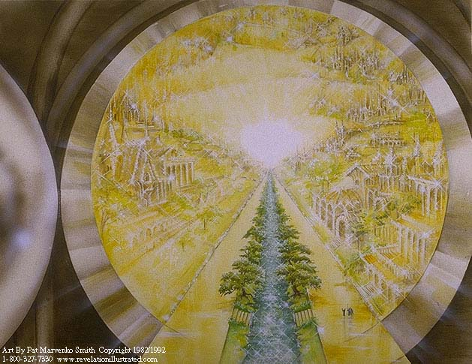
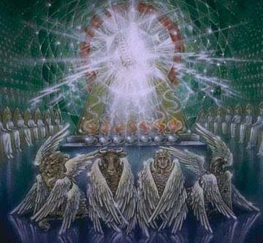
(91:16) With long life will I satisfy him, & shew him my salvation.
91：16 -我要使他足享長壽，將我的救恩顯明給他。
Our security is not only for this life, but by the lord’s salvation is for all eternity!
我們的保障不僅是今生，
藉著耶和華的救恩，是永遠！
Psalm 16:10-11

