Slide 1
We must understand the Certainty of God’s ‘Promise’ & His ‘Oath’ (Hebrews 6:16-19) 我们必须眀瞭上帝的“应许”与“誓言”的确定性
“Men verily swear [the promise] by the greater: & an oath [the covenant] for confirmation is to them an end of all strife.
人指着比他大的发誓（承诺），以誓言为证终止所有争闹。
(17) God, willing more abundantly to show … the immutability of his counsel, confirmed it by an oath:
来6:17-神願意為那承受應許的人格外顯明他的旨意是不更改的，就起誓為證。

Slide 2
We must understand the Certainty of God’s ‘Promise’ & His ‘Oath’ (Hebrews 6:16-19) 我们必须眀瞭上帝的“应许”与“誓言”的确定性
(18) That by two immutable things [the promise & the covenant] in which it was impossible for God to lie, we might have a strong consolation… and lay hold upon the hope set before us:
来6:18 -藉這兩件不更改的事(应许与盟约），神決不能說謊，好叫我們這逃往避難所、持定擺在我們前頭指望的人可以大得勉勵。
(19) Which hope we have as an anchor of the soul”
来6:19 -我們有這指望，如同靈魂的錨，又堅固又牢靠，

Slide 3
God’s PROMISE gives us an Unshakable Faith 上帝的应许帮助我们有一个不摇动的信心
God commits Himself to us with His “Great & Precious Promises” (Gen. 12:1-3; 13:14-17; 22:16-17; 2 Pet. 1:4)
上帝用祂伟大宝贵的应许，将自己委身于我们，
A promise is as sure as the character of the one making it
应许与赐应许者的品格一样确定。
God is omnipotent & Holy [perfect]. It’s impossible for him to lie (Heb. 6:18; Num. 23:19; Titus 1:2; Gen. 35:11; 48:3-4)
上帝无所不能且圣洁，祂不可能说谎。

Slide 4
God’s OATH gives us an Eternally Secure faith 上帝的誓言赐我们永远确定的信心
Sometimes God confirms His Promises with a Blood Covenant Oath (Described in Genesis 15:9-21).
有时上帝使用血盟确立祂的应许；
Once something is sworn to by an unconditional Blood covenant it can never be changed. It is immutable!
一旦誓言藉由无条件的血盟订立，它就不再能被更改。

Slide 5
Blood Covenant is the closest, holiest & most Indissoluble Relationship conceivable 血盟是最亲密、神圣，且最无法消弭的关系
The covenants of God must be understood & interpreted literally.
上帝的盟约必须按字面意义去明白并解释 ，
Like any known legal contract today or yesterday, wording is extremely important. (Rom. 3:4).
它就像现今或过去的法律合同，用字特别重要（罗3:4）
You cannot spiritualize away the literal meaning of the words
你不能用灵意去解释字句的字意。

Slide 6
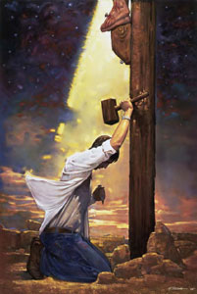
Understand Blood Covenant & you Understand Assurance! 明白盟約,你就明白確據!
God’s Covenants with Israel make it impossible for Israel to ever be totally destroyed.
上帝的約定使以色列永遠不可能完全滅亡.
Likewise If we enter the New Covenant by repentance of sin & faith in Christ we can never lose our salvation
同樣,若我們經由悔罪,相信基督進入新約, 我們絕對不會失去救恩.

Slide 7
2 kinds of Blood Covenant in the Bible 圣经中的两种血盟
1st the conditional covenant. 有条件的盟约
God promises to grant special blessings to the covenanted people provided they fulfill certain conditions set forth in the covenant.
Recognized by the words “If you will… then I will.” The Mosaic or Sinai Covenant was a conditional covenant.
倘若你 … 那我就 ，摩西与西乃之约属于此类。
Such covenants are temporary by nature (Galatians 3:16-26)
这类盟约按本质而言是占时的。

Slide 8
2 kinds of Blood Covenant in the Bible 圣经中的两种血盟
2nd is an Unconditional Blood Covenant: 无条件的血盟 Anchored on the Holy Character of God, whereby He establishes an unconditional relationship with man.
靠上帝神圣的品格而确立，与人建立无条件的关系，
God obligates Himself alone, in grace, to bring definite blessings for the covenanted people.
上帝在恩典中，让自己义务地将福气赐给与祂立约的人。

Slide 9
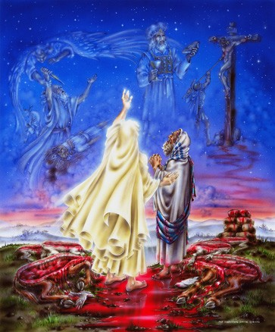
The Abrahamic Covenant is Unconditional & thus Eternal 亚伯拉罕之约是无条件的，因此是永远的
God Confirms it by taking the oath of “I Will… ” (without conditions)
上帝用“我要”的誓言来确立，
It is an immutable declaration of God’s Sovereign purpose (Gen. 12:1-3; 13:14-17; 15:1-21; 17:1-14)
它无法变更地宣告上帝的旨意。

Slide 10
God’s Unconditional Eternal Covenant with Abraham is Key to Understanding History & Eternity! 上帝與亞伯拉罕立的无条件永约是明白歷史與永恆的鑰匙
The Blood Covenant Promises Determine the Ultimate Outcome of History {God’s Covenants are Prophetic by nature}
血盟的應許,決定歷史最終的結局，{具有预言的本质}
God’s Covenants with Israel permanently & irreversibly set God’s plan for Israel & the Middle East
上帝與以色列所立的約, 永遠且無法更改地訂下 上帝對以色列和中東的計畫。

Slide 11
God’s 4 Unconditional Covenants with Israel Guiding History

Slide 12
The Unconditional Palestinian Covenant (Deut. 28 - 30) Prophetic Preparation to enter “The Promised Land” 无条件的巴勒斯坦盟约（申29,30章）- 进入“应许地”的预言式预备
In The Palestinian Covenant God Guarantees that the Promised Land will belong to Israel forever despite Her unfaithfulness!
在巴勒斯坦盟约中，上帝保证应许地将永远属于以色列人，即使他们对上帝不忠诚。
(Deut. 29:1) Makes it clear this is different from the Sinai (Horeb) Covenant but expands upon the Promises to Abraham
从申29:1清楚看出此约不同于西乃（何列山）之约，

Slide 13
The Palestinian Covenant contains some amazing Prophecies 巴勒斯坦之约包含一些奇妙的预言
1. Israel will be removed from the Land for unfaithfulness (Deut. 28:63-68; 30:1-3; Ezek. 16:35-52; Lev. 26:32-33)
1. 申28:63-68 – 以色列将因不忠诚被移出此地，
2. The Land will be under a curse & almost uninhabitable as long as Israel is in Exile. (Deut. 29:22-24)
2. 只要以色列在放逐中，这地将在咒诅之下，且几乎无法居住； （申29:22-24）

Slide 14
3. When the Jews “return unto the LORD” (repent) God will restore them to their Promised Land (Deut. 30:2-5 Ezek. 16:53-63)
3. 当犹太人“转回归主”（悔改），上帝会将他们带回应许地。 （申30:2-5）
4. There will be a future repentance of Israel (Deut 28:63-68; 30:1-3)
4. 以色列日后会悔改，
5. God will miraculously make the Land inhabitable & fruitful again! (Ezekiel 36:1, 4, 6, 8-12)
5. 上帝会奇迹式地使这地再适合居住，且出产富饶!

Slide 15
6. Israel will be converted as a nation (Deut. 30:4-8; Rom. 11:26- 27; Hosea 2:14-23; Ezek. 11:16-21)
6. 以色列全国会悔改，
7. Israel’s Enemies will be Judged (Deut. 30:7; Gen. 12:3)
7. 以色列的敌人将被审判，
8. Israel will then receive the full blessings Promised in the Covenants (Deut. 30:9)
8. 以色列将领受盟约中应许的祝福，
The Palestinian Covenant is confirmed again 1000 years later in Ezekiel 16
巴勒斯坦之约一千年后在以西结书16章再度被确认。

Slide 18
God can never Break His Blood Covenant Promise with Abraham 上帝绝不打破祂藉血盟赐给亚伯拉罕的应许
(15:18) …the LORD made a covenant with Abram, saying, Unto thy seed have I given this land, from the river of Egypt unto the great river, the river Euphrates:
创15:18 -當那日，耶和華與亞伯蘭立約，說：「我已賜給你的後裔，從埃及河直到伯拉大河之地，

Slide 19
Because the Abrahamic Covenant is an unconditional Covenant the Promised Land will be Israel’s Forever 亚伯拉罕之约是无条件的永约，所以应许地永远属于以色列
To Abraham & his seed shall the Promised Land be given forever. (Gen. 12:1)
创12:1 – 应许地永远赐给亚伯拉罕及其后裔；
God says He gives Israel: “all the land of Canaan, for an everlasting possession (Gen. 17:8; also Gen. 22:15-18; 26:2-5; 28:12-13)
创17:8- 上帝说赐给以色列，“迦南全地，賜給你和你的後裔永遠為業”。

Slide 20
Leviticus 26:14-46 is a Prophesy of what Happens to Israel & the promised Land when Israel sins against God 利未记26:14-46 预言以色列犯罪後，以色列与应许地的后果
(Lev. 26:32-33) – God “will bring the land into desolation & your enemies that dwell therein shall be astonished”
利26:32,33 -我要使地成為荒場，住在其上的仇敵就因此詫異。
(Lev. 26:42) Despite having to Judge Israel for her sin God will still eventually fulfill His Covenant with Abraham
利26:42 – 即使上帝审判以色列的罪，祂还是要实现对亚伯拉罕的约定。

Slide 21
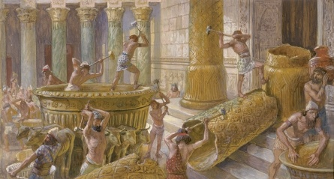
2 Great Dispersions from the Land Prophesied of Israel 以色列从应许地被逐出的两次大分散
Lev. 26:14-45 – Babylon 587 BC (2 Kings 25)
利26:14-45 – 巴比倫, 587 BC (王下25章)
Deut. 28:15-68 – Rome 70 AD (Luke 21:20-24)
申28:15-68 – 羅馬, 70 AD (路21:20-24)

Slide 22
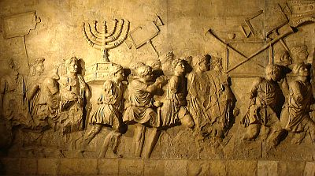
The Arch of Titus in Rome Commemorates Destruction of Jerusalem in 70 AD 罗马提多拱门 纪念主後70年耶路撒冷的毁灭

Slide 23
The Miraculous Relationship Between the People of Israel & the Land of Israel 以色列百姓與以色列土地之間奇蹟式的關係
God Prophesied the Land will be desolate when Israel is not inhabiting it.
上帝預言若以色列人不住在這土地上,它將會荒涼.
(Ezek 33:28-9) “For I will lay the land most desolate… & the mountains of Israel shall be desolate, that none shall pass through…
結33:28-29 我必使這地荒涼…以色列的山都必荒涼， 無人經過…

Slide 24
The Supernatural Miracle of the Land of Israel 以色列地的奇蹟
(Ezek. 33:29) “Then shall they know that I am the LORD, when I have laid the land most desolate because of all the abominations they committed” (see Lev. 26:19-20; 32-33; Deut 28:22-46; 29:23-27)
結33:29 我因他們所行一切可憎的事使地荒涼，令人驚駭。那時，他們就知道我是耶和華。」
God miraculously stopped the rain for 2000 years!
上帝奇蹟式地停止降雨兩千年!

Slide 25
The Land of Israel Remains Desert till the Jews Return 以色列一直是沙漠, 直到猶太人歸回
God Prophesied He would stop the rain when Israel Dispersed
上帝預言, 當以色列分散時,祂會停止降雨.
God miraculously did this for 2000 years! Then miraculously restores the rain in the End Times. (Joel 2:1, 23-25)
雨就奇蹟式地沒有降下兩千年!然後雨又奇蹟式地回來
This is totally supernatural! 這完全是超自然.

Slide 26
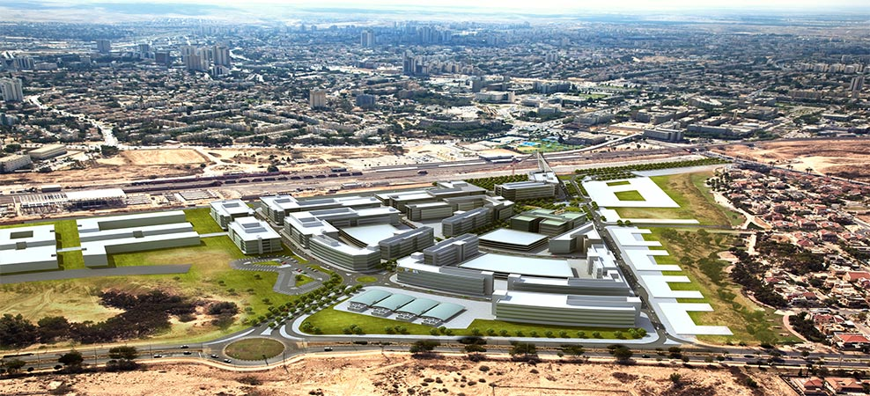
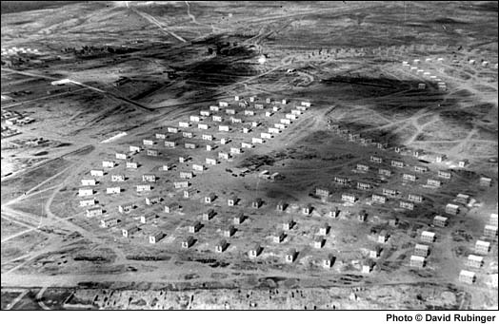
Beersheba 1951 & Today 别是巴1951与今日相比

Slide 27
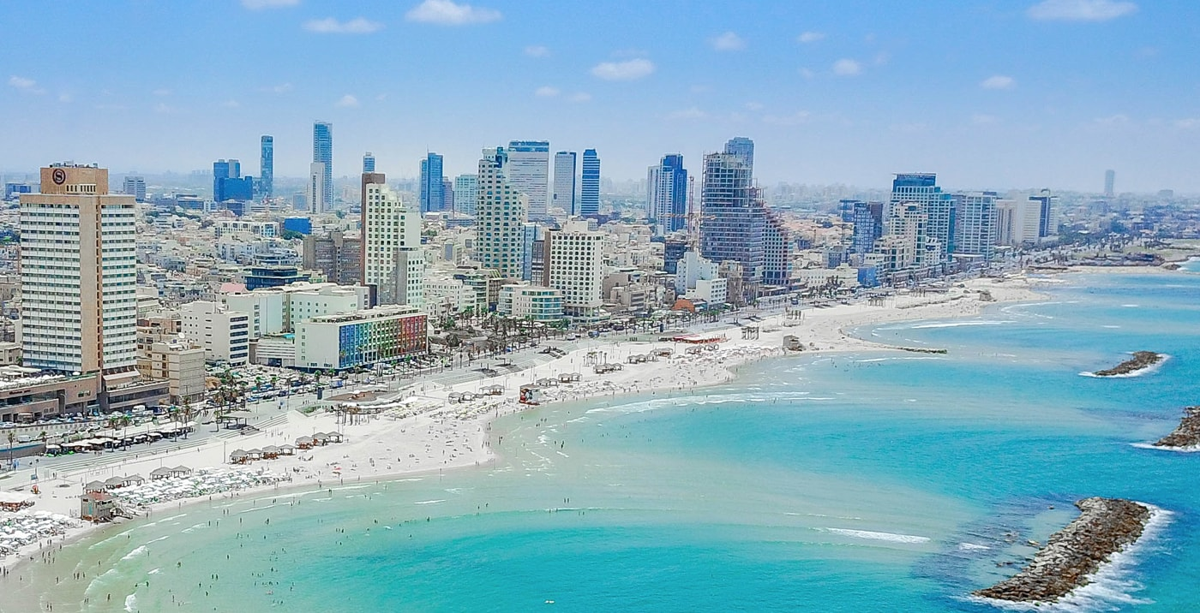
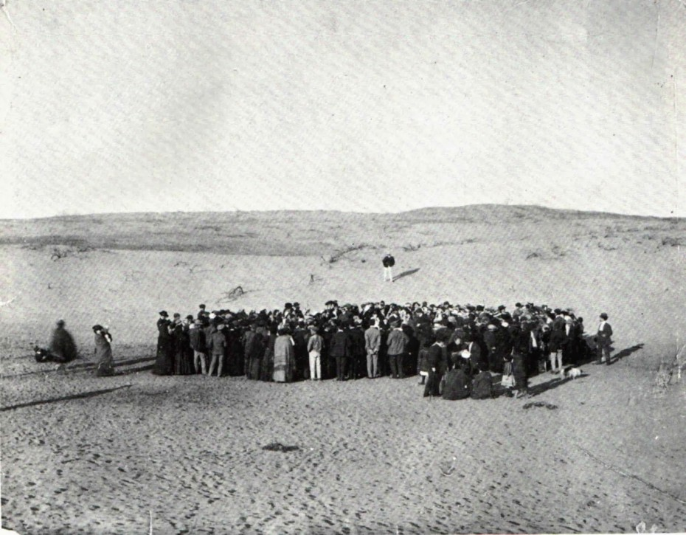
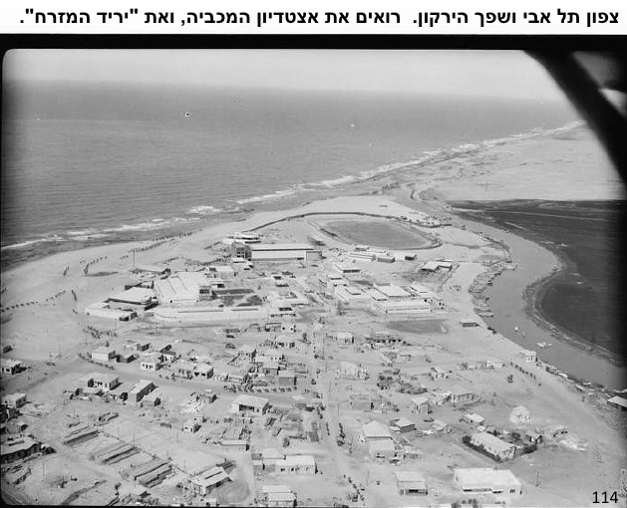
Tel Aviv 1900 & 1920 & today 台拉维夫1900,1920，与今日

Slide 28
Prophecies: The Desolate cities of Israel will be rebuilt 预言：以色列荒凉的城市会重建
“And I will multiply men upon you, all the house of Israel, & the cities shall be inhabited, & the wastes shall be built (Ezek. 36:10-11)
结36:10,11 -我必使以色列全家的人數在你上面增多，城邑有人居住，荒場再被建造。
I will also cause you to dwell in the cities, & the wastes shall be built” (Ezek. 36:33)
结36:33 -必使城邑有人居住，荒場再被建造。

Slide 29
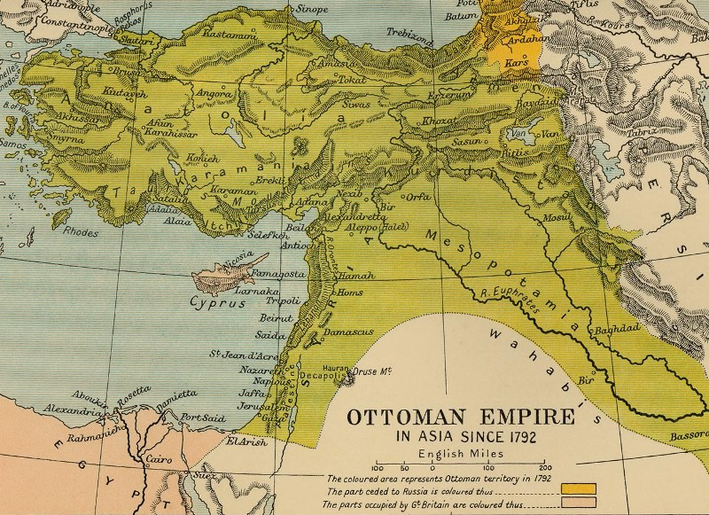
The Desolate cities of Israel will be rebuilt by Jews! 以色列荒凉的城市将被犹太人重建
In 400 yrs. the Ottoman Turks could not rebuild Israel! Why? (read Lev. 26:32-33; Deut. 29:23-27; Locust plagues drove them out - Deut. 28:38-42)
400年间凹凸曼土耳其人无法重建以色列。为何？

Slide 30
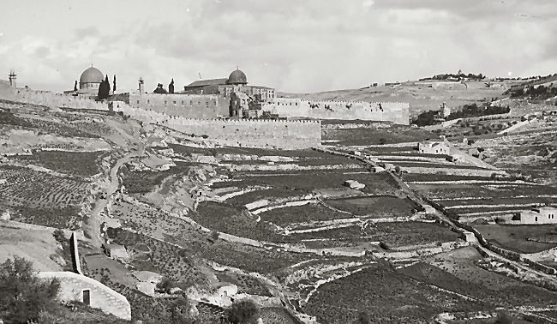
The Land Produces again when the Jews Return 當猶太人歸回時, 土地再度生產
“O mountains of Israel, ye shall shoot forth your branches, & yield your fruit to my people of Israel; for they are at hand to come” (Ezek. 36:8)
結 36:8 「以色列山哪，你必發枝條，為我的民以色列結果子，因為他們快要來到。

Slide 31
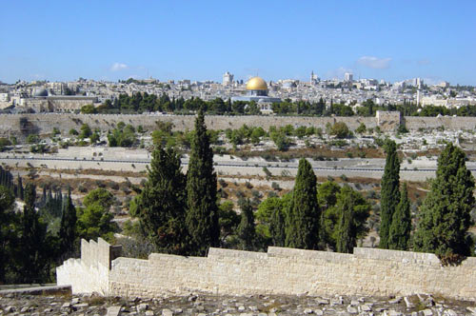
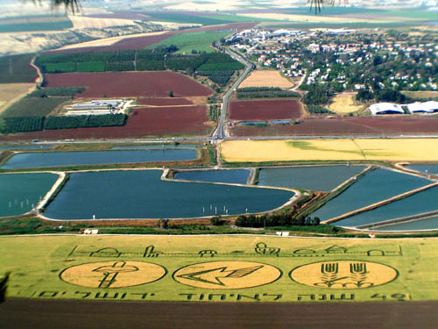
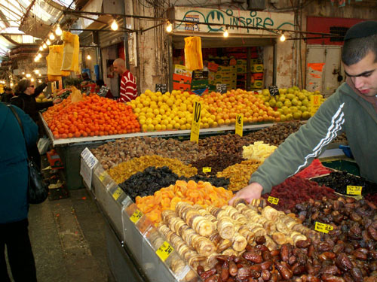
The Land Produces again when the Jews Return 當猶太人歸回時, 土地再度生產
“O mountains of Israel… yield your fruit to my people of Israel
「以色列山哪… 為我的民以色列結果子，因為他們快要來到。

Slide 32
Amos 9:14 阿摩司書9:14
“And I will bring again the captivity of my people of ISRAEL, and they shall build the waste cities, & inhabit them;
and they shall plant vineyards, & drink the wine thereof; they shall also make gardens, & eat the fruit of them.
9:14 我必使我民以色列被擄的歸回；他們必重修荒廢的城邑居住，栽種葡萄園，喝其中所出的酒，修造果木園，吃其中的果子。

Slide 33
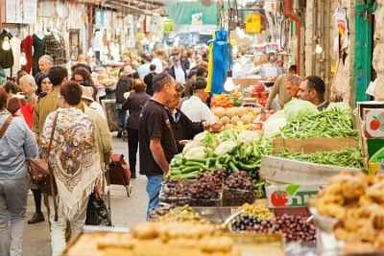
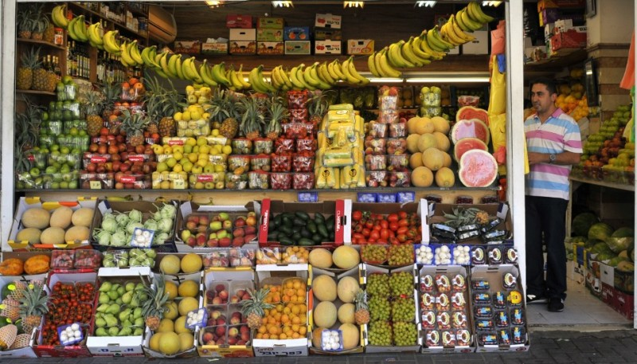
Little Israel fills the World with Fruit 小以色列以水果充滿世界
“… Israel shall blossom & bud, and fill the face of the world with fruit. (Isa. 27:6 and 35:1-2; Amos 9:14-15)
賽27:6 將來雅各要扎根，以色列要發芽開花；他們的果實必充滿世界。

Slide 34
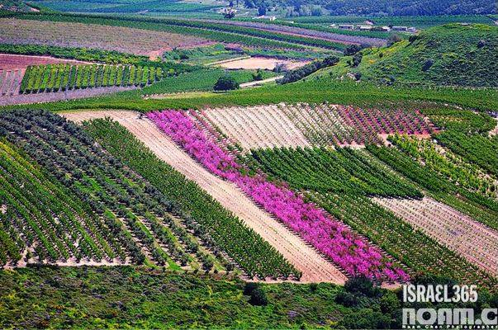
This Desolate Land is become like the garden of Eden (Ezek. 36:35-6) 荒涼之地如今好似伊甸園（结36:35,36）

Slide 35
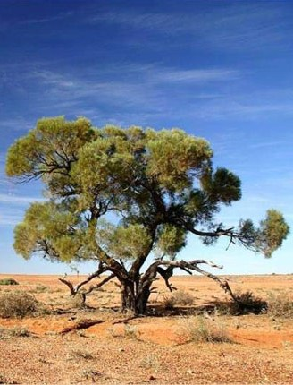
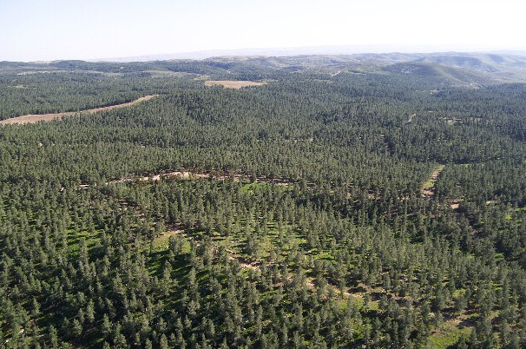
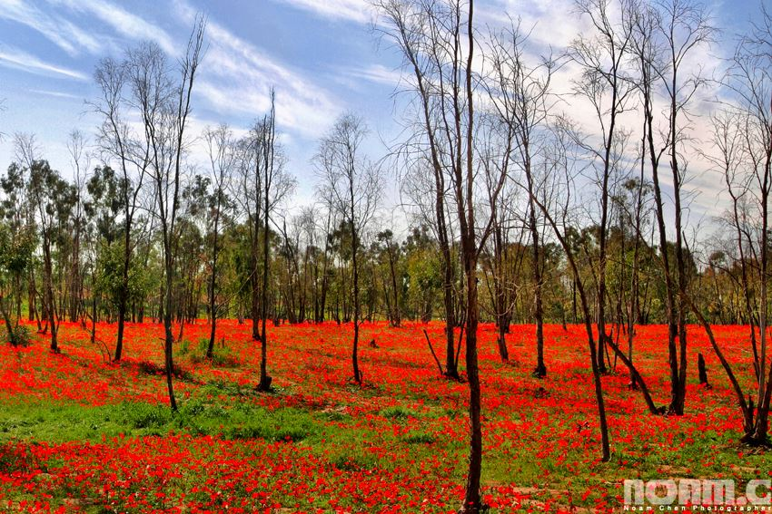
Miraculous Production of Trees: Israel is the Only Country Greatly Increasing the # of Trees 奇蹟式地生產樹木:唯一一個樹木大增的國家
God said He would multiply Trees in the restored Land (Isa. 41:18-20; Ezek. 36:30; Isa. 27:6; 62:4-5).
上帝說祂會在復興的土地倍增樹木.
Tamarisk Tree

Slide 36
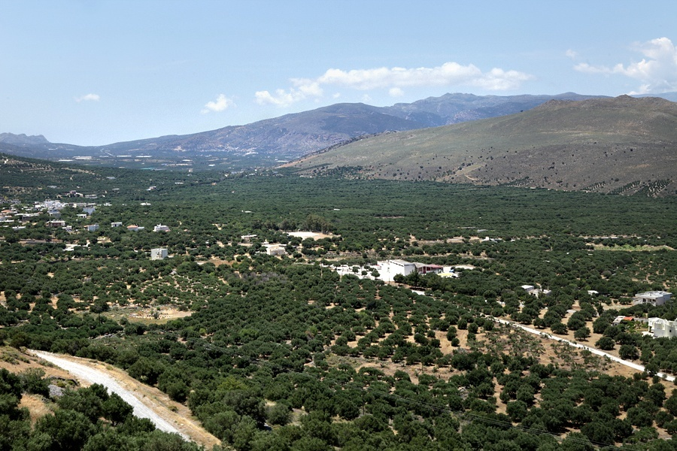
Miraculous Production of Trees 奇蹟式地生產樹木
Over 300 million trees planted since 1920
1920年以來種植了3億棵樹.

Slide 37
Israel’s Return to their Land is sign the End is Near! 以色列歸回故土是末世臨近的預兆
Jesus said: “Now learn the parable of the fig tree.” (Matt. 24:32: Mk. 13:28-31; Lk. 13:6)
耶穌說:「你們從無花果樹學個比方.」
The Fig Tree is a Type of Israel in the Bible (Hosea 9:10; Jer. 24:5, 8; Joel 1:7)
聖經中無花果樹是以色列
的預表.
It is blossoming in front of our eyes!
它在我们眼前绽放！

Slide 38
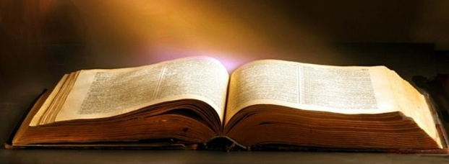
The many Prophesies of Israel returning to Her Promised Land is irrefutable Proof of the Divine Inspiration of the Bible! 以色列回归故土的诸多预言，是圣经为上帝所默示之 无法驳斥的证明
Deuteronomy 申命記 28:62-65; 30:1-3; Ex. 23:31;
Isaiah 以賽亞書 11:11-12; 14:1-3; Isa. 27:12-13; 43:1-7;
Jeremiah 耶利米書 16:24-16; 23:3-8; 29:14; 30:10-11; 31:8-10;
Ezekiel 以西結書 11:17; 20:34; 20:41-42; 34:11-13; 36:24; 36:28; 36:33-38; 37:1-14; Ezek. 37:21-25; 39:25-28;

Slide 39
Hosea 何西阿書1:10-11; Amos 阿摩司書 9:14-15; Micah 彌迦書 4:4-7; Zephaniah 西番雅書 3:18-20; Zechariah 撒迦利亞書 8:4-8;
Acts 使徒行傳 15:14-17; Mark 馬可福音 13:28-29; Matt. 馬太福音 24:32-34
All these Prophecies are directly related to the Fulfillment of the Palestinian Covenant

Slide 40
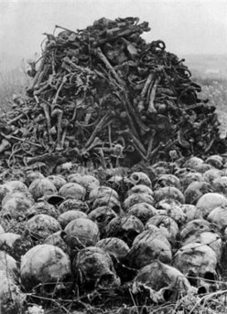
Nazi Persecution required The supernatural resurrection of Israel from the graveyard of the World (Ezekiel 37) 纳粹的逼迫,需要以色列從世界的墓地中 超自然地復活
(37:3) God said to Ezekiel: “can these bones live? I answered, O Lord GOD, thou knowest.
結 37:3 他對我說：
「人子啊，這些骸骨能
復活嗎？」我說：「主
耶和華啊，你是知道的。」

Slide 41
The resurrection of Israel from the Dead 以色列從死裡復活
(Ezek. 37:9) “Then said he unto me, Prophesy …, Thus saith the Lord GOD; Come from the four winds, O breath, & breathe upon these slain, that they may live.”
結 37:9 主對我說：「人子啊， 你要發預言，向風發預言， 說主耶和華如此說：氣息
啊，要從四方（原文作風）而來
，吹在這些被殺的人身上，使他
們活了。」

Slide 42
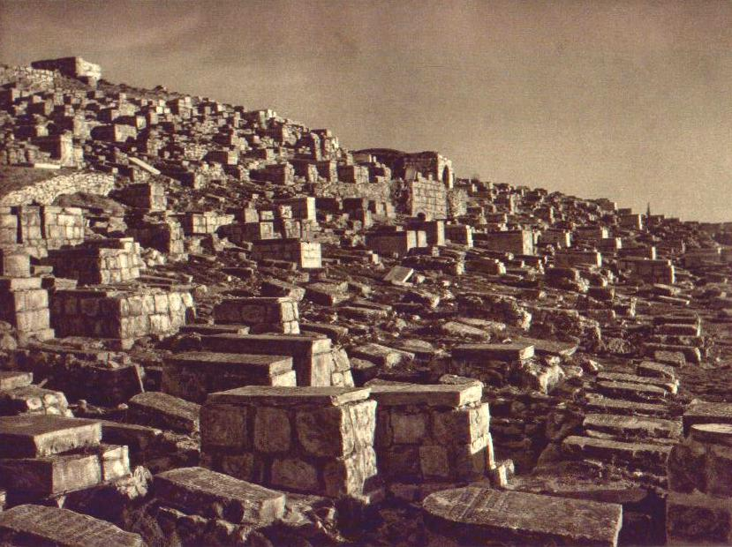
(Ezek 37:12) … Thus saith the Lord GOD; Behold, O my people, I will open your graves, and cause you to come up out of your graves, and bring you into the land of Israel.
結37:12 所以你要發預言對他們說，主耶和華如此說： 『我的民哪，
我必開你們的墳墓，使你
們從墳墓中出來，領你們
進入以色列地。

Slide 43
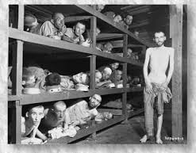
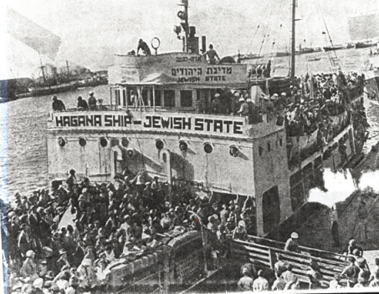
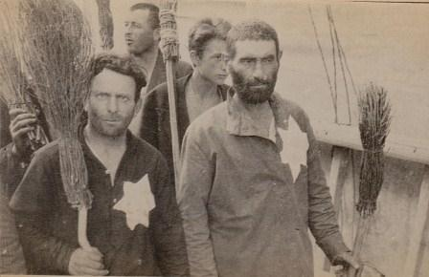
The utterly supernatural unexplainable survival & return of the Jews to Israel must not be understated!!!! 不可低估超自然，无法解释之猶太人的存活與歸回
No homeland for 2000 yrs. But returned from “every corner of the earth” (Deut. 28; Isa. 11:12)
失去家園兩千年,但從地球各個角落回家.
Russian Jews
European Jews

Slide 44
The Nation of Israel will Never be Dispersed Again 以色列国将不再被分散 (Amos 9:14-15; Isa.11:11-12) 阿摩司9:14-15
“And I will bring again the captivity of my people of Israel…
阿 9:14 我必使我民以色列被擄的歸回…
(15) And I will plant them upon their land, and they shall no more be pulled up out of their land which I have given them, saith the LORD thy God.”
9:15 我要將他們栽於本地，他們不再從我所賜給他們的地上拔出來。這是耶和華你的神說的。

Slide 45
Take to Heart Sobering Prophecies of Israel’s Suffering 谨记以色列受苦的清醒預言
Israel brought their unimaginable sufferings upon themselves by their Disobedience to God (Lev. 26:14-15; Deut. 28:15, 45)
以色列因違背上帝,為自己招來無法想像的苦難，
& rejecting their Promised Messiah (Luke 13:34-35; 19:41-42; Matt. 23:37-39)
他們拒绝了应许的彌賽亞。
Not Even God’s People get away with sin
屬上帝的百姓也躲不過犯罪的懲罰.

Slide 46
Important Lessons 重要的功課
1. It is impossible for God to Lie!
上帝不可能說謊!
2. So there will always be an Israel (Jewish Nation). Eventually she will inhabit all of Her “Promised Land”
以色列永遠會存在(猶太國)，她至终会居住在应许地的全部。
3. When we Enter into a Blood Covenant Relationship with God through Jesus Christ we have an unshakable assurance of our salvation
当我们经由耶稣基督进入与上帝的血盟，我们就有无法动摇的救恩确据。

Slide 47
Important Lessons 要緊的功課
4. We have been eyewitnesses to some of the most stunning developments of History.
我們是歷史中最驚人之發展的目擊見證人。
Most people & Christians are totally unaware of the Amazing Prophecies that have been & are being fulfilled!
多數大眾和基督徒完全不知过去和现今所發生之预言奇妙的真相！我们必须由圣经亮光来明白当前世界局势。
The light of God’s Prophetic Word lets us know how close we are to the End of History! (2 Pet. 1:19-21)
上帝预言的话语让我们知道我们离历史终点有多近！（彼後1：19-21）

Slide 48
Important Lessons 要緊的功課
5. Prophesy is a concrete irrefutable proof that God Almighty has spoken.
預言是全能的上帝已經說話的具體,無法反駁的證據.
Study it to strengthen your own Faith!
研讀預言來強固你自己的信心!
Use it to lead people to salvation through faith in Jesus Christ.
使用預言來引領人們相信耶穌基督而得救恩.

Slide 51
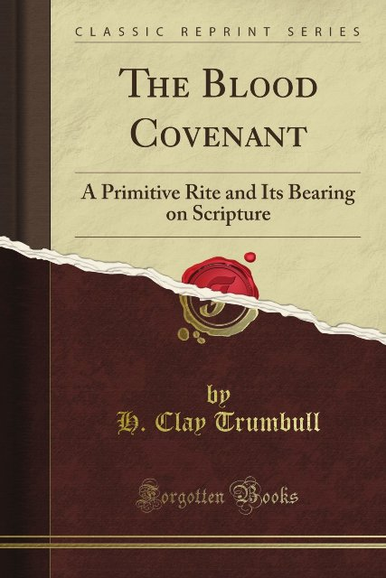
The Universal Sacredness of Blood Covenant recorded in… 普世血盟的神圣性记录在…
The Book: “The Blood Covenant” by H. Clay Trumbull.
“血盟”这本书，作者杜伦布
Writings of Henry M. Stanley & Dr. Livingstone in Africa
史丹利与李文斯顿在非洲的经历

Slide 52
The Universal Sacredness of Blood Covenant recorded in… 普世血盟的神圣性记录在…
David & Jonathan (I Sam. 18:1-4; 20:8-23) – Mephibosheth is saved because of His Father Jonathan’s covenant with David (2Sam. 9:7, 11)
大卫与约拿单的结盟（撒上18:1-4； 20:8-23），
Joshua & the Gibeonites (Joshua 9) – Even though the Gibeonites lied, Israel could not break their Covenant with them
约书亚与基遍人结盟（书9章），
China’s Blood Covenant with Shang-Di (see Booklet)
中国与上帝订立的血盟

Slide 53
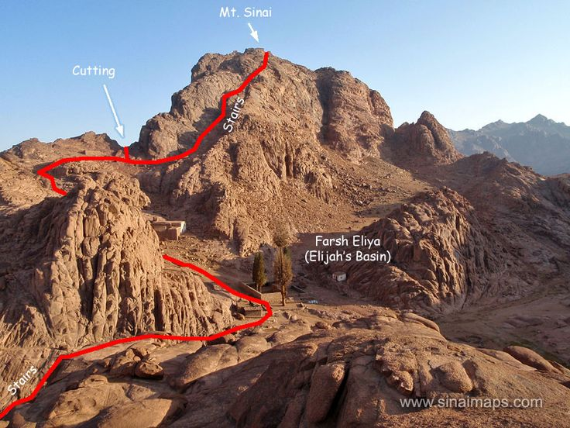
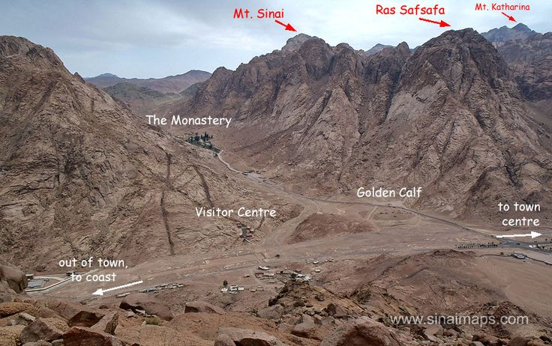
Sinai: a Real Covenant made in a real place with real People 西乃：真实的盟约，与真实的百姓，订立在真实的地点

Slide 54
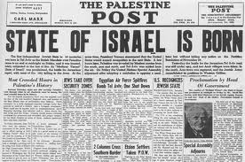
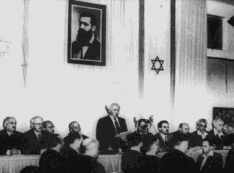
Israel is Reborn in a Day! May 14, 1948 (Isa 66:8 & Rom 11) 以色列在一天誕生！1948年5月14日
“Who hath heard such a thing? who hath seen such things? Shall the earth be made to bring forth in one day? or shall a nation be born at once? for as soon as Zion travailed, she brought forth her children.”
Isa 66:8 國豈能一日而生？民豈能一時而產？因為錫安一劬勞便生下兒女，這樣的事誰曾聽見？誰曾看見呢？ (see Deut. 30:5)

Slide 55
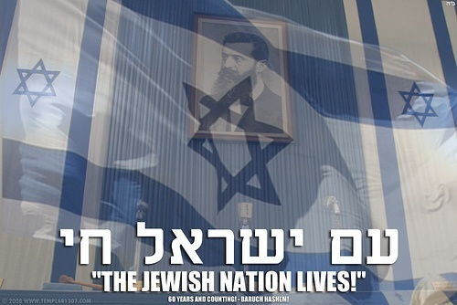
Israel is Reborn in a Day! 以色列在一天誕生
May 14th, 1948 corresponds to the Hebrew year, 5708. Rabbis tell us to Look at the 5,708th verse of the Torah:
1948年5月14日是希伯來曆5708年, 妥拉5708節說:
“The Lord your God will bring you into the land which your fathers possessed & you shall possess it” (Deut. 30:5)
申 30:5 耶和華你的神必領你
進入你列祖所得的地，使你可
以得著；

