Slide 1
認識爭戰的神 Knowing God as Our Warrior
西乃之約 The Sinaitic Covenant

Slide 2
有條件的盟約 Conditional Covenants
伊甸之約和西乃之約Edenic & Sinaitic Covenants
有條件的盟約蘊含著無條件的愛Conditional covenant & unconditional love

Slide 3
 | 伊甸之約 Edenic Covenant | 西乃之約 Sinaitic Covenant
簽約人 Signed By | 亞當 Adam | 摩西 Moses
代表Representing | 全人類 All Races | 以色列人 Israelites
條件 Condition | 勿食禁果 The Forbidden Fruit | 遵守誡命 Ten Commandments
結果 Consequence | 逐出伊甸 Out of Eden | 擄離迦南 Out of Canaan

Slide 4
西乃之約 The Sinaitic Covenant (1)
上帝設立獻祭條例God designs the sacrificial system
上帝頒佈十誡法規God gives the Law to Israelites

Slide 5
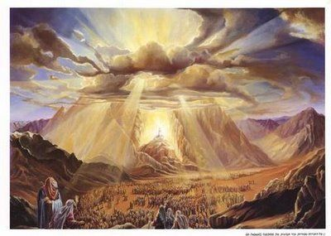
西乃之約 The Sinaitic Covenant (2)
獻祭預表耶穌救贖
The Sacrifice foretells salvation of Christ
律法預示聖靈內住
The Law reveals the indwelling of the Holy Spirit

Slide 6
為什麼上帝揀選以色列人﹖ Why did God choose Israel?
上帝創造以色列民族
God creates a new nation of Israel
上帝旨在拯救全人類
God plans to save mankind

Slide 7
以順服的心愛神! Love God with an Obedient Heart!

