Slide 1
千錘百煉: 培養你的屬靈恩賜
Forged in Fire:
Developing Your Spiritual Gifts

Slide 2
富甲天下 Heavenly Rich 各盡其能 Each According to the Gifts 合乎中道 Make a Sound Judgment 柳暗花明 It Is a Surprise Journey

Slide 3
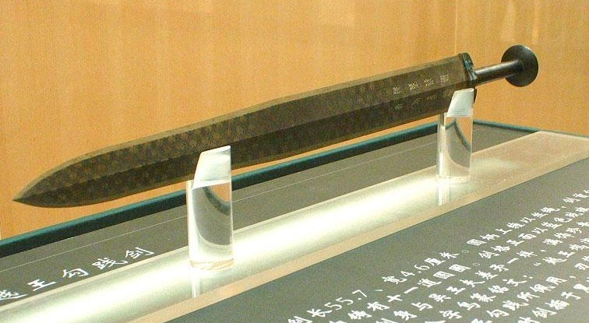

Slide 4
具備屬靈熱忱 Be Passionate about Using the Gifts
以身體為祭﹐討神喜悅
As a living sacrifice to please God
活出人生潛能
Live out the potential of our life

Slide 5
屬靈恩賜 Spiritual Gifts
每個人至少有一種恩賜
Each is gifted by God
每個人或有不同的恩賜
Each is gifted differently
沒有人擁有所有的恩賜
None is bestowed with all the gifts

Slide 6
必須心志專一 Be Devoted to Stewardship
作好神的管家
Be a good manager in God’s house
避免馬失前蹄
Avoid the pitfalls

Slide 7
勇於付諸行動 Be Ready to Take Actions
抓住機會
Take any opportunities
接受回饋
Receive feedbacks
裝備培訓
Participate in trainings
人生規劃
Envision the purpose of life

Slide 8
熱忱﹑專一﹑操練 Passion, Perseverance & Practice

