Slide 1
富甲天下: 認識你的屬靈恩賜
Heavenly Rich:
Knowing Your Spiritual Gifts

Slide 2
上帝啟示你的恩賜 God Reveals Your Gifts
關乎屬靈恩賜的真理不是隱藏的
The Truth is not hidden.
恩賜已經預備﹐但必須去發現和使用
Gifts have been given, but we must discover and make use of them.

Slide 3
屬靈恩賜的定義 Definition of Spiritual Gifts
恩賜:聖靈﹑恩典﹑能力
Gifts: the Spirit, Grace and Power
聖靈按照上帝的恩典分配給每個信徒的超然能力見證耶穌是主According to God’s grace, the Holy Spirit distributes the abilities to each believer to witness that Jesus is the Lord.

Slide 4
生命使你經歷恩賜 New Life Explores Your Gifts
屬靈恩賜蘊藏在聖靈的能力之中
Spiritual gifts are empowered by the Holy Spirit.
教會不應看重才干乃是使用恩賜
Church relies on gifts not capabilities.

Slide 5
重生證明你有恩賜 Born-Again Assures Your Gifts
每個基督徒都有屬靈恩賜
Every believer is gifted.
恩賜不僅局限於奇觀異能
Spiritual gifts are not limited to wonders and miracles.

Slide 6
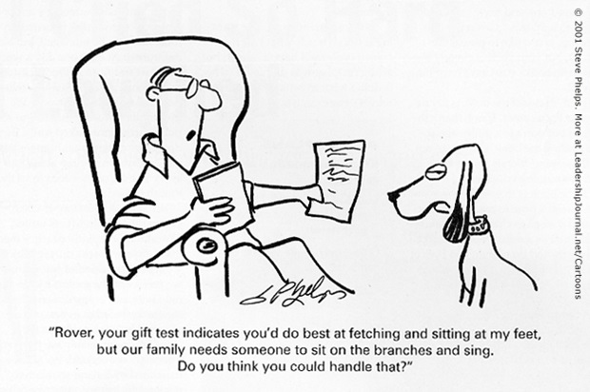

Slide 7
不要埋沒你的潛能! Don’t Overlook Your Potentials!

