Slide 1
屬靈爭戰(II): 全副武裝 The Armor of God
弗Eph 6:10-20

Slide 2
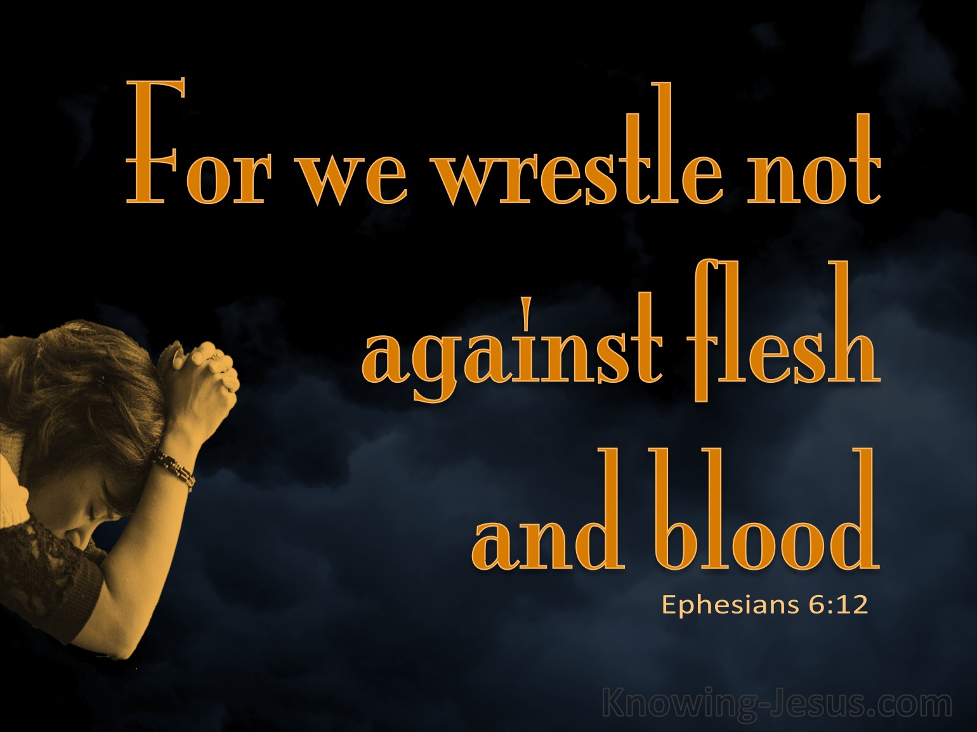
靈性世界 The Spiritual World
#1撒旦在上帝權柄之下
Satan is under God’s power
#2基督已經勝過撒旦
Christ has defeated Satan
#3撒旦依然垂死掙扎
Satan is still active
#4人類唯有靠神得勝
Humans overcome evils only through God

Slide 3
專注上帝 Focus on God
留意上帝的創造和救贖 Pay attention to God’s creation and redemption
以上帝眼光觀察世界
See the world as God sees

Slide 4
逃避試探 Run Away from Temptation
遠離靈界怪異之事
Distance self from evil spirits
置身基督肢體之中
Secure self in the body of Christ

Slide 5
抵擋撒旦 Resist the Devil
披戴屬靈軍裝
Equipped with spiritual armor
運用多方禱告
Supplied with prayers always

Slide 6
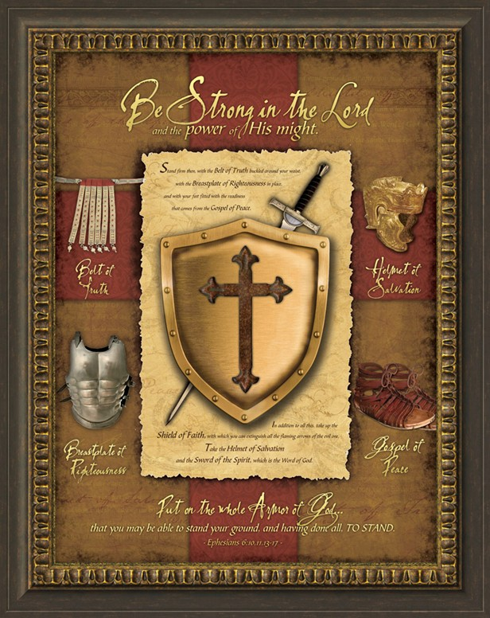
六種屬靈裝備 Six Pieces of Armor (1)
真理:正直與誠實
Truth: integrity and honesty
公義:因信稱義
Righteousness: standing before God
福音:與神和好
Gospel: peace with God
信德:相信上帝
Faith: believe in God

Slide 7
六種屬靈裝備 Six Pieces of Armor (2)
救恩:得救的確據
Salvation: God’s assurance
神的道:上帝的話語
Word of God: God’s instructions

Slide 8
裝備自己﹐抵擋仇敵! Equipped with armor of God, Resist the Devil!

