Slide 1
屬靈爭戰(I):看不見的戰爭 The Invisible War
弗Eph 6:10-20

Slide 2
認識靈性世界 Understand the Spiritual World
物質與靈性世界共存Material & spiritual worlds are co-existed
靈性世界主導一切 The Spiritual world dominates

Slide 3
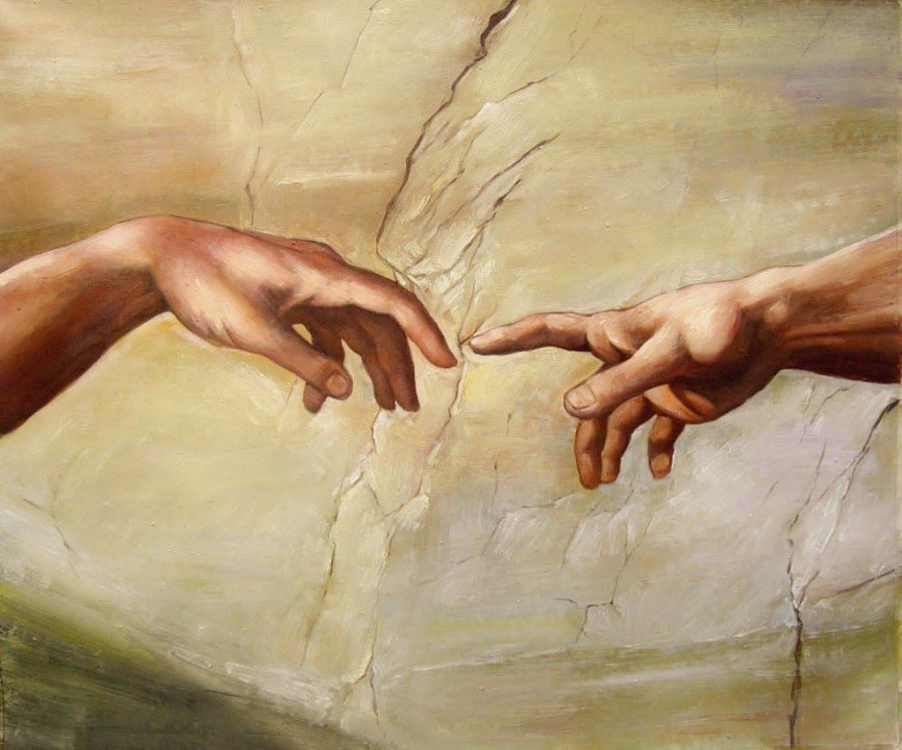
了解屬靈爭戰 Be Aware of Spiritual Warfare
上帝乃是個靈 God is a Spirit
撒旦反叛上帝
Satan rebels against God

Slide 4
四個啟示 Four Biblical Revelations
#1 撒旦在上帝權柄之下 Satan is under the sovereignty of God
#2 基督已經勝過撒旦 Christ has already achieved the victory over Satan

Slide 5
四個啟示 Four Biblical Revelations
#3 撒旦依然垂死掙扎 Satan is still active in deceiving the world
#4 人類唯有靠神得勝 Humans can only overcome through the empowering of God

Slide 6
預備屬靈得勝 Get Ready to Overcome
認清敵人
Recognize your enemies
識破圈套
Recognize their tricks

Slide 7
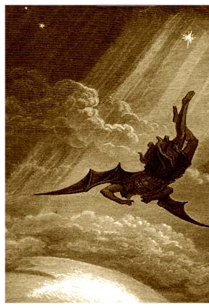
撒旦統治的三種手段 Satan’s Three Means
世界的思想體系
The ideological system of this world
個人的思維習慣
The personal habits formed in this life
邪靈的特別引誘
The deceiving of evil spirits

Slide 8
預備屬靈得勝! Be Ready for Spiritual Warfare!

