Slide 1
建立成熟的教會
Build A Mature Church
弗Eph 4:1-16

Slide 3
教會合一有序 Church Is United and in Order
行事為人當與蒙召的恩相稱 Walk in a manner worthy of the calling
竭力保守聖靈里的合一
Be diligent to
preserve the unity
in the Spirit

Slide 4
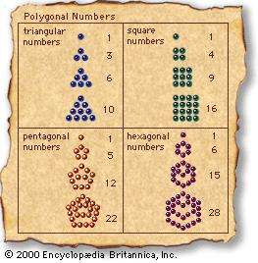
七重合一 Sevenfold Of Oneness
同一身體﹑同一聖靈﹑同一盼望 One Body, One Spirit, One Hope
一主﹑ 一信﹑ 一洗
One Lord, One Faith, One Baptism
一神 One God

Slide 5
信徒各盡其能 Each Exercises One’s Own Gifts
每個信徒都有恩賜﹐但沒有一個信徒具備所有恩賜 Gifts are given to each believer, but none possesses all the gifts
缺一不可﹑彼此依賴
Each is needed, and all rely on one
another

Slide 6
眾人追求成長 All Desire Spiritual Growth
教會當有屬靈風氣 Promote the Spiritual Atmosphere
聯於基督﹑共同成長 Grow up into Christ, each and all together

Slide 7
四種基督徒品德 Four Kinds of Christian Virtues
謙卑:欣賞別人的長處 Humility: appreciate others’ gifts
溫柔:內心平和 Gentleness: peace in the heart
忍耐:接納他人不同 Patience: accept others’ difference
寬容:允許他人成長 Tolerance: allow others to grow

Slide 8
滿有基督長成的身量! Growing Into the Fullness of Christ!

