Slide 1
難言失落
Disappointed with God
Eph 3:14-21

Slide 2
神的愛不會改變 God’s Love Does not Change
經歷神的同在 Experience the Presence of God
經歷神的沉默
Experience the Silence of God

Slide 3
神的愛是根基和動力
God’s Love Is the Foundation and Motivation
神的愛高深莫測 God’s Love Is Beyond Imagination

Slide 4
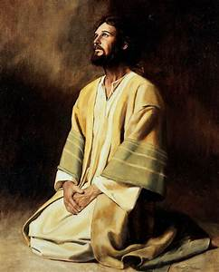
保羅祈求:
信徒剛強起來
Strengthened (16)
愛心有根有基
Be Rooted in Love (17)
明白基督之愛
Comprehend the Love (18)
知道這愛超越
Surpass Knowledge (19a)
神的豐盛充滿
Filled with the Fullness of God (19b)

Slide 5
聖靈工作
藉著聖靈 Through Holy Spirit (16)
住在心裡 Dwell in the Heart (17)
運行在心裡 Power that Works within (20)

Slide 6
神的愛引領成長 God’s Love Guides Spiritual Growth
神呼喚我們回家 God Is Calling Us Home
神期待我們成長
God Expects Us To Grow

Slide 7
神就是愛! God Is Love!

