Slide 1
何謂得救﹖
What Does It Mean to Be Saved?
弗 Eph 2:1-10

Slide 2
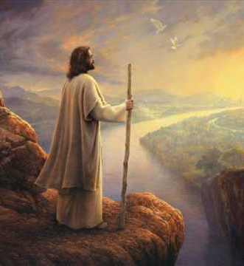
五個對比 Five Contrasts
死亡death vs. 活過來Life
世界world vs. 天上heaven
憤怒wrath vs. 恩典grace
在撒旦權柄之下under the ruler vs. 與基督同坐seated with Christ
墮落的本性sinful nature vs. 與基督聯合union with Christ

Slide 3
#1 得救意味著轉變 To Be Saved Means to Be Transformed
得救不是認同教義 It does not mean to agree with doctrines only
得救乃是認同基督
It means to be identified
with Jesus Christ

Slide 4
主動詞 Main Verbs
一同活過來 Made alive with Christ
一同復活 Raised up with Christ
一同坐在天上 Seated with Christ

Slide 5
#2 得救意味著成長 To Be Saved Means to Grow Spiritually
得救不是一時決定 It does not mean a one-time decision
得救乃是成長過程
It means a process of
spiritual growth

Slide 6
理解得救 To Be Saved
你們得救是本乎恩。
By grace you have been saved
BE + 動名詞 (完成時態/被動語式)
BE + Perfect Passive Participle

Slide 7
#3 得救意味著努力 To Be Saved Means to Make Efforts
得救並非與行為無關 It does have something to do with works
行為是得救的必然結果
It means to have good works
as a result of salvation

Slide 8
做成你們得救的工夫 Work out your salvation with fear and trembling

