Slide 1
生命的旅程
The Journey of Our Life

Slide 2
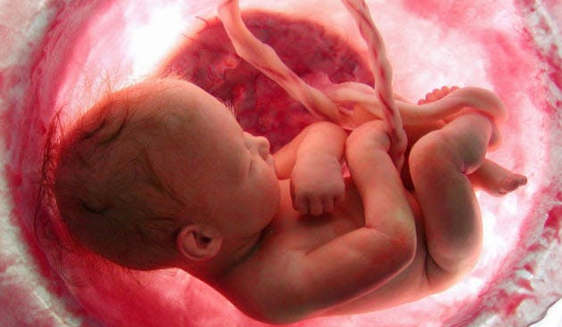
開始 The Beginning
受孕 Conception
出生 Birth
新生 New Life

Slide 3
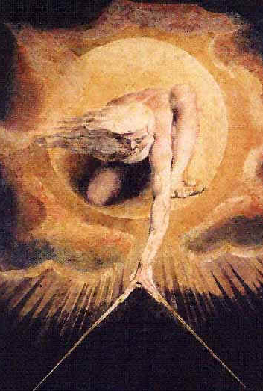
創造諸天，鋪張穹蒼，將地和地所出的一併鋪開，賜氣息給地上的眾人，又賜靈性給行在其上之人的神耶和華 (賽42:5)
Thus says God the LORD, Who created the heavens and stretched them out, Who spread out the earth and its offspring, Who gives breath to the people on it And spirit to those who walk in it. (Isa 42:5)

Slide 4
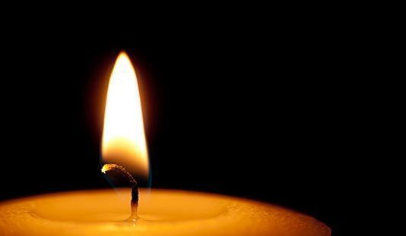
死亡 The Death
身體與靈魂分離 Body and Soul Are Separated
靈魂則去樂園或陰間 The Soul Goes to Paradise or Hades

Slide 5
塵土仍歸於地，靈仍歸於賜靈的神。 (傳12:7)
Then the dust will return to the earth as it was, and the spirit will return to God who gave it. (Ecc. 12:7)

Slide 6
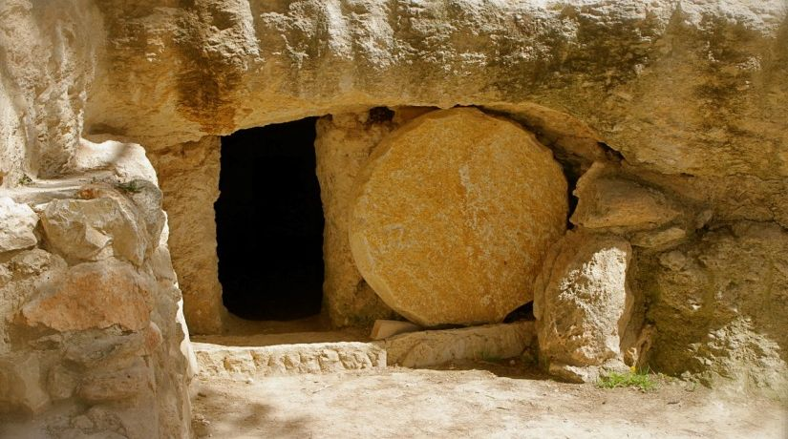
復活 The Resurrection
身體與靈魂結合 Body and Soul Are Reunited
復活的身體 The Resurrected Body

Slide 7
耶穌對他說：復活在我，生命也在我。信我的人雖然死了，也必復活，凡活著信我的人必永遠不死。(約11:25-26)
I am the resurrection and the life; he who believes in Me will live even if he dies, and everyone who lives and believes in Me will never die. (John 11:25-26)

Slide 8
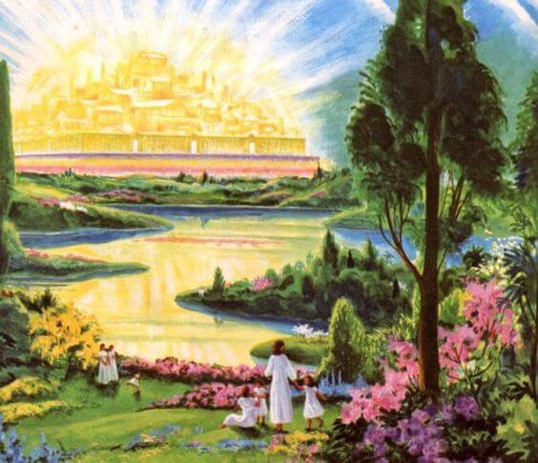
永恆 The Eternity
新天新地 New Heaven and New Earth
上帝與人同住 God will dwell among His People

Slide 9
神要擦去他們一切的眼淚；不再有死亡，也不再有悲哀、哭號、疼痛，因為以前的事都過去了。天使又指示我在城內街道當中一道生命水的河，明亮如水晶，從神和羔羊的寶座流出來。在河這邊與那邊有生命樹，結十二樣果子，每月都結果子；樹上的葉子乃為醫治萬民。 (啟示錄 22:1-2)

Slide 10
Then he showed me a river of the water of life, clear as crystal, coming from the throne of God and of the Lamb, in the middle of its street. On either side of the river was the tree of life, bearing twelve kinds of fruit, yielding its fruit every month; and the leaves of the tree were for the healing of the nations. (Rev.22:1-2)

Slide 11
受孕Conception
新生
New Life
復活Resurrection
審判
Judgment
聖靈內住
Holy Spirit Dwells
開始
The Beginning
千禧年
The Millennium
永恆
The Eternity
出生Birth
與基督同作王Reign with Christ
死亡 Death
神與子民同住
God Dwells in Our Midst

