Slide 1
生死之結
The Knots of Death

Slide 2
對死亡的忌諱 The Fear of Death
未知 Unknown
痛苦 Suffering
毀滅 Non-existence

Slide 3
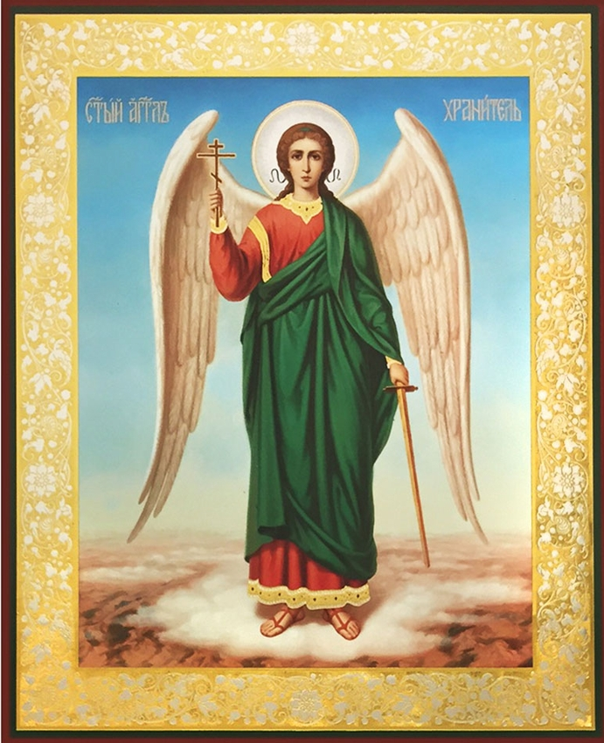
耶穌對他說：「我實在告訴你，今日你要同我在樂園裡了。」 (路23:43)
And He said to him, "Truly I say to you, today you shall be with Me in Paradise." (Luke 23:43)

Slide 4
對長壽的誤解 The Misinterpretation of Longevity 長壽是福﹐ 短命未必是詛咒 Blessed to live long, one may not be cursed if his life is cut short

Slide 5
我留下平安給你們，我將我的平安賜給你們；我所賜的，不像世人所賜的。你們不要心裏憂傷，也不要害怕。 (約14:27)
Peace I leave with you; My peace I give to you; not as the world gives do I give to you. Do not let your heart be troubled, nor let it be fearful. (John 14:27)

Slide 6
對人生的期许 The Expectation for Life and Death 期盼安然離世 Desire to die peacefully

Slide 7
那殺身體，不能殺靈魂的，不要怕他們；惟有能把身體和靈魂都滅在地獄裡的，正要怕他。 (太10:28)
Do not fear those who kill the body but are unable to kill the soul; but rather fear Him who is able to destroy both soul and body in hell. Matthew 10:28)

Slide 8
上帝的應許 The Promise of God
與基督同在
Being with christ
聖靈引導
Guided by holy spirit
天使護佑
Guarded by Angels

Slide 9
神愛世人，甚至將他的獨生子賜給他們，叫一切信他的，不至滅亡，反得永生。 (約翰福音 3:16) For God so loved the world, that He gave His only begotten Son, that whoever believes in Him shall not perish, but have eternal life. (John 3:16)

