Slide 1
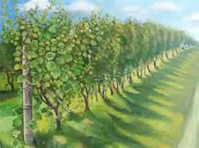
連於元首基督
- 住在基督裡
Abide in Christ
(一)
裴賀安慈師母
Mrs. Annie Petzholt

Slide 2
經文: 約翰福音 John15:1-10
Joh 15:1 「我是真葡萄樹，我父是栽培的人。
I am the true vine, and my Father is the
husbandman.
Joh 15:2 凡屬我不結果子的枝子，他就剪去；凡結果子的，他就修理乾淨，使枝子結果子更多。
Every branch in me that bears not fruit he takes away: and every branch that bears fruit, he purges it, that it may bring forth more fruit.

Slide 3
經文: 約翰福音 John15:1-10
Joh 15:3 現在你們因我講給你們的道，已經乾淨了。
Now you are clean through the word which I have spoken unto you.
Joh 15:4 你們要常(住)在我裡面，我也常(住)在你們裡面。枝子若不常在葡萄樹上，自己就不能結果子；你們若不常(住)在我裡面，也是這樣。
Abide in me, and I in you. As the branch cannot bear fruit of itself, except it abide in the vine; no more can you, except you abide in me.

Slide 4
經文: 約翰福音John 15:1-10
Joh 15:5 我是葡萄樹，你們是枝子。常在我裡面的，我也常在他裡面，這人就多結果子；因為離了我，你們就不能做什麼。
I am the vine, you are the branches: He that abides in me, and I in him, the same brings forth much fruit: for without me you can do nothing.
Joh 15:6 人若不常在我裡面，就像枝子丟在外面枯乾，人拾起來，扔在火裡燒了。
If a man abide not in me, he is cast forth as a branch, and is withered; and men gather them, and cast them into the fire, and they are burned.

Slide 5
經文: 約翰福音 John 15:1-10
Joh 15:7 你們若常在我裡面，我的話也常在你們裡面，凡你們所願意的，祈求，就給你們成就。
If you abide in me, and my words abide in you, you shall ask what you will, and it shall be done unto you.
Joh 15:8 你們多結果子，我父就因此得榮耀，你們也就是我的門徒了。
Herein is my Father glorified, that you bear much fruit; so shall you be my disciples.

Slide 6
經文: 約翰福音15:1-10
Joh 15:9 我愛你們，正如父愛我一樣；你們要常在我的愛裡。
As the Father has loved me, so have I loved you: continue you in my love.
Joh 15:10 你們若遵守我的命令，就常在我的愛裡，正如我遵守了我父的命令，常在他的愛裡。
If you keep my commandments, you shall abide in my love; even as I have kept my Father's commandments, and abide in his love.

Slide 7
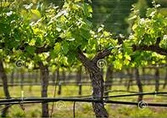
眾枝子
Branches
園主和栽培的人
Owner & Caretaker
葡萄樹 Grapevine

Slide 8
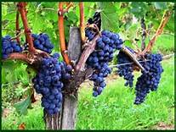
連於元首基督- 住在基督裡
Abide in Christ
引言:
1.葡萄樹枝子唯一的目的就是結果子, 而它結果子唯一的途徑,就是連結在葡萄樹上.
The only purpose for the branches is to bear fruit. The only way for the branches to bear fruit is to connect itself with the grapevine.
2.生命流通的連結, 使結果子成為生長自然的現象.
Once the branch is connected with
the life of the grapevine, bearing
fruit becomes its natural result.

Slide 9
連於元首基督- 住在基督裡
Abide in Christ
引言:
3.耶穌借用葡萄樹與枝子的關係, 說明我們和祂的生命連結流通時,自然會產生的結果.
Jesus uses the relationship of the grapevine and its branches to illustrate – when our life is connected with Him, we will naturally bear fruit.
4. 生命流通, 多結果子,就顯明我們是祂的門徒, 父也因此得榮耀.
When we bear much fruit, we prove
that we are His disciples, and the
Father is glorified.

Slide 10
讓生命流通,結果子的三個
-「住在」基督裡
Three “Abidings” to Bear Much Fruit
        住在上帝的修剪中
        Abide in God’s Pruning
2. 住在上帝的話語中
Abide in God’s Word
3. 住在上帝的愛中
Abide in God’s Love

Slide 11
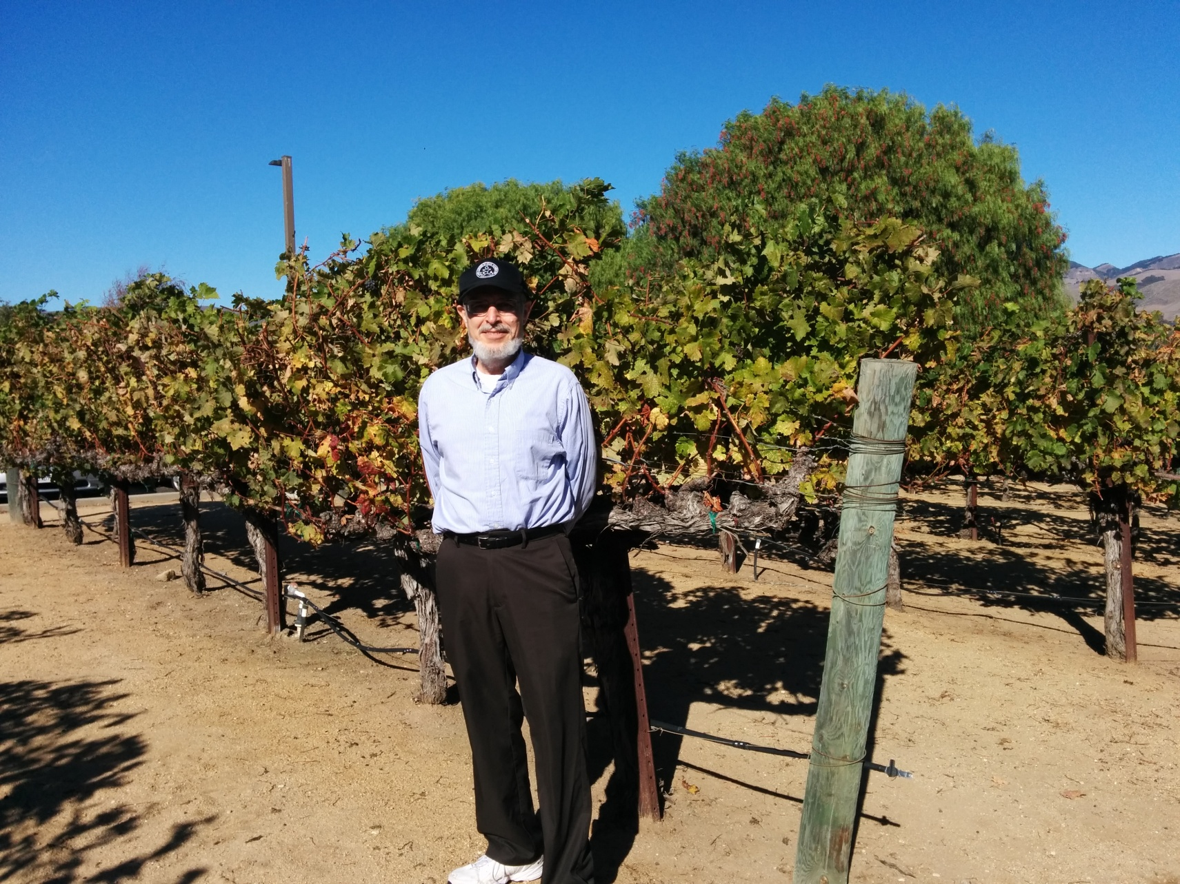
(一) 住在上帝的修剪中
Abide in God’s Pruning

Slide 12
修剪葡萄枝 Pruning the Branches
倘若不去修剪葡萄枝, 葡萄枝和葡萄串會過度生長, 散漫的葡萄枝就無法支撐,也結不出最優等的葡萄,枝子也無法適當生長.
修剪的目的是最高程度收獲最高品質的葡萄, 並預備下一季葡萄藤的生長.
修剪葡萄枝有多次進展的過程.

Slide 13
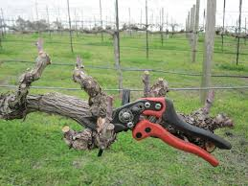
收成季節過後的修剪 – 十分徹底
First Pruning after the Harvest
剪去舊的, 讓新的生長
Cut off the old so the new can grow

Slide 14
1). 脫下舊的 - 明顯的修剪
Take off the Old – Visible Pruning
Rom 6:6 因為知道我們的舊人和他同釘十字架，使罪身滅絕，叫我們不再作罪的奴僕；
Knowing this, that our old man is crucified with him, that the body of sin might be destroyed, that henceforth we should not serve sin.
Eph 4:22 就要脫去你們從前行為上的舊人，這舊人是因私慾的迷惑漸漸變壞的；
That you put off concerning the former conversation the old man, which is corrupt according to the deceitful lusts;

Slide 15
1). 脫下舊的 - 明顯的修剪
Take off the Old – Visible Pruning
Col 3:9 不要彼此說謊；因你們已經脫去舊人和舊人的行為，
Lie not one to another, seeing that you have put off the old man with his deeds;
Col 3:10 穿上了新人。這新人在知識上漸漸更新，正如造他主的形像。
And have put on the new man, which is renewed in knowledge after the image of him that created him:
- 脫下舊的, 才能換上新的 -

Slide 16
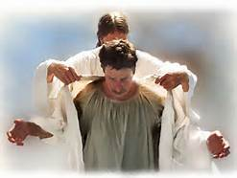

Slide 17
1). 脫下舊的 – 明顯的修剪
Taking off the Old – Visible Pruning
脫下舊的, 才能換上新的 –
我們還有什麼明顯的舊的需要脫下?
What obvious “old things” we still need to take off?
行為的舊人
(作弊, 賄絡, 攀比, 欺騙, 說謊, 偷竊, 說長論短,懶惰, 吸毒, 過度玩電腦, 手機….)
私欲的迷惑變壞的
(自私, 有意佔他人便宜, 好勝, 嫉妒, 爭競….)

Slide 18
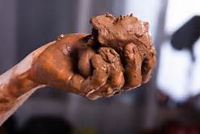
我們是陶匠手中的泥土
We Are Clay in the Potter’s Hand

Slide 19
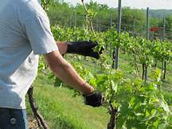
發芽成枝後再次修剪, 去蕪存菁
Pruning after the New Shoots

Slide 20
2).除去雜質 (來 Heb. 12:6-9) – 內在的修剪
Getting rid of Impurities – Inner Pruning
熬煉我們的內心 – 新生命的變化
Heb 12:6 因為主所愛的，他必管教…。
For whom the Lord loves he chastens, and scourges every son whom he receives.
Heb 12:9 再者，我們曾有生身的父管教我們，我們尚且敬重他，何況萬靈的父，我們豈不更當順服他得生嗎？
Furthermore we have had fathers of our flesh which corrected us, and we gave them reverence: shall we not much rather be in subjection unto the Father of spirits, and live?

Slide 21
2). 除去雜質 (來Heb.12:10-11) – 內在的修剪
Getting rid of Impurities – Inner Pruning
Heb 12:10 生身的父都是暫隨己意管教我們；惟有萬靈的父管教我們，是要我們得益處，使我們在他的聖潔上有分。
For they verily for a few days chastened us after their own pleasure; but he for our profit, that we might be partakers of his holiness.

Slide 22
2). 除去雜質 (來12:10-11) – 內在的修剪
Getting rid of Impurities – Inner Pruning
Heb 12:11 凡管教的事，當時不覺得快樂，反覺得愁苦；後來卻為那經練過的人結出平安的果子，就是義。
Now no chastening for the present seems to be joyous, but grievous: nevertheless afterward it yields the peaceable fruit of righteousness unto them which are exercised thereby.

Slide 23
2). 除去雜質 (來12:10-11) – 內在的修剪
Getting rid of Impurities – Inner Pruning
內在的問題 Our Inner Problems:
驕傲, 自大, 狂妄, 叛逆
自卑, 膽怯, 自貶, 屈從
嫉妒, 仇恨, 惡性競爭,輕視,畏懼
面具, - 不敢面對真我
動機, - 不純正的動力
上帝對我的修剪……

Slide 24
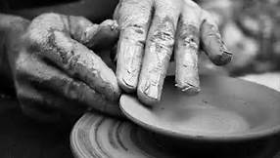
一
塑造的過程-
器皿的美逐漸出現
Beauty begins to show

Slide 25
2). 除去雜質 – 內在的修剪
2Ti 2:21 人若自潔，脫離卑賤的事，就必作貴重的器皿，成為聖潔，合乎主用，預備行各樣的善事。
If a man therefore purges himself from these, he shall be a vessel unto honour, sanctified, and meet for the master's use, and prepared unto every good work.

Slide 26
上帝修剪我們的方法, 目的
God’s Ways & Goal of Purging Us
- 人, 環境, 遭遇, 自我反省
造就我們: 具備對上帝真誠,信靠,清潔, 信心, 愛心, 盼望, 聖潔, 遠見, 勇氣, 寬大, 不計較得失….等等品格…
去多結果子 !–
So we can bear much FRUIT!

Slide 27
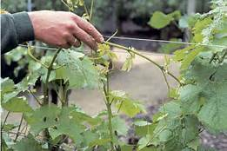
導引枝子 Guiding the Branches

Slide 28
3). 修剪我的旁鶩和累贅 – 導向目標
Pruning off Entanglements
–Guiding toward the Goal
2Ti 2:4 凡在軍中當兵的，不將世務纏身，好叫那招他當兵的人喜悅。
No man that wars entangles himself with the affairs of this life; that he may please him who has chosen him to be a soldier.
耶穌- 豈不知我當以我父的事為念嗎? (路2:49)
Jesus – Don’t you know that I must be about my Father's business?
- 脫去纏累, 浮華, 虛無, 過度外務, 名聲
- 追求生命優先的實質

Slide 29
朝園主獲得最大效益的目標前進
Move toward the greatest benefit of the Owner -
Php 3:13 弟兄們，我不是以為自己已經得著了；我只有一件事，就是忘記背後，努力面前的，
Brethren- this one thing I do, forgetting those things which are behind, and reaching forth unto those things which are before,
Php 3:14 向著標竿直跑，要得神在基督耶穌裡從上面召我來得的獎賞。
I press toward the mark for the prize of the high calling of God in Christ Jesus.

Slide 30
上帝為了什麼目標在塑造你?
For what Goal is God Shaping you?
你經過的人生:
你發現自己的屬靈恩賜了嗎?
什麼負擔最觸動你的內心?
你有哪些才幹能為上帝所用?
你的個性適合做哪些事情?
你的經驗如何用在你的服事中?

Slide 31
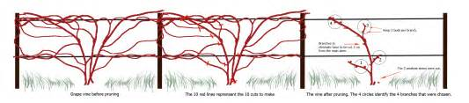
4). 最後的整理-將葡萄枝連接在一起
- 整體使命性
Last Step- Binding the Branches Together
- Unite Their Mission

Slide 32
不是單槍匹馬,
Not as a Lone Ranger
不是個人英雄主義,
Not for Individual Heroism
乃是 - 團結是力量,
But- Unity Is Strength
彼此擔當, 相互同工,
Bear One Another’s Burden
Work Shoulder to Shoulder
歸榮耀與上帝.
To God be the Glory

Slide 33
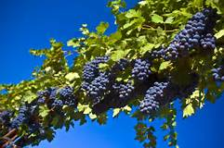
使葡萄豐收
To Reap A Great Harvest

Slide 34
結語 Conclusion
上帝有目標地修剪我們, 使我們多結果子.
修剪生命的過程包括: 外在的, 內在的, 目標性的, 整體使命性的.
結果子的過程不單是關乎個人的, 也是關乎整體的.
多結果子使上帝得榮耀.
你願意讓上帝修剪嗎?被上帝使用嗎?

