Slide 1
Celebrating the Chinese New Year 慶祝中國農曆新年
The Lord’s Reunion Feast
主的團圓飯
Mrs. Annie Petzholt
裴賀安慈師母

Slide 2
回家過年 Going Home for the CNY

Slide 3
Importance of reunion with the family during CNY 新年與 家人 團圓的 重要性

Slide 4
幾個習俗 Some CNY Customs

Slide 5
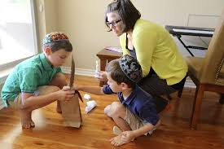
習俗-大掃除 Year-end Cleaning 除舊佈新
潔淨
Cleansing

Slide 6
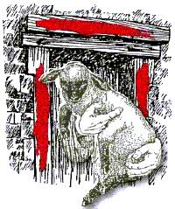
迎春接福, 掛春聯 Hanging Spring Couplets
Covered by the Blood
of the lamb
羊血的
遮蓋
保佑
性命
吉祥字句
說文解字- 吉, 善也。从士、口。字源-名词，举办国家喜庆大典、帝王祭享先祖先帝的都城国庙。

Slide 7
迎春接福, 掛春聯 Hanging Spring Couplets
維基百科: 春聯的內容除了有意義的吉祥語句外，一些文盲也會用紅紙寫上「十」字作為春聯之用。據1940年代的陕西《宜川縣誌》载，人們會寫吉祥語句，不識字的鄉民則寫「十」字. 《宜川縣誌》：「间有用纸书『立新春鸿禧』或『立新春大吉大利，万事亨通』等字者；乡民如不能写字，则画一『十』字代之。」

Slide 8
迎春接福, 掛春聯 Hanging Spring Couplets
祥也。
考工記注曰 : 羊、善也。
《説文解字》：善，吉也。从誩，从羊。此與義美同意。

Slide 9
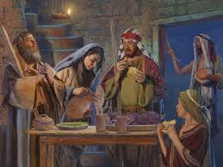
吃年夜團圓飯 Eat New Year’s Eve Dinner
逾越節的晚餐
Feast of the Passover Lamb

Slide 10
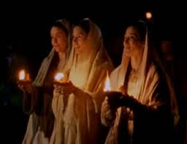
守歲/守夜 Keep Vigil
警醒 Stay Alert

Slide 11
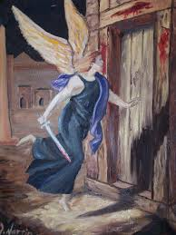
放鞭炮 Setting off Firecrackers
聚在屋內, 躲避滅命的天使
Stay inside to preserve life
趕走年獸
Scaring off the Nian monster

Slide 12
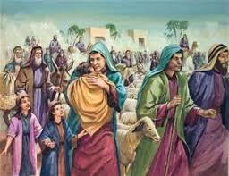
賀年/拜年 New Year Greetings
埃及人長子死亡
First born were killed, but Israelites were safe.
特別給孩子壓歲錢
New Year Congratulations!

Slide 13
The Lord’s Reunion Feast 主的團圓飯
Jesus used parables to teach 耶穌使用比喻來教導
《聖經》裏的比喻跟一般的神話或寓意故事不同，因為主耶穌不用完全虛構，或根本不可能發生的事來作比喻。他採用日常可能發生，或曾經發生過的事實為設喻的內容:
1.用地上(現在)的事說明天上(將來)的事 (漁網分魚, 太13:47-50;王子的婚宴/羔羊的婚宴, 太22:1-13/啟19:6-9);
2. 用物質的事說明屬靈的事; (種子/田地; 話語/人心;太13:1-9)

Slide 14
從人間的團圓飯 思想 主的團圓飯
王的兒子的婚宴 – The Wedding Feast of the King’s Son
Mat 22:1 耶穌又用比喻對他們說：
Mat 22:2 「天國好比一個王為他兒子擺設娶親的筵席，
Mat 22:3 就打發僕人去，請那些被召的人來赴席，他們卻不肯來。
Mat 22:1And Jesus answered and spake unto them again by parables, and said,
Mat 22:2 The kingdom of heaven is like unto a certain king, which made a marriage for his son,
Mat 22:3 And sent forth his servants to call them that were bidden to the wedding: and they would not come.

Slide 15
從人間的團圓飯 思想 主的團圓飯
Mat 22:4 王又打發別的僕人，說：『你們告訴那被召的人，我的筵席已經預備好了，牛和肥畜已經宰了，各樣都齊備，請你們來赴席。』
22:4 Again, he sent forth other servants, saying, Tell them which are bidden, Behold, I have prepared my dinner: my oxen and my fatlings are killed, and all things are ready: come unto the marriage.

Slide 16
從人間的團圓飯 思想 主的團圓飯
Mat 22:5 那些人不理就走了；一個到自己田裡去；一個做買賣去；
Mat 22:6 其餘的拿住僕人，凌辱他們，把他們殺了。
Mat 22:5 But they made light of it, and went their ways, one to his farm, another to his merchandise:
Mat 22:6 And the remnant took his servants, and entreated them spitefully, and slew them.

Slide 17
Mat 22:7 王就大怒，發兵除滅那些兇手，燒燬他們的城。
Mat 22:8 於是對僕人說：『喜筵已經齊備，只是所召的人不配。
Mat 22:9 所以你們要往岔路口上去，凡遇見的，都召來赴席。』
Mat 22:7 But when the king heard thereof, he was wroth: and he sent forth his armies, and destroyed those murderers, and burned up their city.
Mat 22:8 Then saith he to his servants, The wedding is ready, but they which were bidden were not worthy.
Mat 22:9 Go ye therefore into the highways, and as many as ye shall find, bid to the marriage.

Slide 18
Mat 22:10 那些僕人就出去，到大路上，凡遇見的，不論善惡都召聚了來，筵席上就坐滿了客。
Mat 22:11 王進來觀看賓客，見那裡有一個沒有穿禮服的，
Mat 22:12 就對他說：『朋友，你到這裡來怎麼不穿禮服呢？』那人無言可答。
Mat 22:10 So those servants went out into the highways, and gathered together all as many as they found, both bad and good: and the wedding was furnished with guests.
Mat 22:11 And when the king came in to see the guests, he saw there a man which had not on a wedding garment:
Mat 22:12 And he saith unto him, Friend, how camest thou in hither not having a wedding garment? And he was speechless.

Slide 19
Mat 22:13 於是王對使喚的人說：『捆起他的手腳來，把他丟在外邊的黑暗裡；在那裡必要哀哭切齒了。』
Mat 22:14 因為被召的人多，選上的人少。」
Mat 22:13 Then said the king to the servants, Bind him hand and foot, and take him away, and cast him into outer darkness; there shall be weeping and gnashing of teeth.
Mat 22:14 For many are called, but few are chosen.

Slide 20
婚禮的慎重, 被邀請的禮遇

Slide 23
王子的 婚禮 -慎重, 盛大 - 國家大事 A Prince’s Wedding - prudent and discreet, grand - draws national attention

Slide 24
王子的婚禮 A Prince’s Wedding

Slide 26
主的團圓飯 The Lord’s Reunion Feast
王請人赴祂兒子娶親的宴席
The King invites people to his son’s wedding
王的身分 – 宇宙的主宰, 全地的君王, 世人的主人
王一再差遣僕人(先知們)邀請,
被邀者的身分- 先是以色列人,
竟然有人拒絕王赴席的邀請- 不理睬, 對抗/叛變
被邀者的身分- 後是外邦人
錯失的機會變成他人的機會,
(在前的要在後, 在後的要在前)

Slide 27
First shall be Last, Last shall be First 在前的要在後, 在後的要在前

Slide 28
今天 天地的王 也對你發出祂的邀請 – 藉著基督徒, 傳道人, 聖經的話語, 廣播, 電視, 其他媒體….

Slide 29
皇家的宴席 A Royal Feast

Slide 30
賓客盛裝出席 – All are dressed properly

Slide 33
主的團圓飯 The Lord’s Reunion Feast
出席王兒子婚宴的人需要準備
People need to prepare to attend the prince’s wedding
雖然任何人現在都被邀請
但赴席必須穿上適當的禮服
你有這禮服嗎?

Slide 34
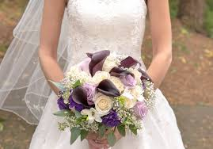
主的團圓飯 The Lord’s Reunion Feast
《聖經》相當有力的暗示，所有赴席者的“禮服”不是赴席者自備，而是主人預備的。因：
這些人是從岔路口請來的（9節）,
王責備那人為何不穿禮服時, 那人“無言可答”（12節）.
這“禮服” 是王所賜給的。
它到底是什麼呢?

Slide 35
天上的實際 - 主的團圓飯
Rev 19:6 我聽見好像群眾的聲音，眾水的聲音，大雷的聲音，說：哈利路亞！因為主我們的神、全能者作王了。
Rev 19:6 And I heard as it were the voice of a great multitude, and as the voice of many waters, and as the voice of mighty thunderings, saying, Alleluia: for the Lord God omnipotent reigneth.
Rev 19:7 我們要歡喜快樂，將榮耀歸給他。因為，羔羊婚娶的時候到了；新婦也自己預備好了，
Rev 19:7 Let us be glad and rejoice, and give honour to him: for the marriage of the Lamb is come, and his wife hath made herself ready.

Slide 36
主的團圓飯
Rev 19:8 就蒙恩得穿光明潔白的細麻衣。（這細麻衣就是聖徒的義。）
Rev 19:8 And to her was granted that she should be arrayed in fine linen, clean and white: for the fine linen is the righteousness of saints.
Rev 19:9 天使吩咐我說：「你要寫上：凡被請赴羔羊之婚筵的有福了！」又對我說：「這是神真實的話。」
Rev 19:9 And he saith unto me, Write, Blessed are they which are called unto the marriage supper of the Lamb. And he saith unto me, These are the true sayings of God.

Slide 37
主的團圓飯 The Lord’s Reunion Feast
出席王兒子婚宴的人需要準備
People need to prepare to attend the prince’s wedding
祂是公義王-穿上配合祂身份的穿著:
- 蒙恩得穿光明潔白的細麻衣 (這細麻衣就是聖徒的義)
細麻衣:侍立在上帝面前的人的穿戴
虔誠, 悔改(拿3:5,6 – 麻衣- 悔改的穿著), 謙卑, 順服(啟15:6- 天使穿潔白光明的細麻衣), 純淨, 尊貴(創41:42- 約瑟當宰相的穿著) – 這就是基督徒的身分.
象徵屬靈的品德(啟19:14), 披戴主耶穌基督(羅13:14)

Slide 39
祂是公義王 He is the King of Righteousness

Slide 40
主的團圓飯 The Lord’s Reunion Feast
參加婚宴, 享受(王)主人的快樂- 這是有福的時刻
Blessed are those who were invited and did come!
在你面前有滿足的喜樂；在你右手中有永遠的福樂。
Ps. 16:11…in thy presence is fullness of joy; at thy right hand there are pleasures for evermore.

Slide 41
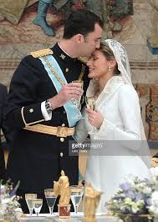
羔羊的婚宴 – 娶新婦(教會) The Marriage Feast of the Lamb 羔羊與新婦的關係:
1. 有愛 There is love
2. 有親密的關係 There is
intimacy
3. 有喜樂 There is joy
4. 有忠誠 There is loyalty
and fidelity

Slide 42
主的團圓飯 The Lord’s Reunion Feast
沒有準備好的人的結局
Outcome of those who are not prepared
王對使喚的人說：『捆起他的手腳來，把他丟
在外邊的黑暗裡；在那裡必要哀哭切齒了。』
Bind him hand and foot, and take him away, and cast him into outer darkness; there shall be weeping and gnashing of teeth.
- 因為被召的人多，選上的人少。」
For many are called, but few are chosen.

Slide 43
不穿禮服者的結局與不肯赴席者的結局相同：
The outcome of those who reject the invitation:
都無分于王的筵席，或被除滅（7節），或被
丟在黑暗裏（13節）。
2. 都是被召而沒有被選上（14節，參4節、10節）。

Slide 44
結語 Conclusion:
Come home to God!
回家吧!
主在召喚你,
邀請你赴羔羊的宴席

Slide 46
結語 Conclusion:
Enter the door- Jesus!
進門吧!
耶穌就是那門,
進了門, 你就踏進家裡了!

