Slide 1

哥林多前書12:7-10
I Cor. 12:7-10
軟弱的力量
The Power of Weakness

Slide 2

軟弱和限制是一個:
Weakness and limitation is:
「更深認識自己」的「禮物」
A “gift” to know yourself deeper

Slide 3

軟弱和限制是一個:
Weakness and limitation is:
「支取更多恩典」的「管道」
A “channel” to “receive more grace”

Slide 4
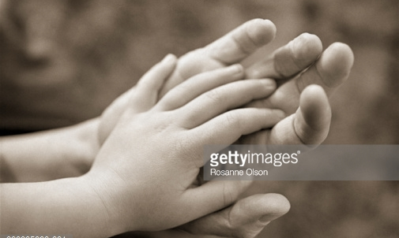
軟弱和限制是一個:
Weakness and limitation is:
「與人關係更密」的「連結」
A “bond” to “connect more intimately
with people”

