Slide 1

連於元首基督
- 住在基督裡
Abide in God’s Love
(三)
裴賀安慈師母

Slide 2
經文: 約翰福音 John 15:9-10
Joh 15:9 我愛你們，正如父愛我一樣；你們要常(住)在我的愛裡。
As the Father has loved me, so have I loved you: continue ye in my love.
愛的實質
Essence of Love

Slide 3
經文: 約翰福音 John 15:9-10
Joh 15:10 你們若遵守我的命令，就常(住)在我的愛裡，正如我遵守了我父的命令，常(住)在他的愛裡。
If you keep my commandments, you shall abide in my love; even as I have kept my Father's commandments, and abide in his love.
愛的關係
Relationship of Love

Slide 4
信息內容 – 讓生命流通,
結果子的三個 -「住在」基督裡
住在上帝的修剪中
Abide in God’s Pruning
2. 住在上帝的話語中
Abide in God’s Word
3.住在上帝的愛中
Abide in God’s Love

Slide 5
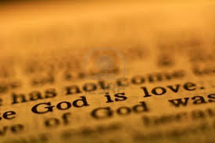
住在上帝的愛中 Abide in God’s Love
上帝就是愛
God Is Love

Slide 6
1. 上帝的愛的特質
Unique Characteristics of God’s Love
1). 立約的愛 – 超越, 承諾,委身, 永久性, 給予
Covenantal Love – transcendent, Commitment, permanent, giving
Isa. 54:10 - 大山可以挪開，小山可以遷移；但我的慈愛必不離開你；我平安的約也不遷移。這是憐恤你的耶和華說的。
For the mountains shall depart, and the hills be removed; but my kindness shall not depart from thee, neither shall the covenant of my peace be removed, saith the LORD that hath mercy on thee.

Slide 7
1. 上帝的愛的特質
Unique Characteristics of God’s Love
1). 立約的愛 Covenantal Love
上帝主動與人立約-
God initiates covenants with men
挪亞之約 Noah(創8,21-22;9:8-17)
亞伯拉罕之約 Abraham(創12:1-3; 17:1-8)
大衛之約 David (撒下7章)

Slide 8
1). 立約的愛 Covenantal Love
Jer 31:3 古時（或作：從遠方）耶和華向以色列（原文作我）顯現，說：我以永遠的愛愛你，因此我以慈愛吸引你。
The LORD hath appeared of old unto me, saying, Yea, I have loved thee with an everlasting love: therefore with lovingkindness have I drawn thee.

Slide 9
1). 立約的愛 Covenantal Love
Psa 136:1 你們要稱謝耶和華，因他本為善；他的慈愛永遠長存。
O give thanks unto the LORD; for he is good: for his mercy endureth for ever. (26次)

Slide 10
1). 立約的愛 Covenantal Love
Psa 63:3 因你的慈愛比生命更好，我的嘴唇要頌讚你。
Because thy lovingkindness is better than life, my lips shall praise thee.

Slide 11
1). 立約的愛 Covenantal Love
- 大衛的例子(2Sa 24:14) 大衛對迦得說：「我甚為難！我願落在耶和華的手裡，因為他有豐盛的憐憫。我不願落在人的手裡。」
David’s Example –
And David said unto Gad, I am in a great strait: let us fall now into the hand of the LORD; for his mercies are great: and let me not fall into the hand of man.

Slide 12
1). 立約的愛 – 守約的上帝
God keeps His covenants
Deu 7:9 所以，你要知道耶和華你的神，他是神，是信實的神；向愛他、守他誡命的人守約，施慈愛，直到千代；
Know therefore that the LORD thy God, he is God, the faithful God, which keepeth covenant and mercy with them that love him and keep his commandments to a thousand generations;

Slide 13
1). 立約的愛 – 守約的上帝
God keeps His covenants
2Ch 6:14 說：「耶和華以色列的神啊，天上地下沒有神可比你的！你向那盡心行在你面前的僕人守約施慈愛；
2Ch 6:15 …你親口應許，親手成就，正如今日一樣。
And said, O LORD God of Israel, there is no God like You in the heaven, nor in the earth; which keeps covenant, and shows mercy unto Your servants… that which You have promised …and has fulfilled it…

Slide 14
1). 立約的愛 – 守約的上帝
God Keeps His Covenants
耶穌與我們立約 Jesus made a covenant with us:
Luk 22:20 飯後也照樣拿起杯來，說：「這杯是用我血所立的新約，是為你們流出來的。
Likewise also the cup after supper, saying, This cup is the new testament in my blood, which is shed for you.

Slide 15
1). 立約的愛 – 守約的上帝
God Keeps His Covenants
Joh 10:28 我又賜給他們永生；他們永不滅亡，誰也不能從我手裡把他們奪去。
And I give unto them eternal life; and they shall never perish, neither shall any man pluck them out of my hand.
Joh 10:29 我父把羊賜給我，他比萬有都大，誰也不能從我父手裡把他們奪去。
My Father, which gave them me, is greater than all; and no man is able to pluck them out of my Father's hand.

Slide 16
1). 立約的愛, 守約的上帝
God keeps His covenant
愛是凡事包容, 凡事相信,
凡事盼望, 凡事忍耐
愛是永不止息
Love Bears all things, believes all things, hopes all things, endures all things.
Love never fails.

Slide 17
1). 立約的愛- 守約的上帝
God Keeps His Covenants
愛裡沒有懼怕；愛既完全，就把懼怕除去。因為懼怕裡含著刑罰，懼怕的人在愛裡未得完全。 (約一4:18)
There is no fear in love; but perfect love casts out fear: because fear has torment. He that fears is not made perfect in love. (I John 4:18)

Slide 18
我們對上帝立約的愛的回應:
Our response to God’s covenantal love:
1.進入與祂立約的關係
Enter into covenant relationship with God
2.信任祂的應許
Trust in His promises
3.除去所有懼怕, 接受祂的慈愛
Cast out all fears, accept His love
4.依靠祂的信實
Rely on His faithfulness

Slide 19
上帝的愛的特質
Unique Characteristics of God’s Love
2). 救贖的愛 –恩慈, 憐憫, 犧牲, 挽回
Redeeming Love – full of grace, mercy, sacrifice, redemption
Psa 103:8 耶和華有憐憫，有恩典，不輕易發怒，且有豐盛的慈愛。
The LORD is merciful and gracious, slow to anger, and plenteous in mercy.

Slide 20
2). 救贖的愛 Redeeming Love
Psa 103:9 他不長久責備，也不永遠懷怒。
He will not always chide: neither will he keep his anger for ever.
Psa 103:10 他沒有按我們的罪過待我們，也沒有照我們的罪孽報應我們。
He has not dealt with us after our sins; nor rewarded us according to our iniquities.
- 不計算人的惡, 不求自己的益處 -
Love thinks no evil, seeks not her own

Slide 21
2). 救贖的愛 Redeeming Love
Isa 53:10 耶和華卻定意（或作：喜悅）將他壓傷，使他受痛苦。耶和華以他為贖罪祭（或作：他獻本身為贖罪祭）…..
Yet it pleased the LORD to bruise him; he has put him to grief: when You shall make his soul an offering for sin,

Slide 22
2). 救贖的愛 Redeeming Love
Joh 3:16 神愛世人，甚至將他的獨生子賜給他們，叫一切信他的，不至滅亡，反得永生。
For God so loved the world, that he gave his only begotten Son, that whosoever believeth in him should not perish, but have everlasting life.

Slide 23
2). 救贖的愛 Redeeming Love
Rom 5:8 惟有基督在我們還作罪人的時候為我們死，神的愛就在此向我們顯明了。
But God commends his love toward us, in that, while we were yet sinners, Christ died for us.

Slide 24

2). 救贖的愛 Redeeming Love
我們對上帝救贖的愛的回應:
Our response to God’s redeeming love:
1. 接受耶穌的救贖
Accepts Jesus’ redemption
2. 悔改自己的罪行,罪性
Repent of our sins and sin nature
3. 感恩祂的犧牲
Grateful to His sacrifice

Slide 25
上帝的愛的特質
Unique Characteristics of God’s Love
3).聖潔的愛 –忌邪,誠實,管教
Holy Love- jealous, honest, discipline
Exo 20:4 「不可為自己雕刻偶像，也不可做什麼形像彷彿上天、下地，和地底下、水中的百物。
Thou shalt not make unto thee any graven image, or any likeness of any thing that is in heaven above, or that is in the earth beneath, or that is in the water under the earth:

Slide 26
3).聖潔的愛 Holy Love
Exo 20:5 不可跪拜那些像，也不可事奉他，因為我耶和華你的神是忌邪的神。
Thou shalt not bow down thyself to them, nor serve them: for I the LORD thy God am a jealous God…

Slide 27
3).聖潔的愛 Holy Love
Exo 34:14 不可敬拜別神；因為耶和華是忌邪的神，名為忌邪者。 (申5:9, 6:15)
For thou shalt worship no other god: for the LORD, whose name is Jealous, is a jealous God:

Slide 28
3).聖潔的愛 Holy Love
Deu 18:9 「你到了耶和華你神所賜之地，那些國民所行可憎惡的事，你不可學著行。
When you come into the land which the LORD your God gives you, you shall not learn to do after the abominations of those nations.

Slide 29
3).聖潔的愛 Holy Love
Deu 18:10 你們中間不可有人使兒女經火，也不可有占卜的、觀兆的、用法術的、行邪術的、
There shall not be found among you any one that makes his son or his daughter to pass through the fire, or that uses divination, or an observer of times, or an enchanter, or a witch,

Slide 30
3).聖潔的愛 Holy Love
Deu 18:11 用迷術的、交鬼的、行巫術的、過陰的。
Or a charmer, or a consulter with familiar spirits, or a wizard, or a necromancer.
Deu 18:12 凡行這些事的都為耶和華所憎惡…
For all that do these things are an abomination unto the LORD.

Slide 31
3).聖潔的愛 Holy Love
- 不喜歡不義, 只喜歡真理 -
Love joices not in iniquity, but rejoices in the truth;
聖潔- 與世俗有別
Holy- separated from the world
聖徒- 為上帝的目的分別出來
Saints – separated for God’s purposes

Slide 32

金牛犢 golden calf

Slide 33
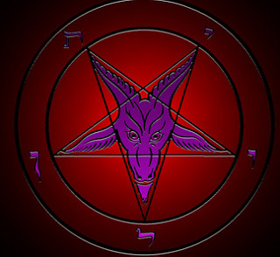
現代版
Modern Version

Slide 34
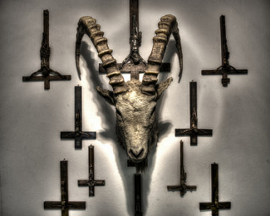
現代版
Modern Version

Slide 35
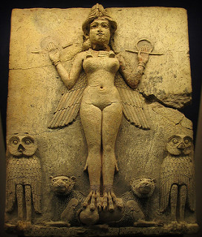
亞舍拉
亞斯他錄
Goddess
Astaroth in demonology, is the Great Duke of Hell, in the first hierarchy with Beelzebub and Lucifer; he is part of the evil trinity.

Slide 36

現代版 Modern Version

Slide 37
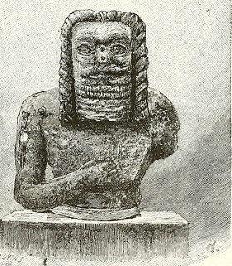
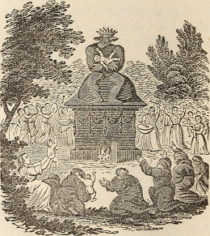
Baal worship
巴力崇拜

Slide 38
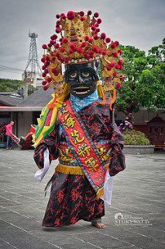
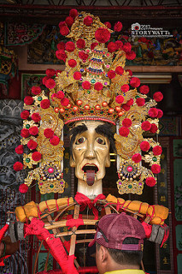
現代版 Modern Version

Slide 39
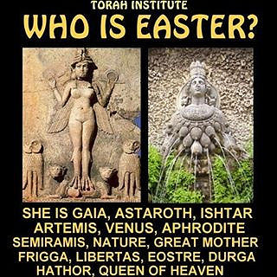

Slide 40
算命 Fortune Telling
塔羅牌 Taro card reading
水晶球 Crystal ball
紫微斗數 Ziwei bucket number
黃曆 Yellow calendar
星座 Constellation
看相 Face reading
看手掌 Palm reading
測字 Name reading

Slide 41
我們對上帝聖潔的愛的回應:
Our response to God’s holy love:
- 清除偶像 get rid of idols
- 脫離綑綁 (歪, 邪, 亂, 癮, 暴力, 詭異, 昏渾) break the bondage
內外的改變 change in-N-out
敬畏上帝 Fear the Lord
效法上帝的聖潔 follow God’s holiness

Slide 42
我們的回應 Our response:
Psa 29:2 要將耶和華的名所當得的榮耀歸給他，以聖潔的妝飾敬拜耶和華。
Give unto the LORD the glory due unto his name; worship the LORD in the beauty of holiness.

Slide 43
2.上帝的愛與遵守命令的關係
Relationship of God’s love and Our Obedience
西乃之約 Sinai Covenant
出 Exo. 19,20章
申 Deut. 5,28章
書 Joshua 24章
有條件的約- Conditional Covenant
賞罰分明
Distinct reward/punishment

Slide 44
2.上帝的愛與遵守命令的關
Relationship of God’s love and Our Obedience
Jud 1:20 親愛的弟兄啊，你們卻要在至聖的真道上造就自己，在聖靈裡禱告，
But you, beloved, building up yourselves on your most holy faith, praying in the Holy Ghost,
Jud 1:21 保守自己常在神的愛中，仰望我們主耶穌基督的憐憫，直到永生。
Keep yourselves in the love of God, looking for the mercy of our Lord Jesus Christ unto eternal life.

Slide 45
Joh 14:15 「你們若愛我，就必遵守我的命令。
If you love me, keep my commandments.
Joh 14:21 有了我的命令又遵守的，這人就是愛我的；愛我的必蒙我父愛他，我也要愛他，並且要向他顯現。」
He that has my commandments, and keeps them, he it is that loves me: and he that loves me shall be loved of my Father, and I will love him, and will manifest myself to him.
- 經歷上帝的同在 -
Experience God’s presence

Slide 46
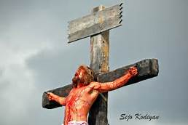
3. 如何住在上帝的愛中
How to Abide in God’s Love
1). 不要懷疑上帝的愛,
Do not doubt God’s Love
- 保守自己在神的愛中
Keep yourself in God’s love
耶穌基督已經為我們死了
Jesus Christ has died for us

Slide 47
1). 不要懷疑上帝的愛Do not doubt God’s love
Rom 8:32 神既不愛惜自己的兒子，為我們眾人捨了，豈不也把萬物和他一同白白的賜給我們嗎？
He that spared not his own Son, but delivered him up for us all, how shall he not with him also freely give us all things?

Slide 48

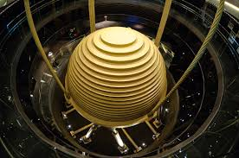
Taipei 101

Slide 49

2). 讓聖靈擴張我們的愛 – 學習捨己
Let the Holy Spirit expand our love- let go of ourselves
讓聖靈將上帝的愛澆灌在我們心裡
Let the Holy Spirit pour God’s love inside us

Slide 50

3). 選擇去愛 Choose to love
不要放棄愛的勇氣
Donot give up the courage to love.
停止愛就停止付出 When you stop loving, you stop giving.

