Slide 1
信徒品德1:1-11 | 善於分辨真偽 1:12-3:13 |  |  | 信徒品德3:14-18
品行上長進 | 基督的威榮 (首次降臨) | 假教師下場 | 基督的威榮 (再次降臨) | 真道上長進
彼得激勵 屬靈成長 | 基督降臨 的預言 1:12-21 | 假教師的 行為和下場 2:1-22 | 基督降臨 的必然 3:1-13 | 彼得激勵 站立得穩
基督必定再來(3:10) ﹗

Slide 2
2Peter: Well Established in the Truth (1:12)
Christian Virtues | Discernment of Spiritual Truth 1:12-3:13 |  |  | Christian Virtues
Growing in Characters 1:1-11 | Glory of Christ (1st Advent) | Punishment of False Teachers | Glory of Christ (2nd Coming) | Growing in Truth 3:14-18
Encourage Spiritual Growth | Prophecy of Christ’s 1st Advent 1:12-21 | Behaviors of False Teachers 2:1-22 | Certainty of Christ’s 2nd Coming 3:1-13 | Encourage Standing Firm in the Truth
The Lord Is Coming (3:10) ﹗

Slide 3
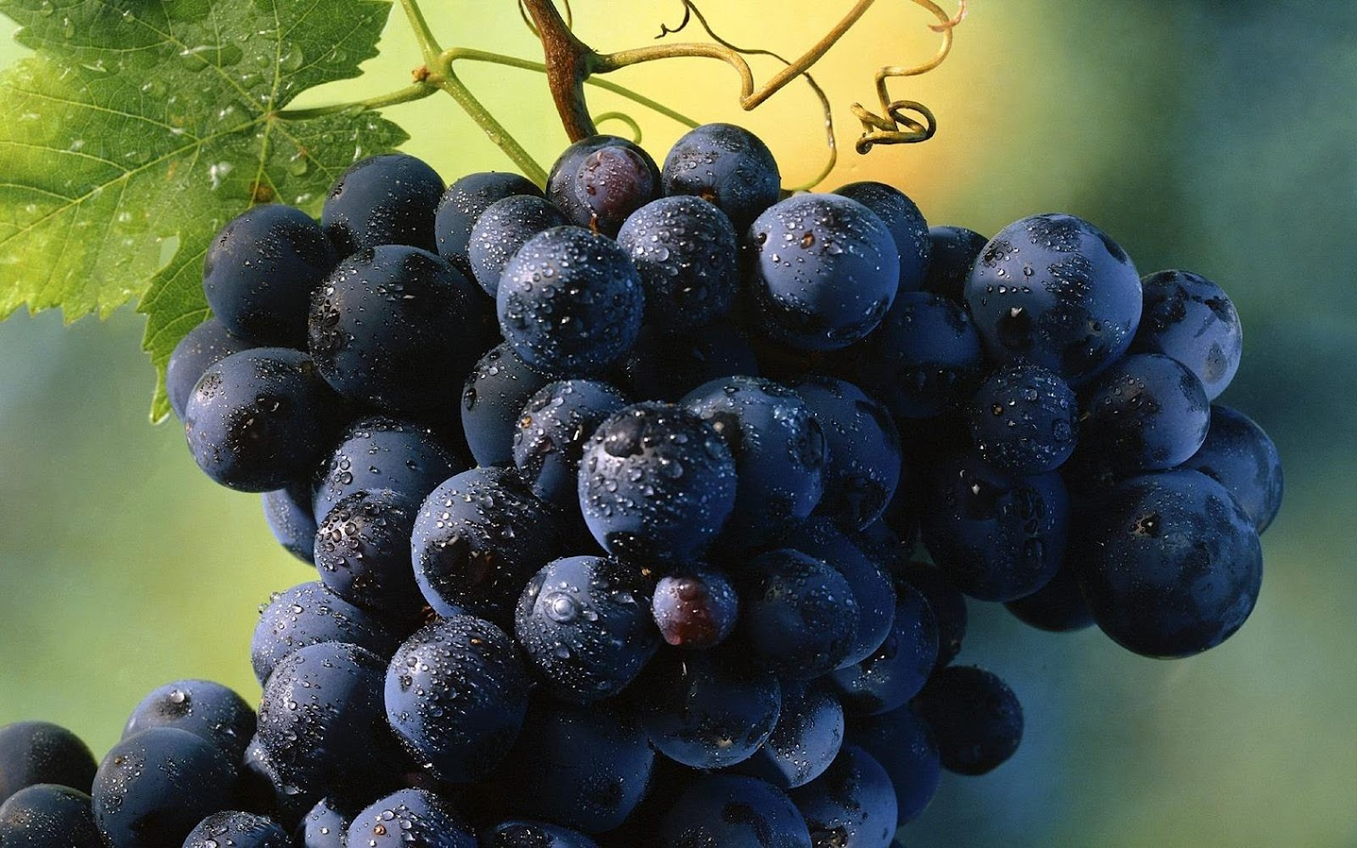
基督徒的品格
 | 八種品格 (彼後1:5-7) | 聖靈果子 (加5:22-23)
與神關係 | 虔敬, 知識
與人關係 | 愛弟兄的心, 愛眾人的心 | 仁愛
生活態度 |  | 喜樂, 和平
信仰生活 | 信心, 節制, 忍耐 | 信實, 節制, 忍耐
個人操守 | 德行 | 恩慈, 良善, 溫柔

Slide 4
Christian Virtues
 | Eight Virtues (2Pe 1:5-7) | Fruit of the Holy Spirit (Gal 5:22-23)
With God | Godliness, Knowledge
With People | Brotherly Kindness, Love | Love
Daily Life |  | Joy, Peace
Faith Life | Faith, Self-Control, Perseverance | Faithfulness, Self-Control, Patience
Characters | Moral Excellence | Kindness, Goodness, Gentleness

Slide 5

基督教名著
《懺悔錄》
《天路歷程》
《返璞歸真》
《荒漠甘泉》
《竭誠為主》
奧古斯丁
本仁約翰
魯益師
考門夫人
章伯斯

Slide 6
Classic Christian Readings
Augustine,“The Confessions”
John Bunyan,“Piligram’s Progress”
C. S. Lewis, “Mere Christianity”
Lettie Cowman,“Streams in the Desert”
Osward Chambers, “My Utmost for His Highest”

