Slide 1
Adam a Magnificent & Tragic ‘Prophetic Type’ of Christ 亞當 – 壯麗且悲劇式的基督預表
Types are Objective Proof the Bible is a supernaturally designed Message whose origin is an Eternal & Omniscient Being from outside our space-time domain
預表是聖經為超自然設計出的信息的客觀證據，它的源始來自我們時空領域之外的永恆且無所不知的那一位。
Illustration: Harry Rimmer debated an atheist on the Divine inspiration of the Bible.

Slide 2
Biblical Prophesy is Powerful Proof the Bible is God’s Word! 聖經的預言強有力地證明聖經是上帝的話語
(John 14:29) Jesus said “I have told you before it come to pass, that, when it is come to pass, ye might believe” (John 13:19)
約14:29 -現在事情還沒有成就，我預先告訴你們，叫你們到事情成就的時候就可以信。(約13:19）
Jesus is the one true Omniscient God (John 1:1-4, 14; 16:30)
耶穌是那位真實無所不知的上帝。
Jehovah fills the O.T. with Prophecies to Prove He Inspired it! (Isaiah 41:22-24; 46:9-10; 48:3-5; Acts 15:18)
耶和華用預言充滿舊約，證明是祂所默示的！ （賽41:22-24；46:9-10；48:3-5；徒15:18）

Slide 3
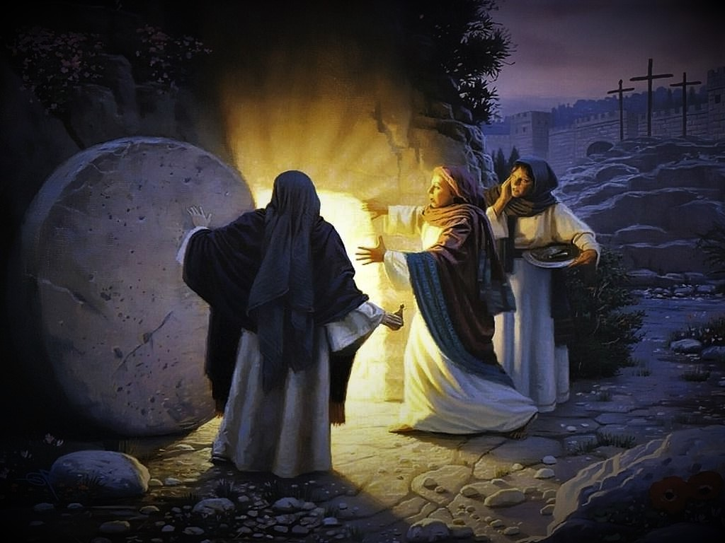
The Bible is more Compelling proof for the Supernatural than someone rising from the Dead! 聖經比人從死裡復活更能證明超自然的存在
Jesus said “If they hear not Moses & the prophets, neither will they be persuaded, though one rose from the dead” (Lk.路16:31)
耶穌說，若不聽從摩西和先知的話，就是有一個從死裡復活的，他們也是不聽勸。
Rejecting such powerful evidence means your problem is not intellectual but moral
拒絕如此有力的證據表示人的問題不是知識上的，而是道德上的。

Slide 4
Why is God’s Word so Powerful? 為何上帝的話語如此有能力？
27 % of the Bible is Prophesy: an infallible, irrefutable, objective proof of inspiration by an Omniscient Eternal Being
聖經27%都是預言：無誤，無可辯駁，具體證明它來自永恆、無所不知上帝的默示。
There are around 300 major Prophecies of Christ in the O.T.
舊約有300個主要關於基督的預言。

Slide 5
Prophesy is Mathematical Proof of supernatural origin 預言起源於超自然的數學證明
Peter Stoner in his book “Science Speaks,” calculates: (p. 99-107)
the probability of just 8 of the 300 major prophecies of Christ being fulfilled in any one individual is 1 in 10 to the 17th power (1 in 100,000,000,000,000,000) or one in 100 quadrillion!
300個關於基督的主要預言中有8個實現， 是100兆之一的可能性。
To reject Christ is to reject a fact proved more absolutely than almost any other fact in the world!
拒絕基督就是拒絕鐵證的事實！

Slide 6
An amazing type of Prophesy is “Prophetic Types” Absolutely inexplicable apart from Divine Revelation! 預言中最奇妙的形式是預表 除非來自神聖的啓示，它們絕對無法解釋
380 of 1,817 different predictions in the Bible are Types (21%)
聖經1817個不同的預言中，380個是預表（21%）；
2,895 verses out of a total 31,124 verses in the Bible deal with “Types” specifically revealed as such. (9%).
聖經31,124經節中，2,895節直接針對“預表”而言（9%）。
(J. B. Payne, Encyclopedia of Biblical Prophecy, pgs. 674-675, 681)

Slide 7
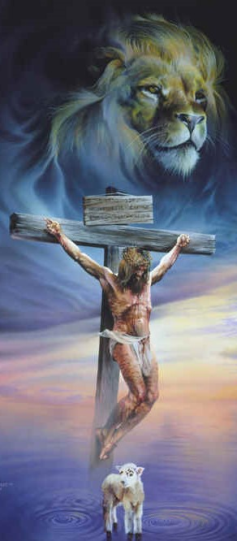
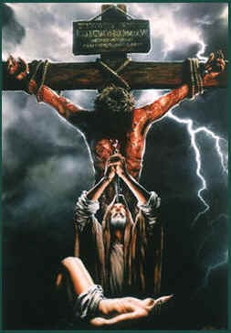
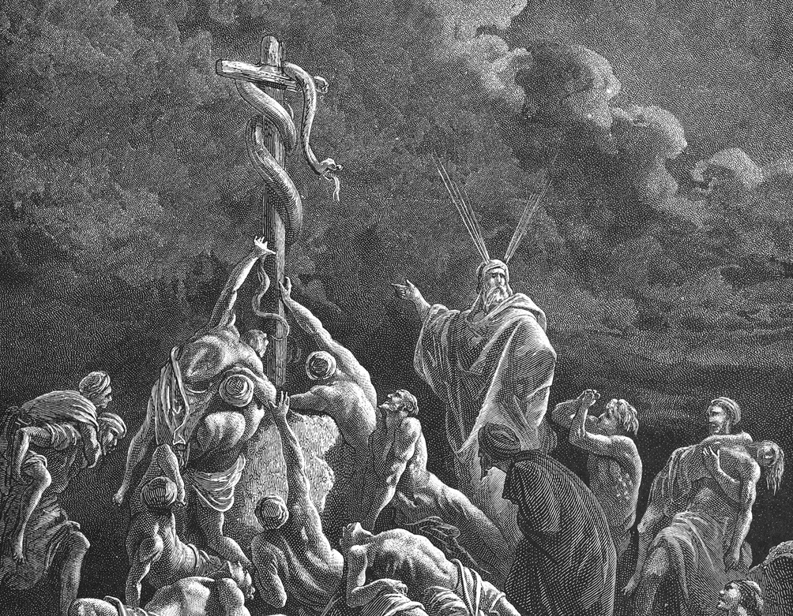
A type is “a shadow, cast by Divine design, of good things to come” & not the very image of the things (Heb. 10:1; 8:5; 9:9, 11).
預表是 - 將來美事的影兒，不是本物的真像(來10:1）
Rev. 4:5-6
John 8:56-58
John 3:14-15; Numb. 21:5-9)
Gen. 22

Slide 8
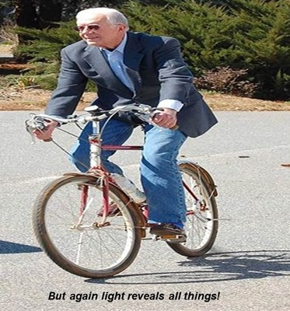
Types are temporary shadows compared to the eternal “body” (or reality) it reveals (Col. 2:16-17). As a cryptic form of Prophesy, they always prefigure something future & far greater.
預表與它們所啓示的永恆“實體”相比，只是暫時的影子（西2:16-17)。它們是預言的一種隱秘形式，預示未來且更大的事情

Slide 9
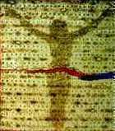
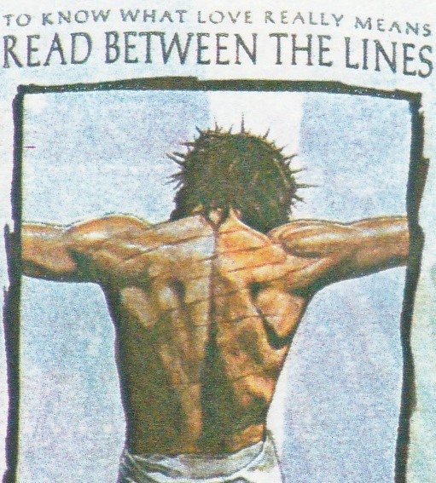
Prophetic Types are Faith Inspiring Wonders 預表是激發信仰的奇跡
It was impossible to know a Type’s importance until Jesus Christ fulfilled its prophetic details (i.e. Unleavened Bread of LORD’s Supper)
我們不可能明白預表的重要性，直到耶穌基督實現它們所預言的細節。
Prophetic Types are obviously supernatural, inspired by someone from outside our space-time domain.
預表明顯是超自然的，是來自我們時空領域之外的某人所啓示的。
Isa. 53:5

Slide 10
The N.T. fulfillment of the OT type is called the ‘antitype’ 新約所實現舊約的預表，被稱爲“原型”
Adam is a ‘Prophetic Type’ of Jesus Christ. The Bible says Adam is “the figure of him that was to come” (Rom. 5:14)
亞當是耶穌基督的“預表”。聖經說 “亞當乃是那以後要來之人的預像。”
The Holy Spirit deliberately designed ‘similarities’ into the record of Adam that would Correspond to great truths about Jesus recorded in the N. T. 4000 yrs. later (Lk. 24:44; John 5:39, 45-46).
聖靈有意地將“類同之處”設計進亞當的記錄中，以其它們能與四千年之後耶穌在新約中的記錄相對應。

Slide 11
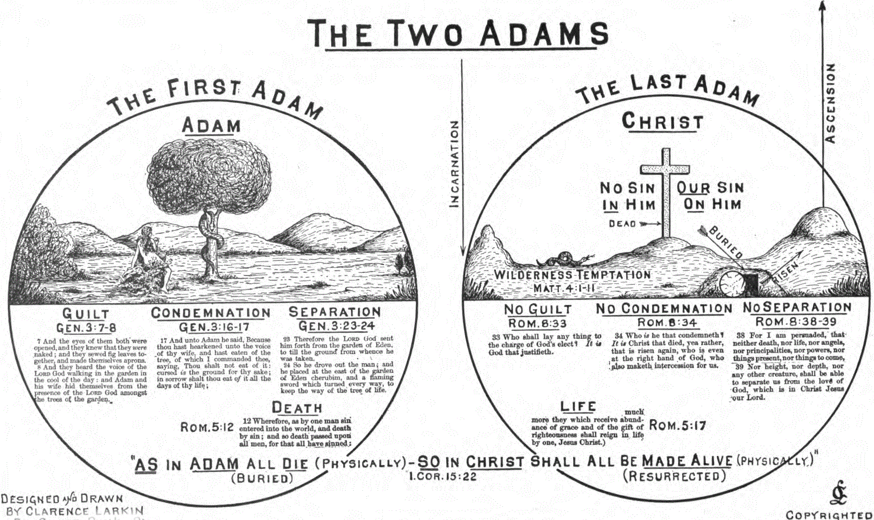

Slide 12
When we study Prophetic Types we must realize there are both similarities & contrasts. 當我們研究預表時，我們必須明白同時有類同與對比之處
Similarities because everyone called of God is “predestined to be conformed to the image of God’s Son” (Rom. 8:28-29).
類同是因爲被上帝所呼召的每個人，都被“預先定下效法上帝兒子的模樣”（羅8：28-29）；
Contrasts because Jesus Christ is the only sinless human being who ever lived (Heb. 4:15; 7:26; I Pet. 1:18-19; 2 Cor. 5:21; I John 3:5)
對比是因爲耶穌基督是唯一活著無罪的人。

Slide 13
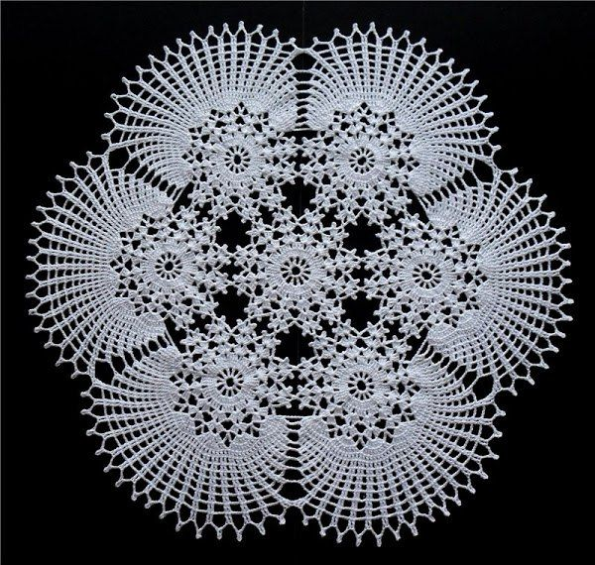
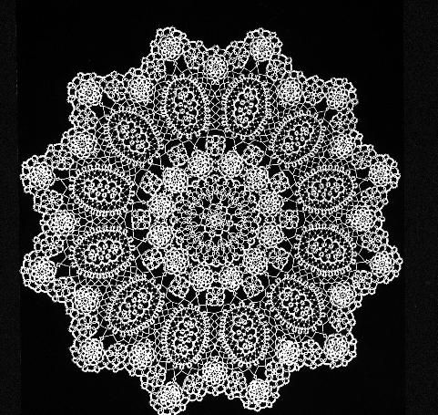
The contrasts allow the Holy Spirit to more vividly & clearly highlight the perfection of the Person & Work of Christ 這些對比讓聖靈更鮮活、清楚地强調基督完美的位格與工作
Illus: best way to look at fine crochet: on black velvet

Slide 14
Contrasts: 1st Adam & 1st Man; Last Adam & 2nd Man (I Cor. 15:45-47) 對比：首先的亞當，第一個男人；末後的亞當，第二個男人
The only son of God by direct creation (Gen. 1:26-27; 5:1; Lk. 3:38). Has a beginning
上帝唯一直接創造的兒子， 有開端
He is Created
他是被造的
The “only begotten Son of God” (John 3:16) eternally co-existent (John 5:26; Isa. 63:16)
永遠與上帝共存的“獨生子”
Jesus is the Creator (John 1:1-3; Col. 1:15-17)
耶穌是造物主

Slide 15
Head of the old Creation (Gen. 1:26-28) begets all his natural offspring & descendants
是舊創造的元首，生下所有後代與後裔；
The 1st man was of “the earth, earthy” & we bear his image (I Cor. 15:47-9; Gen. 5:3)
首先的人“出於地，是屬地的”，我們承受他的形像。
Head of the new Creation (Eph. 1:22-23); begets all his spiritual offspring (Joh 1:12-3; 2Cor. 5:17)
新創造的元首，生出所有屬靈的後裔；
The 2nd man is “the Lord from heaven” & we bear his image (2 Cor. 3:18; I John 3:2-3)
末後的人是“來自天上的主”，我們承受他的形像。

Slide 16
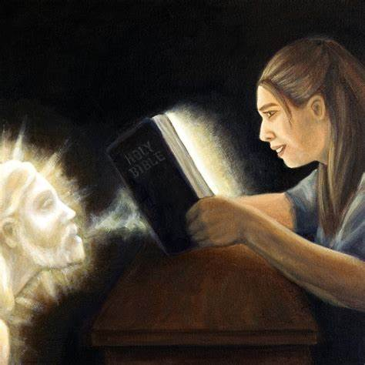
Beholding Prophetic Types in Scripture transforms our lives 上帝將預表放入祂的話語中，為的是改變我們的人生！
“But we all, …beholding as in a glass the glory of the Lord, are changed into the same image from glory to glory,
even as by the Spirit of the Lord.” (2 Cor. 3:18)
我們眾人既然敞著臉得以看見主的榮光，好像從鏡子裡反照，就變成主的形狀，榮上加榮，如同從主的靈變成的。(林後3:18）

Slide 17
(Romans 5:12-21) 2 Men: Keys to understand Redemptive History （羅馬書5:12-21） 兩個人：明白救贖歷史的關鍵
Sin of 1 man: Death enters humanity by his sin & passed on to the whole race for all sinned (Rom. 5:12; 3:23)
第一個人的罪惡：因他的罪 死亡進入人間，並傳遞給全 人類
Brings condemnation Rom 5:16
帶來定罪（羅5：16）。
The Perfection of the 2nd man: Life restored by righteousness of Christ & passes on to many through faith (Rom. 5:1-2)
第二個完美的人：基督的公 義恢復生命，並傳遞給有信 心的人；
Brings justification (Rom. 5:16)
帶來稱義（羅5：16）。

Slide 18
“As in Adam all die, so in Christ shall all be made alive” (I Cor. 15:22) “在亞當裏衆人都死了，照樣，在基督裏衆人都要活過來”
We receive our corruptible body of flesh (with a sin nature – Rom. 7:18-20; Eph. 2:3) by inheritance from Adam (Gen. 2:23; 5:3; 1Cor. 15:49)
我們承繼了來自亞當的朽壞的(具有罪性的)身體。
We will receive an incorruptible glorified spiritual body by resurrection (with a divine nature - 1 Cor. 15:50-4; 2 Cor. 5:1-5; Rom. 8:8-11; I John 3:2)
我們將承受復活，不朽壊、榮耀的屬靈身體(具有神聖的本性)。

Slide 19
The 1st question asked by God in the O.T.: “Where art thou?” (Gen 3:9)
舊約中上帝問的第一個問題：“你在哪裏？”
Adam tried to hide his sin (Job. 31:33; Gen. 3:8, 10)
亞當試圖隱藏他的罪。
The 1st question by man in the N.T.: “Where is he that is born King of the Jews?” (Matt. 2:2)
新約中人問的第一個問題：“那生來要作猶太人的王在哪裏？”
Exposed the horror of our sin by the Cross: (Gospels; I Pet. 2:24; Isa. 53:4-6, 11)
十字架揭露罪的可怕。

Slide 20
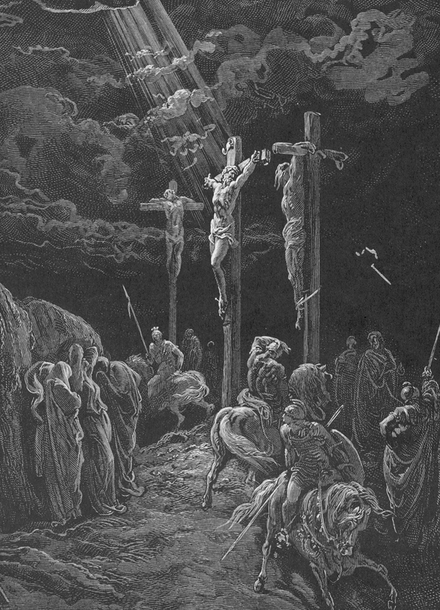
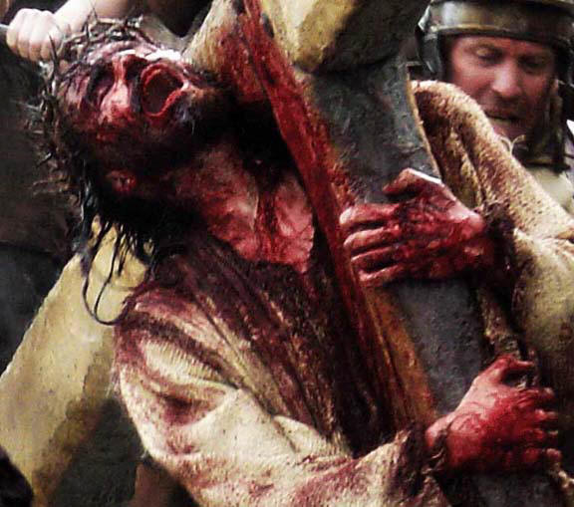
The Cross, a Tree (I Pet. 2:24; Act 13:28-30) is the Greatest Revelation of the Knowledge of Good (Christ) & evil (sin) 十字架，一棵樹， 是對善（基督）惡（罪）樹最偉大的啓示
Gen.2:17
2 Cor. 5:21
Gen. 3:15
Psalm 22:6

Slide 21
God makes the 1st Sacrifice: A substitute dies in the sinner‘s place 上帝做了第一個祭物：它代替罪人死
God clothed them with coats of skins (a Lamb)(3:21). They are redeemed as they “put on the Lamb”
上帝用皮衣（羊皮）給他們穿上；他們“穿上羔羊”而被救贖。
Jesus is the Lamb of God who redeems us (John 1:29, 36). We “put on the Lord Jesus Christ” (Rom. 13:14; Gal. 3:27)
耶穌是上帝的羔羊，救贖我們。我們“穿上主耶穌基督。”

Slide 22
2 Gardens: 1st Adam in Eden; Last Adam in Gethsemane (Matt. 26:36-57; Mk. 14:32-53; Lk. 36-54; John 18:1-13) 兩個園子：首先的亞當在伊甸園；末後的亞當在客西馬尼園
Adam talked with satan; sinned; & fell.
亞當與撒旦説話，犯罪，墮落了，
The whole human race was lost
全人類失喪了。
Jesus prayed to the Father: suffered; & triumphed
耶穌向天父禱告，受苦，得勝了，
Christ said “I have lost none” (John 18:9; Heb. 7:25)
基督說,“我沒有失去一個.”

Slide 23
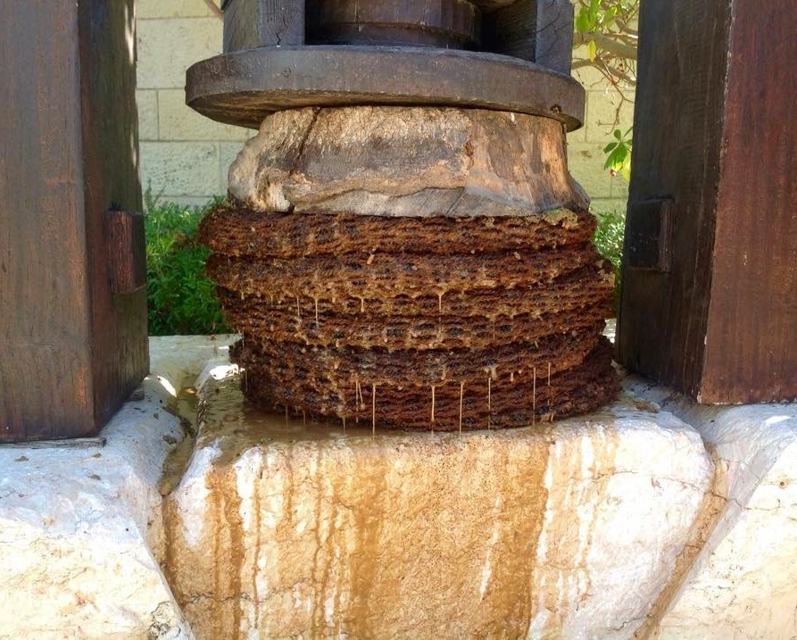
Gethsemane means “olive press.” Where olives are crushed under the weight of a great stone, forcing out every drop of olive oil. 客西馬尼意為“橄欖壓榨機”， 橄欖在石頭的重壓下被壓榨出每一滴橄欖油
Oil is a Type of the Holy Spirit (I Sam. 16:13)
It was truly Jesus’ olive press as he was crushed by our sins (Isa. 53:5, 12; Lk. 22:44) but it leads to Pentecost (Act 2:1-4)
那確實是耶穌的“橄欖壓榨機”，他被我們的罪惡壓傷。

Slide 24
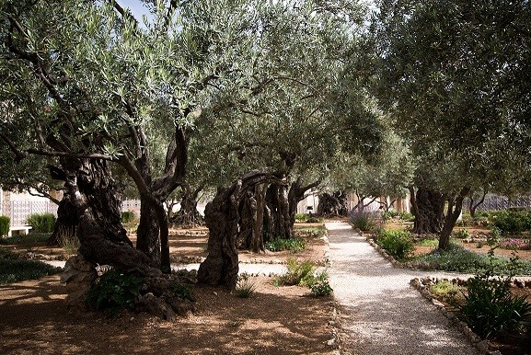
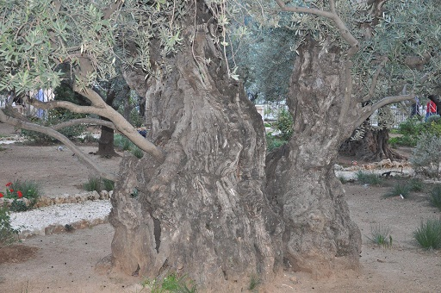
Garden of Gethsemane in Jerusalem where Jesus Prayed 耶路撒冷耶穌禱告的客西馬尼園
2000 yr. old Olive Tree

Slide 25
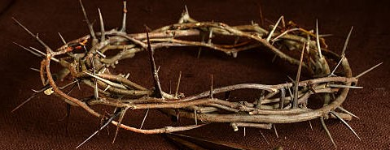
Christ Removes All The Curse Adam Brought upon the World (Rev. 22:3; Gal. 3:13; Deut. 21:23) 基督挪去亞當帶到世界所有的咒詛
Adam’s curse: sorrow (3:17)
亞當的咒詛：憂傷
Travail (Gen. 3:16) 苦楚
thorns, (3:18) 荊棘
Sweat (3:19) 流汗
Jesus was a man of sorrows (Isa. 53:3); experienced “the travail of his soul” (Isa. 53:11); bore the crown of thorns (John 19:2); & sweat blood (Lk. 22:44)
耶穌是“憂患之子”，歷經“心靈的苦楚”，戴上“荊棘冠冕”，汗如血點。

Slide 26
“He who knew no sin became sin for us” (2 Cor. 5:21; Rom. 8:3) “那不知罪的為我們成爲罪”
Adam was Alienated from God (Gen. 3:8)
亞當與上帝遠離；
Physical & spiritual death (Eph. 2:1); returns to the dust (Gen. 3:19)
身體與靈性死亡；歸回塵土。
“God why hast thou forsaken me” (Matt. 27:46; Ps. 22:1)
“上帝啊，爲何離棄我？”
Christ tasted death for every man (Heb. 2:9). Ascends to Glory (Acts 1:9-11; Mk. 16:19)
基督為人人嘗了死亡；升上榮耀。

Slide 27
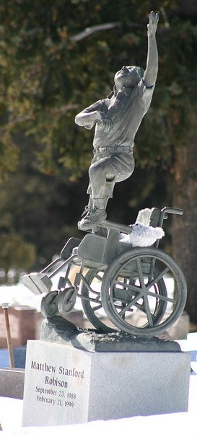
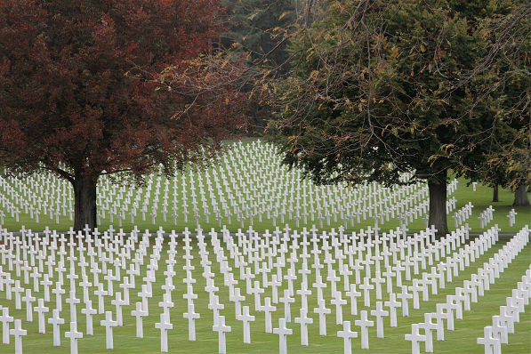
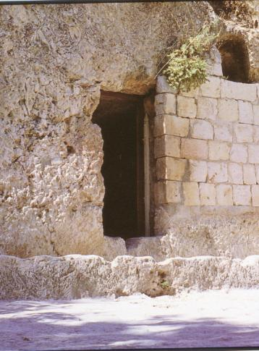
Christ tasted death for every man (Heb. 2:9; Ps. 22:15) Death couldn’t hold Him (Act 2:24) & can’t hold us! 基督為人人嘗了死亡，死亡無法拘禁他，也無法拘禁我們！

Slide 28
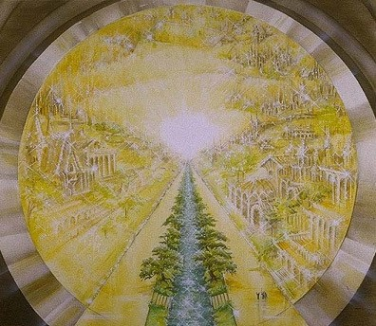
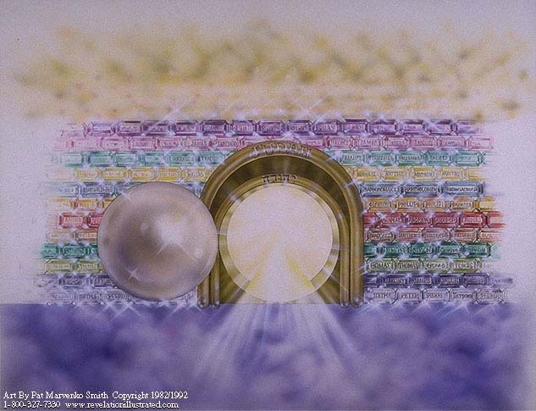
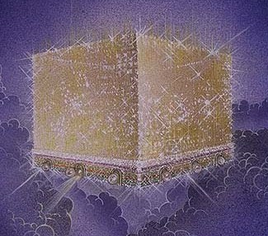
“And there shall be no more curse” (Rev. 22:3) Hallelujah!
“不再有咒詛”，哈利路亞！

Slide 29
Jesus restores to believers the glory the 1st Adam lost (Heb. 2:10-11; I Cor. 15:41-42; 2 Cor. 3:18; Phil. 3:21; Dan. 12:2-3) & clothes us in Garments of salvation (Gen. 3:21; Isa. 61:10) 耶穌恢復信徒因首先的亞當失去的榮耀， 並為我們穿上救恩的衣裳。
Adam was ‘crowned’ (clothed) with God’s glory before the fall (Ps. 8:4-6; Gen. 2:25)
墮落前，亞當穿戴上帝的榮耀。
Jesus is the very “brightness of God’s glory” (Heb. 1:3) & fulfills Psalm 8 (Heb. 2:6-9)
耶穌是“上帝榮耀的光輝”，實現詩篇第八篇。

Slide 30
The Great Mystery of Adam’s Bride & Christ’ Church Ephesians 以弗所書 5:25-32 KJV 亞當的新婦與基督的教會這偉大的奧秘
(5:29) For no man ever yet hated his own flesh; but nourisheth and cherisheth it, even as the Lord the church:
5:29 從來沒有人恨惡自己的身子，總是保養顧惜， 正像基督待教會一樣，
(30) For we are members of his body, of his flesh, & of his bones.
5:30 因我們是他身上的肢體（有古卷加：就是他的骨他 的肉）

Slide 31
Paul Reveals the Mystery by Referring to Adam (Genesis 2) 保羅藉引述亞當揭示此奧秘
(Eph. 5:31) For this cause shall a man leave his father & mother, & shall be joined unto his wife, & they two shall be one flesh.
5:31 為這個緣故，人要離開父母，與妻子連合， 二人成為一體，
(5:32) This is a GREAT mystery: but I speak concerning Christ and the church.
5:32 這是極大的奧秘，但我是指著基督和教會說的。

Slide 32
The Great MYSTERY of ADAM’S BRIDE & CHRIST’S CHURCH (Eph. 5:28-32KJV) 亞當的新婦與基督的教會這偉大的奧秘
Eve made from the wounded side of Adam
夏娃從亞當受傷的肋旁被造，
Eve is taken from Adam while in a ‘deep sleep’ [type of death] (Gen. 2:21-23; John 11:11-13)
夏娃在亞當“沉睡”時從他的身體被造出來。
The Church is given life out of wounded side of Christ
教會的生命來自基督受傷的肋旁，
in the ‘deep sleep’ of death redeems His Bride with His blood (Joh 19:33-37; IPet. 1:18-19)
在死亡的“沉睡”中，基督用他的血救贖他的新婦。

Slide 33
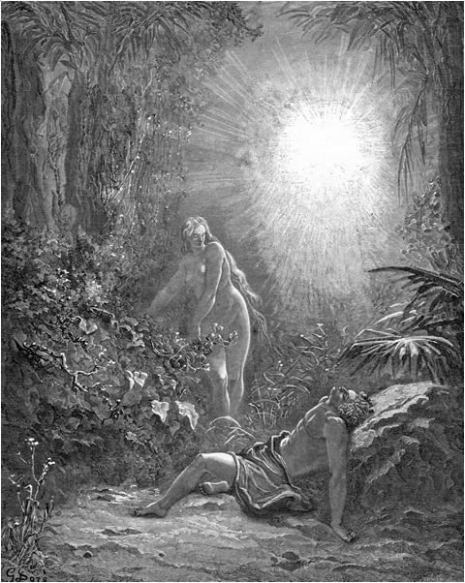
Part of this Mystery is the fact that a man’s wife is considered his own body. 此奧秘的一部分是妻子被看成是 丈夫自己的身體的事實
(Gen. 2:23) And Adam said, This is now bone of my bones, & flesh of my flesh: she shall be called Woman, because she was taken out of Man.
創2:23 那人說：這是我骨中的骨，肉中的肉，可以稱他為「女人」，因為他是從「男人」身上取出來的。
We are the Body & Bride of Christ (I Cor. 12:27; 2 Cor. 11:2) 我們是基督的身體與新婦

Slide 34
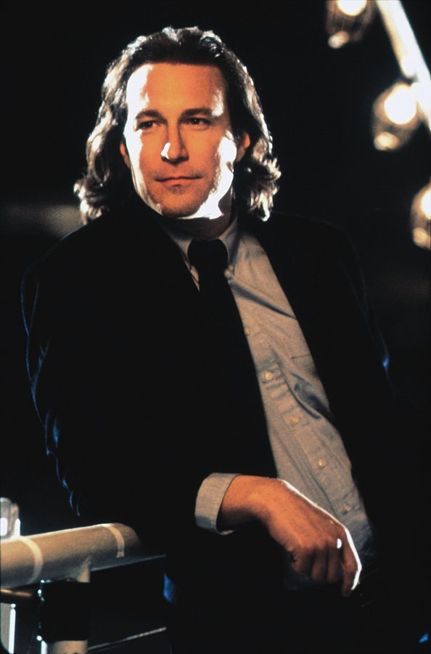
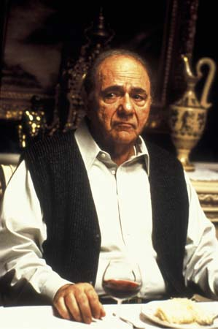
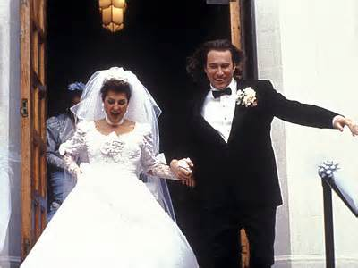
My Big Fat Greek Wedding 我的希臘婚禮 Contrast between 2 men & 2 Kinds of Love 兩個男人與兩種愛的對比
Toula’s Dad - law
Frumpy Toula
Ian - grace
The transformative power of grace filled love
充滿愛的恩典具有改變的能力

Slide 35
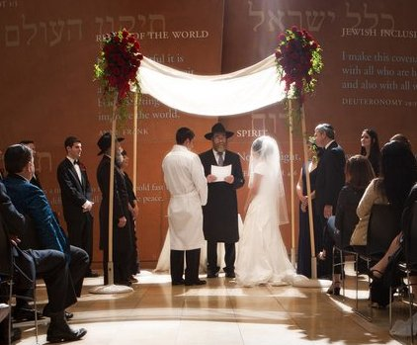
OUR ETERNAL DESTINY My Big Fabulous Jewish Wedding! 我們永恆的去處：我盛大超好的猶太婚禮!!!
Jewish Marriage customs give us insight into our relationship with our Lord Jesus Christ
基督時期的婚禮習俗讓我們看見與主耶穌基督的關係。
Psalm 45; Rev. 19:6-9
詩篇45; 啟示錄19:6-9

Slide 36
1. The Proposal 提親
Jewish Wedding Type
猶太婚禮預表
The Father sets the Bride price (Gen. 34:12; Ex. 22:16-7; I Sam. 18:25)
父親決定聘金
Fulfillment in Christ
在基督裡應驗
The Father Set the Bride price as the Life of His Son (Eph. 5:25; John 3:16; Lev. 17:11, 14)
天父的聘金是祂兒子的血

Slide 37
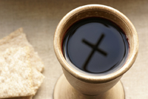
The “Cup of Accptance” 接受之杯 Bride & Groom enter into a Blood Covenant Relationship (Mal. 2:14) 他們進入血盟關係
The prospective bridegroom pours a cup of wine for the prospective bride.
未來的新郎為未來的新娘倒一杯酒
The wine blessed with prayer:
這杯酒蒙禱告祝福:

Slide 38
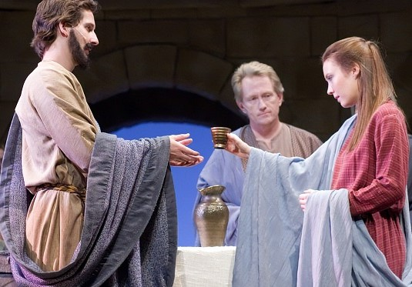
The “Cup of Accptance” 接受之杯
If she agreed to marry, she would drink from the cup, indicating her acceptance.
倘若她同意提親,她會喝這杯酒表示她接受
In this manner, the covenant was sealed, & the couple was considered to be betrothed.
喝酒之後,婚約完成, 二人就算正式訂婚了。
Where have you seen this Cup before?

Slide 39
2. Preparation: Period of Betrothal:預備期:訂婚期間
Jewish Wedding Type
猶太婚禮預表
Exact Time is unknown
確實時間不知
Bride trained & prepared to be a wife
新娘被訓練,預備她 成為妻子
Fulfillment in Christ
基督裡的應驗
(2 Cor. 11:2) “I espoused you to one husband to present you as a pure virgin to Christ”
林後 11:2 我曾把你們許配一個丈夫，要把你們如同貞潔的童女，獻給基督。

Slide 40
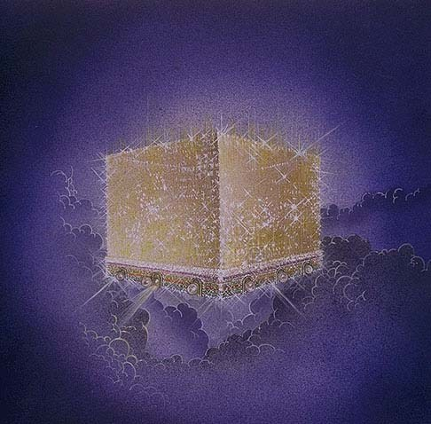
For the Groom: He Prepares a Place 新郎:預備期預備新房
(Joh 14:2) “In my Father's house are many mansions: if it were not so, I would have told you. I go to prepare a place for you. (Joel 2:16)
約14:2 在我父的家裡有許多住處；若是沒有，我就早已告訴你們了。我去原是為你們預備地方去。 (約珥2:16)
Revelation 21
Ancient engagement ring with mansion on top

Slide 41
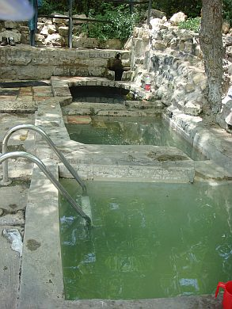
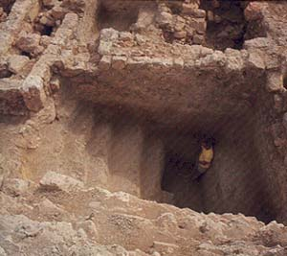
For The Bride: a time of sanctification & anticipation 新娘的預備: 成聖與期待 (Eph. 5:26-27; I John 3:2-3)
She must undergo a “Mikveh” - purifying bath by total immersion (a Baptism!) (I Cor. 6:11; Eph. 5:25-27; Titus 3:5; Heb. 10:25; Rev. 19:7)
她必須完全浸在水中(浸禮), 經歷「潔淨的沐浴」

Slide 42
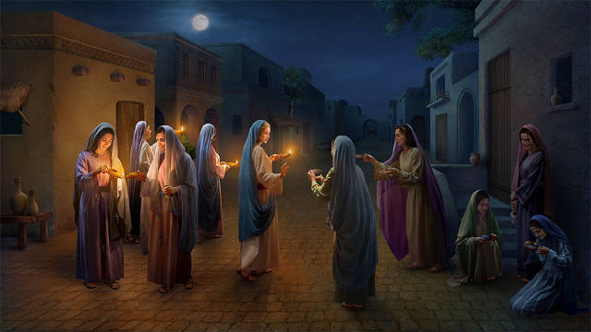
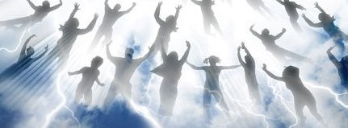
3. “Stealing” away the Bride! 「偷走」新娘
Fulfillment in Christ
基督裡的應驗
Jesus fetches His Bride at the Rapture (I Thess. 4:13-18)
在教會「被提」時,彌賽亞娶走祂的新娘 (Rom. 8:8-11)
Jewish Wedding Type
猶太婚禮預表
The Groom surprises the Bride at her home Matt25:5-6
新郎突然出現在新娘家中

Slide 43
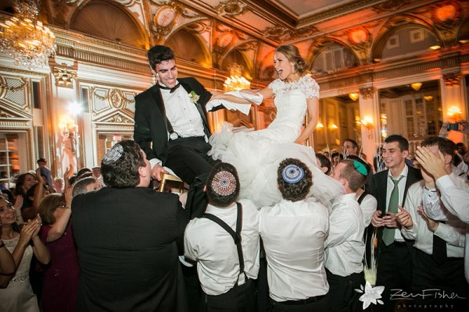
4. The Wedding Ceremony 婚禮儀式
Jewish Wedding Type
猶太婚禮預表
The Ceremony is conducted at the Home of the Groom
婚禮儀式在新郎家舉行
Fulfillment in Christ
基督裡的應驗
Ceremony in Heaven Rev. 19:6-8
婚禮儀式在天堂 啟示錄19:6-8

Slide 44
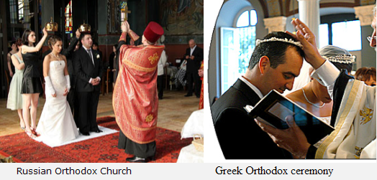
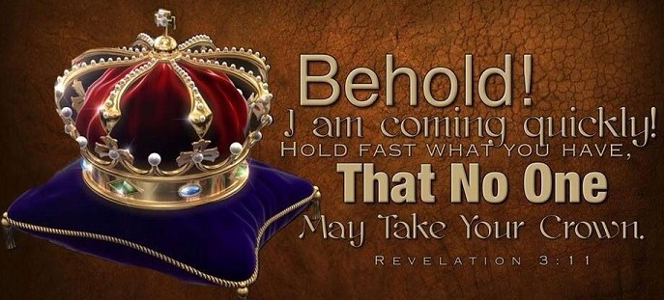
5. The Marriage Supper (Feast) 婚宴 (Rev. 20:4-6)
Jewish Wedding Type
猶太婚禮預表
Bride & Groom treated as King & Queen (Ezek 16:8-14)
新娘與新郎以國王和王后樣式對待!
Fulfillment in Christ
基督裡的應驗
Jesus is King of Kings. He made us Kings & gives us Crowns (Rev. 19:16; 1:6; 20:6; 2:10; 2 Tim. 4:8; Jam. 1:12; I Pet. 5:4; Isa. 61:10)
新娘與新郎穿上特別的衣服與冠冕

Slide 45
Important Lessons 重要功課
1. Honest study reveals concrete irrefutable proof the Bible is supernaturally inspired by an Omniscient Being
誠實的研究揭示出具體無法駁斥的證據：聖經是無所不知的上帝超自然啓示的；
2. 27% of the Bible is Prophecy predicting historical events 100’s & 1000’s of years in the future!
聖經27%的篇幅是預言，預告未來幾百、幾千年的歷史事件！
3. Adam is the 1st Prophetic Type of our LORD Jesus Christ.
亞當是我們主耶穌基督的第一個預表。

Slide 46
Important Lessons 重要功課
4. Adam’s real History reveals God’s original very good plan for the World & how it got so messed up (the problem of evil)
亞當的真實歷史揭示上帝原本為世界訂立的美好計劃， 以及此計劃是如何搞砸的（罪惡的問題）。
5. We learned the curse Adam brought upon the World & how Jesus removes the entire curse
我們學到亞當帶給世界的咒詛，以及耶穌如何挪去 全部的咒詛。
6. We learned why there is death & how we can have eternal life
我們學到爲何有死亡，以及我們如何能夠有永恆的生命。

Slide 47
Important Lessons 重要功課
7. Behind all Creation & History is the Divine love story of the Ages
在創造與歷史的背後,有歷世歷代神聖的愛情故事， It began with the 1st Adam & climaxes with the Last Adam 它從首先的亞當開始，以末後的亞當為高潮。
8. I can be a part of That Love story if I trust Christ as my savior!
我可以是那愛情故事的一部分，倘若我信靠基督為我的救主！
9. I will faithfully prepare for my Bridegroom’s return. Hallelujah, Jesus is coming back for me! For us! For His Bride!
我要忠實地預備新郎的歸來。哈利路亞,耶穌會為我, 為我們,為祂的新娘歸來!

Slide 49
Following are a few extra slides with a few extra insights into the extraordinary prophetic Type of Adam
May they awaken more hope in your spirit
& kindle more love in your heart as Christ’s 2nd Coming draws near

Slide 50
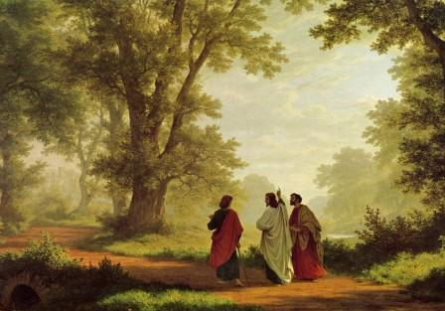
Even after His resurrection Jesus proved He was the Savior of the World by revealing the O.T. Prophecies about Himself (Lk. 24:25-7, 44-7)
即使在祂復活之後，耶穌還用舊約關於祂的預言，來證實祂是世人的救主 （路24:25-27,44-47）。

Slide 51
“Did not our heart burn within us, while he opened to us the scriptures?” (Lk. 24:27, 32)
Once you learn how to discover Prophetic Types you will never doubt the Divine Inspiration of the Bible.
You will know it could only have been inspired by an eternal, Omniscient, Sovereign God!

Slide 52
The Entire Old Testament is About Jesus Christ in some way 整本舊約某方面是關於耶穌基督的
"Search the scriptures; for in them ye think ye have eternal life: and they are they which testify of me” (John. 5:39)
你們查考聖經，因你們以為內中有永生；給我作見證的就是這經。(約5:39）
“Had ye believed Moses, ye would have believed me: for he wrote of me” (John 5:46-7; John 1:45; Acts 26:22)
你們如果信摩西，也必信我，因為他書上有指著我寫的話。(約5:46-47）

Slide 53
The O.T. Reveals how sin separated man from God & why there is so much pain & suffering in the World
It was written in the dark shadows of O. T. prophesy that are always hard to see clearly until Jesus, “the Sun of righteousness arises” and shines His Light on them. (Malachi 4:2)
(2Cor. 4:6) “For God, who commanded the light to shine out of darkness, hath shined in our hearts, to give the light of the knowledge of the glory of God in the face of Jesus Christ.”

Slide 54
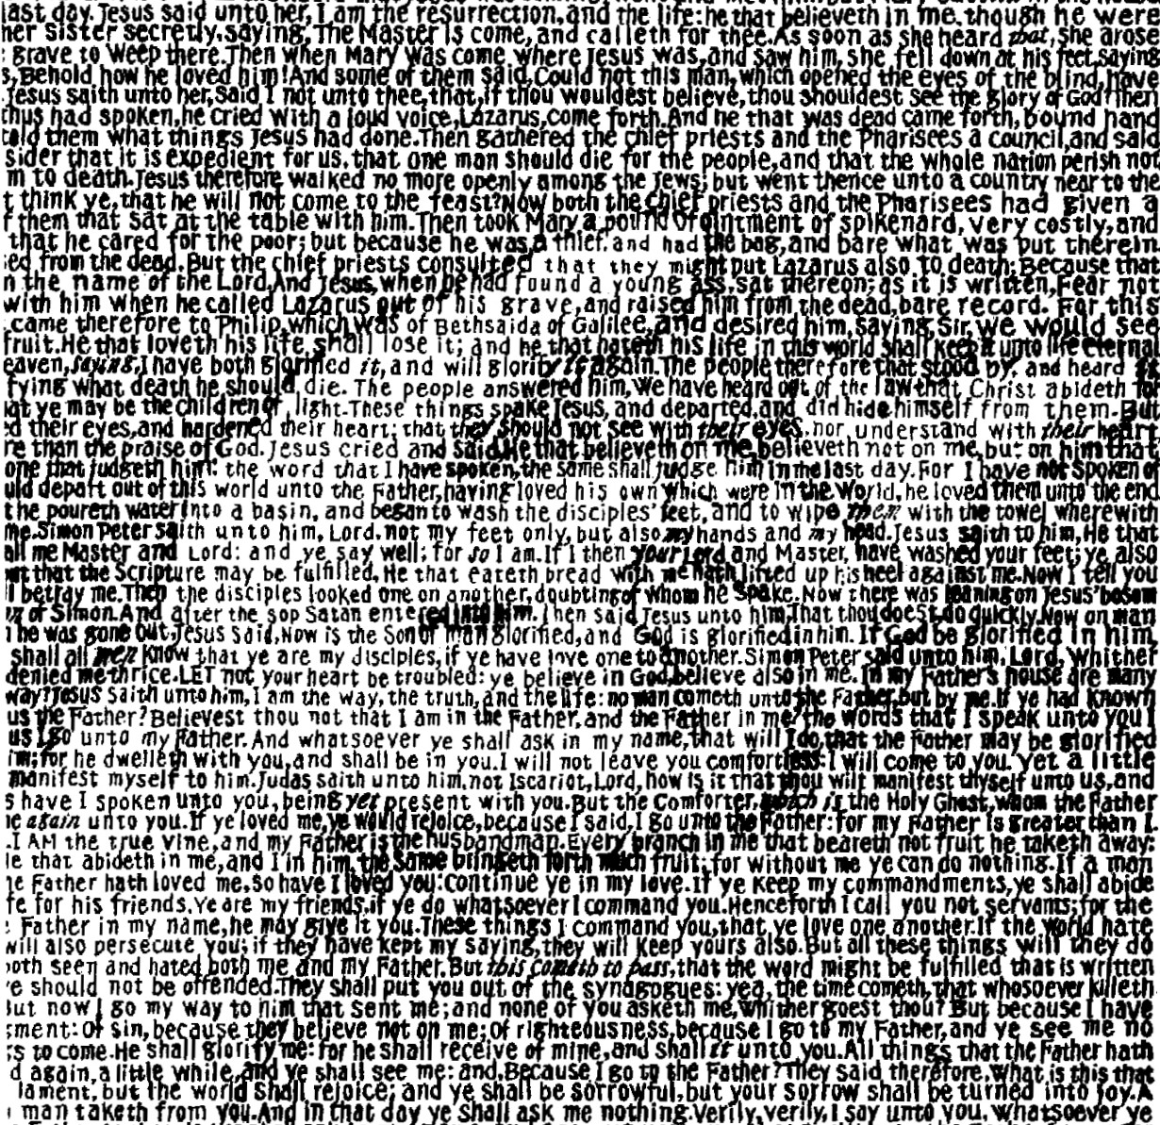
Types are an infallible proof of the Divine Design of all Scripture. [They are hidden until Christ's resurrection]
The picture is formed by writing out the Gospel of John.
So Types (pictures) of Jesus are hidden in the very words of the Bible

Slide 55
(John 14:3) And if I go and prepare a place for you, I will come again, & receive you unto myself; that where I am, there ye may be also. (I Thess. 4:16-18; Ps. 19:6)
約14:3 我若去為你們預備了地方，就必再來接你們到我那裡去，我在那裡，叫你們也在那裡。
Only the “Father” could decide when the time was right! (Matt. 24:36; Mark 13:32)
只有父親能夠決定娶親的正確時間!
That is why Jesus had to say He didn’t know the time!

