Slide 1
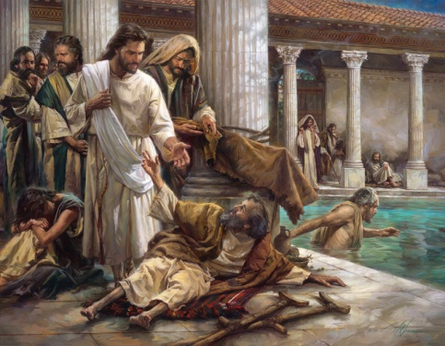
你要痊癒嗎?
Do You want to be Healed?
約翰福音 John 5:1-9
陳振威 Chun-Wai Chan
Notes:
CBCSD Cantonese

Slide 2
約翰福音John 5:1-9
1 這事以後,到了猶太人的一個節期.耶穌就上耶路撒冷去.
2 在耶路撒冷,靠近羊門有一個池子,希伯來話叫作畢士大,旁邊有五個廊子.
3 裡面躺著瞎眼的,瘸腿的,血氣枯乾的,許多病人.〔有古卷在此有等候水動〕
4〔因為有天使按時下池子攪動那水水動之後誰先下去無論害甚麼病就痊愈了〕
¹ After this there was a feast of the Jews, and Jesus went up to Jerusalem. ² Now there is in Jerusalem by the Sheep Gate a pool, in Aramaic called Bethesda, which has five roofed colonnades. ³ In these lay a multitude of invalids—blind, lame, and paralyzed. ⁴for an angel of the Lord went down at certain seasons into the pool, and stirred the water: whoever stepped in first after the stirring of the water was healed of whatever disease he had.

Slide 3
約翰福音John 5:1-9
5 在那裡有一個人,病了三十八年.
6 耶穌看見他躺著,知道他病了許久,就問他說,你要痊愈麼.
7 病人回答說,先生,水動的時候,沒有人把我放在池子裡．我正去的時候,就有別人比我先下去.
8 耶穌對他說,起來,拿你的褥子走罷.
9 那人立刻痊愈,就拿起褥子來走了.
⁵ One man was there who had been an invalid for thirty-eight years. ⁶ When Jesus saw him lying there and knew that he had already been there a long time, he said to him, “Do you want to be healed?” ⁷ The sick man answered him, “Sir, I have no one to put me into the pool when the water is stirred up, and while I am going another steps down before me.” ⁸ Jesus said to him, “Get up, take up your bed, and walk.” ⁹ And at once the man was healed, and he took up his bed and walked. Now that day was the Sabbath.

Slide 4
1 這事以後、到了猶太人的一個節期。耶穌就上耶路撒冷去。
After this there was a feast of the Jews, and Jesus went up to Jerusalem.
節期:住棚節？ Festival of Tents? Passover?
傳福音的機會 Opportunity for evangelism
耶穌主動服事人 Jesus took the initiative to serve 去有需要者當中 To the midst of people in need
人子來、不是要受人的服事、乃是要服事人
For even the Son of Man came not to be served but to serve.” （馬可福音 Mark 10:45)

Slide 5
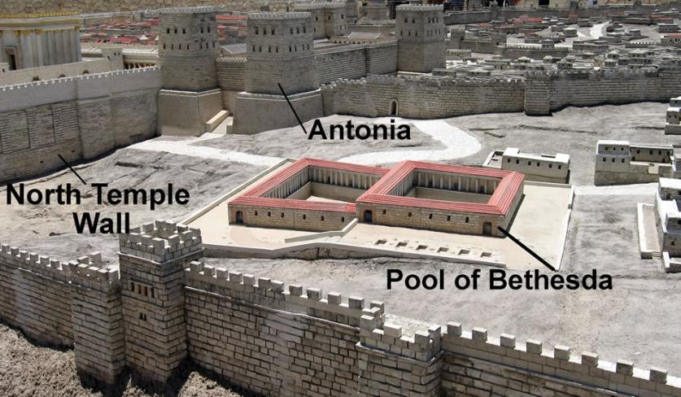
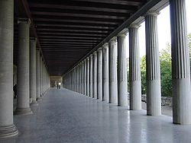
2 在耶路撒冷、靠近羊門有一個池子、希伯來話叫作畢士大、旁邊有五個廊子。
Now there is in Jerusalem by the Sheep Gate a pool, in Aramaic called Bethesda which has five roofed colonnades.
畢士大（憐憫之家）：為殘障人士所蓋
Bethesda (House of Mercy): Built for the handicapped

Slide 6
3 裡面躺著瞎眼的、瘸腿的、血氣枯乾的、許多病人。
4〔因為有天使按時下池子攪動那水水動之後誰先下去無論害甚麼病就痊愈了〕
³ In these lay a multitude of invalids—blind, lame, and paralyzed.
⁴ for an angel of the Lord went down at certain seasons into the pool, and stirred the water: whoever stepped in first after the stirring of the water was healed of whatever disease he had.
許多不同的病人 Many different types of patients
天使治病的迷信 A belief of healing by angels
疾病, 憂抑, 悲傷, 苦毒, 上癮, 壊習慣 lllness, depression, grief, bitterness, addiction, bad habits
對疾病的恐懼 Fear of illness

Slide 7
5 在那裡有一個人、病了三十八年。
One man was there who had been an invalid for thirty-eight years.
久病纏身 先天殘疾？ Chronic illness, congenital?
不得醫治的原因：Why are people not healed
不承認有病 Denial of illness
不願意被醫治 Unwilling to be healed
用同樣的方法 Using the same method

Slide 8
6 耶穌看見他躺著、知道他病了許久、就問他說、你要痊愈麼。
When Jesus saw him lying there and knew that he had already been there a long time, he said to him, “Do you want to be healed?”
祂看見，而且知道 He sees, and He knows
祂知道我們身體 He knows the illness of our
和內心的病痛 body and soul
? 是讓病人： ? is to let the patient:
先承認有病 Admit to the illness
願意被醫治 Willing to be healed
不再用同樣的方法自救 Not using same method
to self-heal

Slide 9
7 病人回答說、先生、水動的時候、沒有人把我放在池子裡．我正去的時候、就有別人比我先下去。
The sick man answered him, “Sir, I have no one to put me into the pool when the water is stirred up, and while I am going another steps down before me.”
患者的心境： Patient’s mental status:
孤單, 無助, 失望, 埋怨 Lonely, helpless, hopeless, complaining
被疾病蒙蔽,看不見耶穌 Blinded by illness, cannot see Jesus
Think outside the box

Slide 10
神的應許God’s promise (Psalms詩篇121)
^{1.} 我要向山舉目。我的幫助從何而來。
^{2.} 我的幫助從造天地的耶和華而來 。
^{3.} 他必不叫你的脚摇動。保護你的必不打盹 。
^{4.} 保護以色列的，也不打盹，也不睡覺 。
¹ I lift up my eyes to the hills. From where does my help come?
² My help comes from the Lord, who made heaven and earth.
³ He will not let your foot be moved; he who keeps you will not slumber.
⁴ Behold, he who keeps Israel will neither slumber nor sleep.

Slide 11
詩篇 121
^{5.} 保護你的是耶和華。耶和華在你右邊蔭庇你。
^{6.} 白日太陽必不傷你，夜間月亮必不害你。
^{7.} 耶和華要保護你，免受一切的災害。他要保護你的性命。
^{8.} 你出你入耶和華要保護你，從今時直到永遠。
⁵ The Lord is your keeper; the Lord is your shade on your right hand.
⁶ The sun shall not strike you by day, nor the moon by night.
⁷ The Lord will keep you from all evil; he will keep your life.
⁸ The Lord will keep your going out and your coming in
from this time forth and forevermore.
神是我們的避難所, 是我們的力量, 是我們在患難中隨時的幫助 God is our refuge and strength, a very present help in trouble. (Ps 46: 1)
你們要休息、要知道我是 神。
Be still, and know that I am God. (Ps 46:10)

Slide 12
⁸ 耶穌對他說,起來,拿你的褥子走罷.
⁹ 那人立刻痊愈,就拿起褥子來走了.
¹⁴後來耶穌…遇見他,對他說,你已經痊愈了.不要再犯罪.
⁸ Jesus said to him, “Get up, take up your bed, and walk.” ⁹ And at once the man was healed, and he took up his bed and walked. Now that day was the Sabbath.
¹⁴ Afterward Jesus found him in the temple and said to him, “See, you are well! Sin no more, that nothing worse may happen to you.”
耶穌知道人身體的需要 Jesus knows our physical needs
耶穌更關心人的靈魂 Jesus cares even more about our soul
爲甚麽除了身體，還需要靈魂的醫治？ Why need healing of both body and soul

Slide 13
1.身體、靈魂的組合 Body/Soul combo
耶和華 神用地上的塵土造人、將生氣吹在他鼻孔裡、他就成了有靈的活人、名叫亞當。 (創 Genesis 2:7)
then the Lord God formed the man of dust from the ground and breathed into his nostrils the breath of life, and the man became a living creature.
神造萬物、各按其時成為美好。又將 永生安置在世人心裡。(傳 Ecclesiastes 3:11)
  He has made everything beautiful in its time. Also, he has put eternity into man's heart,
身體
靈魂
神

Slide 14
2.全人的醫治 Wholistic healing
醫生 (physician)
神 (healer)
生理學者 Physiology scholar
治療(不是醫治)：
Treating, not healing:
保護細胞功能，讓身體有時間自我痊愈 (如抗生素) Protect cellular function, giving the body time to self-heal (antibiotics)
治標不治本 (如血壓藥，胰島素，支架，搭橋) Treating complications and not the cause (e.g. antihypertensives, insulin, stents, bypass)
唯一的全人醫治者 The only wholistic healer
醫治：使身體完整
(如癱子身體和心靈被醫治) 小子,放心罷,你的罪赦了…起來,拿你的褥子回家去罷 Healing: Make the body complete (the invalid was healed in body and spirit). “Take heart, my son; your sins are forgiven… Rise, pick up your bed and go home.” （太 Matt 9:2,6）

Slide 15
3.醫治心靈和關係更重要
Healing of soul and relationships is more important
身體
心靈
關係
Soul
Relationship
Body

Slide 16
林後 II Cor 4:16-18
16所以我們不喪膽．外體雖然毀壞、內心卻一天新似一天. 17我們這至暫至輕的苦楚、要為我們成就極重無比永遠的榮耀.
18原來我們不是顧念所見的、乃是顧念所不見的．因為所見的是暫時的、所不見的是永遠的。
¹⁶ So we do not lose heart. Though our outer self is wasting away, our inner self is being renewed day by day.
¹⁷ For this light momentary affliction is preparing for us an eternal weight of glory beyond all comparison,
¹⁸ as we look not to the things that are seen but to the things that are unseen. For the things that are seen are transient, but the things that are unseen are eternal.(林後 II Cor 4:16-18)

Slide 17
外體毀壞 Outer self wasting away | 內心更新 Inner self being renewed
暫時的苦楚 Transient affliction | 永遠的榮耀 Eternal glory
顧念所見 Look not things that are seen | 顧念所不見 Look at things that are seen
暫時 Transient | 永遠 Eternal
需要從永恆的觀點看病痛
Need to view illness from an eternal perspective

Slide 18
多數人的錯誤 Mistake many make
高估了今天的生命價值
Overestimate the value of present life
低估了將來與主同在的永恒價值
Underestimate the value of the eternal presence of God

Slide 19
從永恆的觀點看病痛
Viewing illness from an eternal perspective
自我反省：虧欠神旳地方
Introspection: any shortcomings?
那種醫治：身體，關係，心靈?
What kind of healing: body, relationship, spirit
醫治目的：為己而活 vs 為主而活
Purpose of healing: living for self or Christ
聖靈所結的果子，就是仁愛、喜樂、和平、忍耐、恩慈、良善、信實、 溫柔、節制 (加拉太書 Galatians 5:22)
The fruit of the Spirit is love, joy, peace, forbearance, kindness, goodness, faithfulness, gentleness and self-control.

Slide 20
你要痊癒麼？Do you want to be healed?
你是否久病纏身？疾病, 憂抑, 悲傷, 苦毒, 上癮, 壊習慣
Have you been chronically ill? Illness, depression, grief, bitterness, addiction, bad habits
耶穌看見，而且知道你的困難
Jesus sees, and knows your difficulty
先要承認你有病，不能自救
Admit your illness, and that you cannot save yourself
不要被困境蒙蔽，看不見耶穌
Do not be blinded by your circumstances that you can’t see Jesus
祂知道你的需要，更關心你的靈魂
He knows your need, and cares even more about your soul
需要用永恆的觀點看病痛
See illness from an eternal perspective

