Slide 1
羅馬書是誰寫的？ Who wrote the Book of Romans?
鄭昌國牧師
Speaker: Pastor Joseph Cheng

Slide 2
耶穌基督的僕人保羅、奉召為使徒、特派傳 神的福音. 羅馬書1：1 Paul, a servant of Christ Jesus, called to be an apostle and set apart for the gospel of God-- Romans 1:1
-

Slide 3
逼迫者一在大馬色蒙光照
A Persecutor- Light Shone on him in Damascus

Slide 4
2. 傳道人一在安提阿被差遣 A preacher – Sent from Antioch

Slide 5
3. 宣教士一在馬其頓有呼聲 A Missionary – Calling from Macedonia

Slide 6
4. 神學家一在哥林多見異象 A Theologian –Vision in Corinth

Slide 7
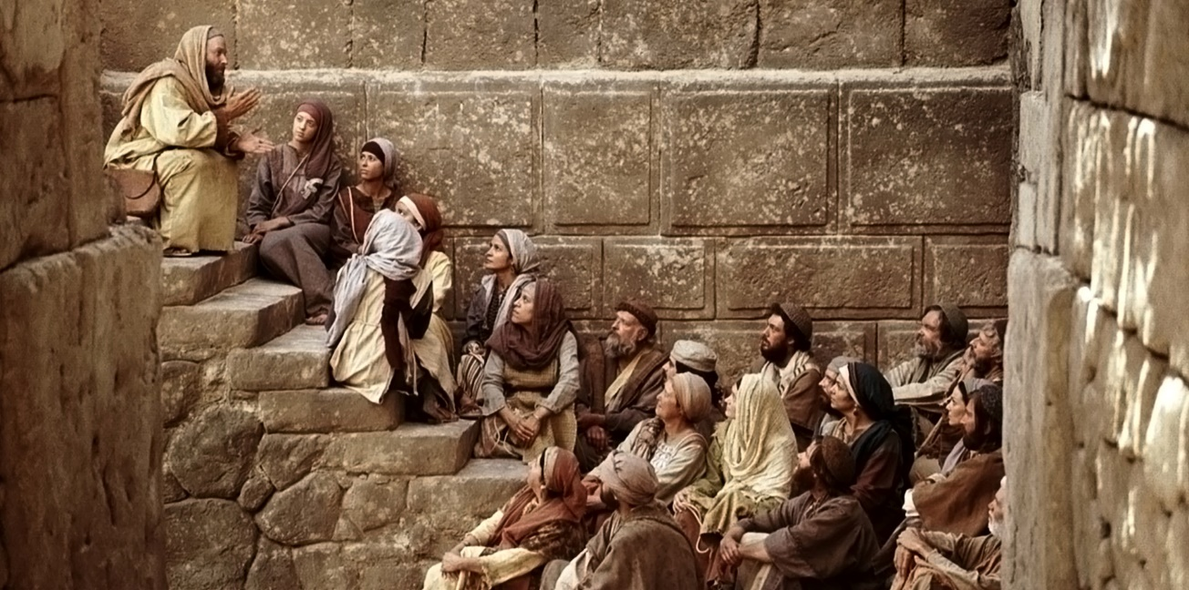
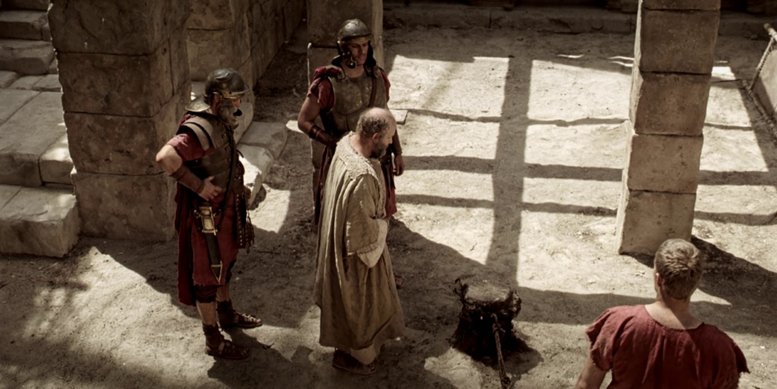
5. 殉道士一在羅馬城還債物 A Martyr- Paying debt in the city of Rome

