Slide 1
真正的自由
Freedom in Christ

Slide 2
以弗所書: 滿有基督長成的身量(4:13)
前言 1:1-2 | 基督裡同歸於一 1:3-6:17 |  |  |  |  |  | 結語 6:18-24
教義原則 1:3-3:21 |  |  |  | 生活應用 4:1-6:17
基督豐富 1:3-23 |  | 合一基礎 2:1-22 | 普世福音 3:1-21 | 信徒合一 4:1-16 | 生活聖潔 4:17-6:9 | 屬靈裝備 6:10-17
屬靈福氣 |  | 教會合一 | 屬靈奧秘 | 教會生活 | 日常生活 | 屬靈生活
基督裡的福氣 |  |  |  | 基督裡的生命
使天上地下一切所有的﹐都在基督裡面同歸於一 (1:10)

Slide 3
Ephesians: To the Measure of the Stature Which Belongs to
the Fullness of Christ (4:13)
Preface 1:1-2 | Unity of the Faith in Christ 1:3-6:17 |  |  |  | Conclusion 6:18-24
Doctrine 1:3-3:21 |  |  | Application 4:1-6:17
Richness in Christ 1:3-23 | Foundation of Unity 2:1-22 | Gospel for All People 3:1-21 | Unity of Faithful 4:1-16 | Holiness of Our Life 4:17-6:9 | Preparation of Spiritual Battle 6:10-17
Spiritual Blessings | Unity of Church | Spiritual Mystery | Church Life | Daily Life | Spiritual Life
Blessings in Christ |  |  | Life in Christ
The summing up of all things in Christ, things in the heavens and things on the earth (1:10)

Slide 4
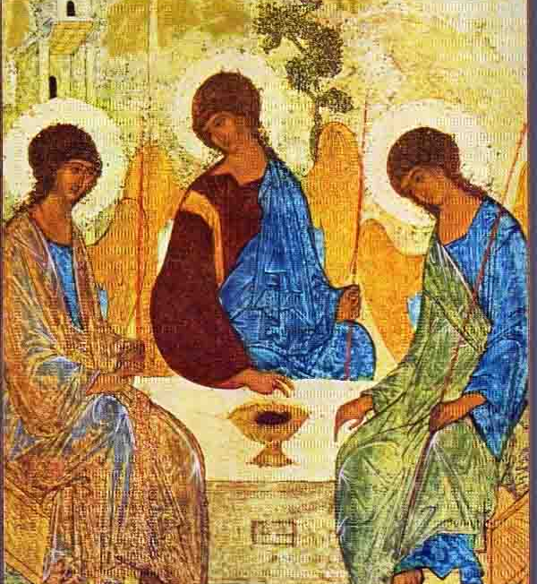
屬靈福氣的特徵Characters of Spiritual Blessings
所有的Every
屬靈的Spiritual
從天上來的In the heavenly Places
在基督里的In Christ
來源Origin﹕上帝God the Father
受益者Beneficiary﹕基督徒Christians

Slide 5
從自我中釋放 Freedom from self fulfillment
上帝是一切祝福的源頭
God is the origin of all blessings
重新塑造自我
Rebuild Self Image in Christ

Slide 6
屬靈的福氣Spiritual Blessings
揀選 Election (v.4)
領養 Adoption (v.5)
接納 Acceptance (v.6)
救贖/赦免 Redemption/Forgiveness (v.7)
智慧/奧秘 Wisdom/Mystery (v.8-9)
基業 Inheritance (v.11)
聖靈印記 Sealed by the Spirit (v.13-14)

Slide 7
從比較中釋放 Freedom from Competition
基督成就了一切福氣 Christ makes all blessings ready
不再相互比較 No longer to compare with others

Slide 8
在基督里 In Christ
上帝憑借Instrumental
信徒遵行 Local or Incorporation

Slide 9
從懼怕中釋放 Freedom from Fear
聖靈內住成為保證
Assurance from the indwelling of
the Holy Spirit
人生沒有懼怕
No fear in this life.

Slide 10
使天上、地上、一切所有的都在基督裡面同歸於一 The summing up of all things in Christ, things in the heavens and things on the earth

