Slide 1
健康的教會
A Healthy Church

Slide 2

以弗所教會
The Church of Ephesus
創建階段Establishment
興旺階段Development
堅固階段Consolidation

Slide 3
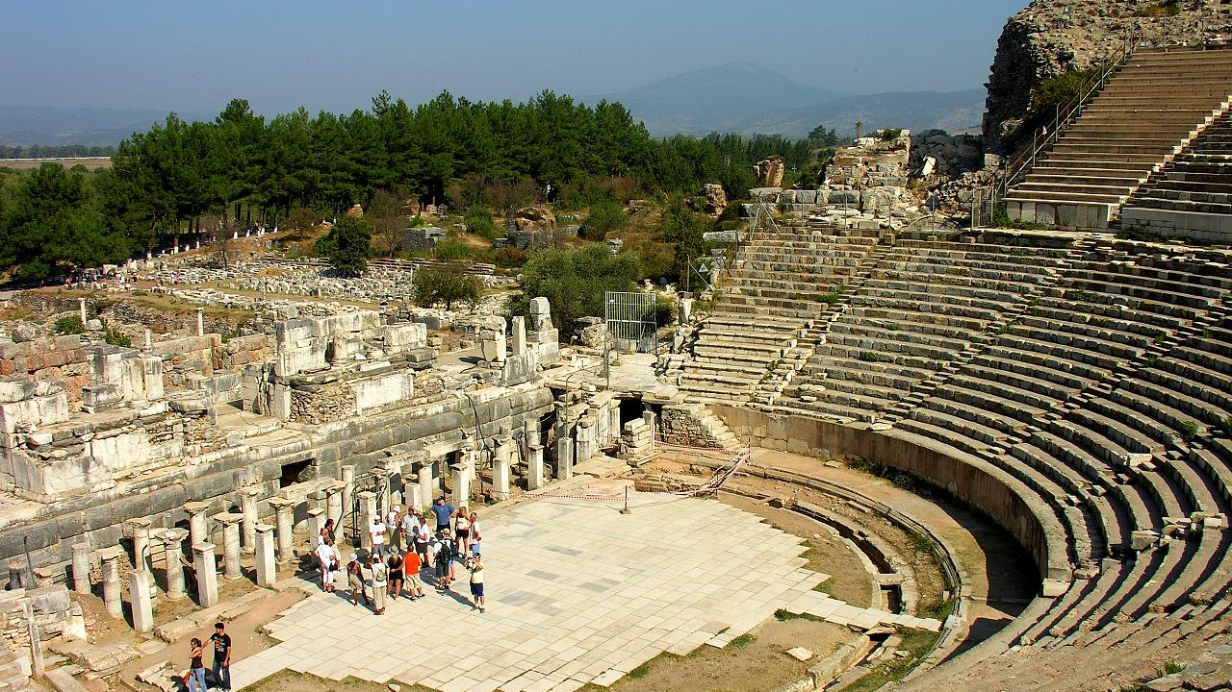
以弗所劇院 The Theater in Ephesus

Slide 4

教會的三個特徵
Three Things about the Church
屬靈的教導
Biblical Teachings
相愛的心志
Love One Another
合一的見證
Unity in Christ

Slide 5

教會好比學校
The church as a school
教導神的話語
Teach the Word of God

Slide 6

教會好比醫院
The church as a hospital
醫治心靈創傷 Heal wounds of the Soul

Slide 7


教會好比家庭
The church as a family
彼此關心照顧
Care for one another

Slide 8

施比受更為有福
It is more blessed to give than to receive

